Slide 1


Analyzing Supermarket MM&A Data.
Digital Ad Partnerships
October 17, 2022. Prepared by Team 40,
Lu Gan, Aleem Hussain-Aamir, Juan Pablo López, Hammad Mirza, Danyal Soomro.

Slide 2



Overview
Explain a little bit
SITUATION
CHALLENGE
QUESTION
MM&A has been moving to digital channels to interact more with customers and suppliers.
MM&A decided to offer digital advertising inventory to manufacturer brands who can buy digital “ad space” to advertise or promote their products using trade promotion.
The digital ads also track ROI and help to provide insights to increase profit.
MM&A wants to partner with manufacturers to pilot the digit ad program.
Find manufacturers with strong national brand and profitability.
Select manufacturers that are suitable for current MM&A customer base.
Consider the ad content of manufacturers, avoid manufacturer ads taking away private brands profit and reducing overall profit.
Which manufacturers to partner with to pilot the digit ad program?
Which manufacturers have strong national brands and large trade promotion budget?
What is the customer base of MM&A, and what manufacturers have product content suitable for current customer base?

Slide 3






Methodology
Manufacturers
MANUFACTURERS WITH TOP NATIONAL BRANDS**
Total % of SALES
Unique CUSTOMER growth
Total COUPON DISCOUNTS ($$ spend)
SALES growth
Overall CUSTOMERS
Rank based on these KPIs - % of Sales has been weighted twice because 80% of revenue comes from 400 manufacturers so we only focus on that.
KPIs
Methodology
Calculation
* Top 80 are responsible for ~45% of the total revenue

Slide 4

Methodology
Customers
CUSTOMER DEMOGRAPHICS AND SPENDING PATTERNS
Measured demographics and price sensitivity to changes in sales and demand by performing regressions*. This helped us identify what groups would increase ROI for manufacturers.
We used Association Rule Learning (ARL) to identify customer patterns and see “if they buy product X what other products are they most likely to buy?”** e.g. someone buying pet litter is very likely to respond to a promotion of air freshener.
* All numbers statistically significant. View slides 14 and 15
** View slide 13

Slide 5




Summary and Recommendations
Overall Conclusions
Partner up with 7 manufacturers in the Grocery, Drug GM, Meat and Produce departments but heavily focused on Grocery.
The above are those that are highly ranked by the scorecard and ARL algorithm, and where we see potential such as 100-124K income levels
Certain demographic segments such as 35-99K income levels and ages 25-54 that are purchasing the above manufacturers’ products have an impact on sales value*
Manufacturer promotion seems to be more effective than retailer promotion on quantity demanded **
* All numbers statistically significant and view slide 14
** View slide 15

Slide 6
Findings

Slide 7
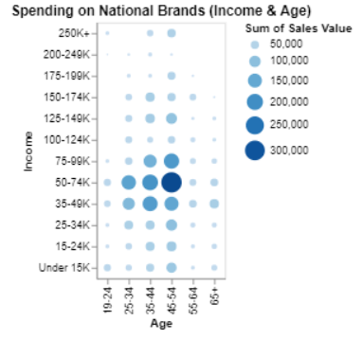
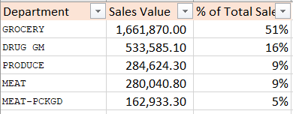


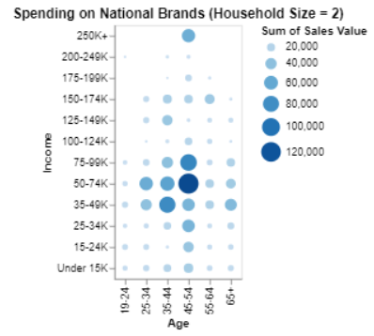

General Findings
Groceries comprise of 51% of total sales value
Income groups 35-99k and Age groups 25-54 have the highest spending in total
Income 50-74k > 35-49k > 75-99k
Ages 45-54 > 35-44 >25-34
They spend mainly on groceries, drug gm, meat and produce; on products such as soft drinks, frozen meat, cigarettes, tropical fruits and salads
Household size = 2 have the highest spending in total; 2 adults with no kids.
Large families tend to spend slightly more than small families..
Homeowners have the highest spending in total.
They are either married or have unknown marital status.

Slide 8
Recommended Manufacturers *
Manufacturer | Scorecard | ARL Rank | Department | Products | Growth (Yr 1 to Yr 2) | Demographics | Notes
584 | 1 | 15 | Grocery | Fruits/ Vegetables | 14% in customers 40% in sales | 35-54 Year Olds 50-99K Income | Also tend to buy from #794
397 | 2 | - | Meat - Packaged | Frozen meat, bacon | 12% in customers 39% in sales | 45-54 Year Olds 35-74K Income | Good to diversify from Groceries
857 | 3 | - | Drug GM | Convenient snacks | 14% in customers 40% in sales | 35-54 Year Olds 35-99K Income | Top rated Drug GM manufacturer
1266 | 4 | 7 | Grocery | Cooking items | 11% in customers 33% in sales High trade budget | 35-54 Year Olds 50-74K Income | Also tend to buy from #5258
499 | 6 | - | Grocery, Produce | Vegetables, popcorn, desserts | 9% in customers 38% in sales | 45-54 Year Olds 35-74K Income | 25% of sales are from “Produce”
764 | 13 | 10 | Grocery, Drug GM | Toiletries | 29% in sales Massive sales Muge trade budget | 25-54 Year Olds 50-74K Income | Also tend to buy from #266
794 | 16 | 15 | Grocery | Breakfast (cereals, pancakes) | 32% in sales | 35-54 Year Olds 50-99K Income | Also tend to buy from #584

Slide 9


Regression: Relationships in the Data
Impact of demographics on Sales
Impact of Price, Discount on Quantity
Methodology:
Stepwise Regression which keeps only the most statistically variables in the regression model *
One-Hot-Encoding to convert categorical variables to numerical
Explanatory variables: Age, Income, Household info, marital status
Dependent variable: Sales Value
Methodology:
Applied regression to see impact of price and discount on quantity demanded. ***
Checked interaction effect between the explanatory variables.
Explanatory variables: Price, Loyalty Price, Non-Loyalty Price
Dependent variable: Quantity
Conclusions:
Ages 25-54 and incomes 35-99K impact sales value**
75-99k incomes generate the most additional revenue on average per customer ~ $0.24.
Target those with 100-124K incomes as they are having a high impact on average sales growth but their # of transactions is low.
Higher earners would likely be shopping from higher end retailers in urban cities.
Target 35-49K income levels as their number of transactions is comparable to 50-74K earners but their spending is not as much.
Partnering with #764 will be good as these 2 segments spend a lot on it’s products
Conclusions:
For each decrease in price by $1, we see an average increase in quantity bought by 1.4 units in the MM&A stores. Demand is elastic.
Direct marketing does seem to improve overall sales and engagement. The manufacturer discount seems to have more of an impact (coefficient of 1.32) compared to the retail discount (coeff of 0.255) on the quantity demanded.
* View Slide 14
** All numbers statistically significant
*** View Sliide 15

Slide 10
Potential Risk and Mitigation
Cannibalization of private label sales; or private label promotions cannibalizing national label sales
Solution: Try trading up consumers and do a promotion on premium SKUs* rather than base SKUs. (this would result in more profit).
Note: Below categories overlap with the most profitable private brand products. Suggestion is to consider the profitability of private brands and national brands when advertising items from manufacturers, avoiding overall profit loss.
Manufacturer 764: BABY DIAPERS, PAPER TOWELS & HOLDERS, TOILET TISSUE
Manufacturer 397: PREMIUM, BREAST - BONELESS(IQF), CHIX:ROTISSERIE(HOT)
* Stock Keeping Units

Slide 11
Appendix

Slide 12
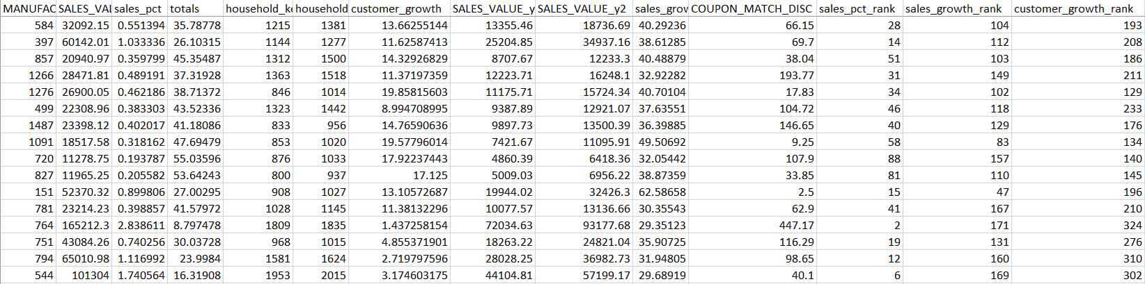
Scorecard
To view scorecard, please clink on this link which will take you to an Excel file on our Google Drive.
We have posted a screenshot of some sample data from the csv file

Slide 13
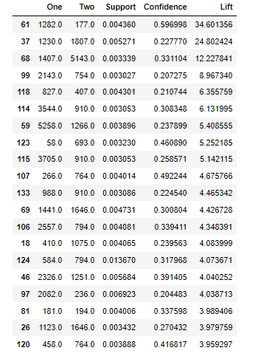
Association Rule Learning (ARL)
We used Association Rule Learning (ARL) to identify customer patterns and see “if they buy product X what other products are they most likely to buy?”.
Ranked in order of most likely manufacturer pairing, an example would be someone who goes with manufacturer #1282 will also tend to buy from #177.
Support is an indication of how frequently the item appears in the dataset
Confidence is the percentage of all transactions satisfying X that also satisfy Y.
Lift of a rule is defined as the ratio of the observed support to that expected if X and Y were independent

Slide 14
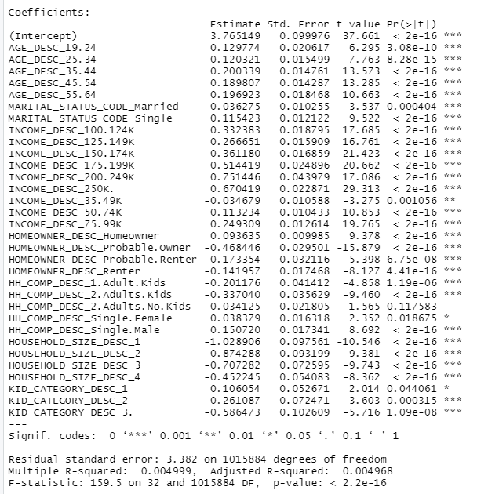
Regression output 1
We used Stepwise Regression to measure the impact of the demographic variables on “SALES_VALUE”.
One-Hot-Encoding was performed to transform these categorical variables into numerical form.
Only the statistically significant remained in the model (<= 5%)
We need to look at the coefficients (Estimate) column to interpret the results. For instance, with each additional customer in the 19-24 age group, it would be associated with an average increase in sales value of $0.12 for MM&A.

Slide 15
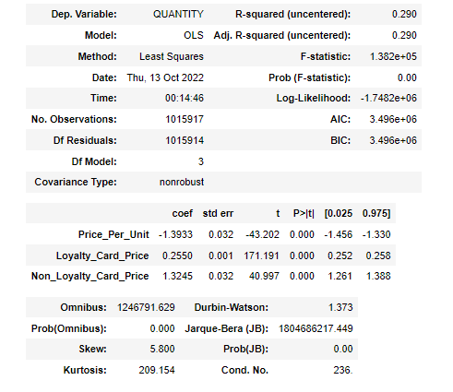
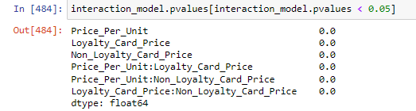
Regression output 2
We used Multiple Linear Regression to measure the impact of price per unit, loyalty and non-loyalty price on “QUANTITY”.
Interaction effects between the 3 explanatory variables were also considered
Demand is elastic for MM&A with a coefficient of -1.39.
The coefficient for Non Loyalty Card Price is higher than the Loyalty Price which means that coupon match discount has a greater impact on quantity demanded as compared to retail discount.
The 3 explanatory variables, along with the 3 interaction effects are all statistically significant

