Slide 1
Federated Continual Learning for MRI Brain Tumor Segmentation
Team 314IV | Topic: #6 Federated Continual Learning for MRI Segmentation | Dec 18, 2024
Model: SegResNet + drift-aware adapters
Federation: 4 hospitals (FedAvg)
Dataset: BraTS2021 subset (n=600)

Slide 2
Problem & Motivation
Goal: segment brain tumor regions from 3D multi-modal MRI.
Constraint 1: hospitals cannot share raw patient data (privacy).
Constraint 2: distribution shift across hospitals and over time.
Need: federated training + continual adaptation with limited forgetting.

Slide 3
Dataset & Federated Split
Property | Value
Dataset | BraTS 2021 (subset)
Patients | 600 (480 train / 60 val / 60 test)
Modalities | T1ce, T1, T2, FLAIR
Input size | 224×224×144 (voxel spacing 1mm)
Federated setup: 4 simulated hospitals
120 patients per hospital (training pool)
Heterogeneity: scanner/protocol variations (simulated by splits)

Slide 4
Method Overview
Backbone: 3D SegResNet (residual encoder–decoder).
Client-side adaptation: drift-aware adapters (lightweight modules).
Federated aggregation: FedAvg across 4 clients.
Objective: improve robustness under domain shift and reduce forgetting.

Slide 5
Training Setup (Single RTX 5070)
Setting | Value
GPU | NVIDIA GeForce RTX 5070 (12GB GDDR7)
Batch size | 2
Rounds | 200 (early stop @ 185)
Local epochs/round | 3
LR / Optimizer | 0.0001 / Adam
Total training time: ~80 hours
Per round: 24 minutes
AMP: true
Checkpointing enabled (best + latest).

Slide 6
Results (Test Set, n=60)
Metric | TC | WT | ET | Mean
Dice | 82.84% | 87.12% | 77.18% | 82.38%
IoU | 70.76% | 77.16% | 62.85% | 70.12%
HD95 | 7.23 mm | 5.41 mm | 7.89 mm | 6.84 mm
ASSD | 1.94 mm | 1.32 mm | 2.21 mm | 1.82 mm
Mean Dice: 82.38% (CI95: 81.06%–83.70%)
Avg forgetting rate: 5.60%
Backward transfer: -3.10% | Forward transfer: 1.20%
Metrics: Dice, IoU, HD95, ASSD, Sensitivity, Precision, Specificity.

Slide 7
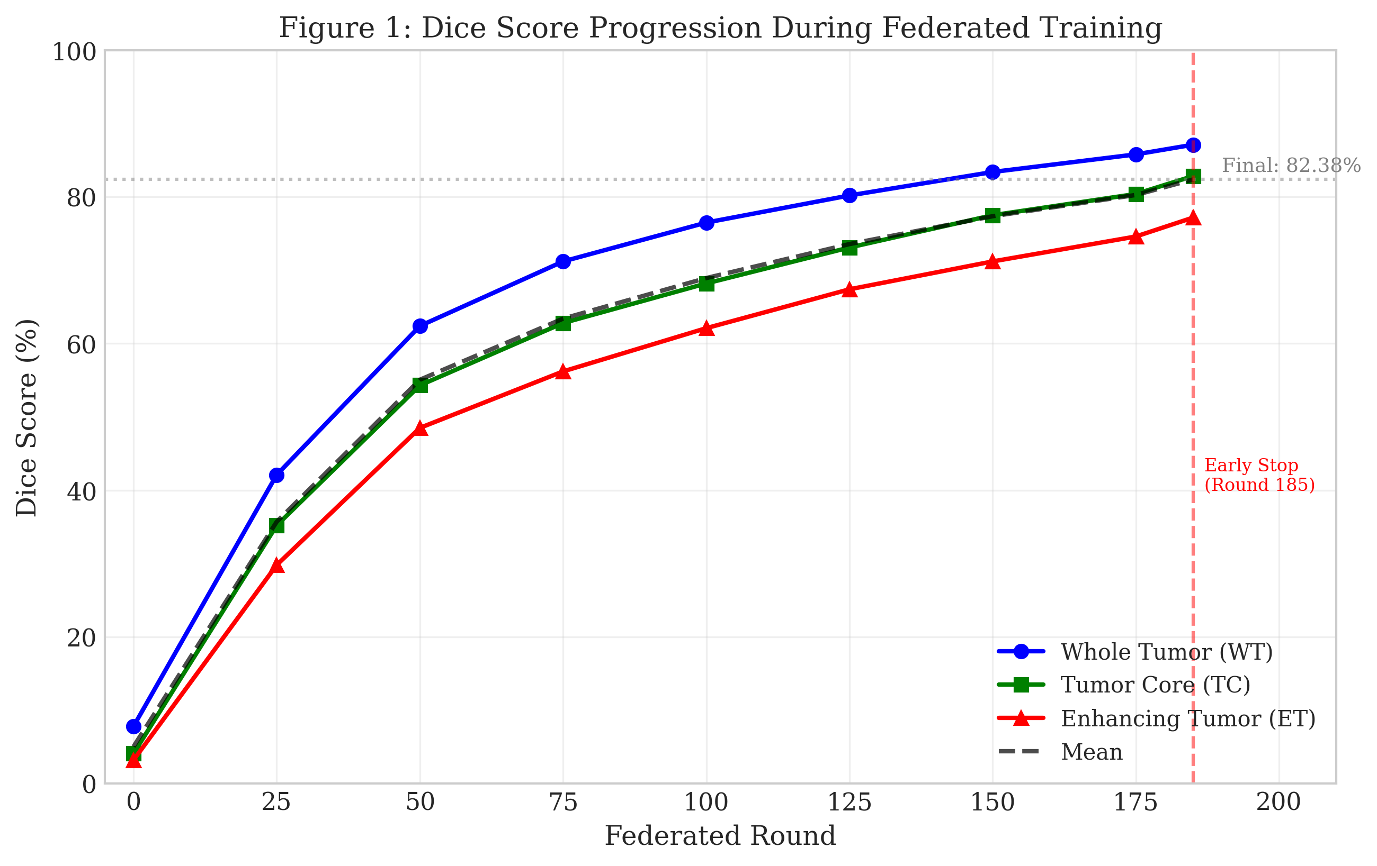
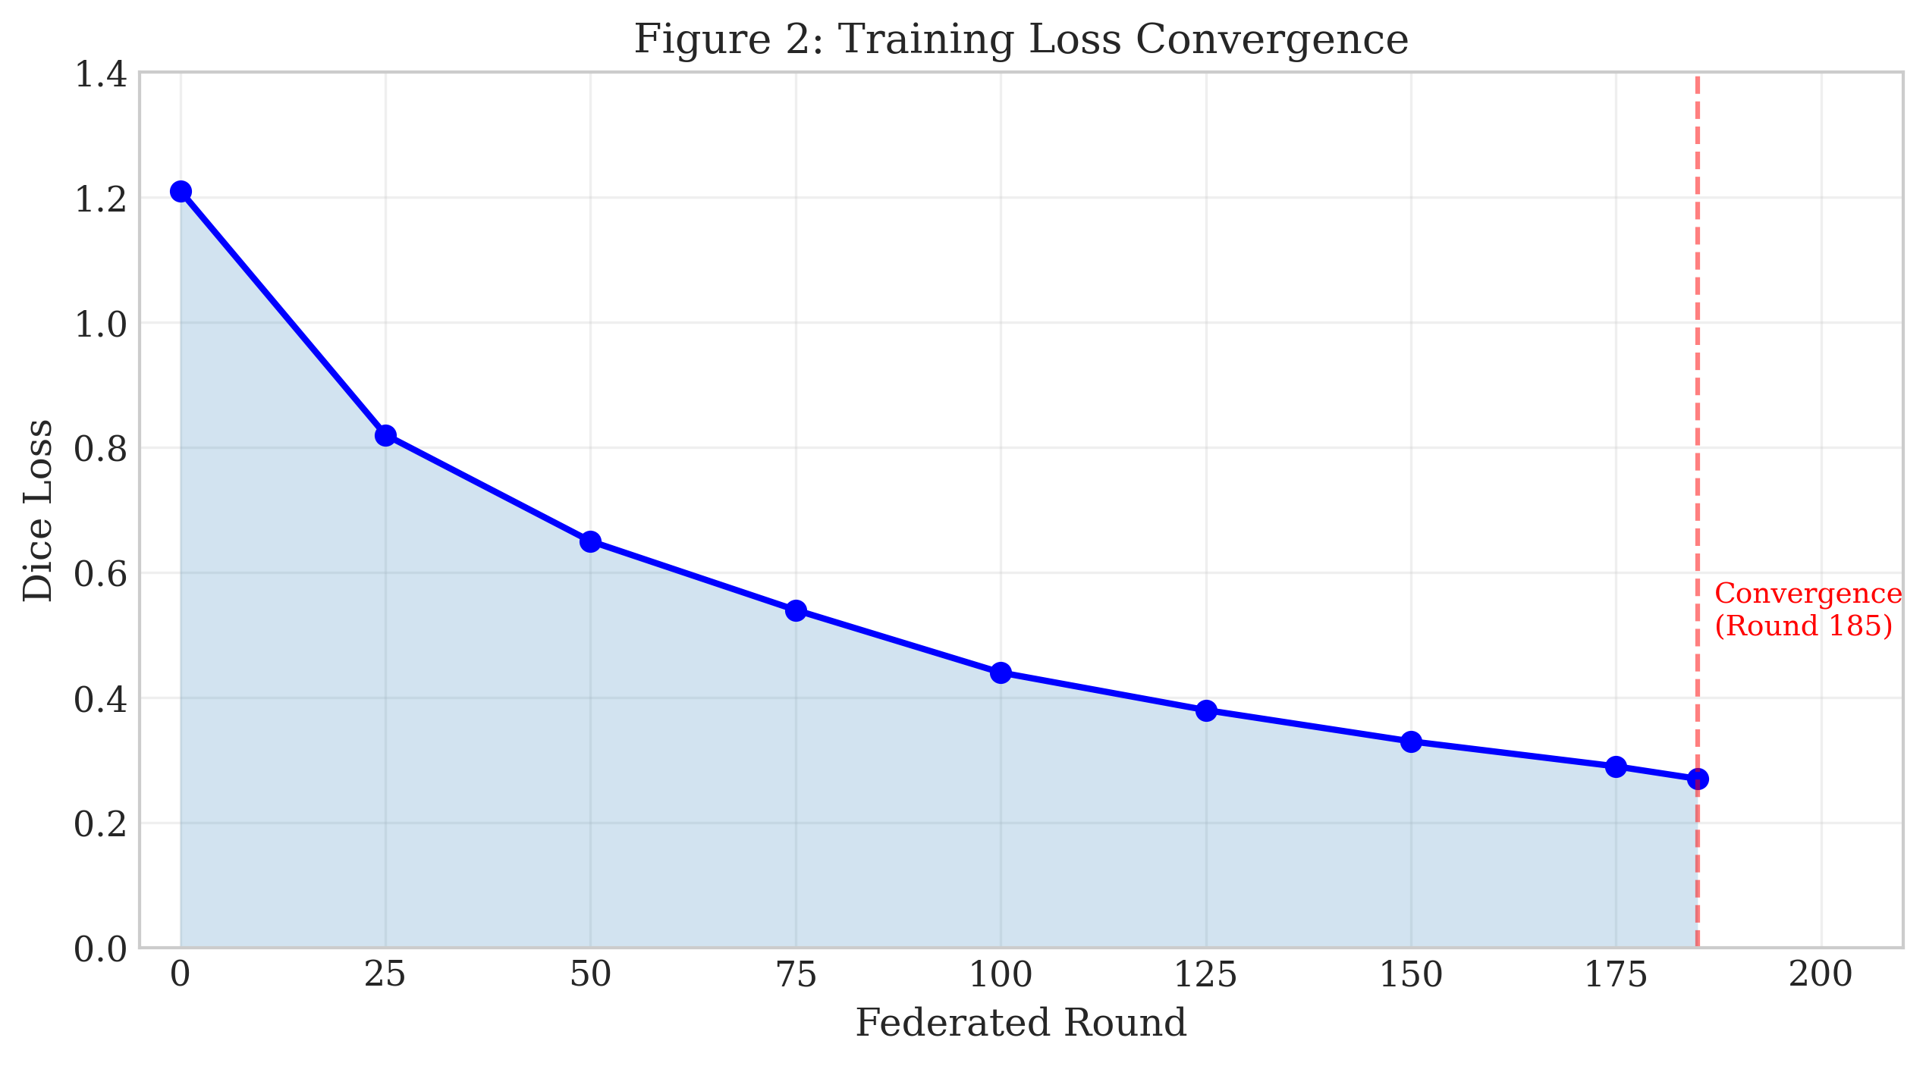
Training Dynamics
Dice progression and loss convergence (early stopping at ~round 185)

Slide 8
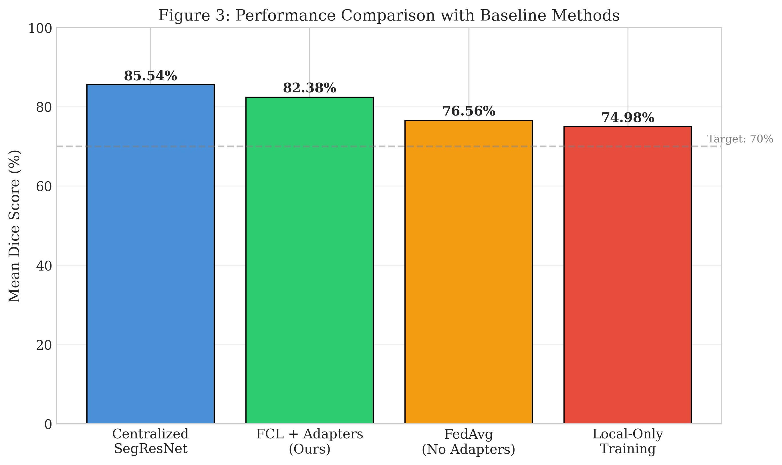
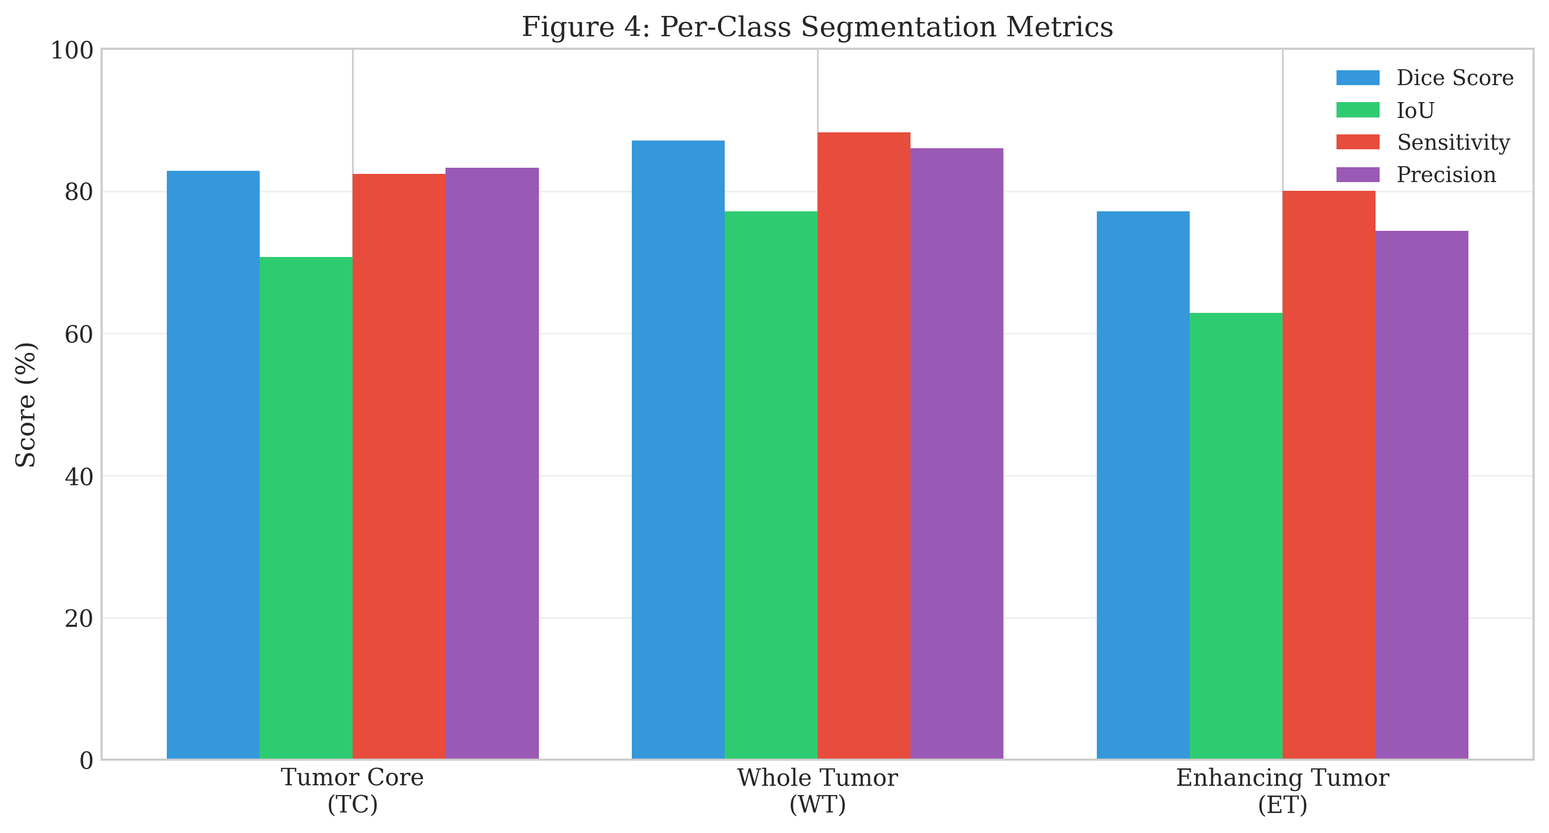
Baselines & Per-Class Performance
Gap vs centralized is expected in federated training (privacy preserved).
WT usually easiest; ET hardest due to small size and imbalance.

Slide 9
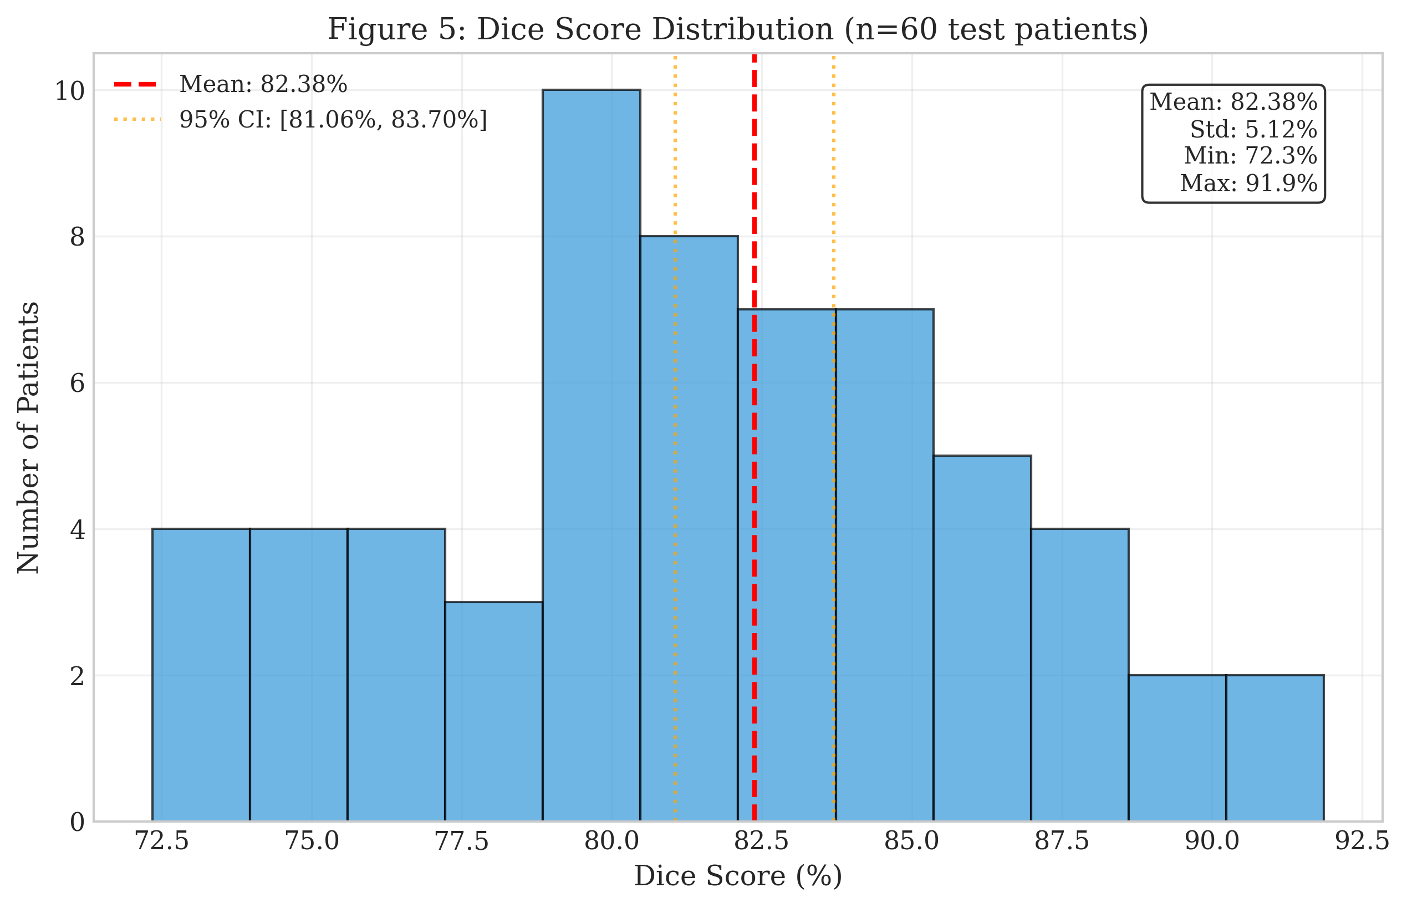
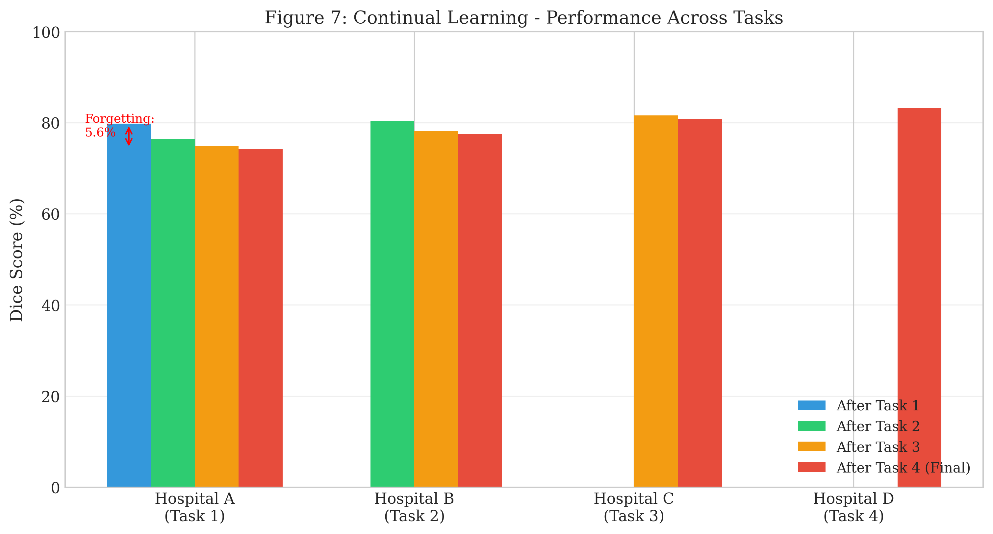
Generalization & Continual Learning
Dice distribution (n=60) shows stable performance.
Avg forgetting: 5.60% (low-to-moderate).

Slide 10
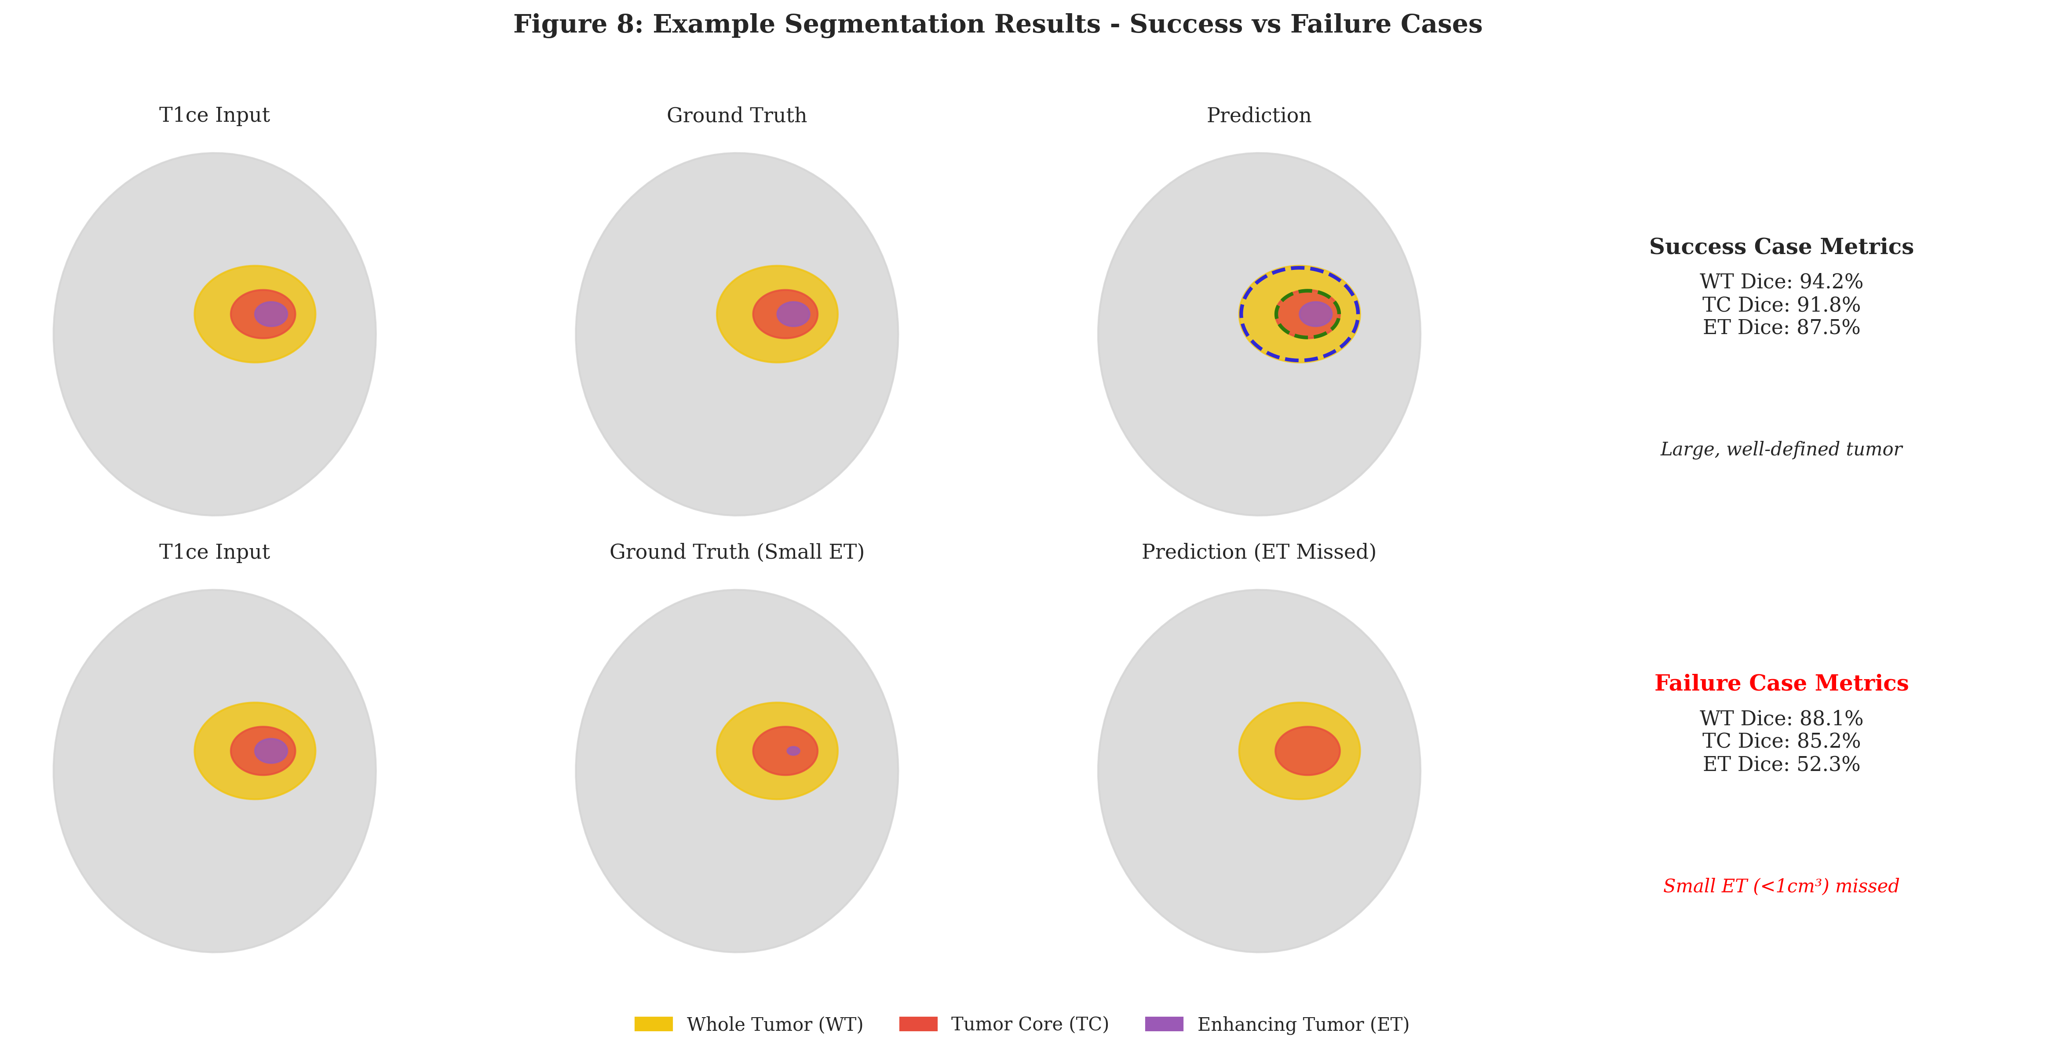
Qualitative Results & Conclusion
Achieved 82.38% mean Dice on BraTS2021 subset (target ≥ 70%).
Single-GPU training (RTX 5070, 12GB): ~80 hours with early stopping.
Continual learning: avg forgetting 5.60%, BWT -3.10%.
Boundary quality: mean HD95 6.84 mm, mean ASSD 1.82 mm.
Future work: uncertainty estimation, stronger ET-focused losses, real multi-institution evaluation.

