Slide 1
GROUP 6
DISTRIBUTED CODE EXECUTION GRID

Slide 2
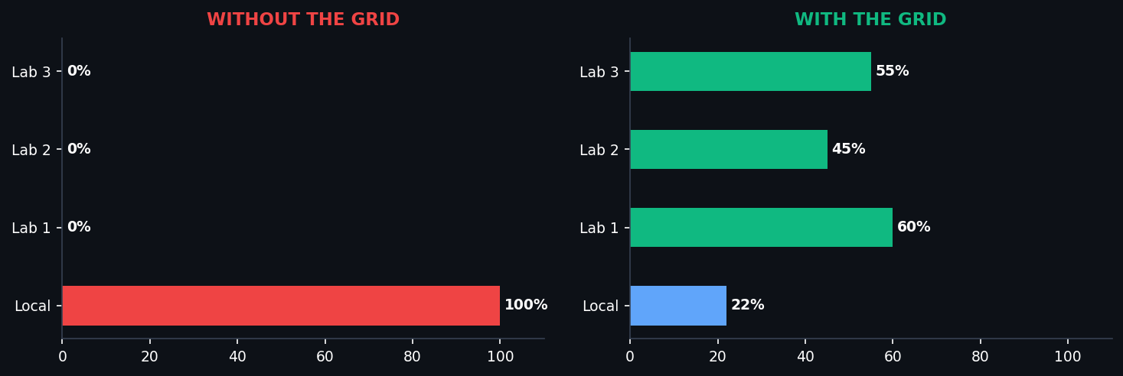
GROUP 6
THE PROBLEM vs THE SOLUTION
Resource Fragmentation — Before & After
✗ WITHOUT THE GRID
✓ WITH THE GRID
✗ CPU pinned at 100% on local machine
✓ Code offloaded to idle LAN machines
✗ Desktop freezes on heavy tasks
✓ Local machine stays free & responsive
✗ Fans spin up — user waits minutes
✓ Dynamic routing to least-loaded node
✗ 30 lab machines sit completely IDLE
✓ Scales from 2 to 100+ worker nodes
✗ All compute locked in ONE node
✓ Compilation local, execution remote
Problem vs Solution · Group 6

Slide 3
GROUP 6
DISTRIBUTED CODE
EXECUTION GRID
Treating a LAN as a Single Supercomputer
C Language
POSIX Threads
TCP Sockets
Linux /proc
GCC -O2
Makefile
Machine A
sender.c
TCP binary payload →
Server
server.c | Route
→ TCP stdout/stderr
Machine B
client.c
Distributed Code Execution Grid · Group 6

Slide 4
GROUP 6
SYSTEM ARCHITECTURE
3-Tier Master-Worker | LAN Star Topology
MACHINE A
SERVER / COORDINATOR
MACHINE B × N
sender.c
node.c
node.c
• Validate .c source
• Accept all connections
• Stream CPU /proc/stat
• Compile with GCC
• pthread per client
• Receive binary TCP
• Heap-buffer binary
binary payload
• Read CPU telemetry
route job
• Write /tmp/<PID>.out
• Serialize & send TCP
• least_loaded_worker()
• Execute via popen()
result
stdout/stderr
• ANSI progress UI
• Route job to best node
• Return stdout/stderr
⟲ Real-time CPU telemetry every 1s via /proc/stat
Machine A → Server → Machine B | All over LAN TCP Sockets | Star Topology

Slide 5
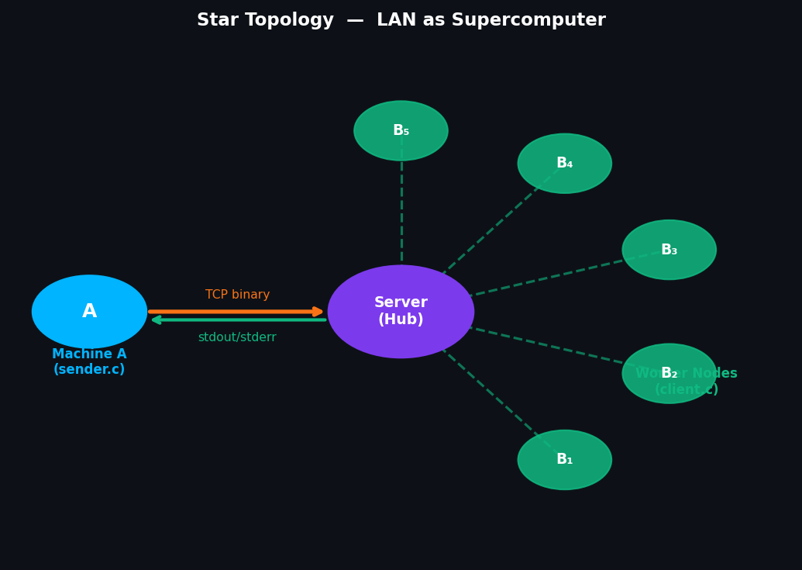
NETWORK TOPOLOGY
GROUP 6
LAN Star Topology — Treating a LAN as a Supercomputer
TOPOLOGY FACTS
Machine A: Sender / Compiler
node.c: Central Hub / Router
node.c: Machine B×N: Worker Nodes
TCP Sockets: All communication
Centralized star — not P2P
📡 Scales 2 → 100+ Nodes
Network Topology · Group 6

Slide 6
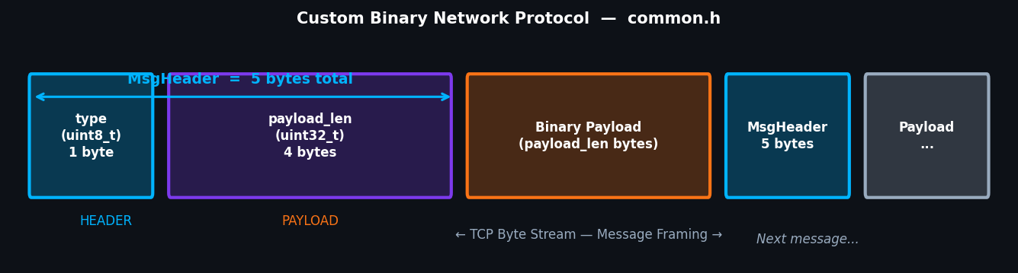
GROUP 6
CUSTOM BINARY NETWORK PROTOCOL
common.h | Message Framing | Robust I/O
Message
Framing
#pragma
pack(1)
Robust I/O
Wrappers
LAN Binary
Transfer
Prefixes every msg
with payload_len
No split/merge bugs
Eliminates padding
ARM vs x86_64 safe
exactly 5 bytes
send_all()/recv_all()
loop until full
payload transferred
Only validated code
crosses the wire A→B
reliable & secure
Binary Protocol · Group 6

Slide 7
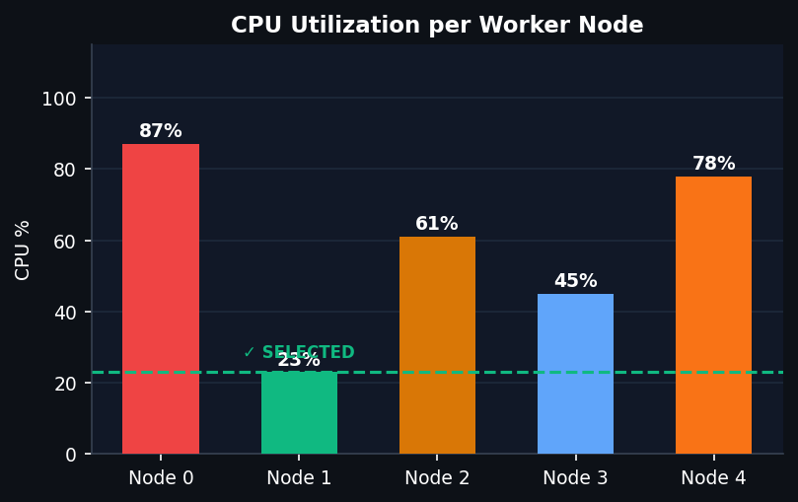
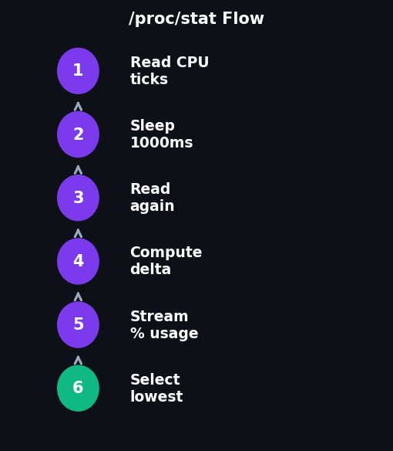
GROUP 6
INTELLIGENT LOAD BALANCING
/proc/stat Telemetry — Least CPU Utilization Policy
✗ Round-Robin (Naïve)
✓ /proc/stat (Engineered)
✗ Blind assignment A→B→C
✓ Real CPU ticks → accurate %
✗ Ignores actual machine load
✓ Deterministic — no guesswork
✗ 90% CPU node still gets routed
✓ Adapts as nodes join or leave
Load Balancing · Group 6

Slide 8
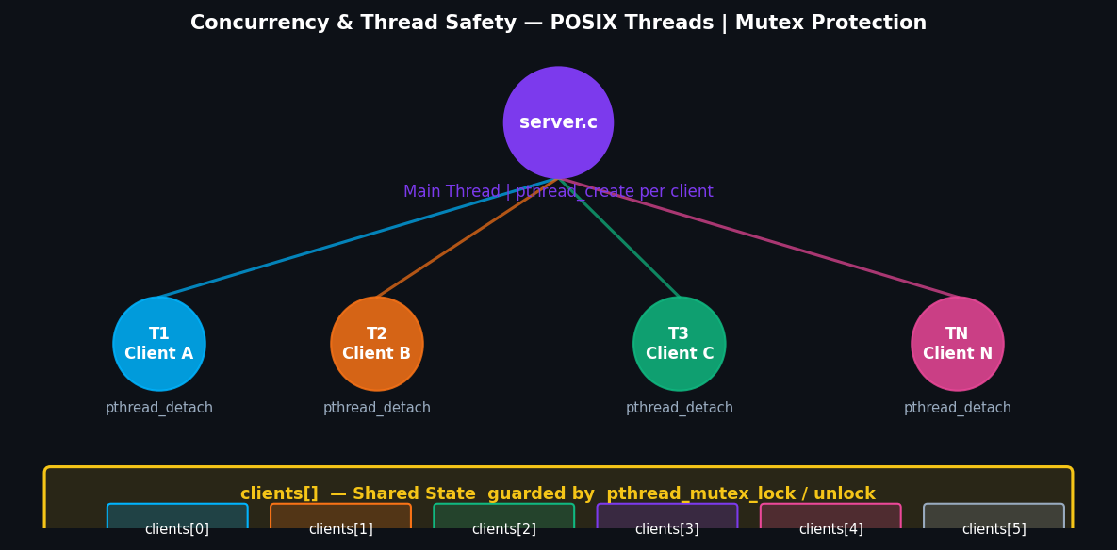
GROUP 6
CONCURRENCY & THREAD SAFETY
server.c — POSIX Threads | Mutex Protection
pthread
create
One thread per
accepted conn.
Never blocks.
pthread
detach
Auto-reclaim on
disconnect.
No zombies.
mutex
lock/unlock
All clients[]
reads & writes
protected.
Stateless
Workers
Zero past memory.
unlink() after
every job.
Concurrency & Thread Safety · Group 6

Slide 9
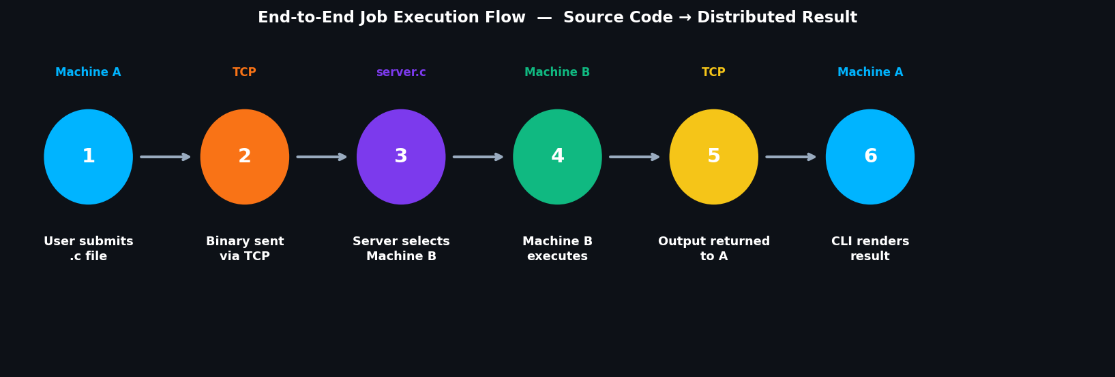
GROUP 6
END-TO-END JOB EXECUTION FLOW
6-Step Pipeline: Source Code → Distributed Result
1. COMPILE
2. SERIALIZE
3. ROUTE
4. EXECUTE
5. RETURN
6. DISPLAY
GCC local
Syntax check
Zero bandwidth
MsgHeader frame
send_all()
Every byte sent
least_loaded()
/proc/stat
Best node chosen
popen() fork
chmod 0755
/tmp/<PID>.out
stdout streamed
A←Server←B
unlink() cleanup
Web interface broadcasts the terminal directly
Execution Flow · Group 6

Slide 10
GROUP 6
LINUX SYSTEM FEATURES
Linux APIs & System Calls Leveraged
P
F
M
Process
Management
Filesystem
& IPC
Memory
Management
getpid() hash
popen() fork
stdout pipe
unlink() cleanup
PID-isolated /tmp
No inode exhaust
fseek+ftell size
malloc() heap
'rb' binary mode
K
D
B
Linux Kernel
Interface
Distributed
Execution
Build System
Makefile
/proc/stat ticks
Delta = real util
Bypasses avg()
A compiles
S routes
B executes
-O2 GCC opt
-Wall -Wextra
-pthread flag
Linux System Features · Group 6

Slide 11
GROUP 6
CLI OBSERVABILITY
Color-coded ANSI State Machine — 3 Phases of Proof
[1/3]
[2/3]
[3/3]
COMPILATION
NETWORK
EXECUTION
GCC compile on A
Errors caught instantly
Zero network wasted
Binary serialized
TCP transfer A→B
Progress real-time
Remote exec Machine B
stdout/stderr captured
Unlink() cleanup done
● ● ● DCEG Terminal — Machine A
[1/3] Compiling hello_world.c ... OK (16008 bytes binary)
[2/3] Sending binary to server via TCP ... MsgHeader + payload
>> Node 0: 8.7% | Node 1: 8.3% | Node 2: disconnected
>> Selected: Node 1 (8.3% CPU) -- Least Loaded Policy
[3/3] Executing on Machine B (Client 1) ... result received
+------ REMOTE OUTPUT ------+
| Hello, Distributed World! |
✓ Least CPU Utilization working correctly — Dynamic node selection proved in live demo

Slide 12
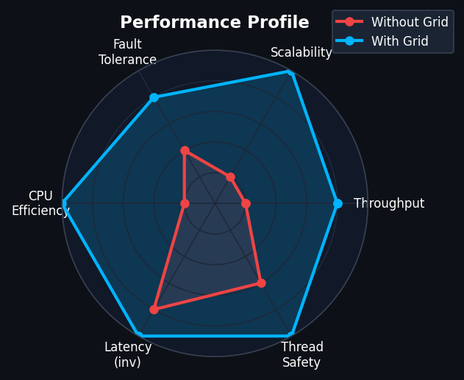
GROUP 6
PERFORMANCE PROFILE
Grid vs Single Machine — Key Metrics
KEY METRICS
Local CPU (without)
100%
Local CPU (with grid)
22%
Worker nodes (Lab 1)
60%
Worker nodes (Lab 2)
45%
Worker nodes (Lab 3)
55%
TCP transfer overhead
~0ms
Max worker scalability
100+
Performance Profile · Group 6

Slide 13
GROUP 6
KEY DESIGN PRINCIPLES
What Makes DCEG Different
1
2
3
LAN as
Supercomputer
Decoupled
3-Tier Design
Least CPU
Policy
Entire LAN abstracted
as one compute unit
transparent to user
A(compile)+S(route)
+B(execute)
clean separation
Real-time /proc/stat
deterministic routing
least-loaded node
4
5
6
Thread-Safe
Concurrent
Stateless
Zero-Footprint
CLI Proves
It Works
Detached pthreads
+ mutex protection
zero race conditions
PID hash + unlink()
+ /tmp isolation
infinite worker nodes
ANSI state machine UI
shows load balancing
visually in demo
Key Design Principles · Group 6

Slide 14
THANK YOU
Distributed Code Execution Grid
Questions & Discussion
C Language
POSIX Threads
TCP Sockets
Linux /proc/stat
GCC -O2
Makefile
GROUP 6
Built in C | POSIX Threads | TCP Sockets | Linux /proc

