Slide 1
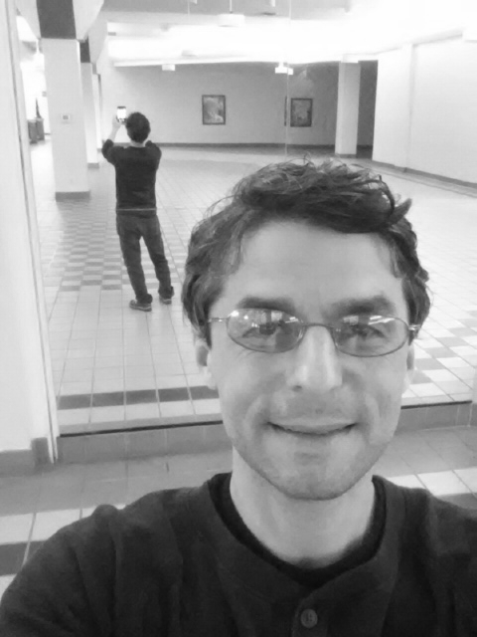

Scales
Scaled image 2
Scaled image 1
Original image

Slide 2
Rectangle features
Sample image from pyramid of scales

Slide 3


Slide 4
A
B
1
2
C
D
3
4
(x,y)

Slide 5
+
…
Stage
Further processing
Sub-window
T
T
…
T
1
2
24
25
T
F
F
F
F
Reject sub-window as face

Slide 6
