Slide 1


Slide 2
Lecture 7: Address Translation
Prof. Seyed Majid Zahedi
https://ece.uwaterloo.ca/~smzahedi

Slide 3
Outline
Virtual to physical address translation
Base and bound
Segmentation
Page table
Multi-level table
Inverted page table

Slide 4
Recall: OS as Illusionist and Referee
Illusion: each process has its own processor with (almost) infinite memory capacity
Physical reality: there are only few processes, memory capacity is limited
Scheduling: need to multiplex processors (done)
Memory management: need to multiplex memory (now!)

Slide 5
Memory Management Goals
Protection: prevent processes/threads from accessing others’ private data
Protect kernel data from user programs
Protect programs from themselves
Give special access permissions to different data
Allow processes to share data (controlled overlap)
E.g., Shared binary file between multiple processes (e.g., fork())
E.g., Shared memory used for inter-process communication
E.g., Memory-mapped file shared by multiple processes
E.g., User-level system libraries
Allocation: divide available physical memory among processes/threads
Manage memory capacity efficiently
Avoid memory fragmentation
Evict memory blocks to persistent storage if needed

Slide 6
Background: Some Basics
Address Space:
Address:
2^{k} “things”
For memory, “things” translates to “bytes” (8 bits)
k bits
What is 2¹⁰ bytes (where one byte is abbreviated as “B”)?
2¹⁰ B = 1024B = 1KiB (for memory, 1KiB = 1024B, not 1000B)
How many bits to address each byte of 4KiB memory?
4KiB = 4 × 1KiB = 4 × 2¹⁰= 2¹² ⇒ 12 bits
How much memory can be addressed with 20 bits? 32 bits? 64 bits?
2²⁰B = 2¹⁰KiB = 1MiB (mebibyte)
2³²B = 2¹²MiB = 2²GiB (gibibyte)
2⁶⁴B = 2³⁴GiB = 2²⁴TiB (tebibyte) = 2¹⁴PiB (pebibyte) = 2⁴EiB (exbibyte)

Slide 7
Recall: Some Terminologies
Address space: set of accessible addresses and their state
Physical memory: data storage medium
Physical addresses: addresses available on physical memory
For 4GiB of memory: 2³²B ~ 4 billion addresses
Virtual addresses: addresses generated by program
For 64-bit processor: 2⁶⁴ > 18 quintillion (10¹⁸) addresses

Slide 8
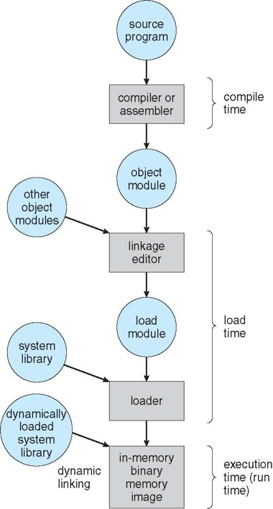
Multi-step Processing of Programs
Compiler: generate object file for each source code
Has incomplete information when compiling each source code
Doesn't know addresses of external objects (e.g., printf routine)
Doesn't know where in memory compiled code will go
Linkage editor: combines objects to single relocatable, executable image
Arranges objects in program’s virtual address space
Reorganizes code and data by changing addresses
Loader: loads image from disk into memory for execution
Allocates memory space to executable image
Transfers control to the beginning instruction of the program
Dynamic linker: defers linkage of shared libraries until run time
Brings shared libraries if it’s not already in memory,
Binds regions of program’s virtual address to shared library

Slide 9
Recall: Virtual Address Space Layout of C Programs
0xFFFF…F
Command line args and environment vars
#include <stdio.h>
#include <stdlib.h>
int x;
int y = 15;
int main(int argc, char *argv[]) {
int *values;
int I;
values = (int *)malloc(sizeof(int)*5);
for (i = 0; i < 5; i++)
values[i] = i;
return 0;
}
Stack
Shared library
Shared library
Heap
Uninitialized Data
Initialized Data
Binary Code
0x0000…0

Slide 10
Recall: What Happens During Program Execution?
Data references: Memory access on load/store instructions
Memory
Execution sequence
Fetch instruction at PC
Decode
Execute (possibly using registers)
Write results to registers/memory
PC ← Next(PC)
Repeat
Data
ALU
Registers
Decode
Instructions
PC
Next
Instruction references:
Memory access on every instruction
E.g., function calls, return, branches, etc.

Slide 11
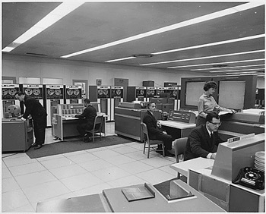
Uni-programming Without Protection and Translation
There is always only one program running at a time
Program always runs at same place in physical memory
Virtual address space = physical address space
Program can access any physical address
Program is given illusion of dedicated machine by literally giving it one
Operating
System
0xFFFFFFFF
Valid 32-bit
Addresses
User Process
0x00000000

Slide 12
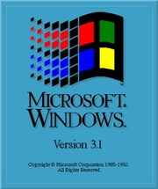
Multi-programming Without Protection and Translation
To prevent address overlap between processes, loader/linker adjust addresses while programs are loaded into memory (loads, stores, jumps)
Virtual address = physical address
Bugs in any program can cause other programs (including OS) to crash
0xFFFFFFFF
Operating
System
User Process 2
0x00020000
User Process 1
0x00000000

Slide 13
Multiprogramming With Protection but Without Translation
Can we protect programs from each other without translation?
Yes: use two special registers base and limit
Prevent application from straying outside designated area
If application tries to access an illegal address, raise exception
During switch, kernel loads new base/limit from PCB
User is not allowed to change base/limit registers
0xFFFFFFFF
Operating
System
limit = 0x10000
User Process 2
0x00020000
base = 0x20000
User Process 1
0x00000000

Slide 14
Recall: Protection With Address Translation
Physical Address Space
Code 2
Stack
Code 1
Stack
Heap
Data 2
Heap
Data
Data 1
Data
Translation Map 1
Translation Map 2
Code
Stack 2
Code
Stack 1
Process 1
Virtual Address Space 1
Heap 2
Process 2
Virtual Address Space 2
Heap 1
OS code
OS data
OS heap &
Stacks

Slide 15
Protection With Address Translation: Discussion
Upsides
Code can be written, compiled, linked, and loaded independently
Threads think they have unrestricted access to their entire virtual memory range
Threads do not need to worry about memory usage of others
OS can provide protection
Threads cannot affect each other if they cannot see each other’s memory
OS can allow memory sharing
Threads’ virtual memory regions can be mapped to same physical regions
Downsides
Address translation adds performance overhead
Address translation needs extra hardware support
Extra hardware consumes area and power

Slide 16
Base and Bound (B&B) Address Translation
0xFFF…F
Virtual Address
Physical Address
Base
0x010…0
0x100…0
0x110…0
Stack
0x101…1
Stack
0x001…1
Heap
+
Heap
Data
Data
Code
Bound
Code
0x100…0
0x000…0
0x010…0
>
Raise Exception
0x000…0

Slide 17
B&B Address Translation: Discussion
Bound
Base
Memory
CPU
Virtual Address
no
Physical Address
>
+
yes
Raise Exception
Process is given illusion of running on its own dedicated memory starting at 0x00000000
Program are mapped to continuous region of memory
Virtual addresses do not change if program is relocated to different physical memory region

Slide 18
B&B Address Translation: Discussion (cont.)
Upsides
OS protection and program isolation
Low overhead address translation
Downsides
Expandable heap?
Expandable stack?
Memory sharing between processes?
Non-relative addresses – hard to move memory around
Memory fragmentation

Slide 19
Issues with B&B Address Translation
Missing support for inter-process memory sharing
E.g., it’s not possible to share code segments in two processes
Fragmentation: wasted space
External: free gaps between allocated chunks
Internal: don’t need all memory within allocated chunks
OS
OS
OS
OS
Process 5
Process 5
Process 5
Process 9
Process 9
Process 11
Process 2
Process 10
Process 6
Process 6
Process 6
Process 6

Slide 20
Multi-segment Address Translation
Virtual Address
Segment map
Seg.
Offset
Seg. | Base | Bound
0 | Base 1 | Bound 1
1 | Base 2 | Bound 2
2 | Base 3 | Bound 3
3 | Base 4 | Bound 4
Memory
Physical Address
>
+
Raise Exception
Segment map resides in processor
Base is added to offset to generate physical address
For each contiguous segment of physical memory there is one entry
Segment addressed by portion of virtual address
However, could be included in instruction instead
E.g., mov ax, es:[bx]

Slide 21
Example: Multi-segment Address Translation
Seg
Offset
Seg ID # | Base | Limit
0 (code) | 0x4000 | 0x0800
1 (data) | 0x4800 | 0x1400
2 (shared) | 0xF000 | 0x1000
3 (stack) | 0x0000 | 0x3000
15
14
13
0
Virtual Address Format
0xC000
0x8000
0x4800
Might
be shared
0x4000
0x4000
Seg. ID = 0
0x0000
Virtual
Address Space
Physical
Address Space

Slide 22
Example: Multi-segment Address Translation (cont.)
Seg
Offset
Seg ID # | Base | Limit
0 (code) | 0x4000 | 0x0800
1 (data) | 0x4800 | 0x1400
2 (shared) | 0xF000 | 0x1000
3 (stack) | 0x0000 | 0x3000
15
14
13
0
Virtual Address Format
0xC000
0x8000
Seg. ID = 1
0x5C00
0x4800
Might
be shared
0x4000
0x4000
Seg. ID = 0
0x0000
0x0000
Virtual
Address Space
Physical
Address Space

Slide 23
Example: Multi-segment Address Translation (cont.)
Seg
Offset
Seg ID # | Base | Limit
0 (code) | 0x4000 | 0x0800
1 (data) | 0x4800 | 0x1400
2 (shared) | 0xF000 | 0x1000
3 (stack) | 0x0000 | 0x3000
15
14
13
0
Virtual Address Format
Shared with
Other Apps
0xF000
0xC000
Space for
Other Apps
0x8000
Seg. ID = 1
0x5C00
0x4800
Might
be shared
0x4000
0x4000
Seg. ID = 0
0x0000
0x0000
Virtual
Address Space
Physical
Address Space

Slide 24
Example: Multi-segment Address Translation (cont.)
0x0240 main: la $a0, varx 0x0244 jal strlen
… …
0x0360 strlen: li $v0, 0 ;count 0x0364 loop: lb $t0, ($a0) 0x0368 beq $r0,$t0, done
… …
0x4050 varx dw 0x314159
Seg ID # | Base | Limit
0 (code) | 0x4000 | 0x0800
1 (data) | 0x4800 | 0x1400
2 (shared) | 0xF000 | 0x1000
3 (stack) | 0x0000 | 0x3000
Fetch 0x0240
Virtual segment number? 0, offset? 0x240
Physical address? Base: 0x4000, so physical address: 0x4240
Fetch instruction at 0x4240, get “la $a0, varx”
Move 0x4050 to $a0, move PC+4 to PC
Fetch 0x244, translated to physical address: 0x4244, get “jal strlen”
Move 0x0248 to $ra (return address!), move 0x0360 to PC
Fetch 0x360, translated to physical address: 0x4360, get “li $v0, 0”
Move 0x0000 to $v0, move PC+4 to PC
Fetch 0x0364, translated to physical address 0x4364, get “lb $t0, ($a0)”
Since $a0 is 0x4050, try to load byte from 0x4050
Translate 0x4050 (0100 0000 0101 0000): virtual segment #? 1, offset? 0x50
Physical address? Base: 0x4800, physical address; 0x4850
Load byte from 0x4850 to $t0, move PC+4 to PC

Slide 25
Multi-segment Address Translation: Discussion
Virtual address space has holes
It’s efficient for sparse address spaces (avoids internal fragmentation)
If program tries to access gaps, trap to kernel (segmentation fault)
When is it OK to address outside valid range?
This is how stack and heap grow
E.g., stack takes segmentation fault, kernel automatically increases size of stack
What must be saved/restored on context switch?
Segment table stored in CPU, not in memory (small)
Might store all of processes memory in disk when switched (called swapping)
What are downsides?
Must fit variable-sized chunks into physical memory (external fragmentation)
Limited options for swapping to disk

Slide 26
Paged Memory
Allocate physical memory in fixed-size chunks called pages
Can use simple bit map to handle allocation 00110001110001101 … 110010
Each bit represents page of physical memory 1 ⇒ allocated, 0 ⇒ free
Should pages be as big as our previous segments?
No, big pages could lead to internal fragmentation
Typically, pages are small (1-16Kib)
Consequently, each segment needs multiple pages

Slide 27
Page-table Address Translation
Virtual Address
Page-table Pointer
Memory
V-Page #
Offset
Page-table Size
V-Page # | P-Page # | Permission | V/N
0 | 10 | R | V
1 | 5 | R/W | V
2 | 22 | - | N
. . . | . . . | . . . | . . .
P-Page 1
P-Page 2
P-Page 3
P-Page 4
P-Page 5
. . .
>
Raise Exception
Physical Address
P-Page #
Offset
Page resides in physical memory
Contains physical page and permission for each virtual page
Offset from virtual address gets copied to physical address
E.g., 10-bit offset ⇒ 1024-byte = 1KiB pages
Virtual page number is all remaining bits
Physical page number is copied from table into physical address

Slide 28
Example: Page-table Address Translation with 4-byte Pages
Physical Memory
Virtual Memory
L
K
J
I
D
C
B
A
Page Table
0x09?
0000 1000
0
4
0001 0000
0x08
0000 1100
0x10
H
G
F
E
1
3
H
G
F
E
0x06?
2
1
0000 0100
0x0E!
0000 0100
0x04
0x0C
D
C
B
A
0000 0000
0x00
0x08
L
K
J
I
0x05!
0000 0110
0000 1110
0x04
0000 1001
0000 0101
0x00
Notes:
What is virtual address 0x6? 1|10 = 3|2 = 0xE
What is virtual address 0x9? 10|01 = 1|1 = 0x5

Slide 29
Page-table Entry
What is in each page-table entry (or PTE)?
Pointer to actual page
Permission bits: valid, read-only, read-write, write-only
Read | Write | Execute | Use Case
X | X | X | Code or data; was common, but now generally deprecated/discouraged due to security risks
X | X | - | Read-write data; very common
X | - | X | Executable code; very common
X | - | - | Read-only data; very common
- | X | X | N/A
- | X | - | Interaction with devices
- | - | X | To protect code from inspection; uncommon
- | - | - | Guard; security feature used to trap buffer overflows or other illegal accesses

Slide 30

Permissions in Action
Demand paging (more on this later)
Keep only active pages in memory
Place others on disk and mark their PTEs invalid
Copy-on-write
UNIX fork gives copy of parent address space to child
How to do this cheaply?
Make copy of parent’s page tables
Mark entries in both sets of page tables as read-only
On write, page fault happens, OS creates two copies
Zero-fill-on-demand
New data pages must carry no information (say be zeroed)
Mark PTEs as invalid; page fault on use gets zeroed page
Often, OS creates zeroed pages in background

Slide 31
Memory Sharing
Process A’s Virtual Address
V-Page #
Offset
Page-table Pointer
V-Page # | P-Page # | Permission | V/N
0 | 10 | R | V
1 | 5 | R/W | V
2 | 22 | - | N
. . . | . . . | . . . | . . .
Memory
P-Page 1
P-Page 2
P-Page 3
P-Page 4
P-Page 5
. . .
Physical Address
P-Page #
Offset
Physical Address
P-Page #
Offset
Process B’s Virtual Address
V-Page #
Offset
Page-table Pointer
V-Page # | P-Page # | Permission | V/N
0 | 5 | R/W | V
1 | 15 | R | V
2 | 4 | R/W | V
. . . | . . . | . . . | . . .

Slide 32
Example: Updating Page Table
Virtual Memory
Page Table
Physical Memory
11111
11110
11101
11100
11011
11010
11001
11000
10111
10110
10101
10100
10011
10010
10001
10000
01111
01110
01101
01100
01011
01010
01001
01000
00111
00110
00101
00100
00011
00010
00001
00000
11101
11100
null
null
null
null
null
null
null
null
null
null
null
10000
01111
01110
null
null
null
null
01101
01100
01011
01010
null
null
null
null
00101
00100
00011
00010
1111 1111
stack
1110 1111
1111 0000
stack
1110 0000
1100 0000
heap
1000 0000
heap
0111 0000
data
data
0101 0000
0100 0000
code
code
0001 0000
0000 0000
0000 0000
page#
offset

Slide 33
Example: Updating Page Table (cont.)
Virtual Memory
Page Table
Physical Memory
11111
11110
11101
11100
11011
11010
11001
11000
10111
10110
10101
10100
10011
10010
10001
10000
01111
01110
01101
01100
01011
01010
01001
01000
00111
00110
00101
00100
00011
00010
00001
00000
11101
11100
null
null
null
null
null
null
null
null
null
null
null
10000
01111
01110
null
null
null
null
01101
01100
01011
01010
null
null
null
null
00101
00100
00011
00010
1111 1111
stack
1110 0000
stack
1110 0000
1100 0000
What happens if stack grows to 1110 0000?
heap
1000 0000
heap
0111 0000
data
data
0101 0000
0100 0000
code
code
0001 0000
0000 0000
0000 0000

Slide 34
Example: Updating Page Table (cont.)
Virtual Memory
Page Table
Physical Memory
11111
11110
11101
11100
11011
11010
11001
11000
10111
10110
10101
10100
10011
10010
10001
10000
01111
01110
01101
01100
01011
01010
01001
01000
00111
00110
00101
00100
00011
00010
00001
00000
11101
11100
11101
11100
null
null
null
null
null
null
null
null
null
10000
01111
01110
null
null
null
null
01101
01100
01011
01010
null
null
null
null
00101
00100
00011
00010
1111 1111
stack
1110 0000
stack
1110 0000
1100 0000
stack
heap
Allocate new pages where room!
1000 0000
heap
0111 0000
data
data
0101 0000
0100 0000
Challenge: table size equal to # of pages in virtual memory!
code
code
0001 0000
0000 0000
0000 0000

Slide 35
Page-table Address Translation: Discussion
What needs to be switched on context switch?
Page-table pointer and page-table size
How big is page table?
32-bits and 4KiB pages ⇒ 2²⁰ entries x 4B each ⇒ 4MiB
64-bits and 4KiB pages ⇒ 2⁵² entries x 8B each ⇒ 32PiB
Upsides
+ Simple memory allocation
+ Easy to share
Downsides
− Inefficient for sparse address spaces
There are too many unused page-table entries
What if page size is very small?
With 1KiB pages, we need 2²² (~4 million) table entries!
What if page size is too big?
Wastes space inside of page (internal fragmentation)

Slide 36
Two-level Page-table Address Translation
10 bits
10 bits
12 bits
P-Page #
Offset
V-P1 Index
V-P2 Index
Offset
Physical Address
Virtual Address
4K
Page-table Pointer
4 bytes
Tables fixed size (e.g., 1024 entries)
On context switch: save single page-table-pointer register
Valid bits on page-table entries
Don’t need every 2nd-level table
Even when exist, 2nd-level tables can reside on disk if not in use
4 bytes

Slide 37
Example: Two-level Page-table Address Translation
Virtual Memory
Physical Memory
Page Tables
(level 2)
1111 1111
stack
1110 0000
11 11101
10 11100
01 10111
00 10110
stack
1110 0000
1100 0000
Page Table
(level 1)
stack
111
110 null
101 null
100
011 null
010
001 null
000
11 null
10 10000
01 01111
00 01110
heap
1000 0000
heap
0111 0000
11 01101
10 01100
01 01011
00 01010
data
data
0101 0000
0100 0000
11 00101
10 00100
01 00011
00 00010
code
p2#
code
0001 0000
0000 0000
0000 0000
p1#
offset

Slide 38
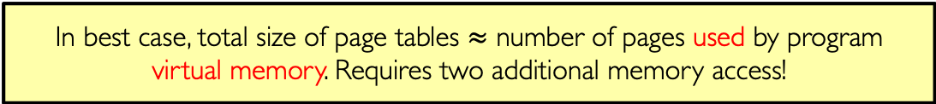
Example: Two-level Page-table Address Translation (cont.)
Virtual Memory
Physical Memory
Page Tables
(level 2)
stack
11 11101
10 11100
01 10111
00 10110
stack
Page Table
(level 1)
stack
111
110 null
101 null
100
011 null
010
001 null
000
11 null
10 10000
01 01111
00 01110
1001 0000
(x90)
heap
heap
1000 0000
(0x80)
11 01101
10 01100
01 01011
00 01010
data
data
11 00101
10 00100
01 00011
00 00010
code
code
In best case, total size of page tables $≈$ number of pages used by program virtual memory. Requires two additional memory access!
0000 0000

Slide 39
Multi-level Address Translation: Segments and Pages
Virtual Address
Physical Address
Seg #
V-Page #
Offset
P-Page #
Offset
>
Segment Map
Page Table
Seg. | Base | Bound
0 | Base 1 | Bound 1
1 | Base 2 | Bound 2
2 | Base 3 | Bound 3
3 | Base 4 | Bound 4
V-Page # | P-Page # | Permission | V/N
0 | 8 | R | V
1 | 19 | R/W | V
2 | 7 | R | V
. . . | . . . | . . . | . . .
Check Permissions
Raise Exception
What must be saved/restored on context switch?
Contents of top-level segment registers

Slide 40
Example: Multi-level Paged Segmentation (x86)
Global descriptor table (segment table)
Pointer to page table for each segment
Segment length
Segment access permissions
What should be saved on context switch?
Change global descriptor table register (GDTR, pointer to global descriptor table)
Multi-level page table
32-bit: two-level page table (per segment)
64-bit: four-level page table (per segment)

Slide 41
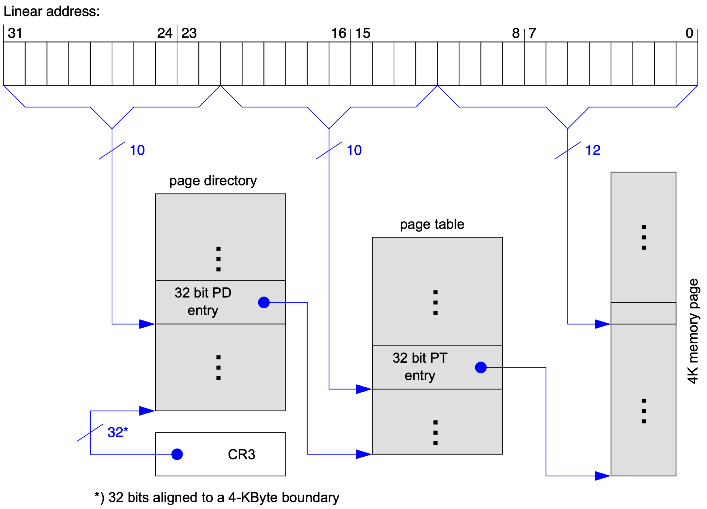
x86 32-bit Virtual Address
4KiB pages; each level of page table fits in one page

Slide 42
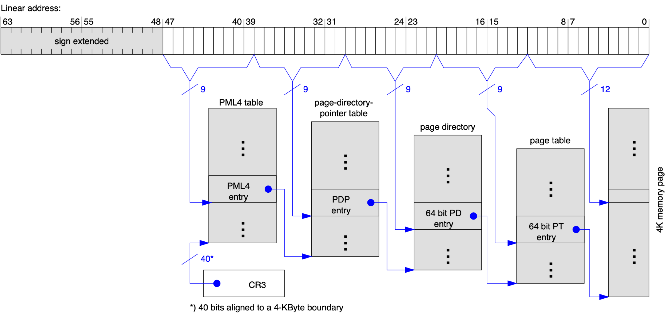
x86 64-bit Virtual Address
Fourth-level table maps 2MiB, and third level table maps 1GiB of data
If physical memory covered by fourth level table is contiguous, then one third-level entry can directly point to this region instead of pointing to fourth-level page table

Slide 43
Example: x86 64-bit PTE
NX
SW
Reserved
P-Page Number
U
P
CW
GL
L
D
A
CD
WT
O
W
V
63
62-52
51-40
39-12
11
10
9
8
7
6
5
4
3
2
1
0
V: Valid
W: Read/write
O: Owner (user/kernel)
WT: Write-through (more on this soon)
CD: Cache-disabled (page cannot be cached)
A: Accessed: page has been accessed recently
D: Dirty bit (page has been modified recently)
L: Large page
G: Global
CP: Copy-on-write
P: Prototype PTE
U: Reserved
SW: Software (working set index)
NX: No-execute

Slide 44
Multi-level Address Translation: Sharing Entire Segment
Process A’s Virtual Address
Seg #
Page #
Offset
Segment Map
Seg. | Base | Bound
0 | Base 1 | Bound 1
1 | Base 2 | Bound 2
2 | Base 3 | Bound 3
3 | Base 4 | Bound 4
V-Page # | P-Page # | Permission | V/N
0 | 8 | R | V
1 | 19 | R/W | V
2 | 7 | R | V
. . . | . . . | . . . | . . .
Segment Map
Seg. | Base | Bound
0 | Base 1 | Bound 1
1 | Base 2 | Bound 2
2 | Base 3 | Bound 3
3 | Base 4 | Bound 4
Seg #
Page #
Offset
Process B’s Virtual Address

Slide 45
Aside: Shared Library Address Space
Shared library’s global and static variables are private to each process
Each process has read and write permissions on its own copy of variables
Shared library’s code is shared between different processes
Each process only has read and execute permissions on shared code
Shared library code must be position-independent code (PIC)
Same library code could be mapped to different virtual address regions in different processes
Code must execute properly regardless of its absolute virtual address
Code cannot contain absolute virtual addresses for data and instruction references
Data references are made indirectly through global-offset tables (GOT)
GOT is located at fixed offset from code and can be accessed using PC-relative offset
GOT has one entry per variable which contains absolute address of that variable
GOT is private to each process, and processes have read and write permissions to their GOT
Similarly, instruction references are made indirectly through procedure-linkage table (PLT)

Slide 46
Multi-level Address Translation: Discussion
+ Allocate only as many page-table entries as needed for application
In other words, sparse address spaces are easy
+ Easy memory allocation
Bit-map memory allocation
+ Easy sharing
Share at segment or page level (need additional reference counting)
− One extra pointer per page
One pointer per 4 -16KiB pages
− Page tables need to be contiguous
However, we can make each table to fit exactly into one page
− Two (or more, if > 2 levels) lookups per reference
Seems very expensive!

Slide 47
Inverted Page Table
In all previous methods (forward page tables), size of page table is at least as large as amount of virtual memory allocated to processes
Physical memory may be much smaller
Inverted page table fixes this problem by using hash table
Size of hash table is related to size of physical memory not virtual address space
Very attractive option for 64-bit address spaces (e.g., PowerPC, UltraSPARC, IA64)
Notice any downsides?
Complexity of managing hash chains: often in hardware!
Poor cache locality of page table
Virtual Address
V-Page #
Offset
Hash
Table
P-Page #
Offset

Slide 48
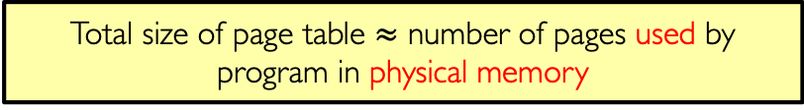
Inverted Paging Example (cont.)
Virtual Memory
Physical Memory
1111 1111
stack
1110 0000
stack
1110 0000
Inverted Table
Hash(v-page#) = p-page#
stack
h(11111)=
h(11110)=
h(11101)=
h(11100)=
h(10010)=
h(10001)=
h(10000)=
h(01011)=
h(01010)=
h(01001)=
h(01000)=
h(00011)=
h(00010)=
h(00001)=
h(00000)=
11101
11100
10111
10110
10000
01111
01110
01101
01100
01011
01010
00101
00100
00011
00010
heap
1000 0000
heap
0111 0000
data
data
0101 0000
0100 0000
code
code
0001 0000
0000 0000
Total size of page table $≈$ number of pages used by program in physical memory
0000 0000

Slide 49
HW vs. SW Address Translation
Does kernel require HW support for translation?
No! Almost anything that can be done in HW can also be done in SW (might end up being too expensive, but possible!)
Implement page tables in HW
All memory reference pass through memory management unit (MMU)
MMU generates page fault if it encounters invalid PTE
Fault handler will decide what to do (more on this later)
+ Relatively fast (but still many memory accesses!)
− Inflexible, complex hardware
Implement page tables in SW
+ Very flexible
− Every translation must invoke fault!
In fact, we need a way to cache translations for either case

Slide 50
Address Translation Comparison
Method | Advantages | Disadvantages
Segmentation | Fast context switching: Segment mapping maintained by CPU | External fragmentation
Page-table translation | No external fragmentation, fast easy allocation | Large table size ~ virtual memory
Multi-level translation | Table size ~ # of pages in virtual memory, fast easy allocation | Multiple memory references per page access
Inverted table | Table size ~ # of pages in physical memory | Hash function more complex

Slide 51
Summary
Segmentation
Segment ID associated with each access
Each segment contains base and limit information
Page tables
Memory divided into fixed-sized chunks of memory
Virtual page # from virtual address mapped through page table to physical page #
Multi-level tables
Virtual address mapped to series of tables
Permit sparse population of address space
Inverted page table
Use of hash-table to hold translation entries
Size of page table ~ size of physical memory rather than size of virtual memory

Slide 52

Questions?
globaldigitalcitizen.org

Slide 53
Acknowledgment
Slides by courtesy of Anderson, Ousterhout, Culler, Stoica, Silberschatz, Joseph, and Canny

