Slide 1

Electricity Load Prediction
Amin Kamali
August 3, 2023

Slide 2
Problem Statement
Given observed and forecasted weather data and historical electricity load, predict the load for the next 24 hours each day at 8 am.
Problem: Multivariate time series forecasting
Potential model options:
Classical: Vector Auto Regressive (VAR)
ML-based Multioutput Regression
Gradient Boosted Trees
Multi-head neural nets
LSTM
Transformer-based

Slide 3
Selection of the modeling approach
Model Selection Criteria:
Amount of data, some models such as NNs need larger amounts
Number of lags required, some models do not scale well for large lags
Desired level of accuracy, there’s usually a trade-off between accuracy and model complexity
Model Evaluation Measures:
Mean Absolute Percentage Error
Root Mean Squared Error
Mean Absolute Error

Slide 4
Selection of the modeling approach
It is best to try both classical approaches as well as ML-based approaches
From ML-based approaches, the ones based on deep learning (MLP, LSTM, Transformer) need very large amounts of data, substantial data preprocessing, and extensive parameter tuning
Gradient boosted trees do not have any of these limitations
Therefore, for this exercise due to the time limitation, I chose LightGBM to represent ML-based techniques

Slide 5
Assumptions
At 8 am of each day, the following data is available to us:
Historical weather data
Historical electricity load
Weather forecast for the next 24 hours

Slide 6
Assets
Notebooks:
electricity_load_prediction_VAR
Captures experiments for building and evaluating a VAR pipeline
electricity_load_prediction_1day_lag
Captures experiments for building and evaluating a Multioutput regression pipeline using LightGBM
electricity_load_prediction_lag_tuning
Captures experiments for tuning number of lags for the Multioutput regression pipeline
Scripts:
./src/tde.py
Used to create time delayed embeddings for the ML-based approach
Courtesy of Vitor Cerqueira (https://github.com/vcerqueira/blog/blob/main/src/tde.py)
Dependencies:
pandas, numpy, matplotlib, sklearn, lightgbm, statsmodels

Slide 7
VAR Methodology *
Exploratory data analysis
Feature Engineering
Data Splitting
Data preprocessing
Determining model parameters
Model training
Making predictions
Prediction post-processing
Model Evaluation
* Experiments captured in notebook:
electricity_load_prediction_VAR

Slide 8
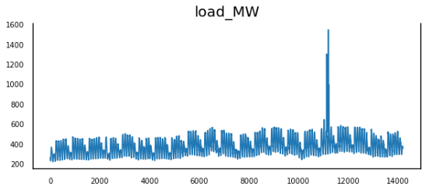
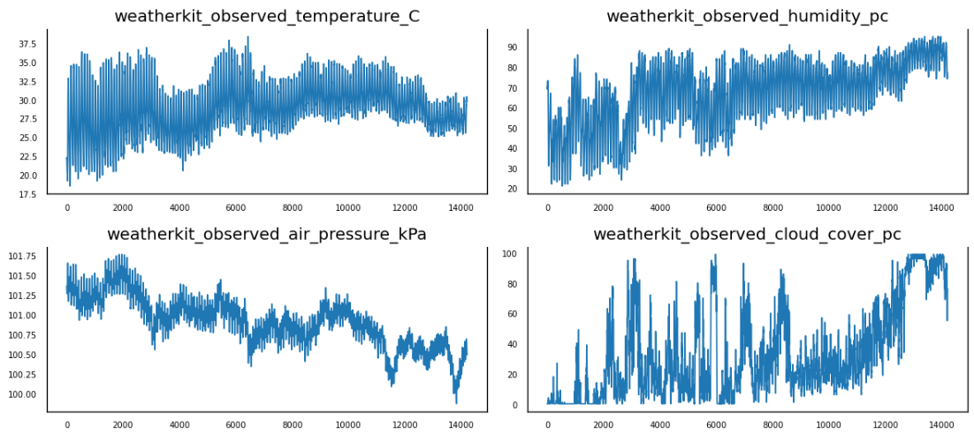
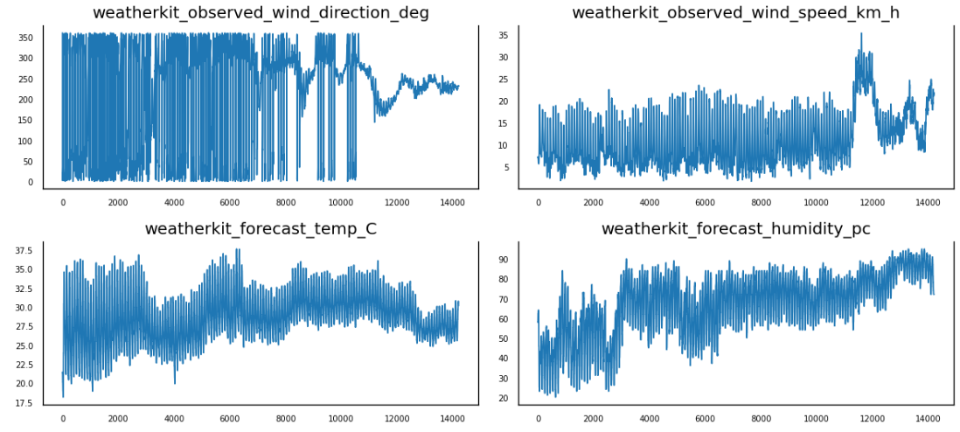
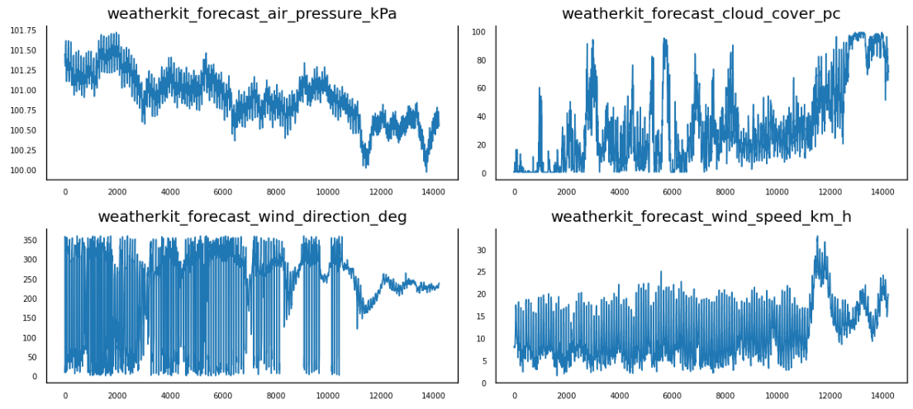
Building the VAR model
EDA
None of the series are stationary

Slide 9
Feature Extraction
Shift the weather forecast data by 1 day so that they are available for training and forecasting
Extract additional features from the timestamps
'ts_month_of_year'
'ts_day_of_month'
'ts_day_of_week'
'ts_hour_of_day'
'ts_minute_of_hour'

Slide 10
Check for causal relationships
Using Granger causality test between predictors and the target (p=0.05)
All predictors had significant causal relationship with the target except for ts_day_of_month and ts_minute_of_hour → drop the features
Data Splitting
I take the last 14 days of the series for testing
For each test day, a model is trained using the data up to 8am of that day

Slide 11
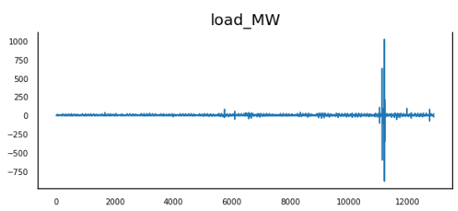
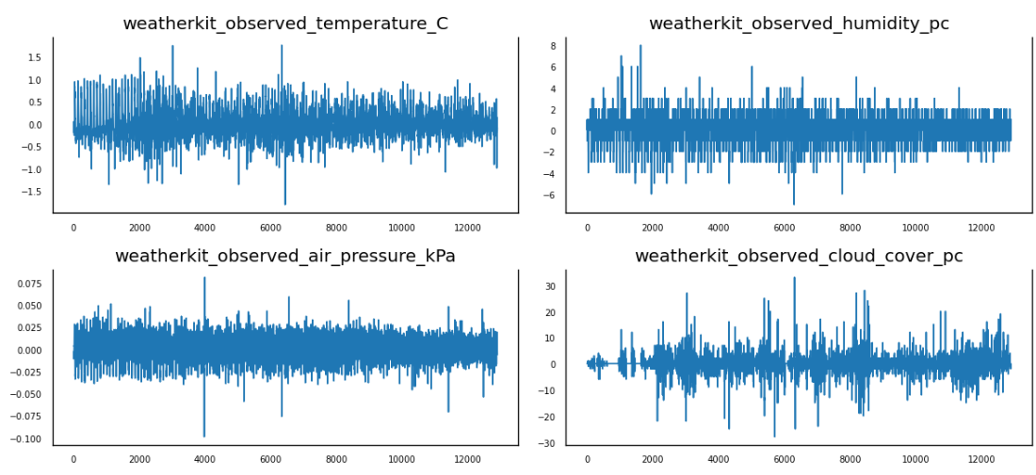
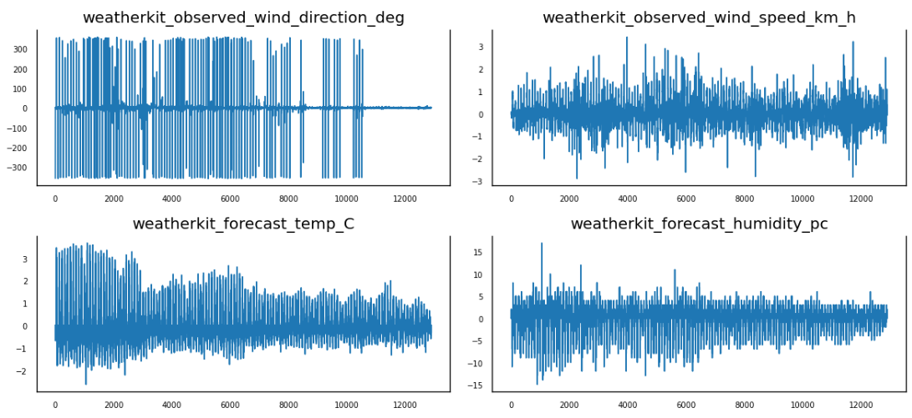
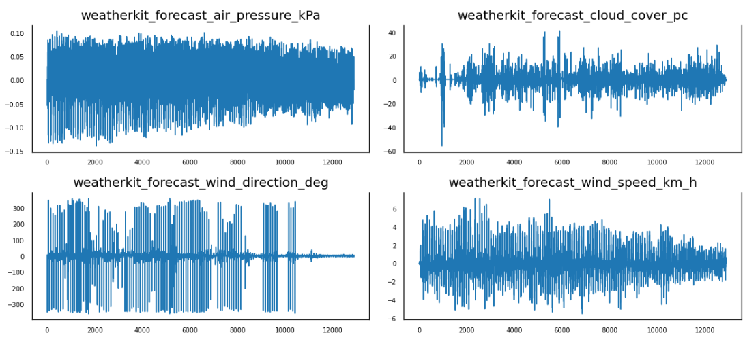
Check for stationarity
Based on ADF and KPSS tests, initially the data is not stationary
Incrementally compute the difference of the series and repeat the tests until the series become stationary
1 difference was sufficient to make all series stationary

Slide 12
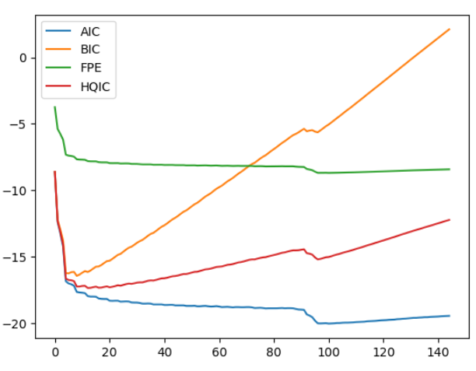
Select the order (P)
Based on AIC and FPE, model with P = 100 was selected
This is roughly equivalent to 1 day (96 time steps)

Slide 13
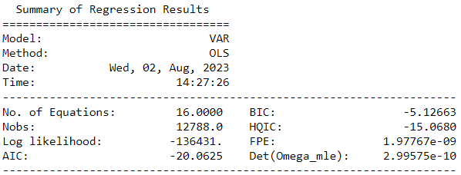
Model training and inference
Model training approach:
For each of the 14 test days, a model was trained using the data up to 8 am of that day
Then each model was tested for making predictions for the next 24 hours

Slide 14
Check for Serial Correlation of Residuals (Errors) using Durbin Watson Statistic
We check for serial correlation of residuals to determine whether there are any unexplained errors in the model.
The Durbin Watson stats for all variables is close to 2.0
Meaning there are not significant correlation of residuals
weatherkit_observed_temperature_C : 2.0
weatherkit_observed_humidity_pc : 2.0
weatherkit_observed_air_pressure_kPa : 2.0
weatherkit_observed_cloud_cover_pc : 2.0
weatherkit_observed_wind_direction_deg : 2.0
weatherkit_observed_wind_speed_km_h : 2.0
weatherkit_forecast_temp_C : 2.0
weatherkit_forecast_humidity_pc : 2.0
weatherkit_forecast_air_pressure_kPa : 2.01
weatherkit_forecast_cloud_cover_pc : 2.0
weatherkit_forecast_wind_direction_deg : 2.0
weatherkit_forecast_wind_speed_km_h : 2.0
ts_month_of_year : 2.0
ts_day_of_week : 2.0
ts_hour_of_day : 1.99
load_MW : 2.0

Slide 15
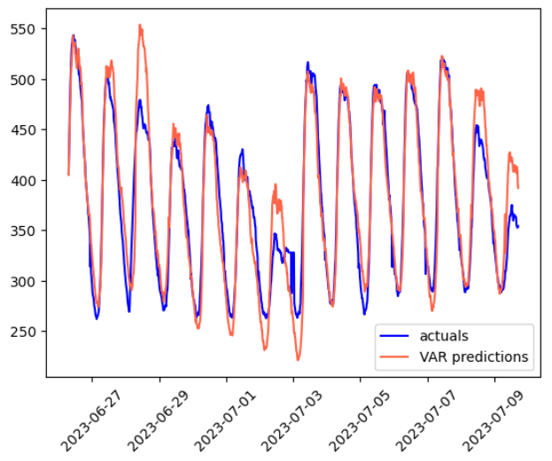
Model Evaluation on the test data (last 14 days)
MAPE: 5.49%
RMSE: 26.4600
MAE: 19.7209
Analysis:
While the predictions have captured the cycles and range of changes very well, they seem to overestimate the peaks and underestimate the valleys for some periods.

Slide 16
ML Methodology *
Exploratory data analysis
Feature Engineering
Data Splitting
Data preprocessing
Model tuning (determining number of lags)**
Model training
Making inference
Model Evaluation
* Experiments captured in notebook:
electricity_load_prediction_1day_lag
** Experiments captured in notebook:
electricity_load_prediction_lag_tuning

Slide 17
Steps similar between VAR and ML
Exploratory data analysis
Feature Engineering
Data Splitting

Slide 18
ML Model Building and Validation
Data preprocessing
Preprocessing such as normalization and scaling are not necessary for gradient boosted tree methods such as LGBM
Creating time delayed embeddings is necessary for an ML-based approach
Time steps | 1 | 2 | 3 | 4 | 5 | 6 | 7
Observed Weather |  |  |  | Feature
Forecast Weather |  |  |  | Feature |  | Feature
Electricity Load |  |  |  | Feature |  | Label
Lags
Horizon
Target step

Slide 19
ML Model Building and Validation
Model tuning (determining number of lags, model parameters)
The number of lags required and the model parameters must be tuned
This is done by further splitting the training data to training and validation sets
Due to time limitations, only n_lags was tuned
Models with each configuration is trained using the training set and tested on the validation set
Optimal n_lags = 1 day (96 steps), which is consistent with the order obtained for the VAR model based on AIC

Slide 20
ML Model Building and Validation
Model training
Model was trained with n_lags = 1 day
For each of the 14 test days, a model was trained using the data up 8 am of that day
Making inference
Inference was made for each of the 14 test days based on the corresponding models using the timestamp representing 8 am of each day

Slide 21
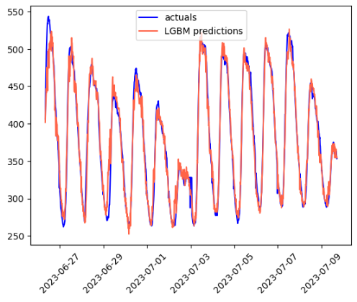
Model Evaluation
VAR
LGBM
MAPE: 5.49%
RMSE: 26.4600
MAE: 19.7209
MAPE: 2.67%
RMSE: 14.5096
MAE: 9.9162

Slide 22
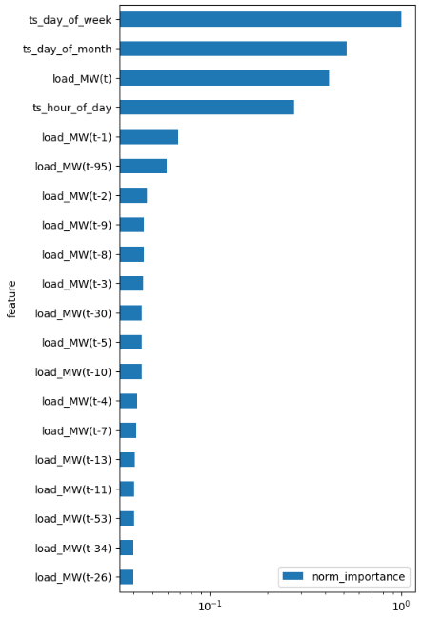
Feature Importance Analysis
The extracted features had the most significant role in making predictions
After that, different lags of the electricity load data had the most important
From the other predictor variables, the following were the most influential:
weatherkit_forecast_temp_C(t+96)
weatherkit_forecast_wind_speed_km_h(t+96)
weatherkit_forecast_air_pressure_kPa(t+96)
weatherkit_forecast_humidity_pc(t+96)
weatherkit_forecast_cloud_cover_pc(t-95)
weatherkit_forecast_wind_speed_km_h(t-95)
weatherkit_forecast_cloud_cover_pc(t+96)
weatherkit_forecast_temp_C(t-95)
weatherkit_forecast_wind_direction_deg(t+96)
weatherkit_observed_wind_speed_km_h(t)

Slide 23
Analysis
 | Pros | Cons
VAR | Well-established Fast model training Decent accuracy | Memory intensive for large values of n_lags While the predictions are accurate overall, they seem to overestimate the peaks and underestimate the valleys for some periods.
Multioutput Regression - LGBM | High level of accuracy No need for extensive feature preprocessing Feature selection is handled internally, not needed as a separate step Provides feature importance from the trained model | Like any other ML-based approach requires considerable amount of parameter tuning LGBM does not support multiple outputs natively, therefore requires MultiOutputRegressor from sklearn which: Does not support early stopping Does not scale well with number of labels Is expensive to tune and to train Model size and training time grow linearly with the number of outputs (in this case by 96x)

Slide 24
Recommendations
Given the limitations of MultiOutputRegressor, testing an ML approach such as the ones based on deep learning is recommended, that:
Natively supports multiple outputs
Scales well for multioutput with almost no model training or model size overheads
Using an approach that models uncertainty of the predictions in terms of confidence intervals can be beneficial to quantify predictions’ reliability (e.g. Informer)
While it was not needed in this exercise, more extensive feature engineering can be helpful for ML-based approaches

