Slide 1



        Kickstart
Stéphane Maldini
doc4web
Luis Arias
balsamiq

Slide 2
About the guys right here

Slide 3


About the guys right here
      Luis Arias ( @kaaloo )
        Web Developer Extraordinaire at
        balsamiq
        French GGUG organizer
        Grails plugin author
      Stephane Maldini ( @smaldini )
        Software consultant at doc4web
        French GGUG group organizer
        New Grails committer

Slide 4
What Are We Going To Learn Today ?
  About Grails
  Setting up your development environment
  Creating, running and debugging your app
  Implementing a domain model
  Adding behavior
  Adding a custom look
  Using services for business logic
  Implementing a secure site
  Testing your app
  Improving performances

Slide 5
About Grails

Slide 6
About Grails
  Grails is a robust & powerful web framework :
    Leveraging the expressive language Groovy
    Built uppon Spring Framework
    Bringing Rails-like productivity to Java shops
    Backed by an Amazing Community
    Getting mature : ~6 years old
      current version : 1.3.7
      next one : 1.4 (M1 is about to be shipped)

Slide 7
Domain
Static resources
Views
Controllers
Services
Custom Artefacts
Plugins

Slide 8
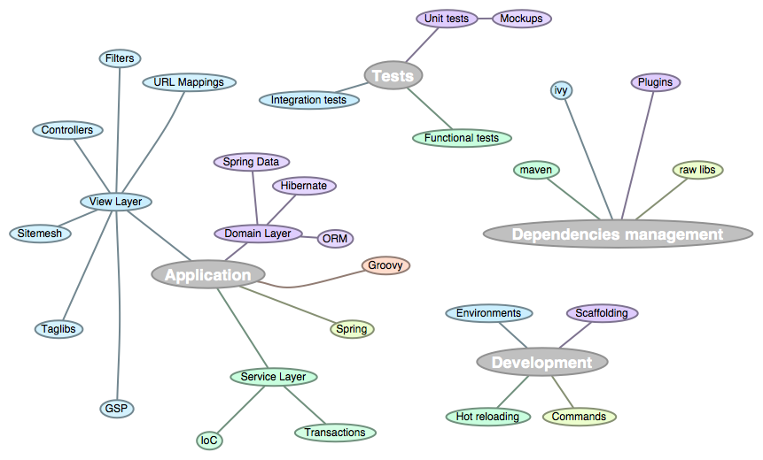
Grails
Features Map

Slide 9
About Grails
  Convention over Configuration :
    configure loads of XML
    implement interfaces
    extend classes
    use duck typing
      directories and naming conventions
      A class that matches a convention is called an Artefact

Slide 10
About Grails
  Dynamic nature
    Injected methods at Compile-time & Runtime
    Groovy DSL features :
      dynamic finders, configuration, builders, constraints...
    restart your server in development mode
      As for 1.3.7, Grails still needs to restart for database schema and non artefacts changes

Slide 11
About Grails
  Mutant technology
    Open plugin architecture :
      A plugin brings functionalities, libraries, frameworks and even languages
      Each Grails application is a candidate plugin
      Examples : Spring Security, GWT, Search (Compass), Scala...
        Endless integration possibilities
        ~4 new plugins / week (now 594)

Slide 12
Today’s goal
  Social Recipe Rating
    Display recipes list
    Filter recipes by user
    «Like» , «Unlike» recipes
    Submit new recipes
    Secure access
    Registration
  Extra-time
    Comments
    Recipes photo
    User Profile ...

Slide 13
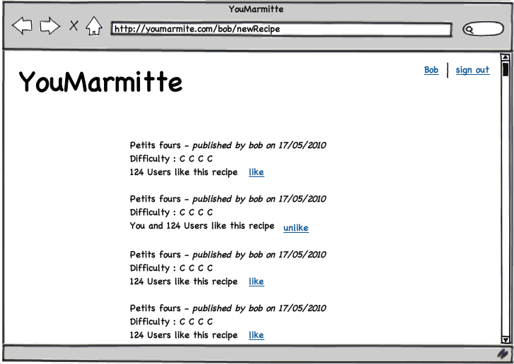

Slide 14
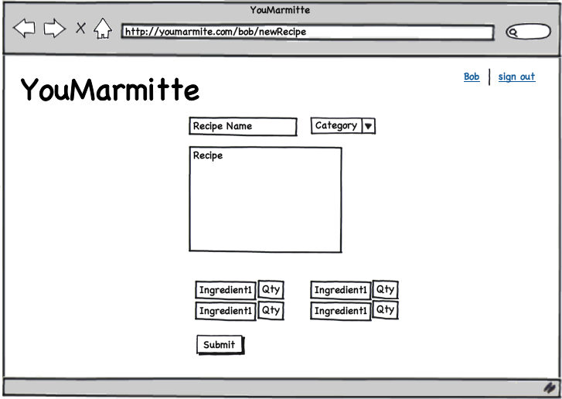

Slide 15
Setting up your dev environment

Slide 16

Getting and Installing Grails
  Make sure you have a JDK installed with JAVA_HOME defined
  Unzip the latest Grails zip from http://grails.org/Download and setup your GRAILS_HOME
  Add $GRAILS_HOME/bin to your PATH

Slide 17
Useful Tools
Intellij IDEA
Great IDE for working with Grails (and much more)
http://www.jetbrains.com/idea
SpringSource STS
Eclipse OpenSource challenger
http://www.springsource.com/products/eclipse-downloads
TextMate (Mac OS)
Awesome text editor
http://macromates.com/

Slide 18
Creating, Running and Debugging your App

Slide 19
Creating, Running and Debugging Your App
  Create your app with grails create-app
  Create your app from within your IDE
  Run your app with grails run-app
  Run your app from within your IDE
  Debug your app from within your IDE

Slide 20
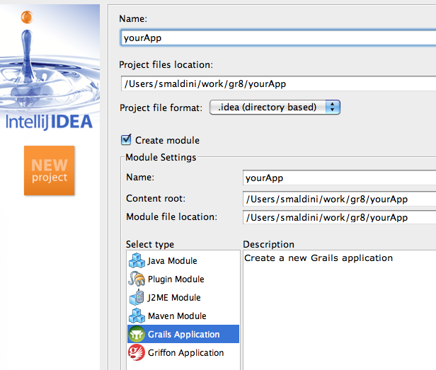

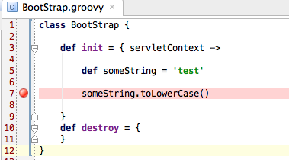
Creating, Running and Debugging Your App

Slide 21
Implementing Your Domain Model

Slide 22
Implementing Your Domain Model
  Grails Object Relational Mapping
    Application data types
    Persistence layer
    Straightforward model with Groovy DSL features
    Directory Convention : /grails-app/domain
    Configuration file : /grails-app/conf/DataSource.groovy

Slide 23
Implementing Your Domain Model
import org.hibernate.....
@Entity
@Table(unique constraints = { @UniqueConstraint(columnNames={‘login’})}
public class User{
@Id @GeneratedValue(strategy=GenerationType.Auto)
private long id;
@Version private long version;
private String name;
private String login;
static constraints = { login(unique:true) }
get/setName(...) get/setLogin(...)
get/setId(...) get/setVersion(...)
}

Slide 24
Implementing Your Domain Model
class User{
String name
String login
static constraints = { login(unique:true) }
}

Slide 25
Implementing Your Domain Model
  Kickstart :
    Define Domain Objects and their Properties
    Add Constraints to Domain Objects
    Define Relationships Between Domain Objects
    Give a try to your Domain Model With Scaffolding
    Optimize your mapping configuration

Slide 26
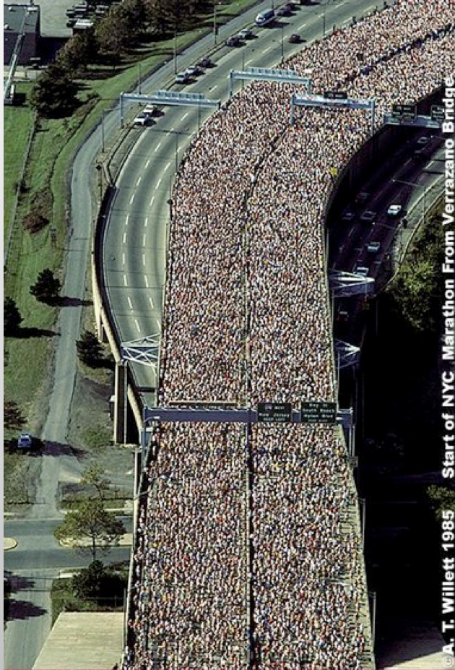
Implementing Your Domain Model
  Database is the main performance bottleneck
  You will find yourself optimizing stuff until the very end
  GORM tries to give you as much tuning tools as it can

Slide 27
Implementing Your Domain Model
    Use logSql = true
    Use cache, wisely
    Tune your lazy associations
    Set your index fields
hibernate {
cache.use_second_level_cache=true
cache.use_query_cache=true
cache.provider_class='org.hibernate.cache.EhCacheProvider'
}

Slide 28
Adding Behavior To Your App

Slide 29
Adding Behavior To Your App
  Define actions to render a view
  Define actions to handle form input
  Define an action to return a JSON response
  Return an HTTP error code instead of rendering a view
  Redirecting or forwarding to other actions
  Using flash scope to keep state between redirects

Slide 30
Adding a Custom Look

Slide 31
Adding a Custom Look
  Creating GSP Views
  Using a Model to Render Your View
  Creating and Applying a Layout
  Use GSP Templates to add Structure to Views
  Use Grails Tags to Implement View Logic
  Create Your Own Tags

Slide 32
GSP Variables
  Variables can be rendered with GString notation
<p>You just entered : ${params.comment}</p>
  You have access to
    Model variables and request attributes directly
    params
    request
    response
    application
    session
    ...

Slide 33
Layouts
Layout
GSP
<html>
<head>
<g:layoutTitle/>
...
<g:layoutHead/>
</head>
<body>
<div id="header">
...
</div>
<div id="main">
<g:layoutBody/>
</div>
<div id="footer">
...
</div>
</body>
</html>
<html>
<head>
<meta name="layout" content="main"></meta>
<title>Cool Web Page</title>
</head>
<body>
<h1>Cool Web Page</h1>
....
</body>
</html>

Slide 34
Using Services for Business Logic

Slide 35
Using Services for Business Logic
  Implementing transactional processing in Controllers
  Creating services
  Implementing transactional processing in Services
  Calling services from Controllers, Tag Libraries, Filters, Bootstrap...

Slide 36
Implementing a Secure Site

Slide 37
Implementing a Secure Site
  Installing and Configuring the Spring Security Plugin
  Securing Actions & View fragments
  Registration process

Slide 38
Testing Your App

Slide 39
Testing Your App
  Unit Tests
  Integration Tests
  Functional Tests with the Selenium-RC plugin
  Functional Tests with Geb

Slide 40
Improving Performance

Slide 41
Improving Performance
  The UI Peformance Plugin
  The Resource Framework
  The Cache Headers Plugin

