Slide 1
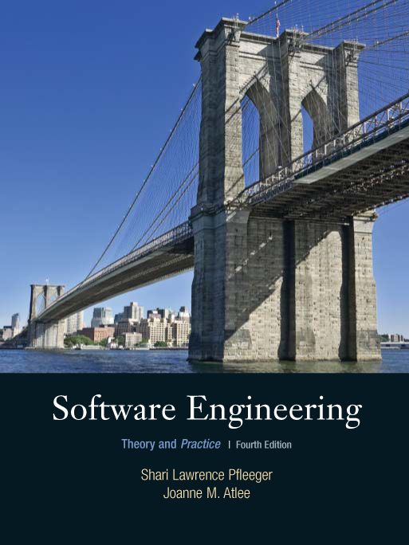
Chapter 7
Writing the
Programs
Shari L. Pfleeger
Joann M. Atlee
4th Edition

Slide 2
Contents
7.1 Programming Standards and Procedures
7.2 Programming Guidelines
7.3 Documentation
7.4 The Programming Process
7.5 Information System Example
7.6 Real Time Example
7.7 What this Chapter Means for You

Slide 3
Chapter 7 Objectives
Standards for programming
Guidelines for reuse
Using design to frame the code
Internal and external documentation

Slide 4
7.1 Programming Standards and Procedures
Standards for you
  methods of code documentation
Standards for others
  Integrators, maintainers, testers
  Prologue documentation
  Automated tools to identify dependencies
Matching design with implementation
  Low coupling, high cohesion, well-defined interfaces

Slide 5
7.2 Programming Guidelines
Control Structures
Make the code easy to read
Build the program from modular blocks
Make the code not too specific, and not too general
Use parameter names and comments to exhibit coupling among components
Make the dependency among components visible

Slide 6
7.2 Programming Guidelines
Example of Control Structures
Control skips around among the program’s statements
    benefit = minimum;
    if (age < 75) goto A;
    benefit = maximum;
    goto C;
    if (AGE < 65) goto B;
    if (AGE < 55) goto C;
    A: if (AGE < 65) goto B;
    benefit = benefit * 1.5 + bonus;
    goto C;
    B: if (age < 55) goto C;
    benefit = benefit * 1.5;
    C: next statement
Rearrange the code
      if (age < 55) benefit = minimum;
      elseif (AGE < 65) benefit = minimum + bonus;
      elseif (AGE < 75) benefit = minimum * 1.5 + bonus;
      else benefit = maximum;

Slide 7
7.2 Programming Guidelines
Algorithms
Common objective and concern: performance (speed)
Efficiency may have hidden costs
  cost to write the code faster
  cost to test the code
  cost to understand the code
  cost to modify the code

Slide 8
7.2 Programming Guidelines
Data Structures
Several techniques that used the structure of data to organize the program
  keeping the program simple
  using a data structure to determine a program structure

Slide 9
7.2 Programming Guidelines
Keep the Program Simple
Example: Determining Federal Income Tax
For the first $10,000 of income, the tax is 10%
For the next $10,000 of income above $10,000, the tax is 12 percent
For the next $10,000 of income above $20,000, the tax is 15 percent
For the next $10,000 of income above $30,000, the tax is 18 percent
For any income above $40,000, the tax is 20 percent
      tax = 0.
      if (taxable_income == 0) goto EXIT;
      if (taxable_income > 10000) tax = tax + 1000;
      else{
      tax = tax + .10*taxable_income;
      goto EXIT;
      }
      if (taxable_income > 20000) tax = tax + 1200;
      else{
      tax = tax + .12*(taxable_income-10000):
      goto EXIT;
      }
      if (taxable_income > 30000) tax = tax + 1500;
      else{
      tax = tax + .15*(taxable_income-20000);
      goto EXIT;
      }
      if (taxable_income < 40000){
      tax = tax + .18*(taxable_income-30000);
      goto EXIT;
      }
      else
      tax = tax + 1800. + .20*(taxable_income-40000);
      EXIT;

Slide 10
7.2 Programming Guidelines
Keep the Program Simple Example (continued)
Define a tax table for each “bracket” of tax liability
Simplified algorithm
  for (int i=2; level=1; i <= 5; i++)
  if (taxable_income > bracket[i])
  level = level + 1;
  tax= base[level]+percent[level] * (taxable_income - bracket[level]);
Bracket | Base | Percent
0 | 0 | 10
10,000 | 1000 | 12
20,000 | 2200 | 15
30,000 | 3700 | 18
40,000 | 55000 | 20

Slide 11
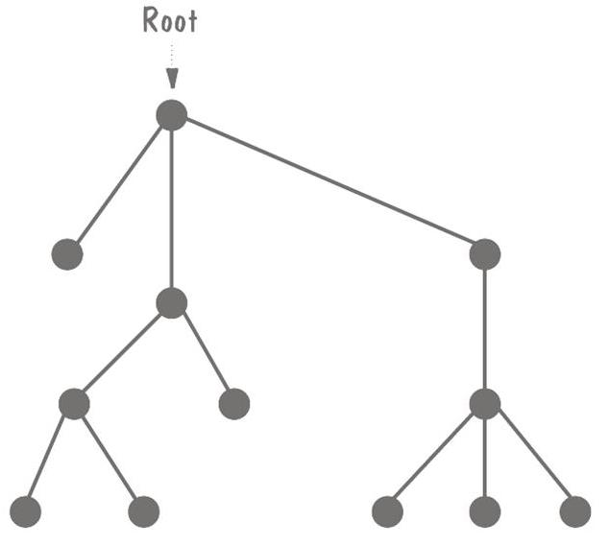
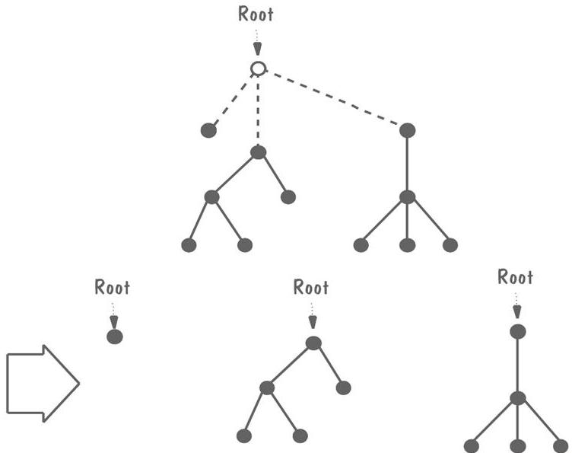
7.2 Programming Guidelines
Data Structures Example: Rooted Tree
Recursive data structure
Graph composed of nodes and lines
  Exactly one node as root
  If the lines emanating from the root are erased, the resulting graph is a rooted tree

Slide 12
7.2 Programming Guidelines
General Guidelines to Preserve Quality
Localize input and output
Employ pseudocode
Revise and rewrite, rather than patch
Reuse
  Producer reuse: create components designed to be reused in future applications
  Consumer reuse: reuse components initially developed for other projects

Slide 13
7.2 Programming Guidelines
Example of Pseudocode
The design for a component of a text processing system states
  COMPONENT PARSE_LINE
    Read nest eighty characters.
      IF this is a continuation of the previous line,
        Call CONTINUE
      ELSE determine command type
      ENDIF
    CASE of COMMAND_TYPE
      COMMAND_TYPE is paragraph: Call PARAGRAPH
      COMMAND_TYPE is indent : Call INDENT
      COMMAND_TYPE is skip line: Call SKIP_LINE
      COMMAND_TYPE is margin : Call MARGIN
      COMMAND_TYPE is new page : Call PAGE
      COMMAND_TYPE is double space : Call DOUBLE_SPACE
      COMMAND_TYPE is single space : Call SINGLE_SPACE
      COMMAND_TYPE is break : Call BREAK
      COMMAND_TYPE is anything else: Call ERROR
    ENDCASE

Slide 14
7.2 Programming Guidelines
Example of Pseudocode (continued)
Intermediate pseudocode
    PARAGRAPH:
      Break line, flush line buffer. Advance one line between paragraph. If fewer than 2 line left on page, eject. Set line pointer to paragraph indent.
    INDENT:
      Break line, flush line buffer. Get indent parameter. Set line pointer to indent parameter, set left margin to indent.
    SKIP_LINE:
      Break line, flush line buffer. Get line parameter. Advance (parameter) lines or eject if not enough space left on current page.
    MARGIN:
      Break line, flush line buffer. Get margin parameter. Set line pointer to left margin. Set right margin to margin.
    PAGE:
      Break line, flush line buffer. Eject page. Set line pointer to left margin
    SOUBLE_SPACE:
      Set interline space to 2.
    SINGLE_SPACE:
      Set interline space to 1
    BREAK:
      Break line, flush line buffer. Set pointer to left margin

Slide 15
7.2 Programming Guidelines
Example of Pseudocode (continued)
Regrouped
    FIRST:
    PARAGRAPH, INDENT, SKIP_LINE, MARGIN, BREAK, PAGE:
      Break line, flush line buffer.
    SOUBLE_SPACE, SINGLE_SPACE :
      No break line, no flush line buffer.
    SECOND:
    INDENT, SKIP_LINE, MARGIN:
    Get parameter.
    PARAGRAPH, BREAK, PAGE, DOUBLE_SPACE, SINGLE_SPACE:
    No parameter needed.
    THIRD:
    PARAGRAPH, INDENT, SKIP_LINE, MARGIN, BREAK, PAGE:
    Set new line pointer.
    DOUBLE_SPACE, SINGLE_SPACE:
    New line pointer unchanged.
    FOURTH:
    Individual action taken

Slide 16
7.2 Programming Guidelines
Example of Pseudocode (continued)
Final pseudocode
    INITIAL:
      Get parameter for indent, skip_line, margin.
      Set left margin to parameter for indent.
      Set temporary line pointer to left margin for all but paragraph; for paragraph, set to paragraph indent.
    LINE_BREAKS:
      If not (DOUBLE_SPACE or SINGLE_SPACE), break line, flush line buffer and set line pointer to temporary line pointer
      If 0 lines left on page, eject page and print page header.
    INDIVIDUAL CASES:
      INDENT, BREAK: do nothing.
      SKIP_LINE: skip parameter lines or eject
      PARAGRAPH: advance 1 line; if < 2 lines or page, eject.
      MARGIN: right_margin = parameter.
      DOUBLE_SPACE: interline_space = 2.
      SINGLE_SPACE: interline_space = 1;
      PAGE: eject page, print page header

Slide 17
7.2 Programming Guidelines
Consumer Reuse
Four key characteristics to check about components to reuse
  does the component perform the function or provide the data needed?
  is it less modification than building the component from scratch?
  is the component well-documented?
  is there a complete record of the component’s test and revision history?

Slide 18
7.2 Programming Guidelines
Producer Reuse
Several issues to keep in mind
  make the components general
  separate dependencies (to isolate sections likely to change)
  keep the component interface general and well-defined
  include information about any faults found and fixed
  use clear naming conventions
  document data structures and algorithms
  keep the communication and error-handling sections separate and easy to modify

Slide 19
7.3 Documentation
Internal documentation
  header comment block
  meaningful variable names and statement labels
  other program comments
  format to enhance understanding
  document data (data dictionary)
External documentation
  describe the problem
  describe the algorithm
  describe the data

Slide 20
7.3 Documentation
Information Included in Header Comment Block
What is the component called
Who wrote the component
Where the component fits in the general system design
When the component was written and revised
Why the component exists
How the component uses its data structures, algorithms, and control

Slide 21
7.4 The Programming Process
Extreme Programming
Two types of participants
  customers: who define the features using stories, describe detailed tests and assign priorities
  programmers: who implement the stories

Slide 22
7.4 The Programming Process
Pair Programming
The driver or pilot: controlling the computer and writing the code
The navigator: reviewing the driver’s code and providing feedback

Slide 23
7.4 The Programming Process
Whither Programming?
Documentation is still essential in agile-methods
  Assist the developers in planning, as a roadmap
  Helps describe key abstractions and defines system boundaries
  Assists in communicating among team members

Slide 24
7.5 Information System Example
Piccadilly System
Design Description
    Input: Opposition schedule
    For each Television company name, create Opposition company.
    For each Opposition schedule,
    Locate the Episode where Episode schedule date = Opposition transmission date AND
    Episode start time = Opposition transmission time
    Create instance of Opposition program
    Create the relationships Planning and Competing
    Output: List of Opposition programs
Data dictionary description
    Opposition schedule = * Data flow *
    Television company name
    + {Opposition transmission date
    + Opposition transmission time + Opposition program name
    + (Opposition predicted rating)}

Slide 25
7.5 Information System Example
Piccadilly System’s Implementation
Passing by value
  void Match:: calv(Episode episode_start_time)
  {
  first_advert = episode_start_time + increment;
  // The system makes a copy of Episode
  // and your program can use the values directly.
  }
Passing by pointer
  void Match:: calp(Episode* episode)
  {
  episode->setStart (episode->getStart());
  // This example passes a pointer to an instance of Episode.
  // Then the routine can invoke the services (such as setStart
  // and getStart) of Episode using the -> operator.
  }
Passing by reference
  void Match:: calr(Episode& episode)
  {
  episode.setStart (episode.getStart());
  // This example passes the address of Episode.
  // Then the routine can invoke the services (such as setStart
  // and getStart) of Episode using the . operator.
  }

Slide 26
7.6 Real-Time Example
Ariane-5
Should have included an exception handler
    try {
    }
    catch (…..) {
      //attempt to patch up state
      //either satisfy postcondition or raise exception again
    }

Slide 27
7.7 What This Chapter Means for You
Things to consider when writing a code
  organizational standards and guidelines
  reusing code from other projects
  writing code to make it reusable on future projects
  using the low-level design as an initial framework, and moving in several iterations from design to code

