Slide 1
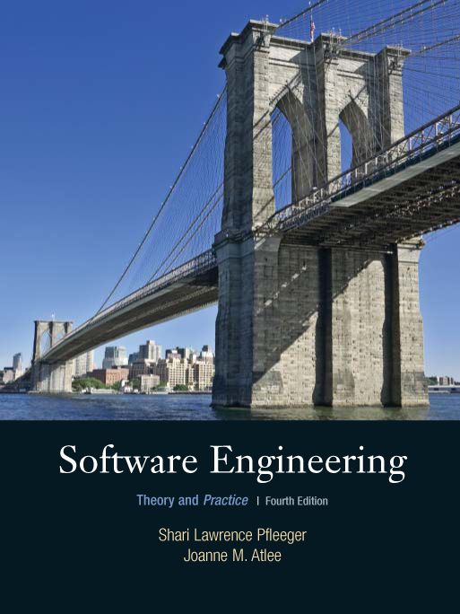
Chapter 11
Managing the
System
Shari L. Pfleeger
Joann M. Atlee
4th Edition
4th Edition

Slide 2
Contents
11.1 The Changing System
11.2 The Nature of Maintenance
11.3 Maintenance Problems
11.4 Measuring Maintenance Characteristics
11.5 Maintenance Techniques and Tools
11.6 Software Rejuvenation
11.7 Information System Example
11.8 Real Time Example
11.9 What this Chapter Means for You

Slide 3
Chapter 11 Objectives
System evolution
Legacy systems
Impact analysis
Software rejuvenation

Slide 4
11.1 The Changing System
Maintenance: any work done to change the system after it is in operation
  Software does not degrade or require periodic maintenance
  However, software is continually evolving
    Maintenance process can be difficult

Slide 5
11.1 The Changing System
Lehman’s System Types
S-system: formally defined, derivable from a specification
  Matrix manipulation
P-system: requirements based on approximate solution to a problem, but real-world remains stable
  Chess program
E-system: embedded in the real world and changes as the world does
  Software to predict how economy functions (but economy is not completely understood)

Slide 6
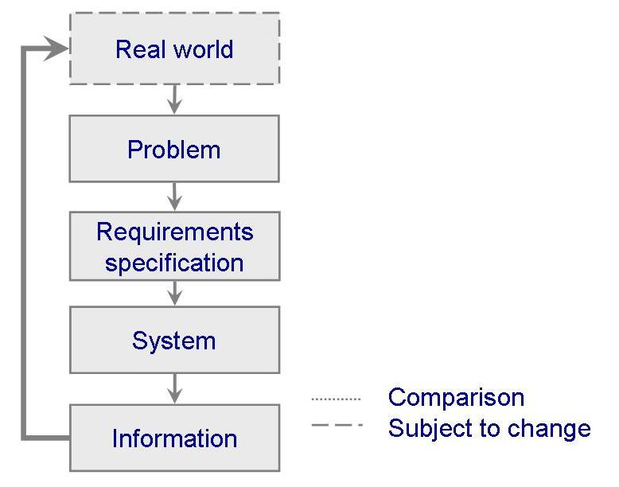
11.1 The Changing System
S-System
Problem solved is related to the real world

Slide 7
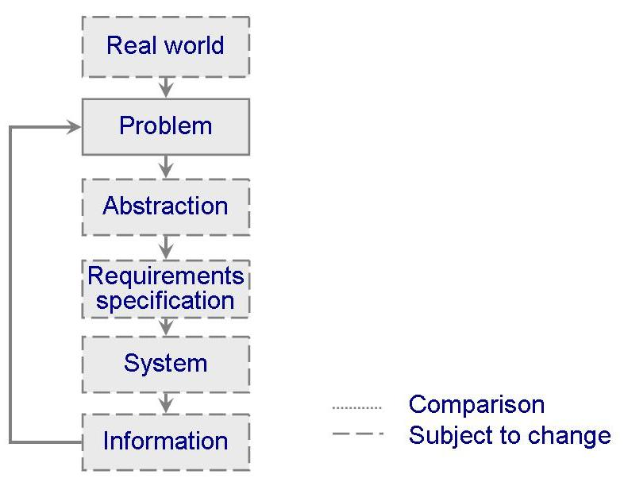
11.1 The Changing System
P-System
The solution produces information that is compared with the problem

Slide 8
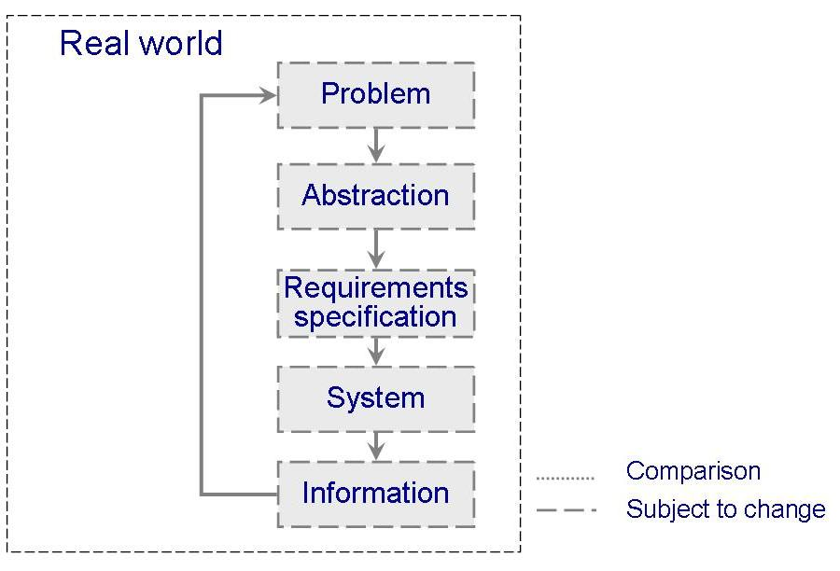
11.1 The Changing System
E-System
It is an integral part of the world it models
  The changeability depends on its real-world context

Slide 9
11.1 The Changing System
Changes During the System Life Cycle
S-system: un-changed
P-system: incremental change
  An approximate solution
  Changes as discrepancies and omissions are identified
E-system: constant change

Slide 10
11.1 The Changing System
Examples of Change During Software Development
Activity from which Initial change results | Artifacts requiring consequent change
Requirement analysis | Requirement specification
System design | Architectural design specification Technical design specification
Program design | Program design specification
Program implementation | Program code Program documentation
Unit testing | Test plans Test scripts
System testing | Test plans Test scripts
System delivery | User documentation Operator documentation System guide Programmer’s guide Training classes

Slide 11
11.1 The Changing System
The System Life Span
Will we need maintenance phase?
  Even if best practices are followed, still need maintenance (because of E and P systems)
Development time vs. maintenance time
  Recent surveys: 20% vs 80%
How much change can we expect?
  System evolution vs. system decline: better to discard and build a new?
    Cost/reliability/adaptability to change unacceptable?
  Laws of software evolution

Slide 12
11.1 The Changing System
Development Time Vs. Maintenance Time
Parikh and Zvegintzov (1983)
  Development time: 2 years
  Maintenance time: 5 to 6 years
Fjedstad and Hamlen (1979)
  39% of effort in development
  61% of effort in maintenance
80-20 rule
  20% of effort in development
  80% of effort in maintenance

Slide 13
11.1 The Changing System
System Evolution vs. Decline
Is the cost of maintenance too high?
Is the system reliability unacceptable?
Can the system no longer adapt to further change, and within a reasonable amount of time?
Is system performance still beyond prescribed constraints?
Are system functions of limited usefulness?
Can other systems do the same job better, faster or cheaper?
Is the cost of maintaining the hardware great enough to justify replacing it with cheaper, newer hardware?

Slide 14
11.1 The Changing System
Laws of Software Evolution
Continuing change: leads to less utility
Increasing complexity: structure deteriorates
Fundamental law of program evolution: program obeys statistically-determined trends and invariants
Conservation of organizational stability: global activity rate is invariant
Conservation of familiarity: release content (changes) is statistically invariant

Slide 15
11.2 The Nature of Maintenance
Types of Maintenance
Corrective: maintaining control over day-to-day functions
Adaptive: maintaining control over system modifications
Perfective: perfecting existing functions
Preventive: preventing system performance from degrading to unacceptable levels

Slide 16
11.2 The Nature of Maintenance
Who Performs Maintenance
Separate maintenance team
  May be more objective
  May find it easier to distinguish how a system should work from how it does work
Part of development team
  Will build the system in a way that makes maintenance easier
  May feel over confident, and ignore the documentation to help maintenance effort

Slide 17
11.2 The Nature of Maintenance
Maintenance Team Responsibilities
Understanding the system
Locating information in system documentation
Keeping system documentation up-to-date
Extending existing functions to accommodate new or changing requirements
Adding new functions to the system
Finding the source of system failures or problems
Locating and correcting faults
Answering questions about the way the system works
Restructuring design and code components
Rewriting design and code components
Deleting design and code components that are no longer useful
Managing changes to the system as they are made

Slide 18
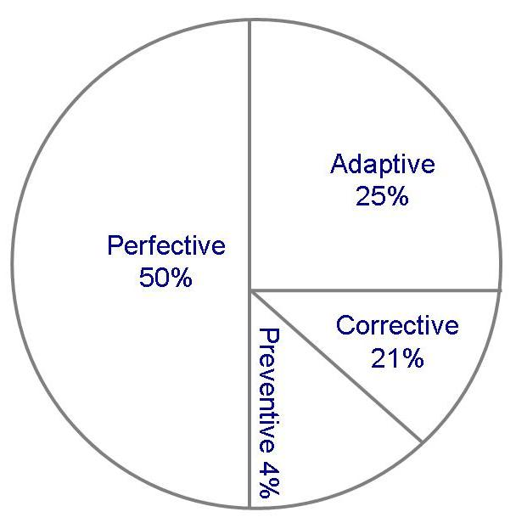
11.2 The Nature of Maintenance
Use of Maintenance Time
Graphical representation of distribution of maintenance effort (Lientz and Swanson)

Slide 19
11.3 Maintenance Problems
Staff problems
  Limited understanding (47% of effort is spent on understanding)
  Management priorities: rushing a new product to the market
  Morale: “second-hand” status accorded to maintenance team
Technical problems
  Artifacts and paradigms (e.g., legacy, non-OO)
  Testing difficulties (some systems must be available around a clock)

Slide 20
11.3 Maintenance Problems
The Need to Compromise
Balancing need for change with the need for keeping the system available to users
  Principles of SE compete with expediency and cost
Fixing problem quick but inelegant solution, or more involved but elegant way
  Solving problem involves only the immediate correction of a fault
Depend on the type of maintenance

Slide 21
11.3 Maintenance Problems
Factors Affecting Maintenance Approach
The type of failures
The failure’s critically or severity
The difficulty of the needed changes
The scope of the needed changes
The complexity of the components being changed
The number of physical locations at which the changes must be made

Slide 22
11.3 Maintenance Problems
Factors Affecting Maintenance Effort
Application type
System novelty
Turnover and maintenance staff ability
System life span
Dependence on a changing environment
Hardware characteristics
Design quality
Code quality
Documentation quality
Testing quality

Slide 23
11.3 Maintenance Problems
Modeling Maintenance Effort: Belady and Lehman
M = p + K^{c-d}
  M : total maintenance effort
  p : productive effort
  c: complexity
  d : degree of familiarity
  K : empirical constant

Slide 24
11.3 Maintenance Problems
Modeling Maintenance Effort: COCOMO II
Size = ASLOC (AA + SU + 0.4DM + 0.3CM + 0.3IM)/100
  ASLOC: number of source lines of code to be adapted
  AA: assessment and assimilation effort
  SU: amount of software understanding required
  DM: percentage of design to be modified
  CM: percentage of code to be modified
  IM: percentage of external code to be integrated

Slide 25
11.3 Maintenance Problems
COCOMO II Rating for SU
 | Very low | Low | Nominal | High | Very high
Structure | Very low cohesion, high coupling, spaghetti code | Moderately low cohesion, high coupling | Reasonably well structured, some weak area | High cohesion, low coupling | Strong modularity, information hiding in data and control structure
Application clarity | No match between program and application worldviews | Some correlation between program and application | Moderate correlation between program and application | Good correlation between program and application | Clear match between program and application worldviews
Self descriptiveness | Obscure code; documentation missing, obscure, or obsolete | Some code commentary headers; some useful documentation | Moderate level of code commentary headers, and documentation | Good code commentary and headers; useful documentation; some weak areas | Self descriptive code; documentation up-to-date , well organized, with design rationale
SU increment | 50 | 40 | 30 | 20 | 10

Slide 26
11.3 Maintenance Problems
COCOMO II Rating AA Effort
Assessment and Assimilation Increment | Level of Assessment and Assimilation Effort
0 | None
2 | Basic component search and documentation
4 | Some component test and evaluation documentation
6 | Considerable component test and evaluation documentation
8 | Extensive component test and evaluation documentation

Slide 27
11.4 Measuring Maintenance Characteristics
Maintainability is not only restricted to code, but also including specification, design and test plan documentations
Maintainability can be viewed in two ways
  External view of the software: users, person performing maintenance
  Internal view of the software: measuring before delivery

Slide 28
11.4 Measuring Maintenance Characteristics
External View of (Measuring) Maintainability
Necessary measures
  time at which problem is reported
  time lost due to administrative delay
  time required to analyze problem
  time required to specify which changes are to be made
  time needed to make the change
  time needed to test the change
  Time needed to document the change
Desirable measures
  ratio of total change implementation time to total number of changes implemented
  number of unresolved problems
  time spent on unresolved problems
  percentage of changes that introduce new faults
  number of components modified to implement a change

Slide 29
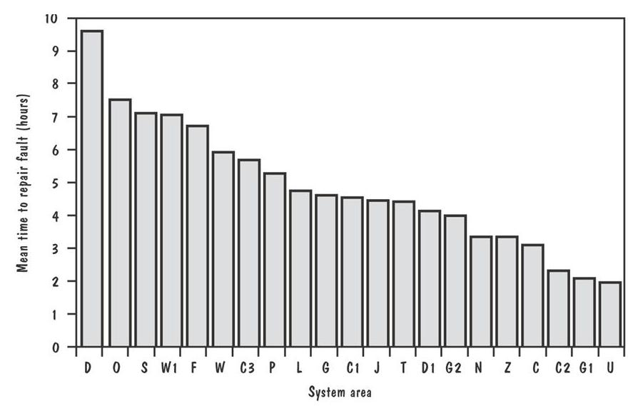
11.4 Measuring Maintenance Characteristics
External View of Maintainability (continued)
Graph illustrates the mean time to repair the various subsystems for software at a large British firm

Slide 30
11.4 Measuring Maintenance Characteristics
Internal Attributes Affecting Maintainability
Cyclomatic number (McCabe, 1976)
  The structural complexity of the source code
    linearly independent path
  Based on graph theoretic concept

Slide 31
11.4 Measuring Maintenance Characteristics Example for Calculating Cyclomatic Number
Consider the following code
  Scoreboard::drawscore(int n)
  {
  while(numdigits-- > 0} {
  score[numdigits]->erase();
  }
  // build new score in loop, each time update position
  numdigits = 0;
  // if score is 0, just display “0”
  if (n == 0) {
  delete score[numdigits];
  score[numdigits] = new Displayable(digits[0]);
  score[numdigits]->move(Point((700-numdigits*18),40));
  score[numdigits]->draw();
  numdigits++;
  }
  while (n) {
  int rem = n % 10;
  delete score[numdigits];
  score[numdigits] = new Displayable(digits[rem]);
  score[numdigits]->move(Point(700-numdigits*18),40));
  score[numdigits]->draw();
  n /= 10;
  numdigits++;
  }
  }

Slide 32
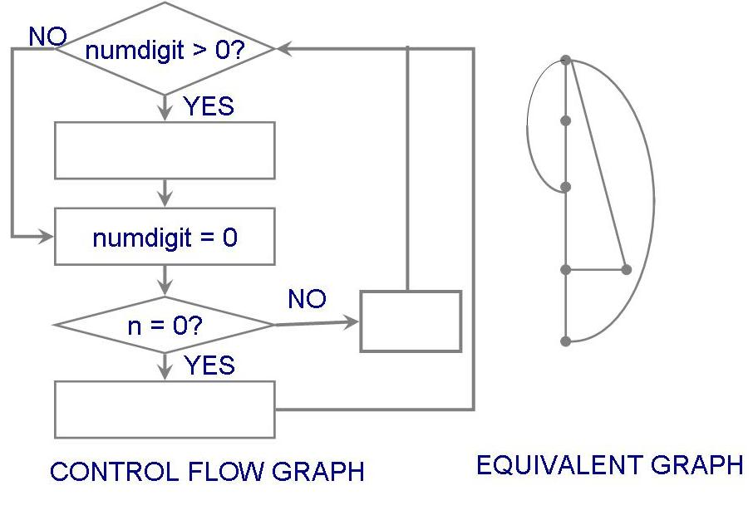
11.4 Measuring Maintenance Characteristics
Example for Calculating Cyclomatic Number (continued)
Linearly independent path = e - n + 2
  e: edges, n : nodes

Slide 33
11.4 Measuring Maintenance Characteristics
Other Measures
Fog index: textual products, readability affects maintainability
  F = 0.4 X (number of words/number of sentences) + percentage of words of three or more syllables
De Young and Kampen readability
  R = 0.295a – 0.499b + 0.13c
    a : the average normalized length of variable
    b: number of lines containing statements
    c : McCabe’s cyclomatic number

Slide 34
11.5 Maintenance Techniques and Tools
Configuration management
  Configuration control board
  Change control
Impact analysis
Automated maintenance tools

Slide 35
11.5 Maintenance Techniques and Tools
Configuration Control Process
Problem discovered by or change requested by user/customer/developer, and recorded
Change reported to the configuration control board
CCB discusses problem: determines nature of change, who should pay
CCB discusses source of problem, scope of change, time to fix; they assign severity/priority and analyst to fix
Analyst makes change on test copy
Analyst works with librarian to control installation of change
Analyst files change report

Slide 36
11.5 Maintenance Techniques and Tools
Change Control Issues
Synchronization: When was the change made?
Identification: Who made the change?
Naming: What components of the system were changed?
Authentication: Was the change made correctly?
Authorization: Who authorized that the change be made?
Routing: Who was notified of the change?
Cancellation: Who can cancel the request for change?
Delegation: Who is responsible for the change?
Valuation: What is the priority of the change?

Slide 37
11.5 Maintenance Techniques and Tools Impact Analysis
The evaluation of many risks associated with the change, including estimates of effects on resources, effort, and schedule
Helps control maintenance cost

Slide 38
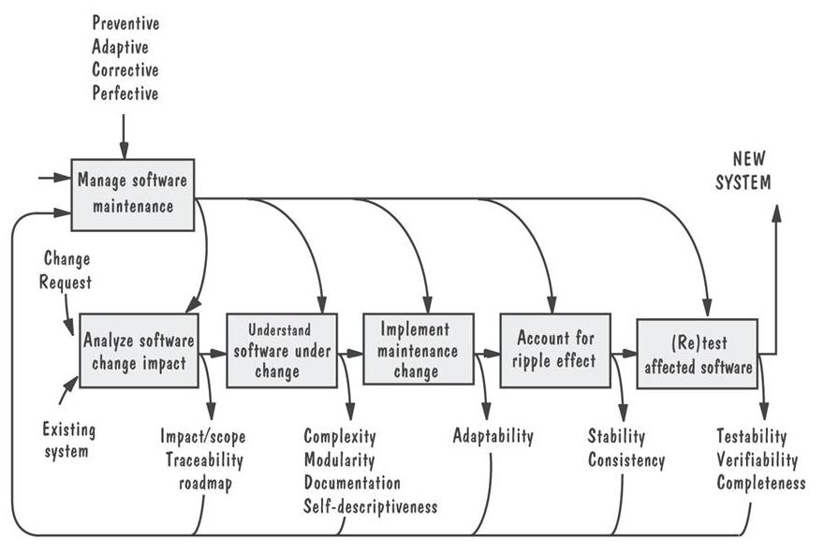
11.5 Maintenance Techniques and Tools Software Maintenance Activities
Graph illustrates the activities performed when a change is requested

Slide 39
11.5 Maintenance Techniques and Tools Measuring Impact of Change
Workproduct: any development artifact whose change is significant
Horizontal traceability: relationships of components across collections of workproducts
Vertical traceability: relationships among parts of a workproduct

Slide 40
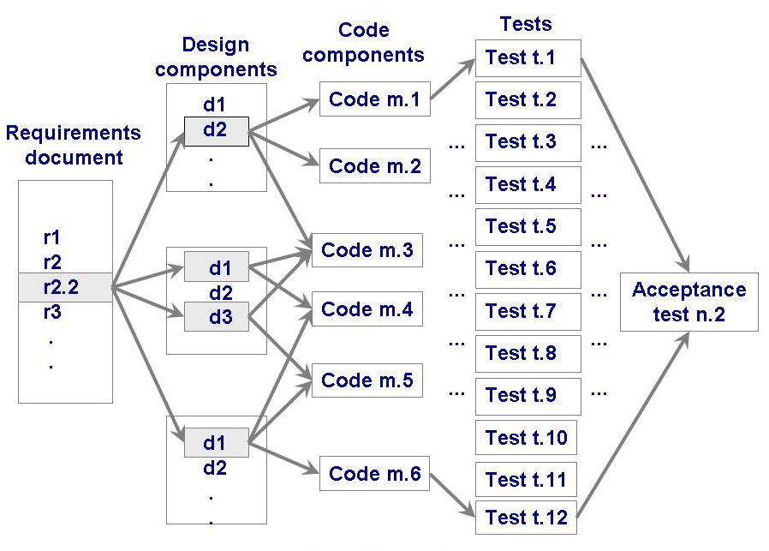
11.5 Maintenance Techniques and Tools Horizontal Traceability
The graphical relationships and traceability links among related workproducts

Slide 41
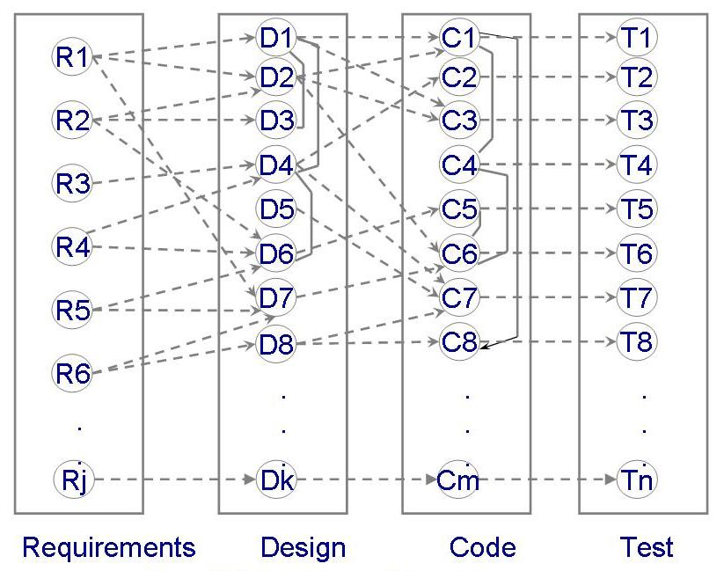
11.5 Maintenance Techniques and Tools
Underlying Graph for Maintenance

Slide 42
11.5 Maintenance Techniques and Tools
Sidebar 11.6 Applying Traceability to Real-World System
Five kinds of traceability
  object-to-object
  association-to-association
  use case-to-use case
  use case-to-object
  two-dimensional object-to-object
How tracing is performed
  Using explicit links
  Using textual references to different documents
  Using names and concepts that are the same and similar
  Using knowledge and domain knowledge

Slide 43
11.5 Maintenance Techniques and Tools
Automated Maintenance Tools
Text editors
File comparators
Compilers and linkers
Debugging tools
Cross-reference generators
Static code analyzers
Configuration management repositories

Slide 44
11.6 Software Rejuvenation
Redocumentation: static analysis adds more information
Restructuring: transform to improve code structure
Reverse engineering: recreate design and specification information from the code
Reengineering: reverse engineer and then make changes to specification and design to complete the logical model; then generate new system from revised specification and design

Slide 45
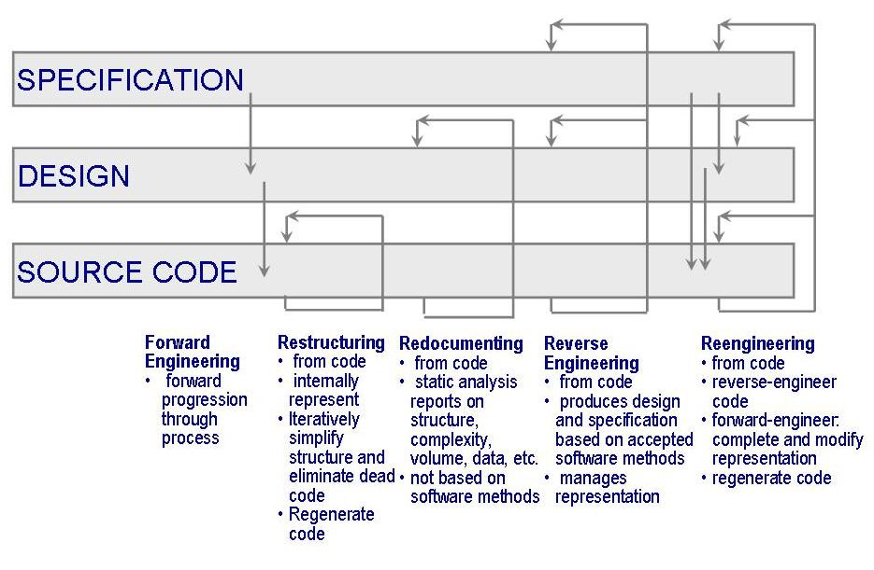
11.6 Software Rejuvenation
Taxonomy
Graph illustrates the relationship among the four types of rejuvenation

Slide 46
11.6 Software Rejuvenation
Redocumentation
Begins by submitting the code to an analysis tool
Output may include:
  component calling relationships
  data-interface tables
  data-dictionary information
  data flow tables or diagrams
  control flow tables or diagrams
  pseudocode
  test paths
  component and variable cross-references

Slide 47
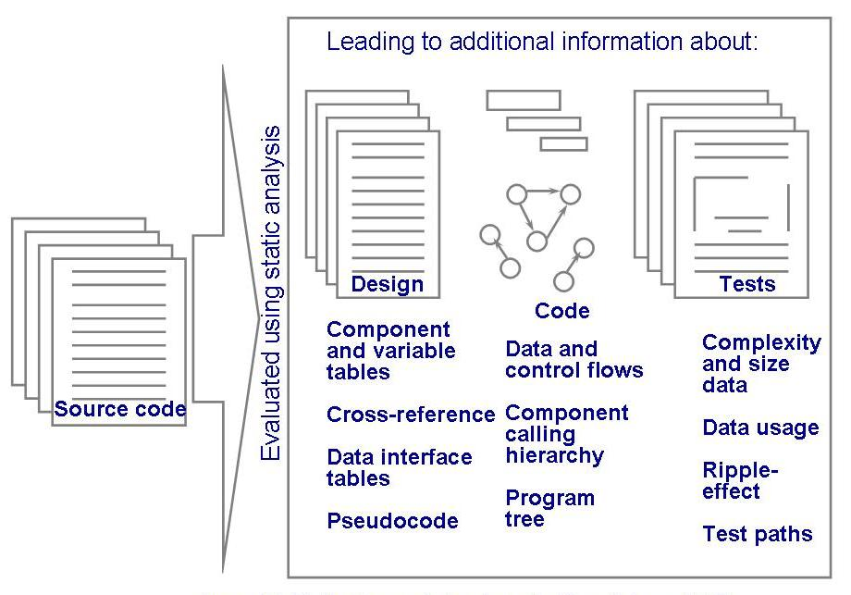
11.6 Software Rejuvenation
Redocumentation Process
Redocumentation process

Slide 48
11.6 Software Rejuvenation
Restructuring Activities
Interpreting the source code and representing it internally
Simplifying the internal representation
Regenerating structured code

Slide 49
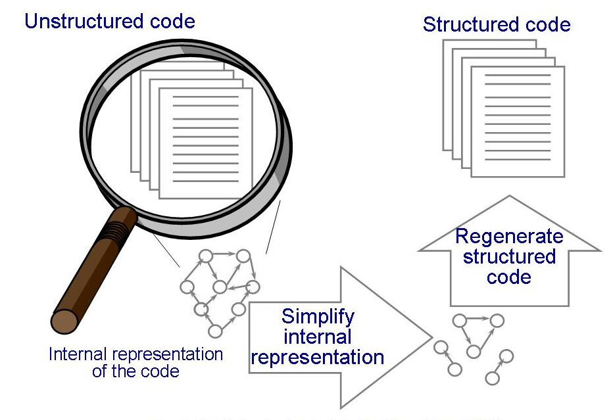
11.6 Software Rejuvenation
Restructuring Activities (continued)
Graph illustrates the three major activities involved in restructuring: (1) static analysis (2) simplification of the representations (3) refined representation used to generate a structured version

Slide 50
11.6 Software Rejuvenation
Reverse Engineering
Attempting to recover engineering information based on software specification and design methods
Obstacles remain before reverse engineering can be used universally
  Real time system problem
  Extremely complex system

Slide 51
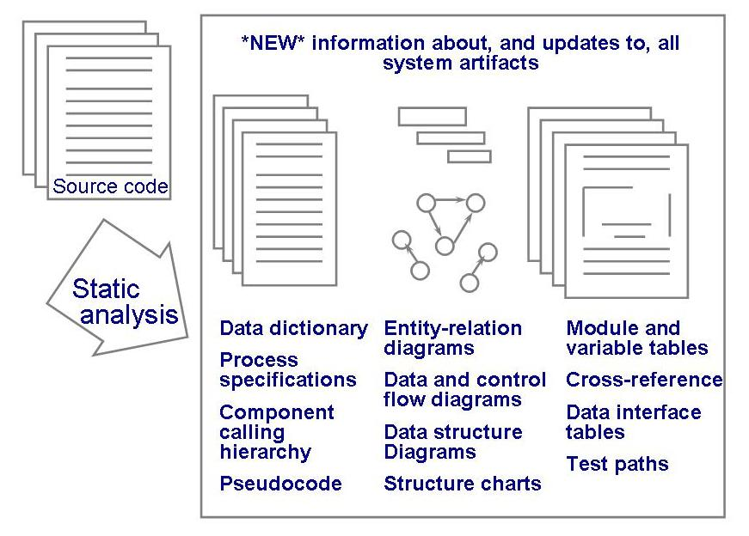
11.6 Software Rejuvenation
Reverse Engineering Process
Graph depicts the reverse-engineering process

Slide 52
11.6 Software Rejuvenation
Reengineering
An extension of reverse engineering
  produces new software code without changing the overall system function
Reengineering steps
  The system is reverse-engineered
  The software system is corrected or completed
  The new system is generated

Slide 53
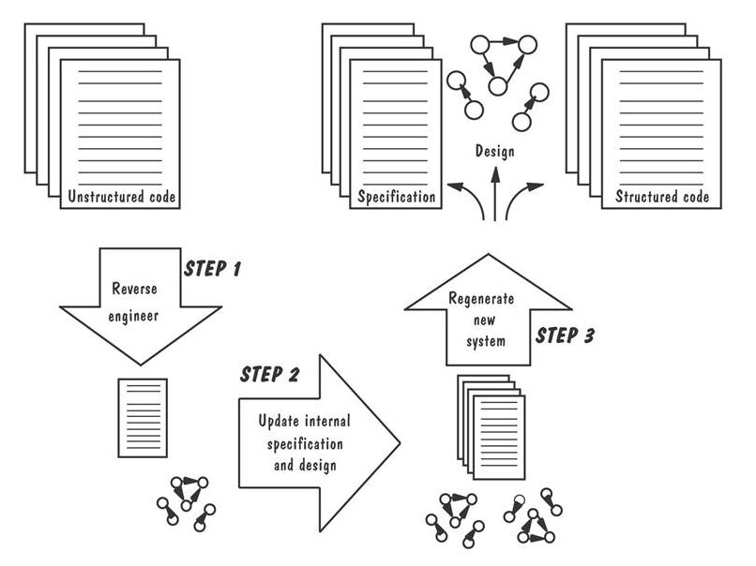
11.6 Software Rejuvenation
Reengineering Process
Graph illustrates the steps in reengineering process

Slide 54
11.7 Information System Example
Piccadilly System
The software can not be an S-system
  the problem may change dramatically
The software can not be a P-system
  P-system requires a stable abstraction, while Piccadilly changes constantly
The software must be E-system
  The system is an integral part of the world it models

Slide 55
11.8 Real-Time Example
Ariane-5
Developers focused on mitigating random failure
  The inertial reference system failed because of a design fault, not a result of a random failure
Needs to change the failure strategy and implement a series of preventive enhancements

Slide 56
11.9 What this Chapter Means for You
The more a system is linked to the real world, the more likely it will change and the more difficult it will be to maintain
Maintainers have many jobs in addition to software developers
Measuring maintainability is difficult
Impact analysis builds and tracks links among the requirements, design, code, and test cases
Software rejuvenation involves redocumenting, restructuring, reverse engineering, and reengineering

