Slide 1
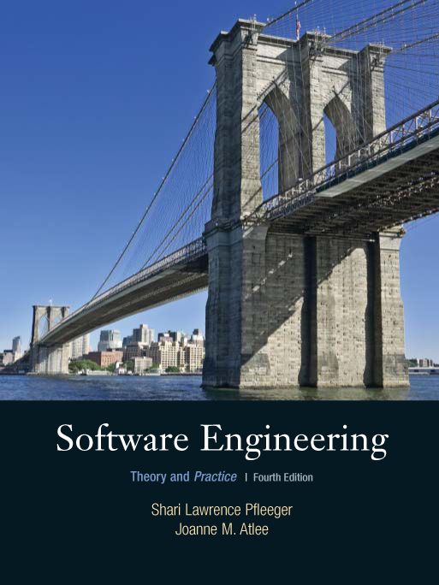
Chapter 12
Evaluating Products,
Processes, and
Resources
Shari L. Pfleeger
Joann M. Atlee
4th Edition
4th Edition

Slide 2
Contents
12.1 Approaches to Evaluation
12.2 Selecting an Evaluation Techniques
12.3 Assessment vs. Prediction
12.4 Evaluating Products
12.5 Evaluating Process
12.6 Evaluating Resources
12.7 Information Systems Example
12.8 Real-Time Example
12.9 What This Chapter Means for You

Slide 3
Chapter 12 Objectives
Feature analysis, case studies, surveys, and experiments
Measurement and validation
Capability maturity, ISO 9000, and other process models
People maturity
Evaluating development artifacts
Return of investment

Slide 4
12.1 Approaches to Evaluation
Measure key aspects of product, processes, and resources
Determine whether we have met goals for productivity, performance, quality, and other desire attributes

Slide 5
12.1 Approaches to Evaluation
Categories of Evaluation
Feature analysis: rate and rank attributes
Survey: document relationships
Case studies
Formal experiment

Slide 6
12.1 Approaches to Evaluation
Feature Analysis Example: Buying a Design Tool
List five key attributes that the tool should have
Identify three possible tools and rate the criterion
Examine the scores, creating a total score based on the importance of each criterion
Based on the score, we select the highest score (t-OO-1)

Slide 7
12.1 Approaches to Evaluation
Buying a Design Tool (continued)
Design tool ratings
Features | Tool 1: T-OO-1 | Tool 2: Object Tool | Tool 3: Easy Design | Importance
Good user interface | 4 | 5 | 4 | 3
Object-oriented design | 5 | 5 | 5 | 5
Consistency checking | 5 | 3 | 1 | 3
Use cases | 4 | 4 | 4 | 2
Runs on UNIX | 5 | 4 | 5 | 5
Score | 85 | 77 | 73

Slide 8
12.1 Approaches to Evaluation
Surveys
Record data
  to determine how project participants reacted to a particular method, tool, or technique
  to determine trends or relationships
Capture information related to products or projects
Document the size of components, number of faults, effort expended

Slide 9
12.1 Approaches to Evaluation
Case Studies
Identify key factors that may affect an activity’s outcome and then document them
Involve sequence of steps: conception hypothesis setting, design, preparation, execution, analysis, dissemination, and decision making
Compare one situation with another

Slide 10
12.1 Approaches to Evaluation
Case Study Types
Sister projects: each is typical and has similar values for the independent variables
Baseline: compare single project to organizational norm
Random selection: partition single project into parts

Slide 11
12.1 Approaches to Evaluation
Formal Experiment
Controls variables
Uses methods to reduce bias and eliminate confounding factors
Often replicated
Instances are representative: sample over the variables (whereas case study samples from the variables)

Slide 12
12.1 Approaches to Evaluation
Evaluation Steps
Setting the hypothesis: deciding what we wish to investigate, expressed as a hypothesis we want to test
Maintaining control over variables: identify variables that can affect the hypothesis, and decide how much control we have over the variables
Making investigation meaningful: the result of formal experiment is more generalizable, while a case study or survey only applies to certain organization

Slide 13
12.2 Selecting An Evaluation Technique
Formal experiments: research in the small
Case studies: research in typical
Surveys: research in the large

Slide 14
12.2 Selecting An Evaluation Technique
Key Selection Factors
Level of control over the variables
Degree to which the task can be isolated from the rest of the development process
Degree to which we can replicate the basic situation

Slide 15
12.2 Selecting An Evaluation Technique
What to Believe
When results conflict, how do we know which study to believe?
  Using series of questions, represented by the game board
How do you know if the result is valid?
  Evaluation pitfalls table

Slide 16
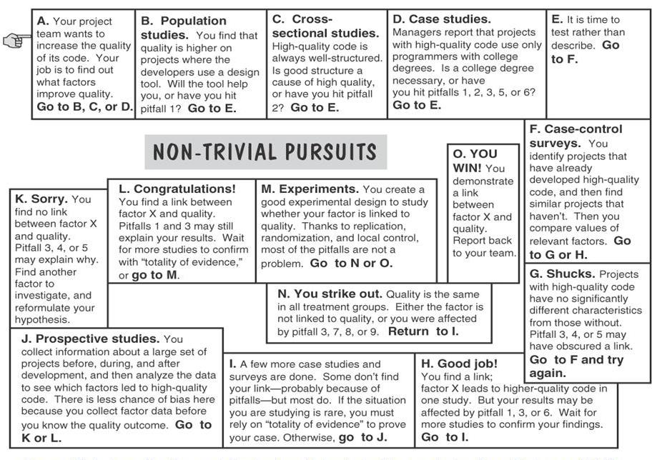
12.2 Selecting An Evaluation Technique
Investigation and Evaluation Board Game

Slide 17
12.2 Selecting An Evaluation Technique
Common Pitfalls in Investigation
Pitfall | Description
1. Confounding | Another factor is causing the effect
2. Cause of effect? | The factor could be a result, not a cause, of the treatment
3. Chance | There is always a small possibility that your result happened by chance
4. Homogeneity | You can find no link because all subjects had the same level of the factor
5. Misclassification | You can find no link because you can not accurately classify each subject’s level of the factor
6. Bias | Selection procedures or administration of the study inadvertently bias the result
7. Too short | The short-term effects are different from the long-term ones
8. Wrong amount | The factor would have had an effect, but not in the amount used in the study
9. Wrong situation | The factor has the desired effect, but not in the situation studied

Slide 18
12.3 Assessment vs. Prediction
Assessment system examines an existing entity by characterizing it numerically
Prediction system predicts characteristic of a future entity; involves a model with associated prediction procedures
  deterministic prediction (we always get the same output for an input)
  stochastic prediction (output varies probabilistically)

Slide 19
12.3 Assessment vs. Prediction
Validating Prediction System
Comparing the model’s performance with known data in the given environment
Stating a hypothesis about the prediction, and then looking at data to see whether the hypothesis is supported or refuted

Slide 20
12.3 Assessment vs. Prediction
Sidebar 12.1 Comparing Software Reliability Prediction
Modeling techniques | Predictive validity | Proportion of false negatives (%) | Proportion of false positive (%) | Proportion of false classification (%) | Completeness (%) | Overall Inspection | Wasted Inspection
Discriminant Analysis | P= 0.621 | 28 | 26 | 52 | 42 | 46 | 56
Principal component analysis plus discriminant analysis | P=0.408 | 15 | 41 | 56 | 68 | 74 | 55
Logistic regression | P=0.491 | 28 | 28 | 56 | 42 | 49 | 58
Principal component analysis plus logistic regression | P=0.184 | 13 | 46 | 59 | 74 | 82 | 56
Logical classification model | P=0.643 | 26 | 21 | 46 | 47 | 44 | 47
Layered neural network | P=0.421 | 28 | 28 | 56 | 42 | 49 | 58
Holographic network | P=0.634 | 26 | 28 | 54 | 47 | 51 | 55
Heads or tails | P=1.000 | 25 | 50 | 50 | 50 | 50 | 50

Slide 21
12.3 Assessment vs. Prediction
Validating Measures
Assuring that the measure captures the attribute properties it is supposed to capture
Demonstrating that the representation condition holds for the measure and its corresponding attributes

Slide 22
12.3 Assessment vs. Prediction
Sidebar 12.2 Lines of Code and Cyclomatic Number
The number of lines of code is a valid measure of program size, however, it is not a valid measure of complexity
On the other hand, there are many studies that exhibit a significant correlation between lines of code and cyclomatic number

Slide 23
12.3 Assessment vs. Prediction
A Stringent Requirement for Validation
A measure (e.g., LOC) can be
  an attribute measure (e.g., program size)
  an input to a prediction system (e.g., predictor of number of faults)
Do not reject a measure if it is not part of a prediction system
  If a measure is valid for assessment only, it is called valid in the narrow
  If a measure is valid for assessment and useful for prediction, it is called valid in the wide sense

Slide 24
12.4 Evaluating Products
Examining a product to determine if it has desirable attributes
Asking whether a document, file, or system has certain properties, such as completeness, consistency, reliability, or maintainability
  Product quality models
  Establishing baselines and targets
  Software reusability

Slide 25
12.4 Evaluating Products
Product Quality Models
Boehm’s model
ISO 9126
Dromey’s Model

Slide 26
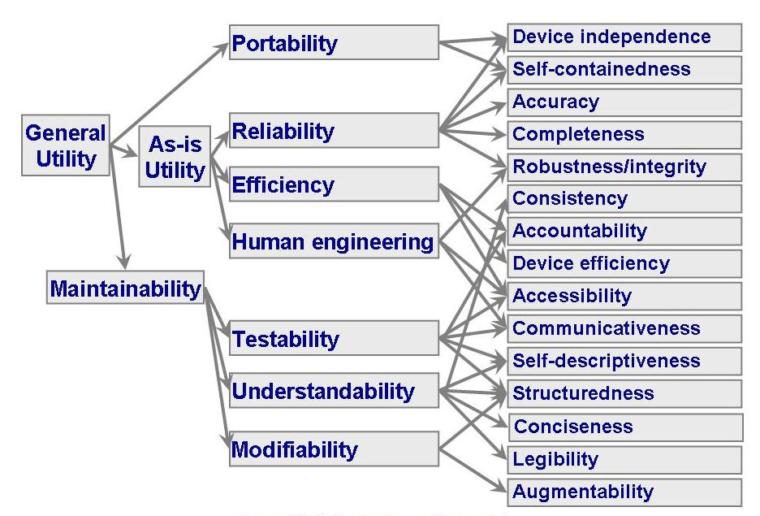
12.4 Evaluating Products
Boehm’s Quality Model

Slide 27
12.4 Evaluating Products
Boehm’s Quality Model (continued)
Reflects an understanding of quality where the software
  does what the user wants it do
  uses computer resources correctly and efficiently
  is easy for the user to learn and use
  is well-designed, well-coded, and easily tested and maintained

Slide 28
12.4 Evaluating Products
ISO 9126 Quality Model
A hierarchical model with six major attributes contributing to quality
  Each right-hand characteristic is related to only to exactly one left-hand attribute

Slide 29
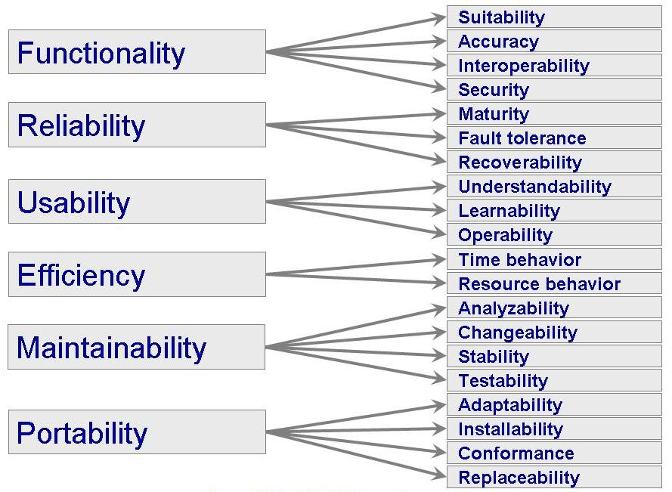
12.4 Evaluating Products
ISO 9126 Quality Model (continued)

Slide 30
12.4 Evaluating Products
ISO 9126 Quality Characteristics
Quality Characteristic | Definition
Functionality | A set of attributes that bear on the existence of a set of functions and their specified properties. The functions are those that satisfy stated or implied needs
Reliability | A set of attributes that bear on the capability of software to maintain its performance level under stated conditions for a stated period of time
Usability | A set of attributes that bear on the effort needed for use and on the individual assessment of such use by a stated or implied set of users
Efficiency | A set of attributes that bear on the relationship between the software performance and the amount of resources used under stated conditions
Maintainability | A set of attributes that bear on the effort needed to make specified modifications (which may include corrections, improvements, or adaptations of software to environmental changes and changes in the requirements and functional specifications)
Portability | A set of attributes that bear on the ability of software to be transferred from one environment to another (including the organizational, hardware or software environment)

Slide 31
12.4 Evaluating Products
Dromey Quality Model
Product quality depends on the tangible properties of components and component composition
  Correctness properties
  Internal properties
  Contextual properties
  Descriptive properties

Slide 32
12.4 Evaluating Products
Dromey Quality Model Attributes
The six attributes of ISO 9126
Attributes of reusability
  machine independence
  separability
  configurability
Process maturity attributes
  client orientation
  well-definedness
  assurance
  effectiveness

Slide 33
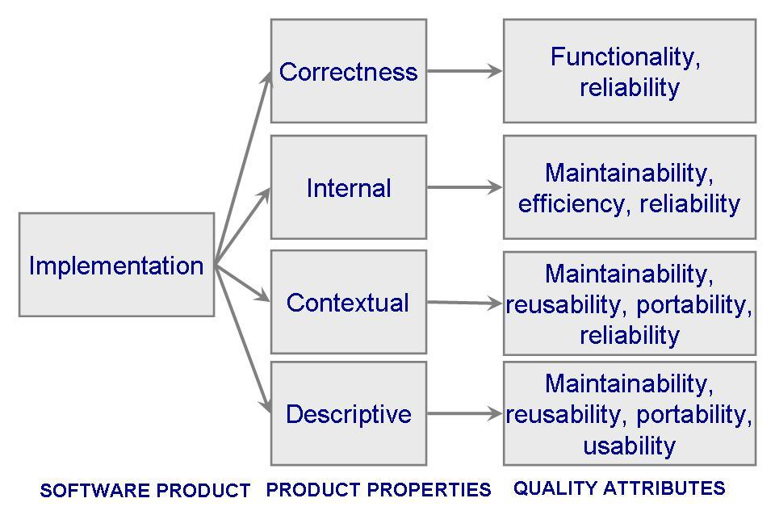
12.4 Evaluating Products
Dromey Quality Model Framework
Linking product properties to quality attributes

Slide 34
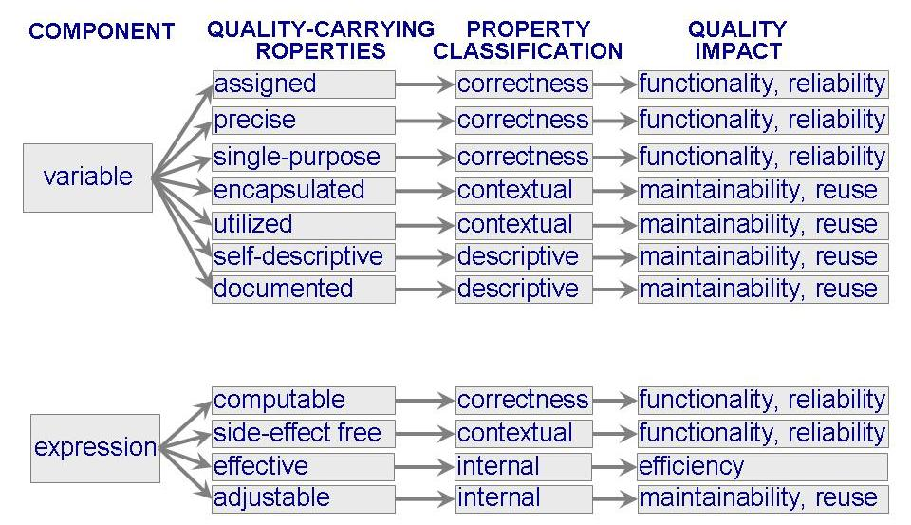
12.4 Evaluating Products
Dromey Quality Model Example

Slide 35
12.4 Evaluating Products
Dromey Quality Model Example (continued)
The model is based on the following five steps
  identify a set of high-level quality attributes
  identify product components
  identify and classify the most significant, tangible, quality-carrying properties for each component
  propose a set of axioms for linking product properties to quality attributes
  evaluate the model, identify its weaknesses, and refine or recreate it

Slide 36
12.4 Evaluating Products
Establishing Baseline and Targets
A baseline describes the usual or typical result in an organization or category
Baselines are useful for managing expectations
A target is a variation of a baseline
  minimal acceptable behavior

Slide 37
12.4 Evaluating Products
Quantitative Targets For Managing US Defense Projects
Item | Target | Malpractice Level
Fault removal efficiency | >95% | <70%
Original fault density | <4 per function point | >7 per function point
Slip or cost overrun in Excess of risk reverse | 0% | >=10%
Total requirements creep (function points or equivalent) | <1% per month average | >= 50%
Total program documentation | <3% pages per function point | >6 pages per function point
Staff turnover | 1 to 3% per year | >5% per year

Slide 38
12.4 Evaluating Products
Software Reusabilty
Software reuse: the repeated use of any part of a software system
  documentation
  code
  design
  requirements
  test cases
  test data

Slide 39
12.4 Evaluating Products
Type of Reuse
Producer reuse: creating components for someone else to use
Consumer reuse: using components developed for some other product
  Black-box reuse: using component without modification
  Clear- or white-box reuse: modifying component before reusing it

Slide 40
12.4 Evaluating Products
Reuse Approaches
Compositional reuse: uses components as building blocks; development done from bottom up
Generative reuse: components designed specifically for a domain; design is top-down
Domain analysis: identifies areas of commonality that make a domain ripe for reuse

Slide 41
12.4 Evaluating Products
Aspects of Reuse
Substance | Scope | Mode | Technique | Intention | Product
Ideas and | Vertical | Planned and | Compositional | Black-box, | Source Code
concepts | Horizontal | Systematic | Generative | as is | Design
Artifacts and |  | Ad hoc, |  | Clear-box | Requirements
components |  | opportunistic |  | modified | Objects
Procedures, |  |  |  |  | Data
skills, and |  |  |  |  | Processes
experience |  |  |  |  | Documentation
Patterns |  |  |  |  | Tests
Architecture

Slide 42
12.4 Evaluating Products
Reuse Technology
Component classification: collection of reusable components are organized and catalogued according to a classification scheme
  hierarchical
  faceted classification

Slide 43
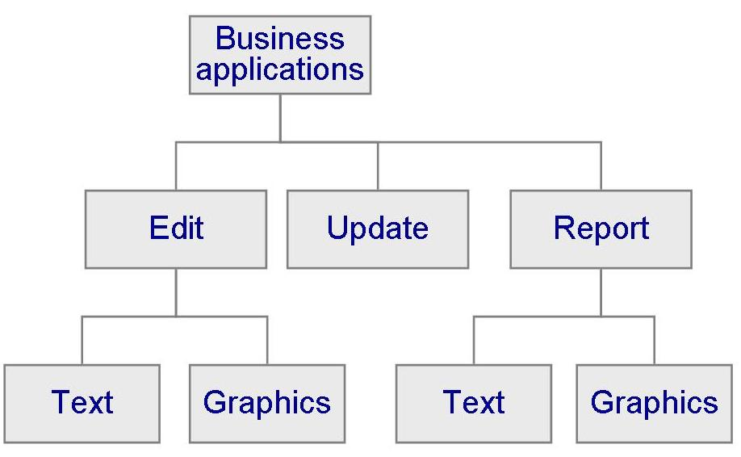
12.4 Evaluating Products
Example of A Hierarchical Scheme
New topic can be added easily at the lowest level

Slide 44
12.4 Evaluating Products
Faceted Classification Scheme
A facet is a kind of descriptor that helps to identify the component
Example of the facets of reusable code
  a application area
  a function
  an object
  a programming language
  an operating system

Slide 45
12.4 Evaluating Products
Component Retrieval
A retrieval system or repository: an automated library that can search for and retrieve a component according to the user’s description
A repository should address a problem of conceptual closeness (values that are similar to but not exactly the same as the desired component)
Retrieval system can
  record information about user requests
  retain descriptive information about the component

Slide 46
12.4 Evaluating Products
Sidebar 12.3 Measuring Reusability
The measures must
  address a goal
  reflect perspective of the person asking the question
Even if we had a good list of measurements, still it is difficult to determine the characteristic of the most reused component
  Look at past history
  Engineering judgment
  Automated repository

Slide 47
12.4 Evaluating Products
Experience with Reuse
Raytheon
  A new system contained an average of 60% reused code increasing productivity by 50%
GTE Data Services
  Established incentives and rewards for program authors whenever their components were reused
  14% reuse on its project, valued at a savings of $1.5 million
Nippon Novel
  Paid 5 cents per line of code to a developer who reused a component

Slide 48
12.4 Evaluating Products
Sidebar 12.4 Software Reuse at Japan’s Mainframe Makers
NEC: reuse library was established to classify, catalog, and document
Hitachi: integrated software environment, called Eagle, to allow software engineers to reuse standard program patterns and functional procedures
Fujitsu: created Information Support Center (ISC), that is a regular library staffed with system analysts, software engineers, reuse experts, and switching system domain experts

Slide 49
12.4 Evaluating Products
Benefits of Reuse
Reuse increases productivity and quality
Reusing component may increase performance and reliability
A long term benefit is improved system interoperability

Slide 50
12.4 Evaluating Products
Example of Reuse Success
Quality, productivity, and time to market at HP
Project Characteristics | HP Project 1 | HP Project 2
Size | 1100 noncommented source statements | 700 noncommented source statements
Quality | 51% fault reduction | 24% fault reduction
Productivity | 57% increase | 40% increase
Time to market | Data not available | 42% reduction

Slide 51
12.4 Evaluating Products
Example of Cost of Reuse
Cost to produce and reuse at HP
 | Air traffic control system (%) | Menu- and forms Management system (%) | Graphics Firmware (%)
Relative cost to create Reusable code | 200 | 120 to 480 | 111
Relative cost to reuse | 10 to 20 | 10 to 63 | 19

Slide 52
12.4 Evaluating Products
Sidebar 12.5 Critical Reuse Success Factors at NTT
Success factors at NTT in implementing reuse
  senior management commitment
  selecting appropriate target domains
  systematic development of reusable modules based on domain analysis
  investing several years of continuous effort in reuse

Slide 53
12.4 Evaluating Products
Reuse Lessons
Reuse goals should be measurable
Management should resolve reuse goals early
Different perspectives may generate different questions about reuse
Every organization must decide at what level to answer reuse questions
Integrate the reuse process into the development process
Let your business goals suggest what to measure

Slide 54
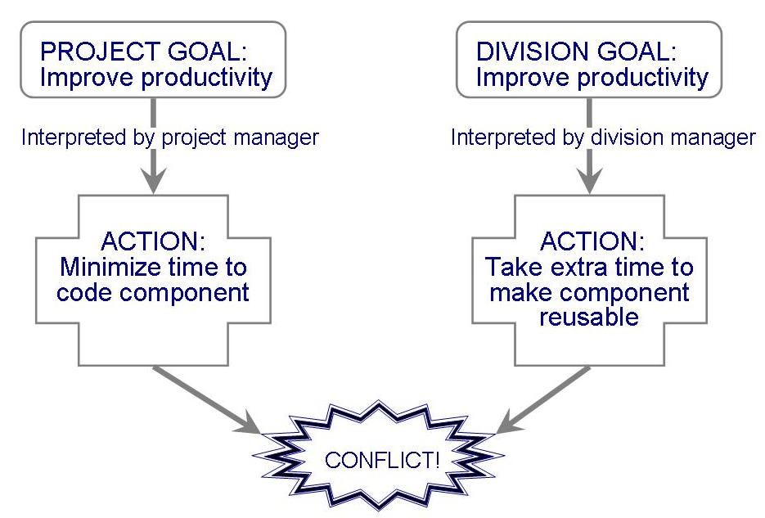
12.4 Evaluating Products
Conflicting Interpretation of Goals
A division manager’s reuse goal may conflict with a project manager’s goal, so no reuse ever gets done

Slide 55
12.4 Evaluating Products
Questions for Successful Reuse
Do you have the right model of reuse
What are the criteria for success
How can current cost models be adjusted to look at collections of projects, not just single projects?
How do regular notions of accounting fit with reuse?
Who is responsible for component quality?
Who is responsible for process quality and maintenance

Slide 56
12.5 Evaluating Process
Postmortem Analysis
A postimplementation assessment of all aspects of the project, including products, process, and resources, intended to identify areas of improvement for future projects
Takes places shortly after a projects is completed, or can take place at any time from just before delivery to 12 months afterward

Slide 57
12.5 Evaluating Process
When Postimplemlentaion Evaluation Is Done
Time period | Percentage of Respondent (of 92% organizations)
Just before delivery | 27.8
At delivery | 4.2
One month after delivery | 22.2
Two months after delivery | 6.9
Three months after delivery | 18.1
Four months after delivery | 1.4
Five months after delivery | 1.4
Six months after delivery | 13.9
Twelve months after delivery | 4.2

Slide 58
12.5 Evaluating Process
Sidebar 12.6 How Many Organizations Perform Postmortem Analysis
Kumar (1990) surveyed 462 medium-sized organizations
  92 organizations that responded, more than one-fifth did not postmortem analysis
  those that did, postmortem were conducted on fewer than half of the projects in the organization

Slide 59
12.5 Evaluating Process
Postmortem Analysis Process
Design and promulgate a project survey to collect relevant data
Collect objective project information
Conduct a debriefing meeting
Conduct a project history day
Publish the results by focusing on lessons learned

Slide 60
12.5 Evaluating Process
Postmortem Analysis Process: Survey
A starting point to collect data that cuts across the interests of project team members
Three guiding principles
  Do not ask for more than you need
  Do not ask leading questions
  Preserve anonymity
Sample questions shown in Sidebar 12.7

Slide 61
12.5 Evaluating Process
Sidebar 12.7 Sample Survey Questions From Wildfire Survey
Were interdivisional lines of responsibility clearly defined throughout the project?
Did project-related meetings make effective use of your time?
Were you empowered to participate in discussion regarding issues that affected your work?
Did schedule changes and related decision involve the right people
Was project definition done by the appropriate individuals?
Was the build process effective for the component area your work on?
What is your primary function on this project?

Slide 62
12.5 Evaluating Process
Postmortem Analysis Process: Objective Information
Obtain objective information to complement the survey opinions
Collier, Demarco and Fearey suggest three kinds of measurements: cost, schedule, and quality
  Cost measurements might include
    person-months of effort
    total lines of code
    number of lines of code changed or added
    number of interfaces

Slide 63
12.5 Evaluating Process
Postmortem Analysis Process: Debriefing Meeting
Allows team members to report what did and did not go well on the project
Project leader can probe more deeply to identify the root cause of positive and negative effects
Some team members may raise issues not covered in the survey questions
Debriefing meetings should be loosely structured

Slide 64
12.5 Evaluating Process
Postmortem Analysis Process: Project History Day
Objective: identify the root causes of the key problems
Involves a limited number of participants who know something about key problems
Review schedule predictability charts
  Show where problems occurred
  Spark discussion about possible causes of each problem

Slide 65
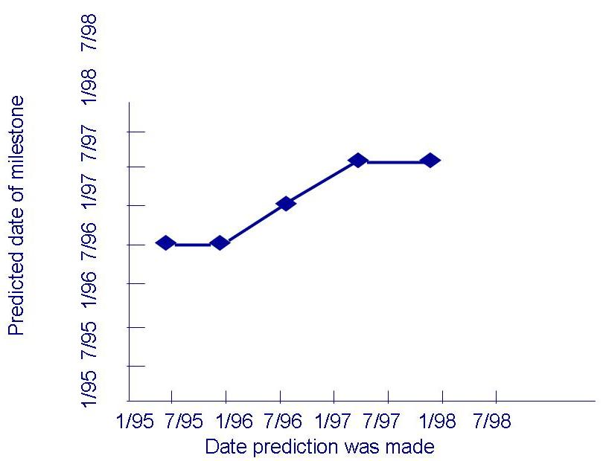
12.5 Evaluating Process
Postmortem Analysis Process: Schedule-Predictability Charts
For each key project milestone, the chart shows when the predictions was made compared with the completion date

Slide 66
12.5 Evaluating Process
Postmortem Analysis Process: Publish Results
Objective: Share results with the project team
Participants in the project history day write a letter to managers, peers, developers
The letter has four parts
  Introduction to the project
  A summary of postmortem’s positive findings
  A summary of three worst factors that kept the team from meeting its goals
  Suggestions for improvement activities

Slide 67
12.5 Evaluating Process
Process Maturity Models
Capability Maturity Model (CMM)
Software Process Improvement and Capability dEtermination (SPICE)
ISO 9000

Slide 68
12.5 Evaluating Process
Capability Maturity Model
Developed by Software Engineering Institute
There are five levels of maturity
Each level is associated with a set of key process area

Slide 69
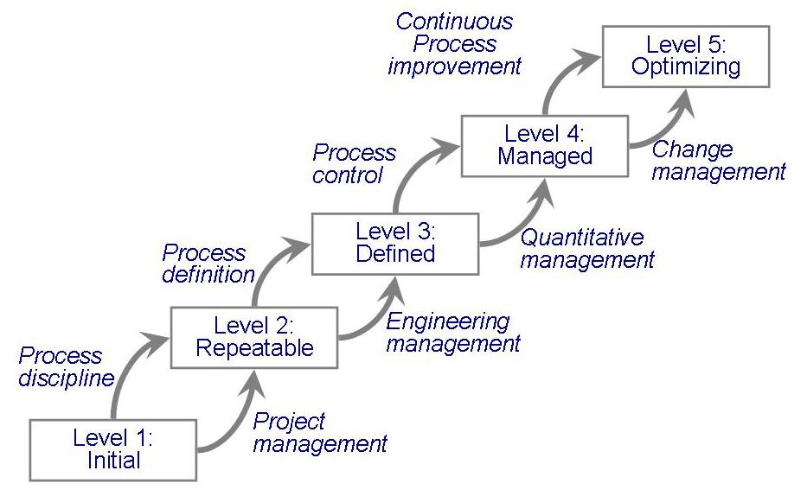
12.5 Evaluating Process
CMM Levels of Maturity

Slide 70
12.5 Evaluating Process
CMM Maturity Levels
Level 1: Initial
Level 2: Repeatable
Level 3: Defined
Level 4: Managed
Level 5: Optimizing

Slide 71
12.5 Evaluating Process
CMM Level 1
Initial: describes a software development process that is ad hoc or even chaotic
It is difficult even to write down or depict the overall process
No key process areas at this level

Slide 72
12.5 Evaluating Process
Required Questions for Level 1 of The Process Maturity Model
Question number | Question
1.1.3 | Does the software quality assurance function have a management reporting channel separate from the software development project management?
1.1.6 | Is there a software configuration control function for each project that involves software development?
2.1.3 | Is a formal process used in the management review of each software development prior to making contractual commitments?
2.1.14 | Is a formal procedure used to make estimates of software size?
2.1.15 | Is a formal procedure used to produce software development schedules?
2.1.16 | Are formal procedures applied to estimating software development cost?
2.2.2 | Are profiles of software size maintained for each software configuration item over time?
2.2.4 | Are statistic on software code and test errors gathered?
2.4.1 | Does senior management have a mechanism for the regular review of the status of software development projects/
2.4.7 | Do software development first-line managers sign off on their schedule and cost estimates?
2.4.9 | Is a mechanism used for controlling changes to the software requirements?
2.4.17 | Is a mechanism used for controlling changes to the code?

Slide 73
12.5 Evaluating Process
Key Process Areas in The CMM
CMM Level | Key Process Areas
Initial | None
Repeatable | Requirement Management Software project planning Software project tracking and oversight software subcontract management Software quality assurance Software Configuration management
Defined | Organization process focus Organization process definition Training program Integrated software management Software product engineering Intergroup coordination Peer reviews
Managed | Quantitative process management Software quality management
Optimizing | Fault prevention Technology change management Process change management

Slide 74
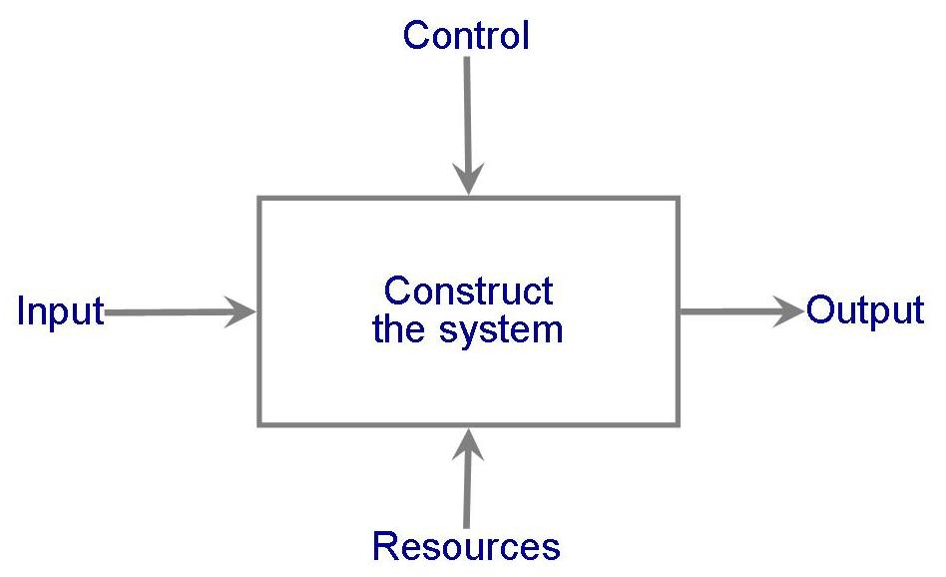
12.5 Evaluating Process
CMM Level 2
Repeatable: identifying the inputs and outputs of the process, the constraints, and the resources used to produce final product

Slide 75
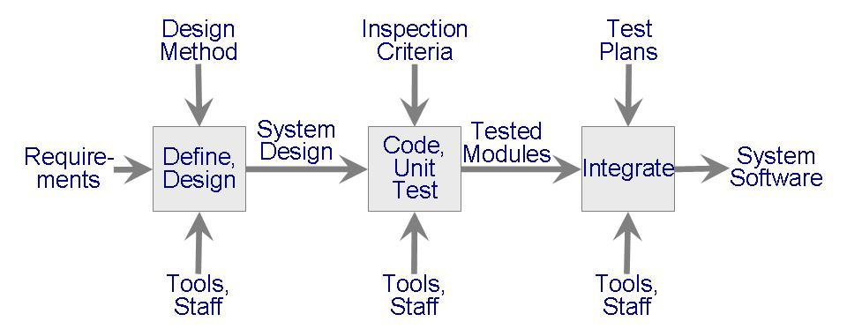
12.5 Evaluating Process
CMM Level 3
Defined: management and engineering activities are documented, standardized and integrated

Slide 76
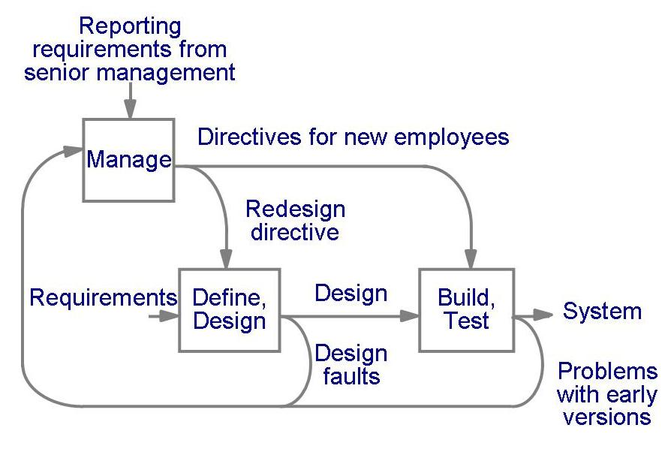
12.5 Evaluating Process
CMM Level 4
Managed: process directs its effort at product quality

Slide 77
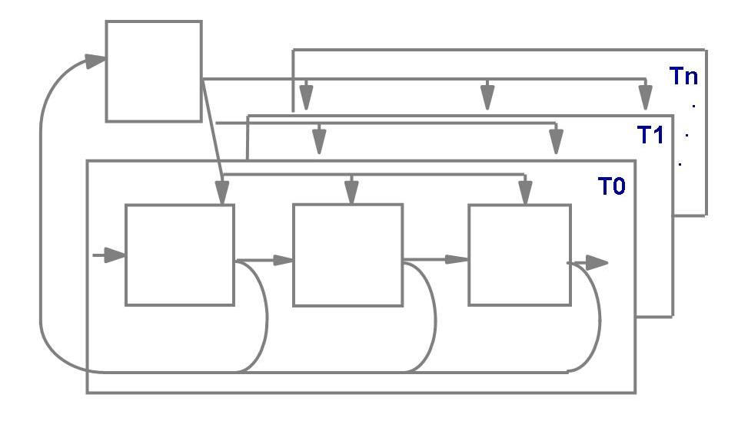
12.5 Evaluating Process
CMM Level 5
Optimizing: quantitative feedback is incorporated in the process to produce continuous process improvement

Slide 78
12.5 Evaluating Process
CMM Key Practices
Commitment to perform
Ability to perform
Activities performed
Measurement and analysis
Verifying implementation

Slide 79
12.5 Evaluating Process
SPICE
SPICE is intended to harmonize and extend the existing approaches (e.g., CMM, BOOTSTRAP)
SPICE is recommended for process improvement and capability determination
Two types of practices
  Base practices: essential activities of a specific process
  Generic practices: institutionalization (implement a process in a general way)

Slide 80
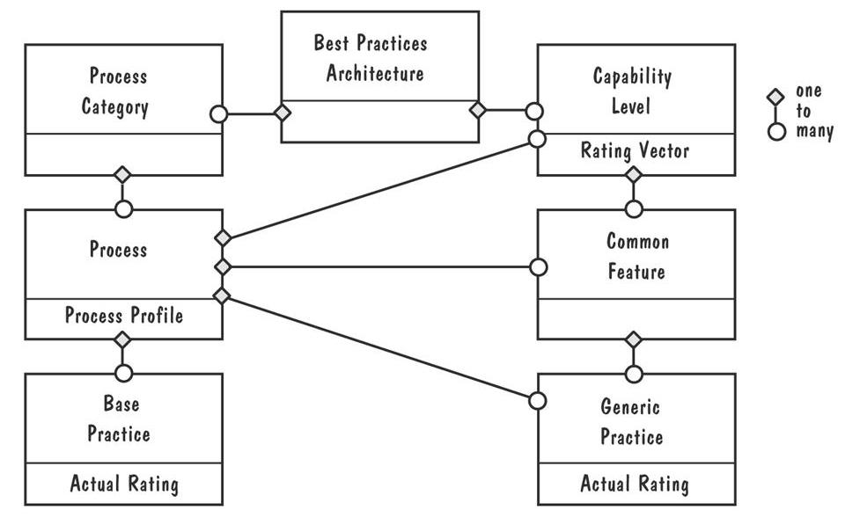
12.5 Evaluating Process
SPICE Architecture for Process Assessment

Slide 81
12.5 Evaluating Process
SPICE Functional View Activities/Processes
Customer-supplied: processes that affect the customer directly
Engineering: processes that specify, implement, or maintain the system
Project: processes that establish the project, and coordinate and manage resources
Support: processes that enable other processes
Organizational: processes that establish business goals

Slide 82
12.5 Evaluating Process
SPICE Six Levels of Capability
0: Not performed – failure to perform
1: Performed informally: not planned and tracked
2: Planned and tracked: verified according to the specified procedures
3: Well-defined: well-defined processusing approved processes
4: Quantitatively controlled: detailed performance measures
5: Continuously improved: quantitative targets for effectiveness and efficiency based on business goals

Slide 83
12.5 Evaluating Process
ISO 9000
Produced by The International Standards Organization (ISO)
Standard 9001 is most applicable to the way we develop and maintain software
Used to regulate internal quality and to ensure the quality suppliers

Slide 84
12.5 Evaluating Process
ISO 9001 Clauses
Clause number | Subject matter
4.1 |  | Management responsibility
4.2 |  | Quality system
4.3 |  | Contract review
4.4 |  | Design control
4.5 |  | Document and data control
4.6 |  | Purchasing
4.7 |  | Control of customer-supplied product
4.8 |  | Product identification and traceability
4.9 |  | Process control
4.10 |  | Inspection and testing
4.11 |  | Control of inspection, measuring, and test equipment
4,12 |  | Inspection and test status
4,.13 |  | Control of nonconforming product
4.14 |  | Corrective and preventive action
4.15 |  | Handling, storage, packaging, preservation, and delivery
4.16 |  | Control of quality records
4,17 |  | Internal quality audits
4.18 |  | Training
4.19 |  | Servicing
4.20 |  | Statistical techniques

Slide 85
12.6 Evaluating Resources
People Maturity Model
Return on investment

Slide 86
12.6 Evaluating Resources
People Maturity Model
Proposed by Curtis, Hefley and Miller for improving the knowledge and skills of the workforce
It has five levels
  Initial
  Repeatable
  Defined
  Managed
  Optimizing

Slide 87
12.6 Evaluating Resources
People Capability Maturity Model Levels
Level | Focus | Key Practices
5: Optimizing | Continuous knowledge and Skill improvements | Continuous workforce innovation Coaching Personal competency development
4: Managed | Effectiveness measure and managed, high-performance teams developed | Organizational performance alignment Organizational competency management Team-based practice Team building Mentoring
3: Defined | Competency-based workforce practice | Participatory culture Competency-based practices Career development Competency development Workforce planning Knowledge and skill analysis
2: Repeatable | Management takes responsibility for managing its people | Compensation Training Performance management Staffing Communication Work environment
1: Initial

Slide 88
12.6 Evaluating Resources
Return on investment
Use net present value
  value today of predicted future cash flows
Example:
Cash flows
COTS
Reuse
Initial investment
-9000
-4000
Year 1
5000
-2000
Year 2
6000
2000
Year 3
7000
4500
Year 4
-4000
6000
Sum of all cash flows
5000
6500
NPV at 15%
2200
2162

Slide 89
12.6 Evaluating Resources
Return on Investment at Chase Manhattan
RMS has increased customer calls by 33% and improved profitability by 27%
By protecting its old investment and encouraging communication among employees, Chase Manhattan accomplished
  avoid huge investment in new hardware
  provide more data more quickly to its service representative
  achieved an admirable return on investment
  created cohesive teams that understand more about Chase Manhattan’s business

Slide 90
12.7 Information Systems Example
Piccadilly System
A postmortem analysis must review the business as well as technology
  “Is this system good for business”

Slide 91
12.7 Real-Time Example
Ariane-5
A fine example of a postmortem analysis
  Focused on the obvious need to determine what caused the fault that required exploding the rocket
  Avoided blamed and complaint

Slide 92
12.8 What This Chapter Means For You
There are several approaches to evaluation, including feature analysis, surveys, case studies, and formal experiments
Measurement is essential for any evaluation
It is important to understand the difference between assessment and prediction
Product evaluation is usually based on a model of the attributes of interest
Process evaluation can be done in many ways
Return-on-investment strategies helps us understands whether business is benefiting from investment in people, tools, and technology

