Slide 1
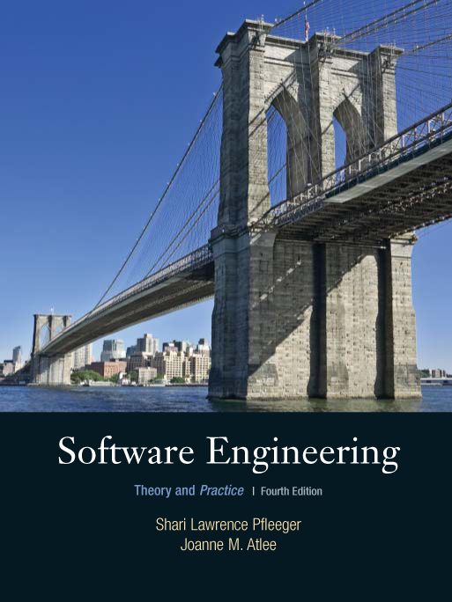
Chapter 1
What is Software
Engineering
Shari L. Pfleeger
Joanne M. Atlee
4th Edition

Slide 2
Contents
1.1 What is Software Engineering?
1.2 How Successful Have We Been?
1.3 What Is Good Software?
1.4 Who Does Software Engineering?
1.5 A System Approach
1.6 An Engineering Approach
1.7 Members of the Development Team
1.8 How Has Software Engineering Changed?
1.9 Information System Example
1.10 Real Time Example
1.11 What this Chapter Means for You

Slide 3
Objectives
What we mean by software engineering
Software engineering’s track record
What we mean by good software
Why a system approach is important
How software engineering has changed since 1970s

Slide 4
1.1 What is Software Engineering
Solving Problems
Software products are large and complex
Development requires analysis and synthesis
  Analysis: decompose a large problem into smaller, understandable pieces
    abstraction is the key
  Synthesis: build (compose) a software from smaller building blocks
    composition is challenging

Slide 5
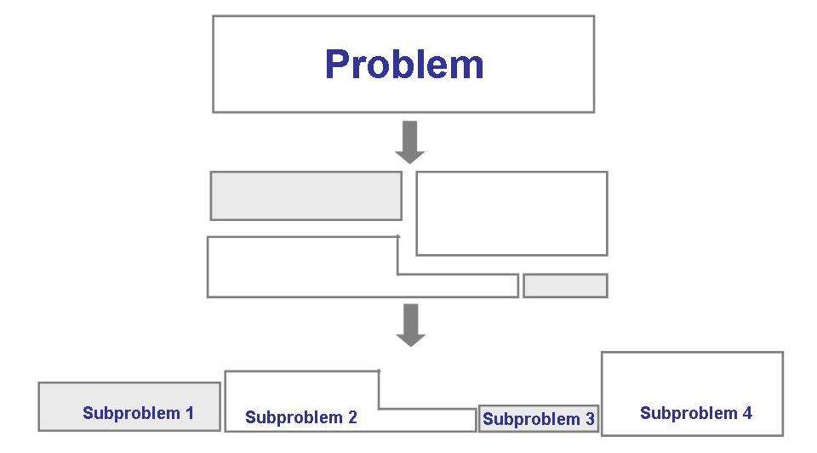
1.1 What is Software Engineering
Solving Problems (continued)
The analysis process

Slide 6
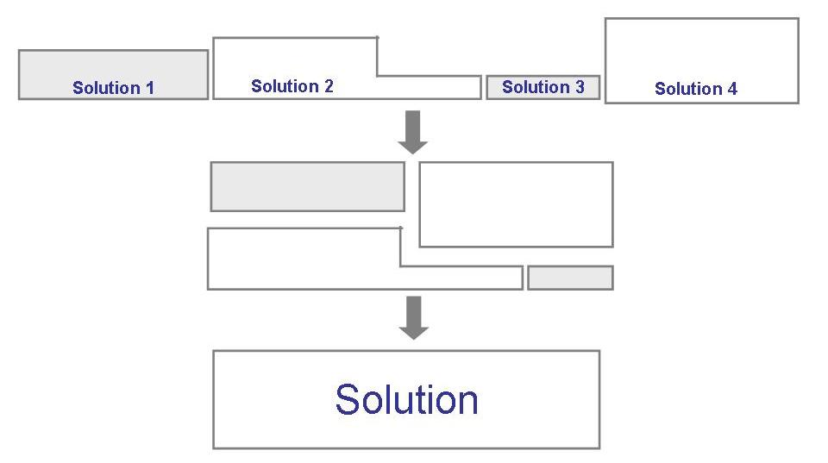
1.1 What is Software Engineering
Solving Problems (continued)
The synthesis process

Slide 7
1.1 What is Software Engineering
Solving Problems (continued)
Method: refers to a formal procedure; a formal “recipe” for accomplishing a goal that is typically independent of the tools used
Tool: an instrument or automated system for accomplishing something in a better way
Procedure: a combination of tools and techniques to produce a product
Paradigm: philosophy or approach for building a product (e.g., OO vs structured approaches)

Slide 8
1.1 What is Software Engineering
Where Does the Software Engineer Fit In?
Computer science: focusing on computer hardware, compilers, operating systems, and programming languages
Software engineering: a discipline that uses computer and software technologies as a problem-solving tools

Slide 9
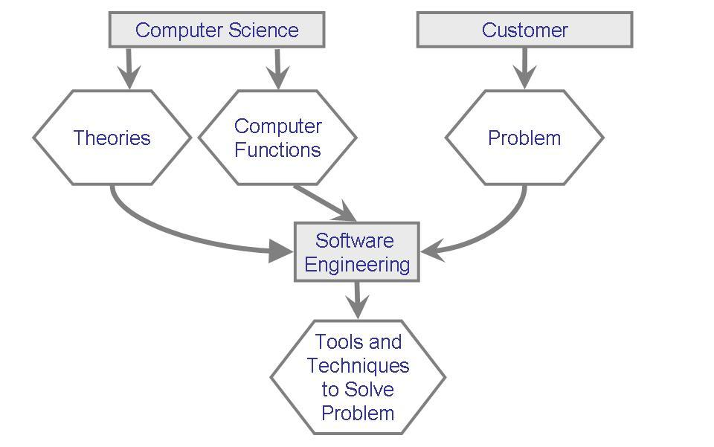
1.1 What is Software Engineering
Where Does the SW Engineer Fit in? (continued)
Relationship between computer science and software engineering

Slide 10
1.2 How Successful Have We Been?
Perform tasks more quickly and effectively
  Word processing, spreadsheets, e-mail
Support advances in medicine, agriculture, transportation, multimedia education, and most other industries
Many good stories
However, software is not without problems

Slide 11
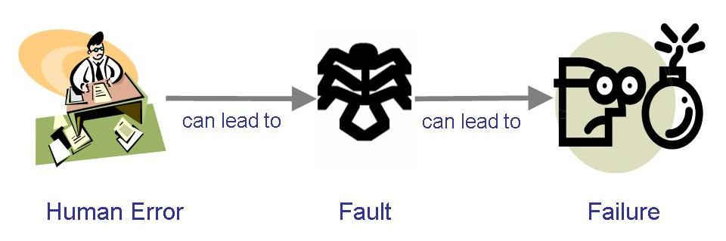
1.2 How Successful Have We Been?
Sidebar 1.1 Terminology for Describing Bugs
A fault: occurs when a human makes a mistake, called an error, in performing some software activities
A failure: is a departure from the system’s required behaviour

Slide 12
1.2 How Successful Have We Been?
Examples of Software Failure
IRS hired Sperry Corporation to build an automated federal income tax form processing process
  An extra $90 M was needed to enhance the original $103 product
  IRS lost $40.2 M on interests and $22.3 M in overtime wages because refunds were not returned on time
Malfunctioning code in Therac-25 killed several people
Reliability constraints have caused cancellation of many safety critical systems
  Safety-critical: something whose failure poses a threat to life or health

Slide 13
1.3 What Is Good Software?
Sidebar 1.2 Perspective on Quality
The transcendental view: quality is something we can recognize but not define
The user view: quality is fitness for purpose
The manufacturing view: quality is conformance to specification
The product view: quality tied to inherent product characteristics
The value-based view: depends on the amount the customers is willing to pay for it

Slide 14
1.3 What is Good Software?
Good software engineering must always include a strategy for producing quality software
Three ways of considering quality
  The quality of the product
  The quality of the process
  The quality of the product in the context of the business environment

Slide 15
1.3 What Is Good Software?
The Quality of the Product
Users judge external characteristics (e.g., correct functionality, number of failures, type of failures)
Designers and maintainers judge internal characteristics (e.g., types of faults)
Thus different stakeholders may have different criteria
Need quality models to relate the user’s external view to developer’s internal view

Slide 16
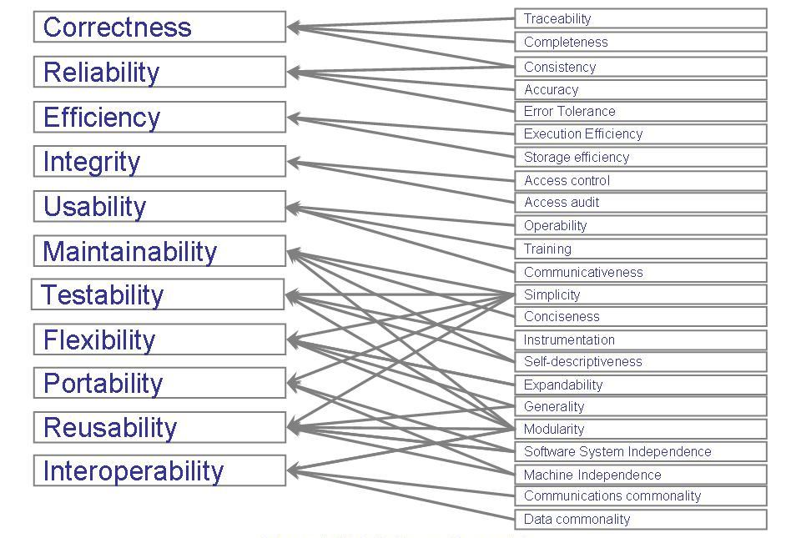
1.3 What Is Good Software?
The Quality of the Product (continued)
McCall’s quality model

Slide 17
1.3 What Is Good Software?
The Quality of the Process
Quality of the development and maintenance process is as important as the product quality
The development process needs to be modeled
Modeling will address questions such as
  Where to find a particular kind of fault
  How to find faults early
  How to build in fault tolerance
  What are alternative activities

Slide 18
1.3 What Is Good Software?
The Quality of the Process (continued)
Models for process improvement
  SEI’s Capability Maturity Model (CMM)
  ISO 9000
  Software Process Improvement and Capability dEtermination (SPICE)

Slide 19
1.3 What Is Good Software?
The Quality in the Context of the Business Environment
Business value is as important as technical value
Business value (in relationship to technical value) must be quantified
A common approach: return on investment (ROI) – what is given up for other purposes
ROI is interpreted in different terms: reducing costs, predicting savings, improving productivity, and costs (efforts and resources)

Slide 20
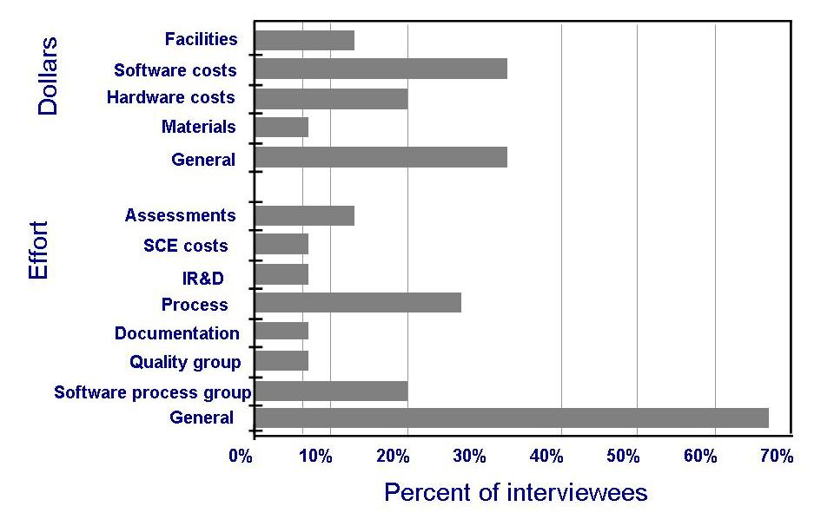
1.3 What Is Good Software?
The Quality of the Context of the Business Environment
Industry’s definition of ROI

Slide 21
1.4 Who Does Software Engineering?
Customer: the company, organization, or person who pays for the software system
Developer: the company, organization, or person who is building the software system
User: the person or people who will actually use the system

Slide 22
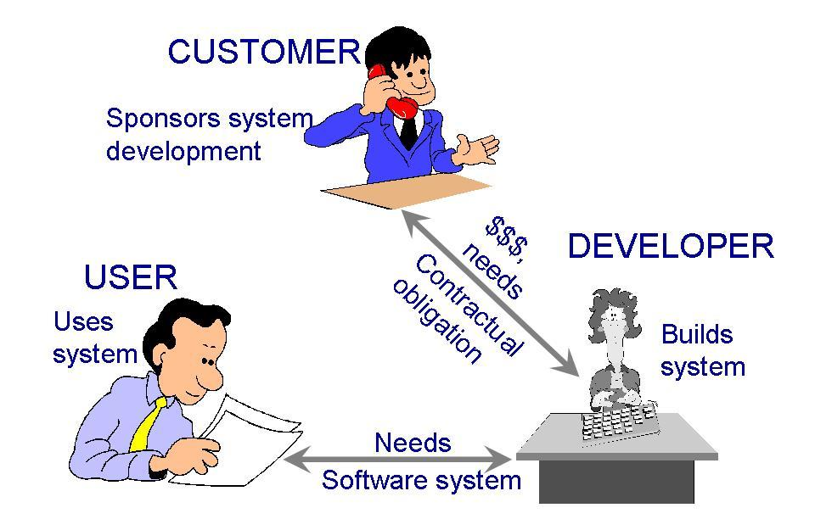
1.4 Who Does Software Engineering? (continued)
Participants (stakeholders) in a software development project

Slide 23
1.5 System Approach
Hardware, software, interaction with people
Identify activities and objects
Define the system boundary
Consider nested systems, systems interrelationship

Slide 24
1.5 System Approach
The Element of a System
Activities and objects
  An activity is an event initiated by a trigger
  Objects or entities are the elements involved in the activities
Relationships and the system boundaries
  A relationship defines the interaction among entities and activities
  System boundaries determine the origin of input and destinations of the output

Slide 25
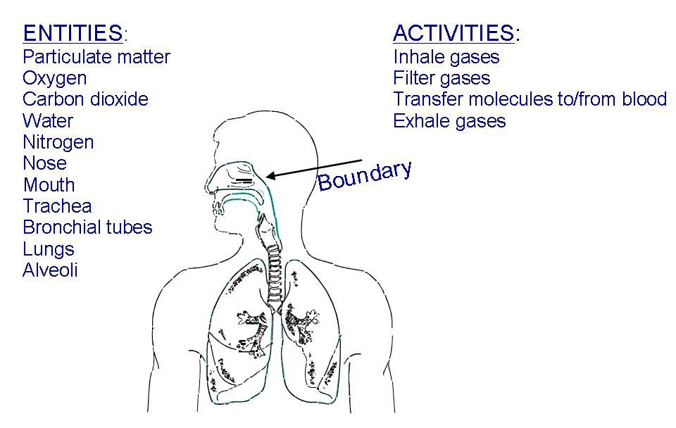
1.5 System Approach
The Element of a System (continued)
Example of systems: a human respiratory system

Slide 26
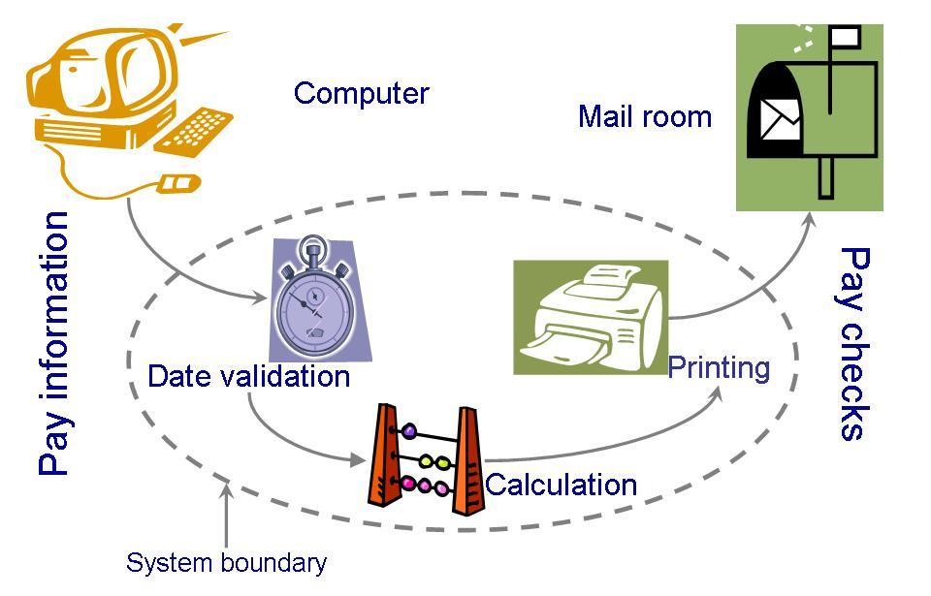
1.5 System Approach
The Element of a System (continued)
A computer system must also be clearly described: System definition of a paycheck production

Slide 27
1.5 System Approach
Interrelated Systems
Some systems are dependent to other systems
  The interdependencies may be complex
It is possible for one system to exist inside another system
If the boundary definitions are detailed, building a larger system from the smaller ones is relatively easy

Slide 28
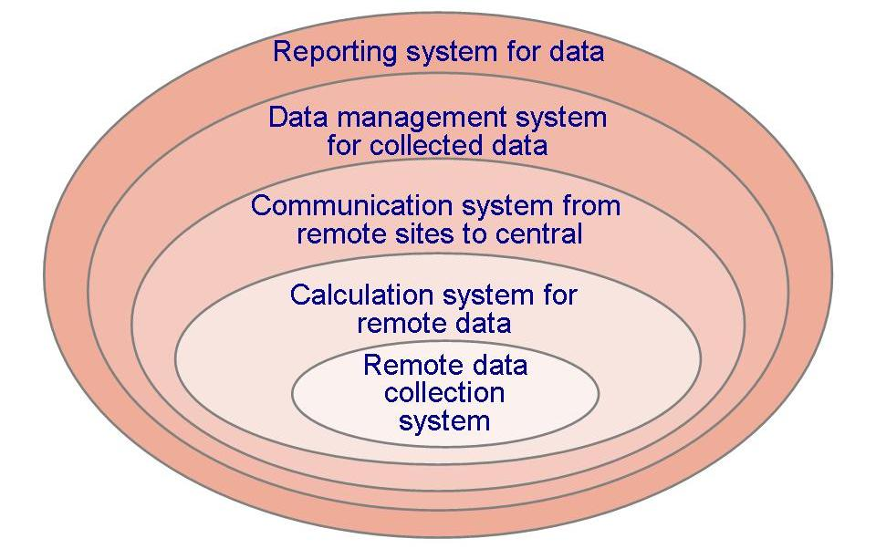
1.5 System Approach
Interrelated Systems (continued)
A layered system

Slide 29
1.6 Engineering Approach
Building a System
Requirement analysis and definition
System design
Program design
Writing the programs
Unit testing
Integration testing
System testing
System delivery
Maintenance

Slide 30
1.7 Members of the Development Team
Requirement analysts: work with the customers to identify and document the requirements
Designers: generate a system-level description of what the system us supposed to do
Programmers: write lines of code to implement the design
Testers: catch faults
Trainers: show users how to use the system
Maintenance team: fix faults that show up later
Librarians: prepare and store documents such as software requirements
Configuration management team: maintain correspondence among various artifacts

Slide 31
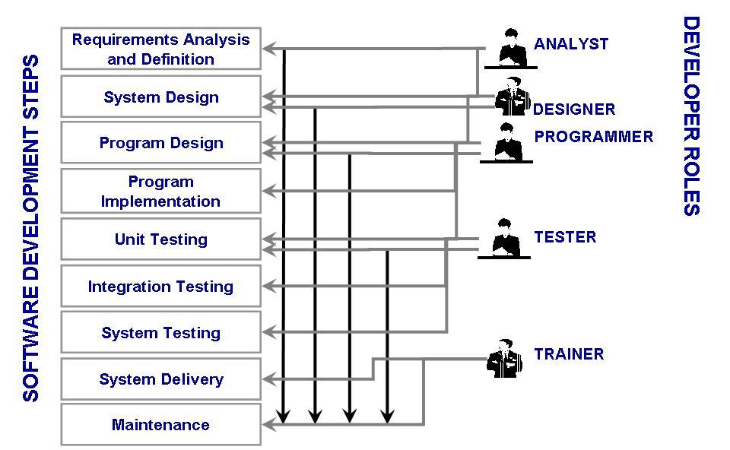
1.7 Members of the Development Team (continued)
Typical roles played by the members of a development team

Slide 32
1.8 How Has Software Engineering Changed?
The Nature of the Change
Before 1970s
  Single processors: mainframes
  Designed in one of two ways
    as a transformation: input was converted to output
    as a transaction: input determined which function should be performed
After 1970s
  Run on multiple systems
  Perform multi-functions

Slide 33
1.8 How Has SE Changed?
Wasserman's Seven Key Factors
Critically of time-to-market
Shifts in the economics of computing
Availability of powerful desktop computing
Extensive local- and wide-area networking
Availability and adoption of object-oriented technology
Graphical user interfaces
Unpredictability of the waterfall model of software development

Slide 34
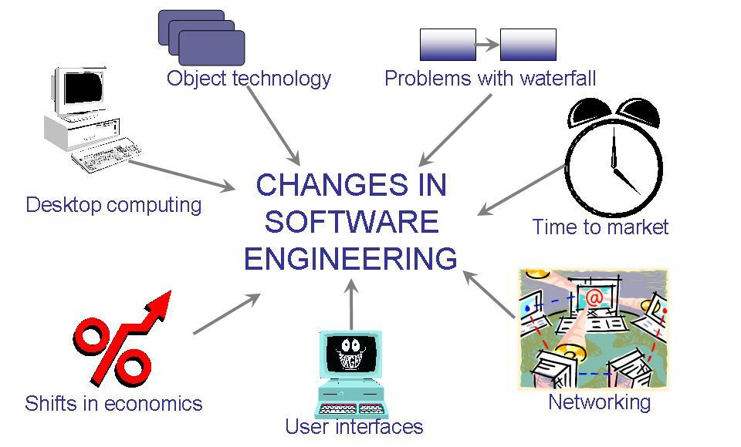
1.8 How Has SE Changed?
Wasserman's Seven Key Factors (continued)
The key factors that have changed the software development

Slide 35
1.8 How Has SE Changed?
Wasserman's Discipline of Software Engineering
Abstractions
Analysis and design methods and notations
User interface prototyping
Software architecture
Software process
Reuse
Measurement
Tools and integrated environments

Slide 36
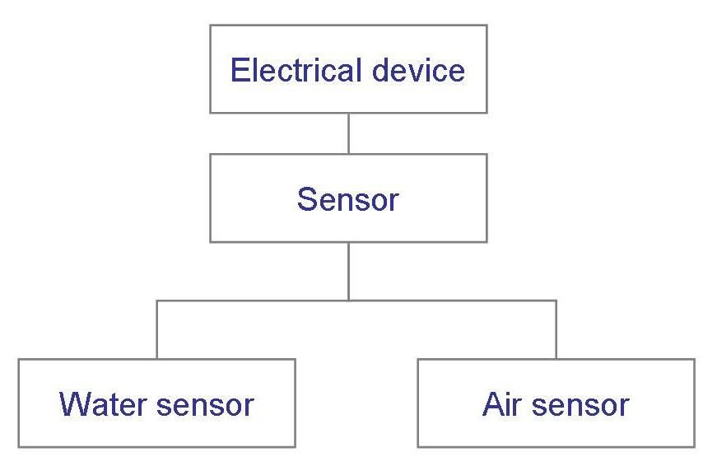
1.8 How Has SE Changed?
Abstraction
A description of the problem at some level of generalization
  Hide details

Slide 37
1.8 How Has SE Changed?
Analysis and Design Methods and Notations
Provide documentation
Facilitate communication
Offer multiple views
Unify different views

Slide 38
1.8 How Has SE Changed?
User Interface Prototyping
Prototyping: building a small version of a system
  Help users identify key requirements of a system
  Demonstrate feasibility
Develop good user interface

Slide 39
1.8 How Has SE Changed?
Software Architecture
A system’s architecture describes the system in terms of a set of architectural units and relationships between these units
Architectural decomposition techniques
  Modular decomposition
  Data-oriented decomposition
  Event-driven decomposition
  Outside-in-design decomposition
  Object-oriented decomposition

Slide 40
1.8 How Has SE Changed?
Software Process
Many variations
Different types of software need different processes
  Enterprise-wide applications need a great deal of control
  Departmental applications can take advantage of rapid development

Slide 41
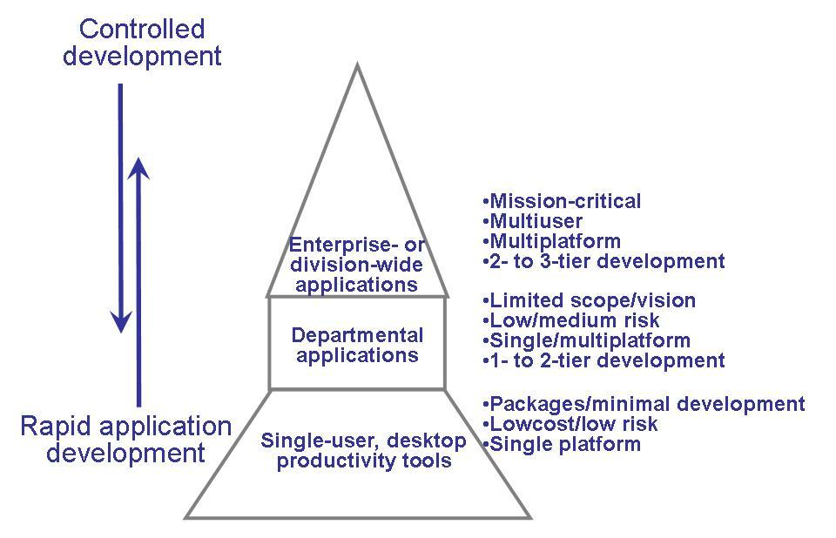
1.8 How Has SE Changed?
Software Process (continued)
Pictorial representation of differences in development processes

Slide 42
1.8 How Has SE Changed?
Software Reuse
Commonalities between applications may allow reusing artifacts from previous developments
  Improve productivity
  Reduce costs
Potential concerns
  It may be faster to build a smaller application than searching for reusable components
  Generalized components take more time to build
  Must clarify who will be responsible for maintaining reusable components
  Generality vs specificity: always a conflict

Slide 43
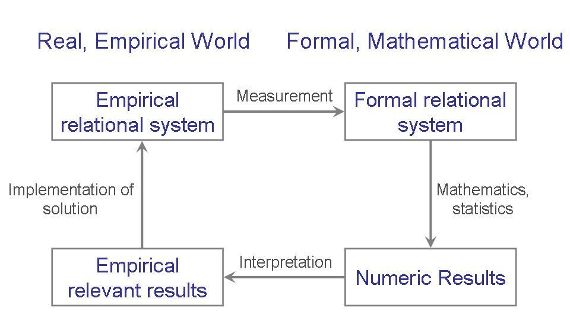
1.8 How Has SE Changed?
Measurement
Objective: describe quality goals in a quantitative way

Slide 44
1.8 How Has SE Changed?
Tools and Integrated Environments
Platform integration (on heterogeneous networks)
Presentation integration (commonality of user interface)
Process integration (linking tools and the development process)
Data integration (to share common data)
Control integration (the ability of one tool to initiate action in another one)

Slide 45
1.9 Information Systems Example
Piccadilly System
Piccadilly Television: regional British TV franchise
Advertising scheme has many constraints:
  alcohol adverts only after 9 pm
  if actor in show, no same actor in advert within 45 minutes
  if advert in a class of products, no other advert in same class during same break
  rates dependent on amount of time bought
Software to determine, track advertising time

Slide 46
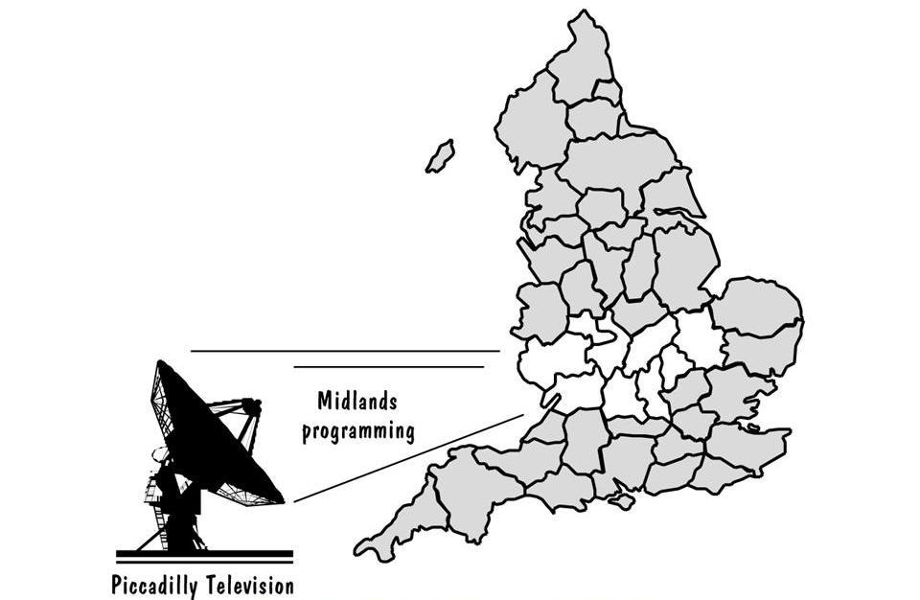
1.9 Information Systems Example
Piccadilly System (continued)
Piccadilly Television franchise area

Slide 47
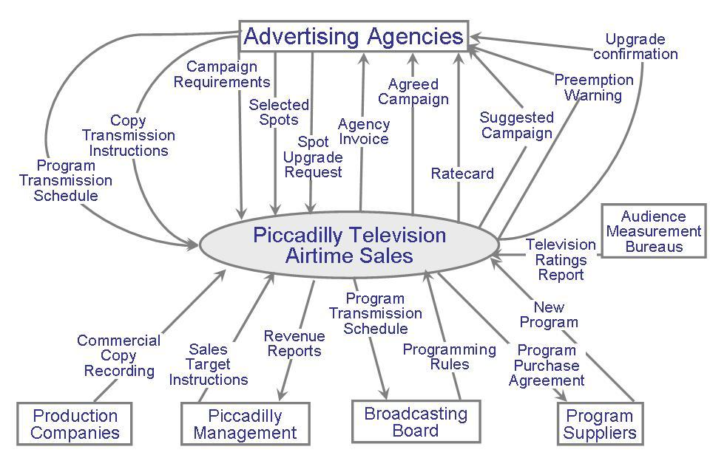
1.9 Information Systems Example
Piccadilly System (continued)
Piccadilly system’s context diagram

Slide 48
1.10 Real Time Example
Ariane-5 rocket, from the European Space Agency
June 4, 1996: functioned well for 40 seconds, then veered off course and was destroyed
Contained four satellites: cost was $500 million
Reused code from Ariane-4 rocket

Slide 49
1.10 Real Time Example
Ariane-5 Definition of Quality
From the Lions et al report:
  “… demonstrated the high quality of the Ariane-5 programme as regards engineering work in general and completeness and traceability of documents.”
  “… the supplier of the SRI … was only following the specification given to it. … The exception which occurred was not due to random failure but a design error.”

Slide 50
1.11 What this Chapter Means for You
Given a problem to solve
  Analyze it
  Synthesize a solution
Understand that requirements may change
Must view quality from several different perspectives
Use fundamental software engineering concepts (e.g., abstractions and measurements)
Keep system boundary in mind

