Slide 1
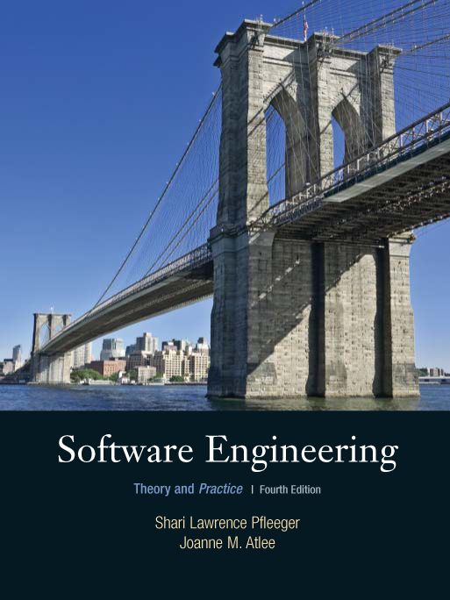
Chapter 2
Modeling the
Process and Life
Cycle
Shari L. Pfleeger
Joanne M. Atlee
4th Edition

Slide 2
2.1 The Meaning of Process
A process: a series of steps involving activities, constraints, and resources that produce an intended output of some kind
A process involves a set of tools and techniques

Slide 3
2.1 The Meaning of Process
Process Characteristics
Prescribes all major process activities
Uses resources, subject to set of constraints (such as schedule)
Produces intermediate and final products
May be composed of subprocesses with hierarchy or links
Each process activity has entry and exit criteria
Activities are organized in sequence, so timing is clear
Includes goals of each activity
Constraints may apply to an activity, resource or product

Slide 4
2.1 The Meaning of Process
The Importance of Processes
Impose consistency and structure on a set of activities
Guide us to understand, control, examine, and improve the activities
Enable us to capture our experiences and pass them along

Slide 5
2.2 Software Process Models
Reasons for Modeling a Process
To form a common understanding
To find inconsistencies, redundancies, omissions
To find and evaluate appropriate activities for reaching process goals
To tailor a general process for a particular situation in which it will be used

Slide 6
2.2 Software Process Models
Software Life Cycle
When a process involves building a software, the process may be referred to as software life cycle
  Requirements analysis and definition
  System (architecture) design
  Program (detailed/procedural) design
  Writing programs (coding/implementation)
  Testing: unit, integration, system
  System delivery (deployment)
  Maintenance

Slide 7
2.2 Software Process Models
Software Development Process Models
Waterfall model
V model
Prototyping model
Phased development: increments and iteration
Spiral model
Agile methods

Slide 8
2.2 Software Process Models
Waterfall Model
One of the first process development models proposed
Works for well understood problems with minimal or no changes in the requirements
Simple and easy to explain to customers
It presents
  a very high-level view of the development process
  sequence of process activities
Each major phase is marked by milestones and deliverables (artifacts)

Slide 9
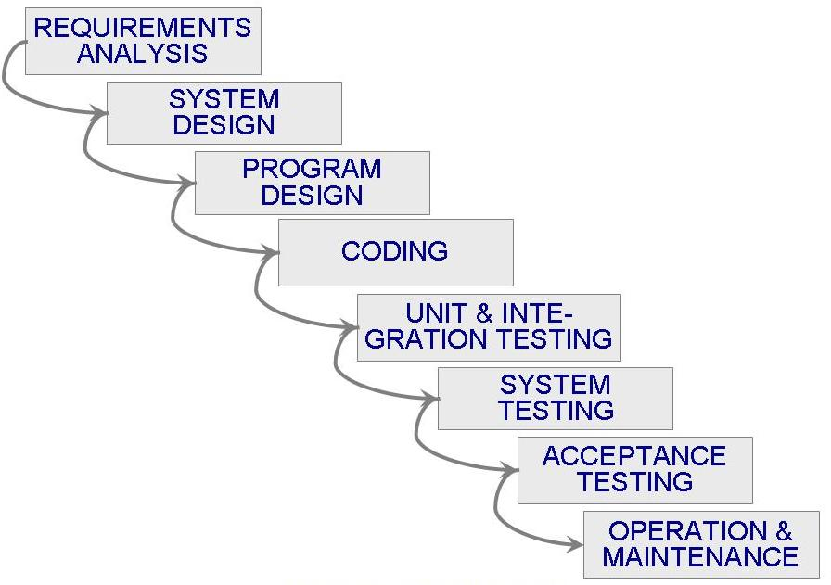
2.2 Software Process Models
Waterfall Model (continued)

Slide 10
2.2 Software Process Models
Drawbacks of The Waterfall Model
Views software development as manufacturing process
No guidance how to handle changes to products and activities during development
There is no iteration
The clients may not know the requirements
Changing requirements in later stages cause increased overall project cost
Long wait before a final product

Slide 11
2.2 Software Process Models
V Model
A variation of the waterfall model
Uses unit testing to verify module design
Uses integration testing to verify system design
Uses acceptance testing to validate the requirements
If problems are found during verification and validation, the left side of the V can be re-executed before testing on the right side is re-enacted
Adoption by medical device industry

Slide 12
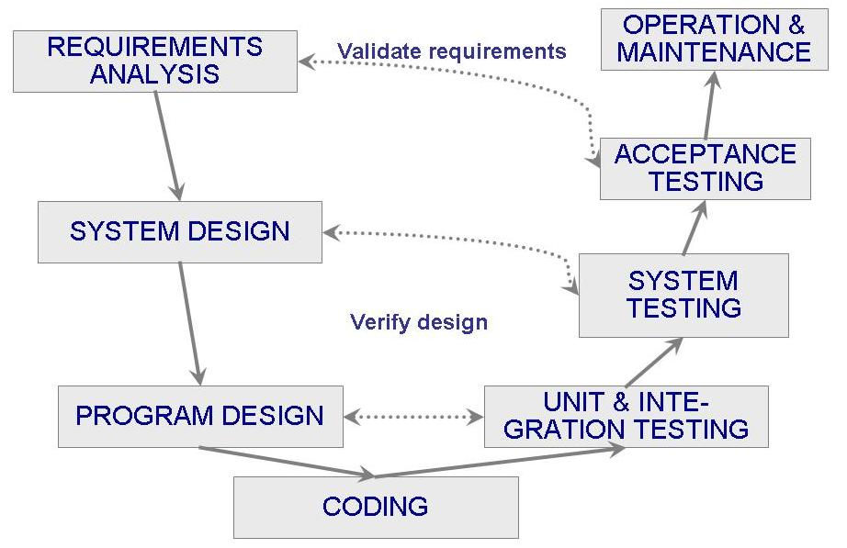
2.2 Software Process Models
V Model (continued)

Slide 13
2.2 Software Process Models
Drawbacks of The V Model
Has similar drawbacks as the waterfall model
Too simple - may not reflect the software process accurately
Use of inefficient and ineffective testing techniques
Rigid link between left-side and right-side (acceptance testing corresponds to the user requirements)

Slide 14
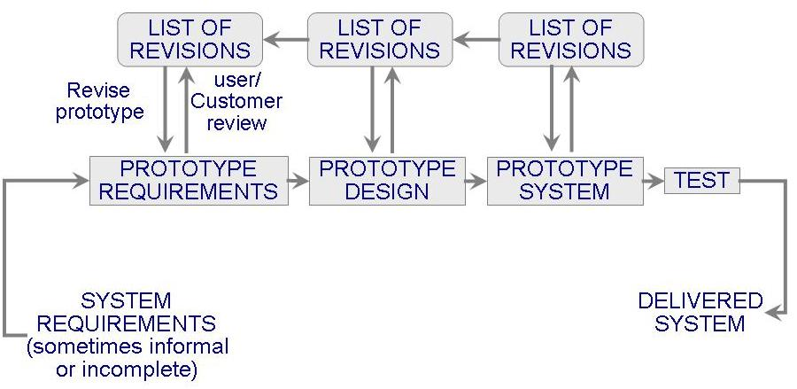
2.2 Software Process Models
Prototyping Model
Reduces risk and uncertainty in the development as well as time and cost
Online systems and HCI

Slide 15
2.2 Software Process Models
Drawbacks of The Prototype Model
Not sufficient analysis (functionality, scalability, maintainability)
User misunderstanding (prototype vs. final product)
Developer misunderstanding the user reqs.
Too much time spent on prototype development
  Increased cost
  Increased involvement and attachment to prototype

Slide 16
2.2 Software Process Models
Phased Development: Increments and Iterations
Shorter cycle time
System delivered in pieces
  enables customers to have some functionality while the rest is being developed
Allows two systems functioning in parallel
  the production system (release n): currently being used
  the development system (release n+1): the next version
Supported by US DoD, NASA

Slide 17
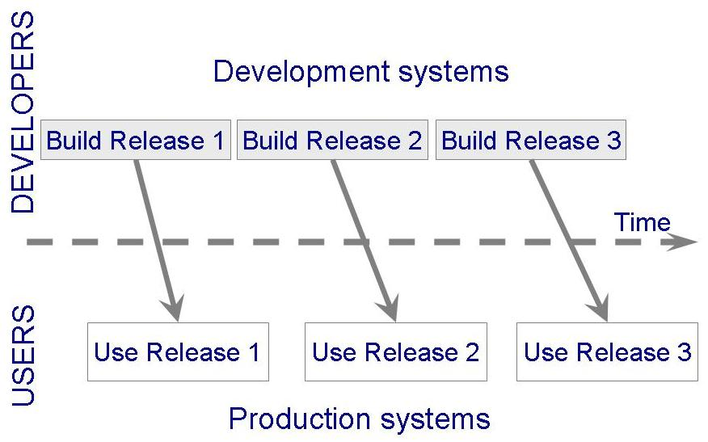
2.2 Software Process Models
Phased Development: Increments and Iterations
(continued)

Slide 18
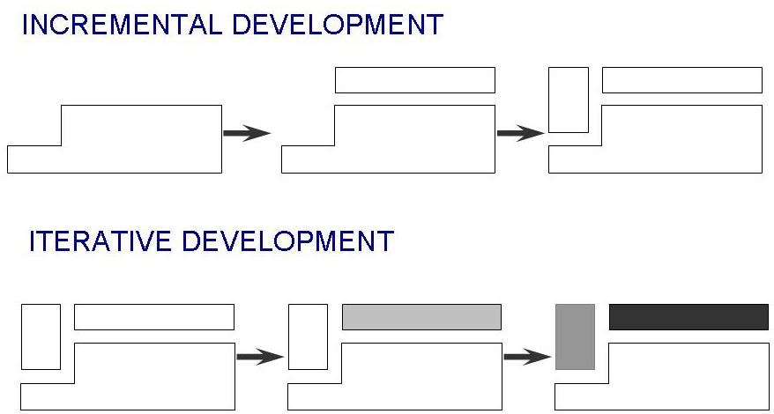
2.2 Software Process Models
Phased Development: Increments and Iterations
(continued)
Incremental development: starts with small functional subsystem and adds functionality with each new release
Iterative development: starts with full system, then changes functionality of each subsystem with each new release

Slide 19
2.2 Software Process Models
Phased Development: Increments and Iterations
(continued)
Phased development is desirable for several reasons
  Markets can be created early for functionality that has never before been offered
  The development team can focus on different areas of expertise with different releases
  Easier to test and debug
  Regression testing after each iteration

Slide 20
2.2 Software Process Models
Spiral Model
Suggested by Boehm (1988)
Combines development activities with risk management to minimize and control risks
The model is presented as a spiral in which each iteration is represented by a circuit around four major activities
  Plan
  Determine goals, alternatives and constraints
  Evaluate alternatives and risks
  Develop and test

Slide 21
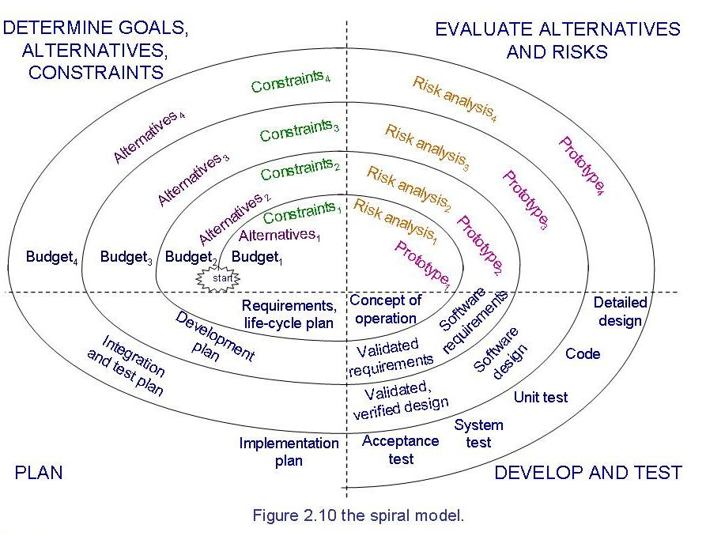
2.2 Software Process Models
Spiral Model (continued)

Slide 22
2.2 Software Process Models
Agile Methods
Emphasis on flexibility in producing software quickly
Agile manifesto
  Value individuals and interactions over process and tools
  Prefer to invest time in producing working software rather than in producing comprehensive documentation
  Focus on customer collaboration rather than contract negotiation
  Concentrate on responding to change rather than on creating a plan and then following it

Slide 23
2.2 Software Process Models
Agile Methods: Examples of Agile Process
Extreme programming (XP)
Scrum: 30-day iterations; multiple self-organizing teams; daily “scrum” coordination

Slide 24
2.2 Software Process Models
Agile Methods: Extreme Programming
Emphasis on four charateristics of agility
  Communication: continual interchange between customers and developers
  Simplicity: select the simplest design or implementation
  Courage: commitment to delivering functionality early and often
  Feedback: loops built into the various activitites during the development process

Slide 25
2.2 Software Process Models
Agile Methods: Twelve Facets of XP
Planning game
(weekly meeting or per iteration)
Small release
(weeks rather than months)
Common vision
Simple design
Writing tests first
Refactoring
Pair programming
Collective ownership
Continuous integration (small increments)
Sustainable pace (40 hours/week)
On-site customer
Coding standard

Slide 26
2.2 Software Process Models
Extreme Programming
Frequent releases in short development cycles to achieve higher quality and productivity
Programming pairs, extensive code review, and unit testing
Frequent communication with the customer and programmers

Slide 27
2.2 Software Process Models
Agile Methods: Scrum
30-day iterations
multiple self-organizing teams
daily “scrum” coordination
three roles: product owner, development team, and scrum master
sprint (iteration): basic unit in scrum

Slide 28
2.3 Tools and Techniques for Process Modeling
Notation depends on what we want to capture in the model
The two major notation categories
  Static model: depicts the process
  Dynamic model: enacts the process

Slide 29
2.3 Tools and Techniques for Process Modeling
Static Modeling: Lai Notation
Element of a process are viewed in terms of seven types
  Activity
  Sequence
  Process model
  Resource
  Control
  Policy
  Organization
Several templates, such as an Artifact Definition Template

Slide 30
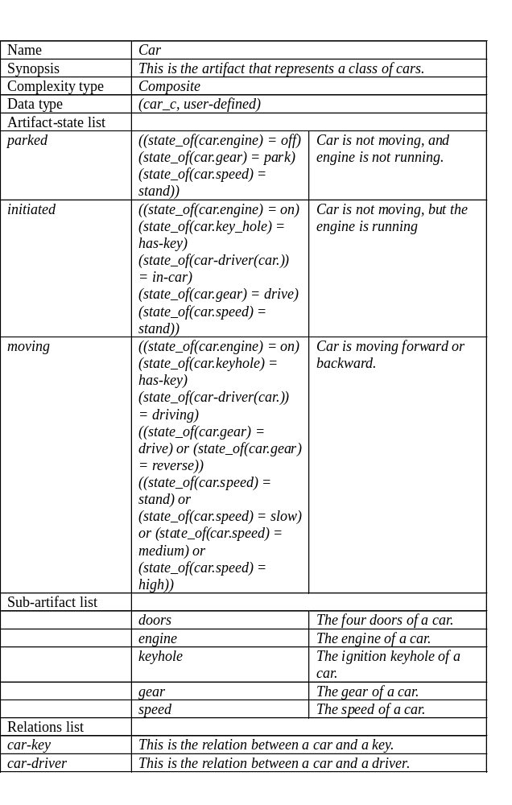
2.3 Tools and Techniques for Process Modeling
Static Modeling: Lai Notation

Slide 31
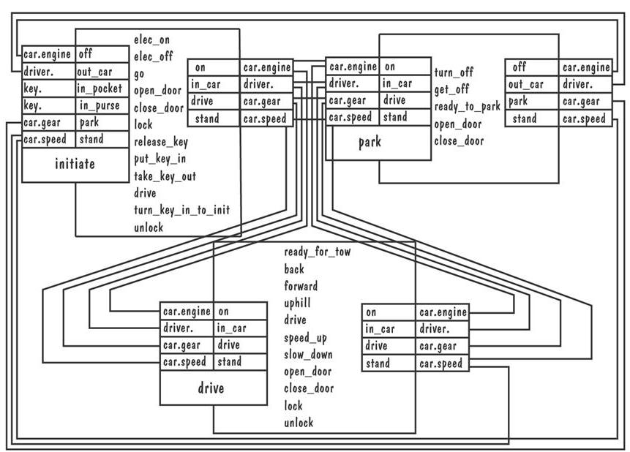
2.3 Tools and Techniques for Process Modeling
Static Modeling: Lai Notation (continued)
The process of starting a car

Slide 32
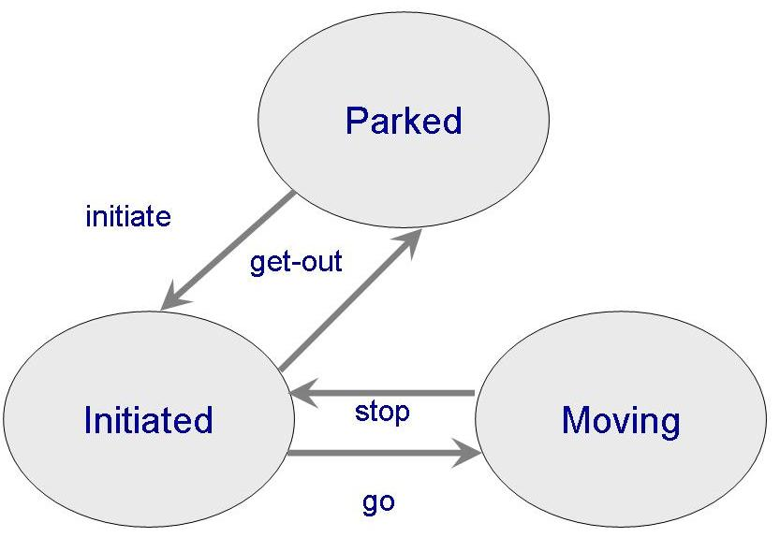
2.3 Tools and Techniques for Process Modeling
Static Modeling: Lai Notation (continued)
Transition diagram illustrates the transition for a car

Slide 33
2.3 Tools and Techniques for Process Modeling
Dynamic Modeling
Enables enaction of process to see what happens to resources and artifacts as activities occur
Simulate alternatives and make changes to improve the process
Example: systems dynamics model

Slide 34
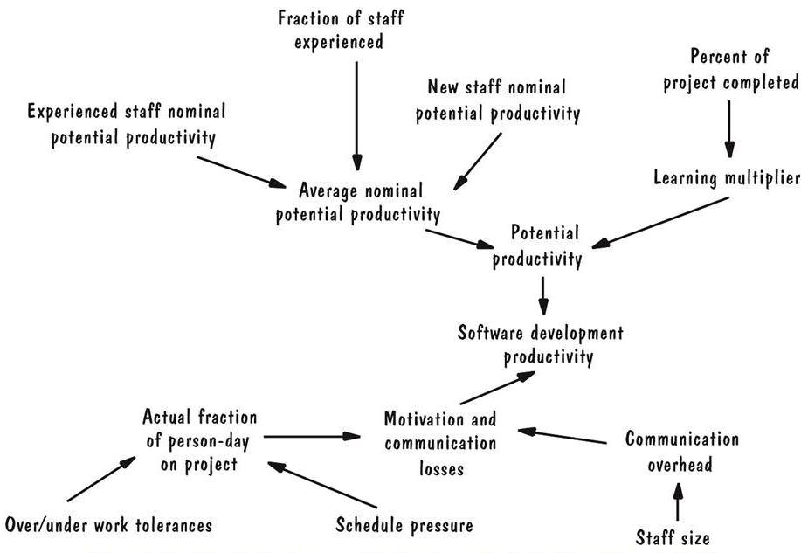
2.3 Tools and Techniques for Process Modeling
Dynamic Modeling: System Dynamics (continued)
Pictorial presentation of factors affecting productivity
Arrows indicate how changes in one factor change another

Slide 35
2.5. Information System Example
Piccadilly Television Advertising System
Needs a system that is easily maintained and changed
Requirements may change
  Waterfall model is not applicable
User interface prototyping is an advantage
There is uncertainty in regulation and business constraints
  Need to manage risks
Spiral model is the most appropriate

Slide 36
2.5. Information System Example
Piccadilly System (continued)
Risk can be viewed in terms of two facets
  Probability: the likelyhood a particular problem may occur
  Severity: the impact it will have on the system
To manage risk, it needs to include characterization of risks in the process model
  Risk is an artifact that needs to be described

Slide 37
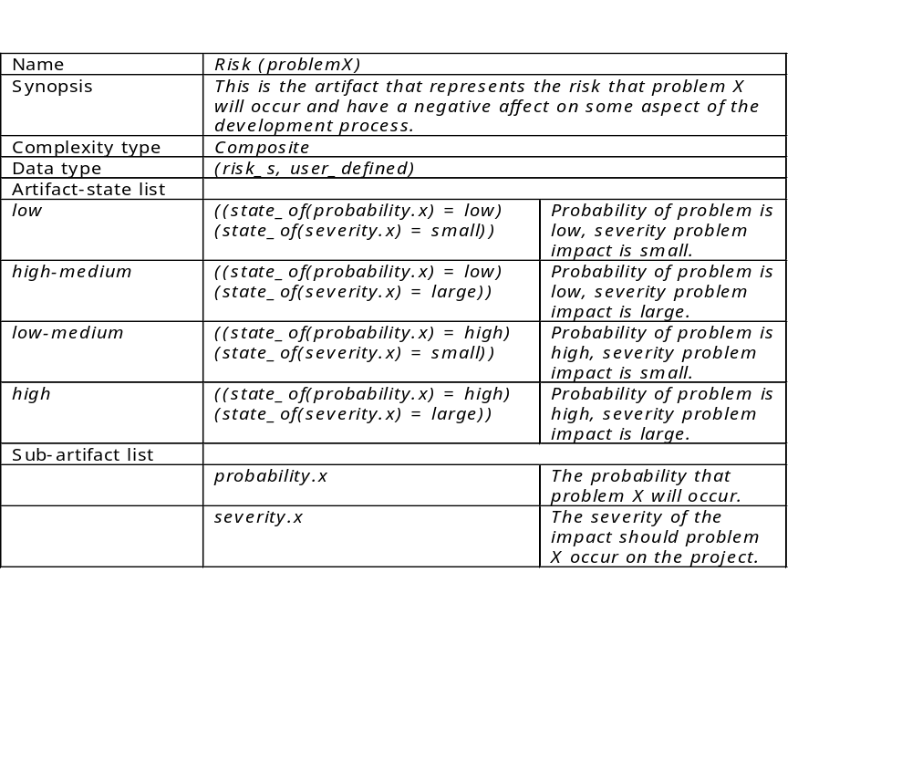
2.5. Information System Example
Lai Artifact Table for Piccadilly System

Slide 38
2.6 Real Time Example
Ariane-5 Software
Involved reuse of software from Ariane-4
The reuse process model
  Identify resuable subprocesses, describe them and place them in a library
  Examine the requirements for the new software and the reusable components from library and produce revised set of requirements
  Use the revised requirements to design the software
  Evaluate all reused design components to certify the correctness and consistency
  Build or change the software

Slide 39
2.7 What this Chapter Means for You
Process development involves activities, resources, and product
Process model includes organizational, functional, behavioral and other prespectives
A process model is useful for guiding team behavior, coordination and collaboration

