Slide 1

Chapter 3
Planning and
Managing
the Project
Shari L. Pfleeger
Joanne M. Atlee
4th Edition

Slide 2
Contents
3.1 Tracking Progress
3.2 Project Personnel
3.3 Effort Estimation
3.4 Risk Management
3.5 The Project Plan
3.6 Process Models and Project Management
3.7 Information System Example
3.8 Real Time Example
3.9 What this Chapter Means for You

Slide 3
Chapter 3 Objectives
Tracking project progress
Project personnel and organization
Effort and schedule estimation
Risk management
Using process modeling with project planning

Slide 4
3.1 Tracking Progress
Do we understand customer’s needs?
Can we design a system to solve customer’s problems or satisfy customer’s needs?
How long will it take to develop the system?
How much will it cost to develop the system?

Slide 5
3.1 Tracking Progress
Project Schedule
Describes the software-development cycle for a particular project by
  enumerating the phases or stages of the project
  breaking each phase into discrete tasks or activities to be completed
Portrays the interactions among the activities and estimates the times that each task or activity will take

Slide 6
3.1 Tracking Progress
Project Schedule: Approach
Understanding customer’s needs by listing all project deliverables
  Documents
  Demonstrations of function
  Demonstrations of subsystems
  Demonstrations of accuracy
  Demonstrations of reliability, performance or security
Determining milestones and activities to produce the deliverables

Slide 7
3.1 Tracking Progress
Milestones and activities
Activity: takes place over a period of time
Milestone: completion of an activity -- a particular point in time
Precursor: event or set of events that must occur in order for an activity to start
Duration: length of time needed to complete an activity
Due date: date by which an activity must be completed

Slide 8
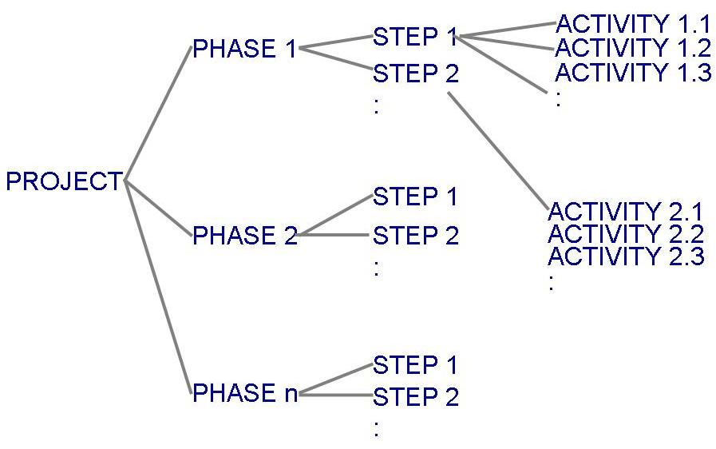
3.1 Tracking Progress
Project Schedule (continued)
Project development can be separated into a succession of phases which are composed of steps, which are composed of activities

Slide 9
3.1 Tracking Progress
Project Schedule (continued)
Table 3.1 shows the phases, steps and activities to build a house
  landscaping phase
  building the house phase
Table 3.2 lists milestones for building the house phase

Slide 10
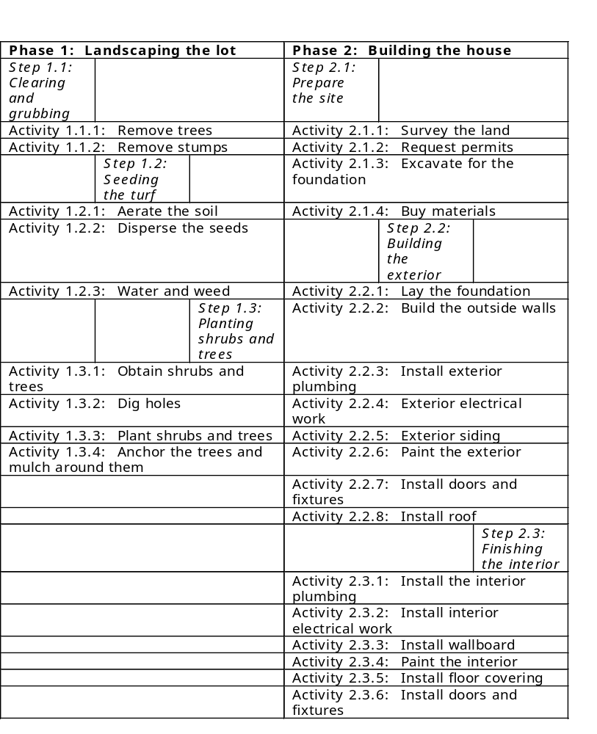
3.1 Tracking Progress
Phases, Steps, and Activities in Building a House

Slide 11
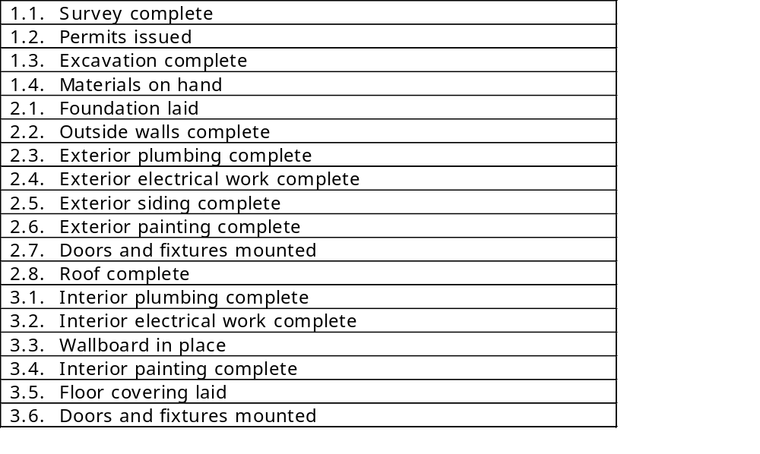
3.1 Tracking Progress
Milestones in Building a House

Slide 12
3.1 Tracking Progress
Work Breakdown and Activity Graphs
Work breakdown structure depicts the project as a set of discrete pieces of work
Activity graphs depict the dependencies among activities
  Nodes: project milestones
  Lines: activities involved

Slide 13
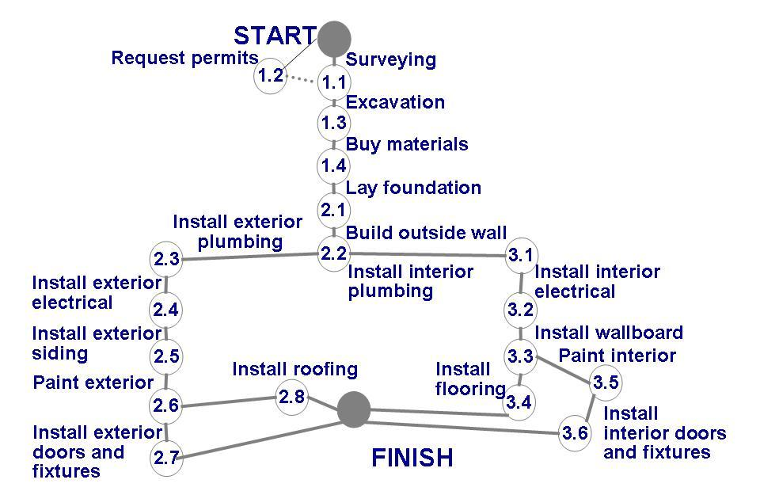
3.1 Tracking Progress
Work Breakdown and Activity Graphs (continued)
Activity graph for building a house

Slide 14
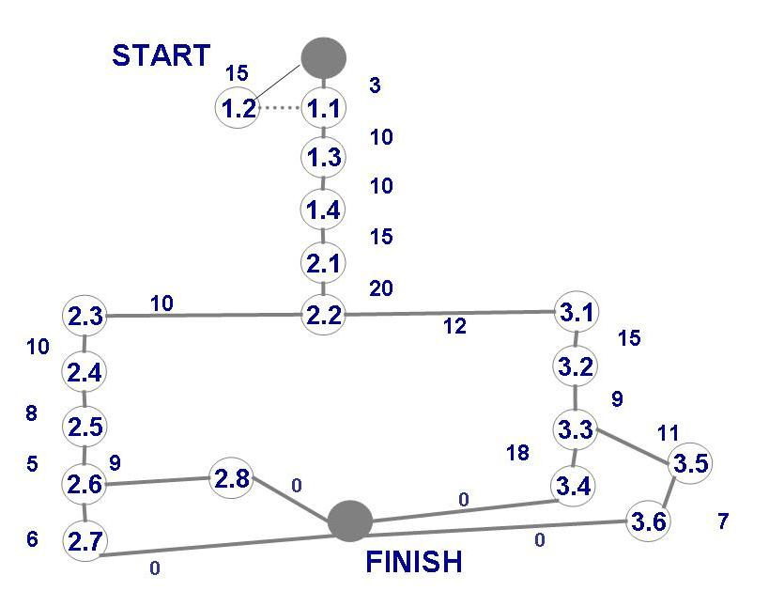
3.1 Tracking Progress
Estimating Completion
Adding estimated time in activity graph of each activity to be completed tells us more about the project's schedule

Slide 15
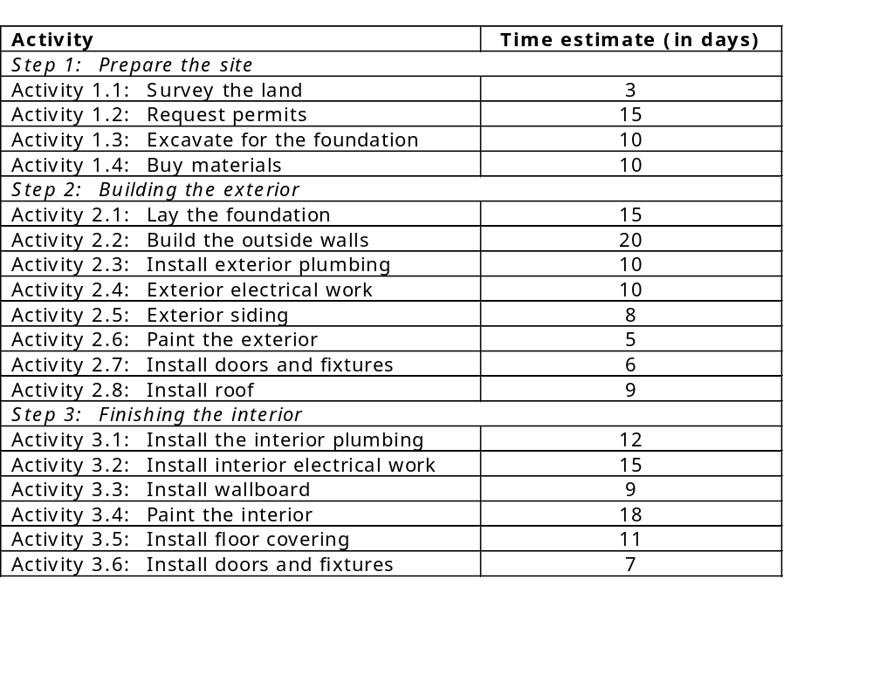
3.1 Tracking Progress
Estimating Completion for Building a House

Slide 16
3.1 Tracking Progress
Critical Path Method (CPM)
Minimum amount of time it will take to complete a project
  Reveals those activities that are most critical to completing the project on time
Real time (actual time): estimated amount of time required for the activity to be completed
Available time: amount of time available in the schedule for the activity's completion
Slack time: the difference between the available time and the real time for that activity

Slide 17
3.1 Tracking Progress
Critical Path Method (CPM) (continued)
Critical path: the slack at every node is zero
  can be more than one in a project schedule
Slack time = available time – real time
= latest start time – earliest start time

Slide 18
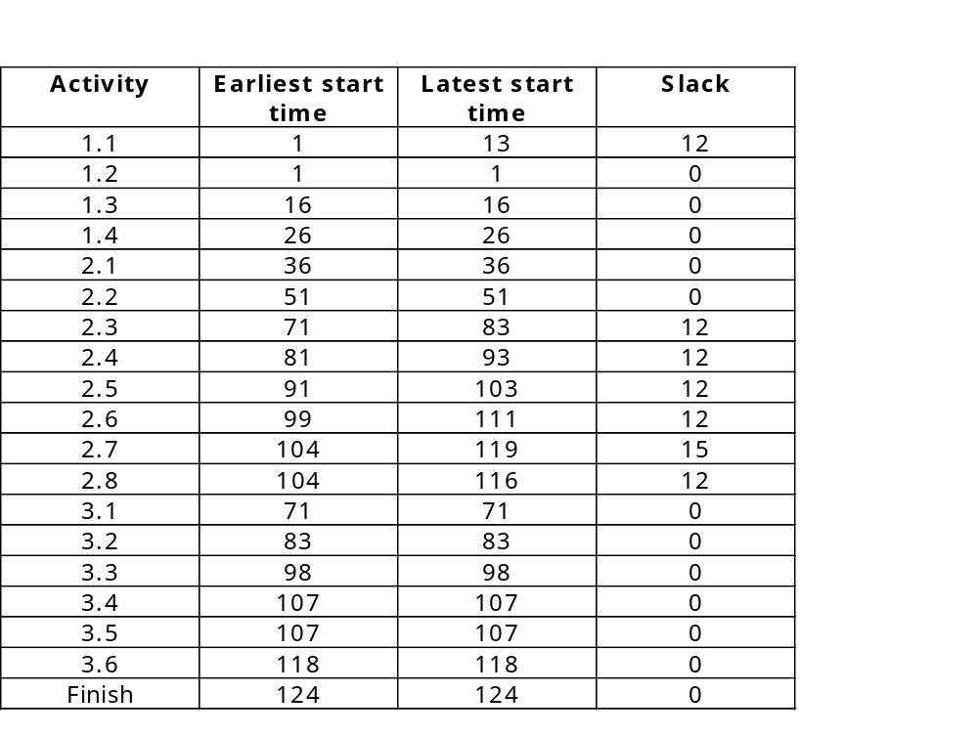
Slack Time for Activities of Building a House

Slide 19
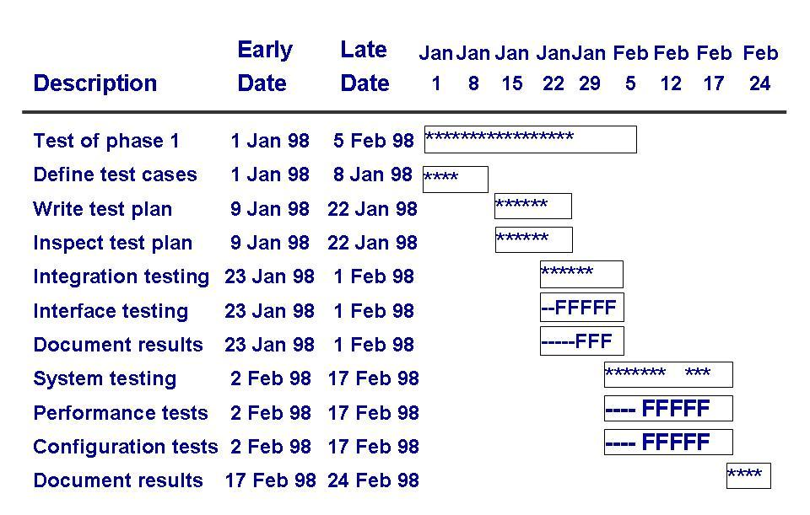
3.1 Tracking Progress
CPM Bar Chart
Including information about the early and late start dates
Asterisks indicate the critical path

Slide 20
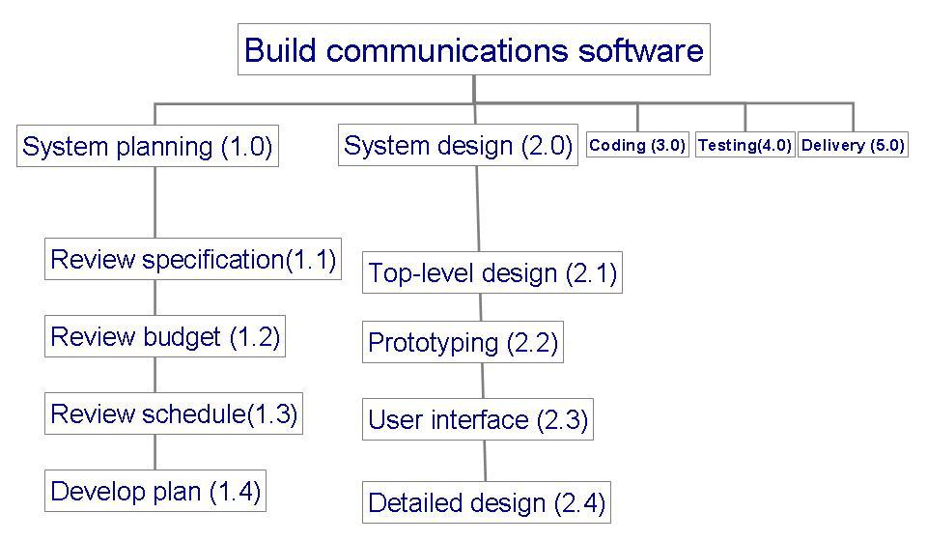
3.1 Tracking Progress
Tools to Track Progress
Example: to track progress of building a communication software

Slide 21
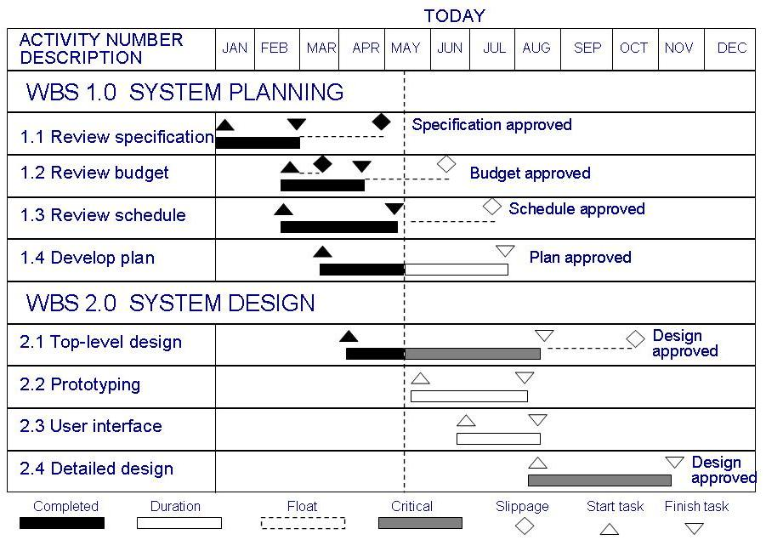
3.1 Tracking Progress
Tools to Track Progress: Gantt Chart
Activities shown in parallel
  helps understand which activities can be performed concurrently

Slide 22
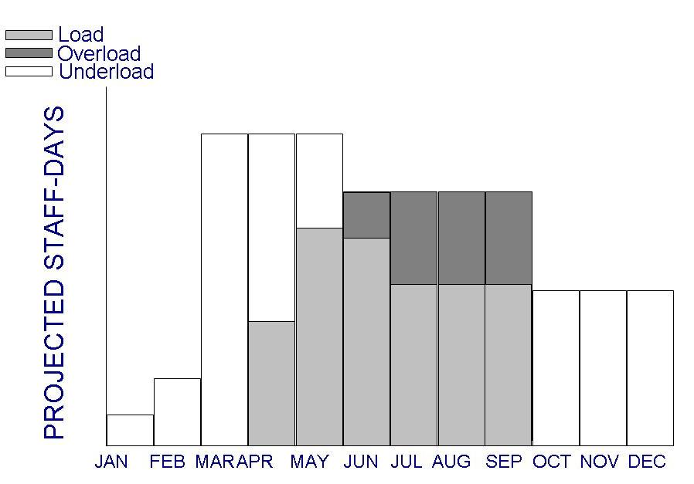
3.1 Tracking Progress
Tools to Track Progress: Resource Histogram
Shows people assigned to the project and those needed for each stage of development

Slide 23
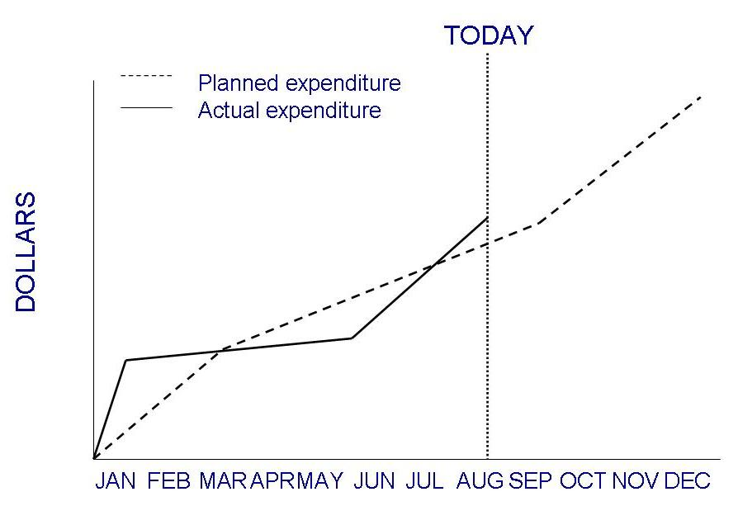
3.1 Tracking Progress
Tools to Track Progress: Expenditures Tracking
An example of how expenditures can be monitored

Slide 24
3.2 Project Personnel
Key activities requiring personnel
  requirements analysis
  system design
  program design
  program implementation
  testing
  training
  maintenance
  quality assurance
There is great advantage in assigning different responsibilities to different people

Slide 25
3.2 Project Personnel
Choosing Personnel
Ability to perform work
Interest in work
Experience with
  similar applications
  similar tools, languages, or techniques
  similar development environments
Training
Ability to communicate with others
Ability to share responsibility
Management skills

Slide 26
3.2 Project Personnel
Communication
A project's progress is affected by
  degree of communication
  ability of individuals to communicate their ideas
Software failures can result from breakdown in communication and understanding

Slide 27
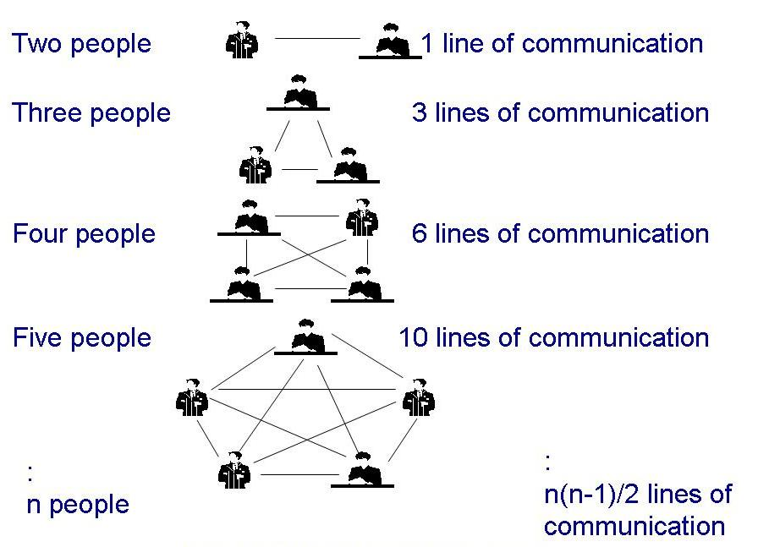
3.2 Project Personnel
Communication (continued)
Line of communication can grow quickly
If there is n worker in project, then there are n(n-1)/2 pairs of communication

Slide 28
3.2 Project Personnel
Sidebar 3.1 Make Meeting Enhance Project Progress
Common complains about meeting
  the purpose is unclear
  the attendees are unprepared
  essential people are late or absent
  the conversation veers away from its purpose
  participants do not discuss, instead argue
  decisions are never enacted afterward
Ways to ensure a productive meeting
  clearly decide who should be in the meeting
  develop an agenda
  have someone who tracks the discussion
  have someone who ensures follow-up actions

Slide 29
3.2 Project Personnel
Work Styles
Extroverts: tell their thoughts
Introverts: ask for suggestions
Intuitives: base decisions on feelings
Rationals: base decisions on facts, options

Slide 30
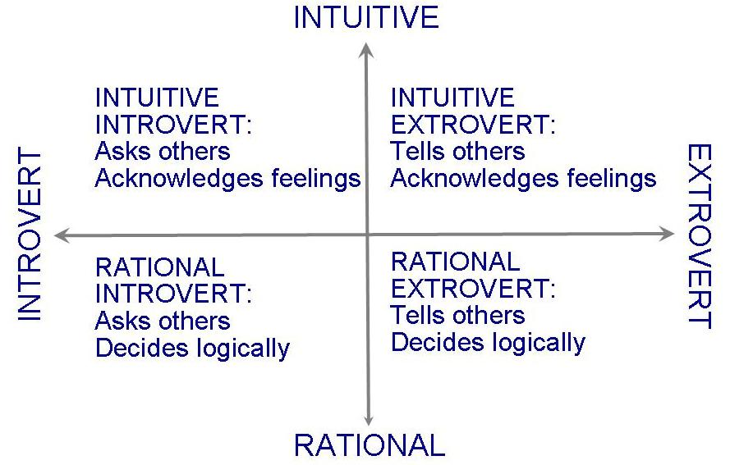
3.2 Project Personnel
Work Styles (continued)
Horizontal axis: communication styles
Vertical axis: decision styles

Slide 31
3.2 Project Personnel
Work Styles (continued)
Work styles determine communication styles
Understanding workstyles
  help to be flexible
  give information based on other's priorities
Impacts interaction among customers, developers and users

Slide 32
3.2 Project Personnel
Project Organization
Depends on
  backgrounds and work styles of team members
  number of people on team
  management styles of customers and developers
Examples:
  Chief programmer team: one person totally responsible for a system's design and development
  Egoless approach: hold everyone equally responsible

Slide 33
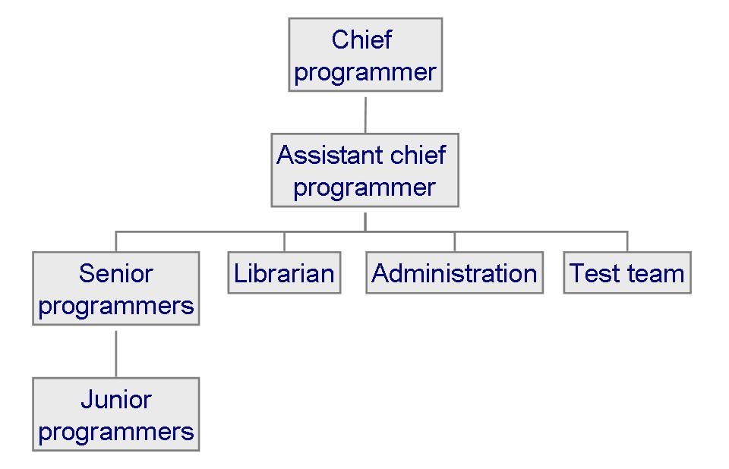
3.2 Project Personnel
Project Organization: Chief Programmer Team
Each team member must communicate often with chief, but not necessarily with other team members

Slide 34
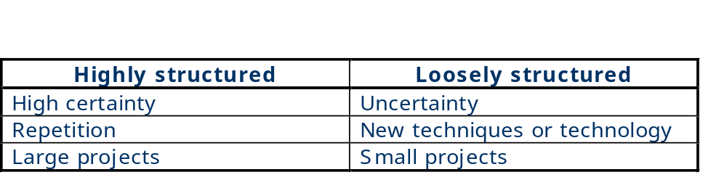
3.2 Project Personnel
Project Organization (continued)
Characteristics of projects and the suggested organizational structure to address them

Slide 35
3.2 Project Personnel
Sidebar 3.2 Structure vs. Creativity
Experiment by Sally Phillip examining two groups building a hotel
  structured team: clearly defined responsibilities
  unstructured team: no directions
The results are always the same
  Structured teams finish a functional Days Inn
  Unstructured teams build a creative, multistoried Taj Mahal and never complete
Good project management means finding a balance between structure and creativity

Slide 36
3.3 Effort Estimation
Estimating project costs is one of the crucial aspects of project planning and management
Estimating cost has to be done as early as possible during the project life cycle
Type of costs
  facilities: hardware, space, furniture, telephone, etc
  software tools for designing software
  staff (effort): the biggest component of cost

Slide 37
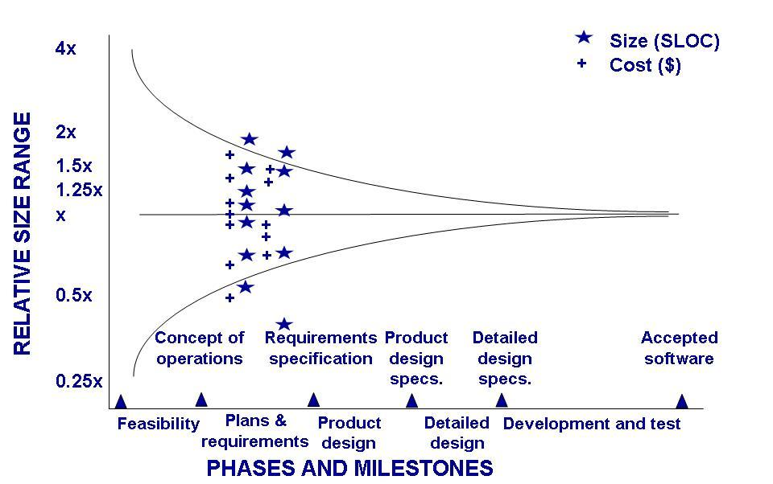
3.3 Effort Estimation
Estimation Should be Done Repeatedly
Uncertainty early in the project can affect the accuracy of cost and size estimations

Slide 38
3.3 Effort Estimation
Sidebar 3.3 Causes of Inaccurate Estimates
Key causes
  Frequent request for change by users
  Overlooked tasks
  User's lack of understanding of the requirements
  Insufficient analysis when developing estimates
  Lack of coordination of system development, technical services, operations, data administration, and other functions during development
  Lack of an adequate method or guidelines for estimating

Slide 39
3.3 Effort Estimation
Sidebar 3.3 Causes of Inaccurate Estimates (continued)
Key influences
  Complexity of the proposed application system
  Required integration with existing system
  Complexity of the program in the system
  Size of the system expressed as number of functions or programs
  Capabilities of the project team members
  Project team's experience with the application, the programming language, and hardware
  Capabilities of the project team members
  Database management system
  Number of project team member
  Extent of programming and documentation standards

Slide 40
3.3 Effort Estimation
Type of Estimation Methods
Expert judgment
  Top-down or bottom-up
  Analogy: pessimistic, optimistic and most likely guess
  Algorithmic methods: E = (a + bS^{c}) m(X)
a, b, c: constants; S: estimated size of the system;
X: vector of cost factors & m: adjustment multiplier
based on these factors
  Walston and Felix model
  Bailey and Basili model

Slide 41
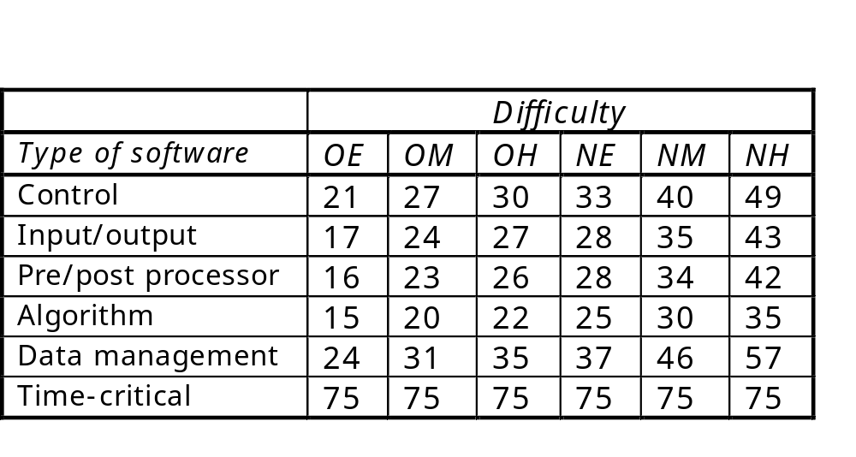
3.3 Effort Estimation
Expert Judgement: Wolverton Model
Two factors that affect difficulty
  whether problem is old (O) or new (N)
  whether it is easy (E) or moderate (M)

Slide 42
3.3 Effort Estimation
Algorithmic Method: Watson and Felix Model
A productivity index is inlcuded in the equation
There are 29 factors that can affect productivity
  1 if increase the productivity
  0 if decrease the productivity

Slide 43
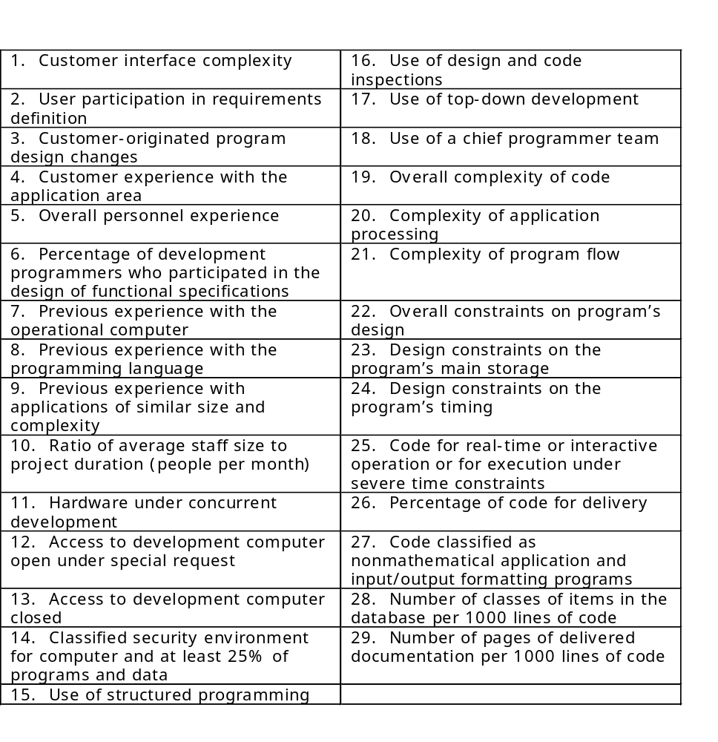
3.3 Effort Estimation
Watson and Felix Model Productivity Factors

Slide 44
3.3 Effort Estimation
COCOMO model
Introduced by Boehm
COCOMO II
  updated version
  include models of reuse
The basic models
  E = bS^{c}m(X)
  where
    bS^{c} is the initial size-based estimate
    m(X) is the vector of cost driver information

Slide 45
3.3 Effort Estimation
COCOMO II: Stages of Development
Application composition
  prototyping to resolve high-risk user interface issues
  size estimates in object points
Early design
  to explore alternative architectures and concepts
  size estimates in function points
Postarchitecture
  development has begun
  size estimates in lines of code

Slide 46
3.3 Effort Estimation
COCOMO II: Estimate Application Points
To compute application points, first we need to count the number of screens, reports and programming language used to determine the complexity level
For Screens
For Reports
Number and source of data tables
Number and source of data tables
Number of
Total < 4
Total < 8
Total 8+
Number of
Total < 4
Total < 8
Total 8+
views
(<2
(2-3
(>3
sections
(<2
(2-3
(>3
contained
server,
server,
server, >5
contained
server,
server, 3-
server,
<3
3-5
client)
<3
5 client)
>5
client)
client)
client)
client)
<3
simple
simple
medium
0 or 1
simple
simple
medium
3 - 7
simple
medium
difficult
2 or 3
simple
medium
difficult
8 +
medium
difficult
difficult
4 +
medium
difficult
difficult

Slide 47
3.3 Effort Estimation
COCOMO II: Estimate Application Point (continued)
Determine the relative effort required to implement a report or screen simple, medium or difficult
Calculate the productivity factor based on developer experience and capability
Determine the adjustment factors expressed as multipliers based on rating of the project

Slide 48
3.3 Effort Estimation
Complexity Weights for Application Points
Object type
Simple
Medium
Difficult
Screen
1
2
3
Report
2
5
8
3GL component
-
-
10

Slide 49
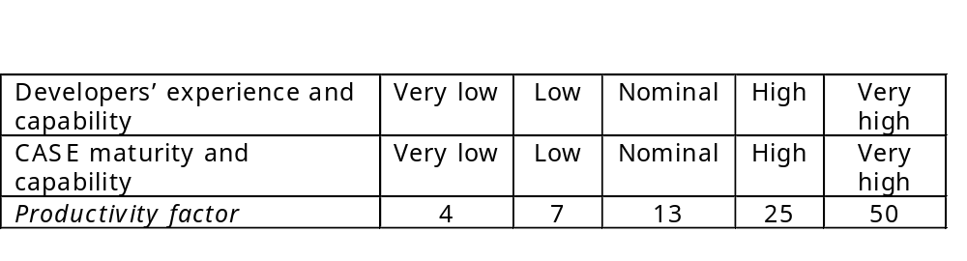
3.3 Effort Estimation
Productivity Estimate Calculation

Slide 50
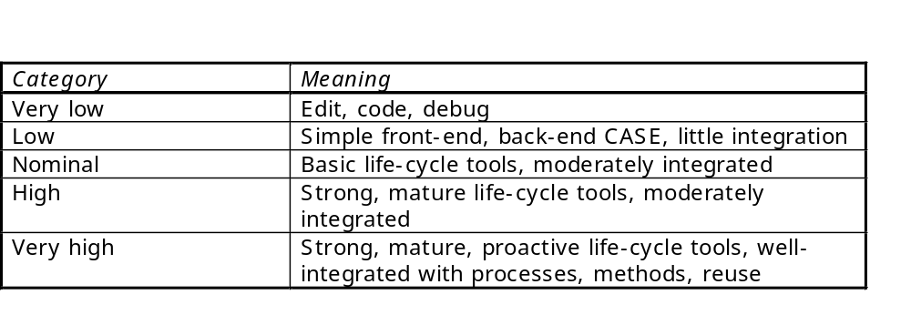
3.3 Effort Estimation
Tool Use Categories

Slide 51
3.3 Effort Estimation
Machine Learning Techniques
Example: case-based reasoning (CBR)
  user identifies new problem as a case
  system retrieves similar cases from repository
  system reuses knowledge from previous cases
  system suggests solution for new case
Example: neural network
  cause-effect network “trained” with data from past history

Slide 52
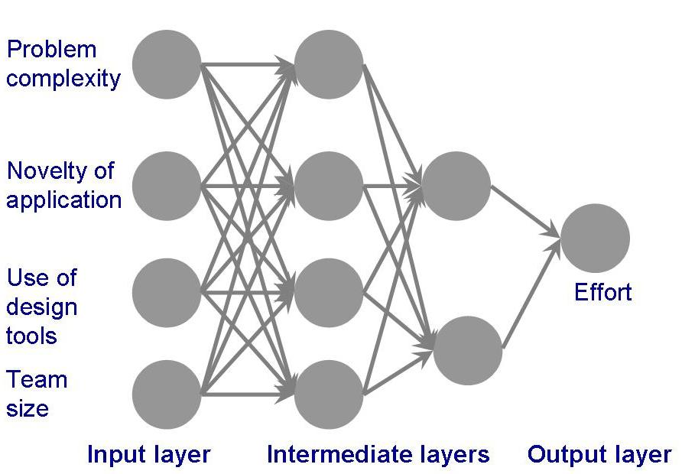
3.3 Effort Estimation
Machine learning techniques: Neural Network
Neural network used by Shepperd to produce effort estimation

Slide 53
3.3 Effort Estimation
Machine Learning Techniques: CBR
Involves four steps
  the user identifies a new problem as a case
  the system retrieves similar case from a respository of historical information
  the system reuses knowledge from previous case
  the system suggests a solution for the new case
Two big hurdles in creating successful CBR system
  characterizing cases
  determining similarity

Slide 54
3.4 Risk Management
What is a Risk?
Risk is an unwanted event that has negative consequences
Distinguish risks from other project events
  Risk impact: the loss associated with the event
  Risk probability: the likelihood that the event will occur
Quantify the effect of risks
  Risk exposure = (risk probability) x (risk impact)
Risk sources: generic and project-specific

Slide 55
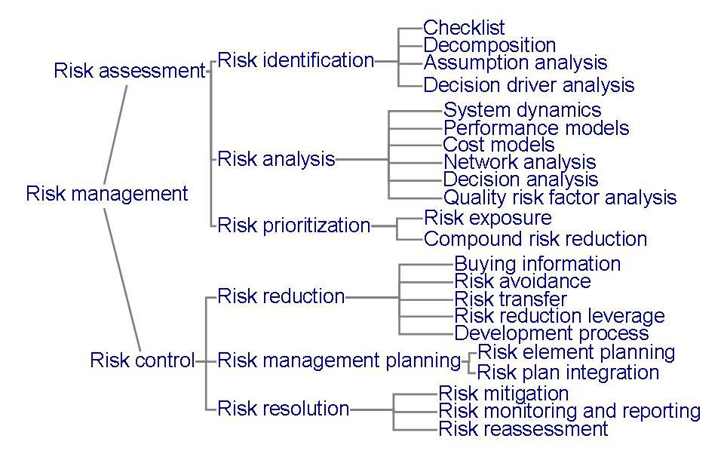
3.4 Risk Management
Risk Management Activities

Slide 56
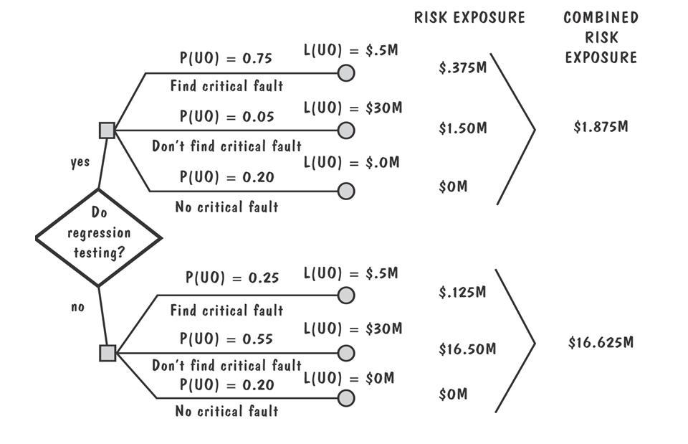
3.4 Risk Management
Risk Management Activities (continued)
Example of risk exposure calculation
  PU: prob. of unwanted outcome
  LU: lost assoc with unwanted outcome

Slide 57
3.4 Risk Management
Risk Management Activities (continued)
Three strategies for risk reduction
  Avoiding the risk: change requirements for performance or functionality
  Transferring the risk: transfer to other system, or buy insurance
  Assuming the risk: accept and control it
Cost of reducing risk
  Risk leverage = (risk exposure before reduction – risk exposure after reduction) / (cost of risk reduction)

Slide 58
3.4 Risk Management
Sidebar 3.4 Boehm’s Top Ten Risk Items
Personnel shortfalls
Unrealistic schedules and budgets
Developing the wrong functions
Developing the wrong user interfaces
Gold-plating
Continuing stream of requirements changes
Shortfalls in externally-performed tasks
Shortfalls in externally-furnished components
Real-time performance shortfalls
Straining computer science capabilities

Slide 59
3.5 Project Plan
Project Plan Contents
Project scope
Project schedule
Project team organization
Technical description of system
Project standards and procedures
Quality assurance plan
Configuration management plan
Documentation plan
Data management plan
Resource management plan
Test plan
Training plan
Security plan
Risk management plan
Maintenance plan

Slide 60
3.5 Project Plan
Project Plan Lists
List of the people in development team
List of hardware and software
Standards and methods, such as
  algorithms
  tools
  review or inspection techniques
  design language or representaions
  coding languages
  testing techniques

Slide 61
3.7 Information System Example
Piccadilly System
Using COCOMO II
Three screens and one report
  Booking screen: complexity simple, weight 1
  Ratecard screen: complexity simple, weigth 1
  Availability screen: complexity medium, weight 2
  Sales report: complexity medium, weight 5
Estimated effort = 182 person-month

Slide 62
3.8 Real Time Example
Ariane-5 System
The Ariane-5 destruction might have been prevented had the project managers developed a risk management plan
  Risk identification: possible problem with reuse of the Ariane-4)
  Risk exposure: prioritization would have identified if the inertial reference system (SRI) did not work as planned
  Risk control: assesment of the risk using reuse software
  Risk avoidance: using SRI with two different designs

Slide 63
3.7 What this Chapter Means for You
Key concepts in project management
  Project planning
  Cost and schedule estimation
  Risk management
  Team Organization
Project planning involves input from all team members
Communication path grows as the size of the team increases and need to be taken into account when planning and estimating schedule

