Slide 1

Chapter 5
Designing
the Architecture
Shari L. Pfleeger
Joanne M. Atlee
4th Edition

Slide 2
Contents
5.1 The Design Process
5.2 Modeling Architectures
5.3 Decomposition and Views
5.4 Architectural Styles and Strategies
5.5 Achieving Quality Attributes
5.6 Collaborative Design
5.7 Architecture Evaluation and Refinement
5.8 Documenting Software Architectures
5.9 Architecture Design Review
5.10 Software Product Lines
5.11 Information System Example
5.12 Real-Time Example
5.13 What this Chapter Means for you

Slide 3
Chapter 5 Objectives
Examine different types of decomposition
Compare competing designs
Document the design
Verify architecture meets the requirements

Slide 4
5.1 The Design Process
Design is the creative process of figuring out how to implement all of the customer’s requirements; the resulting plan is also called the design
Early design decisions address the system’s architecture
Later design decisions address how to implement the individual units

Slide 5
5.1 The Design Process
Design is a Creative Process
Design is an intellectually challenging task
  Numerous possibilities the system must accommodate
  Nonfunctional design goals (e.g., ease of use, ease to maintain)
  External factors (e.g., standard data formats, government regulations)
We can improve our design by studying examples of good design
Most design work is routine design, solve problem by reusing and adapting solutions from similar problems

Slide 6
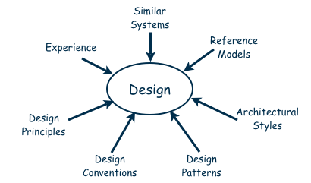
5.1 The Design Process
Design is a Creative Process (continued)
Many ways to leverage existing solutions
  Cloning: Borrow design/code in its entirety, with minor adjustments
  Reference models: Generic architecture that suggests how to decompose the system

Slide 7
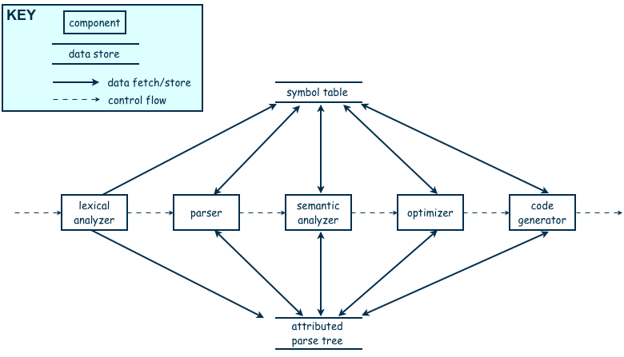
5.1 The Design Process
Design is a Creative Process (continued)
Reference model for a compiler

Slide 8
5.1 The Design Process
Design is a Creative Process (continued)
More typically, a reference model will not exist for the problem
Software architectures have generic solutions too, referred to as architectural styles
  Focusing on one architectural style can create problems
  Good design is about selecting, adapting, and integrating several architectural design styles to produce the desired result

Slide 9
5.1 The Design Process
Design is a Creative Process (continued)
Many tools for understanding options and evaluating chosen architecture, including:
  Design patterns: generic solutions for making lower-level design decisions
  Design convention or idiom: collection of design decisions and advice that, taken together, promotes certain design qualities
  Design principles: descriptive characteristics of good design

Slide 10
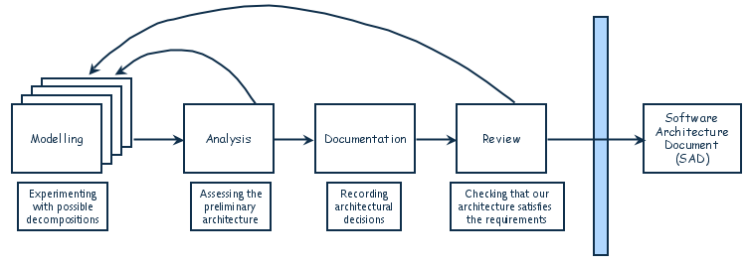
5.1 The Design Process
Design Process Model
Designing software system is an iterative process
The final outcome is the software architecture document (SAD)

Slide 11
5.2 Modeling Architectures
Collection of models helps to answer whether the proposed architecture meets the specified requirements
Six ways to use the architectural models:
  to understand the system
  to determine amount of reuse from other systems and the reusability of the system being designed
  to provide blueprint for system construction
  to reason about system evolution
  to analyze dependencies
  to support management decisions and understand risks

Slide 12
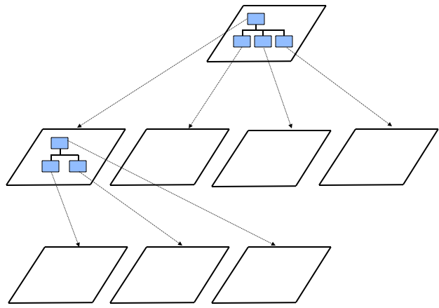
5.3 Decomposition and Views
High-level description of system’s key elements
Creating a hierarchy of information with increasing details
Top
level
First level of
decomposition
Second level of
decomposition

Slide 13
5.3 Decomposition and Views
Popular Design Methods
Some design problems have no existing solutions
  Designers must decompose to isolate key problems
Some popular design methods:
  Functional decomposition
  Feature-oriented decomposition
  Object-oriented design

Slide 14
5.3 Decomposition and Views
Popular Design Methods
Functional decomposition
  partitions functions or requirements into modules
  begins with the functions that are listed in the requirements specification
  lower-level designs divide these functions into subfunctions, which are then assigned to smaller modules
  describes which modules (subfunctions) call each other

Slide 15
5.3 Decomposition and Views
Popular Design Methods
  Feature-oriented decomposition
  assigns features to modules
  high-level design describes the system in terms of a service and a collection of features
  lower-level designs describe how each feature augments the service and identifies interactions among features

Slide 16
5.3 Decomposition and Views
Popular Design Methods
  Object-oriented decomposition
  assigns objects to modules
  high-level design identifies the system’s object types and explains how objects are related to one another
  lower-level designs detail the objects’ attributes and operations

Slide 17
5.3 Decomposition and Views
Popular Design Methods (continued)
A design is modular when each activity of the system is performed by exactly one software unit, and when the inputs and outputs of each software unit are well-defined
A software unit is well-defined if its interface accurately and precisely specifies the unit’s externally visible behavior

Slide 18
5.3 Decomposition and Views
Architectural Views
Common types of architectural views include:
  Dependencies view
  Generalization view
  Work-assignment view

Slide 19
5.3 Decomposition and Views
Dependencies View
The dependencies view shows dependencies among software units
This view is useful in project planning
Also useful for assessing the impact of making a design change to some software unit

Slide 20
5.3 Decomposition and Views
Generalization View
The generalization view shows software units that are generalizations or specializations of one another
This view is useful when designing abstract or extendible software units

Slide 21
5.3 Decomposition and Views
Work-assignment View
The work-assignment view decomposes the system’s design into work tasks that can be assigned to project teams
Helps project managers plan and allocate project resources, as well as track each team’s progress

Slide 22
5.4 Architectural Styles and Strategies
Pipes-and-Filter
Client-Server
Peer-to-Peer
Publish-Subscribe
Repositories

Slide 23
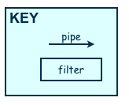
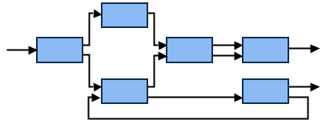
5.4 Architectural Styles and Strategies
Pipes-and-Filter
The system has
  Streams of data (pipe) for input and output
  Transformation of the data (filter)
  The designer can understand the entire system's effect on input and output as the composition of the filters
  The filters can be reused easily on other systems
  System evolution is simple
  Encourages batch processing
  Not good for handling interactive application
KEY
pipe

Slide 24
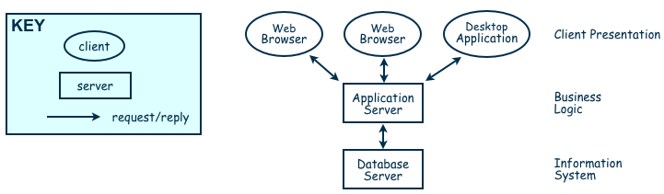
5.4 Architectural Styles and Strategies
Client-Server
Two types of components:
  Server components offer services
  Clients access them using a request/reply protocol
Client may send the server an executable function, called a callback
  The server subsequently calls under specific circumstances

Slide 25
5.4 Architectural Styles and Strategies
Peer-to-Peer (P2P)
Each component acts as its own process and acts as both a client and a server to other peer components.
Any component can initiate a request to any other peer component.
Characteristics
  Scale up well
  Increased system capabilities
  Highly tolerant of failures
Examples: Napster and Freenet

Slide 26
5.4 Architectural Styles and Strategies
Publish-Subscribe
Components interact by broadcasting and reacting to events
  Component expresses interest in an event by subscribing to it
  When another component announces (publishes) that event has taken place, subscribing components are notified
  Implicit invocation is a common form of publish-subscribe architecture
    Registering: subscribing component associates one of its procedures with each event of interest (called the procedure)
Characteristics
  Strong support for evolution and customization
  Easy to reuse components in other event-driven systems
  Need shared repository for components to share persistent data
  Difficult to test

Slide 27
5.4 Architectural Styles and Strategies
Repositories
Two components
  A central data store
  A collection of components that operate on it to store, retrieve, and update information
The challenge is deciding how the components will interact
  A traditional database: transactions trigger process execution
  A blackboard: the central store controls the triggering process
  Knowledge sources: information about the current state of the system’s execution that triggers the execution of individual data accessors

Slide 28
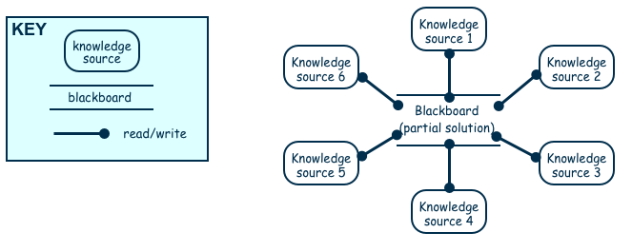
5.4 Architectural Styles and Strategies
Repositories (continued)
Major advantage: openness
  Data representation is made available to various programmers (vendors) so they can build tools to access the repository
  But also a disadvantage: the data format must be acceptable to all components

Slide 29
5.4 Architectural Styles and Strategies
Combining Architectural Styles
Actual software architectures rarely based on purely one style
Architectural styles can be combined in several ways
  Use different styles at different layers (e.g., overall client-server architecture with server component decomposed into layers)
  Use mixture of styles to model different components or types of interaction (e.g., client components interact with one another using publish-subscribe communications
If architecture is expressed as collection of models, documentation must be created to show relation between models

Slide 30
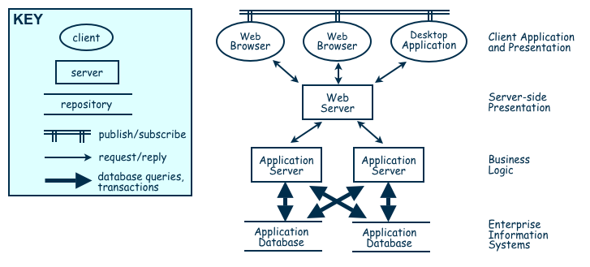
5.4 Architectural Styles and Strategies
Combination of Publish-Subscribe, Client-Server, and Repository Architecture Styles

Slide 31
5.5 Achieving Quality Attributes
Architectural styles provide general beneficial properties. To support specific quality attribute tactics are utilized:
  Modifiability
  Performance
  Security
  Reliability
  Robustness
  Usability
  Business goals

Slide 32
5.5 Achieving Quality Attributes
Modifiability
Design must be easy to change
Two classifications of affected software units:
  Directly affected
  Indirectly affected
Directly affected units’ responsibilities change to accommodate a system modification
Indirectly affected units’ responsibilities do not change, but implementations must be revised

Slide 33
5.5 Achieving Quality Attributes
Modifiability (continued)
Tactics for minimizing the number of software units affected by a change focus on clustering the anticipated changes:
  Anticipate expected changes: Identify design decisions that are most likely to change, and encapsulate each in its own software unit
  Cohesion: Keeping software units highly cohesive increases the chances that a change to the system’s responsibilities is confined to the few units that are assigned those responsibilities
  Generality : The more general the software units, the more likely change can be accommodated by modifying a unit’s inputs rather than modifying the unit itself

Slide 34
5.5 Achieving Quality Attributes
Modifiability (continued)
Tactics for minimizing the impact on indirectly affected units focus on reducing dependencies
  Coupling: Lowering coupling reduces the likelihood that a change to one unit will ripple to other units
  Interfaces: If a unit interacts with other units only through their interfaces changes to one unit will not spread beyond the unit’s boundary unless its interface changes
  Multiple interfaces: A unit modified to provide new data or services can offer them using a new interface to the unit without changing any of the unit’s existing interfaces

Slide 35
5.5 Achieving Quality Attributes
Performance
Performance attributes describe constraints on system speed and capacity:
  Response time: How fast does our software respond to requests?
  Throughput: How many requests can it process per minute?
  Load: How many users can it support before response time and throughput start to suffer?

Slide 36
5.5 Achieving Quality Attributes
Performance
Tactics for improving performance include:
  Improve utilization of resources
  Manage resource allocation more effectively
    First-come/first-served: Requests are processed in the order in which they are received
    Explicit priority: Requests are processed in order of their assigned priorities
    Earliest deadline first: Requests are processed in order of their impending deadlines
  Reduce demand for resources

Slide 37
5.5 Achieving Quality Attributes
Security
Two key architectural characteristics particularly relevant to security: immunity and resilience
Immunity: ability to thwart an attempted attack
  The architecture encourages immunity by:
    Ensuring all security features are included in the design
    Minimizing exploitable security weaknesses
Resilience: ability to recover quickly and easily from an attack
  The architecture encourages resilience by:
    Segmenting functionality to contain attack
    Enabling the system to quickly restore functionality

Slide 38
5.5 Achieving Quality Attributes
Reliability
A software system is reliable if it correctly performs its required functions under assumed conditions
  Is the software internally free of errors?
A fault is the result of human error, compared to a failure, which is an observable departure from required behavior
  Software is made more reliable by preventing or tolerating faults

Slide 39
5.5 Achieving Quality Attributes
Robustness
A system is robust if it includes mechanisms for accommodating or recovering from problems in the environment or in other unit
Mutual suspicion: each software unit assumes that the other units contain faults
Robustness tactics differ from reliability tactics
Recovery tactics are similar:
  Rollback to checkpoint state
  Abort a transaction
  Initiate a backup unit
  Provide reduced service
  Correct symptoms and continue processing
  Trigger an exception

Slide 40
5.5 Achieving Quality Attributes
Usability
Usability reflects the ease in which a user is able to operate the system
  User interface should reside in its own software unit
  Some user-initiated commands require architectural support
  There are some system-initiated activities for which the system should maintain a model of its environment

Slide 41
5.5 Achieving Quality Attributes
Business Goals
Business Goals are quality attributes the system is expected to exhibit (e.g., minimizing the cost of development and time to market)
  Buy vs. Build
    Save development time, money
    More reliable
    Existing components create constraints; vulnerable to supplier
  Initial development vs. maintenance costs
    Save money by making system modifiable
    Increased complexity may delay release; lose market to competitors
  New vs. known technologies
    Acquiring expertise costs money, delays product release
    Either learn how to use the new technology or hire new personnel
    Eventually, we must develop the expertise ourselves

Slide 42
5.7 Architecture Evaluation and Refinement
Design is iterative: we propose design decisions, assess, make adjustments, and propose more decisions
Many techniques to evaluate the design:
  Measuring design quality
  Safety analysis
  Security analysis
  Trade-off analysis
  Cost-benefit analysis
  Prototyping

Slide 43
5.7 Architecture Evaluation and Refinement
Safety Analysis
Several techniques during design to identify possible faults
Fault-tree analysis traces backwards through a design
  Trees then used to determine which faults to correct/avoid/tolerate
  Data-flow graph: depicts the transfer of data from one process to another
  Control-flow graph: depicts possible transfer of control among software units

Slide 44
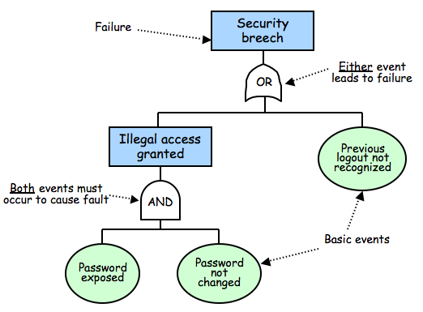
5.7 Architecture Evaluation and Refinement
Safety Analysis (continued)

Slide 45
5.7 Architecture Evaluation and Refinement
Safety Analysis (continued)
Once fault tree is constructed we search for weaknesses
Cut-set tree reveals event combinations can cause failure
  Rules for forming cut-set tree:
    Assign the top node of the cut-set tree to match the logic gate at the top of the fault tree.
    Working from the top down, expand the cut-set tree as follows:
      Expand an or-gate node to have two children, one for each or-gate child
      Expand an and-gate node to have a child composition node listing both of the and-gate children
      Expand a composition node by propagating the node to its children, but expanding one of the gates listed in the node
    Continue until all leaf nodes are basic events or composition nodes of basic events

Slide 46
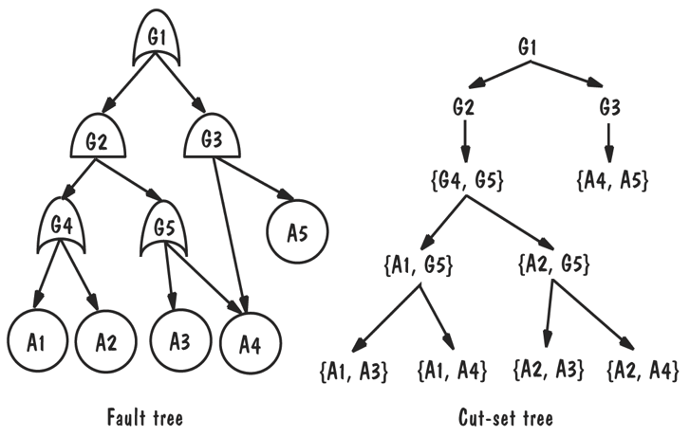
5.7 Architecture Evaluation and Refinement
Safety Analysis (continued)
Once fault is found in design:
  Correct the fault
  Add components or conditions to prevent
  Add components that detect fault and recover from damage

Slide 47
5.7 Architecture Evaluation and Refinement
Trade-off Analysis
Often several alternative designs to consider
  professional duty to explore design alternatives and not simply implement the first design that comes to mind
  different members of design team may promote competing designs
  need a measurement-based method for comparing design alternatives

Slide 48
5.7 Architecture Evaluation and Refinement
Cost-Benefit Analysis
A cost–benefit analysis is a widely used business tool for estimating and comparing the costs and benefits of a proposed change

Slide 49
5.7 Architecture Evaluation and Refinement
Cost-Benefit Analysis and Computing Benefits
A cost–benefit analysis is a widely used business tool for estimating and comparing the costs and benefits of a proposed change
A cost-benefit analysis contrasts financial benefits with financial costs
  Costs are one time capital expense
  Benefits accrue overtime
Return on Investment (ROI)
  ROI = Benefits/Cost
Payback period
  the length of time before accumulative benefits recover the costs of implementation

Slide 50
5.8 Documenting Software Architectures
System's architecture is vital to overall development and serves as the basis on decisions for:
  Design
  Quality assurance
  Project management
The SAD serves as the repository for design information and includes:
  System overview
  Views
  Software units
  Analysis data and results
  Design rationale
  Definitions, glossary, acronyms

Slide 51
5.9 Architecture Design Review
Design review is an essential part of engineering practice
SAD quality is evaluated in two ways:
  Validation: making sure the design satisfies all of the customer’s requirements (i.e., is this the right system?)
  Verification: ensuring the design adheres to good design principles (i.e., are we building the system right?)

Slide 52
5.9 Architecture Design Review
Validation
Several key people included in review:
  The analyst(s) who helped define the system requirements
  The system architect(s)
  The program designer(s) for this project
  A system tester
  A system maintainer
  A moderator
  A recorder
  Other interested developers not otherwise involved in this project

Slide 53
5.9 Architecture Design Review
Verification
Judge whether it adheres to good design principles:
  Is the architecture modular, well structured, and easy to understand?
  Can we improve the structure and understandability of the architecture?
  Is the architecture portable to other platforms?
  Are aspects of the architecture reusable?
  Does the architecture support ease of testing?
  Does the architecture maximize performance, where appropriate?
  Does the architecture incorporate appropriate techniques for handling faults and preventing failures?
  Can the architecture accommodate all of the expected design changes and extensions that have been documented?

Slide 54
5.9 Architecture Design Review
Verification (continued)
Active design review: exercise the design document by using is in ways the developers will use the final document in practice
Passive review process: reading the documentation and looking for problems

Slide 55
5.10 Software Product Lines
Organizations can find success by reusing their expertise and software assets across families of related products
The corporate strategy for designing and developing the related products is based on the reuse of elements of a common product line
A distinguishing feature of building a product line is the treatment of the derived products as a product family; their simultaneous development is planned from the beginning
The family’s commonalities are described as a collection of reusable assets (including requirements, designs, code, and test cases), all stored in a core asset base

Slide 56
5.10 Software Product Lines
Core Asset Base
Candidate elements in a core asset base:
  Requirements
  Software architecture
  Models and analysis results
  Software units
  Testing
  Project planning
  Team organization

Slide 57
5.10 Software Product Lines
Strategic Scoping
Product lines are based not just on commonalities among products but also on the best way to exploit them
  First, employ strategic business planning to identify the family of products we want to build, using knowledge and good judgment to forecast market trends and predict the demand for various products
  Second, scope the plans, so that the focus is on products that have enough in common to warrant a product-line approach to development. That is, the cost of developing the (common) product line must be more than offset by the savings we expect to accrue from deriving family members from the product line

Slide 58
5.10 Software Product Lines
Sidebar 5.8 Product-line Productivity
CelsiusTech AB, a Swedish naval defense contractor, motivated by desperation, transitioned from custom to product-line development. In 1985, the company, then Philips Elektronikindustier AB, was awarded two major contracts simultaneously, one for the Swedish Navy and one for the Danish Navy.
  senior managers questioned whether they would be able to meet the demands of both contracts, particularly the promised (and fixed) schedules and budgets, using the company’s current practices and technologies.
Development of the product line and the first system were initiated at the same time; development of the second system started six months later. The two systems plus the product line were completed using roughly the same amount of time and staff that was needed previously for a single product. Subsequent products had shorter development timelines. On average, 70–80 percent of the seven systems’ software units were product-line units (re)used as is.

Slide 59
5.10 Software Product Lines
Advantages of Product-Line Architecture
A product lines promotes planned modifiability
Examples of product-line variability:
  Component replacements
  Component specializations
  Product-line parameters
  Architecture extensions and retractions

Slide 60
5.10 Software Product Lines
Product-Line Evolution
Key contributor to product-line success is having a product-line mindset
  Company’s primary focus is development and evolution of product-line assets as opposed to individual products
  Changes made to improve capability to derive products
  Backwards capability

Slide 61
5.11 Information System Example
Piccadilly System
What might be a suitable architecture for the Piccadilly systems?
Key components
  A repository of information
  Address multiple heterogeneous queries
A typical reference architecture for an information system
  n-tiered client-server architecture

Slide 62
5.12 Real-Time Example
Ariane-5 Failure
Inquiry found that the Ariane program had a “culture...of only addressing random hardware failures” and assuming the software was correct
Hardware failures are independent of one another
Software faults tend to be logical
  All redundant components will have the same faults
Redundancy in Ariane-5 is likely to recover only from hardware failures

Slide 63
5.13 What This Chapter Means For You
Systems need to be designed based on carefully expressed requirements
Design begins with a high-level architecture, where architectural decisions are based not only on system functionality and required constraints but also on desirable attributes and the long-term intended use of the system (including product lines, reuse, and likely modification)
Keep in mind several characteristics of good architecture as you go, including appropriate user interfaces, performance, modularity, security, and fault tolerance
The goal is not to design the ideal software architecture for a system, because such an architecture might not even exist. Rather, the goal is to design an architecture that meets all of the customer’s requirements while staying within the cost and schedule constraints

