Slide 1

Chapter 6
Designing the
Modules
Shari L. Pfleeger
Joanne M. Atlee
4th Edition

Slide 2
Contents
6.1 Design Methodology
6.2 Design Principles
6.3 OO Design
6.4 Representing OO Designs in the UML
6.5 OO Design Patterns
6.6 Other Design Considerations
6.7 OO Measurement
6.8 Design Documentation
6.9 Information System Example
6.10 Real-Time Example
6.11 What this Chapter Means for You

Slide 3
Chapter 6 Objectives
Design principles
Object-oriented design heuristics
Design patterns
Exceptions and exception handling
Documenting designs

Slide 4
6.1 Design Methodology
We have an abstract description of a solution to our customer’s problem, a software architectural design, a plan for decomposing the design into software units and allocating the system’s functional requirements to them
No distinct boundary between the end of the architecture-design phase and the start of the module-design phase
No comparable design recipes for progressing from a software unit’s specification to its modular design
The process taken towards a final solution is not as important as the documentation produced

Slide 5
6.1 Design Methodology
Refactoring
Design decisions are periodically revisited and revised
Refactoring
Objective: to simplify complicated solutions or to optimize the design

Slide 6
6.2 Design Principles
Design principles are guidelines for decomposing a system’s required functionality and behavior into modules
The principles identify the criteria
  for decomposing a system
  deciding what information to provide (and what to conceal) in the resulting modules
Six dominant principles:
  Modularity
  Interfaces
  Information hiding
  Incremental development
  Abstraction
  Generality

Slide 7
6.2 Design Principles
Modularity
Modularity is the principle of keeping separate the various unrelated aspects of a system, so that each aspect can be studied in isolation (also called separation of concerns)
If the principle is applied well, each resulting module will have a single purpose and will be relatively independent of the others
  each module will be easy to understand and develop
  easier to locate faults (because there are fewer suspect modules per fault)
  Easier to change the system (because a change to one module affects relatively few other modules
To determine how well a design separates concerns, we use two concepts that measure module independence: coupling and cohesion

Slide 8
6.2 Design Principles
Coupling
Two modules are tightly coupled when they depend a great deal on each other
Loosely coupled modules have some dependence, but their interconnections are weak
Uncoupled modules have no interconnections at all; they are completely unrelated
Uncoupled -
no dependencies
Loosely coupled -
some dependencies
Tightly coupled -
many dependencies

Slide 9
6.2 Design Principles
Coupling (continued)
There are many ways that modules can be dependent on each other:
  The references made from one module to another
  The amount of data passed from one module to another
  The amount of control that one module has over the other
Coupling can be measured along a spectrum of dependence

Slide 10
6.2 Design Principles
Coupling: Types of Coupling
Content coupling
Common coupling
Control coupling
Stamp coupling
Data coupling
Content coupling
Common coupling
Control coupling
Stamp coupling
Data coupling
Uncoupled
TIGHT COUPLING
LOOSE COUPLING
LOW COUPLING

Slide 11
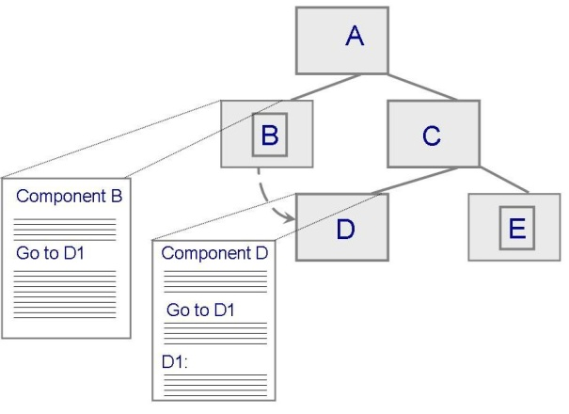
6.2 Design Principles
Content Coupling
Occurs when one component modifies an internal data item in another component, or when one component branches into the middle of another component
Module B
_________________
_________________
_________________
_________________
Generate D
Call D
_________________
_________________
_________________
_________________
_________________
_________________
_________________
_________________
Module D
_________________
_________________
_________________
_________________
_________________
_________________
_________________
_________________
_________________
_________________

Slide 12
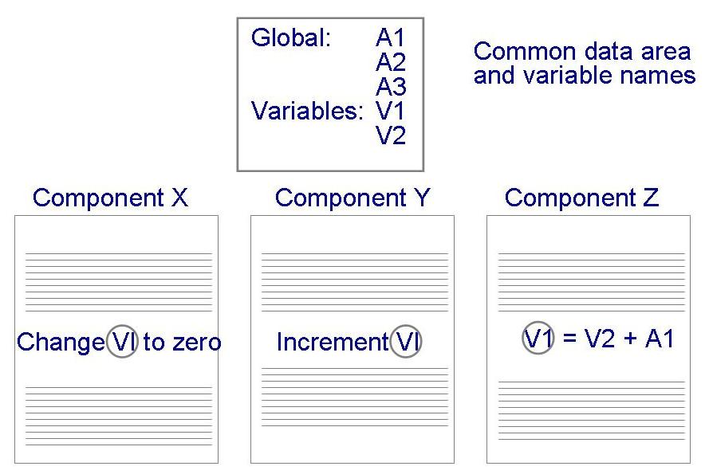
6.2 Design Principles
Common Coupling
Making a change to the common data means tracing back to all components that access those data to evaluate the effect of the change

Slide 13
6.2 Design Principles
Control Coupling
When one module passes parameters or a return code to control the behavior of another module
It is impossible for the controlled module to function without some direction from the controlling module

Slide 14
6.2 Design Principles
Stamp and Data Coupling
Stamp coupling occurs when complex data structures are passed between modules
  Stamp coupling represents a more complex interface between modules, because the modules have to agree on the data’s format and organization
If only data values, and not structured data, are passed, then the modules are connected by data coupling
  Data coupling is simpler and less likely to be affected by changes in data representation

Slide 15
6.2 Design Principles
Cohesion
Cohesion refers to the dependence within and among a module’s internal elements (e.g., data, functions, internal modules)
Coincidental
Logical
Temporal
Procedural
Communicational
Functional
Informational
LOW COHESION
HIGH COHESION

Slide 16
6.2 Design Principles
Cohesion (continued)
Coincidental (worst degree)
  Parts are unrelated to one another
Logical
  Parts are related only by the logic structure of code
Temporal
  Module’s data and functions related because they are used at the same time in an execution
Procedural
  Similar to temporal, and functions pertain to some related action or purpose

Slide 17
6.2 Design Principles
Cohesion (continued)
Communication
  Operates on the same data set
Functional (ideal degree)
  All elements essential to a single function are contained in one module, and all of the elements are essential to the performance of the function
Informational
  Adaption of functional cohesion to data abstraction and object-based design

Slide 18
6.2 Design Principles
Interfaces
An interface defines what services the software unit provides to the rest of the system, and how other units can access those services
  For example, the interface to an object is the collection of the object’s public operations and the operations’ signatures, which specify each operation’s name, parameters, and possible return values
An interface must also define what the unit requires, in terms of services or assumptions, for it to work correctly
A software unit’s interface describes what the unit requires of its environment, as well as what it provides to its environment

Slide 19
6.2 Design Principles
Interfaces (continued)
A software unit may have several interfaces that make different demands on its environment or that offer different levels of service
Module
Interface A
Operation 1 ()
Operation 2 ()
Operation 4 ()
Data
________________
_________________
_________________
Operation 1
_________________
_________________
_________________
_________________
Operation 2
_________________
_________________
_________________
_________________
Operation 3
_________________
_________________
_________________
_________________
Operation 4
_________________
_________________
_________________
_________________
Interface B
Operation 2 ()
Operation 3 ()

Slide 20
6.2 Design Principles
Interfaces (continued)
The specification of a software unit’s interface describes the externally visible properties of the software unit
An interface specification should communicate to other system developers everything that they need to know to use our software unit correctly
  Purpose
  Preconditions (assumptions)
  Protocols
  Postconditions (visible effects)
  Quality attributes

Slide 21
6.2 Design Principles
Information Hiding
Information hiding is distinguished by its guidance for decomposing a system:
  Each software unit encapsulates a separate design decision that could be changed in the future
  Then the interfaces and interface specifications are used to describe each software unit in terms of its externally visible properties
Using this principle, modules may exhibit different kinds of cohesion
  A module that hides a data representation may be informationally cohesive
  A module that hides an algorithm may be functionally cohesive
A big advantage of information hiding is that the resulting software units are loosely coupled

Slide 22
6.2 Design Principles
Sidebar 6.2 Information Hiding in OO Designs
In OO design, we decompose a system into objects and their abstract types
  In this sense, each object hides its data representation from other objects
  The only access that other objects have to a given object’s data is via a set of access functions that the object advertises in its interface
  This information hiding makes it easy to change an object’s data representation without perturbing the rest of the system
However, data representation is not the only type of design decision we may want to hide
  May need to expand our notion of what an object is, to include types of information besides data types
Objects cannot be completely uncoupled from one another, because an object needs to know the identity of the other objects so that they can interact.
  Might mean that changing the name of an object, or the number of object instances, forces us also to change all units that invoke the object
  Such dependence cannot be helped when accessing an object that has a distinct identity but it may be avoided when accessing an arbitrary object

Slide 23
6.2 Design Principles
Incremental Development
Given a design consisting of software units and their interfaces, we can use the information about the units’ dependencies to devise an incremental schedule of development
Start by mapping out the units’ uses relation
  relates each software unit to the other software units on which it depends
Uses graphs can help to identify progressively larger subsets of our system that we can implement and test incrementally

Slide 24
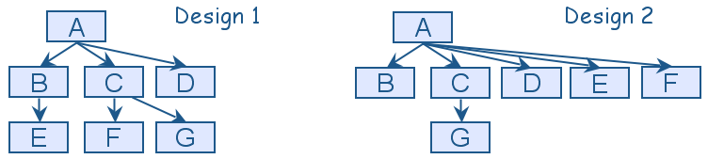
6.2 Design Principles
Incremental Development (continued)
Uses graphs for two designs
  Fan-in refers to the number of units that use a particular software unit
  Fan-out refers to the number of units used by particular software unit

Slide 25
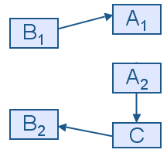
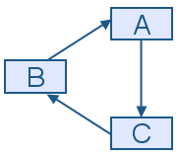
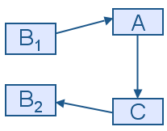
6.2 Design Principles
Incremental Development (continued)
We can try to break a cycle in the uses graph using a technique called sandwiching
  One of the cycle’s units is decomposed into two units, such that one of the new units has no dependencies
  Sandwiching can be applied more than once, to break either mutual dependencies in tightly coupled units or long dependency chains
(α)
(β)
(χ)

Slide 26
6.2 Design Principles
Abstraction
An abstraction is a model or representation that omits some details so that it can focus on other details
The definition is vague about which details are left out of a model, because different abstractions, built for different purposes, omit different kinds of details

Slide 27
6.2 Design Principles
Sidebar 6.3 Using Abstraction
Suppose that one of the system functions is to sort the elements of a list L. The initial description of the design is:
Sort L in nondecreasing order
The next level of abstraction may be a particular algorithm:
DO WHILE I is between 1 and (length of L)–1:
  Set LOW to index of smallest value in L(I),..., L(length of L)
Interchange L(I) and L(LOW)
ENDDO
The algorithm provides a great deal of additional information, however, it can be made even more detailed

Slide 28
6.2 Design Principles
Sidebar 6.3 Using Abstraction (continued)
The third and final algorithm describes exactly how the sorting operation will work:
DO WHILE I is between 1 and (length of L)-1
Set LOW to current value of I
DO WHILE J is between I+1 and (length of L)
IF L(LOW) is greater than L(J)
THEN set LOW to current value of J
ENDIF
ENDDO
Set TEMP to L(LOW)
Set L(LOW) to L(I)
Set L(I) to TEMP
ENDDO

Slide 29
6.2 Design Principles
Generality
Generality is the design principle that makes a software unit as universally applicable as possible, to increase the chance that it will be useful in some future system
We make a unit more general by increasing the number of contexts in which can it be used. There are several ways of doing this:
  Parameterizing context-specific information
  Removing preconditions
  Simplifying postconditions

Slide 30
6.2 Design Principles
Generality (continued)
The following four procedure interfaces are listed in order of increasing generality:
  PROCEDURE SUM: INTEGER;
  POSTCONDITION: returns sum of 3 global variables
  PROCEDURE SUM (a, b, c: INTEGER): INTEGER;
  POSTCONDITION: returns sum of parameters
  PROCEDURE SUM (a[]: INTEGER; len: INTEGER): INTEGER
  PRECONDITION: 0 <= len <= size of array a
  POSTCONDITION: returns sum of elements 1..len in array a
  PROCEDURE SUM (a[]: INTEGER): INTEGER
  POSTCONDITION: returns sum of elements in array a

Slide 31
6.3 OO Design
Object oriented methodologies are the most popular and sophisticated design methodologies
A design is object oriented if it decomposes a system into a collection of runtime components called objects that encapsulate data and functionality
  Objects are uniquely identifiable runtime entities that can be designated as the target of a message or request
  Objects can be composed, in that an object’s data variables may themselves be objects, thereby encapsulating the implementations of the object’s internal variables
  The implementation of an object can be reused and extended via inheritance, to define the implementation of other objects
  OO code can be polymorphic: written in generic code that works with objects of different but related types

Slide 32
6.3 OO Design
Terminology
A class is a software module that partially or totally implements an abstract data type
If a class is missing implementations for some of its methods, we say that it is an abstract class
The class definition includes constructor methods that spawn new object instances
Instance variables are program variables whose values are references to objects

Slide 33
6.3 OO Design
Terminology (continued)
The runtime structure of an OO system is a set of objects, each of which is a cohesive collection of data plus all operations for creating, reading, altering, and destroying those data
An object’s data are called attributes, and its operations are called methods
An object may have multiple interfaces, each offering a different level of access to the object’s data and methods
  Such interfaces are hierarchically related by type: if one interface offers a strict subset of the services that another interface offers, we say that the first interface is a subtype of the second interface (the supertype)

Slide 34
6.3 OO Design
Terminology (continued)
Date
Sale
∗
1
day: 1..31
month : 1..12
year : integer
subtotal : Money
tax : Money
total : Money
sale date
addItem(Item)
removeItem(product No.)
computeSubtotal()
computeTax()
computeTotal()
voidSale()
Item
∗
product No.
name
description
price : Money

Slide 35
6.3 OO Design
Terminology (continued)
Variables can refer to objects of different classes over the course of a program’s execution, known as dynamic binding
The directed arrows in the figure below depict the relationships between constructs, and the adornments at the ends of each arrow indicate the multiplicity (how many of an item may exist)

Slide 36
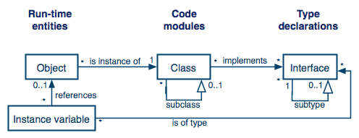
6.3 OO Design
Terminology (continued)
Four OO constructs: classes, objects, interfaces, and instance variables

Slide 37
6.3 OO Design
Terminology (continued)
Building new classes by combining component classes, much as children build structures from building blocks is done by object composition
Alternatively, we can build new classes by extending or modifying definitions of existing classes
  This kind of construction, called inheritance, defines a new class by directly reusing (and adding to) the definitions of an existing class

Slide 38
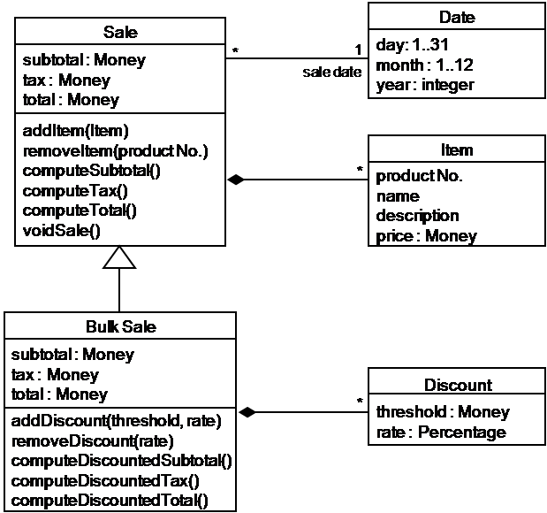
6.3 OO Design
Terminology (continued)
Example of inheritance

Slide 39
6.3 OO Design
Terminology (continued)
Polymorphism occurs when code is written in terms of interactions with an interface, but code behavior depends on the object associated with the interface at runtime and on the implementations of that object’s method
Inheritance, object composition, and polymorphism are important features of an OO design that make the resulting system more useful in many ways

Slide 40
6.3 OO Design
Inheritance vs. Object Composition
A key design decision is determining how best to structure and relate complex objects
In an OO system, there are two main techniques for constructing large objects
  Inheritance
  composition
A new class can be created by extending and overriding the behavior of an existing class, or it can be created by combining simpler classes to form a composite class.

Slide 41
6.3 OO Design
Inheritance vs. Object Composition (continued)
Each construction paradigm has advantages and disadvantages
Composition is better than inheritance at preserving the encapsulation of the reused code, because a composite object accesses the component only through its advertised interface
By contrast, using the inheritance approach, the subclass’s implementation is determined at design time and is static
The resulting objects are less flexible than objects instantiated from composite classes because the methods they inherit from their parent class cannot be changed at runtime
The greatest advantage of inheritance is the ability to change and specialize the behaviors of inherited methods, by selectively overriding inherited definitions

Slide 42
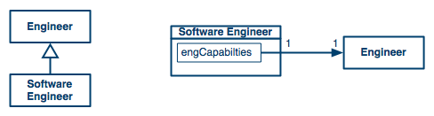
6.3 OO Design
Inheritance vs. Object Composition (continued)

Slide 43
6.3 OO Design
Substitutability
Ideally, a subclass must preserve the behavior of its parent class, so that client code can treat instances of it as instances of the parent class
Liskov Substitutability Principle
  The subclass supports all of the methods of the parent class, and their signatures are compatible
  The subclass’s methods must satisfy the specifications of the parent class’s methods
    Precondition rule pre_{_parent} ⇒ pre_{_sub}
    Postcondition rule pre_{_parent} ⇒ (post_{_sub} ⇒ post_{_parent} )
  The subclass must preserve all declared properties of the parent class
As with most other design principles, substitutability is not a rigid design rule. Rather, the principle serves as a guideline for determining when it is safe not to reexamine the client modules of an extended class

Slide 44
6.3 OO Design
Law of Demeter
Law of Demeter: Allows reducing dependencies by including in each composite class methods for operating on the class’s components
Benefit: client code that uses a composite class needs to know only about the composite itself and not about the composites’ components
Designs that obey the Law of Demeter have fewer class dependencies, and classes with fewer dependencies tend to have fewer software faults

Slide 45
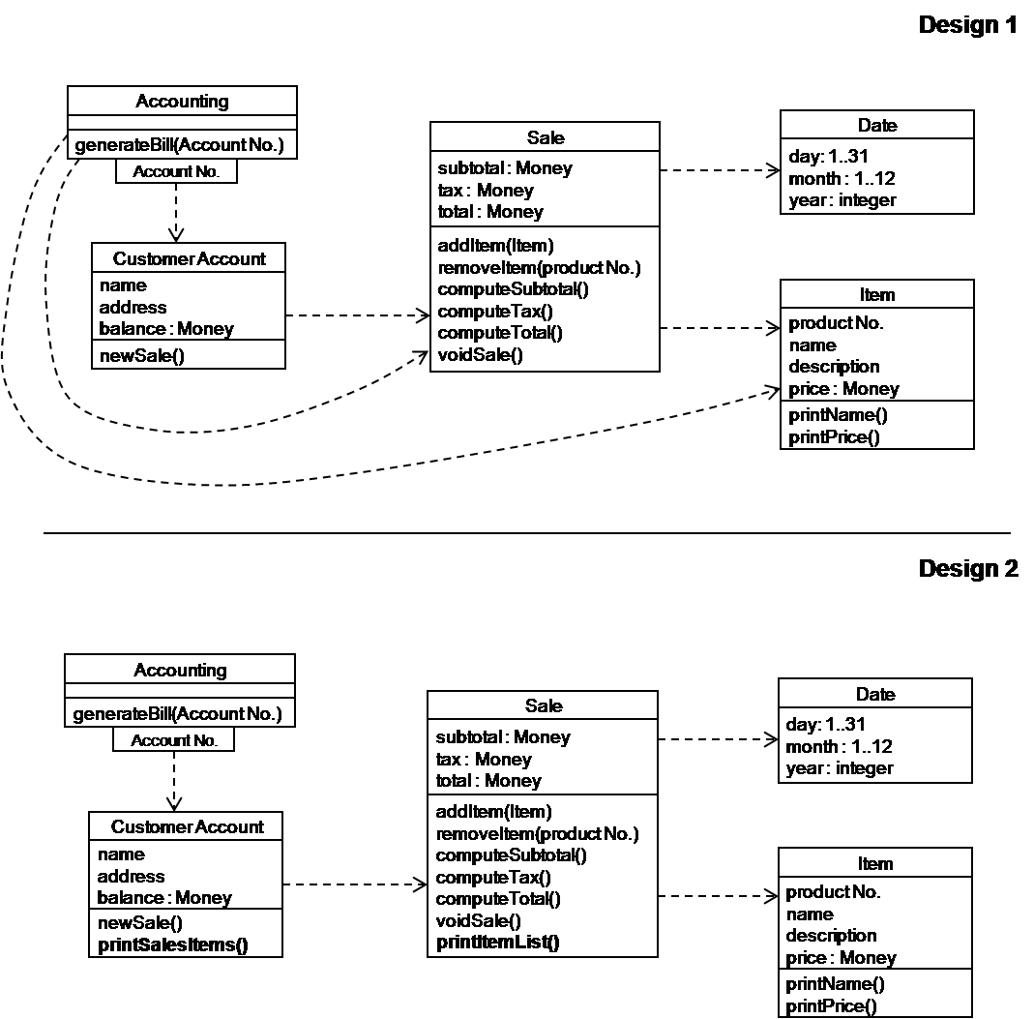
6.3 OO Design
Law of Demeter (continued)

Slide 46
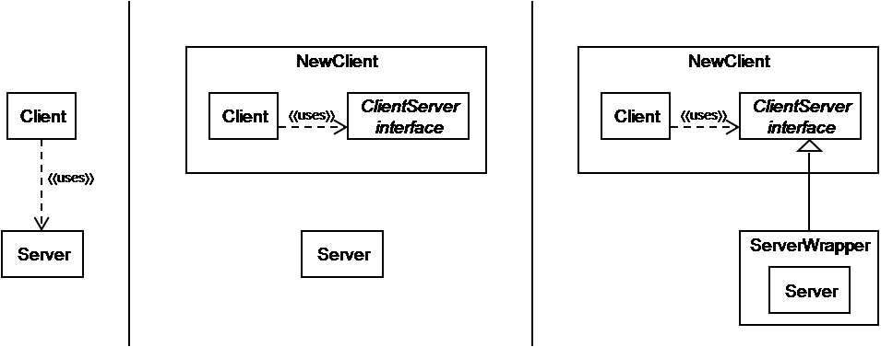
6.3 OO Design
Dependency Inversion
Dependency inversion is the last final OO design heuristic
  used to reverse the direction of a dependency link between two classes
Dependency inversion works by introducing interfaces
The dependency inversion principle is used in the definitions of several design patterns

Slide 47
6.4 Representing OO Designs in the UML
The UML is a suite of design notations that is popular for describing OO solutions
The UML can be used to visualize, specify, or document a software design
UML especially useful for describing different design alternatives, and eventually for documenting design artifacts

Slide 48
6.4 Representing OO Designs in the UML
UML in the Process
Use case diagrams
UML activity diagrams
Domain model
Component diagrams
Deployment diagrams
Class diagrams
Interaction diagrams
Sequence diagrams
Communication diagrams
Activity diagrams
State diagrams
Package diagrams

Slide 49
6.4 Representing OO Designs in the UML
UML in the Process (continued)
How UML is used in the development process
Design
Requirements
Architecture
Domain models
UML sequence diagrams
UML communication diagrams
UML use case diagrams
Scenarios
UML object diagrams
UML component diagrams
UML class diagrams
UML activity diagrams
UML package diagrams
UML deployment diagrams
UML activity diagrams
UML state diagrams

Slide 50
6.4 Representing OO Designs in the UML
Sidebar 6.4 Royal Service Station Requirements
Royal Service station provides three types of services
The system must track bills, the product and services
System to control inventory
The system to track credit history, and payments overdue
The system applies only to regular repeat customer
The system must handle the data requirements for interfacing with other system
The system must record tax and related information
The station must be able to review tax record upon demand
The system will send periodic message to customers
Customer can rent parking space in the station parking lot
The system maintain a repository of account information
The station manager must be able to review accounting information upon demand
The system can report an analysis of prices and discounts
The system will automatically notify the owners of dormant accounts
The system can not be unavailable for more than 24 hours
The system must protect customer information from unauthorized access

Slide 51
6.4 Representing OO Designs in the UML
UML Class Diagram
UML class diagrams describe the object types and their static relationships
  Depict associations among objects and relationships between types and subtypes
  Diagrams should illustrate the attributes of each object, their individual behaviors, and the restrictions on each class or object
Look for and seek
  Actors, physical objects, places, organizations, records, transactions, collections of things, operations procedures, things manipulated by the system to be built

Slide 52
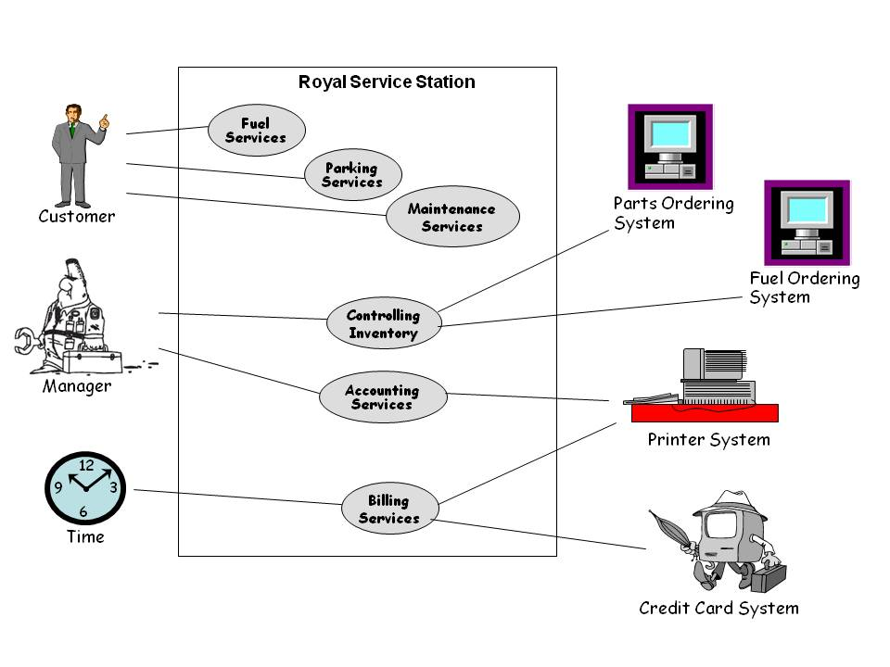
6.4 Representing OO Designs in the UML
UML Class Diagram (continued)
Royal Service Station use case diagram

Slide 53
6.4 Representing OO Designs in the UML
UML Class Diagram (continued)
What needs to be “processed” in some way?
What items have multiple attributes?
When do you have more than one object in a class?
What is based on the requirements themselves, not derived from your understanding of the requirements?
What attributes and operations are always applicable to a class or object?

Slide 54
6.4 Representing OO Designs in the UML
Initial Grouping of Attributes and Classes: Step 1
Attributes | Classes
Personal check | Customer
Tax | Maintenance
Price | Services
Cash | Fuel
Credit card | Bill
Discounts | Purchase Station manager

Slide 55
6.4 Representing OO Designs in the UML
Initial Grouping of Attributes and Classes: Step 2
Attributes | Classes
Personal check | Customer
Tax | Maintenance
Price | Services
Cash | Parking
Credit card | Fuel
Discounts | Bill
Name | Purchase
Address | Maintenance reminder
Birthdate | Station manager

Slide 56
6.4 Representing OO Designs in the UML
Guidelines for Identifying Behaviors
Imperative verbs
Passive verbs
Actions
Membership in
Management or ownership
Responsible for
Services provided by an organization

Slide 57
6.4 Representing OO Designs in the UML
Initial Grouping of Attributes and Classes: Step 3
Attributes | Classes
Personal check Tax Price Cash Credit card Discounts Name Address Birthdate | Customer Maintenance Services Parking Fuel Bill Purchase Maintenance reminder Station manager Overdue bill letter Dormant account warning Parts Accounts Inventory Credit card system Part ordering system Fuel ordering system

Slide 58
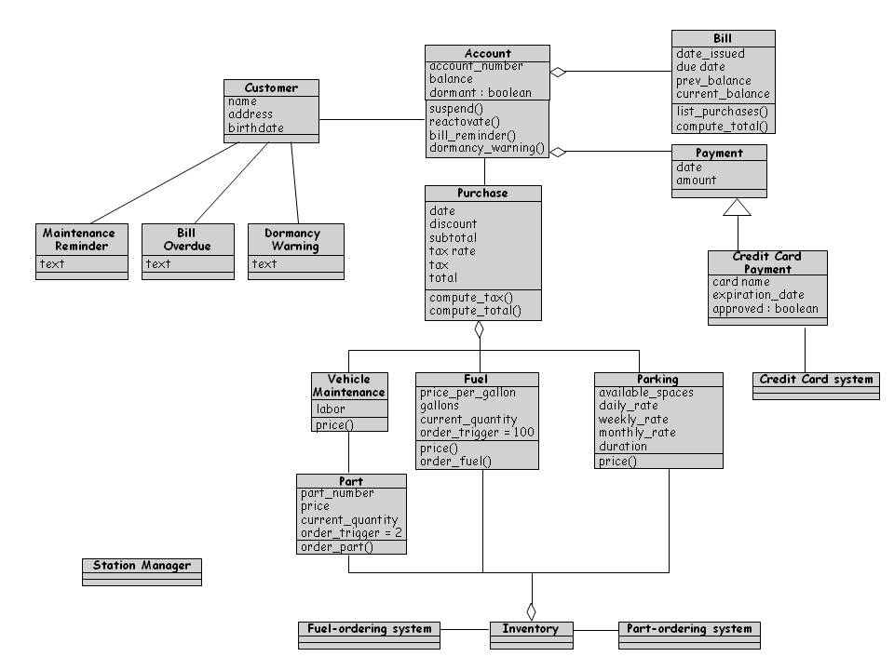
6.4 Representing OO Designs in the UML
First Cut at Royal Service Station Design

Slide 59
6.4 Representing OO Designs in the UML
Types of Class Relationships
association
composition
aggregation
generalization
dependency
navigation

Slide 60
6.4 Representing OO Designs in the UML
Other UML Diagrams
Class description template
Package diagrams
Interaction diagrams
Sequence diagrams
Communication diagrams
State diagrams
Activity diagrams

Slide 61
6.4 Representing OO Designs in the UML
Other UML Diagrams – Class Description Template
Class name: Refuel
Category: service
External documents:
Export control: Public
Cardinality: n
Hierarchy:
Superclasses: Service
Associations:
<no rolename>: fuel in association updates
Operation name: price
Public member of: Refuel
Documentation:
// Calculates fuel final price
Preconditions:
gallons > 0
Object diagram: (unspecified)

Slide 62
6.4 Representing OO Designs in the UML
Other UML Diagrams – Class Description Template (cont)
Semantics:
price = gallons * fuel.price_per_gallon
tax = price * purchase.tax_rate
Object diagram: (unspecified)
Concurrency: sequential
Public interface:
Operations:
price
Private interface:
Attributes:
gallons
Implementation:
Attributes:
gallons
State machine: no
Concurrency: sequential
Persistence: transient

Slide 63
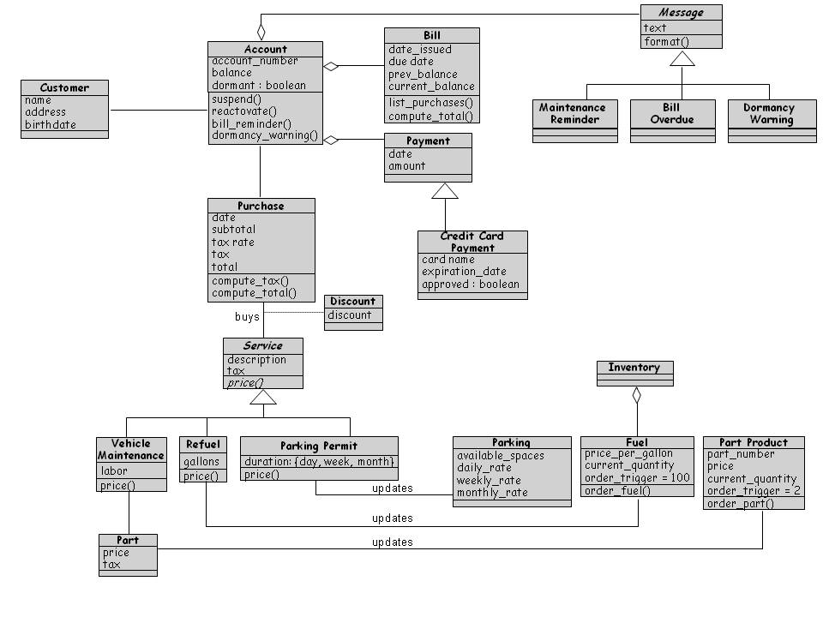
6.4 Representing OO Designs in the UML
Second Cut at Royal Service Station Design

Slide 64
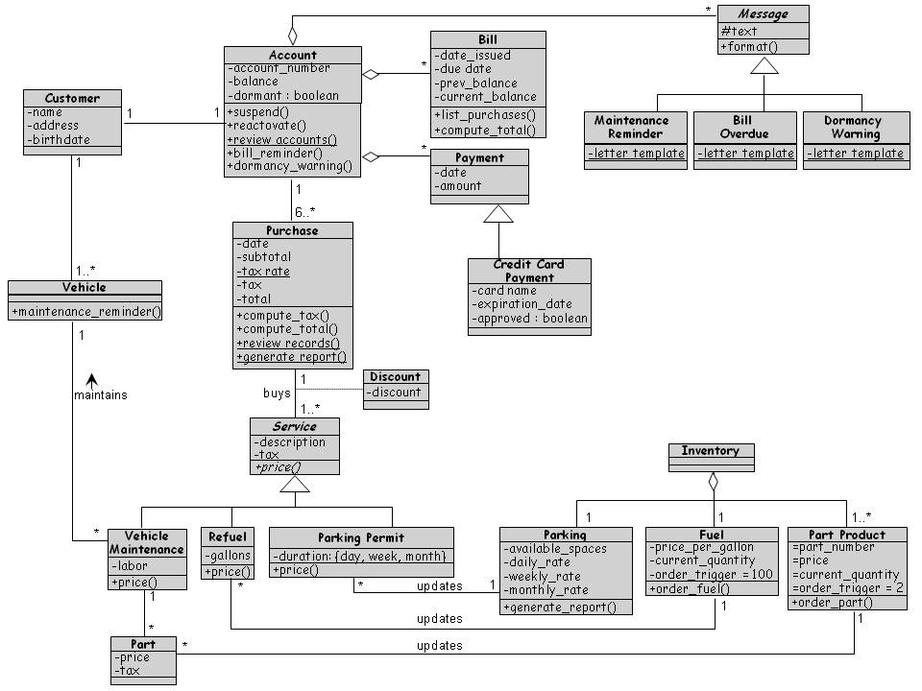
6.4 Representing OO Designs in the UML
Final Cut at Royal Service Station Design

Slide 65
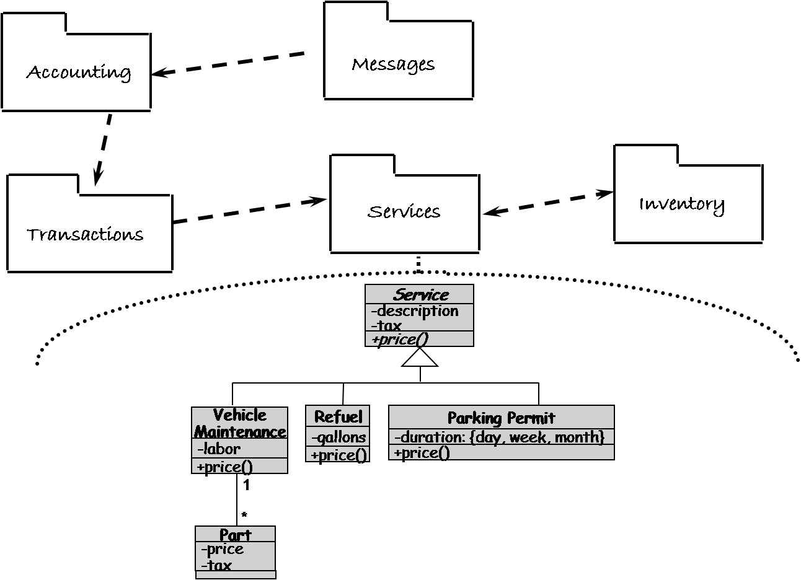
6.4 Representing OO Designs in the UML
Other UML Diagrams – Package Diagram
UML package diagrams allow viewing a system as a small collection of packages each of which may be expanded to a larger set of classes

Slide 66
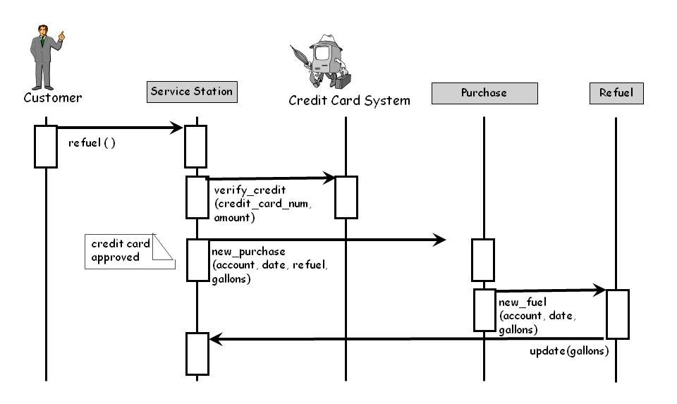
6.4 Representing OO Designs in the UML
Other UML Diagrams – SequenceDiagram
Interaction diagrams describe how operations and behaviors are realized by the objects

Slide 67
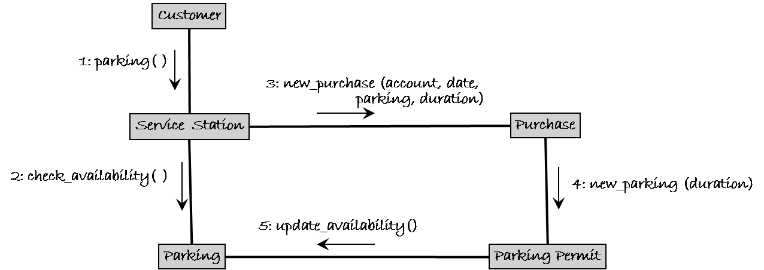
6.4 Representing OO Designs in the UML
Other UML Diagrams – Communication Diagram
A communication diagram depicts a sequence of messages between objects but it is superimposed on an object and uses the links between object as implicit communication channels

Slide 68
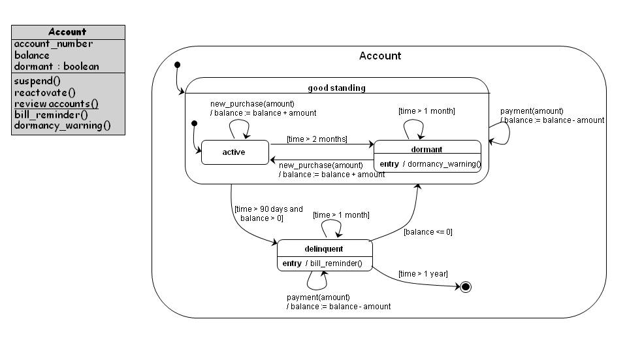
6.4 Representing OO Designs in the UML
Other UML Diagrams – StateDiagram
A state diagram shows the possible states an object can take, the events that trigger the transition between one state to the next, and the actions that result from each state change

Slide 69
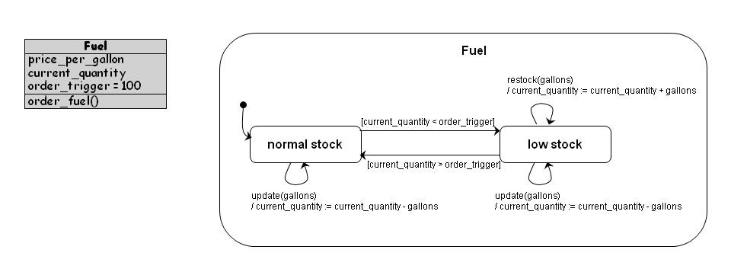
6.4 Representing OO Designs in the UML
Other UML Diagrams – State Diagram (continued)

Slide 70
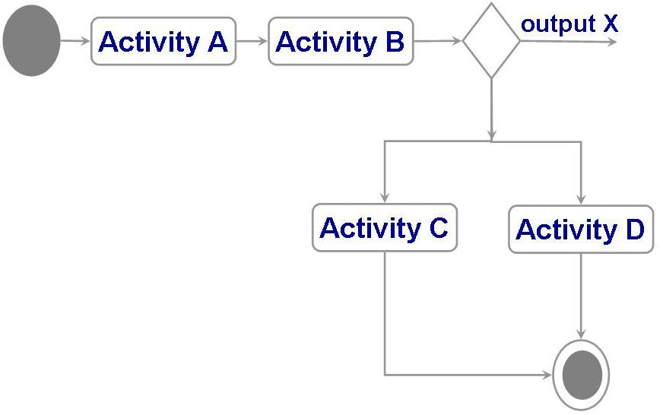
6.4 Representing OO Designs in the UML
Other UML Diagrams – Activity Diagram
Activity diagrams are used to model the flow of procedures or activities in a class
A decision node is used to represent a choice of which activity to invoke

Slide 71
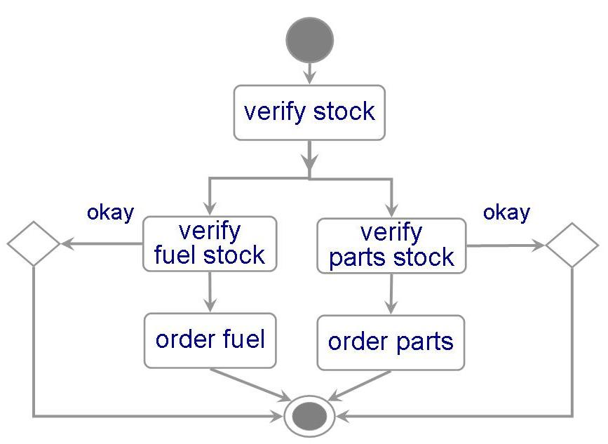
6.4 Representing OO Designs in the UML
Other UML Diagrams – Activity Diagram (continued)
Activity diagrams are used to model the flow of procedures or activities in a class
An activity diagram for the inventory class
It may have two decisions
  to verify that there are enough fuel
  to verify that a part is in stock

Slide 72
6.5 OO Design Patterns
A design pattern codifies design decisions and best practices for solving a particular design problem according to design principles
Design patterns are not the same as software libraries; they are not packaged solutions that can be used as is. Rather, they are templates for a solution that must be modified and adapted for each particular use

Slide 73
6.5 OO Design Patterns
Template Method Pattern
The Template Method pattern aims to reduce the amount of duplicate code among subclasses of the same parent class
  It is particularly useful when multiple subclasses have similar but not identical implementations of the same method
  This pattern addresses this problem by localizing the duplicate code structure in an abstract class from which the subclasses inherit
The abstract class defines a template method that implements the common steps of an operation, and declares abstract primitive operations that represent the variation points

Slide 74
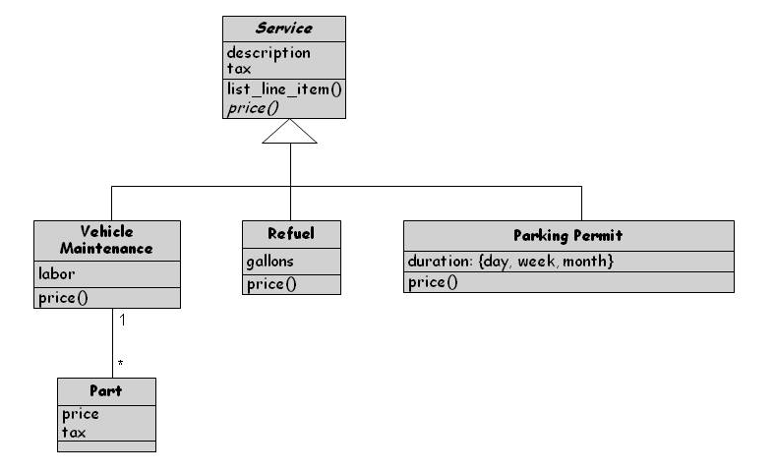
6.5 OO Design Patterns
Template Method Pattern (continued)

Slide 75
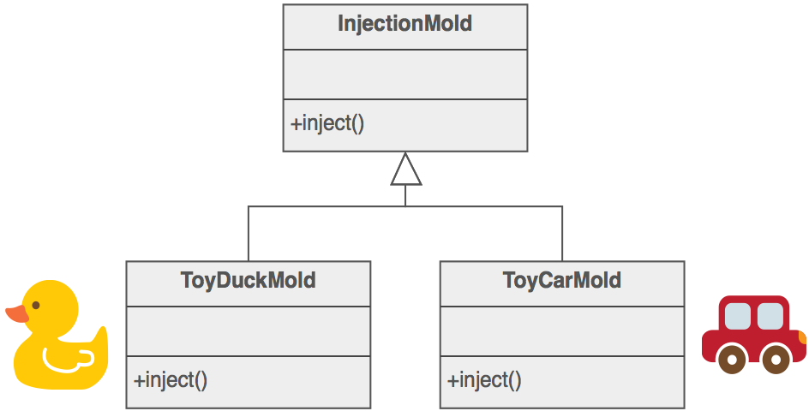
6.5 OO Design Patterns
Factory Method Pattern
The Factory Method pattern is used to encapsulate the code that creates objects
The similar but not identical methods are the constructor methods that instantiate objects
Create an abstract class that defines an abstract constructor method (Factory Method) and subclasses override the Factory Method to construct specific objects
More customizable designs: Factory method requires new operation
Reference: https://sourcemaking.com/design_patterns/factory_method

Slide 76
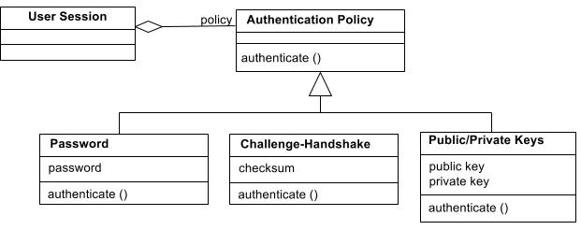
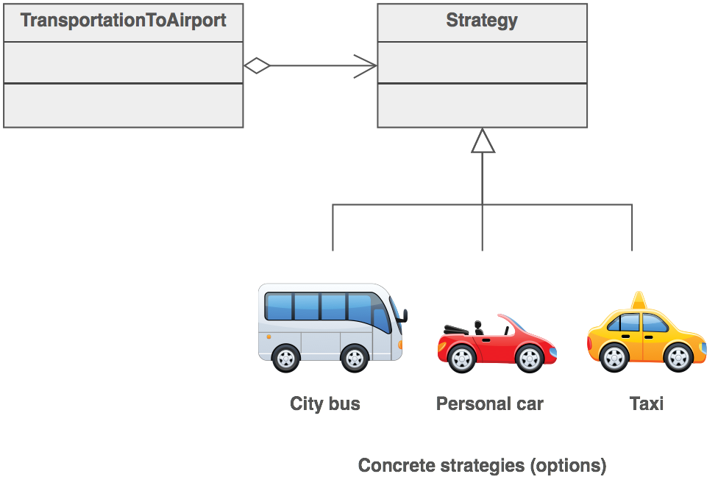
6.5 OO Design Patterns
Strategy Pattern
The Strategy pattern allows algorithms to be selected at runtime
It is useful when various algorithms are available to an application but the chose of best algorithm is not known
Reference: https://sourcemaking.com/design_patterns/strategy

Slide 77
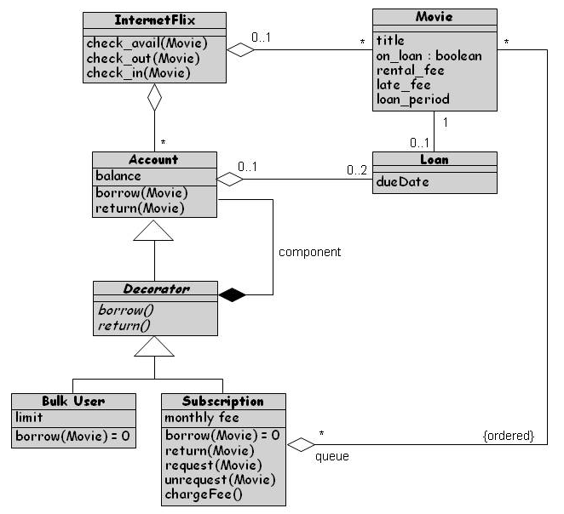
6.5 OO Design Patterns
Decorator Pattern
Extend an object’s functionality at runtime
Decorator is a subclass of the object it decorates
Decorator contains a reference to the object it decorates
Flexible alternative to using inheritance at design time to create subclasses that support new features

Slide 78
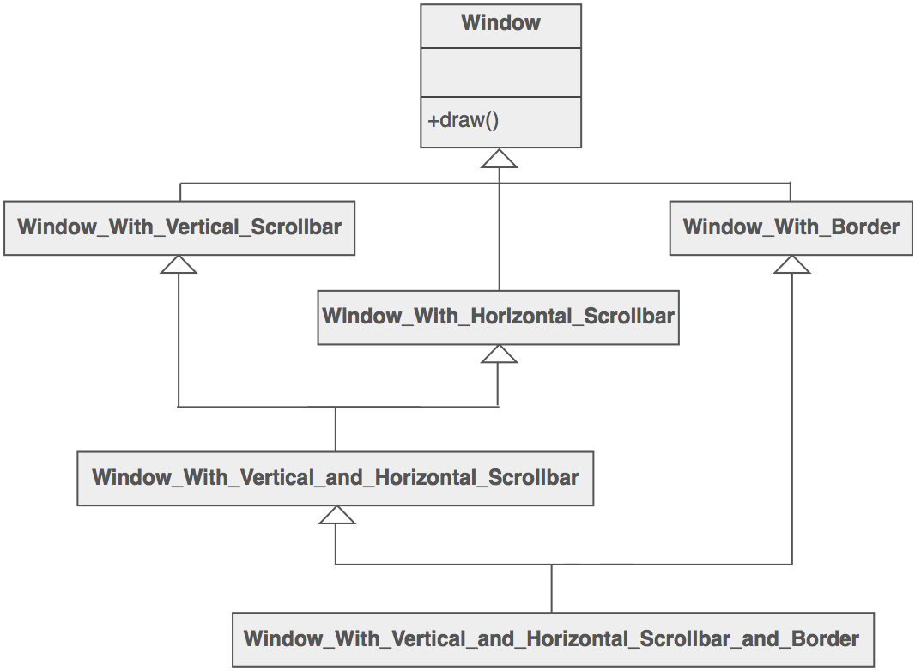
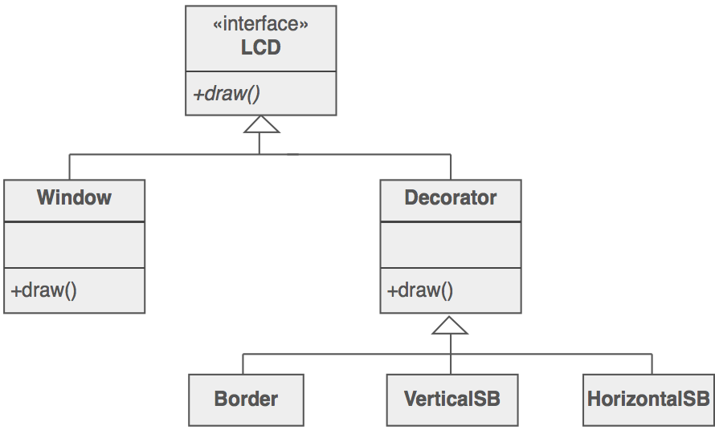
6.5 OO Design Patterns
Decorator Pattern – More examples
Analogy: wrapping a gift, putting in a box, and wrapping the box
Example: Interested in adding borders and scrollbars to the windows
Design 1
Design 2
Reference: https://sourcemaking.com/design_patterns/decorator

Slide 79
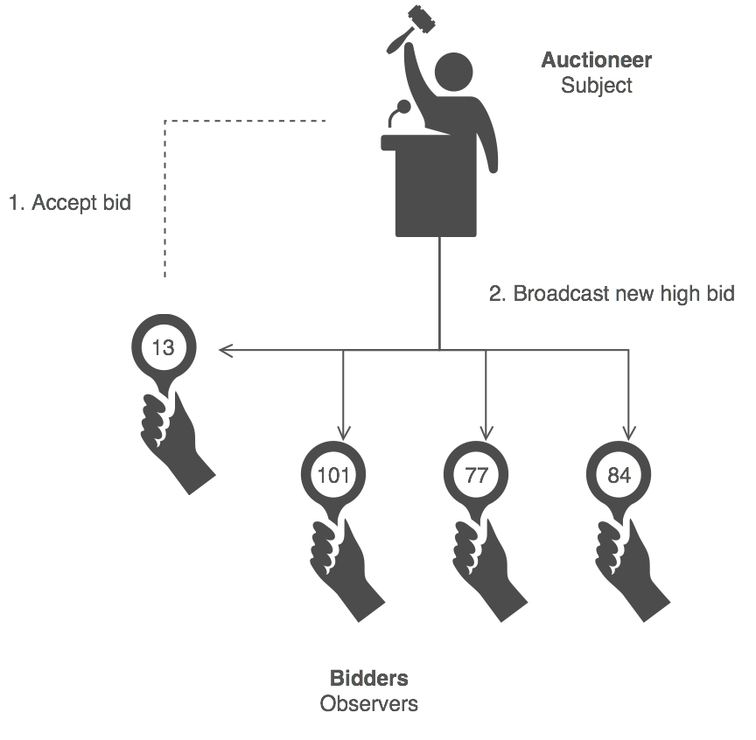
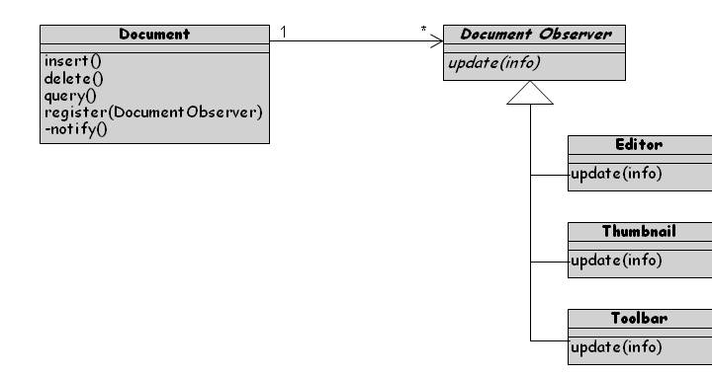
6.5 OO Design Patterns
Observer Pattern
An application of the publish–subscribe architecture style
Useful when software needs to notify multiple objects of key events
Reference: https://sourcemaking.com/design_patterns/observer

Slide 80
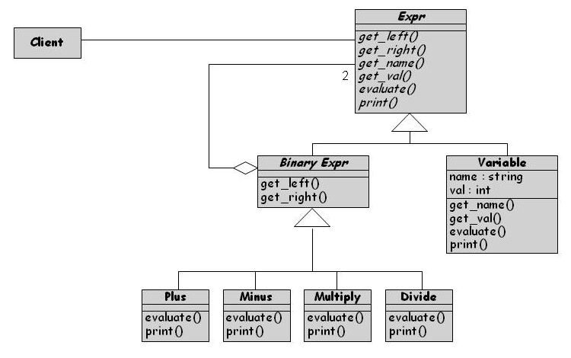
6.5 OO Design Patterns
Composite Pattern
A composite is an object designed as a composition of one or multiple objects with similar functionality
Composes objects in terms of a tree structure (e.g., mathematical expressions) to represent part (or whole) of the hierarchy
The composite pattern promotes the uses of a single uniform interface

Slide 81
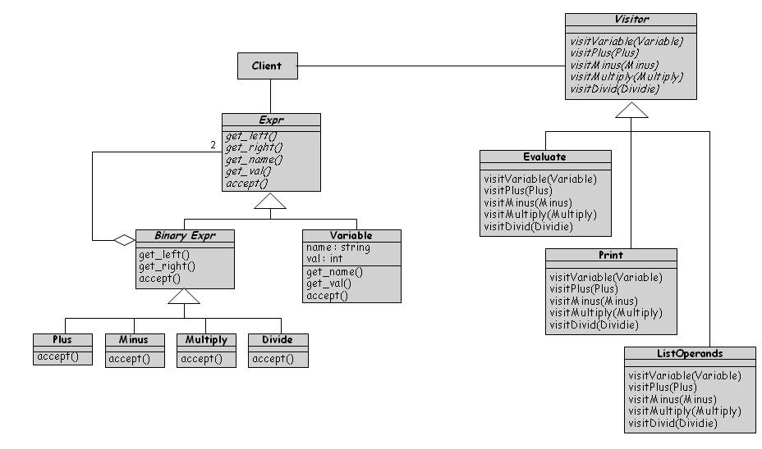
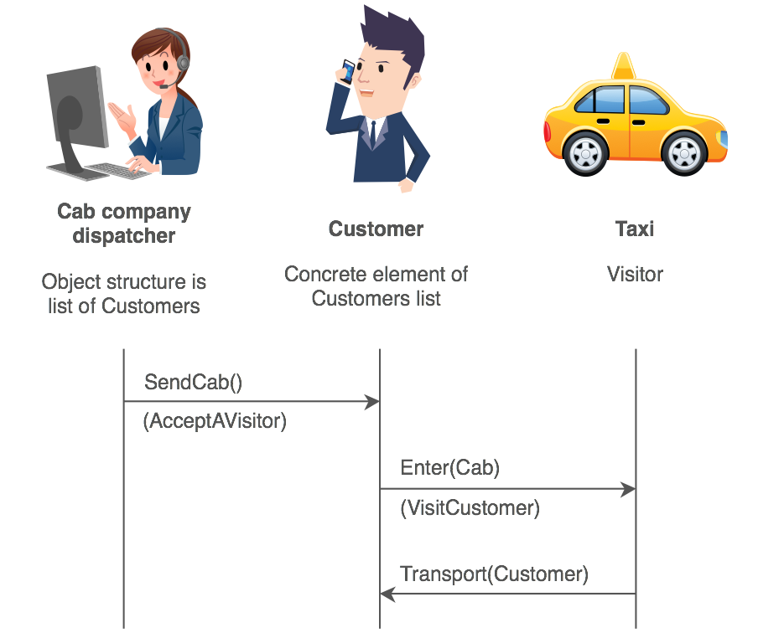
6.5 OO Design Patterns
Visitor Pattern
Collects and encapsulates operation fragments into their own classes
Each operation is implemented as a separate subclass of abstract Visitor class
New operations can be added without changing the composite object’s code
Operations can be performed on elements of an object structure without changing the classes on which it operates
Reference: https://sourcemaking.com/design_patterns/visitor
Notes:
When a person calls a taxi company (accepting a visitor), the company dispatches a cab to the customer. Upon entering the taxi the customer, or Visitor, is no longer in control of his or her own transportation, the taxi (driver) is.

Slide 82
6.6 Other Design Considerations
Data Management
Data management takes into account the system requirements concerning performance and space
Four steps:
  Identify the data, data structures, and relationships among them
  Design services to manage the data structures and relationships
  Find tools, such as database management systems, to implement some of the data management tasks
  Design classes and class hierarchies to oversee the data management functions

Slide 83
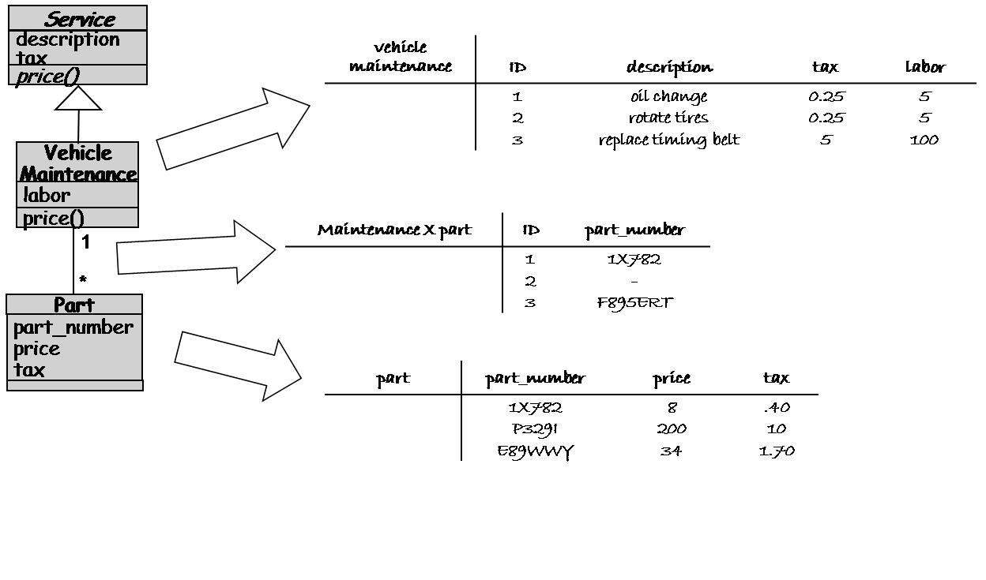
6.6 Other Design Considerations
Data Management for the Royal Service Station

Slide 84
6.6 Other Design Considerations
Exception Handling
Allows making programs become more robust
Helps separate error checking and recover from a program’s main functionality

Slide 85
6.6 Other Design Considerations
Exception Handling (continued)
attempt_transmission (message: STRING) raises TRANSMISSIONEXCEPTION
// Attempt to transmit message over a communication line using // the low-level procedure unsafe_transmit, which may fail, //triggering an exception.
// After 100 unsuccessful attempts, give up and raise an exception
local
failures: INTEGER
try
unsafe_transmit (message)
rescue
failures := failures + 1;
if failures < 100 then
retry
else
raise TRANSMISSIONEXCEPTION
end
end

Slide 86
6.6 Other Design Considerations
Designing User Interfaces
Must consider several issues:
  identifying the humans who will interact with the system
  defining scenarios for each way that the system can perform a task
  designing a hierarchy of user commands
  refining the sequence of user interactions with the system
  designing relevant classes in the hierarchy to implement the user-interface design
  decisions
  integrating the user-interface classes into the overall system class hierarchy

Slide 87
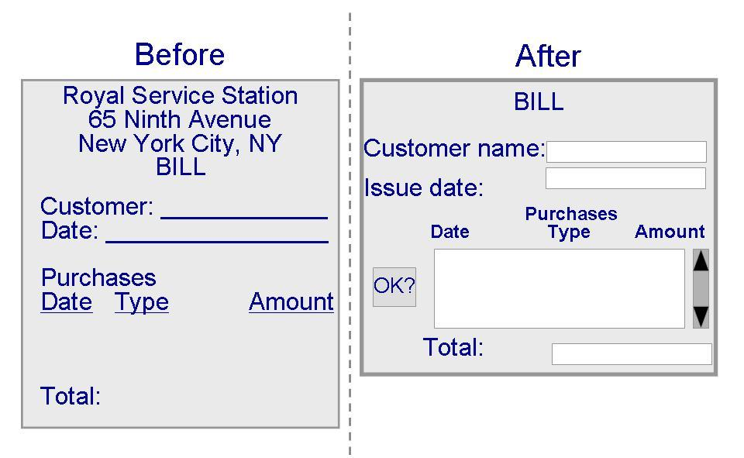
6.6 Other Design Considerations
Designing User Interfaces (continued)

Slide 88
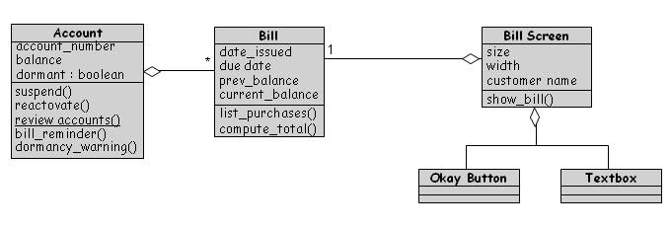
6.6 Other Design Considerations
Designing User Interfaces (continued)

Slide 89
6.6 Other Design Considerations
Frameworks
  A framework is a large reusable design for a specific application domain
  GUI editors, web applications, accounting systems
  Different from software product lines
    Product lines are developed by a company for its own use
    Frameworks tend to be publically available resources like toolkits
      High-level architectures whose low-level details need to be filled-in

Slide 90
6.7 OO Measurement
OO Size Measures
Objects and methods as a basic size measure
Lorenz and Kidd’s nine aspects of size
  Number of scenario script (NSS)
  Number of key classes
  Number of support classes
  The average number of support classes per key classes
  Number of subsystems
  Class size
  Number of operations overridden by a subclass (NOO)
  Number of operation added by a subclass
  Specialization index = (NOO X depth) / (total class methods)

Slide 91
6.7 OO Measurement
Lorenz and Kidd Metrics Collection in Different Phases of Development
Metric | Requirements Description | System Design | Program Design | Coding | Testing
Number of scenario script | X
Number of key classes | X | X
Number of support classes |  |  | X
Average number of support classes per key class |  |  | X
Number of subsystem |  |  | X | X
Class size |  | X | X | X
Number of operations overridden by a subclass |  | X | X | X | X
Number of operations added by a subclass |  | X | X | X
Specialization index |  | X | X | X | X

Slide 92
6.7 OO Measurement
Use Case Diagram of the Royal Service Station

Slide 93
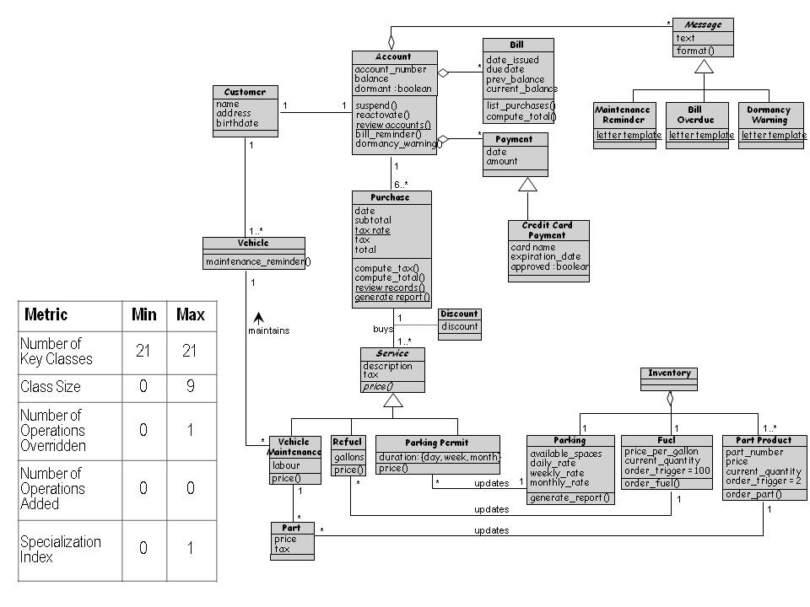
6.7 OO Measurement
Class Hierarchy for the Royal Service Station

Slide 94
6.7 OO Measurement
OO Design Quality Measures
Chidamber and Kemerer have also devised a suite of metrics for object-oriented development
Focused on design quality (not size)
  Weighted methods per class = Σ^{n} _{i=1} c_{i}
    n: number of methods and c: complexity of each method
  Depth of inheritance
  Number of children
  Coupling between objects
  Response for a class
  Lack of cohesion of methods

Slide 95
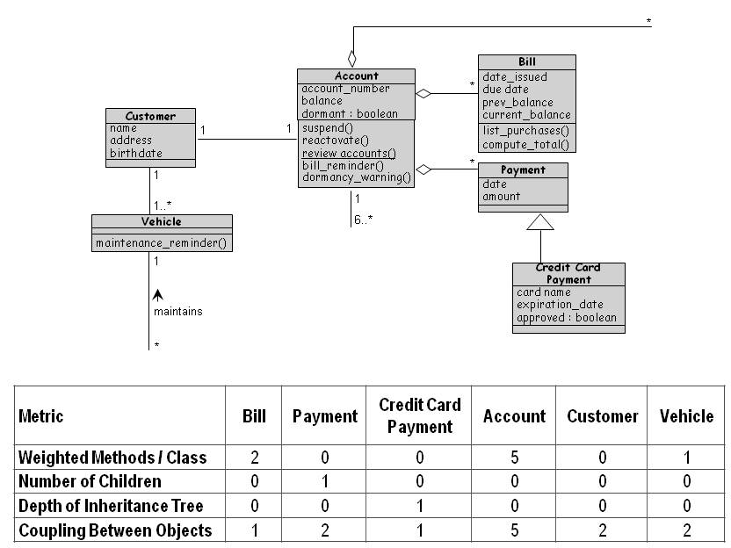
6.7 OO Measurement
Chidamber-Kemerer Metrics applied to the Royal Service Station’s System Design

Slide 96
6.7 OO Measurement
Calculating the Degree of Cohesion
Given class C with n methods, M₁ through M_{n}
Suppose {I_{j}} is the set of instance variables used by the method M
We can define P to be collection of pairs (I_{r} , I_{s}) where I_{r} and I_{s}, share no common members
  P = {(I_{r} , I_{s}) | I_{r} ∩ I_{s} = Ø}
Q is the collection of pairs (I_{r} , I_{s}) where I_{r} and I_{s}, share at least one common member
  Q = {(I_{r} , I_{s}) | I_{r} ∩ I_{s} ≠ Ø}
Lack of cohesion in methods for C to be
  |P|-|Q| if |P| > |Q|
  Zero if otherwise

Slide 97
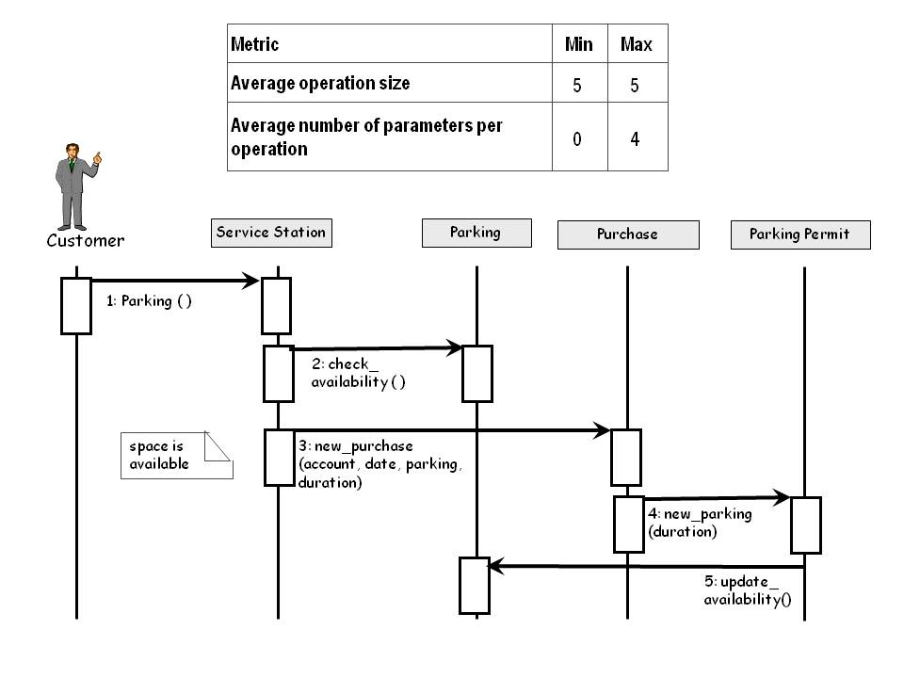
6.7 OO Measurement
Measuring From a Sequence Diagram

Slide 98
6.7 OO Measurement
Where to Do OO Measurement
Measurement is only valuable when it increases our understanding, prediction, or control
Metrics are available for many types of documents including
  Use cases
  Class diagrams
  Interaction diagrams
  Class descriptions
  State diagrams
  Package diagrams

Slide 99
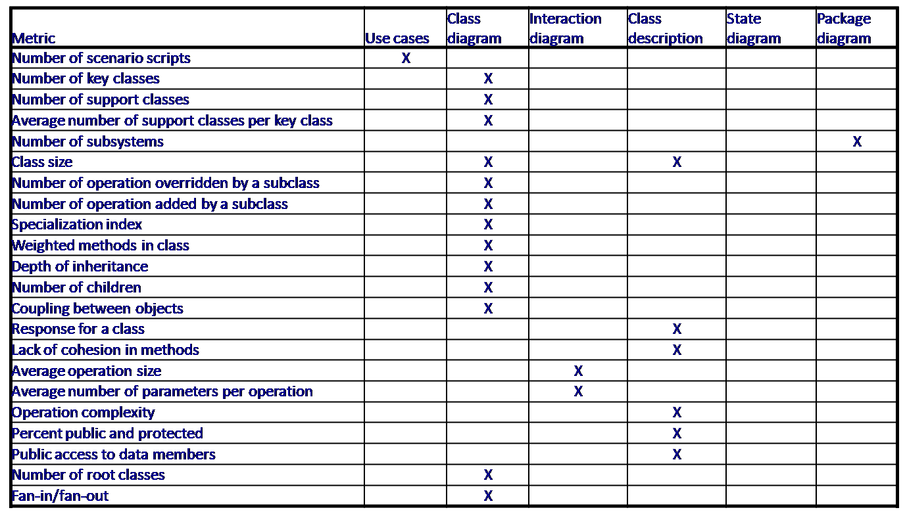
6.7 OO Measurement
Where to Do OO Measurement (continued)

Slide 100
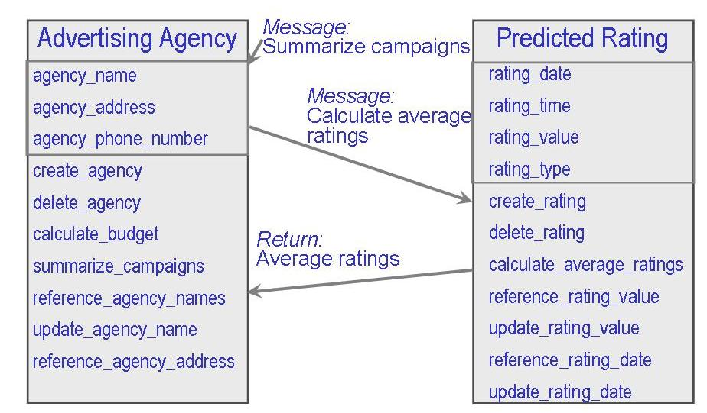
6.9 Information System Example
Data Model of Opposition Programs
Broadcast by Piccadilly’s Competition
Domain elements and relationships that the Piccadilly database will maintain
A closer examination will reveal that there are considerable commonality

Slide 101
6.10 Real-Time Example
Design by Contract
Had Ariane-5 been implemented using an object-oriented approach, the reuse would have been either in terms of composition or inheritance
In composition approach: the SRI is viewed as a black box and called from the main system
In inheritance approach: the SRI structure and behavior are open to view, inheriting as much structure and behavior from parent classes as possible

Slide 102
6.11 What This Chapter Means For You
The design process describes the system components using a common language with which to communicate
Object orientation is a particularly appealing basis for such design, because it allows us to describe and reason about the system from its birth to its delivery in the same terms: classes, objects, and methods
Consistent notation makes it easier for your team to understand the implications of using a particular object or class
  Consistency assists the maintainers and testers, enabling them to build test cases and monitor changes more easily
  Because the requirements, design, and code are expressed in the same way, it is easier for you to evaluate the effects of proposed changes to the requirements or designs

