Slide 1
Y10 2D command &
Corresponding Reg. setting in DISP
Jerry Chang

Slide 2
Abbreviation
Multi-Format Decoder (MFD)
DISP (DISPlay)
  Video Post Processor (VPP)
    Deinterlace Data FetCH (DDFCH)
    DEINTerlacing (DEINT)
  Auto Frame Rate Conversion (AFRC)

Slide 3
Discussed Issues
MBus R/W sequences for DISPLAY
  Command formats in DISPs.
  R/W sequences using register controlling .
Memory mapping for DISP functions in DDR.

Slide 4
Outline
Introduction
  2D Command
  Masters in DISP
MBUS Commands in DISP
  1/2D CMDs modification for 10-bit rawdata
Register Setting in DISP DDFCH using 2D CMDs
  Register Setting
  Example: Register setting by 2D commands
  Example: Read Sequence of Luma 720x576

Slide 5
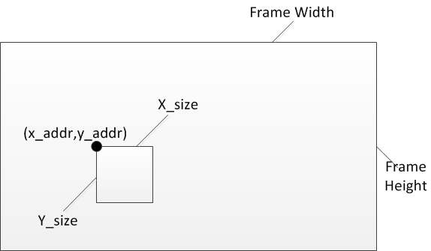
Intro. – MBUS 2D Command
D(X_{ADDR}, Y_{ADDR})
where X_{ADDR}, Y_{ADDR} are defined in 2D command.
Every D(X_{ADDR}, Y_{ADDR} ) represents a 4-byte data.

Slide 6
Intro. – MBUS 2D Command
Command Phase | Bits | Description
CMD | [2:0] | Command write: 3'b001 read: 3'b010
ADDR | [31:0] | Address 2D MODE: [22:12] y_addr [11:2] x_addr
BURST_LEN | [5:0] | Burst Length (Burst Unit: 64 bits, bus width)
BURST_SEQ | [2:0] | Burst Type 1D: 3'b000 2D: 3'b111 Others follow OCP Spec.
REQ_INFO | [1:0] | Command Type [0] : for urgent at ND1.0 and ND1.1
ADDR_SPACE | [10:0] | Address Space ( For 2D command ) [10:9]: PIC_INDEX (No used) [8:2] : BASE_INDEX : 0~127, #Reference frame [1:0] : 2D MODE 2'b00 : Linear mode 2'b01 : Frame mode 2'b10 : Field mode Others: Reserved *10'b1100 in some case is for MSI Command
BLOCK_HEIGHT | [5:0] | Block Height (Burst Unit: bytes)

Slide 7
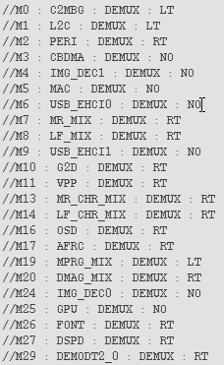
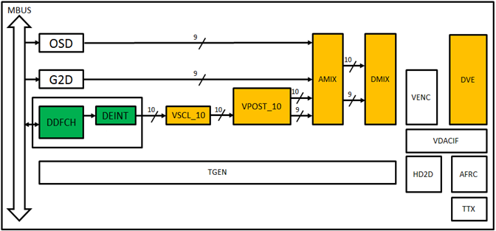
Intro. – Masters in DISP

Slide 8
MBus Commands in DISP
# | Master Name | CMD | BURST_SEQ | ADDR |  | REQ_INFO | BURST_ LENGTH | ADDR_SPACE |  |  | BLOCK_HEIGHT
 |  |  |  | BASE ADDRESS | INCR. OFFSET |  |  | PIC_INDEX | BASE_INDEX | 2D_MODE
10 | G2D | READ | 1D | Register Setting | 32(Minimum) | URGENT | 16/32 | 0s |  |  | 0
11 | VPP (DDFCH) | R/W | 1D | Register Setting | 128 (Minimum) | URGENT | 16/32 | 0s |  |  | 0
 |  | READ | 2D | Register Setting |  | URGENT | 16/32 | 2'b0 | Register setting | 2'b01 (Frame mode) | 1
16 | OSD | READ | 1D | Register Setting | 32(Minimum) | URGENT | 16/32 | 0s |  |  | 0
17 | AFRC | R/W | 1D | Register Setting | 128 (Minimum) | URGENT | 32 | 0s |  |  | 0
Only MFD and DISP in MBUS use 2D command.
G2D/OSD : 8bit YUV/RGB : 1D command
Source are not related with MFD.
VPP : MOTION/EDGE : 1D command, 8 bytes per 6 pixels.
For DEINT, not related with MFD.
8 bit LUMA/CHROMA: 1/2D CMD.
2D CMD is for MFD. Need to extend the bit width to 10 bits.
AFRC : 8bit YCbCr422: 1D command (TBD)
*This table are produced by my RTL code tracing.
It may have some differences in real case.

Slide 9
2D CMDs for 10-bit rawdata
# | Master Name | CMD | BURST_SEQ | ADDR | REQ_INFO | BURST_ LENGTH | ADDR_SPACE |  |  | BLOCK_HEIGHT
 |  |  |  |  |  |  | PIC_INDEX | BASE_INDEX | 2D_MODE
11 | VPP (DDFCH) | READ | 2D | Register Setting STARTPOINT + OFFSET [22:12] Y_{ADDR} [11:2] X_{ADDR} | URGENT | 16/32 | 2'b0 | Register setting | 2'b01 (Frame mode) | 1
(X_{ADDR} , Y_{ADDR}) = (X_{STARTPOINT} , Y_{STARTPOINT} ) + (X_{OFFSET} , Y_{OFFSET} )
(X_{STARTPOINT}, Y_{STARTPOINT}) ➔ Defined in registers G80.4, G80.5
One Transfer → MBus Data width = 8 bytes → ADDR = ADDR + 8 → X_{ADDR} += 2
CASE: 8-bit extension CASE: 10-bit extension
WHEN BURST_LENGTH = 16
X_{OFFSET} = 16*2 = 32 → X_{OFFSET} = 16*2*1.25 = 40
BURST_LENGTH = 16 → BURST_LENGTH = 16 *1.25 = 20
WHEN BURST_LENGTH = 32
X_{OFFSET} = 32*2 = 64 → X_{OFFSET} = 32*2*1.25 = 80
BURST_LENGTH = 32 → BURST_LENGTH = 32 *1.25 = 40
Y_{OFFSET} = 1, no need to change.
All follows the rules of 8-byte alignment.

Slide 10
1D CMDs for 10-bit rawdata
# | Master Name | CMD | BURST_SEQ | ADDR |  | REQ_INFO | BURST_ LENGTH | ADDR_SPACE |  |  | BLOCK_HEIGHT
 |  |  |  | BASE ADDRESS | INCR. OFFSET |  |  | PIC_INDEX | BASE_INDEX | 2D_MODE
17 | AFRC | R/W | 1D | Register Setting | 128 (Minimum) | URGENT | 32 | 0s |  |  | 0
CASE: 10-bit extension
NEW BURST_LENGTH = 32*1.25 = 40
NEW INCR. OFFSET = 128*1.25 = 160

Slide 11
MBus Read Sequence for MFD rawdata using 2D CMD
Register Setting
Read Sequence

Slide 12
Register Setting for DDFCH
We have to clarity the following settings:
DISP
  2D CMD Enable – G80.28.6
  Setting for X_{STARTPOINT}, Y_{STARTPOINT} – G80.0 and G80.1
  Frame Width and Height – G80.2 and G80.3
  Pointer to Reference Frame in SDCTRL – G80.17 to G80.22
    Pervious/Current/Next frame with Luma/Chroma
SDCTRL
  Address Mapping in SDCTRL – G36.0 to G39.31
  MB size setting matched with MFD

Slide 13


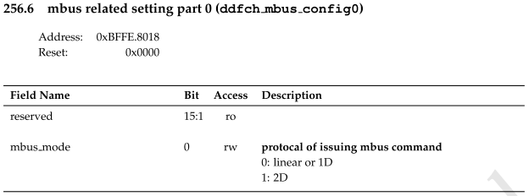
2D CMD Enable
Default : G80.28.6 = 1 → Set to 2D mode
USER MODE

Slide 14
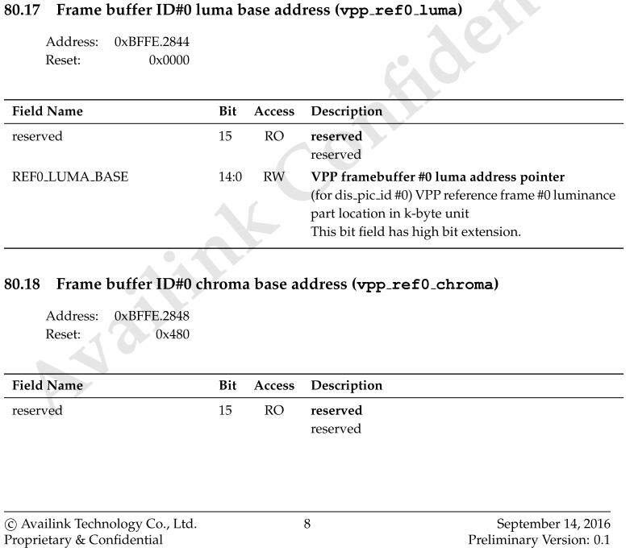
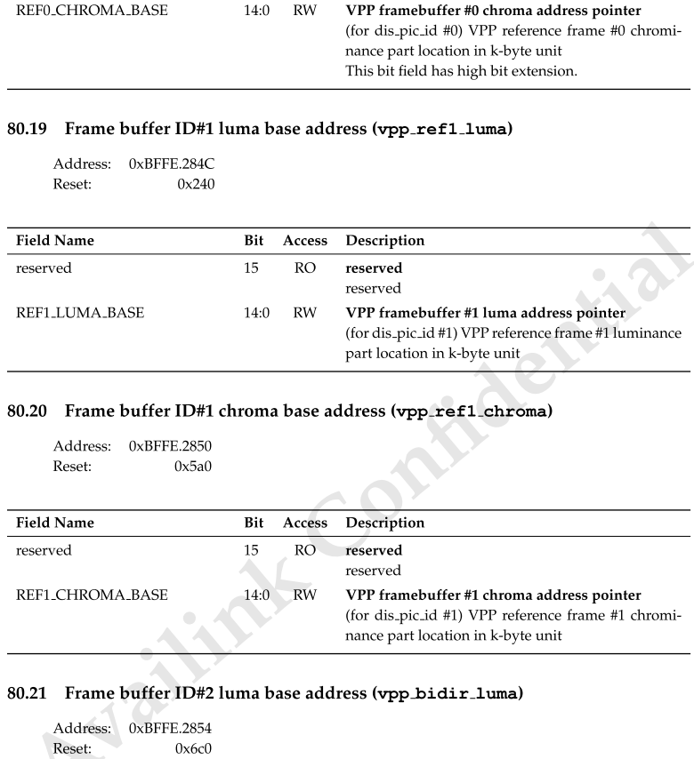
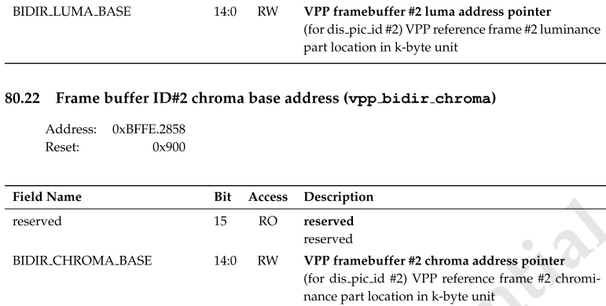
Pointer to Reference Frame in SDCTRL
Current Frame
Next
Pervious
Pervious and next frames are used for DEINT.
This setting value will point to a corresponding address which stored in G36 to G39.

Slide 15
Pointer to Reference Frame in SDCTRL
Example
e.g. Set G80.17 = 15’d35
35 % 32 = 1 … 3 → G(36+1).(3-1)= G37.2
Appended in this filed for 2D CMDs.
SDCTRL can use this to identify the base address of data
Command Phase | Bits | Description
ADDR_SPACE | [10:0] | Address Space ( For 2D command ) [10:9]: PIC_INDEX (No used) [8:2] : BASE_INDEX : 0~127, #Reference frame [1:0] : 2D MODE 2'b00 : Linear mode 2'b01 : Frame mode 2'b10 : Field mode Others: Reserved *10'b1100 in some case is for MSI Command

Slide 16
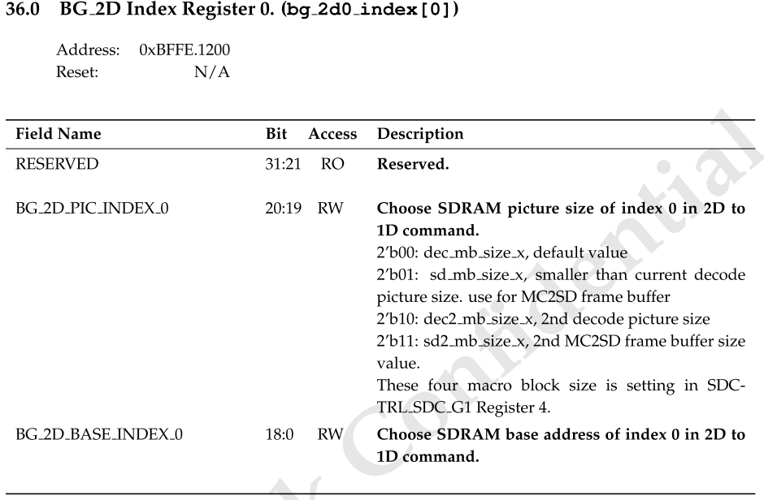
Actual Address mapping in SDCTRL
G36 to G39, total 128 registers
Actual MBUS ADDR:
0xb0000000 +
(BG_2D_BASE_INDEX * 1024)

Slide 17
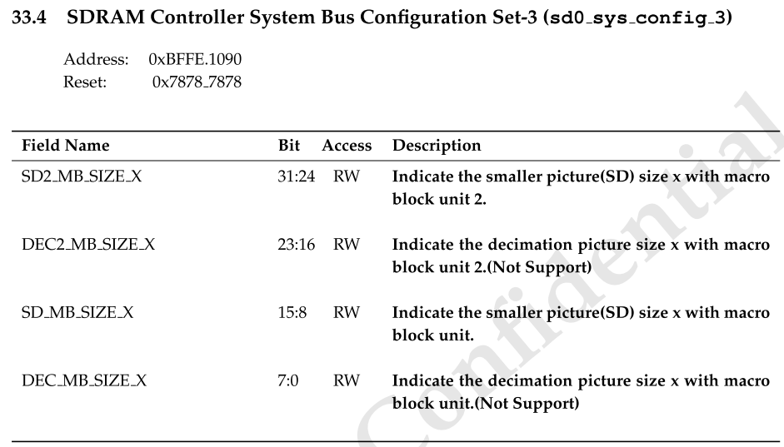
Actual Address mapping in SDCTRL
MFD and DISP must have the same value.
Write Frame Width = XX_XX_SIZE_X *16.
2’b00
2’b01
2’b10
(for DISP)
2’b11
(for MFD)

Slide 18
  Case: An example uses 2D commands
720x576 YUV420, MFD output using 2D CMDs
MFD follows the same setting with DISP
  Luma 720x576, stored in 0xa3086c00
  Chroma 720x288, stored in 0xa18de000

Slide 19
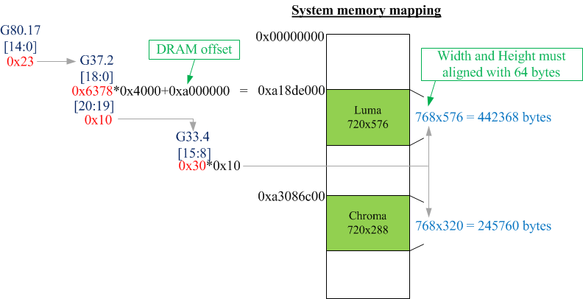
  Case : An Example with register setting for 2D CMDs

Slide 20
Read Sequence of Luma 720x576
 | X_{ADDR}
Y_{ADDR} | 0x00 | 0x40 | 0x80
0x00 | 0 | 3 | 4
0x01 | 1 | 2 | 5
0x02 | 6 | 8 | 10
0x03 | 7 | 9 | 11
0x04 | 12 | 15 | 16
0x05 | 13 | 14 | 17
…
0x23F (575)
Read Order
256x1 bytes data with BURST_WIDTH=32

Slide 21
HISTORY, no patterns use 2D Commands

Slide 22
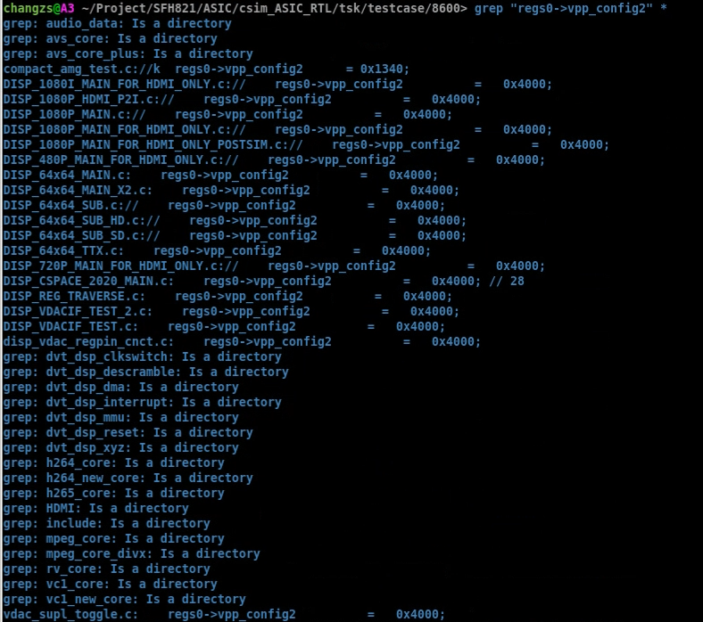

Slide 23
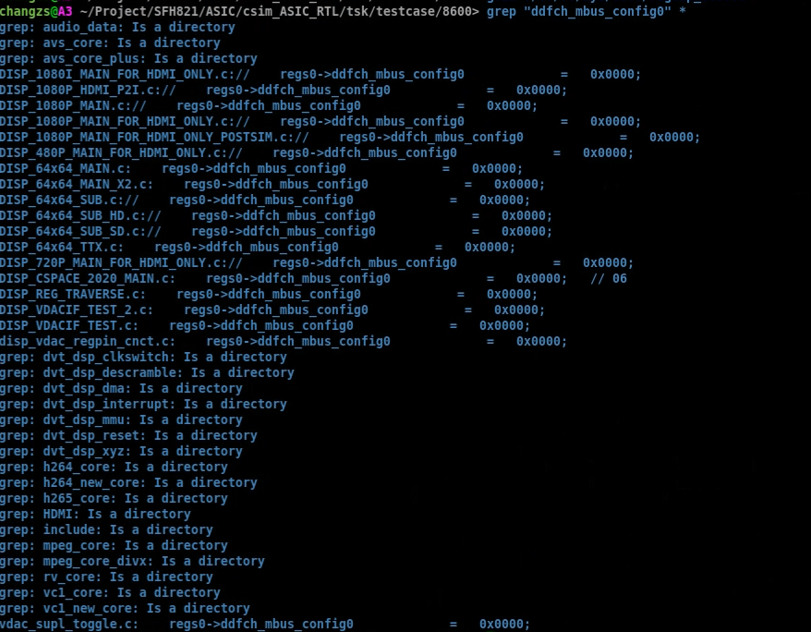

Slide 24
