Slide 1
Introduction of
M4 SSE-050 Coremark Build-Up
Jerry

Slide 2
Outline
SSE-050 Build-Up Steps
Testcode Compilation
CoreMark Porting for SSE050
Run Simulations

Slide 3

SSE-050 Build-Up Step
Steps 1: Copy files

Slide 4
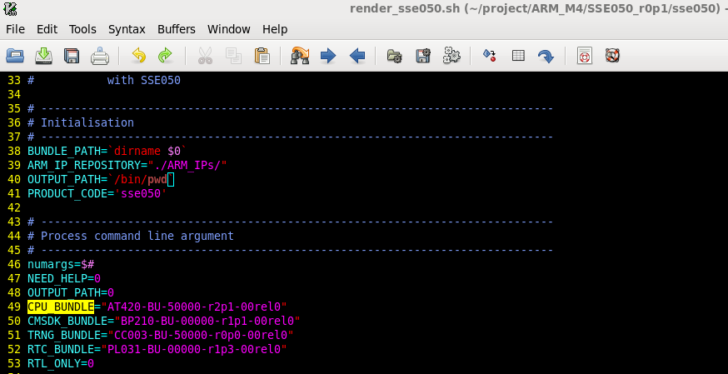
SSE-050 Build-Up Steps
Step 2
  Modify the IP install dir. & confirm the necessary IPs

Slide 5
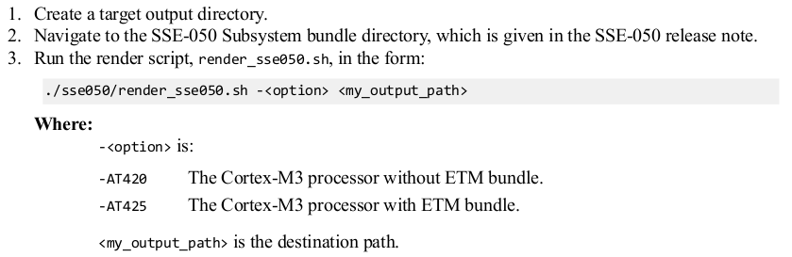
SSE-050 Build-Up Steps
Step3
  Execute render_sse050.sh

Slide 6
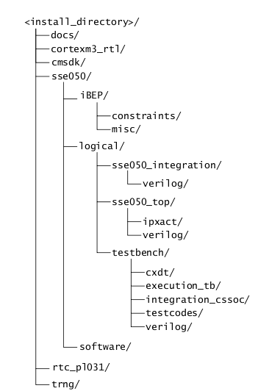
Testcode Compilation
Main Directories for SSE-050 Subsystem
Project files for each test code
Library files for software integration tests

Slide 7
Testcode Compilation
1. Copy this folder to WINDOWS
2. Build Project using KEIL Compiler in this folder
3. Put .bin into the original folder in workstation

Slide 8
CoreMark Porting for SSE050
Download codes from github & put source code to “./software”
Change MEM_METHOD to MEM_STATIC
Add UART & SystemTick initial process
implement clock() by SysTick
  Uses SystemTick in M3 to calculate the execution time
Change operating clock freq. setting in C code
Change compiler version and coefficients
Change TOOL_CHAIN and SIM in make.cfg

Slide 9
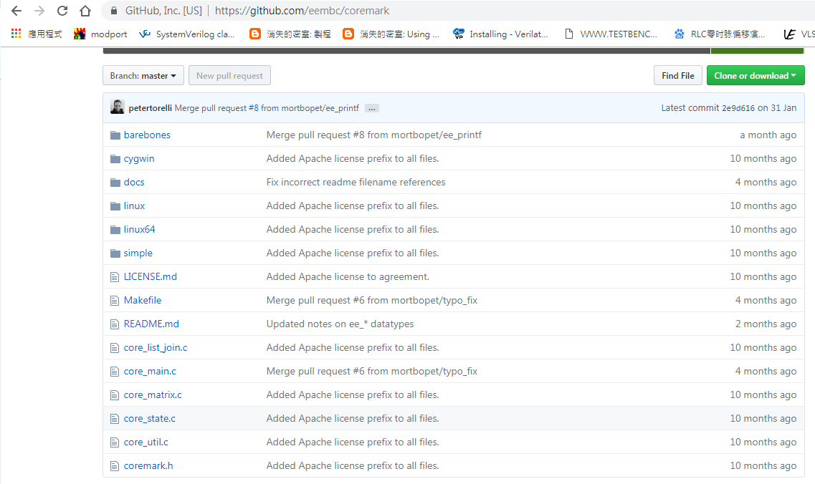
Download codes from github
Related with system setting
Related with performance evaulation process
Move source code to “./software”

Slide 10
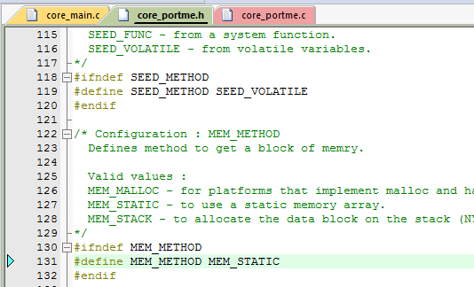
Change MEM_METHOD to MEM_STATIC
Follow the setting of F87382

Slide 11
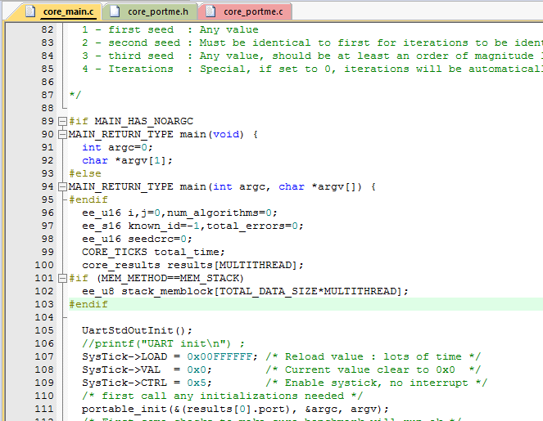
Add UART & SystemTick initial process

Slide 12
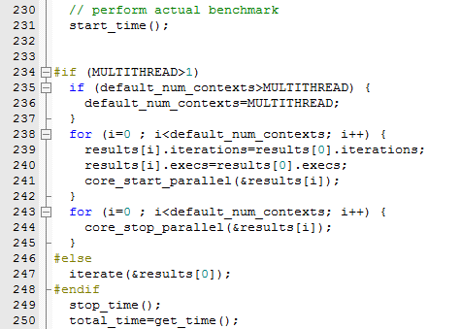
Implement clock() by SysTick
Time Calculation

Slide 13
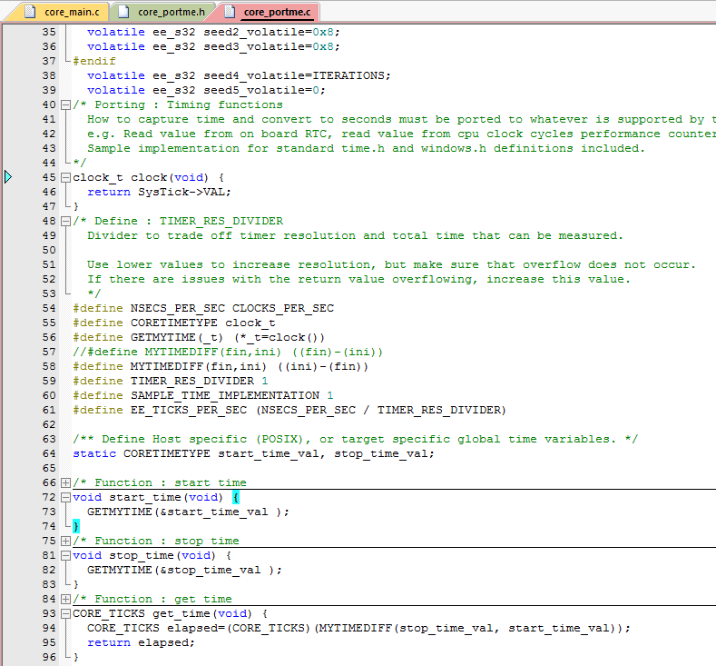
Implement clock() by SysTick

Slide 14
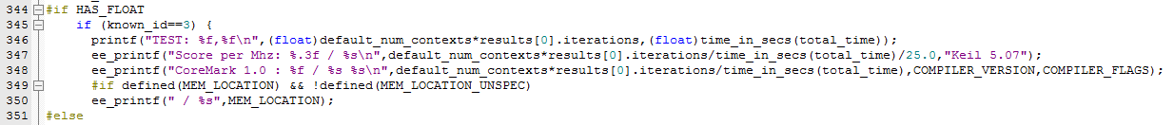
Change operating clock freq. setting in C code
default_num_contexts*results[0].iterations
  Iteration times of CoreMark
time_in_secs(total_time)
  Execution time (s)
/25.0
  System Operating freq.

Slide 15
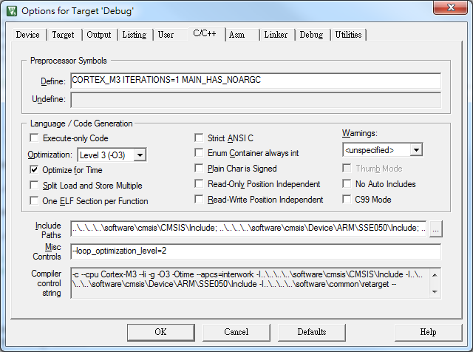
Change compiler version and coefficients

Slide 16
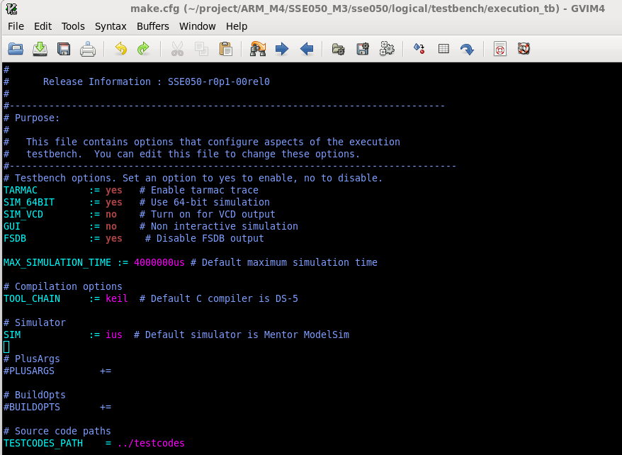
Change TOOL_CHAIN and SIM in make.cfg

Slide 17
Run Simulation
*Please use irun 14.2 & verdi 201509
1.cd sse050/ logical/testbench/execution_tb
2.make compile, and make sure no error message.

Slide 18
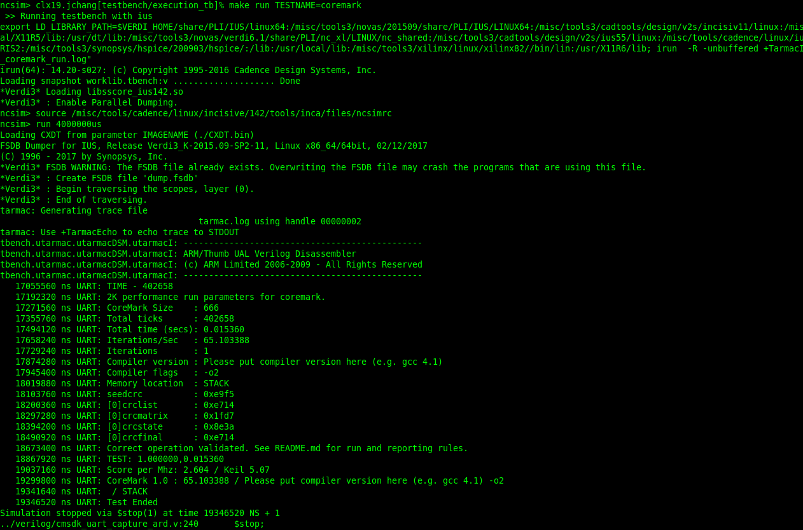
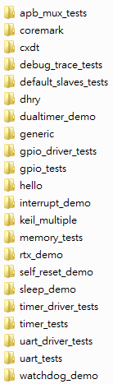
Run Simulation
3. make run TESTNAME=$testcase
The $testcase can be any string in the following lists.
For example, make run TESTNAME=coremark. The following figure shows the result.
TESTNAME List:
logical\testbench\testcodes\

Slide 19
Run Simulation
4. Debug, open verdi
make debug TESTNAME=coremark

