Slide 1
PART X
<Paper / talk title>
<Authors · Affiliation>
<Venue Year>
Notes:
[cover] 封面：论文原标题(+中文意译)、会议/年份、作者单位、汇报人与日期。读别人论文时汇报人与作者分开写。不要放摘要。
详见 references/page-content-guide.md

Slide 2
02
<Section name>
2
Notes:
[section] 章节页：章节号 + 这一部分要回答的问题。停留 10–20 秒。
详见 references/page-content-guide.md

Slide 3
<Claim of this slide + keyword>
Block 1
Block 2
Block 3
<Caption: what to look at>
3
Notes:
[focus] 聚焦页：主图中当前讲的模块高亮、其余变暗。
详见 references/page-content-guide.md

Slide 4
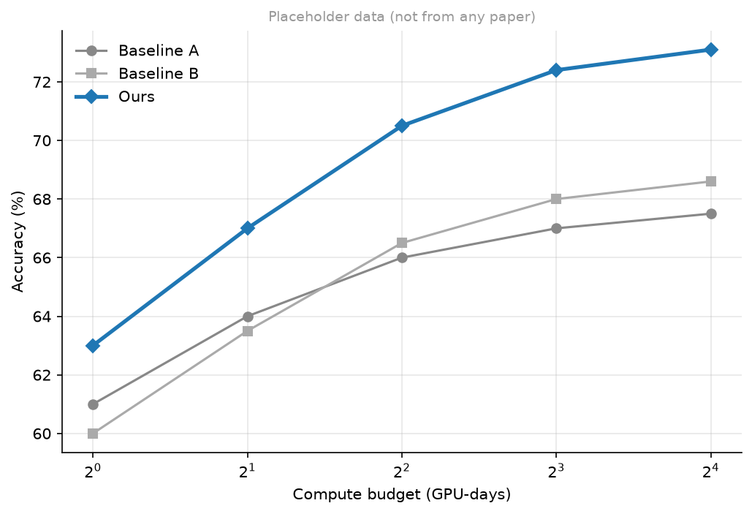
<Claim of this slide + keyword>
<What to notice in the figure>
4
Notes:
[explain] 解释页：一张图 + 一句看图要点。
详见 references/page-content-guide.md

Slide 5
<One statement with the key number>
<Attribution>
5
Notes:
[statement] 陈述页：一个反直觉观察或结论 + 一个支撑数字。
详见 references/page-content-guide.md

