Slide 1
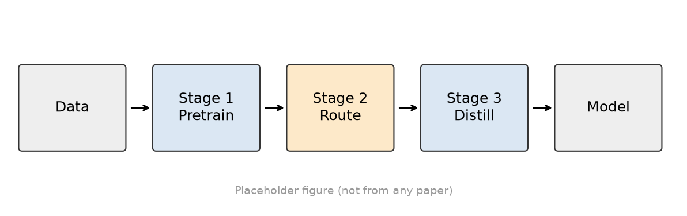
<Paper / talk title>
<Authors · Affiliation>
Notes:
[cover] 封面：论文原标题(+中文意译)、会议/年份、作者单位、汇报人与日期。读别人论文时汇报人与作者分开写。不要放摘要。
详见 references/page-content-guide.md

Slide 2
<Section name>
2
Notes:
[section] 章节页：章节号 + 这一部分要回答的问题。停留 10–20 秒。
详见 references/page-content-guide.md

Slide 3
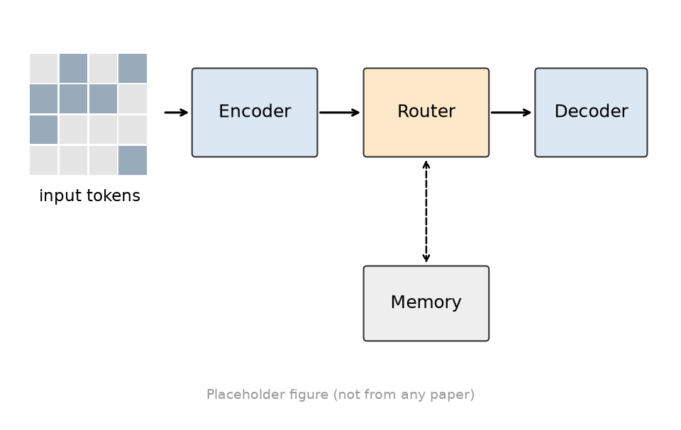
<Claim of this slide + keyword>
<Question this part answers>
<Caption: what to look at>
3
Notes:
[hero] 主视觉页：一图一句话，适合动机或概念引入。
详见 references/page-content-guide.md

Slide 4
<Claim of this slide + keyword>
1
<Point 1>
<one-line explanation>
2
<Point 2>
<one-line explanation>
3
<Point 3>
<one-line explanation>
4
<Point 4>
<one-line explanation>
4
Notes:
[chips] 要点卡片：3–4 个并列要点，每个标题 + 一行解释。
详见 references/page-content-guide.md

Slide 5
“
<A quote or design goal>
<Attribution>
5
Notes:
[quote] 引语页：一句话的设计目标或观点，注明出处。
详见 references/page-content-guide.md

