Slide 1
<Paper / talk title>
<Authors · Affiliation>
<Venue Year>
<Presented by name>
Notes:
[cover] 封面：论文原标题(+中文意译)、会议/年份、作者单位、汇报人与日期。读别人论文时汇报人与作者分开写。不要放摘要。
详见 references/page-content-guide.md

Slide 2
<Claim of this slide + keyword>
Q1)
<Item 1, ≤5 words>
Q2)
<Item 2, ≤5 words>
Q3)
<Item 3, ≤5 words>
2
Notes:
[questions] 问题式提纲：用 2–4 个问题组织全场，每部分开头高亮当前问题。
详见 references/page-content-guide.md

Slide 3
<Section name>
<Question this part answers>
3
Notes:
[section] 章节页：章节号 + 这一部分要回答的问题。停留 10–20 秒。
详见 references/page-content-guide.md

Slide 4
<Claim of this slide + keyword>
Step 1
Step 2
Step 3
Step 4
Step 5
<What is new on this slide>
4
Notes:
[buildSteps] 方法总览/逐步构建：同一张主图在后续页复用，只高亮当前模块；说明这一页新增了什么。
详见 references/page-content-guide.md

Slide 5
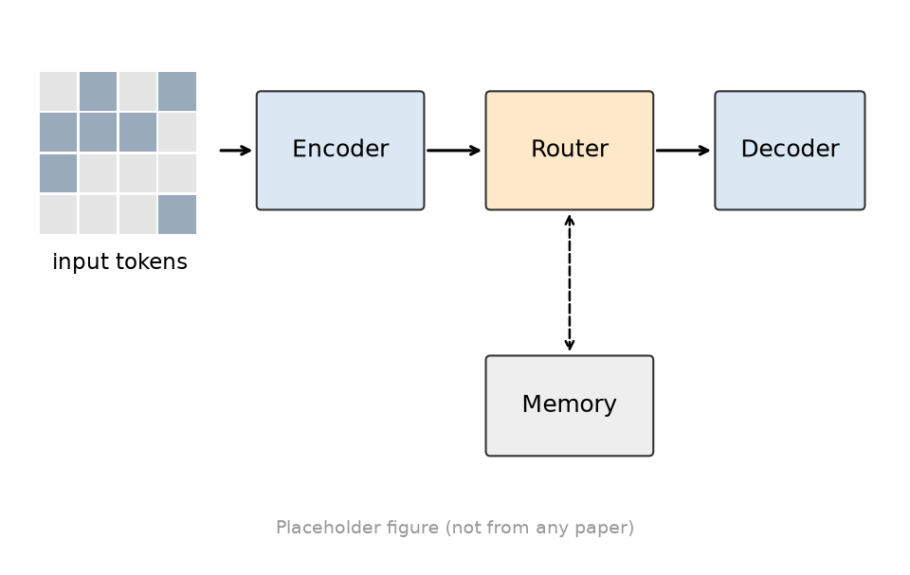
<Claim of this slide + keyword>
[Source]
<Point 1: ≤15 words>
<Point 2: ≤15 words>
<Point 3: ≤15 words>
<One-line takeaway>
Figure: <paper Fig./Table no.>
5
Notes:
[figureNotes] 图 + 要点：标题写结论；要点只解释图里看不出的东西；注明图源。
详见 references/page-content-guide.md

Slide 6
<Claim of this slide + keyword>
want: y = f_L( ... f_1(x) ) for every token
do: y = r(x) · f_deep(x) + (1 − r(x)) · f_shallow(x)
router score r(x)
cheap path
<Point 1: ≤15 words>
6
Notes:
[equation] 公式页：一个核心式，逐项标注符号含义；推导放备份页。
详见 references/page-content-guide.md

Slide 7
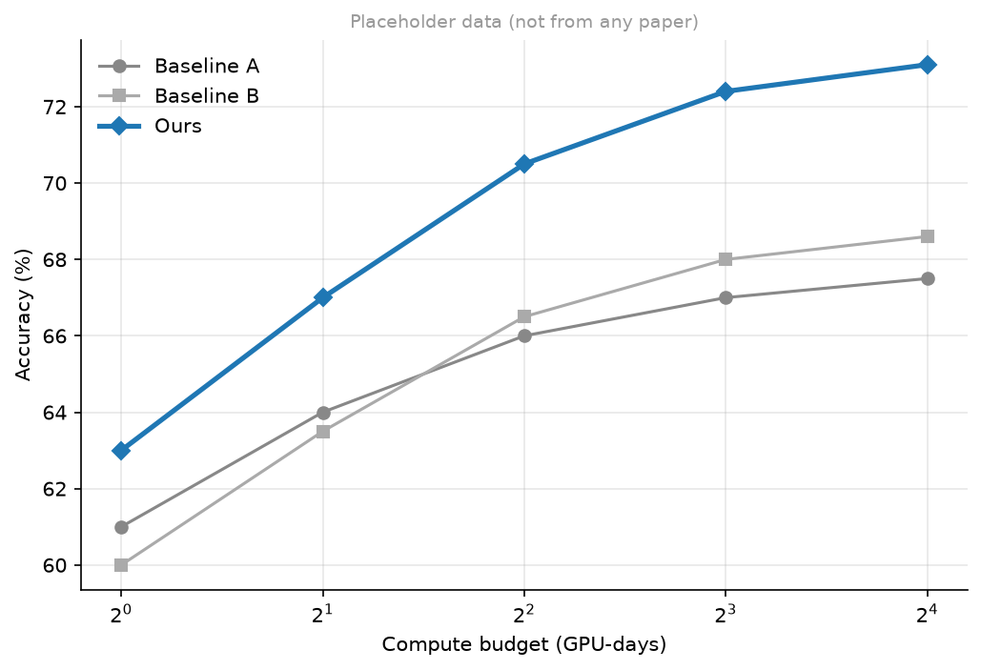
<Claim of this slide + keyword>
[Source]
+X%
<compared to what, under which setting>
<Conditions: data, seeds, hardware>
Figure: <paper Fig./Table no.>
7
Notes:
[result] 主结果：标题 = 结论 + 关键数字；标出基线、方向（↑/↓）、比较条件与 Table/Fig 出处。一页只证明一件事。
详见 references/page-content-guide.md

Slide 8
<Claim of this slide + keyword>
<Point 1: ≤15 words>
<Point 2: ≤15 words>
<Point 3: ≤15 words>
8
Notes:
[closing] 结尾：takeaway / 局限 / 开放问题，不要只写“谢谢”。
详见 references/page-content-guide.md

