Slide 1
<Paper / talk title>
<Question this part answers>
<Authors · Affiliation>
<Venue Year>
Notes:
[cover] 封面：论文原标题(+中文意译)、会议/年份、作者单位、汇报人与日期。读别人论文时汇报人与作者分开写。不要放摘要。
详见 references/page-content-guide.md

Slide 2
<Claim of this slide + keyword>
<Claim subtitle>
<Point 1: ≤15 words>
<Point 2: ≤15 words>
<One statement with the key number>
2
Notes:
[statement] 陈述页：一个反直觉观察或结论 + 一个支撑数字。
详见 references/page-content-guide.md

Slide 3
PART X
<Section name>
3
Notes:
[section] 章节页：章节号 + 这一部分要回答的问题。停留 10–20 秒。
详见 references/page-content-guide.md

Slide 4
<Claim of this slide + keyword>
<Claim subtitle>
Block 1
Block 2
Block 3
Block 4
Block 5
<Caption: what to look at>
4
Notes:
[focus] 聚焦页：主图中当前讲的模块高亮、其余变暗。
详见 references/page-content-guide.md

Slide 5
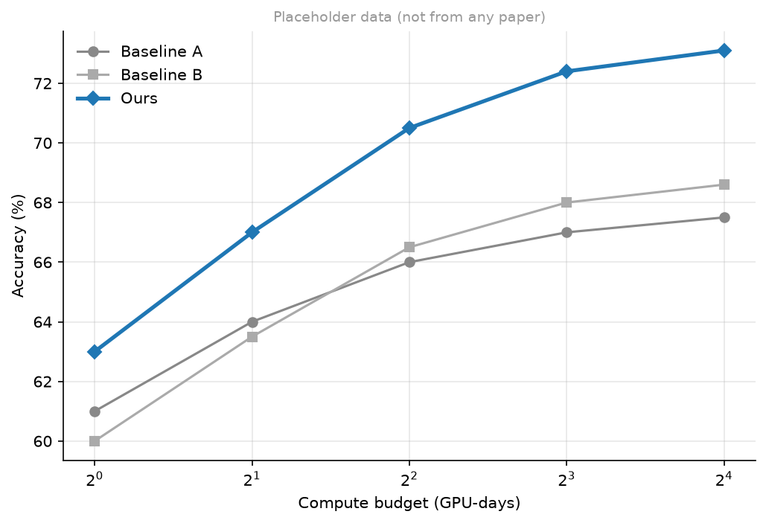
<Claim of this slide + keyword>
<Claim subtitle>
<Caption: what to look at>
5
Notes:
[figure] 图页：标题写结论，副标题写一句解释；图注说明看哪里。
详见 references/page-content-guide.md

Slide 6
<Claim of this slide + keyword>
1
<Point 1: ≤15 words>
2
<Point 2: ≤15 words>
3
<Point 3: ≤15 words>
6
Notes:
[closing] 结尾：takeaway / 局限 / 开放问题，不要只写“谢谢”。
详见 references/page-content-guide.md

