Slide 1
<Paper / talk title>
<Authors · Affiliation>
<Venue Year>
<code / project link>
Notes:
[cover] 封面：论文原标题(+中文意译)、会议/年份、作者单位、汇报人与日期。读别人论文时汇报人与作者分开写。不要放摘要。
详见 references/page-content-guide.md

Slide 2
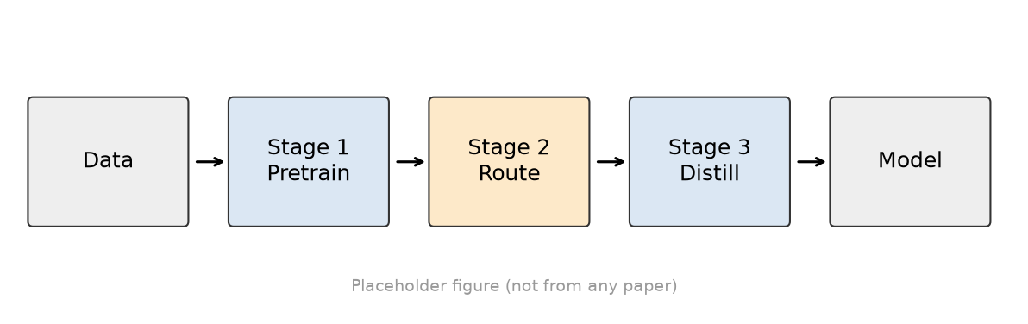
<Claim of this slide + keyword>
Insight #1 <Point 1>
<one-line explanation>
Insight #2 <Point 2>
<one-line explanation>
Motivation
Design
Evaluation
Notes:
[insights] Insight 卡：动机→设计逐页累积，当前卡高亮；顶部/底部追踪条显示所处阶段。
详见 references/page-content-guide.md

Slide 3
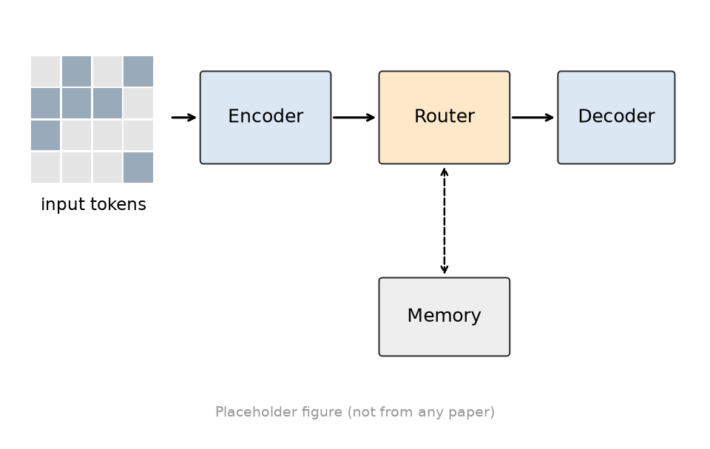
<Claim of this slide + keyword>
Insight #1 <Point 1>
<one-line explanation>
Insight #2 <Point 2>
<one-line explanation>
Insight #3 <Point 3>
<one-line explanation>
Motivation
Design
Evaluation
Notes:
[insights] Insight 卡：动机→设计逐页累积，当前卡高亮；顶部/底部追踪条显示所处阶段。
详见 references/page-content-guide.md

Slide 4
<Claim of this slide + keyword>
def score(rack, task):
s = cpu_fit(rack, task) + mem_fit(rack, task)
s -= alpha * uplink_util(rack) # new
return s
best = max(racks, key=lambda r: score(r, task))
<What the highlighted line does>
<Talk title · Speaker>
Motivation
Design
Evaluation
Notes:
[code] 代码页：≤8 行，高亮关键一行，旁边写这行的意义。
详见 references/page-content-guide.md

Slide 5
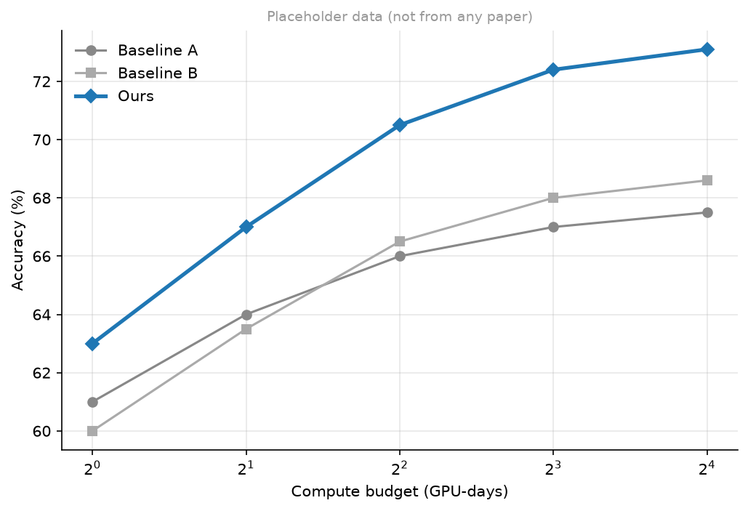
<Claim of this slide + keyword>
X×
<improvement over baseline>
lower is better ↓
<Conditions: data, seeds, hardware>
Motivation
Design
Evaluation
Notes:
[resultRatio] 结果比值：一个大数字（如 9.6×）+ 比较对象 + 越高/越低越好 + 实验条件。
详见 references/page-content-guide.md

Slide 6
<Claim of this slide + keyword>
<One-line takeaway>
Motivation
Design
Evaluation
Notes:
[banner] 结论横幅：图 + 底部一句 takeaway。
详见 references/page-content-guide.md

