Slide 1
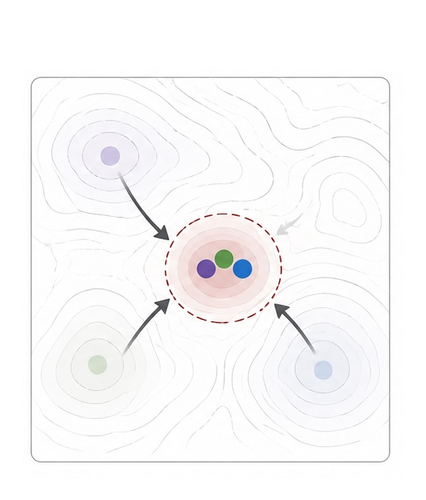
The Interaction
Tax
When communication erases diversity
in multi-agent teams
Convergence after full-output exchange
Summer Eunhyung Ann, Haokun Liu, Chenhao Tan
University of Chicago
ICML 2026 / arXiv:2608.23541v1
Paper reading / October 2026
Notes:
开场约 25 秒。论文研究的不是所有通信都是否有害，而是在统一预算的优化任务上，完整候选解的交换如何影响不同模型原本具有的探索差异。右图是论文图 1 的概念说明，不是实验轨迹。来源：Figure 1，https://arxiv.org/abs/2608.23541

Slide 2
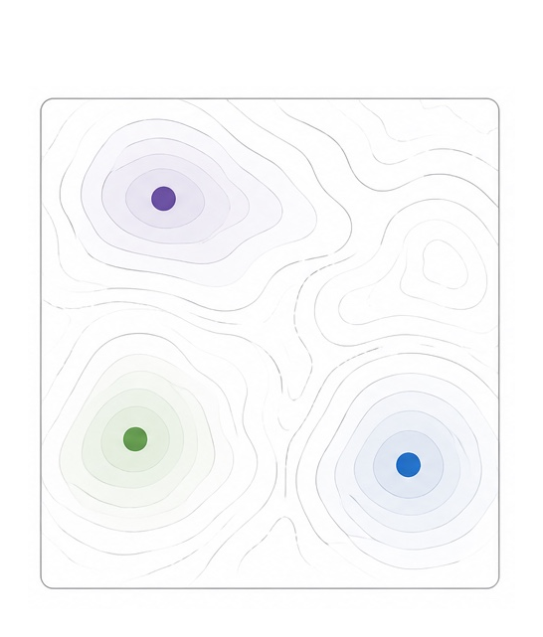
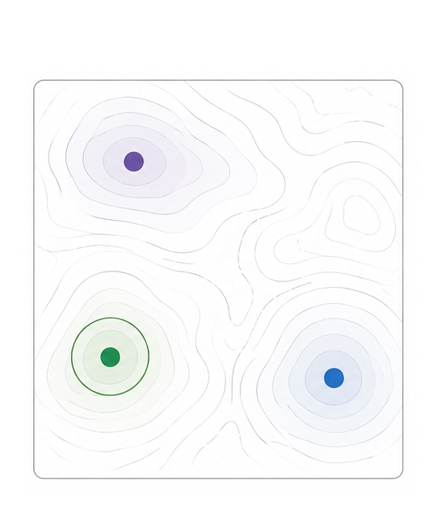
Two paths from independent proposals
Full-output exchange
Independent proposals
Best-of-N selection
Proposals converge
Different model families explore
Exploration remains independent
Figure 1: conceptual illustration, not measured trajectories
2
Notes:
约 65 秒。从中间的独立提案开始读。三个模型家族探索不同区域。向左是让提案者读取完整输出，后续解趋于相似；向右是保持提案独立，最后选择已有解。这里是两条替代路径，不是先收敛再靠选择恢复多样性。
来源：Figure 1: conceptual illustration, not measured trajectories。https://arxiv.org/abs/2608.23541

Slide 3
Ten workflows share the same resource budget
11 verifier-scored tasks / three model families
Single-agent controls (4)
Multi-agent workflows (6)
Single-Shot | One attempt
Best-of-N | Independent sampling
Self-Refine | Self-critique and revise
VGS | Verifier-guided search
Homo-Chain | Same-model revision
Cross-Chain | Cross-model revision
MAgICoRe | Solve, review, refine
Debate | Critique exchange
HPE | Plan and execute
MoA | Independent proposals
200K tokens / 600 s
Claude Sonnet 4 / GPT-4o
Gemini 2.5 Flash
MoA proposers never
read one another
Section 3 and Table 15
3
Notes:
约 65 秒。四个单智能体控制组，六个多智能体工作流。Homo-Chain 和 Cross-Chain 是两个配置，不要合并成一个计数。控制预算相同不代表工作流除了信息可见性以外完全相同：轮次、角色和搜索方式也不同。MoA 的关键区别是三个提案者不互看，合成器才读取提案。统一预算 T=200K, W=600s, C=30s, K=25，具体含义按原论文配置。
来源：Section 3 and Table 15。https://arxiv.org/abs/2608.23541

Slide 4
MEG and MIG use different baselines
MEG
MIG
Does the workflow improve?
Does interaction add value?
Workflow hidden score
Workflow hidden score
−
Best single-agent control score
−
Same agents’ independent score
Q ∈ [0, 1], higher is better. The hidden evaluator scores the final artifact.
Appendix AE: formal metric definitions
4
Notes:
约 65 秒。两种指标都用隐藏评分 Q，且越高越好。MEG 减去三个控制组中最好的分数，问整个工作流有没有超过最佳单智能体。MIG 减去同一批 agent 独立运行的并行基线，问交互本身有没有增加收益。它们不是同一个零点；MIG 为正不意味着 MEG 为正。并行基线的选择过程在论文 formal definition 的同一配置中固定。
来源：Appendix AE: formal metric definitions。https://arxiv.org/abs/2608.23541

Slide 5
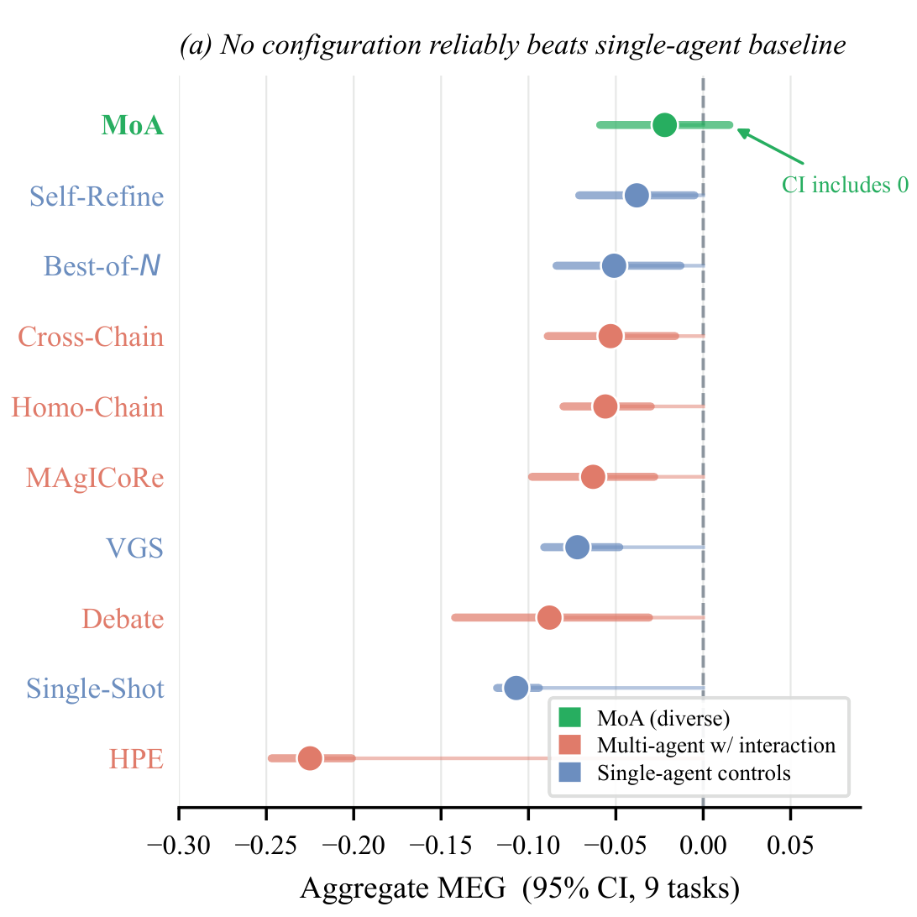
No workflow reliably beats the best single agent
0 / 10
Configurations with reliably positive aggregate MEG
MoA is the only configuration whose CI includes zero
Scope: the nine-task aggregate, not every task individually
Figure 2(a): aggregate MEG, 9 tasks, 95% CI
5
Notes:
约 65 秒。先看虚线零点，右侧才是正增益。0/10 表示这十个配置里，没有一个聚合 MEG 的置信区间完整位于零右侧。MoA 是唯一置信区间包含零的配置。这是九任务聚合结果，不能推出每个任务上交互都失败，更不能把相同预算下的质量损失说成测得了额外成本。
来源：Figure 2(a): aggregate MEG, 9 tasks, 95% CI。https://arxiv.org/abs/2608.23541

Slide 6
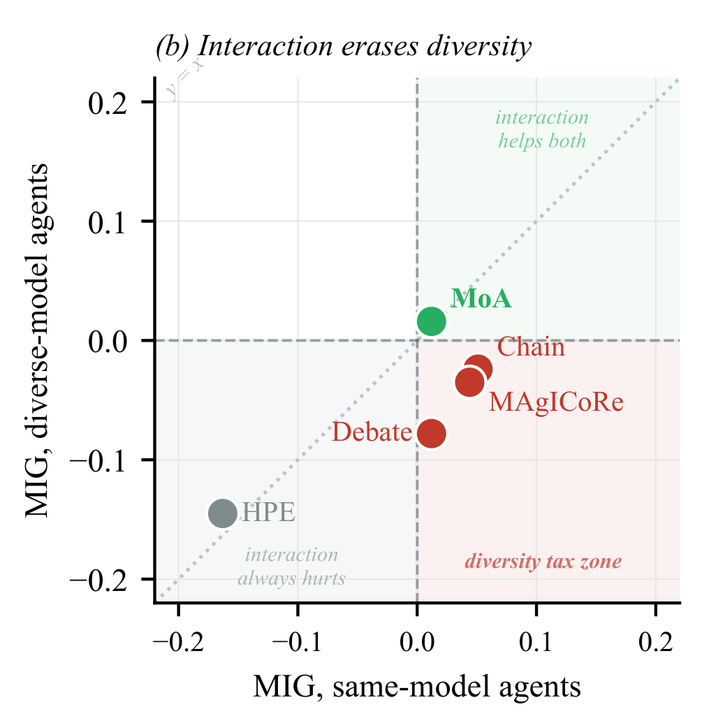
Three workflows lose their gain with diverse models
Workflow | Same | Diverse
Chain | +0.051 | −0.024
MAgICoRe | +0.044 | −0.035
Debate | +0.012 | −0.078
MoA | +0.012 | +0.016
The gain from full-output exchange depends on the model mix
HPE has negative MIG in both conditions
Figure 2(b) and Table 2: mean MIG across 8 tasks
6
Notes:
约 65 秒。横轴是同模型团队 MIG，纵轴是多模型团队 MIG。Chain、MAgICoRe、Debate 位于右下：同模型时有正增益，多模型时是负增益。表格给出对应数值。MoA 两种条件都略为正；HPE 两种条件都为负，不符合标题中的三种工作流，所以不能把这个模式说成所有交互系统的规律。
来源：Figure 2(b) and Table 2: mean MIG across 8 tasks。https://arxiv.org/abs/2608.23541

Slide 7
The diversity advantage is task-dependent
All three tasks
+0.188
95% CI [+0.073, +0.299]
Without Erdős
+0.014
95% CI [-0.109, +0.139]
-0.1
0.0
0.1
0.2
0.3
Estimated diversity effect with 95% confidence interval
N=120 overall; n=80 after withholding Erdős
Tables 10–11: diversity effect in the 2×2 factorial
7
Notes:
约 70 秒。这一页单独讨论另一个实验，不与 MIG 象限图混用。因子实验把同/多模型与选择/合成交叉，在 Erdős、DiffBases、MolQED 三任务上每格十次，合计 N=120。整体多样性系数 +0.188，但去掉 Erdős 后 +0.014，置信区间跨零。说明显著平均效应主要依赖任务构成，不证明多样性在所有任务上都带来稳定好处。
来源：Tables 10–11: diversity effect in the 2×2 factorial。https://arxiv.org/abs/2608.23541

Slide 8
Diverse Debate regresses after full-output exchange
Visible score (lower is better) Blue: same-model Red: diverse-model
Difference Bases
Erdős
Diverse
889 → 72 → 274
Diverse
1.28 → 0.3 → 0.38
R1 independent proposals R2 critique exchange R3 full-output exposure
Table 28: visible raw scores, lower is better on both tasks
8
Notes:
约 80 秒。这里按表 28 的真实数值重绘，两张图的纵轴量纲不同，不能跨图比较数值大小。蓝色同模型，红色多模型。第二轮交换批评，第三轮暴露完整输出。DiffBases 的多模型分数 889→72→274，Erdős 1.28→0.30→0.38，均第二轮最好、第三轮回退。同模型在这两任务上持续改善。这支持作者关于完整输出暴露时点的机制解释，但两任务观察不等于普遍因果定律。
来源：Table 28: visible raw scores, lower is better on both tasks。https://arxiv.org/abs/2608.23541

Slide 9
Fault localization and the value of critique
Feasibility rate (%), n=10 per condition
Knapsack: capacity violations are easy to locate
3AP-Free: locating a violating triple is harder
Can the critique identify a concrete repair?
Separate result: MAgICoRe / Gemini regresses in 17/30 first critiques on Erdős + Flat Poly (Table 7)
Table 3: Debate feasibility, n=10 per condition
9
Notes:
约 75 秒。纵轴是可行率，不是质量评分。每格十次。同模型 Debate 的 Knapsack-50 是 2/10，多模型是 10/10；3AP-Free-100 则从同模型 6/10 降为多模型 0/10。作者解释 Knapsack 的超重约束容易直接修复，而三项等差数列违例更难定位。另一个结果：MAgICoRe/Gemini 在 Erdős 与 Flat Polynomials 首轮批评退化 17/30=57%，不能泛化成所有优化任务的批评退化率。
来源：Table 3: Debate feasibility, n=10 per condition。https://arxiv.org/abs/2608.23541

Slide 10
The evidence is strongest within this benchmark
Evidence | Scope | Generalization limit
Main benchmark | 11 tasks, 5 seeds/cell | Writing, planning, dialogue
Diversity factorial | 3 tasks, N=120 | CI crosses zero without Erdős
Feasibility contrast | 2 tasks, n=10/cell | Other types of violation
Limited information | Proposed direction | Channels not directly compared
The next question: which information helps, on which tasks, and when?
Section 5: limitations and future work
10
Notes:
约 55 秒。四个边界：优化任务不是开放式写作；主基准每格五种子；多样性因子只三任务且依赖 Erdős；错误定位边界只两个可行性任务。低带宽信息通道在论文中提出，但没有直接比较哪种最好。区分已观察到的机制与下一步待验证假设。
来源：Section 5: limitations and future work。https://arxiv.org/abs/2608.23541

Slide 11
Independent proposals preserve useful coverage
Preserve differences
Diverse models are useful when exploration stays independent.
Control exposure
Full-output exchange can make distinct strategies converge.
Repair concrete faults
Critique is more useful when the violation can be located.
Open question: do scores, failure causes or verified summaries preserve exploration?
Proposed ablation: the paper has not directly compared these sharing channels.
Section 5 and Appendix A: author-proposed workflow
11
Notes:
约 55 秒。论文的建议是在这些优化任务上先独立生成，再用验证器排序；当错误可定位时加入针对性批评，最后用更严格的隐藏验证器检查。不要把建议说成适用于所有 agent 系统的定律。下一步可以比较仅共享分数、失败原因、验证摘要和完整输出，控制预算、任务和提案数。
来源：Section 5 and Appendix A: author-proposed workflow。https://arxiv.org/abs/2608.23541

