Slide 1
SW
３
２
０
０
SW
SW
SW
１
１
３
２
SW

Slide 2
SW
3
4
1
1
SW
SW
SW
2
2
0
3
4
host
SW

Slide 3
SW
SW
３
２
５
０
４
０
SW
SW
SW
１
５
１
４
SW
３
２
SW

Slide 4
SW
SW
3
6
4
5
1
1
SW
SW
SW
2
2
6
3
0
SW
5
4
SW
host

Slide 5
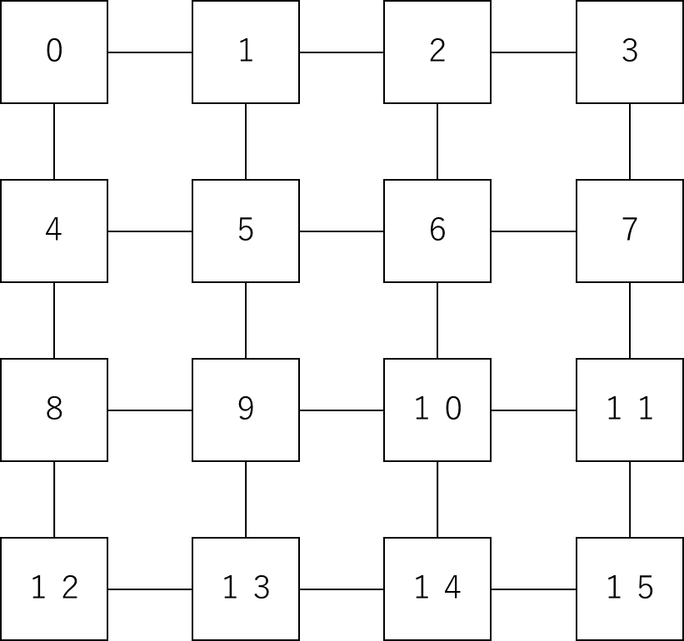
３２
３３
３４
３５
１６
１７
１８
１９
３９
２３
４３
２７
４７
３１

Slide 6
１６
１７
１８
１９
２０
２１
２２
２３
２４
２５
２６
２７
２８
２９
３０
３１

Slide 7
３２
３３
３４
３５
１６
１７
１８
１９
３９
２３
４３
２７
４７
３１

Slide 8
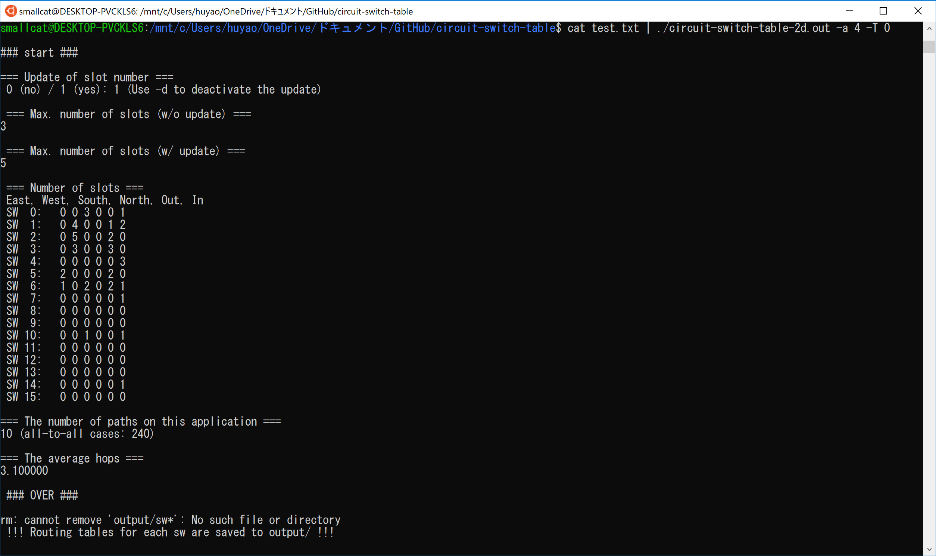
-a 4
Number of switches is 4*4 = 16
-T 0
→ 0 mesh, 1 torus
Routing table for each switch is generated in output/

Slide 9
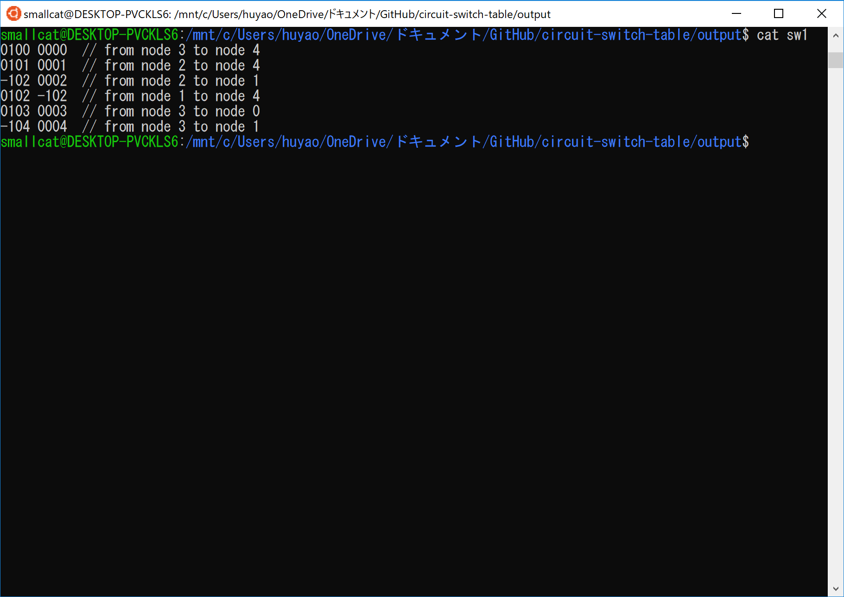
output-port output-slot input-port input-slot
XX---------XX XX------- XX // X → 1-digit number
0101 0001 ← from port 0 slot 1 to port 1 slot 1
0102 -102 ← from localhost (-1) slot 2 to port 1 slot 2
-104 0004 ← from port 0 slot 4 to localhost (-1) slot 4

Slide 10
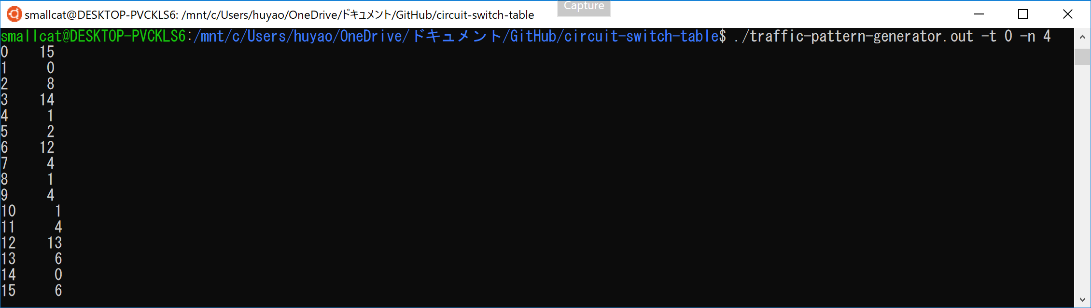
-t 0
Traffic pattern
0 uniform, 1 matrix, 2 reversal, 3 hotspot, 4 neighbor, 5 shuffle, 6 butterfly, 7 complement, 8 tornado, 9 all-to-all
-n 4
→ Number of nodes is 4*4 = 16
src-node dst-node
0 15 ← from node 0 to node 15
1 0 ← from node 1 to node 0
8 ← from node 2 to node 8
……
……

Slide 11
Host_Num (-n) = 4
PORT = 5
node_num (-a) = 16
20
Usage:
cat $trace | ./circuit-switch-table.out –T 2 –n 4 –a 4 ← 16 nodes
SW4
1
2
3
4
16
0
17
18
19
SW0
SW1
SW2
SW3
1
3
4
2
0
1
2
3
4
5
6
7
8
9
10
11
12
13
14
15

Slide 12
host
host
0
1
0
1
1
0
3
2
2
3
0
0
1
1
2
3
3
2
2
3
host
output port = dst ID
localhost port = sw ID
host
Usage:
cat $trace | ./circuit-switch-table.out –T 3 –a 2 ← 4 switches/nodes

