Slide 1
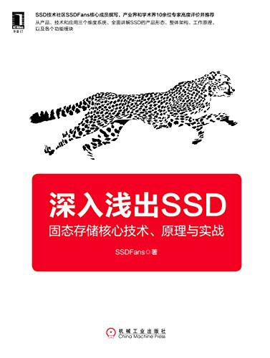
Purpose
Introduce the basic concept of FTL (Flash Transition Layer) in SSD, since computer science does not cover SSD-related course
Book: 深入淺出 SSD

Slide 2
die
smallest unit that can independently execute commands
or report status
(die interleave)
plane
block
page
…
…
…
…

Slide 3
die
plane
block
page
empty data
valid data
invalid data
…
…
Only consider 1 plane in this project

Slide 4
die
plane
block
page
empty data
valid data
invalid data
…
…
Only consider 1 plane in this project

Slide 5
die
plane
block
page
empty data
valid data
invalid data
…
…

Slide 6
Garbage Collection (GC)
die
plane
block
page
empty data
valid data
invalid data
…
…
Find a block that contains most invalid data
Move the valid data to an empty block
No move operation in NAND Flash
Must decompose to read, and then write

Slide 7
Garbage Collection (GC)
die
plane
block
page
empty data
valid data
Erase to get new empty block
invalid data
…
…

Slide 8
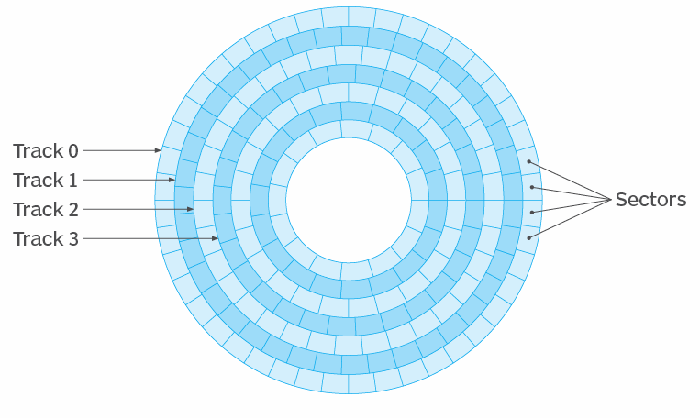
Scenario
The unit in user’s view
sector (512 B)
The addressing scheme
logical block address (lba)
The unit in NAND Flash’s view
page (4KB)
The addressing scheme
physical page address (ppa)
sector: 512 Bytes
page: 4096 Bytes
Reference: https://www.techtarget.com/whatis/definition/logical-block-addressing-LBA

Slide 9
API Design
writeData (lba, sector_cnt, *source_data)
readData (lba, sector_cnt, *tar_data)
programPage (pca, *source_data)
readPage (pca, *tar_data)
eraseBlock(block)
1
3
2
unit conversion, table mapping
FTL
(Flash Transition Layer)
NAND Flash
User

Slide 10
FTL
ppa
lpa to which ppa is decided by FTL
lpa 0
lba0
lba1
lba2
lba3
lba4
lba5
lba6
lba7
lpa 1
lba8
lba9
lba10
lba11
lba12
lba13
lba14
lba15
…
lpa n
lba 8n
lba 8n+1
lba 8n+2
lba 8n+3
lba 8n+4
lba 8n+5
lba 8n+6
lba 8n+7
FTL can calcutae lpa from lba
FTL decide write lpa to which ppa
So, we can construct a lpa to ppa mapping table (l2p table)

Slide 11
Something you should think about
The number of valid/invalid data in a block
Which ppas are vaild/invalid
Which blocks are empty
When page data is moved because of erase, how to know the corresponding lpa and update lpa to ppa table?

Slide 12
Conclusion
Erase before write
The units of erase, program and read are different
erase: block
program/read : page
some read commands can read in plane unit, we exclude this case in the project
FTL task
unit conversion
table mapping
ppa allocation

Slide 13
die
plane
block
page
die
plane
block
page

