Slide 1
WHY DO WE NEED AN ORCHESTRATOR?

Slide 2
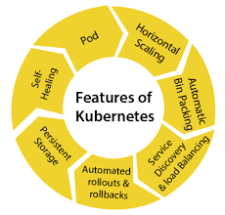
KUBERNETES
Kubernetes is a portable, extensible, open-source platform for managing containerized workloads and services, that facilitates both declarative configuration and automation. It has a large, rapidly growing ecosystem. Kubernetes services, support, and tools are widely available.

Slide 3
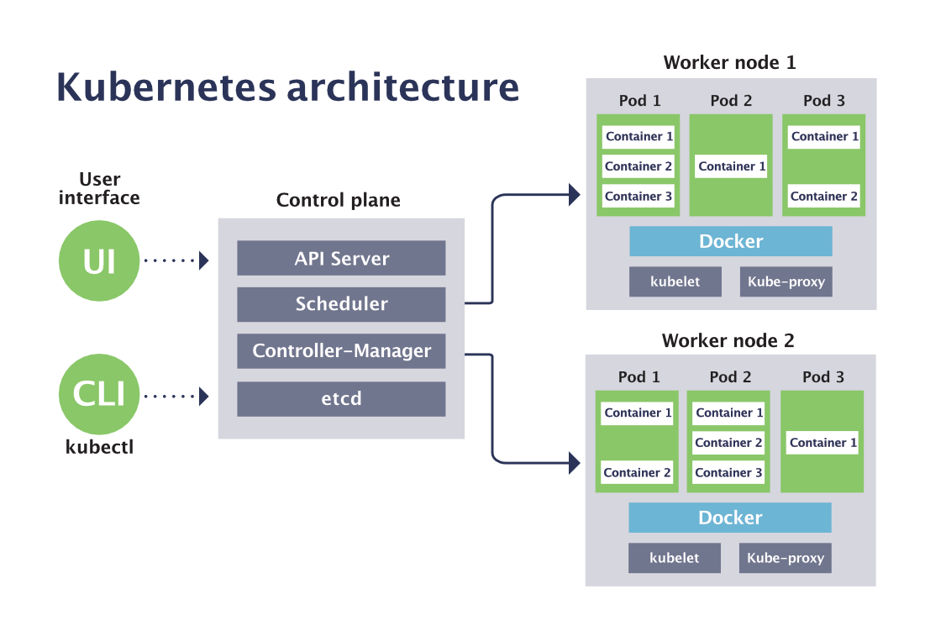

Cloud controller
Data Plane / node pool / worker pool /agent pool

Slide 4
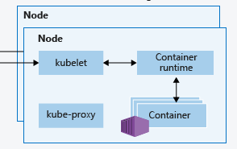
Compute
Nodes:Kubernetes runs your workload by placing containers into Pods to run on Nodes. A node may be a virtual or physical machine, depending on the cluster.
Control Plane

Slide 5
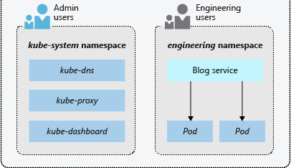
Namespaces
Kubernetes resources, such as pods and deployments, are logically grouped into a namespace to divide an AKS cluster and restrict create, view, or manage access to resources. For example, you can create namespaces to separate business groups. Users can only interact with resources within their assigned namespaces.

Slide 6
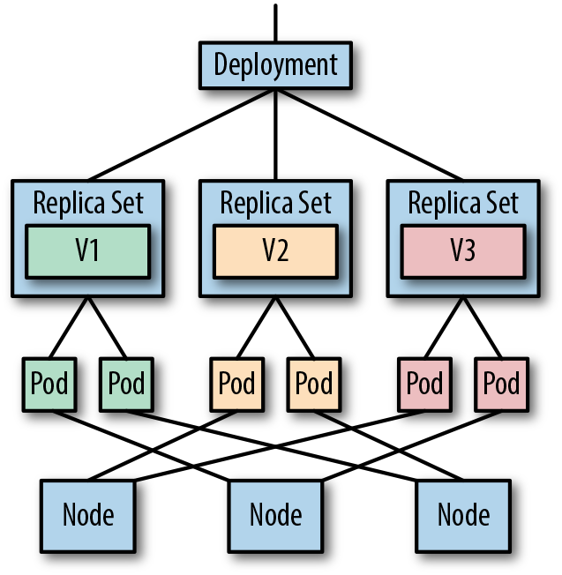
Kubernetes Workloads
A workload is an piece of code running on Kubernetes
Kubernetes provides several built-in workload resources:
Pod
Deployment and Replica Set
StatefulSet
DaemonSet
Job and CronJob

Slide 7
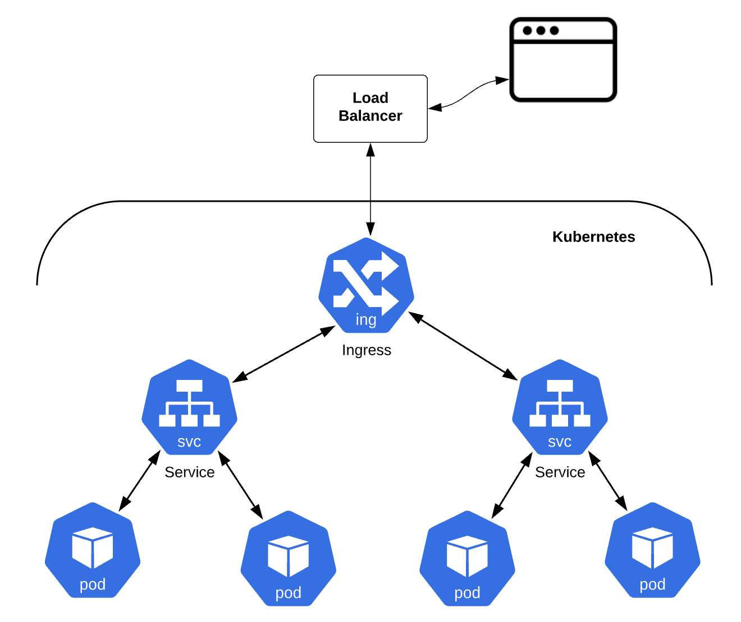
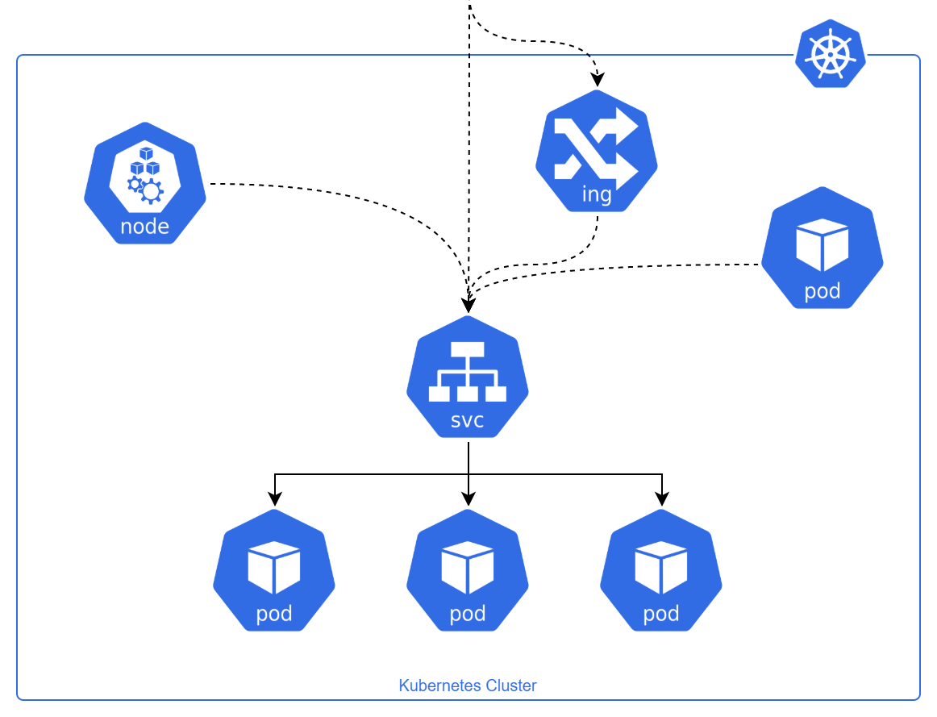
Networking
foo.com/catalog
foo.com/cart

Slide 8
Networking contd
CoreDNS
Kube-proxy
Container Networking Interface

Slide 9
Storage
Persistent Volume:It is a piece of storage in the cluster that has been provisioned by an administrator or dynamically provisioned using Storage Classes. It is a resource in the cluster just like a node is a cluster resource.
Persistent Volume Claim :It is a request for storage by a user. It is similar to a Pod. Pods consume node resources and PVCs consume PV resources. Pods can request specific levels of resources (CPU and Memory). Claims can request specific size and access modes (e.g., they can be mounted ReadWriteOnce, ReadOnlyMany or ReadWriteMany
Storage Class : A StorageClass provides a way for administrators to describe the "classes" of storage they offer. Different classes might map to quality-of-service levels, or to backup policies, or to arbitrary policies determined by the cluster administrators.

Slide 10
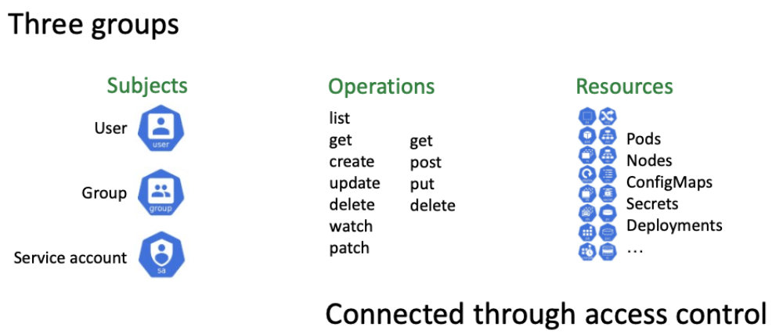
RBAC

Slide 11
Cont…
Service Account : A service account provides an identity for processes that run in a Pod.
Roles and Roles Binding : An RBAC Role or ClusterRole contains rules that represent a set of permissions. A role binding grants the permissions defined in a role to a user or set of users. It holds a list of subjects (users, groups, or service accounts), and a reference to the role being granted.
Cluster role and Cluster role binding : A ClusterRole is a set of permissions that can be assigned to resources within a given cluster. ClusterRoleBinding grants that access cluster-wide

Slide 12
QnA

