Slide 1
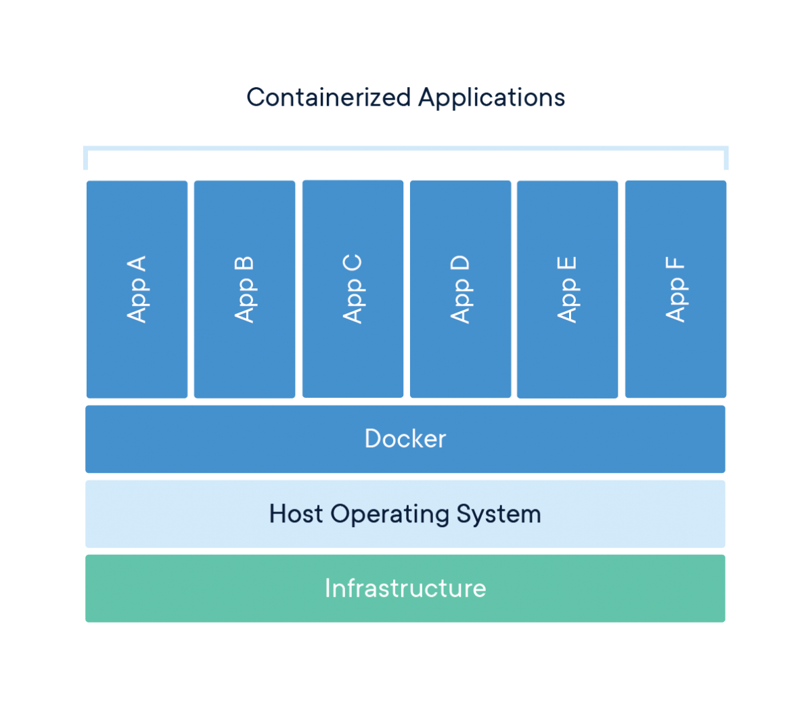
What is a container?
A container is a standard unit of software that packages up code and all its dependencies, so the application runs quickly and reliably from one computing environment to another.
P.S: It runs as a process in the Host.

Slide 2
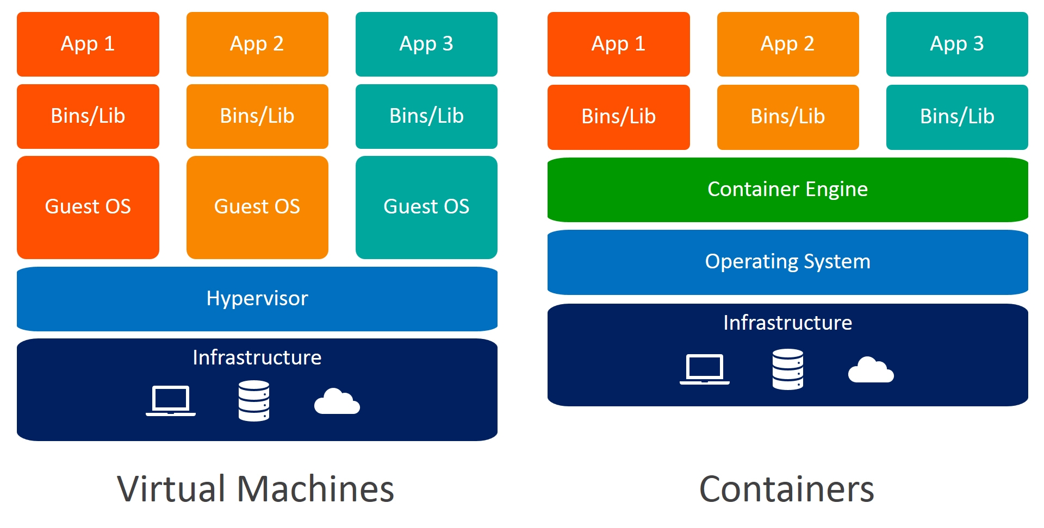
Virtualization v Containers

Slide 3
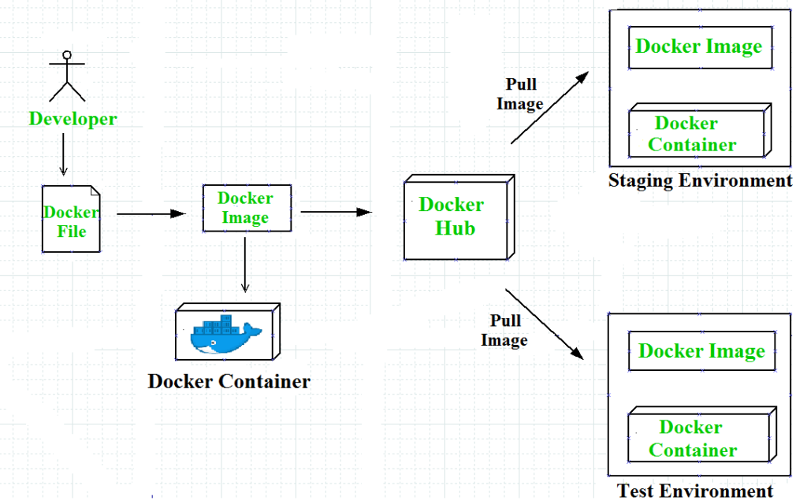


How are containers made?
Can be any container registry private / public
Container image is a lightweight, standalone, executable package of software that includes everything needed to run an application: code, runtime, system tools, system libraries and settings.
Container images become containers at runtime and in the case of Docker containers - images become containers when they run on Docker Engine.

Slide 4
Container Runtimes
Rkt
Moby
Containerd
Docker

Slide 5
Features of Docker
Standard: Docker created the industry standard for containers, so they could be portable anywhere
Lightweight: Containers share the machine’s OS system kernel and therefore do not require an OS per application, driving higher server efficiencies and reducing server and licensing costs
Secure: Applications are safer in containers and Docker provides the strongest default isolation capabilities in the industry
Pluggable: Robust for pluggable drivers

Slide 6
Docker Networking
Docker’s networking subsystem is pluggable, using drivers. Several drivers exist by default, and provide core networking functionality:
bridge
host
overlay
macvlan
none
3rd party network plugins

Slide 7
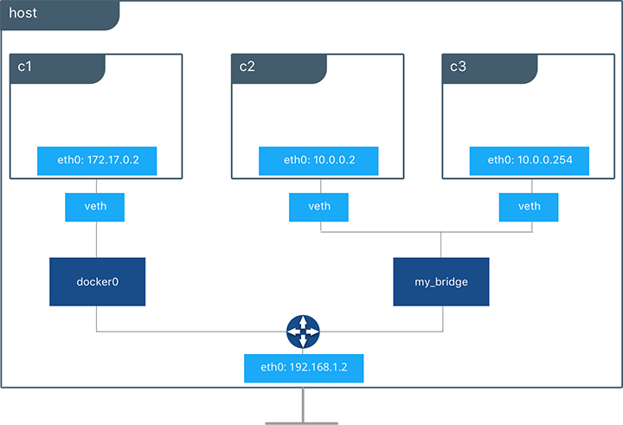
Docker Bridge

Slide 8
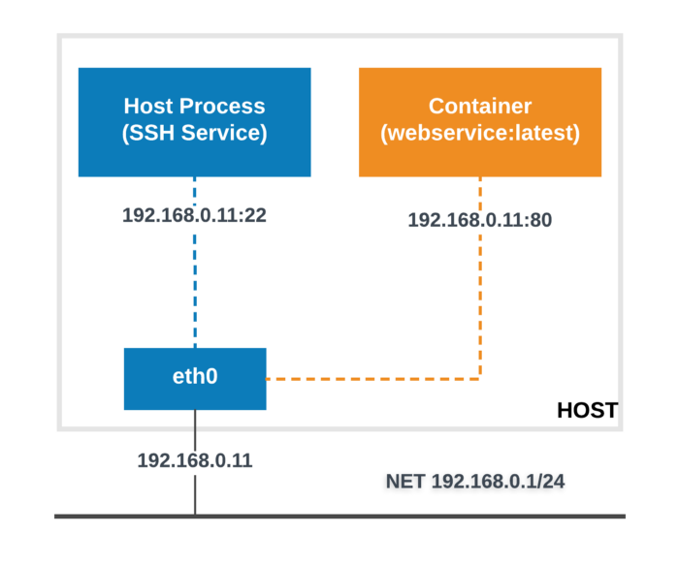
Host networking

Slide 9
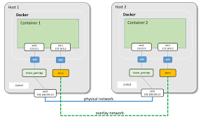
Overlay networking

Slide 10
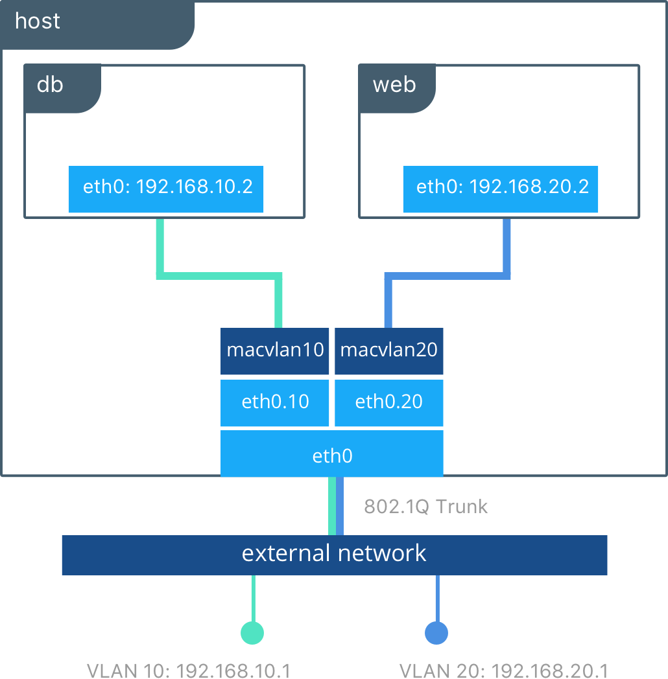
Using the macvlan driver

Slide 11
Docker storage mounts
Volumes are stored in a part of the host filesystem which is managed by Docker (/var/lib/docker/volumes/ on Linux). Non-Docker processes should not modify this part of the filesystem. Volumes are the best way to persist data in Docker.
Bind mounts may be stored anywhere on the host system. They may even be important system files or directories. Non-Docker processes on the Docker host or a Docker container can modify them at any time.
tmpfs mounts are stored in the host system’s memory only, and are never written to the host system’s filesystem.
named pipes: An npipe mount can be used for communication between the Docker host and a container. Common use case is to run a third-party tool inside of a container and connect to the Docker Engine API using a named pipe.

Slide 12
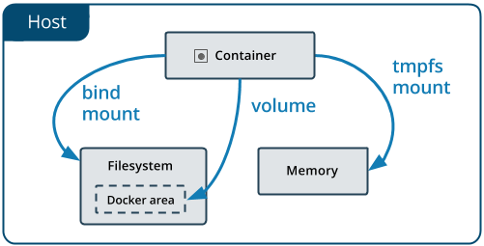
Docker storage mounts

Slide 13
QnA

