Slide 1




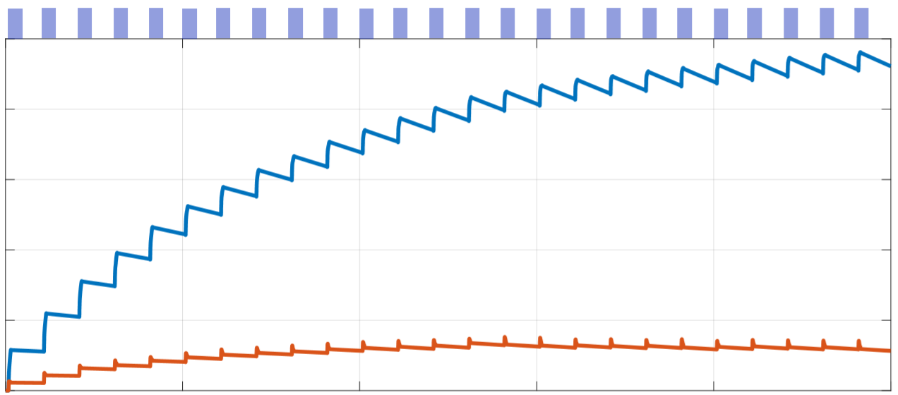
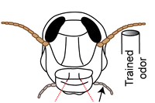

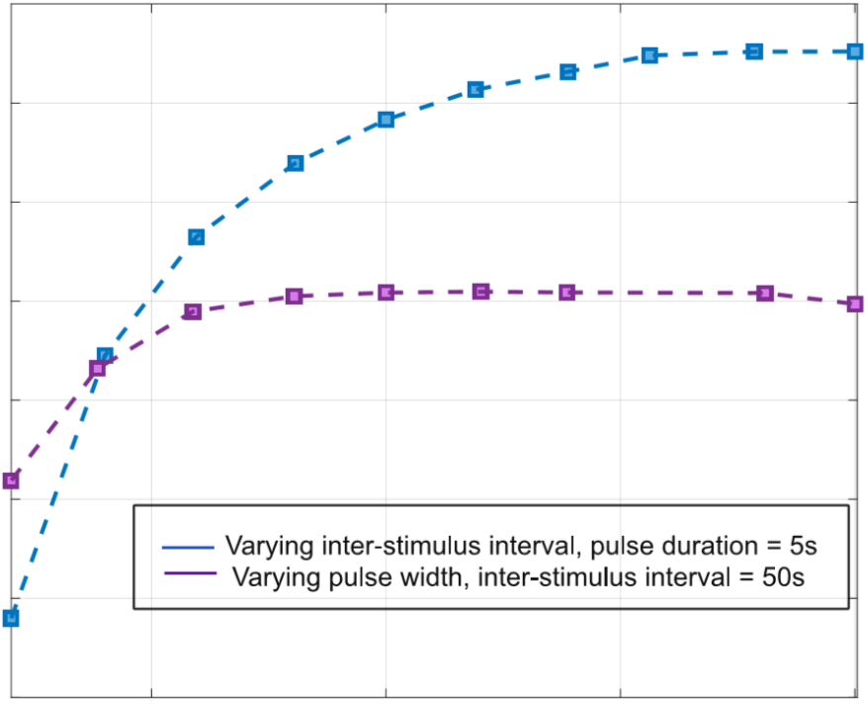
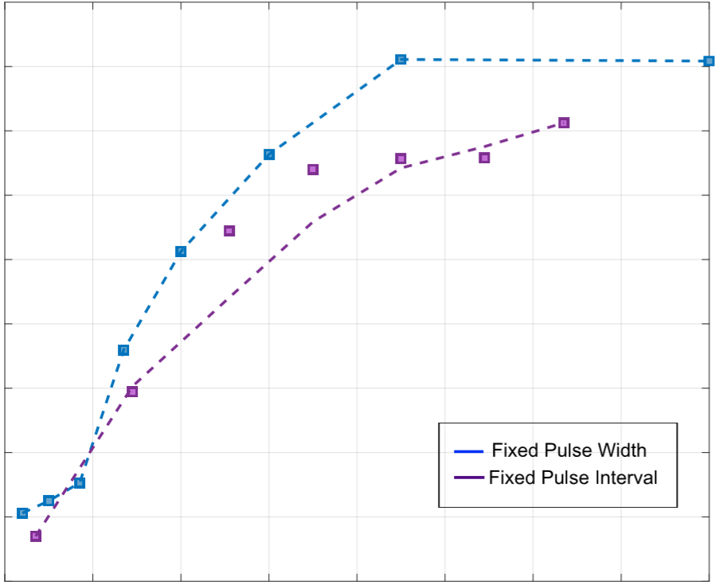
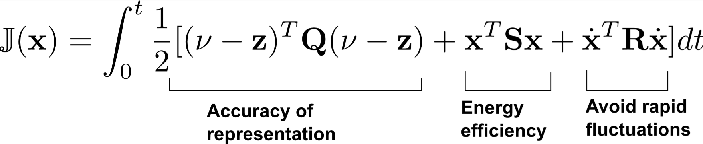
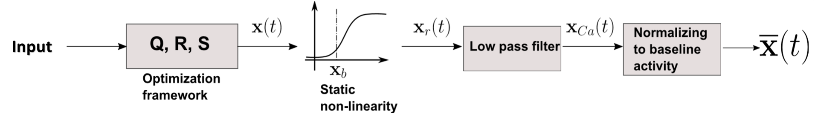
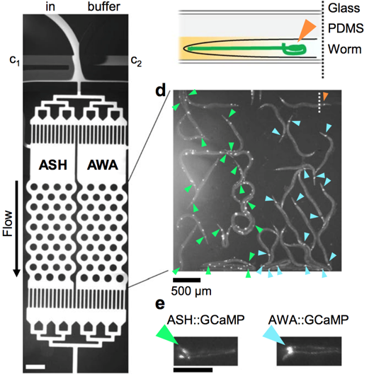
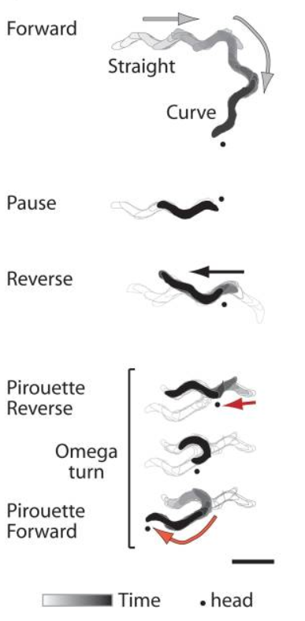
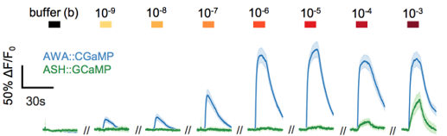

Multiple time-scale normative circuit model of C. elegans sensory adaptation and behavior
Hamilton White^{1,3}, Sruti Mallik⁴, ShiNung Ching⁴, Baranidharan Raman⁵, Dirk R. Albrecht^{1,2}
¹Department of Biomedical Engineering, ²Department of Biology and Biotechnology, Worcester Polytechnic Institute
³Worcester Polytechnic Institute – University of Massachusetts Medical School Joint PhD Program
⁴Department of Electrical and Systems Engineering, ⁵Department of Biomedical Engineering, Washington University at St Louis
Introduction & Objectives
Results: Model Parameterization
Results: Optogenetic stimulation
Sensory neural networks mediate state-dependent transformations from external stimuli to behavioral response, allowing dynamic adjustment to the environment and organism needs.
We seek to uncover rules that govern these neural computations and how emergent phenomena arise in normal and disease conditions.
For example, neurons in early olfactory networks adapt their responses to repetitive stimuli, while retaining their ability to respond to a novel stimulus^{1,2}.
Neural responses adapt to repeating stimulus due to slow but steady build-up of memory during successive encounters.
Parameters of the computational model were fit to AWA neuron calcium responses using a single stimulation pattern:
4 s pulse of 1 µM diacetyl every 60 s
The transformation between neural representation of sensory information and behavior is unknown.
Several possible scenarios allow uniform behavior from uniform stimulation, despite neuronal adaptation, such as:
Stimulus
1
Linear compensation: downstream circuits become equally sensitized to respond to weaker input
Nonlinear flip-flop: downstream circuits are insensitive to changes in neural response above inflection
, ν
0
5
15
25
…
The general olfactory system architecture is conserved across species³.
Characteristic adaptation responses to repetitive stimulation are observed in locust and C. elegans⁴⁻⁶.
We aim to investigate inter-species similarity in neural adaptation, and extend observations to behavior.
C. elegans contains 302 neurons and ~7000 synapses.
Stimulus (odor)
C. elegans
locust
Behavior
Sensory
other
e.g., diacetyl
ORNs
e.g. geraniol
2
Experiment
To test these models, optogenically-evoked AWA sensory neural and behavioral responses were compared before and after odor adaptation.
Animals expressing the ion channel Chrimson^{5,7} in AWA neurons respond consistently to red light with minimal adaptation (neurons and behavior).
neurons
AWA
AWA Neuronal
Activity dF/F0
Model simulation
Interneurons
AIZ
AIA
PNs
1
AIB
ADA
AIY
0
Command
AVA
AVB
0
5
10
15
20
25
Red light, 20 s
1 µM diacetyl, 20 s
Red light, 20 s
interneurons
AVD
PVC
KCs
Experiment time (min)
30
trials
Motor neurons
AVE
Results: Predictions & experiment
Behavior
DA,VA
DB,VB
AWA
neural
activity
100%
dF/F₀
Locomotion
reverse
/ forward
Palp
close
/ open
Neural responses were simulated to varying pulse patterns: width, inter-stimulus interval (ISI), and duty cycle (width/ISI).
Adaptation in peak neural responses was predicted to be more sensitive to stimulus interval than to pulse width.
Forward
behavior
Each neuron is individually addressable via genetic expression.
50%
Prob.
Methods
Pirouette
reverse
The predictions were verified experimentally in C. elegans chemosensory experiments, using both naïve and pre-exposed animals.
Pulse width
Interval
Duty cycle
Stimulus pre-eposure
Trial #
1-3
4-6
7-9
10-12
13-15
16-18
19-21
22-24
25-27
28-30
Computational Model:
Multiple timescales of information are embedded in the neural response.
γ – residual memory
ν – latent representation
Odor receptors
Sensory neurons
2 s | 60 s | 3.3% | naïve
4 s | 60 s | 6.7% | naïve
4 s | 90 s | 4.4% | naïve
2 s | 60 s | 3.3% | 1 h pre-exp
20 s | 60 s | 33% | 1 h pre-exp
*
If downstream circuits become sensitized to weaker sensory neural responses during adaptation, then behavior responses to optogenetic stimulation should strengthen. This was not observed experimentally, despite some increase in optogenetic light response after adaptation.
Behavior
0.6
Pulse width = 5 s
1.0
Training
Pulse interval = 50 s
0.9
0.5
0.8
2 s
20 s
Summary & Future directions
0.7
Peak dF/F₀ trial 25 vs. first trial
Peak dF/F₀ vs. first trial
Decoders
0.4
0.6
An optimization based framework converts odor cues to neural responses.
0.5
*
A two time-scale normative model of C. elegans sensory neural responses, structured on locust olfaction and parameterized with one stimulus pattern, effectively predicted adaptation to other temporal patterns.
Current model may benefit from interaction among time scales, such as adjustment of fast inactivation during slow adaptation.
The fast model – experiment feedback loop enables rapid hypothesis testing and model refinement.
Further experimental data will test alternative sensory – behavior transformations, examine circuit-level feedback from additional neurons, and compare adaptation to mixtures, during starvation, and across species.
B
0.3
40%
0.4
10%
20%
30%
0.3
0
5
10
15
20
25
Duty cycle
Trial #
300 μm
MODEL
EXPERIMENT
Calcium dynamics are obtained from the optimal motif as follows:
Shorter trial intervals cause more adaptation in peak neural activity than longer intervals.
Pulse duration does not change adaptation rate or peak height for durations > 2 s, but does alter the calcium waveform.
Pre-exposure alters adaptation rates at least for 1 hr.
Glass
Experimental Data:
Microfluidic experiments measure C. elegans neural responses to precise chemical or optogenetic stimulation via fluorescent calcium imaging^{4,5,7}.
Behavior responses were quantified as locomotory state probability⁸.
Results: Sensory adaptation & behavior
References & Support
Difference
Repeated odor stimulation results in adaptation of neural responses, but no change in behavior responses.
How do behaviors remain constant during sensory adaptation?
25
trials
1 µM diacetyl, 20 s
1. R.F. Thompson. “Habituation.” International Encyclopedia of the Social & Behavioral Sciences, (2015): 480-483
2. Rankin, C.H., et al. “Habituation revisited: an updated and revised description of the behavioral characteristics of habituation.” Neurobiology of learning and memory 92.2 (2009): 135-138.
3. Strausfeld, N. J. and Hildebrand, J. G. “Olfactory systems: common design, uncommon origins?” Current opinion in neurobiology, 9.5 (1999): 634-639.
4. Larsch, J., Ventimiglia, D., Bargmann, C.I., and Albrecht, D.R. “High-throughput imaging of neuronal activity in Caenorhabditis elegans” PNAS 110.45 (2013):E4266-E4273.
5. Larsch, J., et al. “A circuit for gradient climbing in C. elegans chemotaxis.” Cell Reports 12.11 (2015):1748-1760.
6. Zhang, L., et al. “Encoding the expectation of a sensory stimulus.” bioRxiv (2018): 281071.
7. Lagoy, R.L., and Albrecht, D.R. “Automated fluidi delivery from multiwell plates to microfluidic devices for high-throughput experiments and microscopy” Scientific Reports (2018): 6217.
8. Albrecht, D.R. and Bargmann, C.I. “High-content behavioral analysis of Caenorhabditis elegans in precise spatiotemporal environments.” Nature Methods 8.7 (2011): 599-605.
This work was supported by NSF 1724218: CRCNS Collaborative Research: Studying Competitive Neural Network Dynamics Elicited By Attractive and Aversive Stimuli and their Mixtures
Peak Ca²⁺ activity $\frac{ΔF}{F_{o}}$
AWA
neural
activity
100%
1.2
*
1
0.8
Forward
behavior
probability
50%
0.6
0.4
0.2
Trial #
1-3
13-15
23-25
0
1-3
23-25

