Slide 1
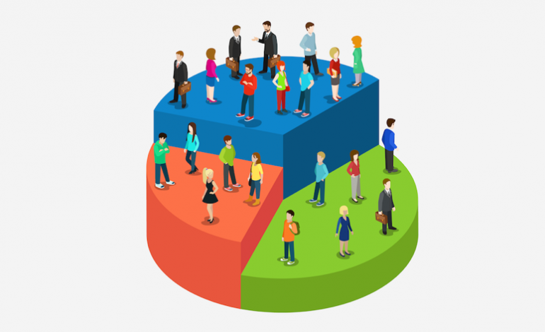
BATH SOAP CUSTOMER SEGMENTATION

Slide 2



BUSINESS GOAL
Financial Management
Sales & Estimating
Marketing
STEP 01
STEP 02
STEP 03
Profitable, sustainable growth can only happen with a solid understanding of your numbers. More than just dollars, "Knowing Your Numbers," refers to the meaningful tracking and reviewing of the key financial and non-financial drivers of your business.
This is the driving force of your business. A business must have a constant flow of leads that will keep you in the public's eye, and will ultimately be the foundation of your growth. True success is achieved when a business is marketing.
This is the cornerstone of profitability. Sales is not a complicated or mysterious process. Following a consistent process will bring more consistent results. Do you understand why your customers are buying? Are you able to quickly dis-qualify non-buyers?.

Slide 3
Customer Classification
01
02
03
These are the customers who are more loyal to brands.
They are loyal to that brand because of either price or promotional offers offered.
These customers tend to buy products in a particular price range.
These are the customers who are mindful about what about to purchase and when to purchase.
These customers who understand a product, it’s features, capabilities & limitations.
They tend to buy products that provide better offer.
These are the customers who buy products for low price.
They tend to switch brands more often than not based on promotions available.
They are buying daily based goods more than durable goods.
Cheap Customers
Driven Customers
Educated Customers

Slide 4
Price Range
Educated customers can be targeted by proper marketing and giving appropriate promotional offers on timely basis.
Driven customers can be targeted by providing discounts in their price range.
Promotional Offers
Opportunity
Cheap customers buy more daily based products in large numbers
So by giving them promotions we can achieve more loyalty.

Slide 5
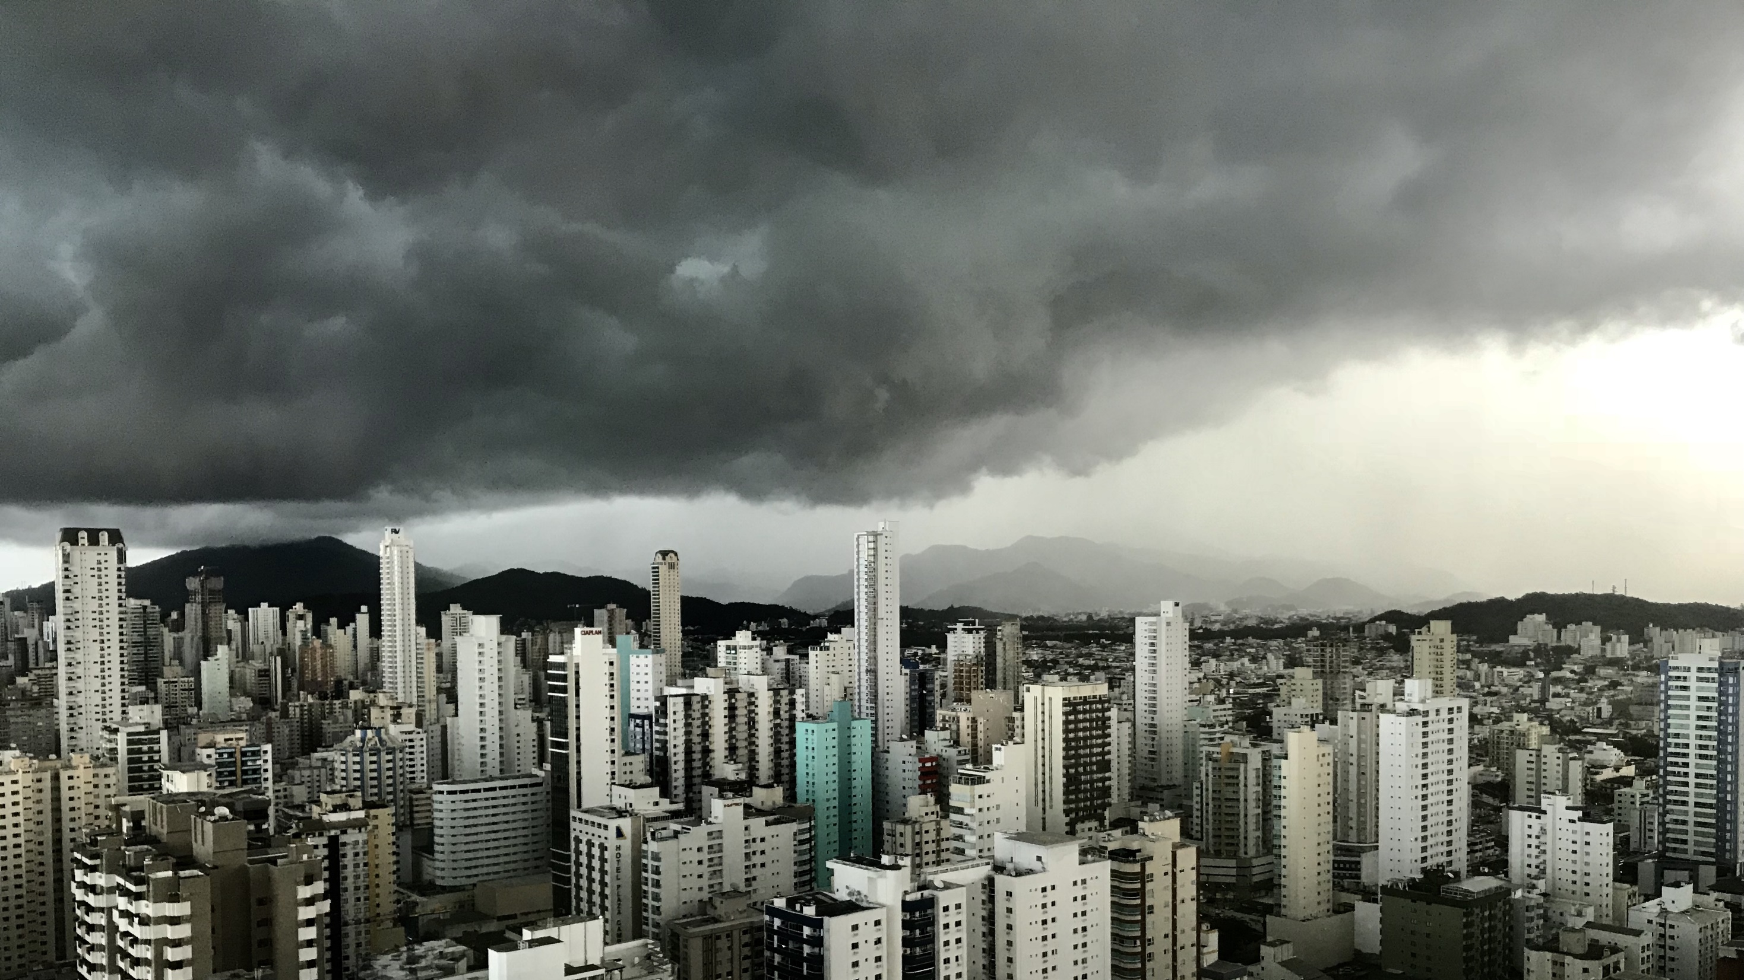
THANK YOU

