Slide 1
$ certbot certonly --server http://acme-lan.lan:8000/acme/directory -d db.example.net
acme-lan
Real, publicly-trusted certificates for the hosts
the internet can never reach.
No relation to the anvil company. Although both are elaborate schemes that mostly work.
PyCon AU 2026 · Brisbane · lightning talk · github.com/smallsam/acme-lan · MIT
Notes:
[0:00] Hi — five minutes, so I am going to talk quickly. acme-lan: an internal ACME server that hands out REAL, publicly-trusted certificates to hosts the internet has never heard of. Pause on the joke about ACME Corp only if the room is warm.

Slide 2
1
One name, two worlds
PUBLIC VIEW
LAN VIEW
db.example.net
db.example.net → 192.168.3.5
Not reachable. No open ports. Possibly no A record at all.
The CA cannot knock on this door.
Split-horizon DNS. A real public domain, pointed at a box
that lives behind your firewall forever.
The CA does not need to reach the box. It only needs proof you control the name.
That proof is a TXT record. Which means someone has to hold DNS credentials.
# dns-01: prove the name, not the network path
Notes:
[0:12] Here is the shape of the problem. One name, two worlds. db.example.net is a real name in a real public zone. On the LAN it resolves to a private IP. Let's Encrypt will happily certify that name — it just has to be able to check you own it.

Slide 3
2
How ACME actually works
A CA will certify any name you can prove you control. Three ways to prove it:
HTTP-01
TLS-ALPN-01
DNS-01
Serve a token
Answer a handshake
Publish a TXT record
Put it at /.well-known/acme-challenge/… and the CA fetches it over port 80.
The token rides inside a special TLS handshake on 443. No HTTP server needed. (RFC 8737)
At _acme-challenge.<name>. The CA looks it up. Nothing of yours has to be reachable at all.
Your LAN host can never answer the first two from the internet. So: dns-01.
# the CA never has to see your host — only your proof
Notes:
[0:32] Quick recap of how ACME actually works, because the whole talk hangs off it. A CA will certify any name you can prove you control, and there are three ways to prove it: serve a token over HTTP, answer a special TLS handshake, or publish a TXT record. Only the last one works when the CA can never reach the box.

Slide 4
3
The one prerequisite
Your internal names have to be public names.
NOT NEGOTIABLE
GOOD NEWS
No .local. No .internal. No .lan.
Split horizon stopped hurting
A public CA will not certify a name nobody owns. You need a real, registered zone.
Good time to use that two-letter domain you have been hoarding.
No second copy of the zone to keep in sync. Override only the names you host on the LAN; everything else resolves normally.
unbound local-zone: "example.net." transparent
dnsmasq address=/db.example.net/192.168.3.5
# one line per host, and the rest of your zone never notices
Notes:
[0:54] One prerequisite, and it is not negotiable: the names on your LAN have to be real, public names. No .local, no .internal, no .lan — a public CA will not certify a name nobody owns. The good news is that split-horizon DNS stopped being painful. unbound and dnsmasq will override just the names you host and pass the rest of the zone straight through.

Slide 5
4
The three usual answers
OPTION A
OPTION B
OPTION C
DNS token
on every host
Run your own CA
Self-signed and
look away
Every box that needs a cert now holds a credential that can rewrite your whole zone.
Including the printer.
Genuinely fine — until you have to install that root on every laptop, phone, CI runner and contractor.
Forever.
The industry standard.
Every browser warning you have clicked through, and every one you have taught somebody else to click through.
* Yes — you can shrink that token by delegating _acme-challenge to a zone of its own. Hold that thought; we come back to it.
# all three work. none of them made me happy.
Notes:
[1:12] The three usual answers, and why I stopped liking all of them. Tokens everywhere: a zone-wide credential on a printer. Private CA: now distribute a root to every device anyone ever brings. Self-signed: every browser warning you have ever clicked through.

Slide 6
5
The whole idea
Be an ACME server.
Be an ACME client.
Sit in the middle.
CLIENT DIFF
One line.
RFC 8555 both directions, so certbot, acme.sh and the ACME client already built into Proxmox need no plugin, no patch and no idea anything unusual is happening.
- --server https://acme-v02.api.letsencrypt.org/directory
+ --server http://acme-lan.lan:8000/acme/directory
# stock clients only. nothing that needs a custom hook script.
Notes:
[1:32] The idea is one sentence: be an ACME server on the inside, and an ACME client on the outside. Your clients change exactly one thing — the directory URL.

Slide 7
6
The architecture, all of it
ACME downstream http-01 / tls-alpn-01
ACME upstream dns-01
certbot · acme.sh
acme-lan
Let's Encrypt
proxmox · truenas · unmodified
ACME server + ACME client
ZeroSSL · EAB CA · private CA
The only box on the
LAN with a DNS
credential is this one.
your delegated _acme-challenge zone
_acme-challenge.db.example.net TXT
# ~5k lines of Python standing between two ACME conversations
Notes:
[1:48] The architecture. Client talks ACME to me over the LAN and proves control with http-01 or tls-alpn-01. I turn around, open an order at the real CA for the same names, and prove control with DNS-01 — writing the TXT into a zone I delegated for exactly this. Only this one box holds a DNS credential, and it is a small one.

Slide 8
7
The one decision that matters
acme-lan forwards your CSR upstream.
The issued cert matches the key the client already has
acme-lan never sees, stores or transmits that private key
Renewal is just ACME again — no state to keep in sync
order = upstream.new_order(csr_from_the_client) # not one we made up
# a proxy that generated its own keys would be a very expensive self-signed cert
Notes:
[2:18] This is the one design decision that actually matters. At finalize, the client sends me its CSR. I do not generate a key. I forward that same CSR upstream. So the cert that comes back matches the private key that never left the client.

Slide 9
8
Where the DNS credentials live
OPTION 1
OPTION 2
OPTION 3 · ACME-LAN
Zone creds,
every host
Delegated creds,
every host
Delegated creds,
one host
A token that can rewrite the whole zone — your MX, your website — copied onto every box that needs a cert.
Rotating means touching all of them.
CNAME _acme-challenge to a zone of its own, so the token can only write there.
Much smaller blast radius. Still on every box, still rotated everywhere.
The same narrow token, held in one place. Every other box speaks plain ACME and holds nothing at all.
Rotate it once.
Two axes at once: what a leaked credential can do, and how many places you have to fix.
# the CNAME is the good idea. one holder for it is the better one.
Notes:
[2:38] So where do the DNS credentials live? Three options, and they get better on two axes at once: how much a leaked credential can do, and how many places you have to go when you rotate it. Option two — CNAME _acme-challenge at a zone of its own — is the trick I promised you earlier. Option three is this project: keep that narrow credential, and put it in exactly one place.

Slide 10
That’s the core.
Everything after this is scope creep I’m happy about —
and the reason I actually still run it.
# extras
Notes:
[3:08] That is the whole core idea. Everything after this is scope creep I am happy about.

Slide 11
9
For the things that will never run ACME
MODE: DEVICE (PREFERRED)
MODE: LOCAL
The key never leaves the box
We make the key and push both
Fetch a CSR the device generated itself, sign it upstream, push back only the certificate.
Nothing secret ever crosses the wire.
For gear that cannot generate a CSR. The key is stored encrypted — never in plaintext at rest — and the UI tells you off about it anyway.
Install happens through deploy plugins: local (write files, run a reload) and ssh (SFTP + reload).
Most network gear is driven over SSH, so a vendor plugin is one class and a list of PluginFields.
ESXi · iDRAC · iLO · switches · printers · NAS · load balancers
Notes:
[3:14] Extra number one: the things that will never run an ACME client at all. Register the box as a managed host and acme-lan does issuance, installation and renewal for it. Preferred mode: we fetch a CSR the DEVICE generated, sign it, and push back only the certificate.

Slide 12
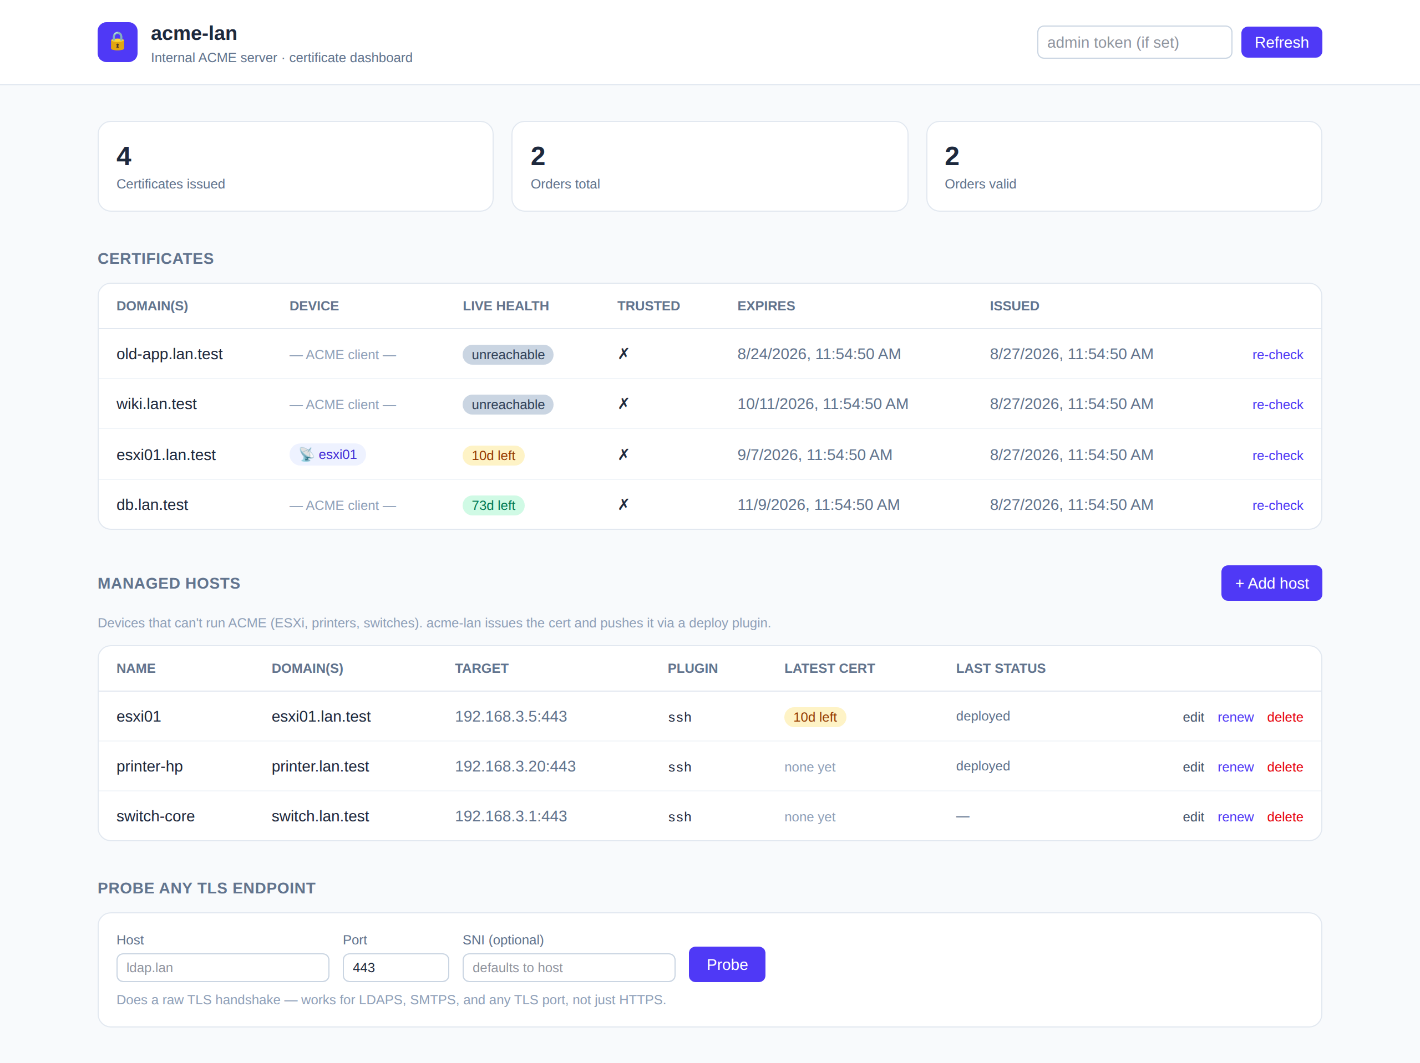
10
It comes with a dashboard
Every certificate, every managed host, one page. Live health badges are a raw TLS probe, not a database lookup. Certificates link back to the device they were pushed to, and back again. Expiry warnings, retire-when-done, email + webhook notifications.
# GET /api/certificates · GET /api/hosts · POST /api/health/probe
Notes:
[3:36] And yes, it has a dashboard. Every issued cert, what it is for, which device it was pushed to, and a live health badge — not what the database thinks, what the endpoint is actually serving right now.

Slide 13
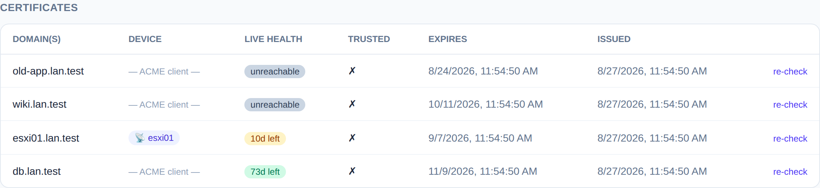
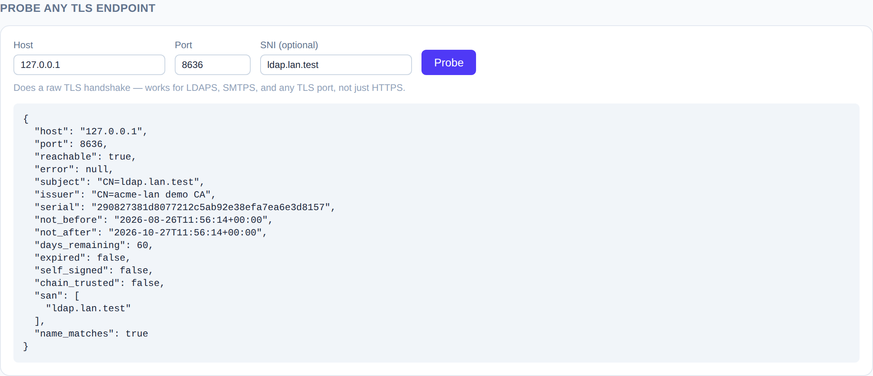
11
Live health, not a spreadsheet
A raw TLS handshake. Not an HTTP request that assumes port 443 speaks HTTP. LDAPS. SMTPS. That one appliance on 8443. Anything that completes a handshake gets an honest answer: expiry, chain trust, SAN match, self-signed.
Notes:
[3:52] The health column is the bit I use most. It opens a raw TLS connection and reads the leaf certificate — so it works for LDAPS and SMTPS, not just HTTPS. Ten days left on the ESXi box, and it tells me before the ticket does.

Slide 14
12
Should you use this? Maybe!
Your hosts reach the internet and can hold DNS creds
certbot + a DNS plugin. You don’t need me.
One reverse proxy already fronts everything you own
Caddy or Traefik. Two lines of config.
Happy to run a private CA and push a root everywhere
step-ca / smallstep. Genuinely excellent.
You want delegated DNS-01 — with the clients you already have
This. The alternative is standing up acme-dns.
It is at least easier than the thing I would otherwise be telling you to build.
Notes:
[4:08] Should you use it? Maybe! Which is a stronger answer than it sounds. If your hosts reach the internet and can hold DNS credentials, you do not need me. But if you want delegated DNS-01 with the clients you already have, the alternative — as far as I know — is standing up acme-dns, and that is more work than this.

Slide 15
13
The Python bits
FastAPI + async SQLAlchemy
certbot’s own acme library
One app. RFC 8555 endpoints, REST API, and the SPA, all from one process.
The reference implementation is on PyPI. I did not write an ACME client.
cryptography
Alembic on startup
CSRs, signing, and the raw TLS probe behind every health badge.
The container migrates itself. Upgrades are docker pull.
Pebble + pytest
Vue 3 + Playwright
A real ACME CA in a container that issues deliberately terrible certs. e2e for the whole chain.
The dashboard, and UI tests in CI. Sorry — that bit is not Python.
# uv sync && uv run acme-lan
Notes:
[4:26] The Python, quickly. FastAPI and async SQLAlchemy, Alembic migrations that run on container start. The upstream client is certbot's own acme library — the reference implementation is right there on PyPI. And the end-to-end tests run against Pebble, a real ACME CA that issues deliberately awful certificates.

Slide 16
Try it
docker run -d --name acme-lan -p 8000:8000 -v acme-lan-data:/app/data \
-e ACME_LAN_EXTERNAL_URL="http://acme-lan.example.net:8000" \
-e ACME_LAN_SECRET_KEY="$(...fernet key...)" \
-e ACME_LAN_DNS_PROVIDER="cloudflare" \
ghcr.io/smallsam/acme-lan:latest # defaults to LE staging
github.com/smallsam/acme-lan
MIT · docs for deployment, plugins and key handling in the repo · issues and vendor plugins very welcome
Thanks. No questions — lightning talk rules — but I’m in the hallway,
and my printer finally has a certificate nobody has to click through.
Notes:
[4:42] One docker run, defaults to Let's Encrypt staging so you cannot hurt yourself. MIT, on GitHub. Thank you — no questions, lightning talk rules — but I will be in the hallway and my printer finally has a valid certificate.

Slide 17
Appendix
Prior art, and the bit about challenge directions
that did not fit in five minutes.
# for the hallway track
Notes:
[appendix] Do not present these. They are here for the hallway conversation afterwards.

Slide 18
Prior art I borrowed from
ACME-DNS
ACME2CERTIFIER
A DNS server with one opinion
ACME in front of other CAs
Its entire job is answering _acme-challenge, and it expires its own records. Lovely idea — but it is an internet-facing DNS server you run, and clients have to speak acme-dns. Most appliances never will.
acme-lan ships a provider for it anyway.
Fronts a CA that is not Let’s Encrypt through ca_handler plugins. That is exactly where acme-lan’s private-CA handler comes from.
But it does not do the split-horizon or device-push half.
Both solve part of it. Neither solved it the way I wanted — so this borrows from both.
# appendix · standing on shoulders, then wandering off
Notes:
[appendix] Prior art. acme-dns is a tiny DNS server whose entire job is answering _acme-challenge — a lovely idea, but it is an internet-facing DNS server to run, and clients have to speak acme-dns, which most appliances never will. acme2certifier is an ACME server that fronts other CAs through ca_handler plugins; that is where acme-lan's private-CA handler comes from. Neither did the split-horizon and device-push half I wanted, so acme-lan borrows from both.

Slide 19
Two challenges, two directions
DOWNSTREAM · PROVE IT TO ME
UPSTREAM · PROVE IT TO THEM
http-01
tls-alpn-01
dns-01
http-01 at the edge
Port 80 if the box has a web server.
RFC 8737 over port 443 if it does not — the challenge rides in the TLS handshake itself.
Whichever listener the appliance already has.
dns-01 (default): nothing needs to be publicly reachable. Ever.
edge http-01: faster than DNS propagation, but you need a public IP and a wildcard A record.
One env var switches it.
# appendix · ACME_LAN_UPSTREAM_CHALLENGE=dns-01
Notes:
[appendix] Two challenge conversations, and they are completely independent. Downstream — proving to me, on the LAN — is http-01 or tls-alpn-01, so a box that only speaks TLS is fine. Upstream — proving to Let's Encrypt — is DNS-01 by default, or edge http-01 if you are actually publicly reachable.

