Slide 1


Slide 2
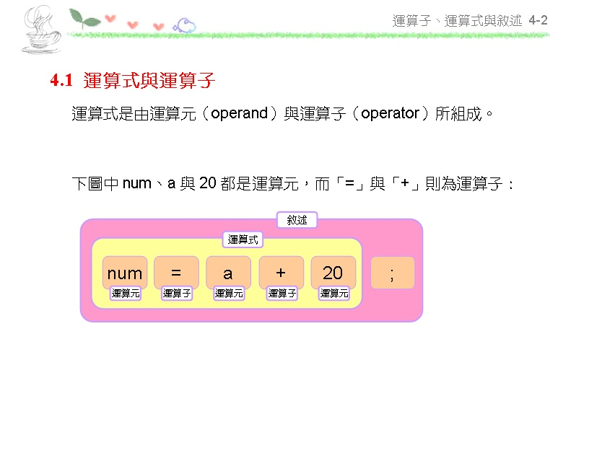

Slide 3
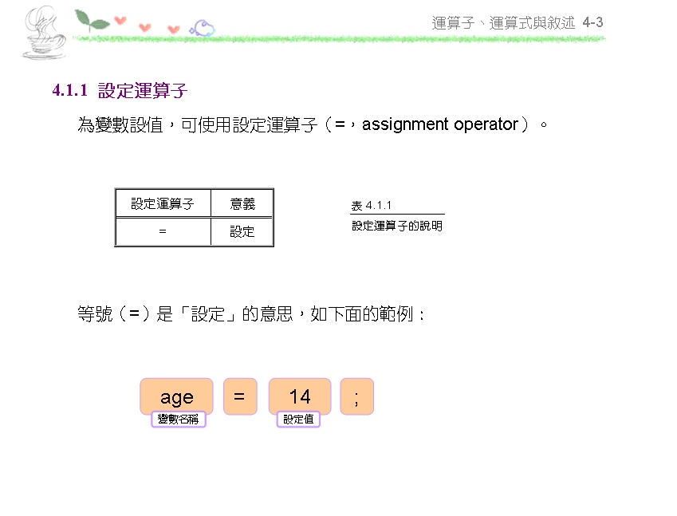

Slide 4
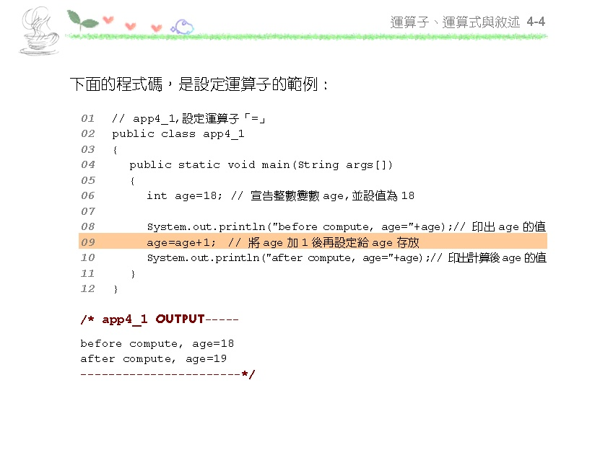

Slide 5
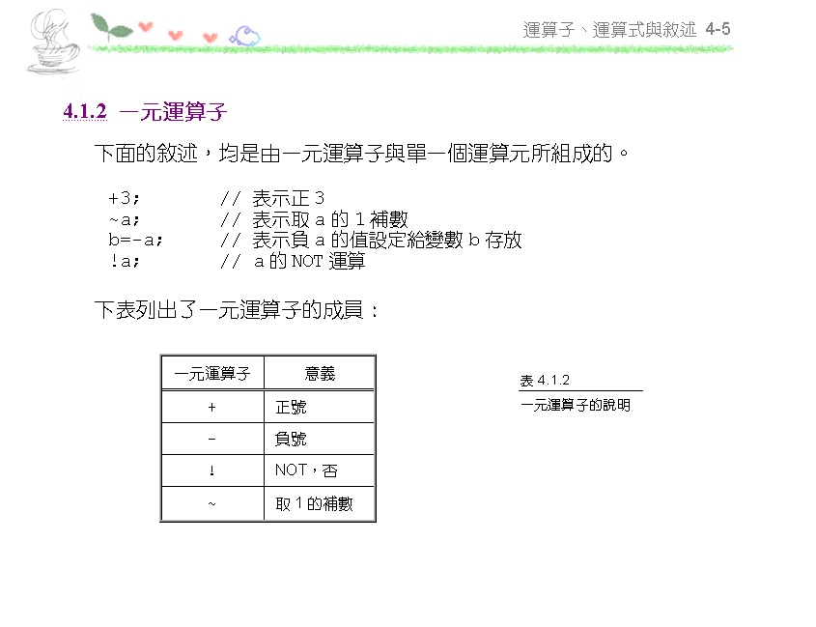

Slide 6
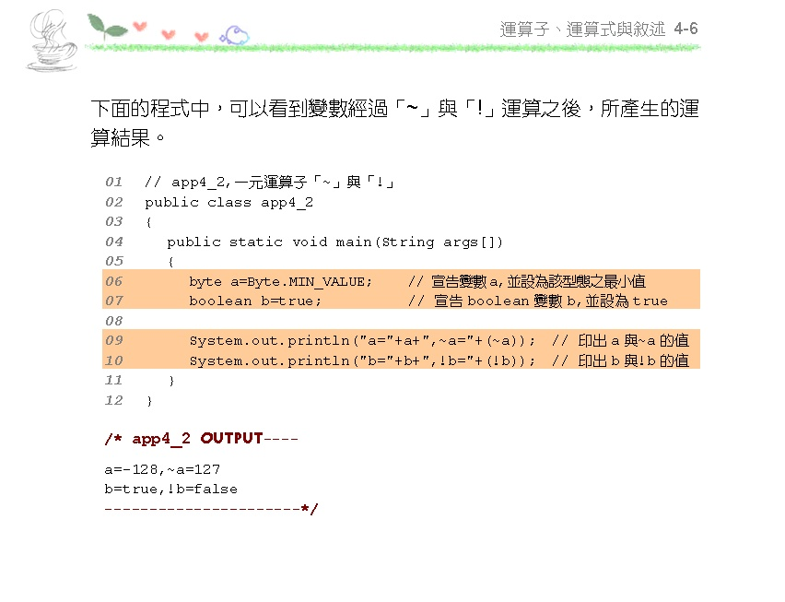

Slide 7
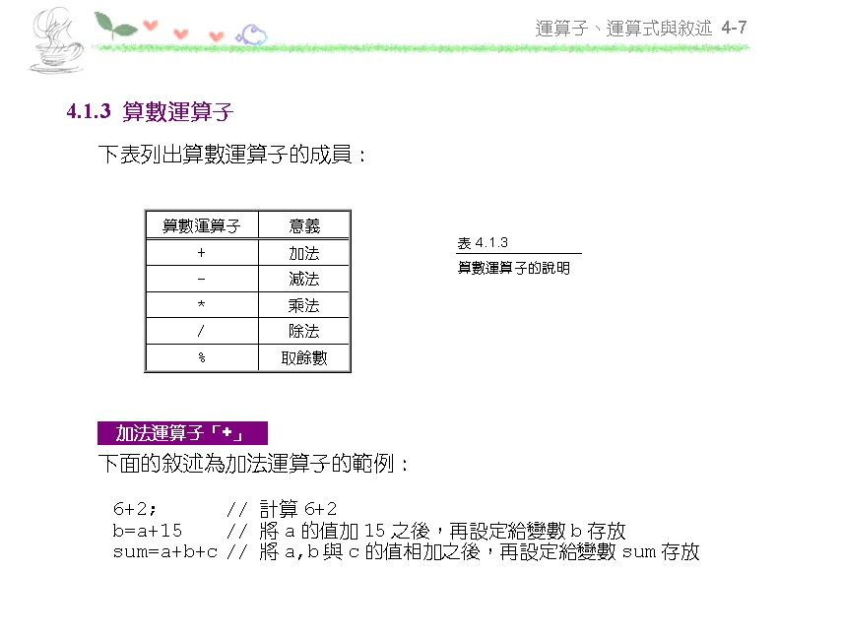

Slide 8
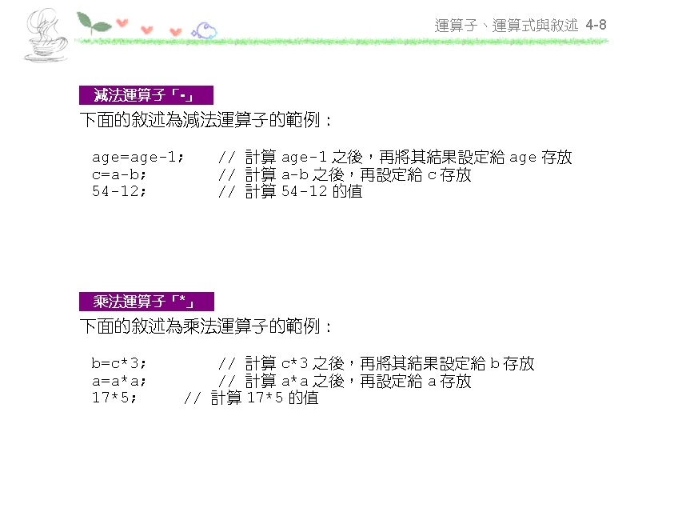

Slide 9
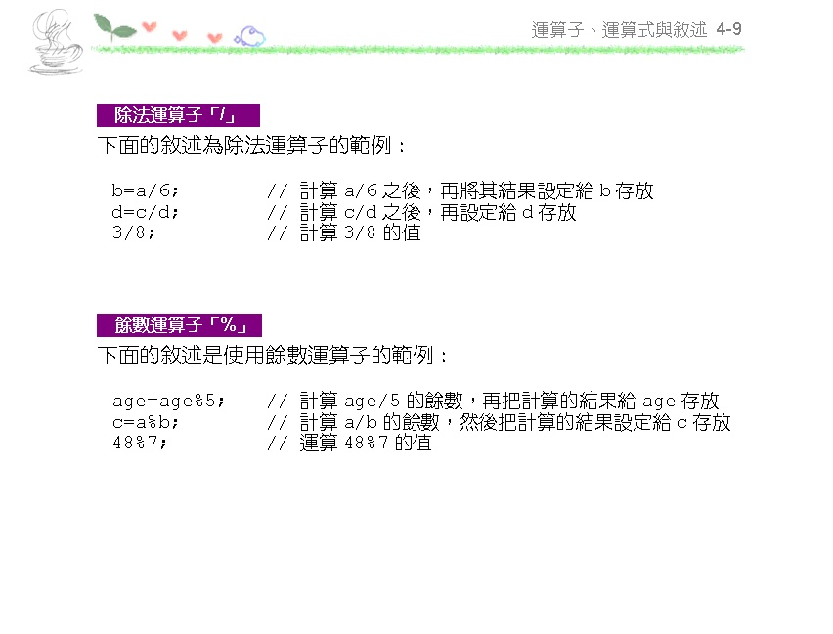

Slide 10
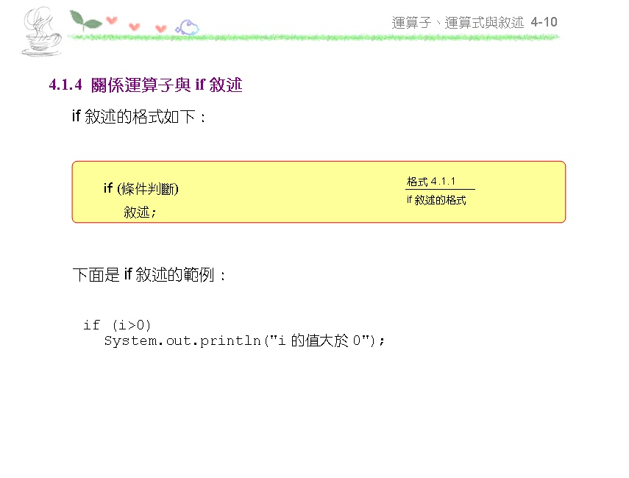

Slide 11
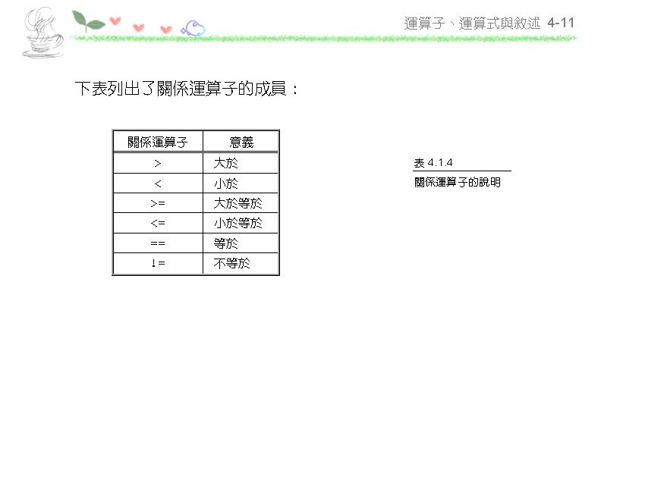

Slide 12
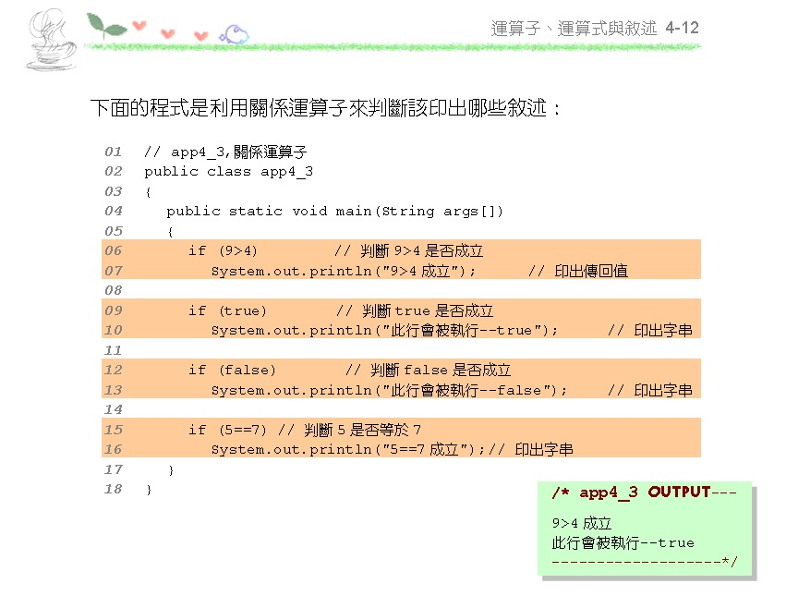

Slide 13
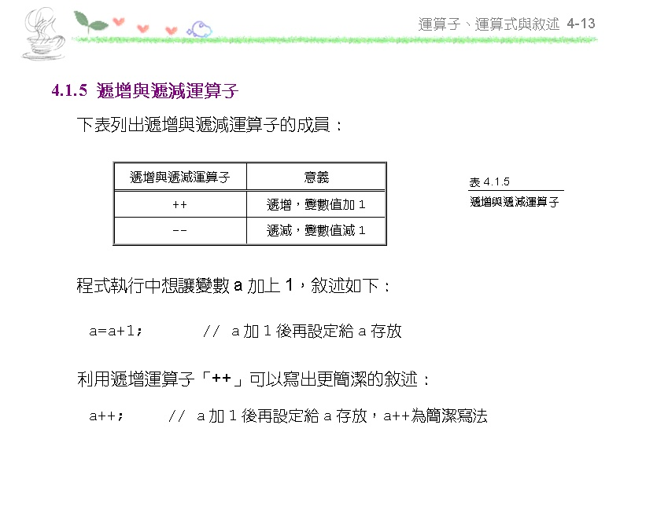

Slide 14
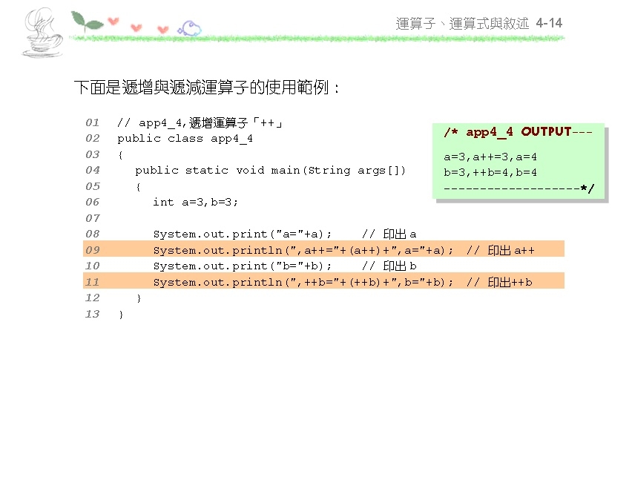

Slide 15
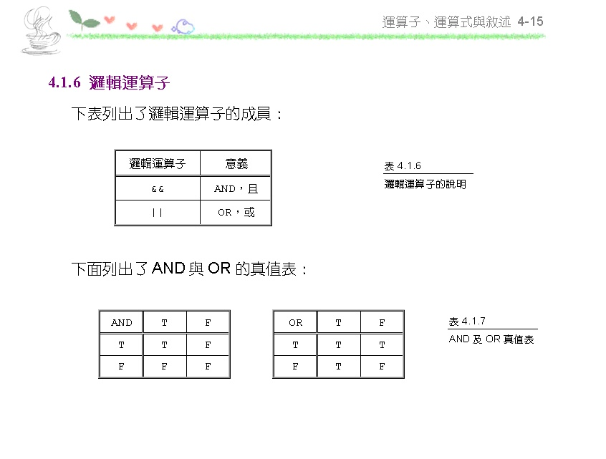

Slide 16
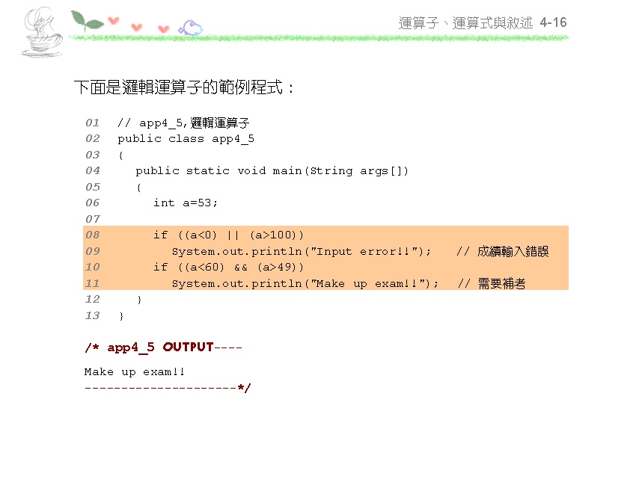

Slide 17
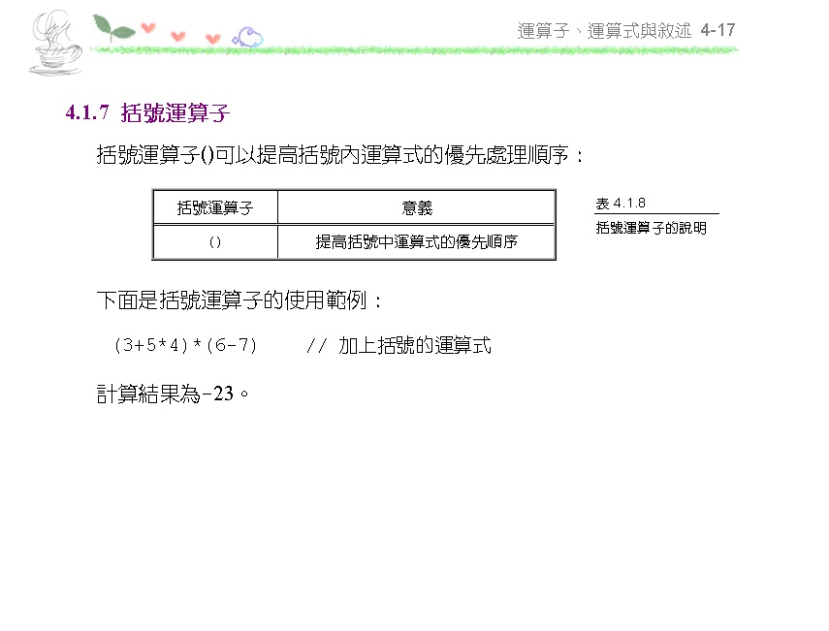

Slide 18
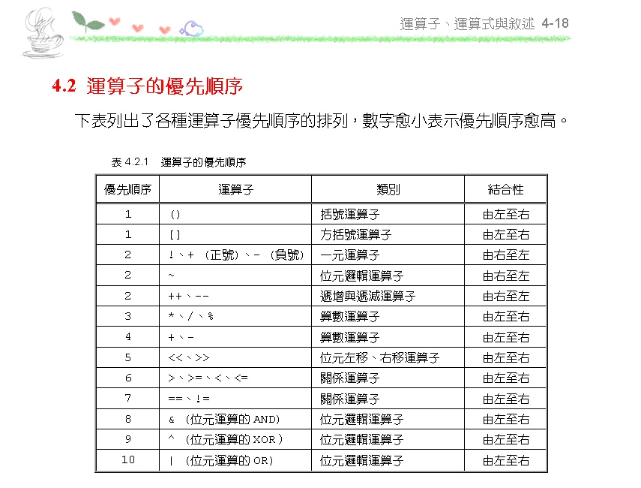

Slide 19
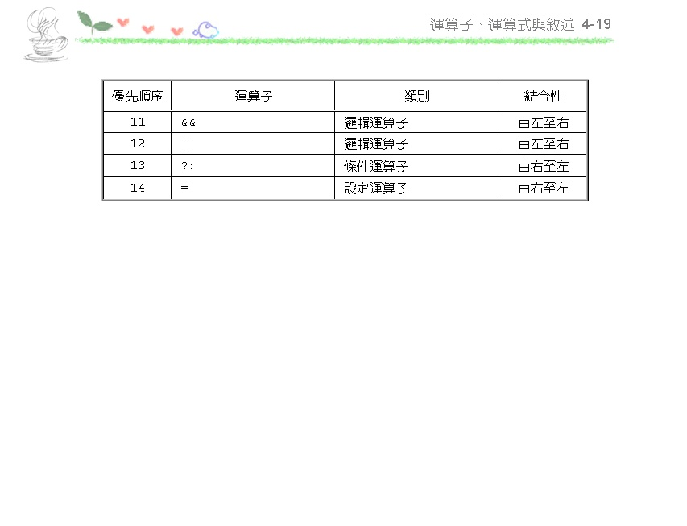

Slide 20
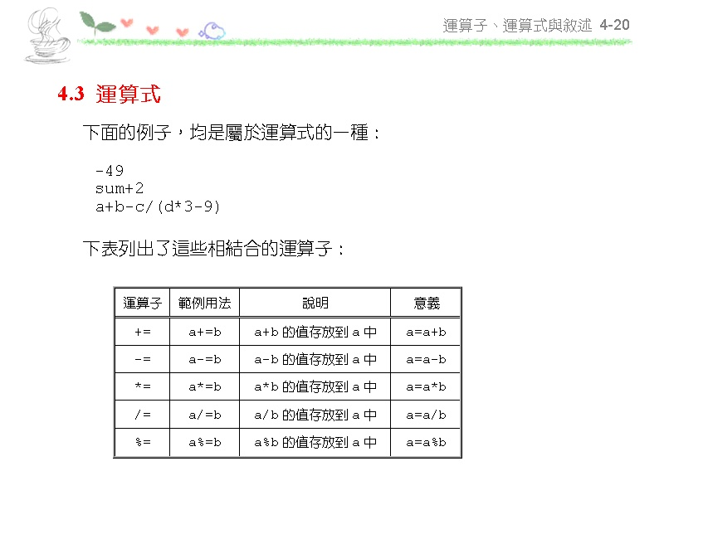

Slide 21
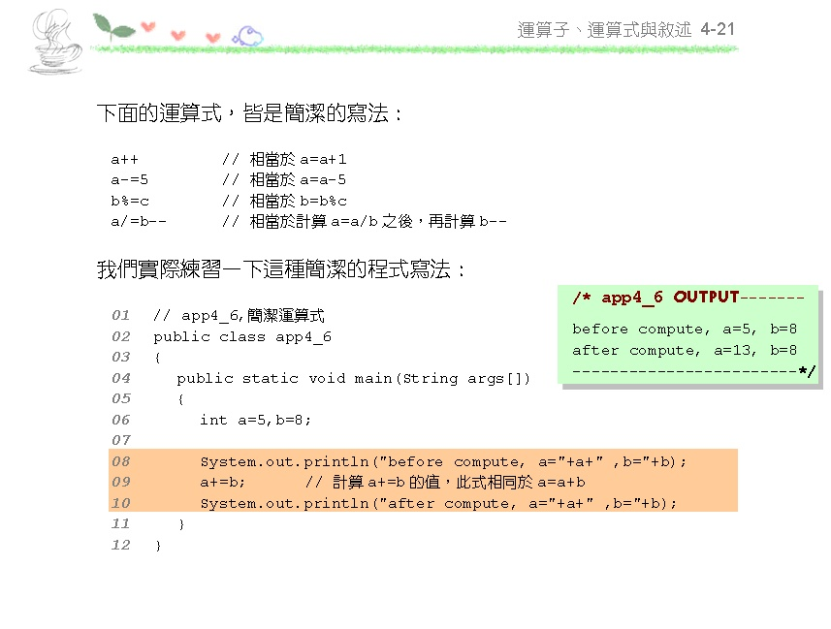

Slide 22
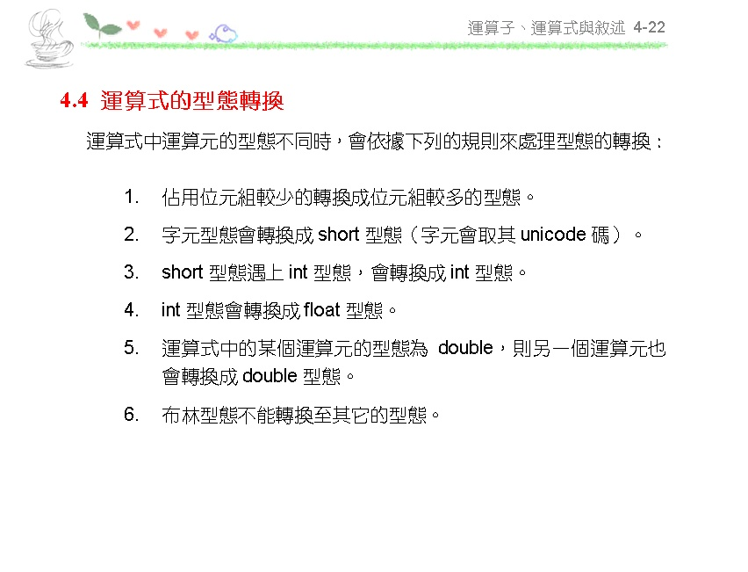

Slide 23
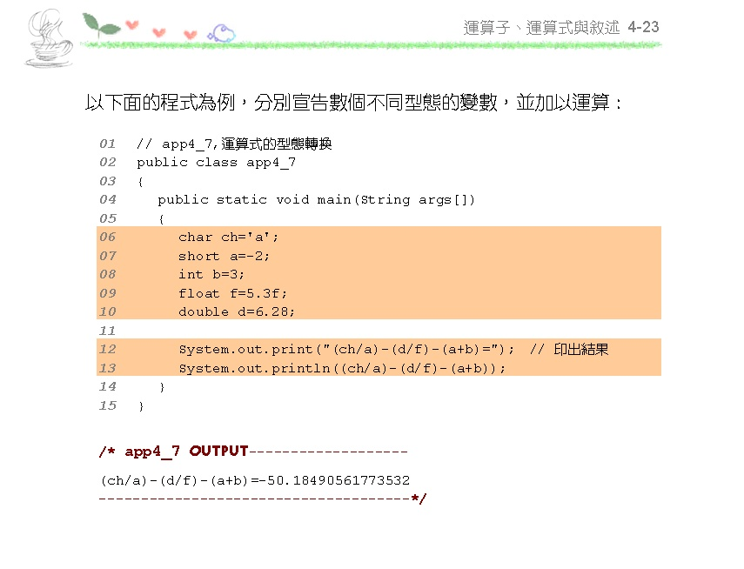

Slide 24
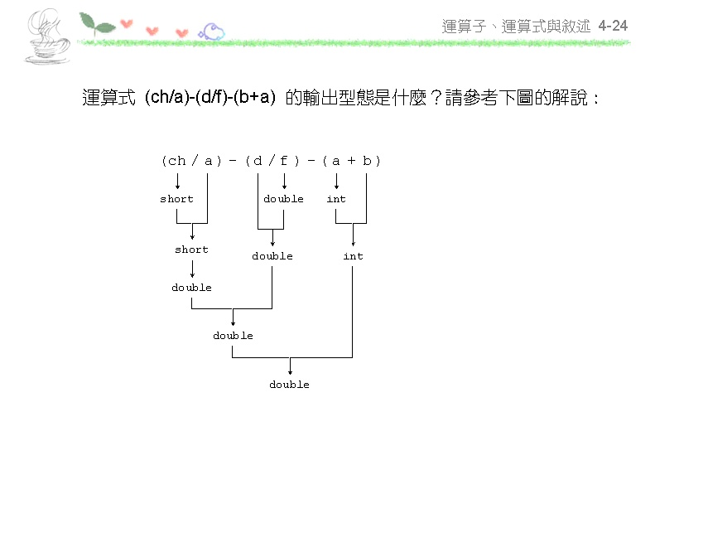

Slide 25
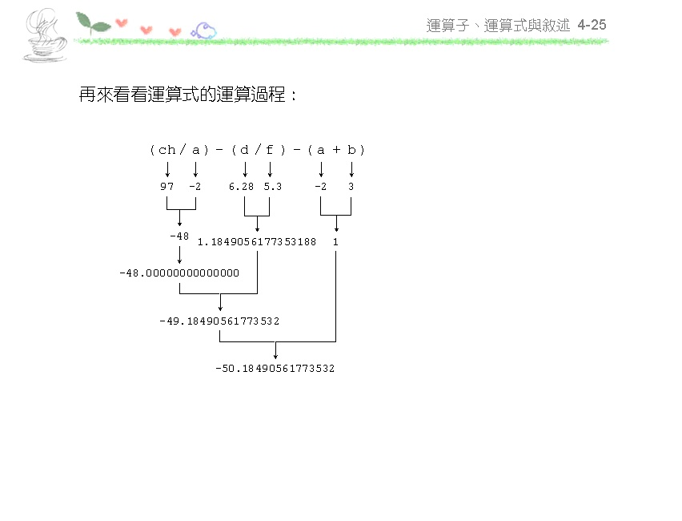

Slide 26
請指出並訂正以下2段程式碼的錯誤：
short a = 10;
byte b = 5;
short c = a + b;
short c = short (a + b) ;
short a = 10;
long b = 5;
int c = a + b;
int c = int (a + b) ;

Slide 27
請寫出以下2段程式碼運算後的執行結果：
short a = 10;
short b = 5;
a%=b++;
System.out.print(a + ", " + b);
Ans: 0 , 6
short a = 10;
short b = 5;
int c = (a++) + (++b) ;
System.out.print(a + ", " + b + ", " + c);
Ans: 11, 6, 16

Slide 28
