Slide 1
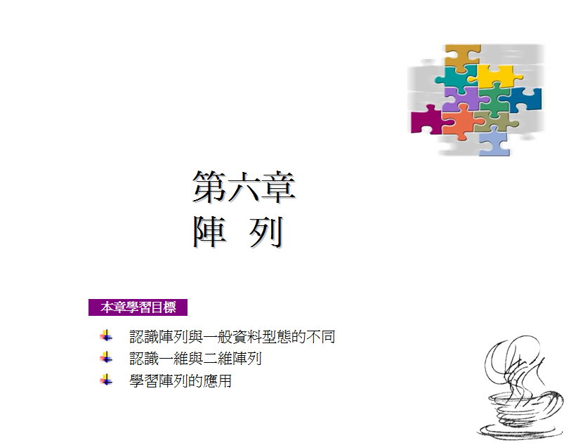

Slide 2
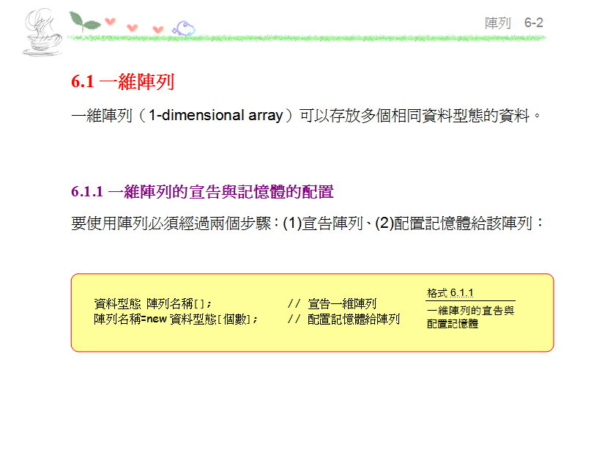

Slide 3
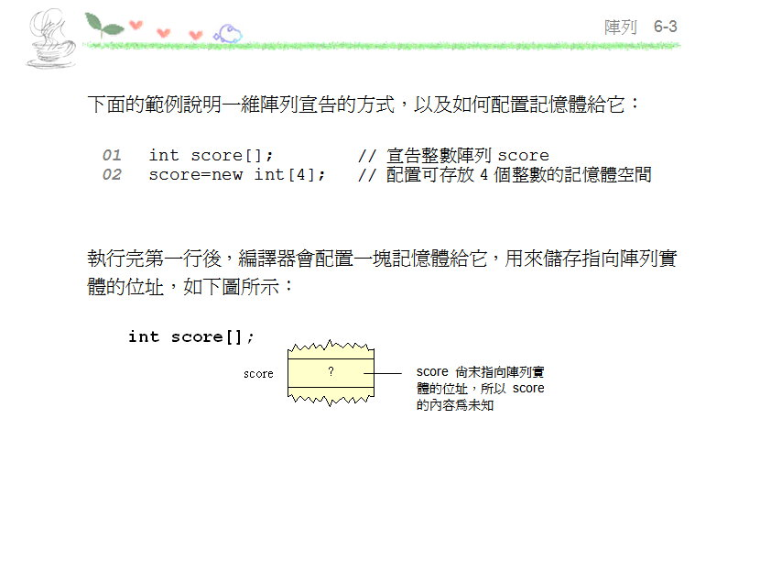

Slide 4
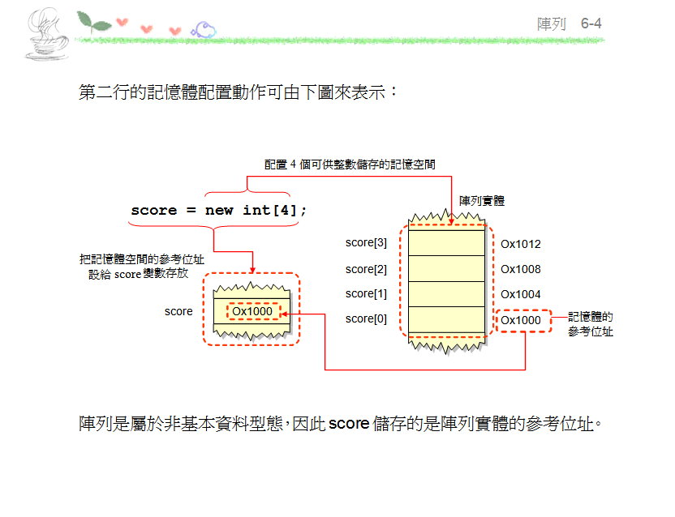

Slide 5
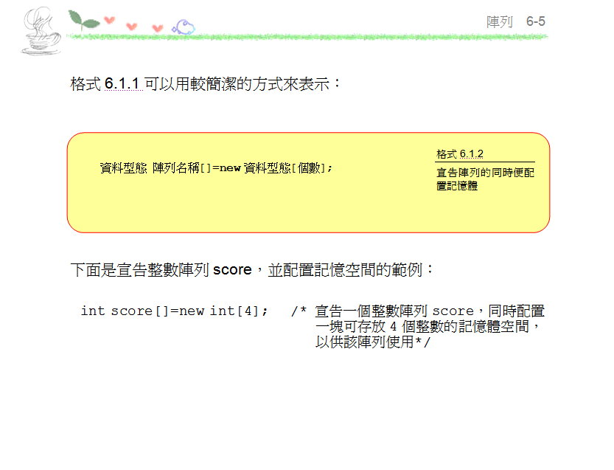

Slide 6
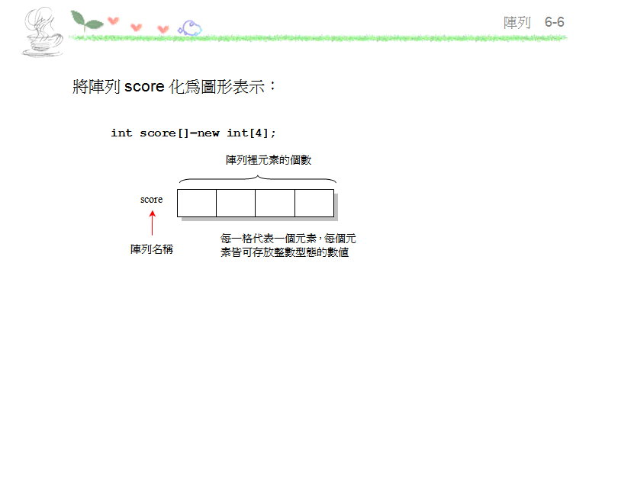

Slide 7
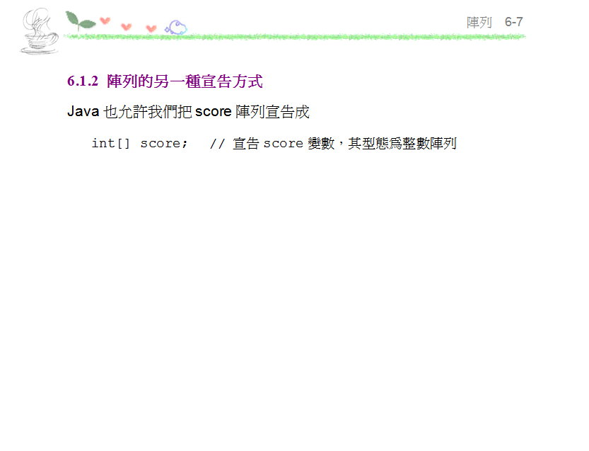

Slide 8
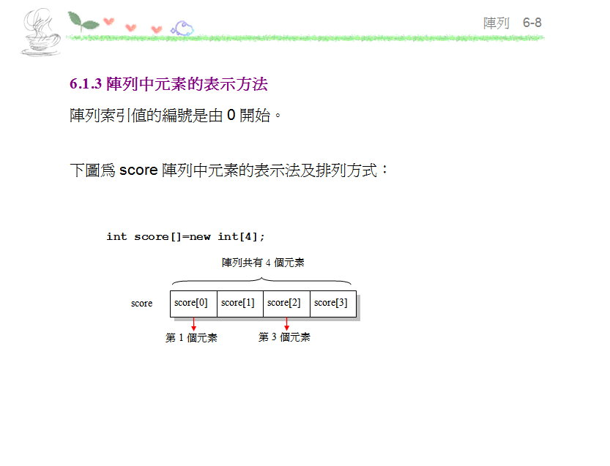

Slide 9
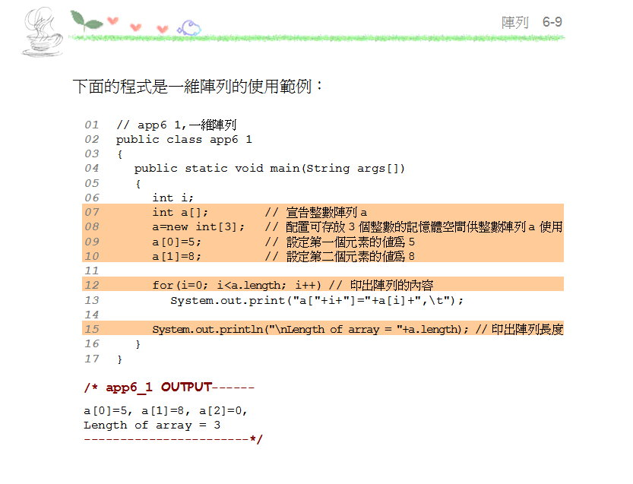

Slide 10
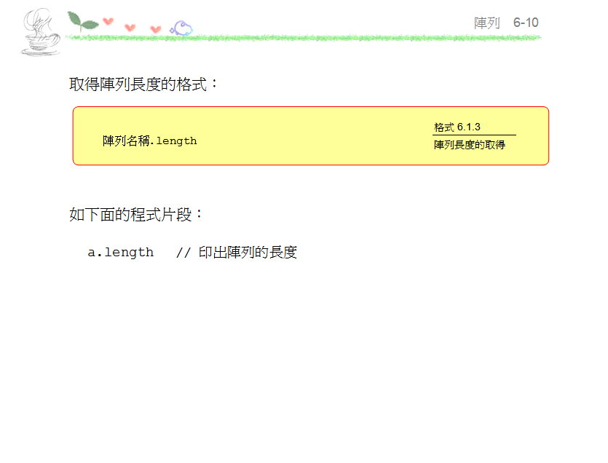

Slide 11
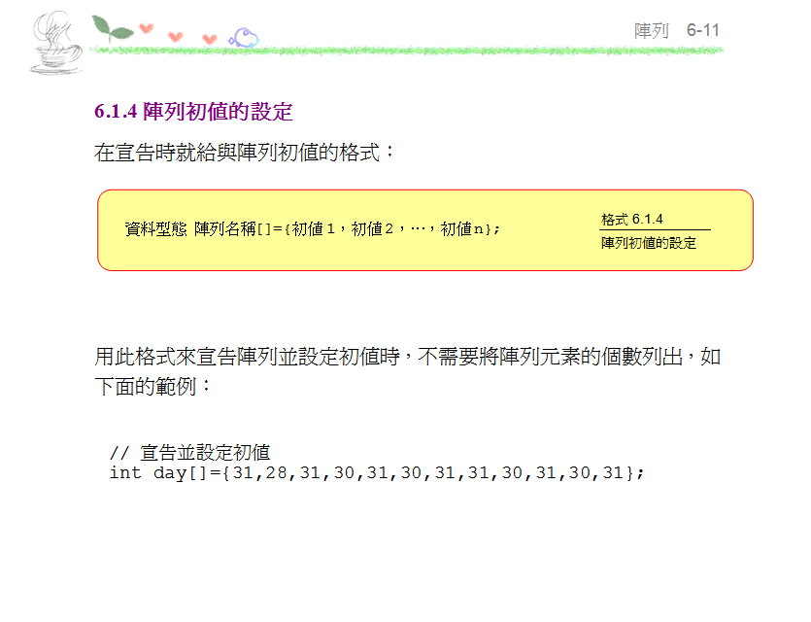

Slide 12
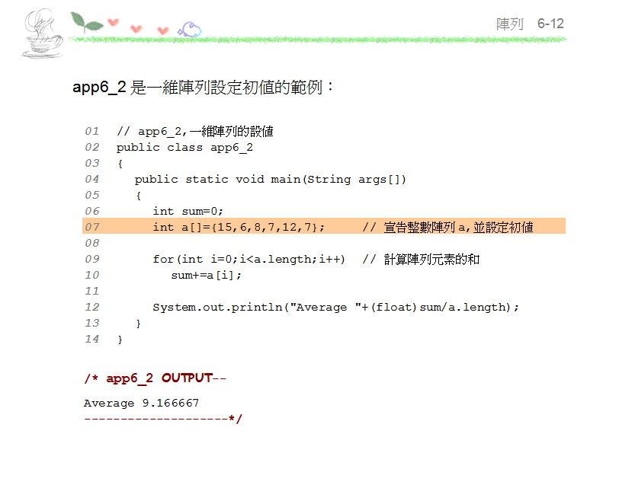

Slide 13
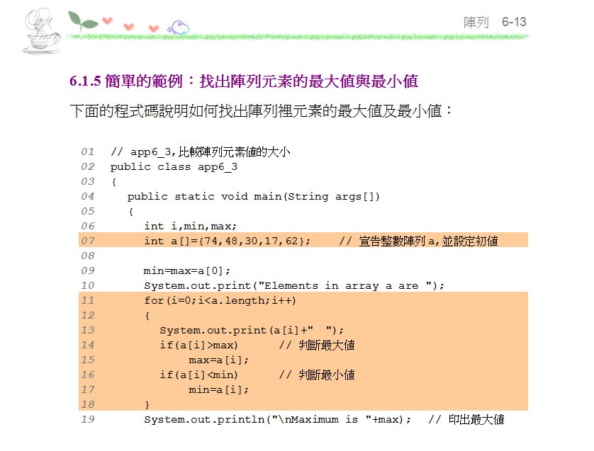

Slide 14
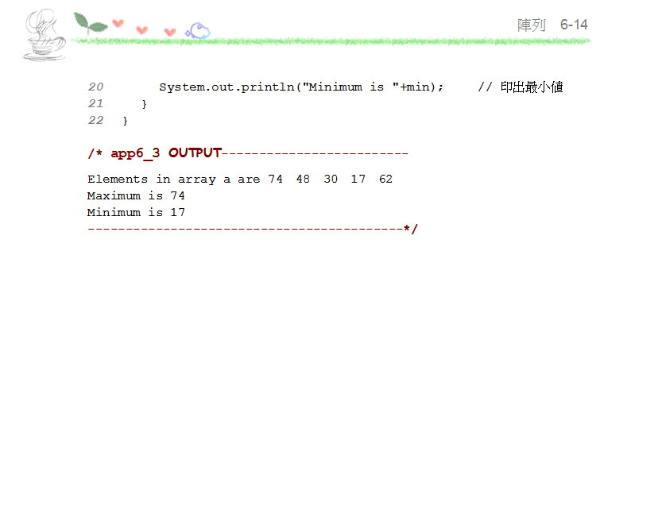

Slide 15
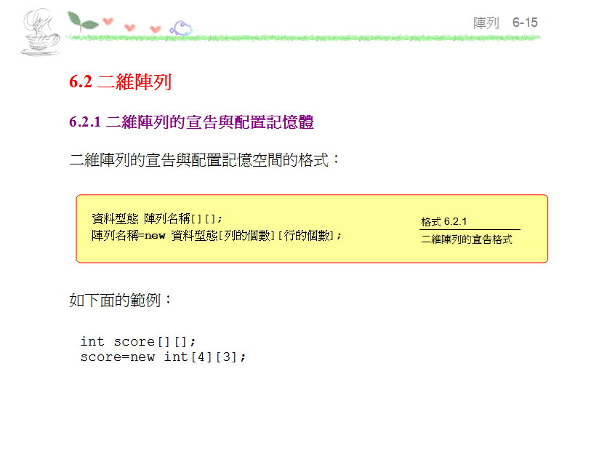

Slide 16
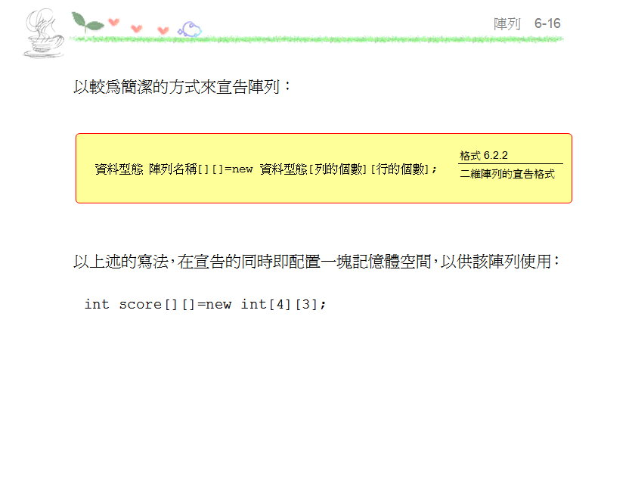

Slide 17
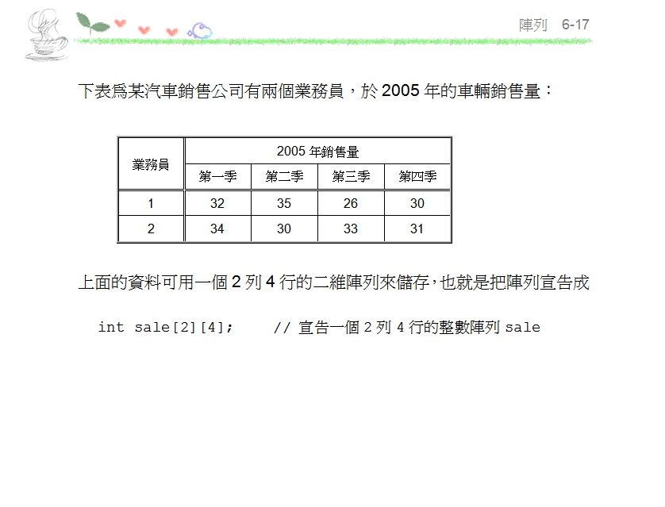

Slide 18
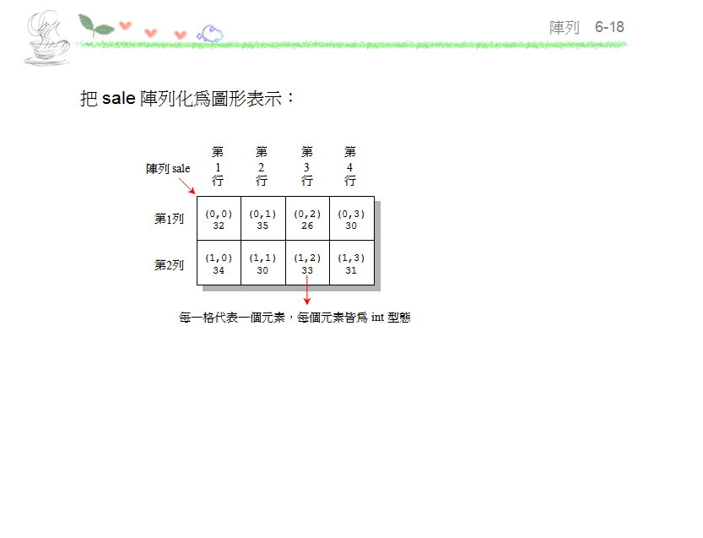

Slide 19
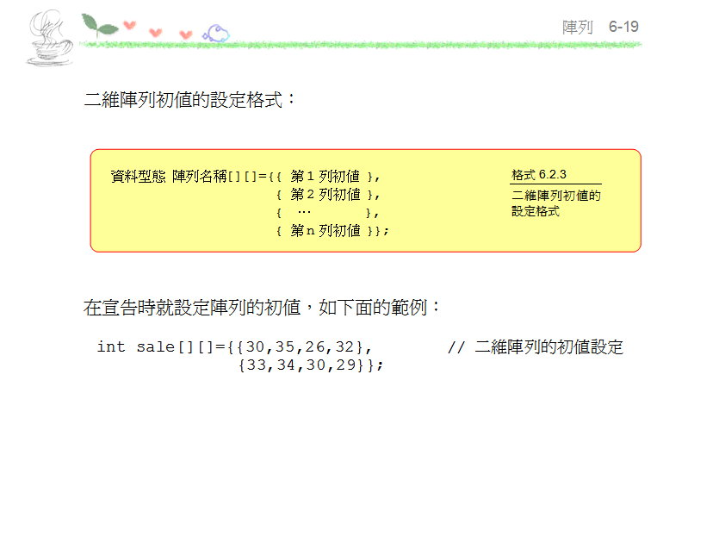

Slide 20
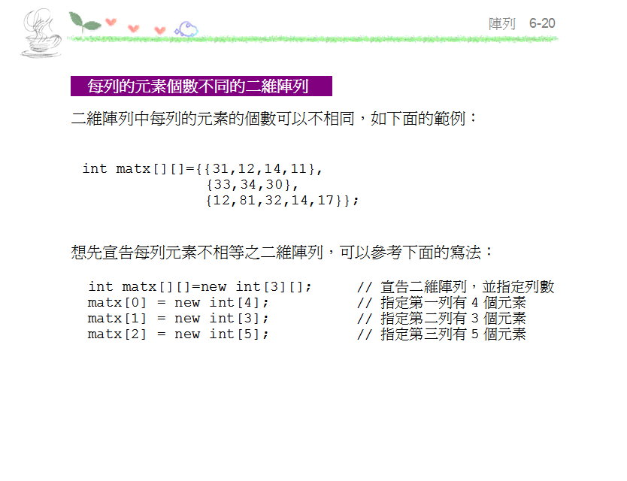

Slide 21
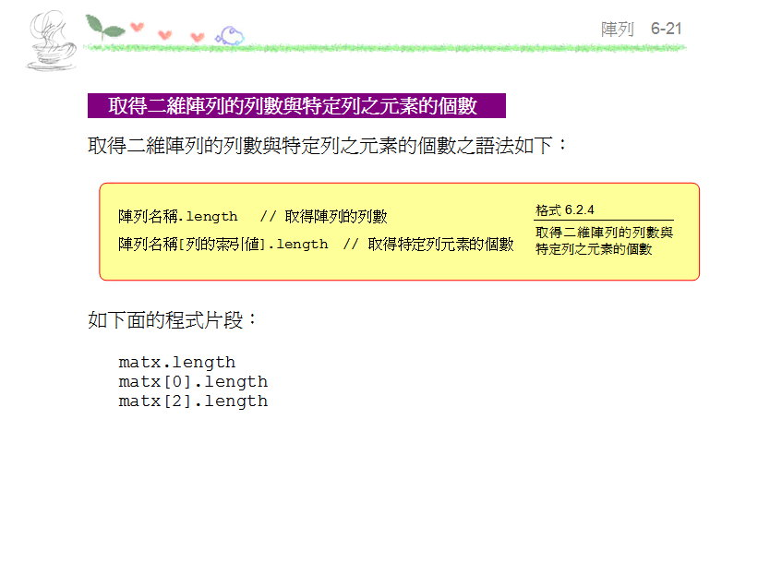

Slide 22
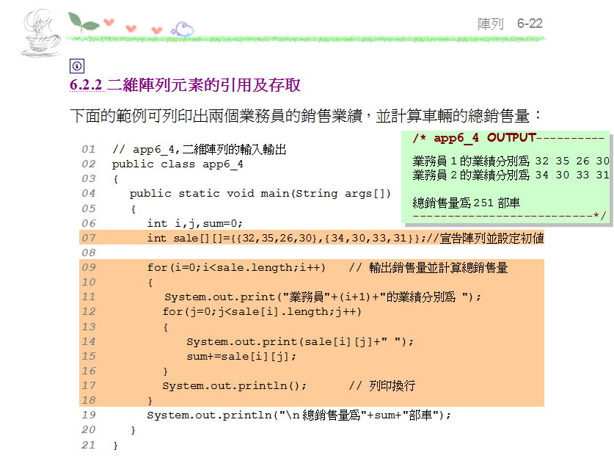

Slide 23
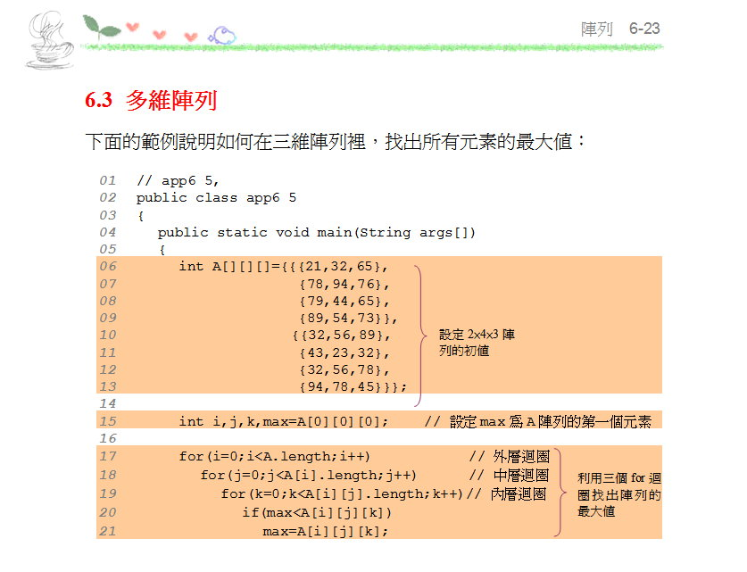

Slide 24
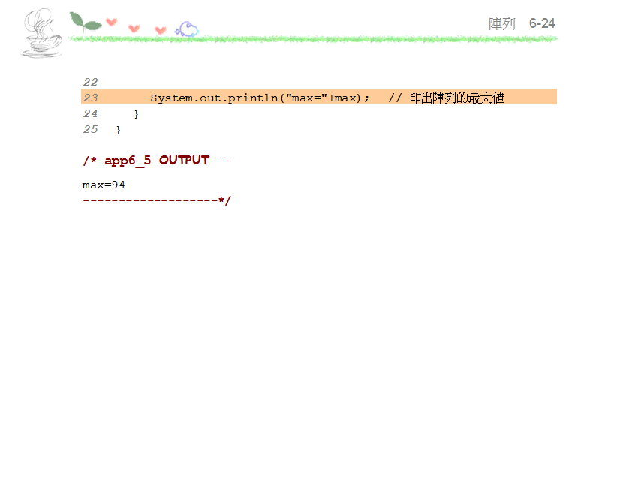

Slide 25
以下陣列宣告何者錯誤 ：
A. String s[] = {"A","B","C"};
B. int [] a = new int[3];
C. char c[] = new char[]{'A','B','C'};
D. short s[] = new short[3]{1,2,3};
E. int score[][] = {3,4}{1,5,8,9};
F. int [][]score = new int[3][];
G. int score[][] = new int[][4];
Ans : D、E、G

Slide 26
以下程式碼執行結果為何?
…
int a[] = new int [3];
a[0] = 5;
a[2] = 8;
int b[]=a;
b[2]=9;
for(int i : a )
System.out.print(i);
…
Ans: 509

Slide 27
