Slide 1
Chapter 2
C++
FUNCTION ENHANCEMENTS

Slide 2
Contents
Objective
2.1 C++ Prototyping
2.2 Inline Functions
  2.2.1 Using C Macros
  2.2.2 Using Inline Functions
2.3 Default Arguments
2.4 Function Overloading
2.5 Function Templates

Slide 3
Objectives
To introduce the advantages of C++ functions over C functions
To become familiar with inline functions
To understand default arguments
To be able to use function overloading and function templates

Slide 4
Introduction
C programs are designed as collections of functions (built‑in or user‑defined).
C++ provides
  inline function
  function overloading
  default arguments
  function templates
C++ is much more rigid than C when handling function prototypes

Slide 5
2.1 C++ prototyping
C is less rigid than C++ when dealing with function prototypes , thus leads to increased errors.
function prototypes are required for all user‑defined functions unless they are defined before being called.
A function's prototype provides the compiler with information needed to compile the program successfully.

Slide 6
Prototyping
prototype consists of
  function's name
  its return type
  a list of parameters
Identifiers for the function parameters are optional in the function prototype, however, a data type should be specified for each parameter.

Slide 7
Prototyping
If the function's return type is not specified, both C and C++ assume type int.
int calc(int x, float y);
int calc(int, float);
calc(int, float);

Slide 8
Differences between C and C++
If no value is returned in the function definition, C ignores the int return type; that is, the void return type does not need to be specified if a return statement is missing.
If no value is returned in the function definition, C++ requires the void return type.

Slide 9
Differences between C and C++
C treats missing parameters in the function's prototype as unspecified. If parameters are not specified in the function's prototype, any number of values (or no value) can be passed to the function when it is called.
C++ treats missing parameters in the function's prototype as void‑i.e., the function without parameters. No value can be passed to the function when it is called.

Slide 10
Differences between C and C++
If C++ programmers want to create functions with an unspecified number of parameters of any type, they place ellipses (...) at the end of the parameter list. (not suggest)

Slide 11
Example
void fun1();
void fun2( int, ...) ;
fun1(8, 3.7, -1.3); //No problem in C; an error in C++.
fun1(); //No problem in C and C++,
fun2(8, 3., -1.3 ); //A valid function call in C++,
fun2(1, "C++"); //A valid function call in C++.

Slide 12
Parameter
Variable‑length parameter lists are used when passing different numbers of arguments to the function at different places in the program.

Slide 13
Parameter
C++ required all elements of the function prototype to be explicitly specified.
A request to create a function with an unspecified number of parameters should be explicit as well.
The rigidity protects against possible errors.

Slide 14
C++ provides
Inline functions
Passing references to functions
Default arguments
Function overloading
Function templates

Slide 15
2.2 Inline functions
The calling of a normal function involves a series of instructions that are processed by the CPU.
These instructions push function arguments onto the stack, allocate local variables, return from the function, and keep track of the memory location where the program execution resumes.

Slide 16
2.2 Inline functions
This function call, run‑time overhead decreases the speed of the program, particularly when the function is called frequently.

Slide 17
Macro
C offers a tool called a macro to eliminate the function call overhead.
The #define preprocessor directive is used to create macros.
A macro can be implemented with or without parameters.
neither macros nor their parameters have a type.
#define macro_identifier (parameters) substitution_text

Slide 18
Expansion of the Macro
The preprocessor handles macros before the program is compiled.
It simply replaces the macro_identifier with its substitution text every time the identifier is used in the code.
The process is essentially an expansion of the macro within the code.

Slide 19
1 //PROG2_1: Program demonstrates parameterized macros. 2 #include <iostream> 3 using namespace std; 4 #define AREA(ln,wd) (ln)*(wd) //Parameterized macros 5 #define PRINT(x) cout«"\tArea = "«(x)«endl 6

Slide 20
7 int main() 8 { 9 float length=3.0, width=4.0, a; 10 cout«"Computing the area of a rectangle:"« endl; 11 cout «"\nLength = "<<length; 12 coot«"\tWidth = "<<width; 13 a=AREA(length, width); //Macros are expanded here. 14 PRINT(a); //Macros are expanded here. 15 coot«"\nAfter incrementing length and width by 1:"« endl; 16 cout «"\nLength = "« (length+1); 17 coot «"\tWidth = "« (width+1); 18 a=AREA(length+l, width+1); //Macros are expanded here. 19 PRINT(a); //Macros are expanded here. 20 return 0; 21 }

Slide 21
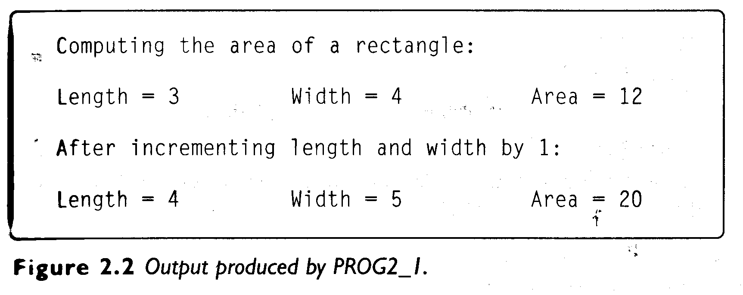
OUTPUT

Slide 22
Macro
There is no semicolon(;) at the end of the macro definition.
It may seem unnecessary, but it is good programming practice to enclose all macro parameters in parentheses () to prevent errors.

Slide 23
Macro
#define AREA(ln,wd) ln*wd
a=AREA(length+1, width+1)
⇒ a=length+1 * width+1
This type of logic error is not easy to detect because macros are preprocessor directives and cannot be debugged interactively.
Programmers should test their programs carefully when using macros.

Slide 24
Example
If substitution text is longer than one line, a backslash(\) should be placed at the end of the line and continued on the next line,
#define DISPLAY cout«"The program PROG2_1 is designed to "; \
cout«"demonstrate parameterized macros."; \
cout«"\nInline functions are more powerful"; \
cout«" than macros."

Slide 25
Benefit of Macro
function‑call overhead is eliminated,
may increase the speed of the program.

Slide 26
Disadvantage of Macro
The size of the program may be increased as well, however, because a macro expansion causes duplicate code.
Macros can also be a source of logic errors that are difficult to detect.

Slide 27
2.2.2 Using Inline function
A more powerful tool like Macro in C++
The compiler substitutes an inline function call with the function’s code
Inline function can reduce the program execution time, i.e., increase the speed of the program.

Slide 28
Inline function
Good candidates for inline functions are small, frequently called functions.
inline return_type function_name (parameter list)
{
//body of the function
}

Slide 29
1 //PROG2_2: Program demonstrates inline functions.
2 #include <iostream>
3 using namespace std;
4 inline float area(float ln, float wd) //inline fun.
5 {
6 return ln * wd;
7 }
8 inline void print(float x) //inline fun.
9 {
10 cout«"\tArea = "«x«endl ;
11 }

Slide 30
13 int main()
14 {
15 float length = 3.0, width = 4.0, a;
16 cout«"Computing the area of a rectangle:"« endl;
17 cout«"\n Length = “ « length ;
18 cout«"\tWi dth = "<<width;
19 a = area(length, width); //area() is expanded here
20 print(a); //print() is expanded here

Slide 31
21 cout«"\nAfter incrementing length and width by 1:"« endl;
22 cout«"\n Length = "« (length+1) ;
23 cout«"\tWidth = "« (width+1);
24 a = area(length+1, width+1); //area() is expanded here
25 print( a); //print() is expanded here
26 return 0;
27 }

Slide 32
Extra parentheses are not required to enclose function arguments within the body of the function to ensure a proper inline expansion.

Slide 33
significant advantages as compared with macros:
  Programmers can debug them interactively in order to detect logic or run­time errors.
  Expanding inline functions is less prone to errors than expanding macros.
  Programmers do not require extra parentheses to ensure proper inline expansion.
  When handling inline functions, the compiler also performs all necessary data type conversions. The preprocessor is not capable of doing type conversions.

Slide 34
TIP: Use inline functions rather than parameterized macros to reduce the function‑call overhead.

Slide 35
Inline function
A negative side effect of using inline functions is that inserting multiple copies of a function's code into the program can make the program larger.
Most C++ compilers generate a warning message to notify the programmer that the inline request is not accepted and explain the reason.

Slide 36
Inline function
The C++ compiler, however, may ignore an inline request and compile the function as a normal non‑inline function.
  Large functions
  Functions containing loops
  Functions containing switch or goto
  Recursive functions
  Functions containing static variable

Slide 37
2.3 Default arguments
A C++ function can have a variable number of arguments when called during run‑time.
It is accomplished by using ellipses (...) and an unspecified parameter list or more conveniently by assigning default values to the function's arguments.
Default arguments are specified in the function prototype, or the header of the function definition if the function prototype is not used.

Slide 38
Default arguments
Values assigned to default arguments can be constants, global variables, or function calls.
Default arguments can be used with both inline and non‑inline functions.

Slide 39
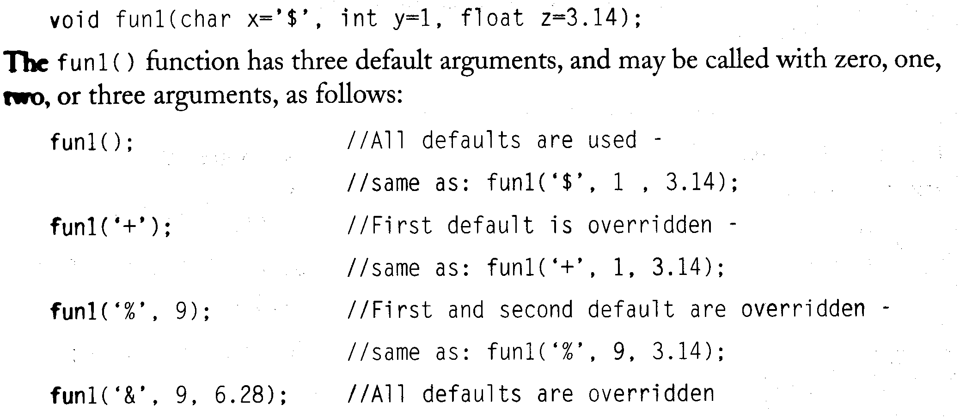
Example

Slide 40
Default arguments
If a function has both default and non‑default arguments, the non‑default arguments must be listed first in the function's parameter list.
The default arguments must always be to the right of those specified as non‑default arguments in the parameter list.

Slide 41
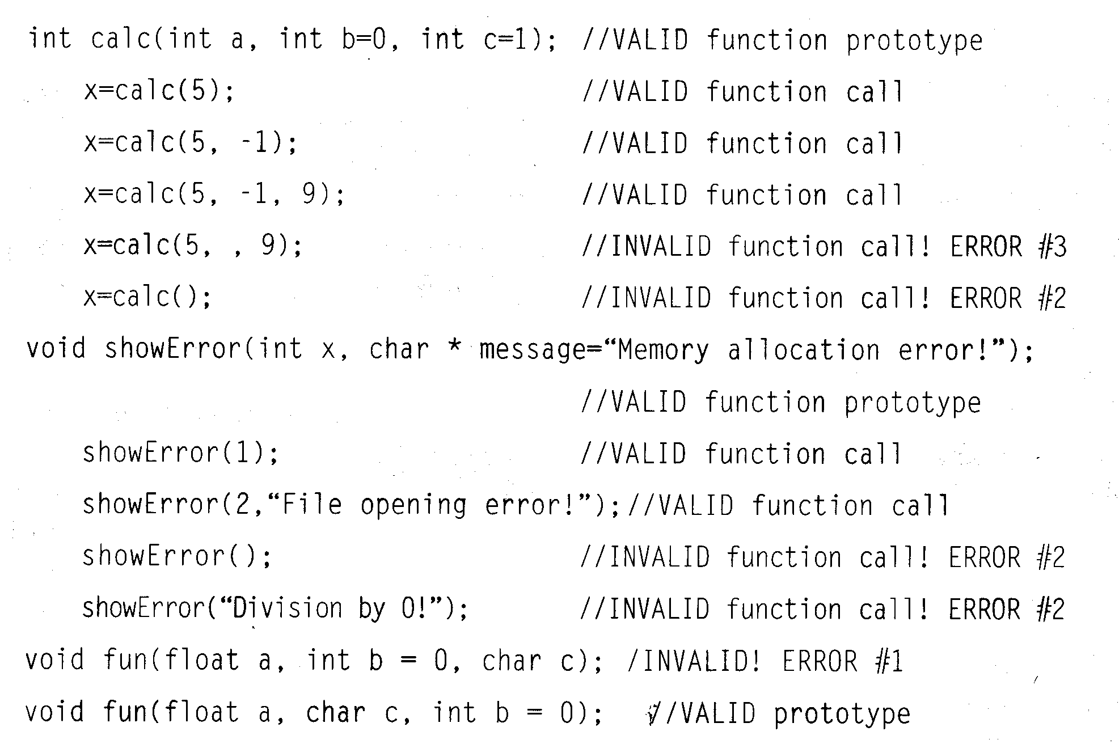
Example

Slide 42
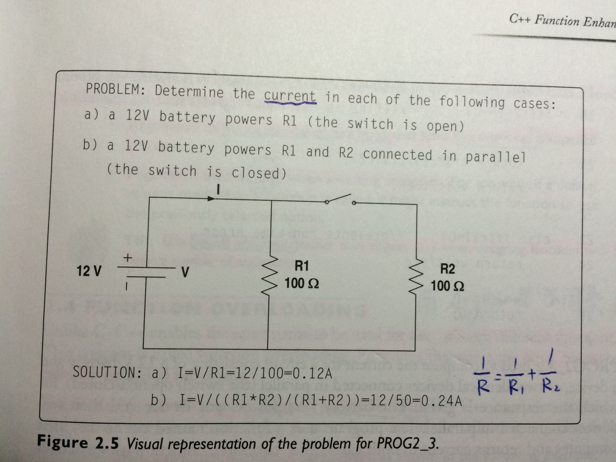

Slide 43
1 //PROG2_3: Program demonstrates a use of default arguments.
2 #include <iostream>
3 using namespace std;
4 const float volt = 12.0; //battery’s voltage
5 float current(float r1, float r2=0); // Use a default argument
6
7 int main()
8 {
9 cout <<“\t*** Device resistance = 100 ohms *** \n”<<endl;
10 cout<<“\t Switch open: Current[A] = “<<current(100)<<endl ;

Slide 44
11 cout<<“\t Switch closed: Current[A] = " <<
current(100, 100);
12 return 0;
13 }
14
15 float current(float r1, float r2)
16 {
17 float totR;
18 if (r2 != 0)
19 {
20 totR = (r1*r2)/(r1+r2)
21 return volt/totR;
22 }
23 else if(r1!=0)
24 return volt/r1;
25 else
26 return 0;
27 }

Slide 45
Good candidates for default arguments
Arguments of frequently called functions that have the same value most of the time
Arguments used as flags when selecting an option.
Use default arguments rather than ellipses (…) when designing functions with a variable number of arguments.

Slide 46
2.4 Function overloading
Unlike C, C++ enables the same name to be used for two or more different functions. This concept is called function overloading.
Functions that share the same name are celled overloaded functions.

Slide 47
Overload Functions
Requirements:
  Have a different number of parameters,
    int fun1(int);
    int fun1(int, float);
    int fun1(int, float, int);
  Have the same number of parameters, then:
  a. Parameter types should be in a different
  order,
    void fun2(char, int, float);
    void fun2(int, char, float);
    void fun2(float, char, int)

Slide 48
Overload Functions
  b. At least one parameter type should
  be different,
    void fun3(int, char);
    void fun3(double, char);
Note: It is not possible to overload functions by changing their return types.

Slide 49
Incorrect Example
int fun(double, int);
double fun(double, int);
When using function overloading, the compiler checks the function's arguments on each call to determine which function to use.

Slide 50
//PROG2_4: Program uses overloaded functions to sort
arrays.
#include <iostream>
#include <iomanip>
using namespace std;
const int size = 10;
void sort(int arr[]); //overloaded function
void sort(float arr[]);
int main()
{
int nums1[size]={3,9,1,-5,0,1,-3,4,6,7};
float nums2[size]={9.1,-0.7,4.6,0.3,9.9,1.1,3.2,-1.2,6.7,-4.9};
sort(nums1); //Calls overloaded function
sort(nums2);
cout<<" Sorted arrays:"<<endl;
for(int j=0; j<size; j++)
cout<<setw(5)<<nums1[j]<<setw(8)<<nums2[j]<<endl;
return 0;
}

Slide 51
Example
void sort(int arr[])
//Sorts an integer array
{
int temp;
for(int j =1; j<size; j++)
for(int k =0; k<size-1; k++)
if(arr[k]>arr[k+1])
{
temp = arr[k];
arr[k] = arr[k+1];
arr[k+1] = temp;
}
}
void sort(float arr[])
//Sorts a floating-point array
{
float temp;
for(int j =1; j<size; j++)
for(int k =0; k<size-1; k++)
if(arr[k]>arr[k+1])
{
temp = arr[k];
arr[k] = arr[k+1];
arr[k+1] = temp;
}
}

Slide 52
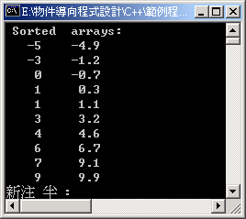
Result

Slide 53
Function Name mangling
The C++ compiler uses function name mangling to implement function overloading.
The compiler creates a function's signature and uses that signature to identify the function.

Slide 54
Function Name mangling
A function's signature is usually a combination of the function's name used in the source code to identify the function and the letters representing its parameter types.
There is no standard for function name mangling. Different compilers might perform function name mangling in different ways.

Slide 55
Ambiguity
If the compiler is confused when deciding which version of the overloaded function to use, it produces an error message.
There are several possible sources of ambiguity (or compiler confusion) when using function overloading.

Slide 56
Ambiguity
The most common sources of ambiguity are
  Automatic type conversions
  Using default arguments
  Using references as function parameters
  Calling overloaded functions
Ambiguity must be eliminated in order to compile a program successfully.

Slide 57
Example of Ambiguity
void fun1(float);
void fun1(double);
void fun2(int=1);
void fun2();
//Assume these declarations
int x=3;
float y=4.4;
double z=5.5555;
//Calling overloaded functions:
fun1(y); //Valid call;
// fun1(float) is called
fun1(z); //Valid call;
// fun1(double) is called
fun1(x); //Ambiguity: x can be
converted to float or double
fun2(x); //Valid call;
//fun2(int) is called
fun2();
//Ambiguity: default argument can be
used

Slide 58
Discussion
It may reduce the complexity of program, particularly of large programs.
In C++, only one function name needs to be used, leaving the compiler to select the correct version of the function.
Function overloading is widely used when designing C++ classes and object-oriented programs.

Slide 59
Discussion
TIP: It is not good programming practice to use the same name for functions that perform logically different operations.

Slide 60
2.5 Function templates
Both C and C++ apply the same programming logic to perform identical operations on different data types.
C++ offers a more efficient and convenient tool called a function template to solve problems similar to that illustrated in PROG2_4.
A function template serves as a function pattern, which defines a set of operations that can be applied to different data types.

Slide 61
void sort(int arr[])
//Sorts an integer array
{
int temp;
for(int j =1; j<size; j++)
for(int k =0; k<size-1; k++)
if(arr[k]>arr[k+1])
{
temp = arr[k];
arr[k] = arr[k+1];
arr[k+1] = temp;
}
}
void sort(float arr[])
//Sorts a floating-point array
{
float temp;
for(int j =1; j<size; j++)
for(int k =0; k<size-1; k++)
if(arr[k]>arr[k+1])
{
temp = arr[k];
arr[k] = arr[k+1];
arr[k+1] = temp;
}
}

Slide 62
Function templates
It uses user‑defined identifiers instead of specific data types. When a function defined as a template is called, arguments of specific data types are passed to it.
The compiler automatically generates a complete version of the function that operates on that specific set of data types.
A function that the compiler generates using a function template is called an instance of the function template or a template function.

Slide 63
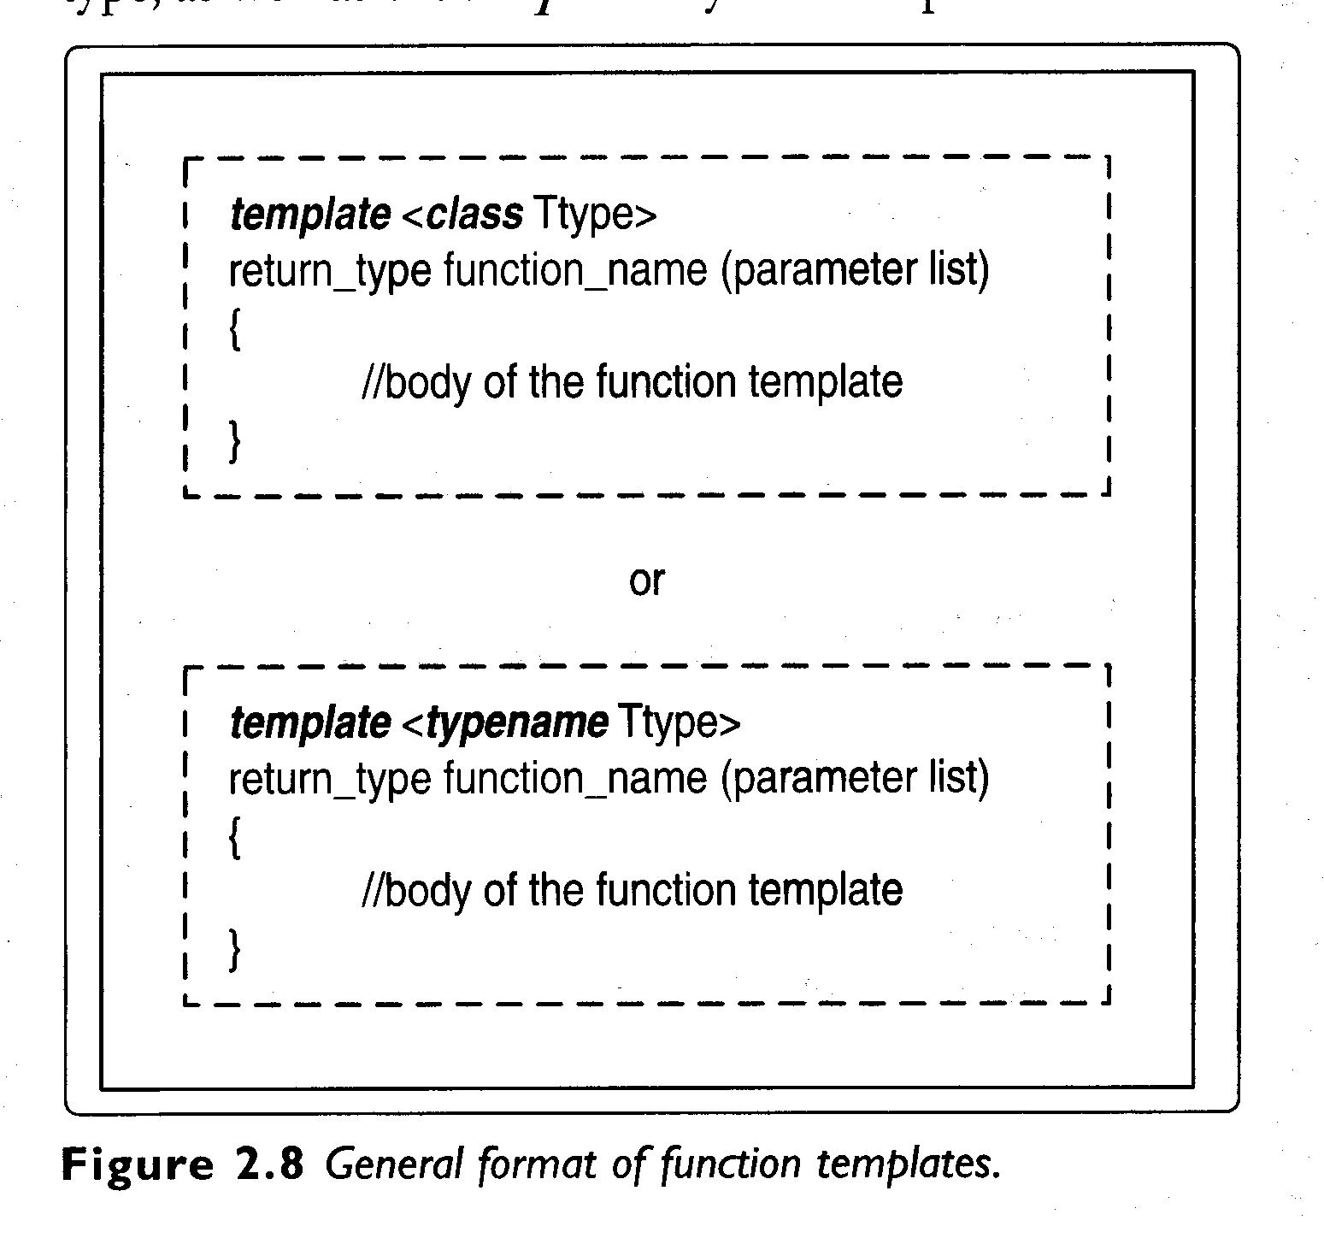
Format

Slide 64
#include <iostream>
#include <iomanip>
using namespace std;
const int size = 10;
template<class arrType>
//Function template definition
void sort(arrType arr[])
{
arrType temp;
for(int j =1; j<size; j++)
for(int k=0; k<size-1; k++)
if(arr[k]>arr[k+1])
{
temp = arr[k];
arr[k] = arr[k+1];
arr[k+1] = temp;
}
}

Slide 65
int main()
{
int nums1[size]={ 3,9,1,-5,0,1,-3,4,6,7 };
float nums2[size]={9.1,-0.7, 4.6, 0.3, 9.9, 1.1,3.2,-1.2,6.7,-4.9};
sort(nums1); //template function call
sort(nums2); //template function call
cout<<"Sorted arrays:"<<endl;
for(int j=0; j<size; j++)
cout<<setw(5)<<nums1[j]<<setw(8)
<<nums2[j]<<endl;
cin.get();
return 0;
}

Slide 66
The sort() function template is designed as a general procedure that can be used to sort arrays of different data types such as char, int, float, double, etc.
The formal type parameter arrType is used in this example as a placeholder for an array type in the function parameter list and as a placeholder for a data type of a local variable temp.
In general, the formal type parameters can be used as placeholders for
  A function's return type
  Data types of function parameters
  Data types of local variables

Slide 67
Example
template <class T1, class T2, class T3>
T1 fun(T1 x, T2 y, T3 z);
A function template called fun( ) in this example uses three formal type parameters Tl, T2, and T3.
It maybe called as follows:
  double a=1.3333;
  float b=7.3;
  int c=8;
  a=fun(a, b, c); //template function call
  cout « fun(c, b, a); //template function call

Slide 68
Example
Note that the compiler automatically generates two instances of the function template fun( ), because the argument list types are different on each call.

Slide 69
A function template overloads itself automatically relative to a specific set of data types.
However, it may be overloaded explicitly in a manner similar to normal functions.
If a function template is overloaded, it means that there is a non‑template function that shares the same name with the function template.

Slide 70
//PROG2_6: Program demonstrates function template
overloading.
#include <iostream>
#include <iomanip>
using namespace std;
template<class vType> //function template
void display(vType x)
{
cout<<" X = ";
cout<<setw(8)<<x<<endl;
}
void display(char c) //Overloads function template
{
cout<<'*'<<c;
}

Slide 71
int main()
{
char *cp = "TEMPLATE";
int a = 3;
float b = 5.6;
double c = 1.3333;
for(int i = 0; i<8; i++)
display(cp[i]); //Calls function that overrides template
cout<<'*'<<endl;
display(a); //Calls template function, version #1.
display(b); //Calls template function, version #2.
display(c); //Calls template function, version #3.
cin.get();
return 0;
}

Slide 72
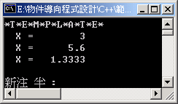

Slide 73
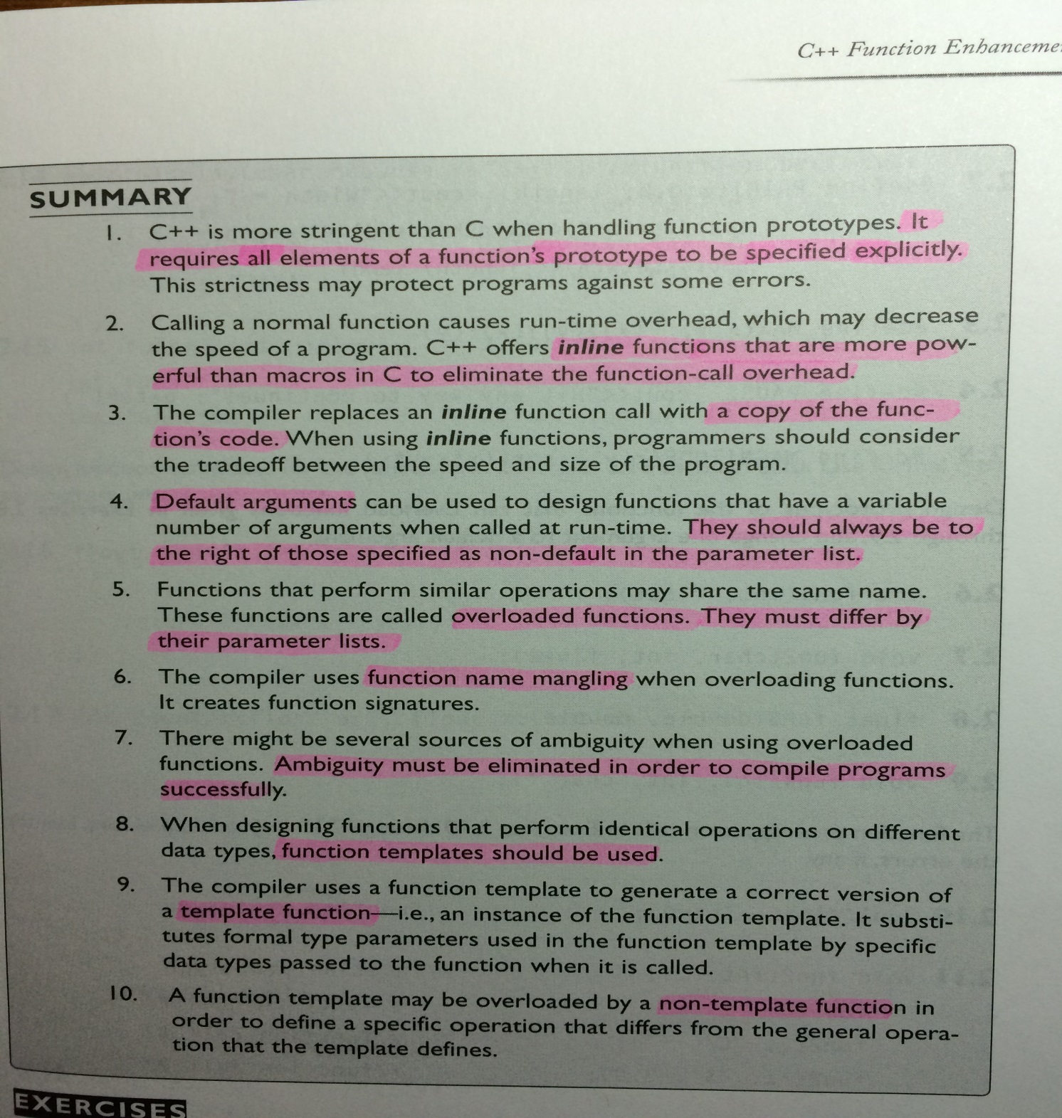

Slide 74
Homework 1
TEXT BOOK CH. 6
Programming Challenges 6. String Compare (P426)
Deadline 3/21 16:10

