Slide 1
Chapter 1
MOVING FROM C TO C++
蕭如淵

Slide 2
OBJECTIVES
To understand the differences between C and C++
To be able to use C++ input/output and formatting
To understand the namespace mechanism and to be able to define and use namespaces
To become familiar with the C++ standard

Slide 3
Outlines
Differences Between C and C++
  The C++ Standard and Compilers
  C++ Comments
  Header Files
  Data Types
  Resolving Scope and Variable Declarations
  Constants
C++ Input/Output
  C++ I/O Methods
  C++ Formatting
Namespaces

Slide 4
Introduction
C++ evolved from C
C++ as a superset of C
  functions, pointers, and structures.
C : a pure structured (procedural)
language
C++ : object‑oriented programming
language

Slide 5
Introduction
Object­oriented programming is more efficient when dealing with large, complex projects and requires a different way of visualizing solutions to programming problems.

Slide 6
Introduction
Instead of C's standard I/O functions, C++ uses different tools to get input and produce output.
C++ also provides a new tool called a namespace to prevent errors that may occur when linking multiple files containing source code into one application.

Slide 7
Drawback of C
Hard to design and maintain
  C++ is much more efficient when dealing with large and complex problem.
  Decrease the program’s development time and improves its maintainability.
C is less rigid than C++
  E.g. function prototypes. C++ forces programmers to follow very strict rules to reduce error.

Slide 8
Reason for creating C++
To provide a new approach to programming (object‑oriented programming) that would overcome the limits of C's structured approach when dealing with large and complex programming problems.
To design new programming tools that would help programmers write code quickly and efficiently, as well as help improve maintainability of large projects.

Slide 9
Reason for creating C++
To design a more rigid programming language that would require programmers to follow certain strict rules, thus reducing chances for making errors.
To create a highly extendable programming language.
To enhance some important C concepts such as functions, pointers, and structures and make these tools even more powerful.

Slide 10
Graphical representation of the relationship between C and C++
C++
C

Slide 11
C
C is very efficient when solving small and simple programming problems.
C++ is the language of choice when dealing with large and complex problems.
There is no reason to use C++'s advanced tools in small and simple programs‑it may even needlessly increase their complexity.

Slide 12
C++ standard
1998 ANSI/ISO C++ standard
http://www.ansi.org

Slide 13
C++ Comment
Improves program readability and provides help when maintaining program.
Single line comment : two forward slashes (//)
Multiple lines comment: /* */

Slide 14
Example
/* This is the old C commenting style, in which multiple comment lines (a comment block) begin with a forward slash followed by an asterisk and end with an asterisk followed by a forward slash. */
// This is the new C++ commenting style, in which each
// line begins with two forward slashes without end symbols.

Slide 15
Header Files
C ++:
  The C++ library is a collection of files, called header files, containing definitions and declarations of programming entities such as functions, data types, and constants.

Slide 16
Header Files
C ++:
  The #include preprocessor directive, followed by a header file name, is placed at the beginning of a program to include the contents of that header file in the program.
  A standard library header file name is enclosed in angle brackets (< >).
  The C++ standard does not require any extension for standard header files.

Slide 17
Example
#include <stdio.h> // Includes C's standard header file #include <iostream> // Includes C++'s standard header file
user‑defined header files. A user‑defined header file should also have an .h extension. The #include preprocessor directive is also used to enclosed in double quotes (” “).
#include <iostream> //Includes a standard header file
#include “myheader.h" //Includes a user‑defined header file

Slide 18
Search header file sequence
First : the same directory where the source file being compiled is stored
Second: the specified path for standard library header files
Appendix C : C++ standard library header files (Svenk)
Appendix I : Header File and Library Function Reference (Gaddis, Walters and Muganda)

Slide 19
Data Types
C’s five data type (char, int, float, double, and void)
C++ provide a new type named bool (Boolean value: true or false)
A value of the bool type can be converted to a value of the int type
  True : 1, false : 0

Slide 20
Example
bool fun (float x, float y) // function returns true or fasle
{
  bool answer;
  If (x<y && x>0)
    answer=true;
    else
      answer=fasle;
    return answer;
}
Using bool values makes a program more readable and its logic clearer.
In addition to improving the program's clarity, the bool type consumes less memory than the int type.

Slide 21
automatic data type conversions
Values of different types are first converted to the largest data type used in an expression and then the expression is evaluated.
A value on the right side of an assignment statement is converted to the data type on the left side.
int a=2;
float b=3.12;
double c=1.9999, d;
d=a/b*c // a and b are temporarily converted to double
a=c; // Value of c is temporarily converted to int

Slide 22
type cast
It should be noted that a type cast is an explicit data type change that is requested by the programmer.
int a=9, b=10;
float percent;
percent=a/b*100; //assigns 0.0 to percent
// Use type cast to change a to float before performing division.
percent=(float)a/b*100; //assigns 90.0 to percent

Slide 23
Cast operators provided by C++
static_cast ‑ for standard type conversions
  For example:
  s t a t i c_c a s t < f1oat > ( a )
  converts a to float
const_cast ‑ for casting constants
reinterpret_cast ‑ for nonstandard type conversions

Slide 24
Type checking
Unlike C, C++ is more rigid in data type checking.
Although C++ still enables mixing or assigning values of different data types, a type cast must be used in some cases before a value can be assigned.

Slide 25
Resolving Scope and variable declarations
Variables in C and C++ can be declared
  globally (outside function definitions, usually before main())
  locally (within a function).

Slide 26
Resolving Scope and variable declarations
Local declaration
  Local variables in standard C have to be declared after the opening brace ({)that indicates the beginning of a function definition, or after the opening brace that indicates the beginning of a block within the function definition.
  Local variables in C++ can be declared anywhere within the body of a function or within a block, as long as they are declared before being used.

Slide 27
Scope resolution
C:
  When using two or more variables with the same name in a C program, the most locally declared variable is only accessible at any time.
  A global variable cannot, therefore, be accessed within a function or a block within the function that uses a local variable with the same name as the global variable.
C++
  provides the scope resolution operator (::), which can be used to access global variables that have same names as local variables.

Slide 28
Example
int x=l; //global variable (not good)
int main()
{
int x=2; //local variable
::x=8; //assigns 8 to the global variable { //beginning of a block i
int x=3; //new local variable whose scope //is the inner block
cout«x; //prints value of local variable (3) cout« ::x; //prints value of global variable (8)
}
cout<<x; //prints value of local variable (2)
Return 0;
}

Slide 29
Constants
C: uses the #define preprocessor directive to create constants
C++ : uses the const keyword to declare constants
Format:
const data_type constant_name =value;
using const must have a data type specified and a value assigned by the assignment operator.
If a constant data type is omitted, C++ assumes int.

Slide 30
Example
// C constants
#define MAX_SPEED 100
#define MESSAGE “Switch printer on!”
#define RATE 1.15
//C++ constants
const int MAX_SPEED=100;
const char MESSAGE[]= “Switch printer on!”;
const float RATE=1.15;

Slide 31
Disadvantages of using #define
#define does not perform type checking
#define cannot be debugged (i.e., the value of the constant cannot be checked)

Slide 32
Common error
const PI=3.14159265
const float X;

Slide 33
1.2 C++ INPUT/OUTPUT
C’s standard I/O functions: scanf(), printf()
C++ provides new I/O methods
  stream: a sequence of data (input /output)
  objects:
    cin (console input device)
    cout (console output device)
  defined within std namespace in the iostream header file
I/O operations
  stream insertion operator <<
  stream extraction operator >>

Slide 34
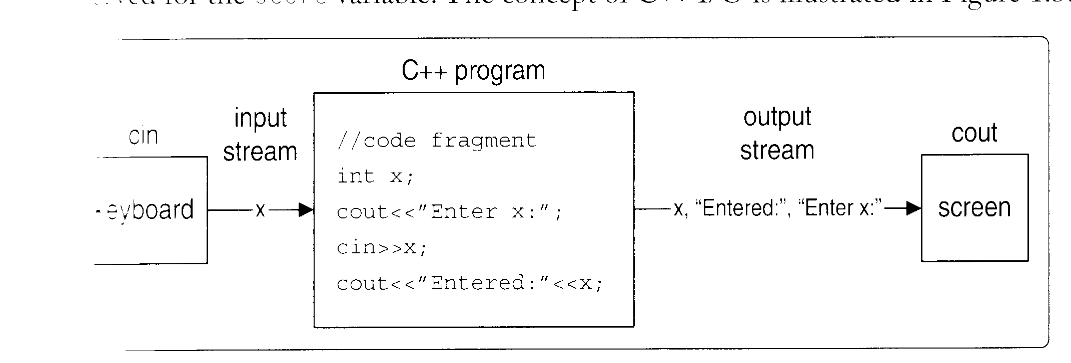
Example
cout << “OOP Using C++”;
cin >> score;

Slide 35
Example
cin>> or cout<< statement can be used to input or output more than one value.
Example : P11 PROG 1_1
…
cin>>length>>width;
…
cout<<“Area = ”<<area;
…

Slide 36
Example
>> is terminated by a whitespace or Enter
getline() or get() can be used
  get() is used to get a single character (include white space)
  char ch;
  count << “Enter a character”;
  ch=cin.get();

Slide 37
Example
getline() is used to get a sequence of character (a string) that can include whitespace(s).
  char message[50];
  cout<< “Enter a message”;
  cin.getline(message, 50);
  cout<<“The message entered:“<<message;

Slide 38
Advantages of C++ over C I/O methods
Unlike C's standard I/O library functions that only work with built‑in data types, C++'s stream extraction and stream insertion operators can work with any data type, including user‑defined data types.
Data types of values being entered or displayed/printed do not have to be specified.
C++ provides more powerful formatting tools than C.

Slide 39
C++ Formatting
C++ provides a variety of manipulators to control the format of the output produced by a program.
Three groups:
  Numeric base manipulators
  Character control manipulators
  Format control manipulators

Slide 40
C++ Output Stream Manipulators
Manipulator | Description
Numeric Base Manipulators
dec | Sets decimal base
hex | Sets hexadecimal base
oct | Sets octal base
Character Control Manipulators
endl | Inserts a new-line character `\n' and flushes the buffer
ends | Inserts a null character `\0'
flush | Flushes the buffer
Format Control Manipulators
setw(int) | Sets the field width for a single output field
setprecision(int) | Sets the floating point precision
Setiosflag(flag) | Sets the output format flags
Resetiosflags(flag) | Resets the output format flags
setfill(char) | Sets the fill character

Slide 41
Numeric base manipulators
used to set a numeric base (decimal, hexadecimal, octal) prior to displaying integer numbers.
Integer numbers are normally output base 10.
Inserting one of the base manipulators into the output stream, changes subsequent integer output to that base.

Slide 42
Character control manipulators
\n (endl)
\0 (ends)
flushing the output buffer (endl and flush)

Slide 43
Format control manipulators
setw(int)
setprecision(int)
setiosflag(flag)
resetiosflags(flag)
setfill(char)

Slide 44
Format control manipulators
Format control manipulators are defined in the iomanip header file.
setw() is the only manipulator that is reset each time after a value is displayed and should be specified for each value individually.

Slide 45
Format state Flags
Format Flag | Description
ios::left | Sets left justification within a field
ios::right | Sets right justification within a field
ios::dec | Sets decimal numeric base
ios::hex | Sets hexadecimal numeric base
ios::oct | Sets octal numeric base
ios::showbase | Shows a numeric base before a number
ios::uppercase | Shows uppercase letters in hexadecimal values
ios::showpos | Shows a positive/negative sign before a number
ios::fixed | Shows decimal numbers with a fixed decimal point
ios::scientific | Shows decimal numbers in scientific notation

Slide 46
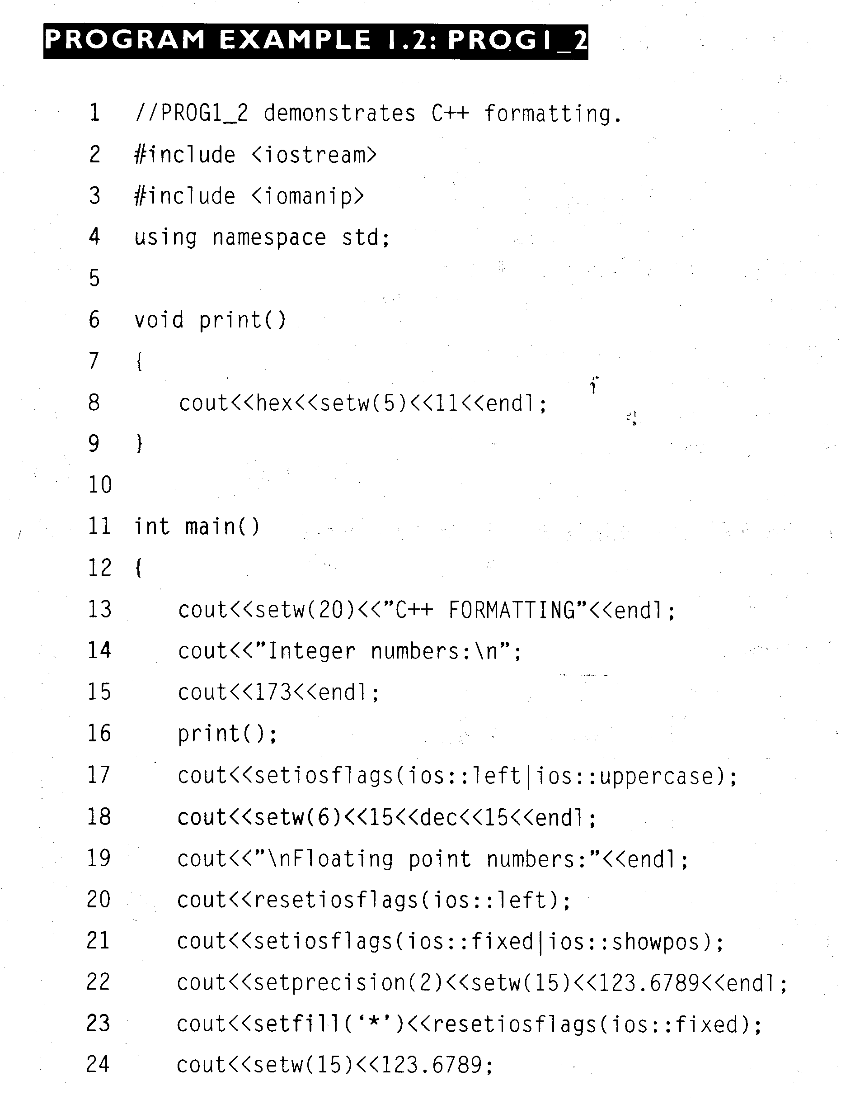
Example
25 return 0;
26 }

Slide 47
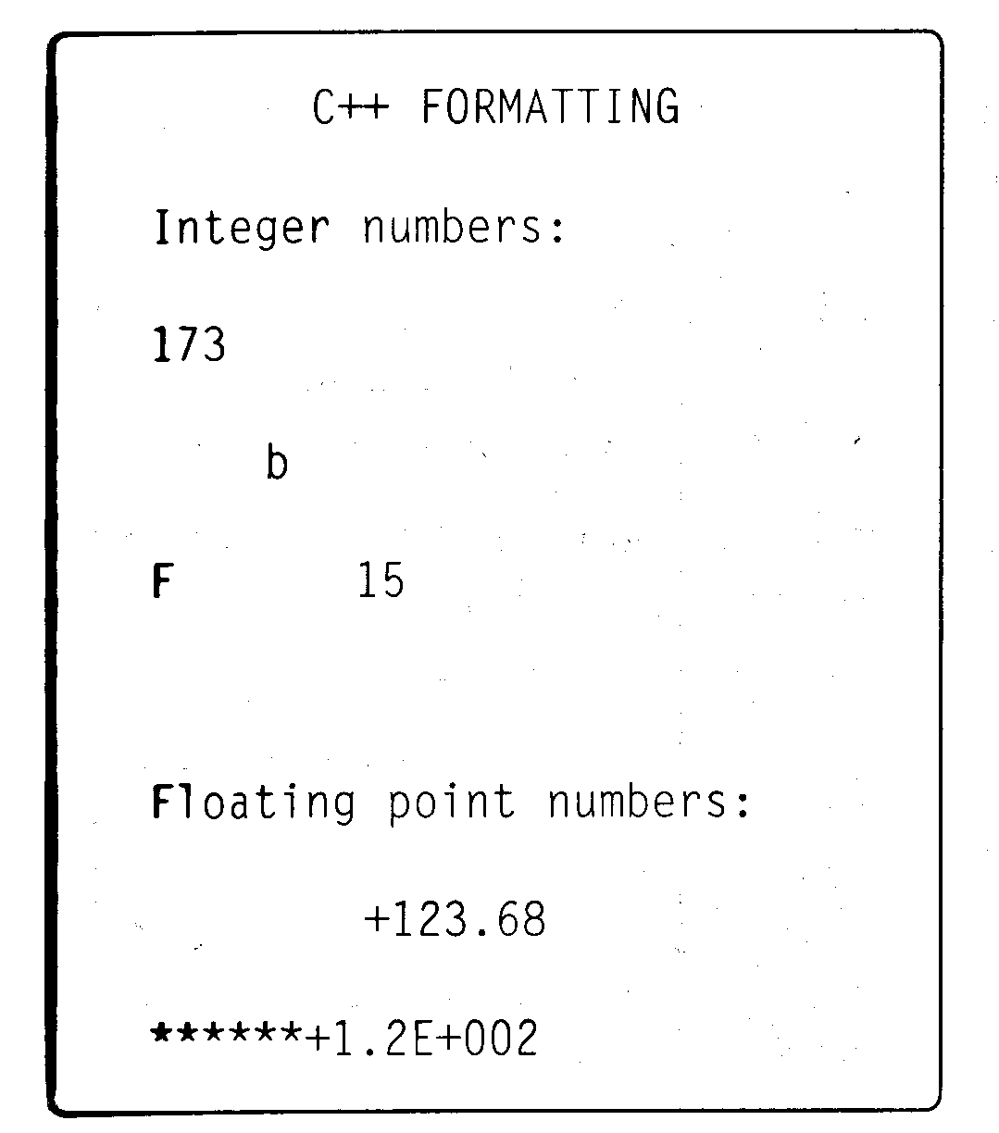
Example

Slide 48
Example
25 return 0;
26 }

Slide 49
Example

Slide 50
Example
25 return 0;
26 }

Slide 51
Example

Slide 52
Example
25 return 0;
26 }

Slide 53
Example

Slide 54
Example
25 return 0;
26 }

Slide 55
Example

Slide 56
Example
25 return 0;
26 }

Slide 57
Example

Slide 58
Example
25 return 0;
26 }

Slide 59
Example

Slide 60
Example
25 return 0;
26 }

Slide 61
Example

Slide 62
Comparison
The main advantage of C++ formatting (over C formatting) is that it only needs to be done once (except setw() )in instances where all output values are required to have the same format.
C requires that each value be formatted individually, even if the same format is used for all values. C++ formatting also provides more options than C formatting.

Slide 63
1.3 Namespace
to assist in developing or maintaining large programs.
Those files (modules) that may have been designed by different programmers are eventually linked together into the final application.

Slide 64
1.3 Namespace
errors may occur if duplicate identifiers (names of variables, constants, functions, structures, typedefs, etc.) are used in the same global scope that is shared by all modules.
C++ provides a mechanism called a namespace to prevent errors that may occur when linking multiple modules (source files and libraries).

Slide 65
Namespace
The namespace keyword is used to group together logically related programming entities such as variables, objects, functions, and structures.
Programming entities that are grouped within one namespace share a common namespace name.

Slide 66
Declaration
namespace namespace_name
{
//body of the namespace
//that contains declarations
//and definitions
}

Slide 67
Namespace v.s. Structure
Similar:
  group together related variables.
Difference:
  Structures: contain only variables,
  Namespaces: can contain other programming entities as well―such as functions and classes

Slide 68
Namespace member
Programming entities declared within a namespace are called namespace members.
A namespace member identifier has a namespace scope; that is, the identifier is only visible within its namespace.
no conflict and an error will not occur if the same identifiers are used in different namespaces.

Slide 69
Example
namespace Sample
{ //namespace declaration
int i;
float f;
void display() { cout«i «f ; }
float getf() { return f; }
}

Slide 70
How to access namespace member
accessing namespace members outside the namespace is by preceding a member identifier with its namespace name followed by the scope resolution operator(::).
Sample::i=33; Sample::f=1.23; float x=Sample::getf(); Sample::display();

Slide 71
How to access namespace member
A namespace can also be unnamed (anonymous namespace). An unnamed namespace has no identifier.

Slide 72
Compilation unit
Global (unname) namespace
Namespace name_1
Namespace name_2
Namespace name_3
Namespace name_N

Slide 73
Example
1 //PROG1_3: Program demonstrates named and unnamed namespaces.
2 #include <iostream>
3 using namespace std;
4
5 namespace Circle { //named namespace declaration
6 const double PI=3.14159265;
7 float r; //radius of a circle
8 float a; //area of a circle
9 float area() {return PI*r*r;} //Computes and returns area
10 void print( ) {cout«"Area = "«a«endl;} //Prints area
11 }
12
13 namespace { //unnamed namespace declaration
14 float a=0; //total area
15 void print() {cout« "\nTotal area = "«a;} //Prints total area
16 }

Slide 74
17 int main()
18 {
19 for(int i=0; i<3; i++)
20 {
21 cout«"Enter radius of circle #"«(i+1)«" => ";
22 cin » Circle:: r;
23 Circle::a=Circle::area();
24 Circle::print(); //Calls print() from Circle
25 a=a+Circle::a;
26 }
27 print(); //Calls print() from unnamed namespace
28 return 0;
29 }

Slide 75
Enter radius of circle #1 => 1
Area = 3.14159
Enter radius of circle #2 => 2
Area = 12.5664
Enter radius of circle #3 => 3
Area = 28.2743
Total area = 43.9823

Slide 76
Nested namespaces
A namespace can also be declared within another namespace (nested namespaces).
When used within an outer namespace, a member identifier of an inner namespace must be preceded with its namespace name followed by the scope resolution operator.

Slide 77
Using directive
Repetitive use of a namespace name followed by:: each time a preceding member of a namespace is listed is often not convenient, particularly if they are used frequently.
To eliminate this redundant syntax, C++ provides the using directive, general format is as follow:
using namespace namespace_name

Slide 78
1//PROGl_4: Program demonstrates using directives.
2 #include <iostream>
3 using namespace std; //predefined namespace
4
5 namespace Rectangle {//user‑defined namespace
6 float length;
7 float width;
8 void area() {cout «"Area = "« (length*width); }
9 }
10 using namespace Rectangle;//Specifies user‑defined namespace
11
12 int main()
13 {
14 cout «"Enter length => ";
15 cin » length;
16 cout «"Enter width => ";
17 cin » width ;
18 area();
19 return 0;
20 }

Slide 79
1//PROGl 4: Program demonstrates using directives.
2 #include <iostream>
3
4 namespace Rectangle {//user‑defined namespace
5 float length;
6 float width;
7 void area() {cout «"Area = "« (length*width); }
8 }
9
10 int main()
11 {
12 std::cout «"Enter length => ";
13 std::cin » Rectangle::length;
14 std::cout «"Enter width => ";
15 std::cin » Rectangle:: width ;
16 Rectangle:: area();
17 return 0;
18 }

Slide 80
Summary
1. C++ provides new objected-oriented programming tools to decrease the development time and improve maintainability of large programs.
2. C++ is more rigid than C and forces programmers to follow strict rules when writing code, thus preventing some types of errors.
3. C++ can be defined as a superset of C. Therefore, any C++ complier can compile C programs as well with very few coding changes.
4. The programmers should check if the compiler they use compiles with the C++ standard before design programs.
5. In addition to C’s commenting style, C++ also provides a new commenting style, in which each line begins with two forward slashes.

Slide 81
Summary
6. C++ does not require any extension for standard library header file, while a .h extension is required for user-defined header files.
7. C++ provides a data type named bool for the true and false Boolean balues.
8. In addition to the C-style type cast, C++ also provides the static_cast, const_cast, and reinterpret_cast operators when performing typecasting.
9. C++ provides the scope resolution operator (::), which can be used to access global variables that have the same names as local variables.
10. C++ uses the const keyword when declaring constants. Unlike constants created using the #defined directive, types and values of constants created using const can be checked.

Slide 82
Summary
11. C++ I/O methods are based on the use of input/output streams, objects(usually cout and cin) and operators. The stream extraction operator (>>) and stream insertion operator (<<) can be used to input/output values of any type, including user-defined types.
12. C++ provides a large collection of output stream manipulators to format an output. Numeric base manipulator (dec, hex, and oct) are used to set a numeric base for integer number. Character control manipulator (endl, ends, and flush) manipulate a sequence of characters. Commonly used format control manipulators are setw(), setprecision(), setfill(), setiosflags(), and resetiosflags().

Slide 83
Summary
13. C++ provides namespaces to prevent errors when linking together code modules or libraries that may declare identical identifiers ( names of variables, functions, structures, etc.) A namespace can be named or unnamed (global namespace). Duplicate identifiers can be declared in two or more different named namespaces.
14. The using directive is used to avoid redundant coding. Placing the using directive with a specified namespace name eliminates the need for preceding namespace members to be listed with namespace name followed by the scope resolution operator.

