Slide 1
Chapter 3
Pointers, References,
and
Dynamic Memory Allocation

Slide 2
Outlines
Objectives
Introduction
C++ pointer
References
Using References and Pointer with Constants
Dynamic memory allocation
Case Study

Slide 3
Objectives
To understand the differences between C and C++ pointers
To be able to use references as independent variables and function parameters
To be able to return references by functions
To be able to use pointers and references with constants
To understand the difference between static and dynamic memory allocation
To be able to allocate, process, and deallocate dynamic arrays

Slide 4
Introduction
C pointers are very powerful.
If they are not used properly they are prone to producing unpredictable results, including system crashes.
C++ enhances C pointers and provides increased security because of its rigidity.

Slide 5
Introduction
In addition, C++ provides a new kind of pointer called a reference.
References have advantages over regular pointers when passed to functions.

Slide 6
3.1 C++ pointer
A pointer is a variable that is used to store a memory address. This address can be a location of Variable, Pointer, Function.

Slide 7
3.1 C++ pointer
The major benefits of using pointers in C/C++ are
  To support dynamic memory allocation
  To provide the means by which functions can modify their actual arguments
  To support some types of data structures such as linked lists and binary trees
  To improve the efficiency of some programs

Slide 8
Pointer
A pointer variable is declared using
data_type *variable_name;
Data type the pointer points can be any valid C/C++ type including void and user-defined types
int *ptr1;
double *ptr2;
void *ptr3; //can point to a variable of any type
Robot *ptr4; //user defined

Slide 9
Operators
indirection operator (*) precedes a pointer and returns the value of a variable, the address of which is stored in the pointer.
float x=1.23, y; float *pt; /* pt can point to any variable of type float */ pt=&x; /* places the memory address of x into pt */ cout « *pt; //prints the value of x: 1.23

Slide 10
Operators
address-of operator (&) returns the memory address of its operand.
float x=1.23, y; float *pt; /* pt can point to any variable of type float */ pt=&x; /* places the memory address of x into pt */ cout « *pt; //prints the value of x: 1.23

Slide 11
Operator
operation that the * operator performs on a pointer (accessing the value the pointer points to) is also described as dereferencing the pointer.
A void pointer cannot be dereferenced.
Example:
void *pt1; //pt1 is a void pointer
int *pt2; //pt2 is an integer pointer
int x=3,y,z;
pt1=pt2=&x; //pt1 and pt2 point to x
y=*pt1; //ERROR! pt1 cannot be dereferenced.
z=*pt2; //CORRECT! pt2 is dereferenced
// and the value of x is placed into z.

Slide 12
Pointer expressions
Pointers can be used as operands in assignment, arithmetic, and comparison expressions.
Only addition and subtraction operation can be used on pointers.

Slide 13
Example
float f=13.3; // f :address 1000
float *ptr1,*ptr2;
ptr1=&f;
ptr2=ptr1; //assigning pointers: ptr1 and ptr2 point to f
ptr1--; //decrementing ptr1
cout « ptr1; //The value of ptrl is 992 (=1000-8)
ptr2=ptr2+5; //adding 5 to ptr2 and assigning
//result to ptr2
cout «ptr2; //The value of ptr2 is 1040 (=1000+5*8)
if (ptr1==ptr2) //comparing pointers by equality
cout «"Both pointers contain the same memory address.";

Slide 14
Point to another pointer
When declaring a pointer that points to another pointer, two asterisks must precede the pointer name.
float a=0.99, *b,**c;
b=&a; //pointer b points to variable
c=&b; //pointer c points to pointer
cout «**c; //dereferencing pointer c
//two times to access a

Slide 15
Access array by pointer
An array name returns the starting address of the array (the address of the first element of the array), an array name can also be used as a pointer to the array.
Faster than index

Slide 16
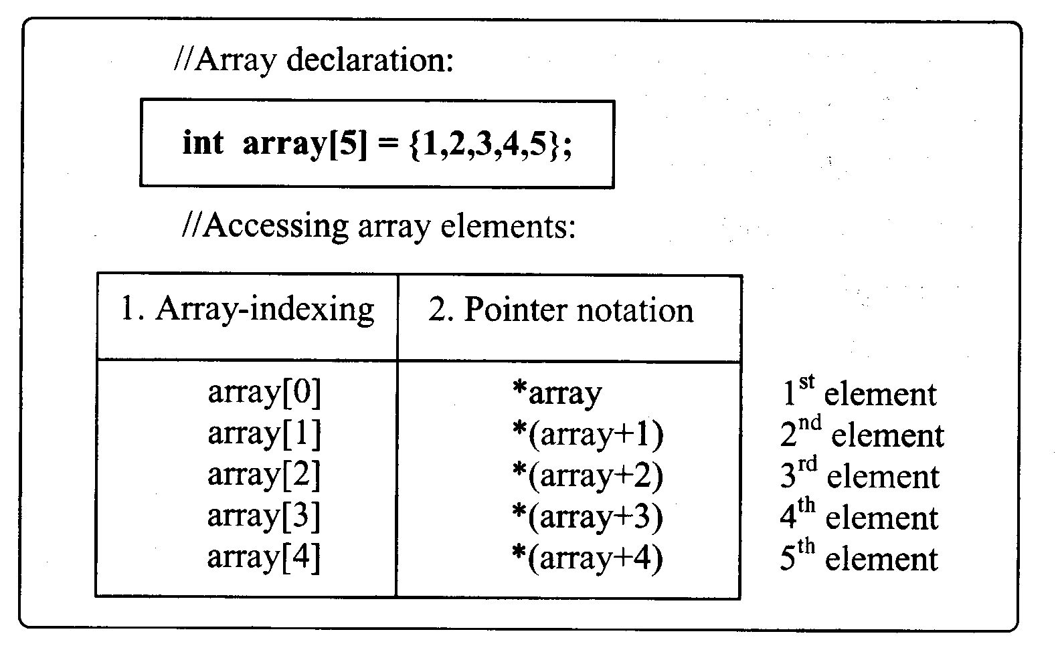
Access array by pointer

Slide 17
String
string is equivalent to a character pointer.
Operations with strings are often performed by using pointers.
char scientist[13]="Nikola Tesla";
char *cptr;
cptr = scientist; //cptr is set to the address of
//scientist
cout« *(cptr+2); //prints the third character 'k‘
cout « cptr;
//prints the entire string "Nikola Tesla“

Slide 18
Differences between C and C++ pointers
C++ is much more strict when dealing with pointer types.
This is especially apparent in the implementation of void pointers.
A void pointer can point to a variable of any type.

Slide 19
int ivalue=13;
float fvalue=8.3;
int *iptr;
float *fptr;
void *vptr;
fptr=&ivalue; //ERROR! A float pointer cannot
//point to an integer variable.
iptr=&ivalue; //CORRECT
vptr=&ivalue; //CORRECT
vptr=&fvalue; // CORRECT
iptr=fptr; //ERROR! A float pointer cannot
//be assigned to an integer pointer
vptr=fptr; //CORRECT
vptr=iptr; //CORRECT

Slide 20
Both C and C++ do not permit the direct assigning pointers of different types. C can accomplish that indirectly, however, through a void pointer.
mytype1 *ptr1;
mytype2 *ptr2;
void *vptr;
//Assume all pointers have been initialized at this point.
vptr = ptr1;
ptr2 = vptr; // No problem in C; Invalid in C++.

Slide 21
Pointers of different types can be assigned to each other by using a type cast as follows:
ptr2 = (mytype2 *) ptr1;

Slide 22
3.2 References
A reference is an implicit pointer that is automatically dereferenced.
References also act as alternative names for other variables.
A reference can be used in three different ways:
  Created as an independent variable
  Passed to a function
  Returned by a function

Slide 23
References as Independent Variables
References can be created as independent variables.
To create a reference variable, the & operator has to be put before the variable name when it is declared.
The & operator is an example of an overloaded operator (address of or bitwise AND operator ).
The type of reference variable should be the same as the type of the variable to which it points.

Slide 24
References as Independent Variables
If used as independent variables, reference variables have to be initialized when declared.
data_type & reference_name = variable_name;
float num = 7.3;
float & refnum = num;
The refnum reference is initialized to num and it acts as an alias for num

Slide 25
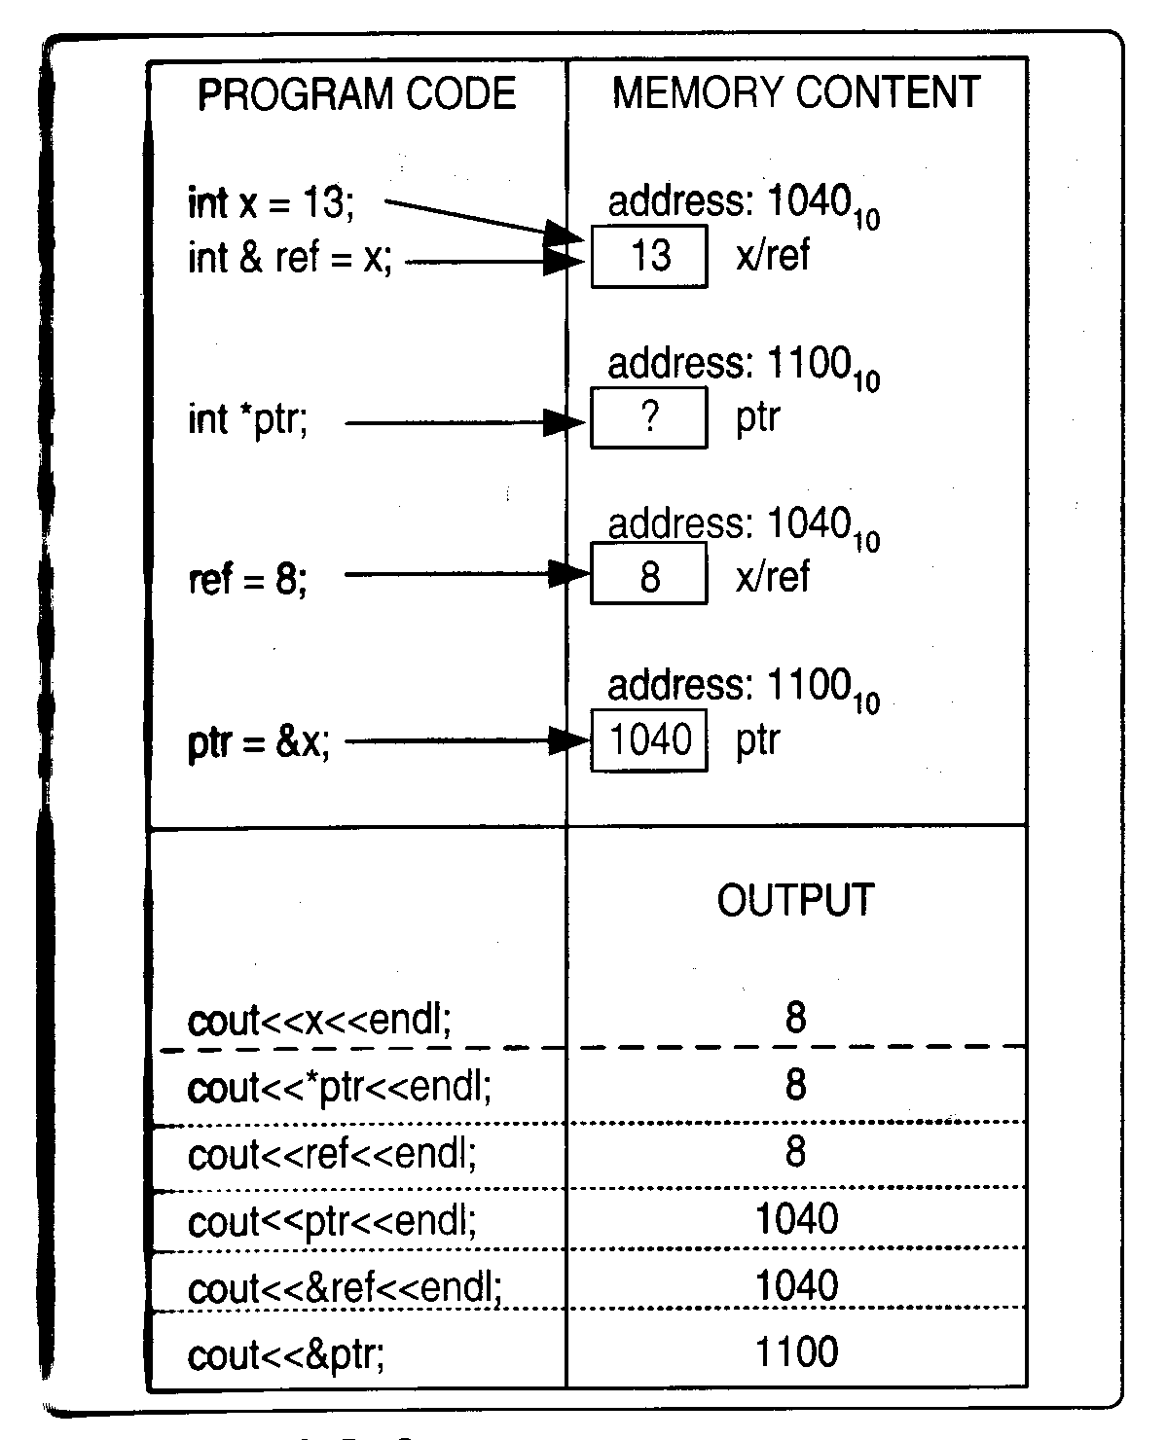

Slide 26
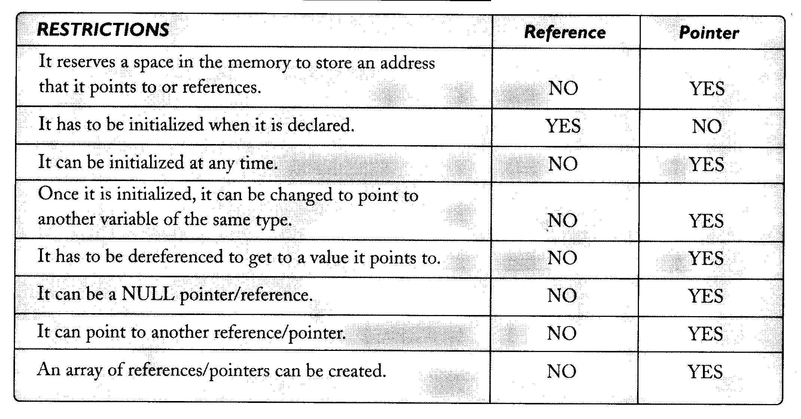
Differences Between Pointers and References

Slide 27
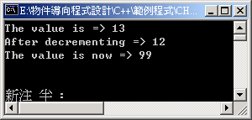
#include <iostream>
using namespace std;
int main()
{
int i = 13;
int &iref = i; //declaring a reference variable
cout<<"The value is => "<<iref;
i--;
cout<<"\nAfter decrementing => "<<iref<<endl;
iref = 99;
cout<<"The value is now => "<<i;
cin.get();
return 0;
}

Slide 28
Passing references to functions
C++ supports the following three methods for passing values to functions: by value, address, and by reference.
When passed to functions, references have a clear advantage over pointers.
Passing a reference to a function is like passing the address of the variable used as the argument in the function call.

Slide 29
#include <iostream>
#include <iomanip>
#include <cstdlib>
#include <ctime>
using namespace std;
const long NUM = 1000000;
const int RANGE = 100;
void odd_even(int x, int &ce, int &co)
{ //references as parameters
if ((x % 2)==0)
ce++;
else
co++;
}

Slide 30
int main()
{
long i;
int num;
float perc_even; //even numbers percentage
float perc_odd; //odd numbers percentage
int counteven = 0; //even numbers counter
int countodd = 0; //odd numbers counter
srand(time(0)); //Initializes random number generator
for(i=0; i<NUM; i++)
{
num = 1 + rand() % RANGE; //Generates a random
// number num
odd_even(num, counteven, countodd); //Checks num
} // and increments even/odd counter

Slide 31
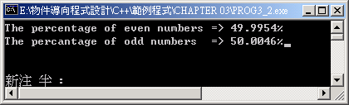
perc_even=static_cast<float>(counteven*100)/NUM;
perc_odd = static_cast<float>(countodd*100)/NUM;
cout<<setiosflags(ios::fixed)<<setprecision(4);
cout<<"The percentage of even numbers => "<< perc_even <<"%";
cout<<"\nThe percantage of odd numbers => “ << perc_odd <<"%";
cin.get();
return 0;
}

Slide 32
Reference parameters can be preceded with const to prevent a function from changing them inadvertently, as is shown in the following example:
void fun(const int &cref)
{
cout«cref/15; //NO PROBLEM
cref++; //ERROR! Cannot modify
}

Slide 33
Comparison with pointer
void odd_even(int x, int *ce, int *co)
{
//Pointers as function parameters
if((x % 2)==0)
*ce++; //a pointer has to be dereferenced
else
*co++;
}
odd_even(num, &counteven, &countodd);

Slide 34
References
The code is cleaner, because it is not necessary to use the * operator.
The programmer does not have to remember to pass the address of the function argument.
Unlike passing with a pointer, no memory location is required and no copy of the function argument is made when using a reference.
This becomes very important when objects are passed to functions .
TIP: Use references rather than pointers when passing variables to functions by address.

Slide 35
Returning Reference by Function
A function may return a reference.
This is particularly important when overloading some types of operators― e.g., inserter and extractor
Returning a reference by a function also permits the function to be called from the left side of the assignment operator.

Slide 36
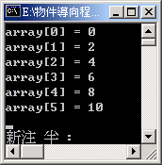
#include <iostream>
using namespace std;
const int SIZE = 6;
int & put_val(int a[], int n) //function returns a reference
{
if(n>=SIZE || n<0)
{
cout<<"Outside of boundaries!";
exit(1);
}
return a[n];
}
int main()
{
int array[SIZE];
for(int i=0; i<SIZE; i++)
put_val(array, i)=i*2; //function call is on the left side
for(int j=0; j<SIZE; j++)
cout<<"array["<<j<<"] = "<<array[j]<<endl;
cin.get();
return 0;
}

Slide 37
This approach is less error prone than a direct assignment.
The function put_val() checks at run-time that the array boundaries are not exceeded before it returns a reference to an array element.
This prevents run­time errors such as array overflows or underflows (caused by assigning a value to an array element specified by the index that is outside of the boundaries of the array).

Slide 38
3.3 Using References and Pointers with Constants
If the const keyword is applied to references and pointers, one of the following four types can be created
  A reference to a constant
  A pointer to a constant
  A constant pointer
  A constant pointer to a constant

Slide 39
A reference to a constant
By preceding a reference type with the const keyword, a reference to a constant is created.
It is a read‑only alias, which cannot be used to change the value it references; however, a variable that is referenced by this reference can be changed.
int x=8;
const int & xref=x; //A reference to a constant
x=33;
cout«xref ; //Displays 33
xref=15;
//ERROR! Cannot modify a reference to a constant.
X=50; //OK

Slide 40
A pointer to a constant
const double *pt; //A pointer to a constant
double x=3.3, y=4.4;
pt=&x;
cout «*pt; //Displays 3.3
pt=&y;
cout «*pt; //Displays 4.4
*pt=5.05; //ERROR! Cannot modify a pointer to a constant
The pt points to a constant used in this example can store different addresses ­ that is, it can point to different variables.
It cannot, however, be used to change a value, which is stored at the address to which it points.

Slide 41
A constant pointer
int var1=15, var2=8;
int * const cpt=&varl;
//A constant pointer to an integer
*cpt=34;
cout «var1; //Displays 34
cpt=&var2; //ERROR! A constant pointer cannot
// be changed.
A constant pointer can be used to change the value it points to; however, it cannot be changed to point to another value‑i.e., the address stored in a constant pointer cannot be changed.

Slide 42
A constant pointer to a constant
const int value1=11, value2=22; const int *cptc=&valuel; //A constant pointer to a constant *cptc=33; //ERROR! Cannot modify a constant. cout « *cptc; //Displays 11 cptc=&value2; cout « *cptc; //Displays 22 A constant pointer to a constant cannot be used to change the constant value to which it points. It can, however, be changed to point to another constant of the same type.

Slide 43
Summary
Type/feature | Reference to a Constant | Pointer to a Constant | Constant Pointer | Constant Pointer to a Constant
It can be changed to point to another value.
It can be used to change the value it points to.
The value it points to can be changed.
NO
Yes
NO
Yes
NO
NO
Yes
NO
Yes
Yes
Yes
NO

Slide 44
3.4 Dynamic Memory Allocation
Static memory allocation is a technique that uses the explicit variable and fixed­-size array declarations to allocate memory.
An amount of memory allocated using this technique is reserved when a program is loaded into the memory.
If static/fixe-d­size arrays are used, a program could fail when running on some computer systems that lack enough memory, or the program could reserve an excessive amount of memory and make it difficult to run any other programs at the same time.

Slide 45
struct comp_part { //a structure comp‑part definition
char code[7];
char description[30];
int on_stock;
int sold;
float price;
};
comp_part list[100]

Slide 46
Dynamic memory allocation
Run-time allocate
Heap: a region of free memory
C: malloc(), calloc(), realloc(), free()
C++: new and delete
new data_type;
pointer_var = new data_type(initial_value);
delete pointer_var;

Slide 47
Example
float *fpt = new float(0.0);
//Allocates a float variable and initializes
//to 0.0
if( fpt == 0)
//Checks for a memory allocation error
//Can be changed to if(!fpt)
{ cout «"Memory allocation error.";
exit(1);
}
*fpt=3.45;//Uses pointer to access memory
cout«*fpt;
delete fpt;

Slide 48
Memory leaking
A very common type of error and failing to prevent it could result in a memory resource problem.
float *ptr = new float; //Allocates first block
*ptr = 7.9; //Accesses first block
ptr = new float; //Allocates second block
*ptr = 5.1; //Accesses second block

Slide 49
Memory leaking
If the pointer is set to point to another block of memory without the delete statement that frees the previous block, it causes a memory leak.

Slide 50
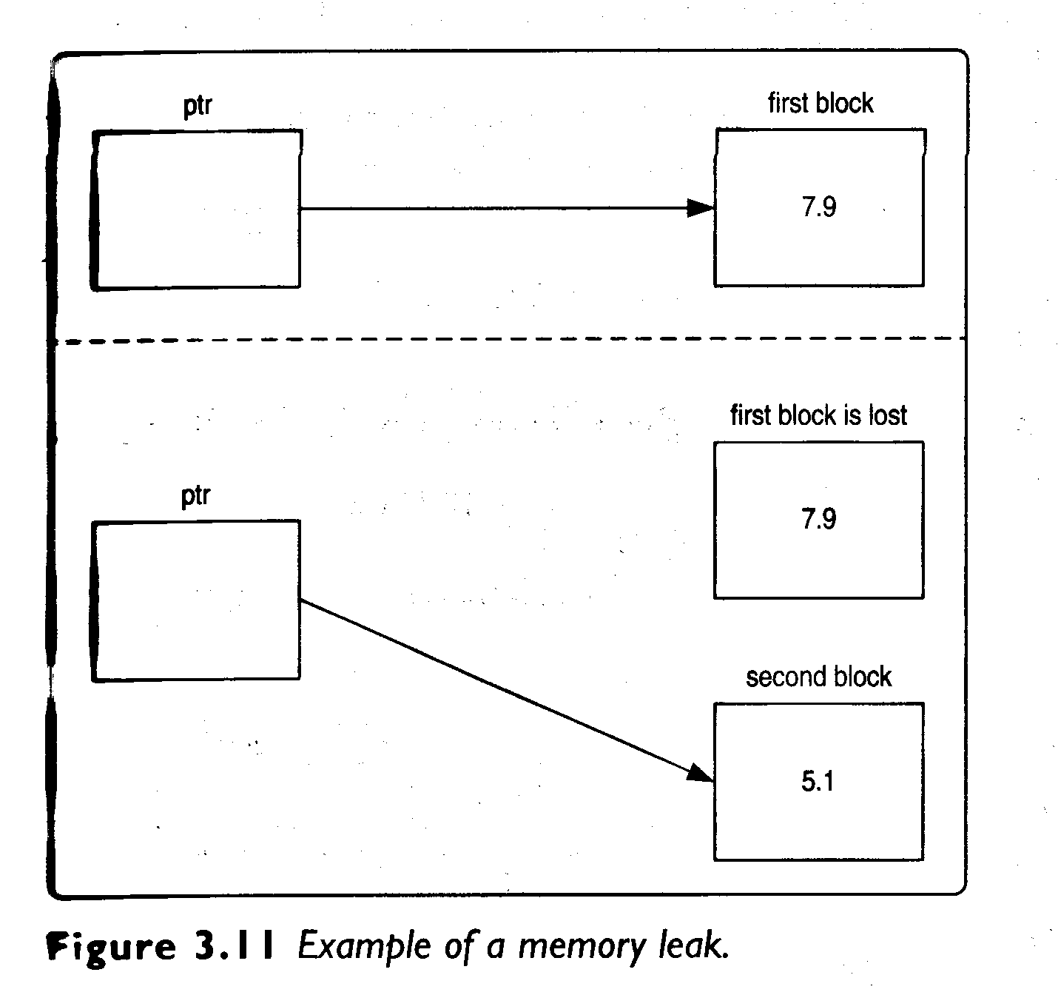

Slide 51
Dynamic arrays
A dynamically allocated array may have a variable size decided in run time.
Using new and delete
pointer_var = new data_type[size];
delete []pointer_var;
size: integer, variable or expression

Slide 52
#include <iostream>
#include <iomanip>
using namespace std;
int main()
{
int *ptr, n=10;
ptr = new int[n]; //Allocates an array dynamically
if(!ptr) //Checks for a memory allocation error
{
cout<<"Memory allocation error!";
exit(1);
}

Slide 53

for(int i=0; i<n; i++)
{
ptr[i]=(i+1)*2; //Initializes the array
cout<<setw(4)<<ptr[i]; //Displays its values
}
delete []ptr; //Deletes the array from the heap
cin.get();
return 0;
}

Slide 54
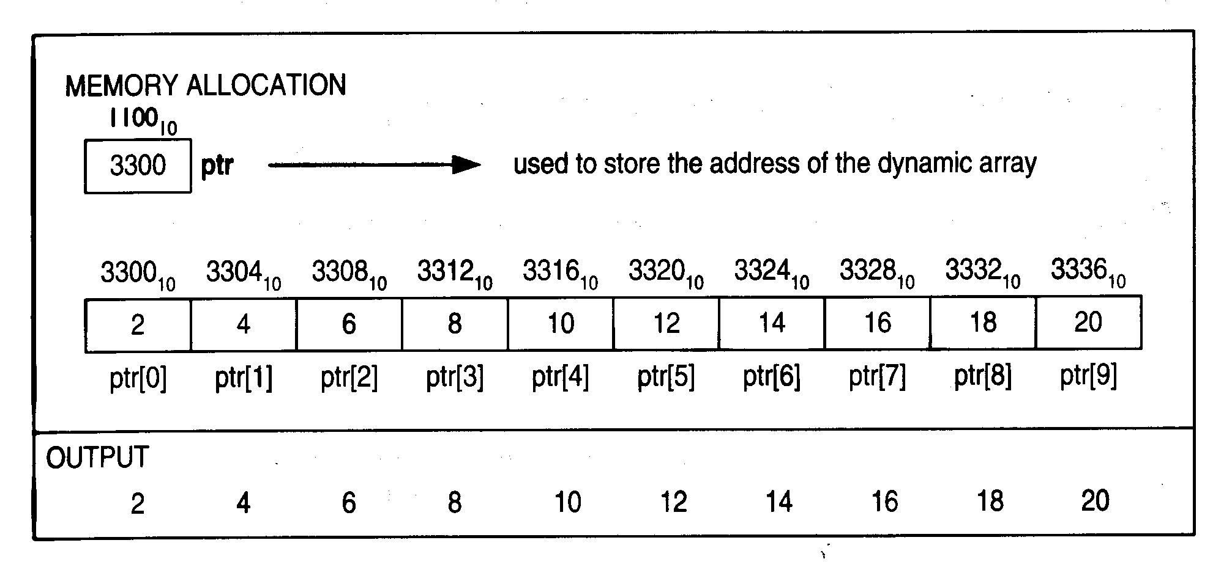

Slide 55
#include <iostream>
#include <iomanip>
using namespace std;
int main()
{
int *ptr, n;
cout<<"Enter how many even numbers to generate => ";
cin>>n; //Gets the size of the array from the user
ptr=new int[n]; //Allocates the array dynamically
if(!ptr) //Checks for a memory allocation error
{
cout<<"Memory allocation error!";
exit(1);
}
cout<<"\n\tEven numbers are: \n"<<endl;

Slide 56
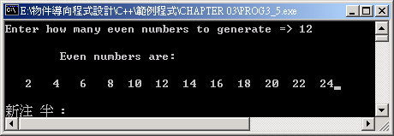
for(int i=0; i<n;i++)
{
ptr[i]=(i+1)*2;
cout<<setw(4)<<ptr[i];
}
delete []ptr; //Frees dynamically
// allocated memory
cin.get();
return 0;
}

Slide 57
Multi-dimensional array
/* PROG3_6: Program demonstrates a two-dimensional dynamic array. */
#include <iostream>
#include <iomanip>
using namespace std;
void memError()
{
cout<<"Memory allocation error!";
exit(1);
}
int main()
{
int rows, columns, i, j;
int **p2d; //Declares a pointer to pointer

Slide 58
cout<<"Enter a number of rows => ";
cin>>rows;
cout<<"\nEnter a number of columns => ";
cin>>columns;
p2d=new int*[rows]; //Sets up an array of row
// elements of pointers
if(!p2d) //Checks for an allocation error
memError( );
for(i=0; i<rows; i++)
{
p2d[i]=new int [columns]; //Sets up the columns
if(!p2d[i]) //Checks for an allocation error
memError();
}
cout<<"\n***MULTIPLICATION TABLE***"<<endl;

Slide 59
for(i=0; i<rows; i++)
{
for(j=0; j<columns; j++)
{
p2d[i][j]=(i+1)*(j+1); //Initializes the array
cout<<setw(5)<<p2d[i][j]; //Displays its values
}
cout<<endl;
}
for(i=0; i<rows; i++)
delete [] p2d[i]; //Deletes the columns
delete [] p2d; //Deletes the rows
return 0;
}

Slide 60
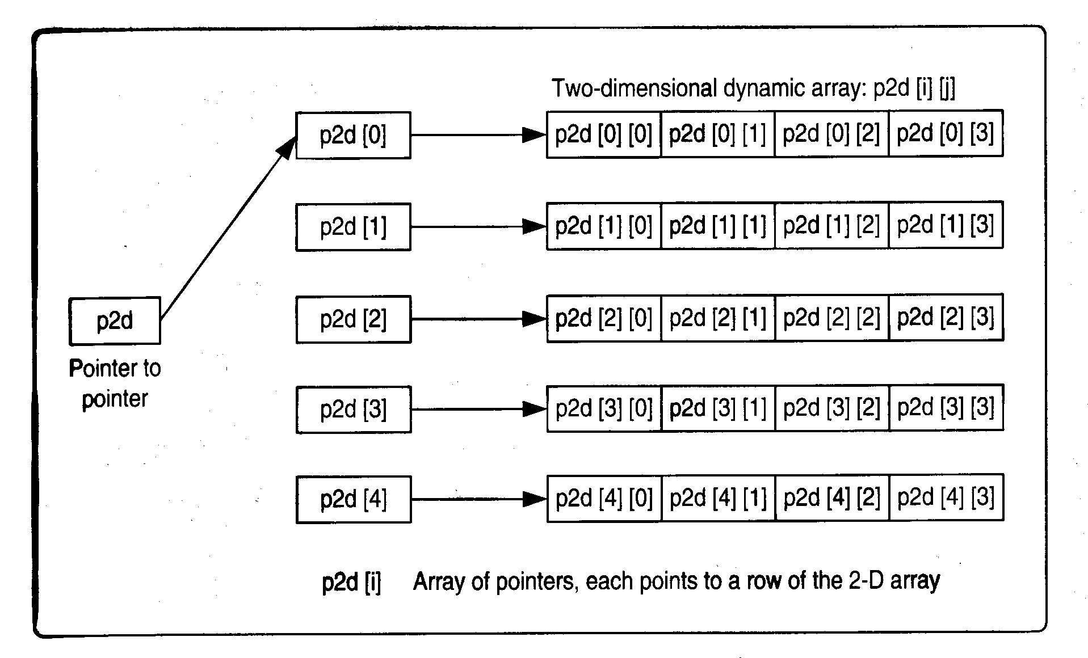

Slide 61
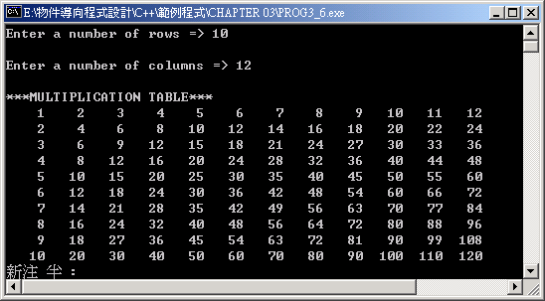

Slide 62
3.5 Case Study
LOTO 6/49 numbers
randomly generate sets of tickets of six numbers ranging from 1 to 49, excluding any duplicate numbers within each set.
display the numbers in a table format, sorted in ascending order within each set.
check to see how many times a number chosen by the user occurred in all sets.

Slide 63
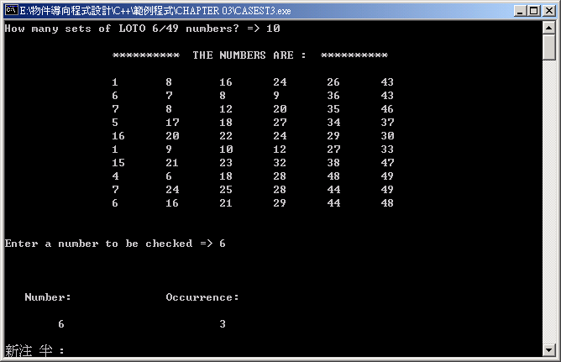

Slide 64
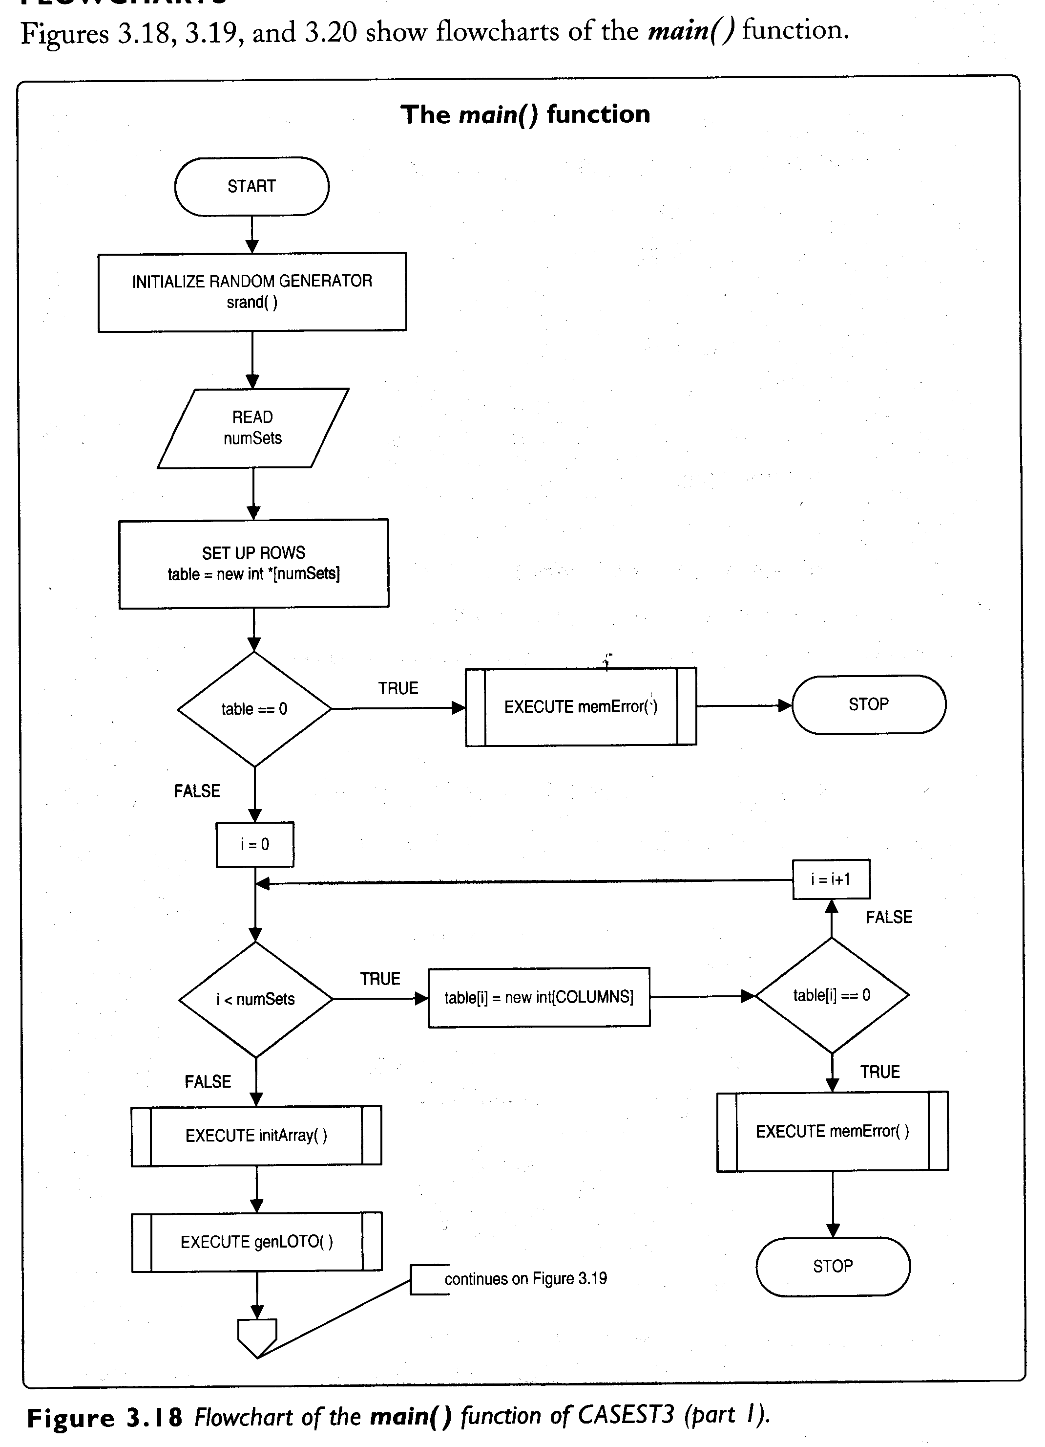

Slide 65
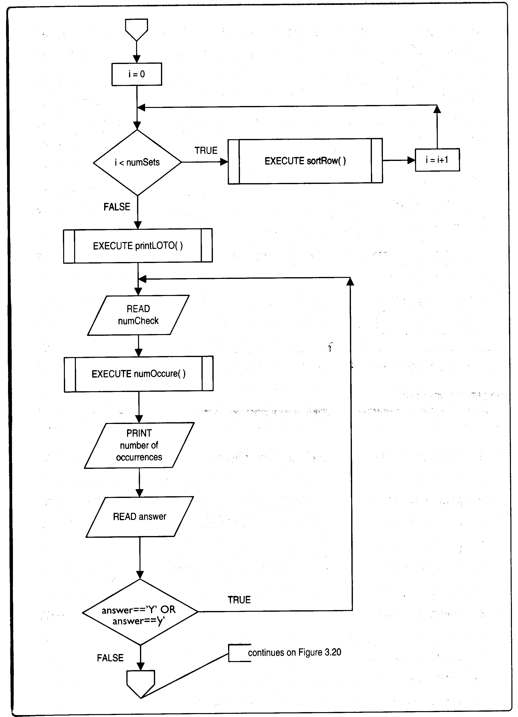

Slide 66
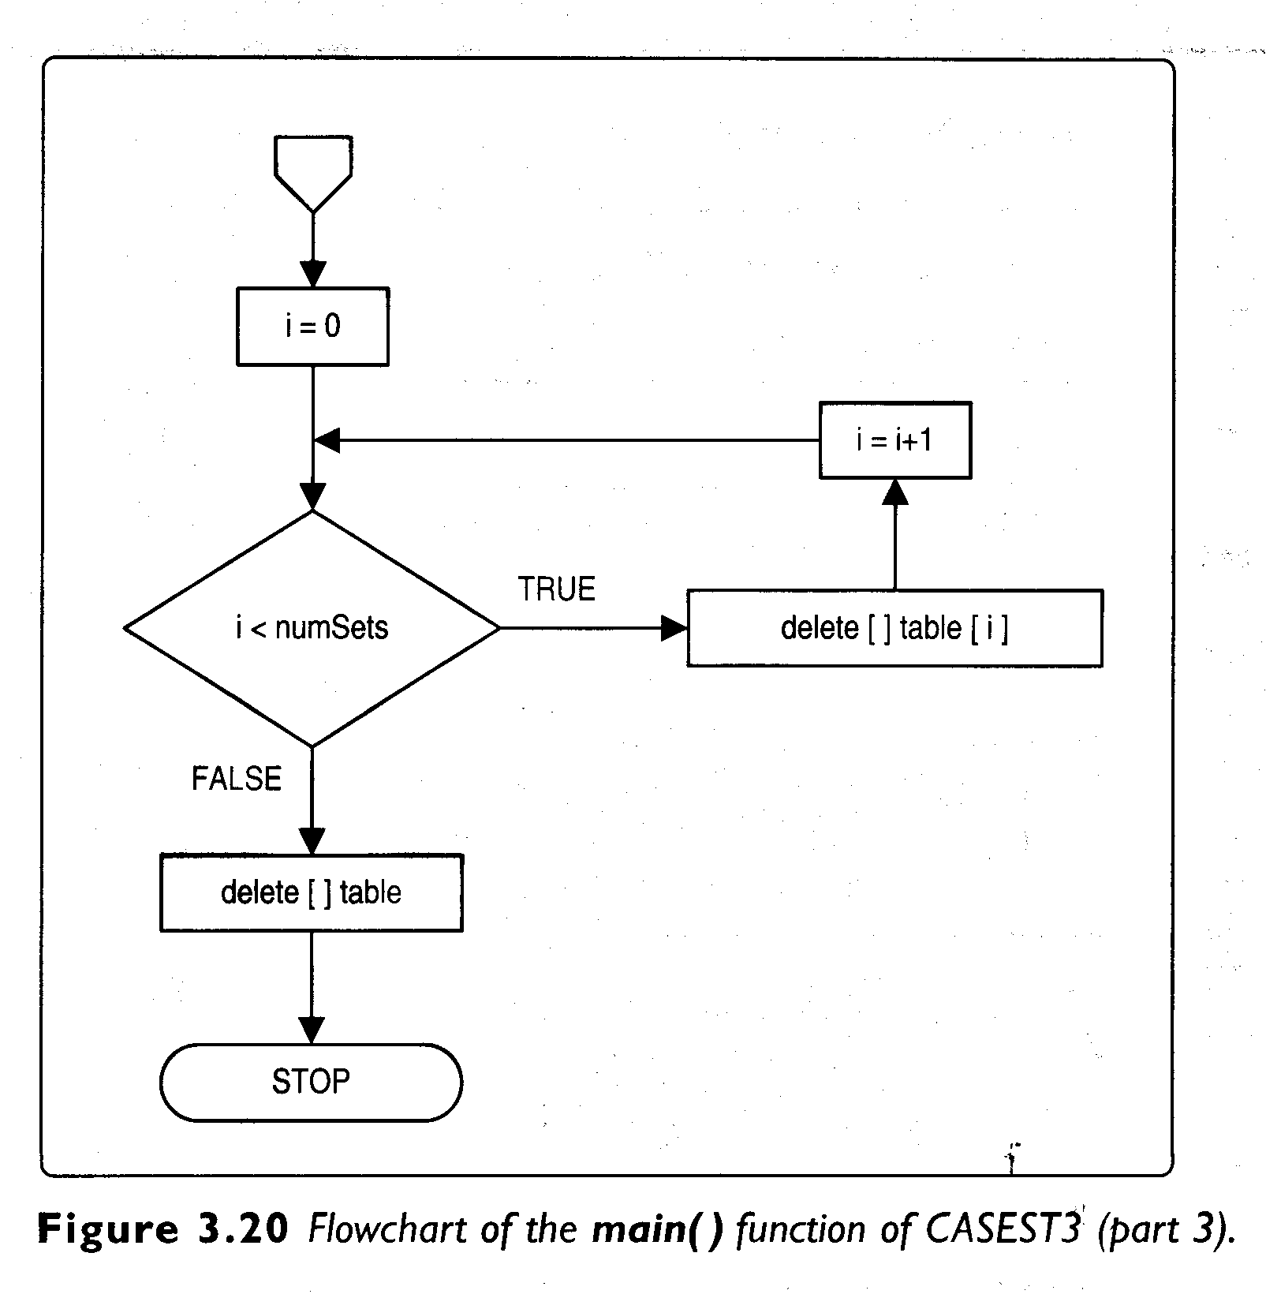

Slide 67
#include <iostream>
#include <cstdlib>
#include <ctime>
#include <stdio.h>
using namespace std;
const int COLUMNS = 6; //a number of columns
const int MAXNUM = 49; //the largest number to be
//generated
void initArray(int **,int); //Initializes array
void genLOTO(int **,int); //Generates LOTO numbers
int isDuplicate(int **,int,int); //Checks for duplicate
//numbers
void sortRow(int **,int); //Sorts a row
void printLOTO(int **,int); //Prints LOTO numbers
int numOccure(int **,int,int); //Returns a number of
// occurrences

Slide 68
inline void memError() //Handles a memory
//allocation error
{
cout<<"Memory allocation error!";
exit(1);
}
/******************************************/
int main()
{
int **table; //a pointer that points to a 2-D array
int numSets; //a number of sets/rows
int numCheck; //a number to be checked
int i;
char answer;
srand((unsigned)time(0)); //Initializes the random
// generator

Slide 69
cout << "How many sets of LOTO 6/49 numbers? => ";
cin >> numSets; //Gets the number of sets
table = new int *[numSets]; //Sets up the rows
if(!table) //Checks for an allocation error
memError();
for (i = 0; i < numSets; i++)
{
table[i] = new int[COLUMNS]; //Sets up the columns
if(!table[i]) //Checks for an allocation error
memError();
}
initArray(table,numSets);
genLOTO(table,numSets);
for (i = 0; i < numSets; i++)
{
sortRow(table, i); //Sorts numbers in a row
}
printLOTO(table,numSets);

Slide 70
do{ //Checks for the number of occurrences
cout << "\n\nEnter a number to be checked => ";
cin>>numCheck; //Gets a number to be checked.
cout << "\n\n\n Number:\t\tOccurrence:\n\n";
cout << "\t" << numCheck << "\t\t\t";
cout<<numOccure(table, numCheck, numSets) << endl;
cout<<"\n\n\nAnother number to check? (Y/N) => ";
cin>>answer;
}while(answer=='Y'||answer=='y'); //Loop back if
//answer is y/Y
for(i=0;i<numSets;i++)
delete []table[i]; //Deletes columns
delete []table; //Deletes rows
getchar();
return 0;
}
/**********************************************/

Slide 71
void initArray(int **table, int numSets)
{
for (int i = 0; i < numSets; i++)
for (int j = 0; j < COLUMNS; j++)
table[i][j] = 0; //Initialize the array by 0s
}
back

Slide 72
void genLOTO(int **table, int numSets)
{
int newNum; //random number
for (int i = 0; i < numSets; i++) {
for (int j = 0; j < COLUMNS; j++) {
do {
newNum = rand()%MAXNUM + 1; //Generates a
//random number
}while ( isDuplicate(table, i, newNum) );
//Loop back, if the number is a duplicate
table[i][j] = newNum; //Stores the number into
//the array
}
}
}
back

Slide 73
int isDuplicate(int **table, int rowNum, int newNum)
{
for (int i = 0; i < COLUMNS; i++) {
if (table[rowNum][i] == 0)
return 0;
if (table[rowNum][i] == newNum)
return 1; //Returns 1 if a duplicate number is found
}
return 0; //Returns 0 if a duplicate number is not
// found
}
back

Slide 74
void sortRow(int **table, int rowNum)
{
int temp;
for (int i = 0; i < COLUMNS - 1; i++) {
for (int j = 0; j < COLUMNS - 1; j++) {
if(table[rowNum][j] > table[rowNum][j+1])
{
temp = table[rowNum][j];
table[rowNum][j] = table[rowNum][j+1];
table[rowNum][j+1] = temp;
}
}
}
}
back

Slide 75
void printLOTO(int **table, int numSets)
{
cout<<endl;
cout<<"\t\t********** THE NUMBERS ARE : **********\n“ << endl;
for (int i = 0; i < numSets; i++) {
cout<<"\t\t";
for (int j = 0; j < COLUMNS; j++) {
cout << table[i][j] << '\t';
}
cout <<endl;
}
}
back

Slide 76
int numOccure(int **table, int num, int numSets)
{
int count = 0; //Counts a number of occurences
for (int i = 0; i < numSets; i++) {
for (int j = 0; j < COLUMNS; j++) {
if (table[i][j] == num)
count++;
}
}
return count;
}
back

Slide 77
Summary
1. C++ is much more stringent than C when dealing with pointer types. It does not permit an assignment of pointers of different types to each other through a void pointer.
2.A reference is an implicit pointer that is automatically dereferenced. It can be passed to a function, returned by a function, or used as an independent variable.
3.Unlike pointers, references have to be initialized when they are declared. Once a reference is initialized to a variable, it cannot be changed to point/refer to another variable. Its address is the same as the address of the variable to which it refers. An array of references cannot be created.
4.If used as function parameters, references have several advantages over pointer. When pass to functions, they produce much cleaner and less error-prone code than pointers.

Slide 78
Summary
5. Returning a reference from a function permits the function to be called from the left side of the assignment operator.
6.If the const keyword is applied to references and pointer, it may result in one of the following four types : a reference to a constant, a pointer to a constant, a constant pointer, or a constant pointer to a constant.
7.When a program uses static arrays, it could fail if there isn’t available memory to store the array. While statically allocating enough memory will prevent this, the program may use memory inefficiently by reserving memory that is never used.
8. A program that uses dynamic memory allocation allocates exactly as much memory as needed during execution. A region of memory called heap is used to allocate memory dynamically.

Slide 79
Summary
9. An amount of memory allocated dynamically at run-time has to be returned back to the heap when it is not needed, or a memory leak may occur.
10. C++ provides a more efficient and convenient way to implement dynamic memory allocation than C. It uses the new and delete operators to allocate and free memory at run-time.
11Pointers are needed to implement dynamic memory allocation.
12. A dynamic array may have a variable size unlike a static array, where size is fixed.
13. The new and delete operators can be used to allocate and free both single-dimensional and multidimensional dynamic arrays.

Slide 80
Homework 2
TEXT BOOK CH. 10
Programming Challenges 2. Test Scores #2
Deadline 3/28 16:10

