Slide 1
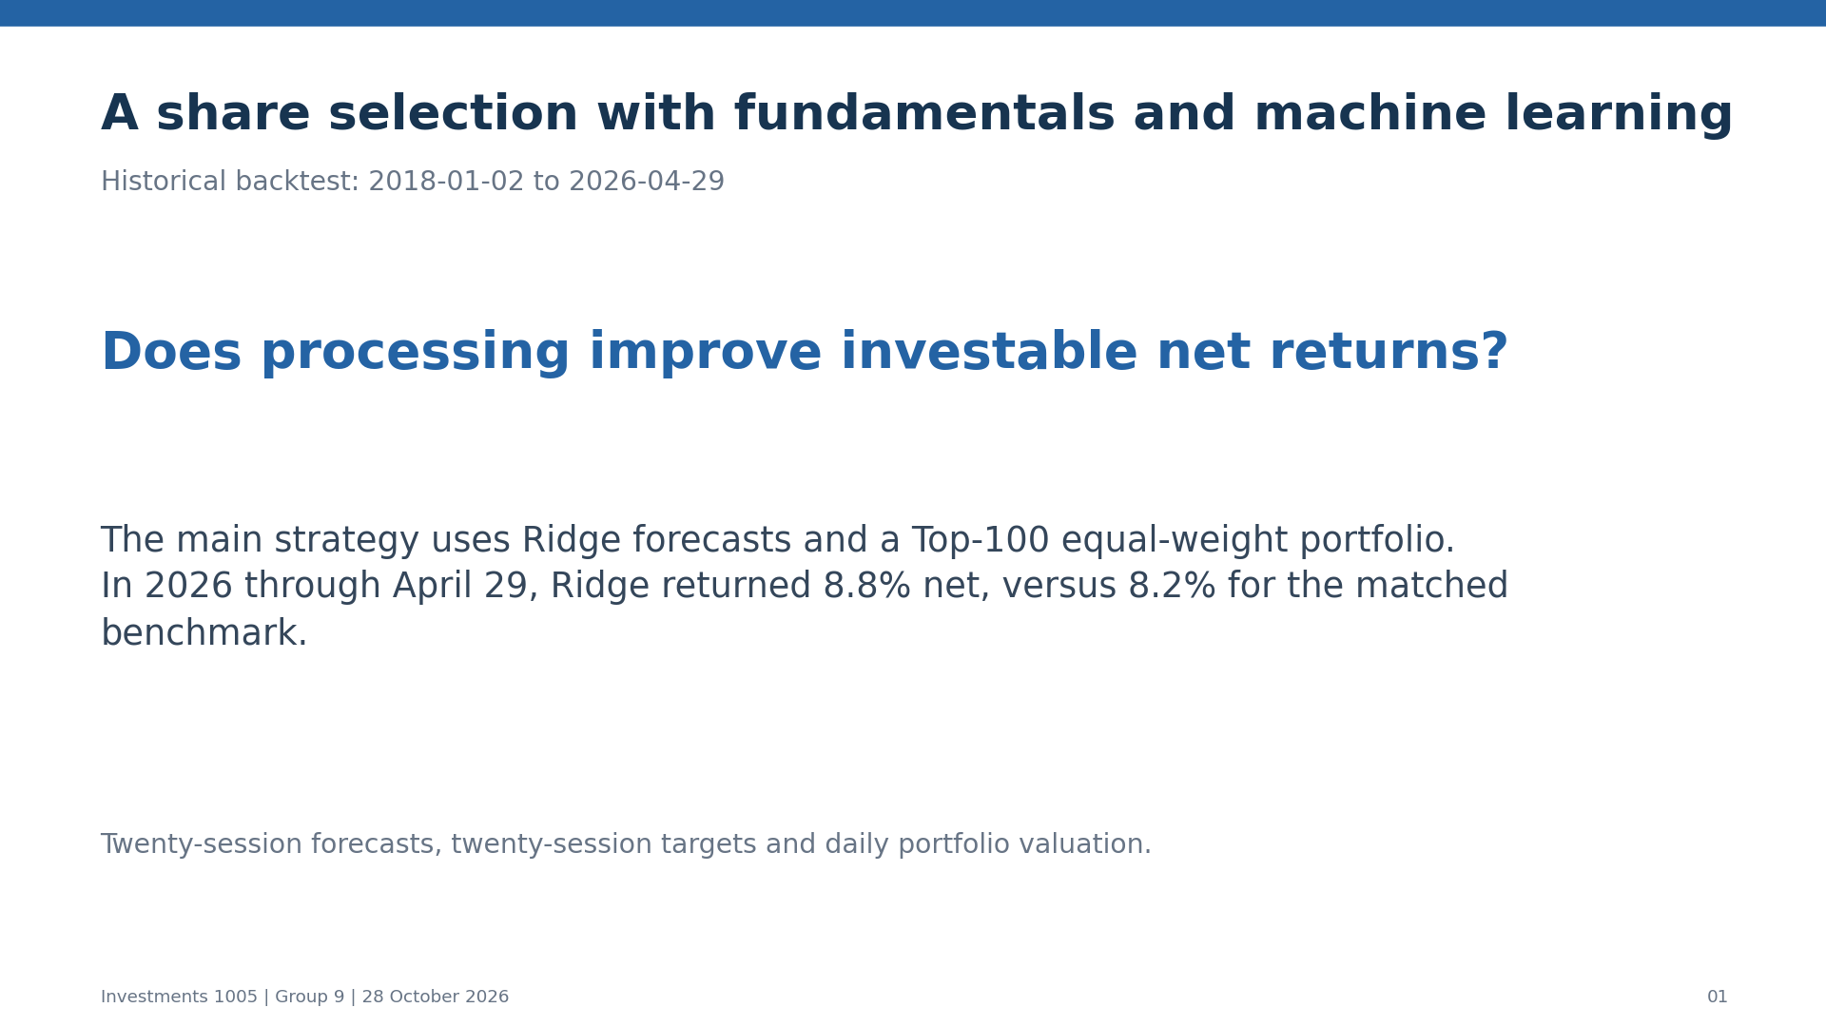
Notes:
Suggested speaking time: 45 seconds. State the strategy, main comparison and actual historical dates.

Slide 2
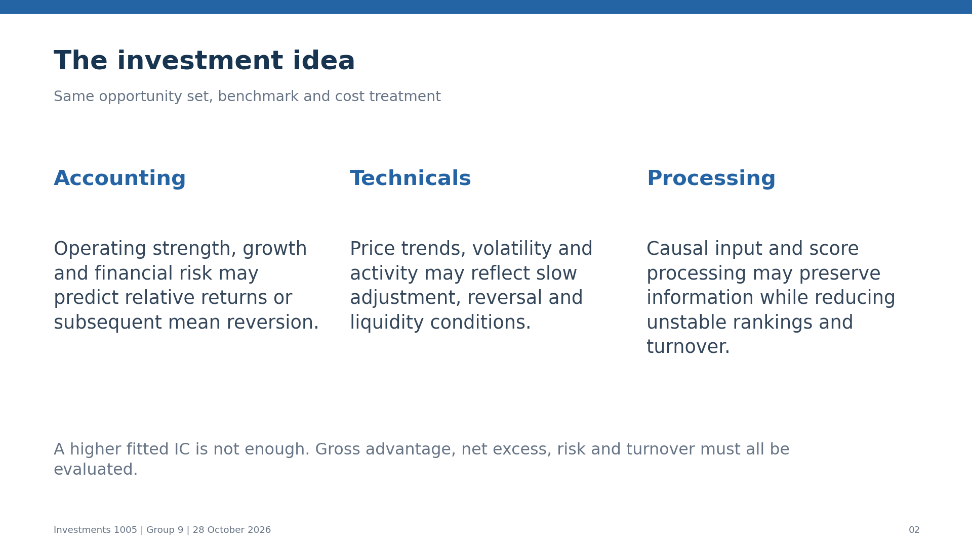
Notes:
Suggested speaking time: 75 seconds. Explain the economic mechanisms behind financial, technical and processing inputs.

Slide 3
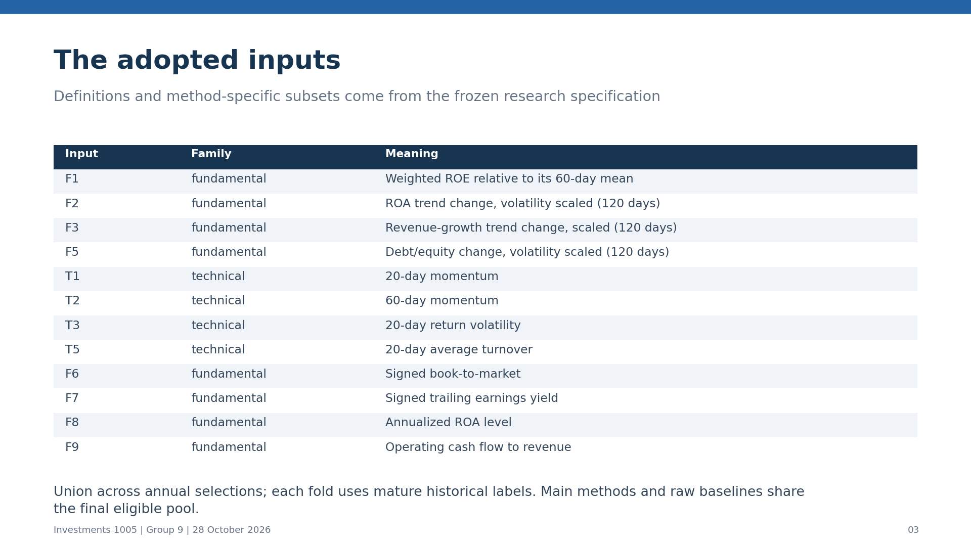
Notes:
Suggested speaking time: 70 seconds. Explain actual model input unions; complete definitions are in the supplementary materials.

Slide 4
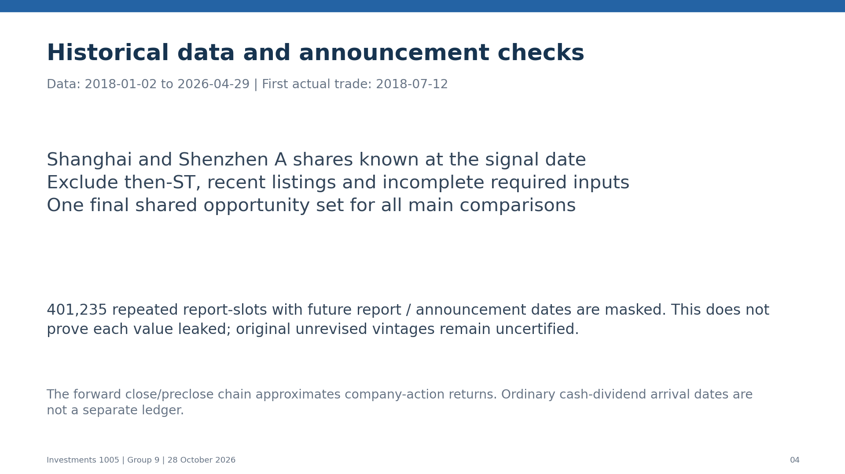
Notes:
Suggested speaking time: 90 seconds. Explain historical eligibility, announcement screening, price adjustment and uncertified vendor vintages.

Slide 5
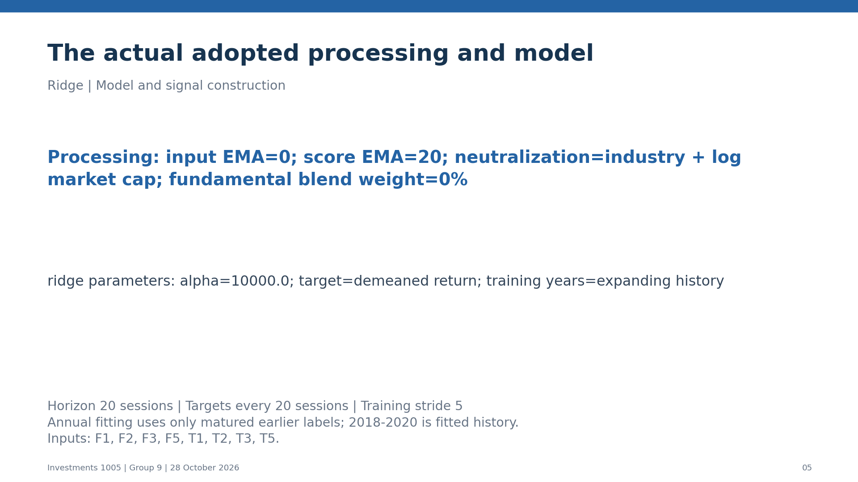
Notes:
Suggested speaking time: 100 seconds. Explain the recorded parameters and mature-label annual fitting. The 2018-2020 history is fitted, not an independent forecast evaluation.

Slide 6
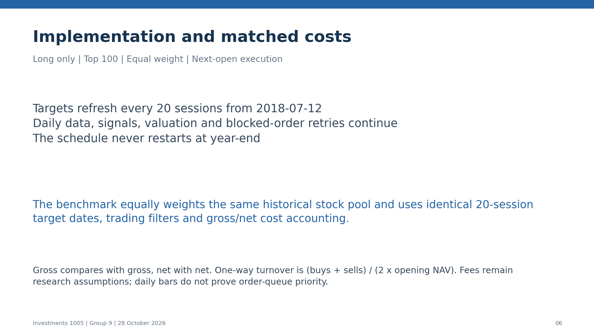
Notes:
Suggested speaking time: 110 seconds. Explain daily signals and valuation versus twenty-session targets, continuous scheduling, order retries and the same-cost benchmark.

Slide 7
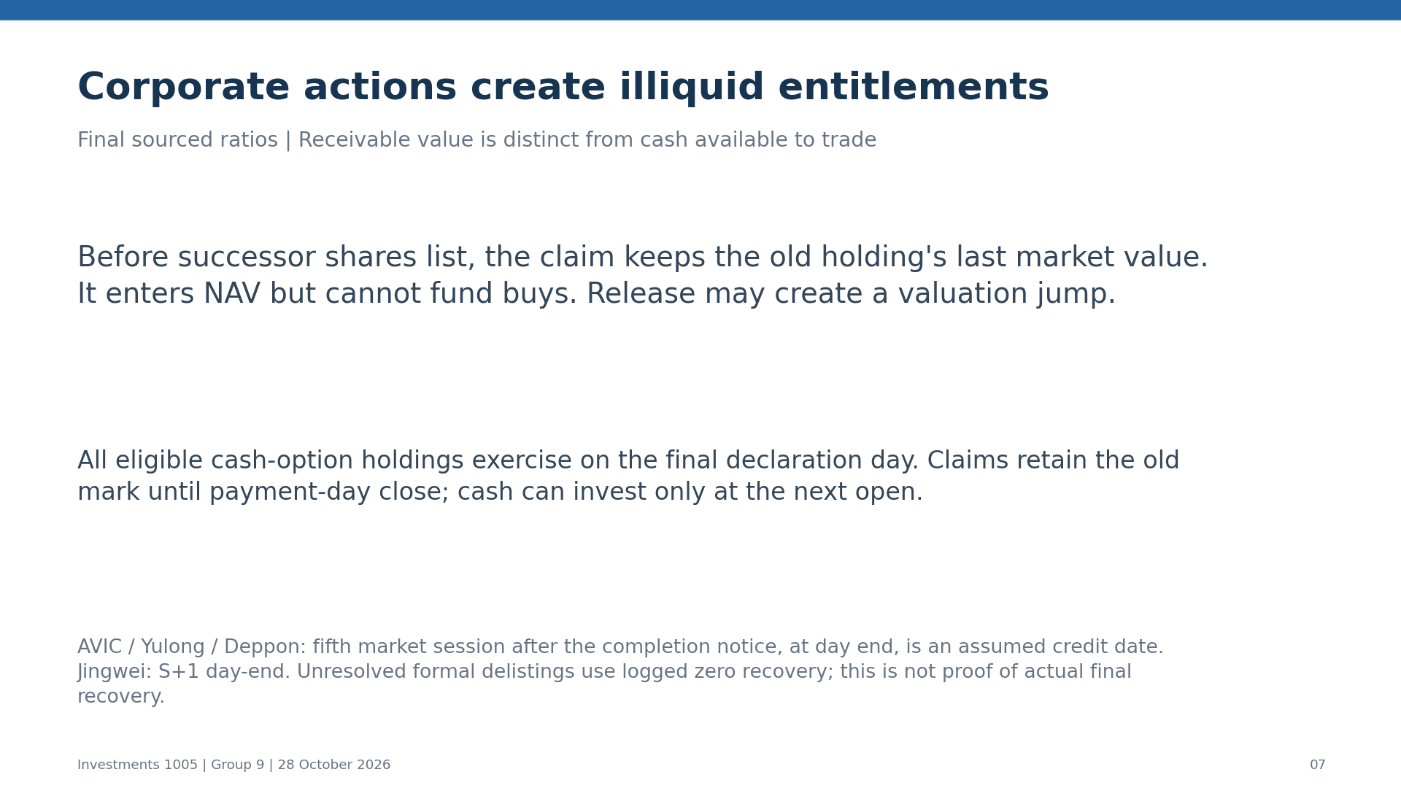
Notes:
Suggested speaking time: 95 seconds. Explain nontradable claims, final event ratios, interim marks, cash availability and settlement assumptions.

Slide 8
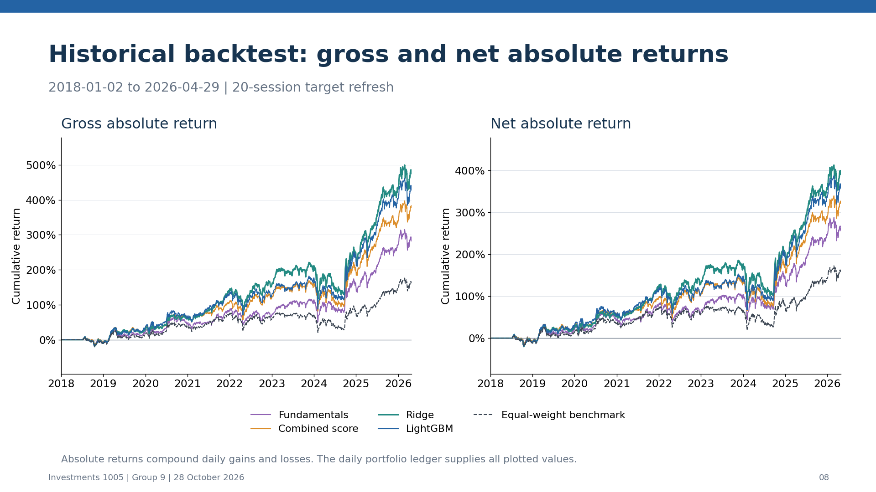
Notes:
Suggested speaking time: 90 seconds. Absolute returns compound the actual daily portfolio returns across the entire displayed history.

Slide 9
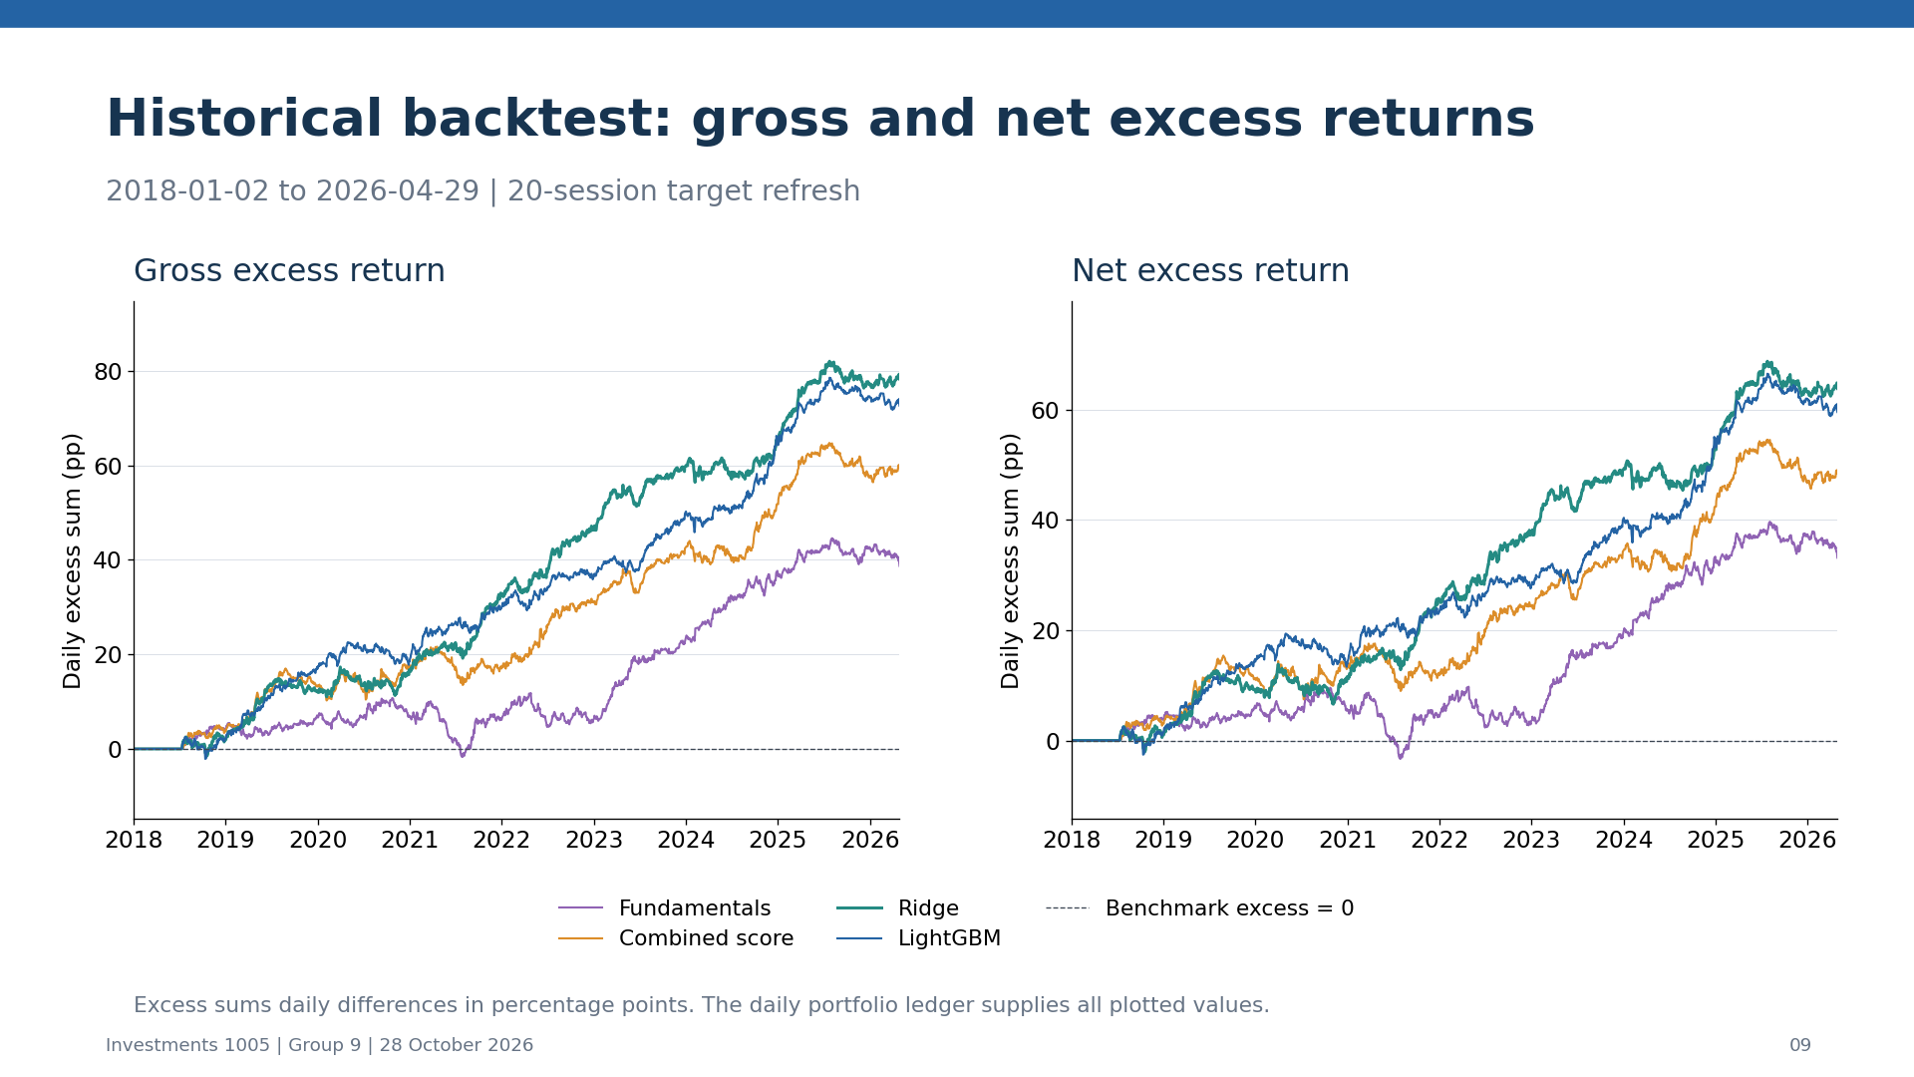
Notes:
Suggested speaking time: 90 seconds. Excess sums same-cost daily return differences in percentage points and is not a compounded wealth gap.

Slide 10
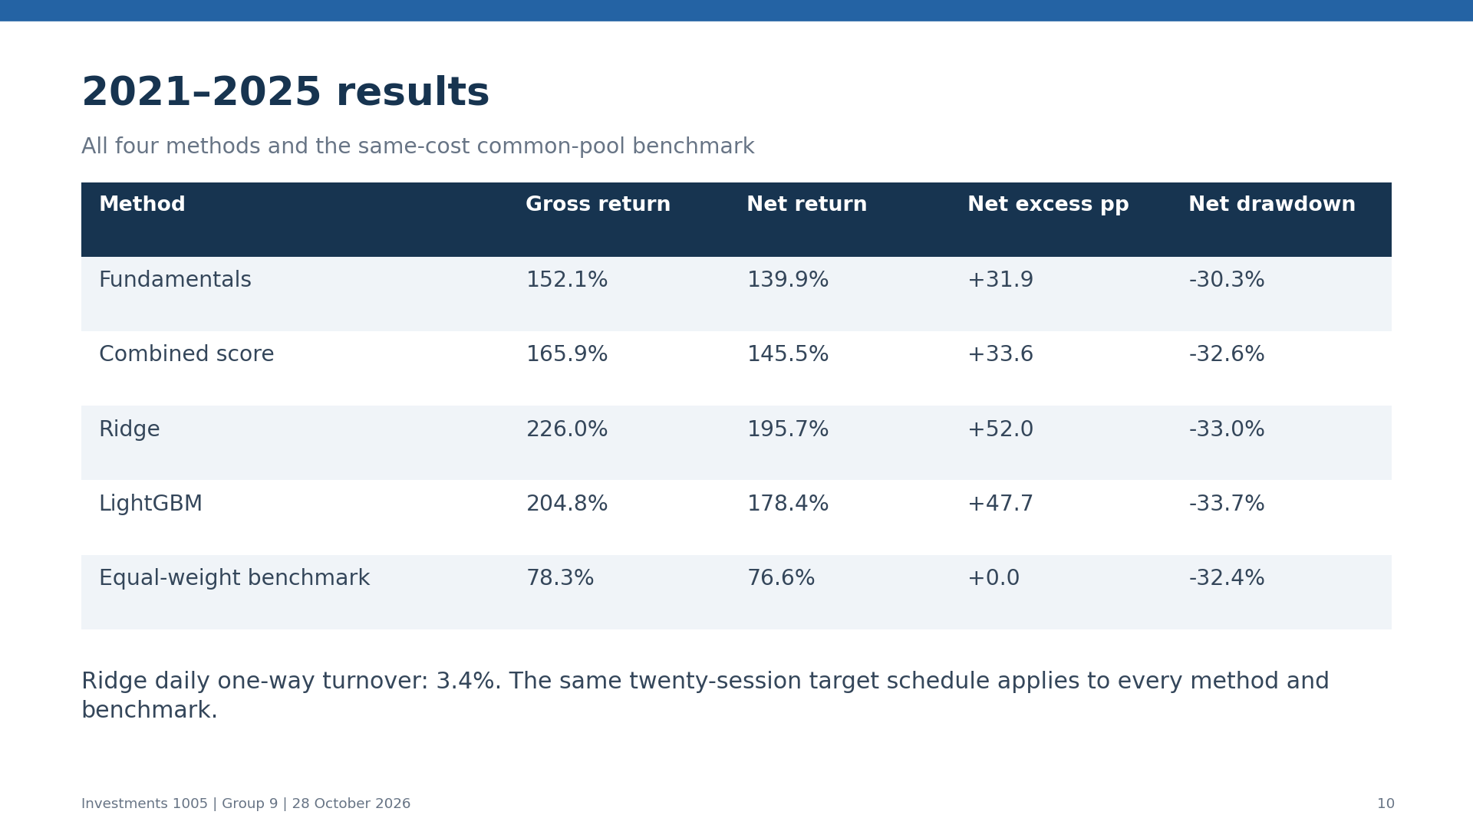
Notes:
Suggested speaking time: 105 seconds. Compare all four methods and benchmark during 2021-2025 at the same target cadence.

Slide 11
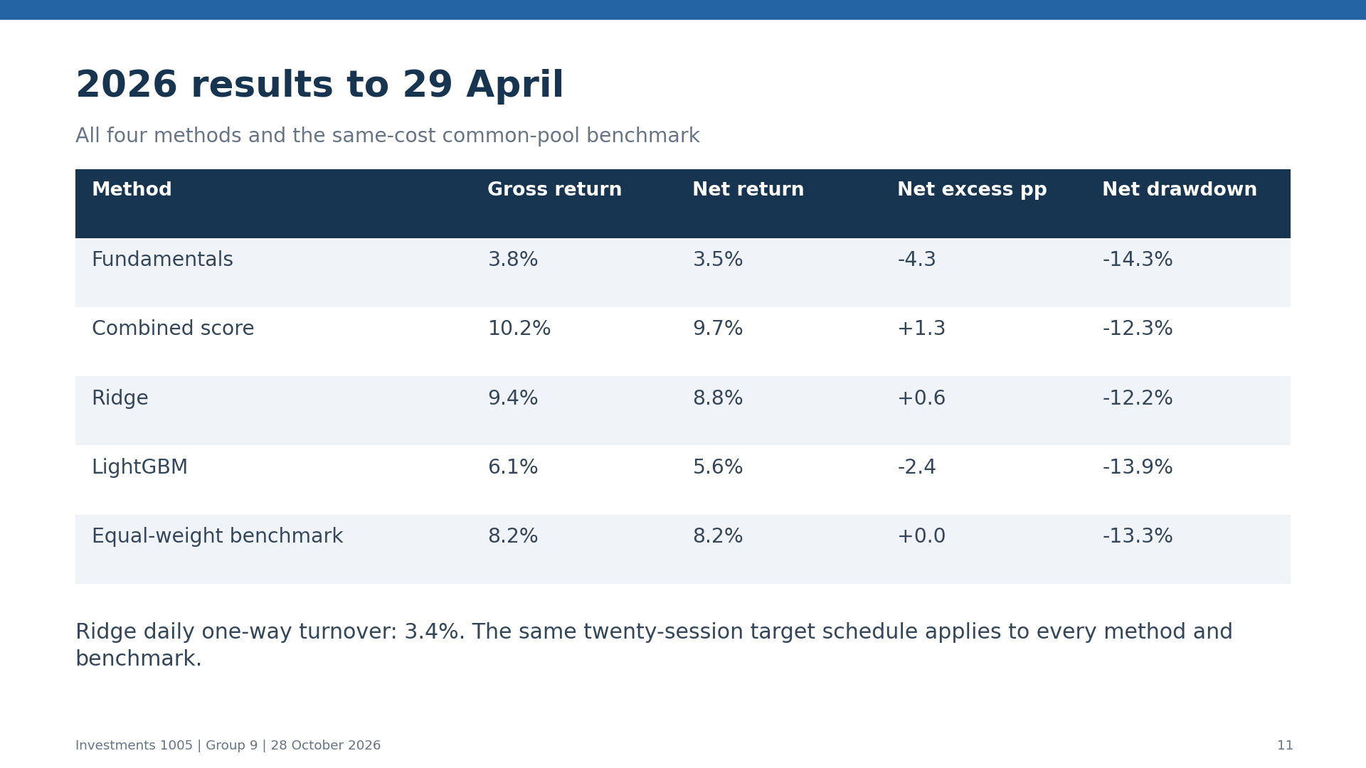
Notes:
Suggested speaking time: 75 seconds. Compare 2026 gross and net returns. Model weights remain fixed during 2026; portfolio target weights still update on the scheduled dates.

Slide 12
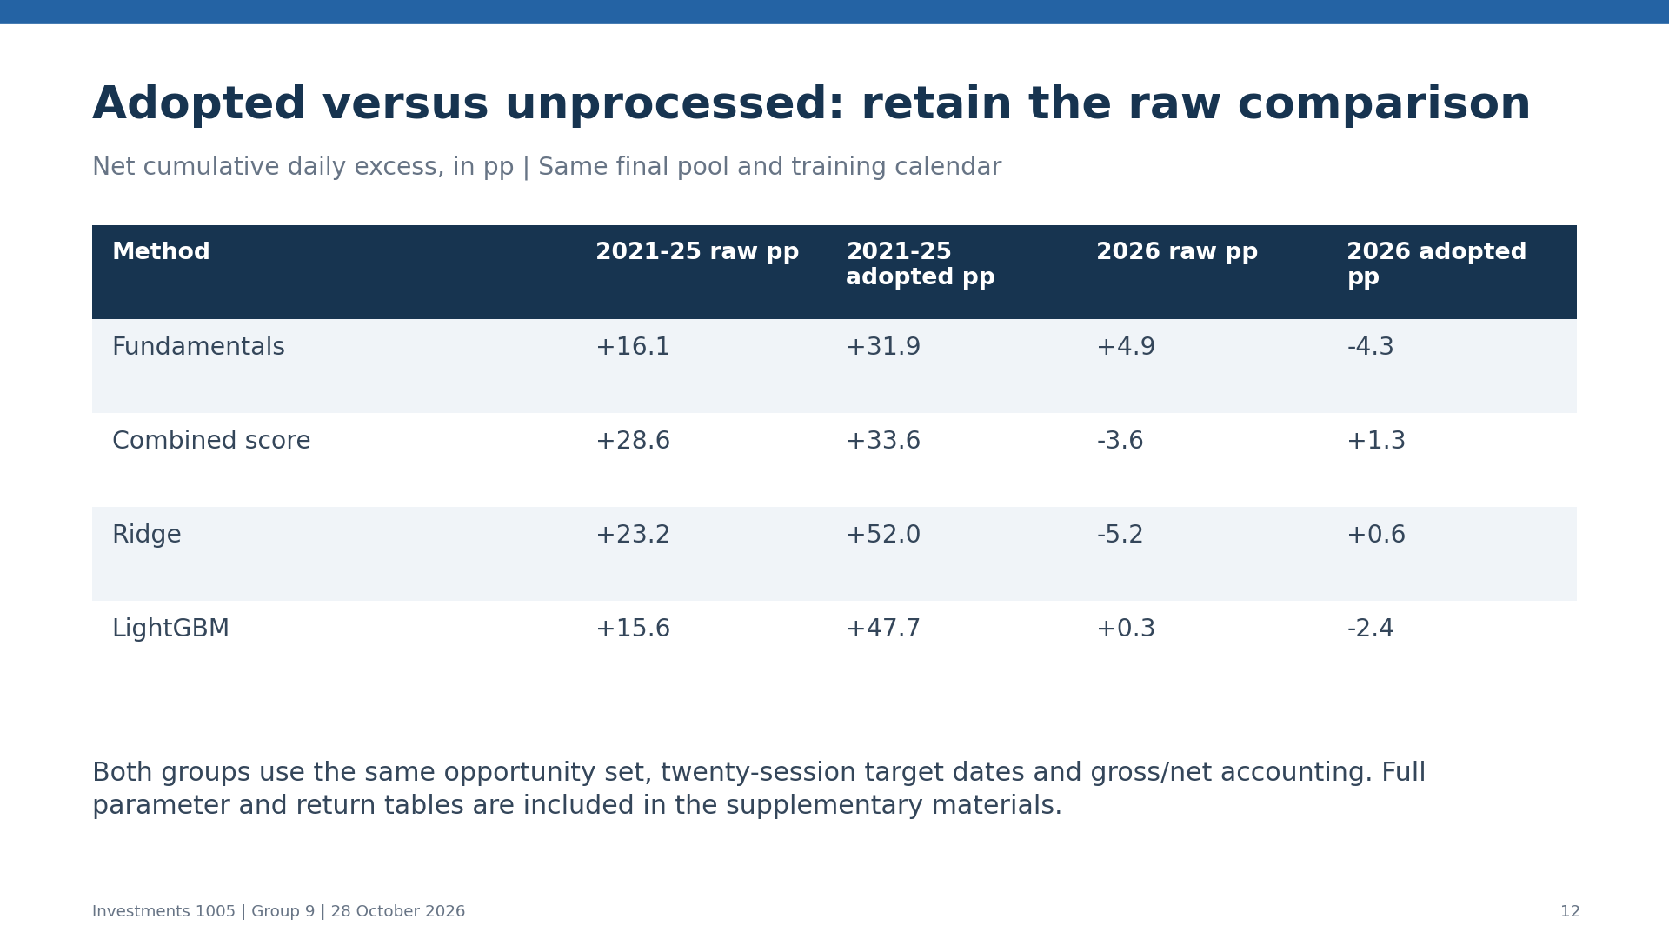
Notes:
Suggested speaking time: 85 seconds. Compare the adopted and raw-signal portfolios with the identical opportunity set and implementation cadence.

Slide 13
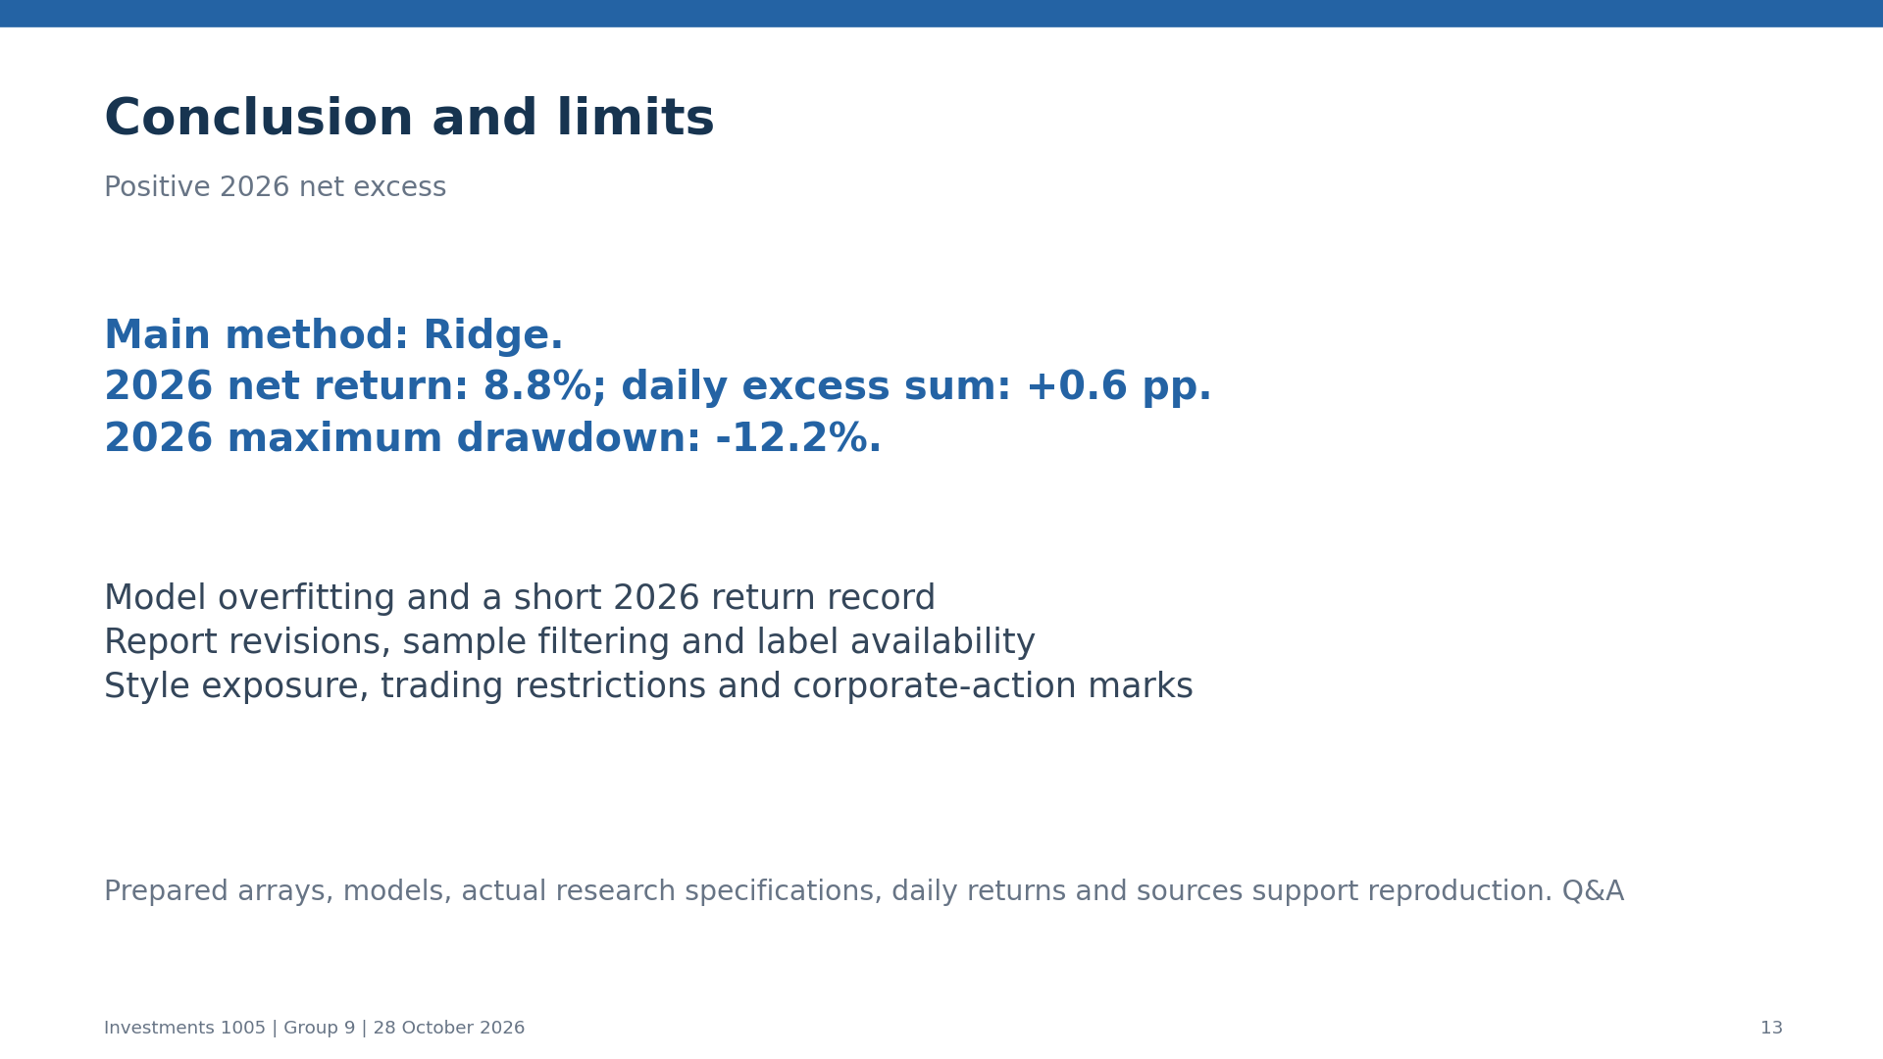
Notes:
Suggested speaking time: 50 seconds. Summarize returns, drawdown and data/execution limitations, then invite questions.

