Slide 1

APSCE · FESTIVAL OF LEARNING 2026
Kumamoto, Japan
Effects of Integrating an AI Learning Companion into a Self-Regulated Learning 4L Framework
on Elementary Mathematics Learning
A quasi-experimental study on TALPer-supported SRL in fifth grade
Bor-Chen Kuo · Zong-En Bai · Chia-Hua Lin
Graduate Institute of Educational Information and Measurement, National Taichung University of Education, Taiwan
Full Paper · 15 min + 5 min Q&A
1 / 13

Slide 2

01 · CORE STORY
TALPer improves learning, but regulation explains who benefits
A 15-minute storyline: problem -> intervention -> evidence -> implication
TALPer improves mathematics learning, but its strongest lesson is differentiated: students benefit when they regulate, question, monitor, and reflect with AI.
Problem
Intervention
Evidence
Takeaway
GenAI may scaffold or create dependence
TALPer embedded in SRL 4L
Outcome, process, and ENA networks
AI access is not enough
TALPer x SRL 4L Framework | Kuo, Bai, & Lin
2 / 12
2 / 13

Slide 3
02 · BACKGROUND
The GenAI promise comes with a dependence risk
Structured AI feedback can scaffold SRL, but passive use may reduce learner agency
Scaffold
Dependence
Real-time feedback
Step-by-step guidance
Planning, monitoring, and reflection
Differentiated support
Passive answer-seeking
Procedural shortcutting
Reduced learner agency
Ability-level differences
(Chiu, 2024; Wu et al., 2023)
(Jin et al., 2023; Lee & Low, 2024)
Grounded in Zimmerman's (2002) SRL cycle: forethought -> performance -> self-reflection
Research gap: whether this scaffold-dependence tension differs across learner ability levels remains underexplored.
TALPer x SRL 4L Framework | Kuo, Bai, & Lin
3 / 12
3 / 13

Slide 4
02 - THEORY
Zimmerman's SRL Cycle x Ho's 4L Framework
Forethought -> Performance -> Self-Reflection
Zimmerman (2002) SRL Cycle
Ho (2014) SRL 4L Framework
Forethought
Self-learning
Goal setting / prior activation
Goal setting - Prior-knowledge activation
<-> Forethought
Co-learning
Monitoring & scaffolded feedback
Performance
<-> Performance
Monitoring - Strategy - Peer adjustment
Mutual learning
Cross group strategy sharing
<-> Performance
Self-Reflection
Error noticing - Conceptual consolidation
Teacher-guided
Misconception fix & integration
<-> Self Reflection
The 4L phases map onto Zimmerman's cycle. We apply this mapping to design our SRL coding scheme and ENA dimensions.
TALPer x SRL 4L Framework | Kuo, Bai, & Lin
4 / 13

Slide 5
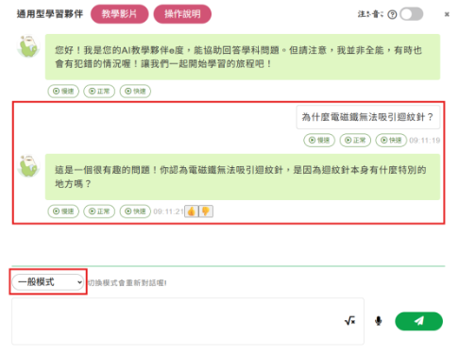
03 · MODEL
TALPer is embedded inside the SRL 4L learning cycle
Self-learning -> co-learning -> mutual learning -> teacher-guided consolidation
Based on Ho's (2014) SRL 4L framework, grounded in Zimmerman's (2002) SRL cycle
Original TALPer interface from the source deck
Self-learning
pre-class
Teacher intro
uses logs
Co-learning
AI feedback
Student asks a mathematical question
Mutual learning
peer sharing
Teacher-guided
reflection
TALPer responds through guided reasoning
TALPer roles: records questions and traces, provides dialogic feedback, and supports logical verification.
Interaction logs become classroom evidence
The design connects SRL forethought, performance, and reflection inside a classroom routine.
This is the concrete system view behind the SRL 4L integration.
TALPer: an AI learning companion on TALP for elementary math problem solving (Kuo et al., 2026)
TALPer x SRL 4L Framework | Kuo, Bai, & Lin
4 / 12
5 / 13

Slide 6
04 · QUESTIONS
The study follows three evidence layers
Outcome, process, and cognitive network structure
Does TALPer + SRL 4L improve learning outcomes compared with SRL 4L alone?
RQ1 · Outcome
Do high- and low-achieving students differ in SRL strategy use when TALPer is available?
RQ2 · Process
Do their cognitive network structures differ in ENA representations?
RQ3 · Structure
TALPer x SRL 4L Framework | Kuo, Bai, & Lin
5 / 12
6 / 13

Slide 7
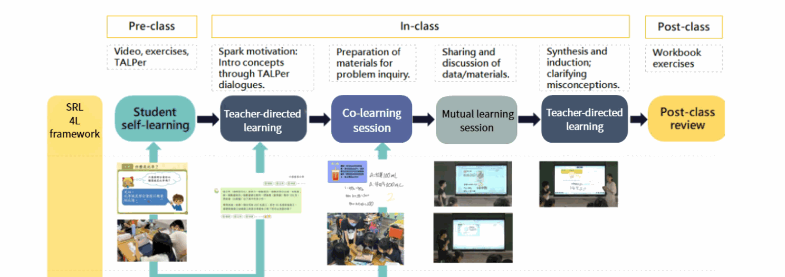
05 · DESIGN
The comparison isolates TALPer within the same 4L structure
44 fifth-grade students, 5 lessons on Ratios and Percentages, 2-week intervention
Original SRL 4L teaching process from the source deck
44
21 / 23
5
2 weeks
fifth-grade students
experimental / control
lessons
Ratios and Percentages
Experimental group
Control group
SRL 4L instruction + TALPer support
Same SRL 4L structure, no TALPer access
Baseline pre-test difference: not significant (p = .376)
Pre-class TALPer self-learning
In-class 4L discussion sequence
Post-class review and exercises
TALPer x SRL 4L Framework | Kuo, Bai, & Lin
6 / 12
7 / 13

Slide 8

06 · ANALYSIS
The analysis moves from scores to learning-process structure
04 - METHOD
SRL Coding Framework and ENA Dimensions
Pre/post test, ANCOVA, SRL coding, and Epistemic Network Analysis
Table 1 - Metacognition x Cognition - 8 codes
Main category
Sub-category
Code
Explanation
Coding framework connects TALPer dialogue to ENA networks
M Metacognition
Setting Goals
M.SG
Proactively sets or adjusts learning objectives or sequences.
Selecting Strategies
M.SS
Selects or modifies learning strategies, modalities, or task forms.
Outcome
Process
Structure
SRL dialogue coding
From codes to ENA
Monitoring & Evaluation
M.ME
Real-time awareness and evaluation of conceptual understanding.
Students' TALPer dialogues were coded into metacognitive and cognitive learning behaviors.
ENA does not only count behaviors. It models how coded behaviors co-occur and form learning-process structures.
Pre/post tests
ANCOVA with pre-test covariate
SRL coding
Metacognition x cognition
ENA
Co-occurring strategy networks
Reflection
M.R
Reviews problem solving to identify errors or revise strategies.
Metacognitive
Metacognitive
Cognitive
C Cognition
Cognitive
Conceptual Und. Ask
C.CUA
Asks questions about concepts, principles, meanings, or applications.
1. Segment TALPer dialogue events
Goal setting
M.SG Goal setting
Conceptual question
C.CUA Conceptual Q
Conceptual Und. Explain
C.CUE
Articulates or constructs conceptual understanding.
Strategy selection
M.SS Strategy selection
Conceptual explanation
C.CUE Conceptual expl.
Procedural Know. Ask
C.PKA
Asks about computational methods or problem solving steps.
2. Apply SRL coding categories
Procedural Know. Execute
C.PKE
Performs actual computations or formulates equations / answers.
Monitoring / evaluation
Why ENA: it shows not only how often strategies appear, but how cognitive and metacognitive actions connect during learning.
M.ME Monitoring / eval.
Procedural question
C.PKA Procedural Q
Purpose: show whether students connect planning, inquiry, execution, monitoring, and reflection when learning with TALPer.
3. Compare co-occurrence networks
ENA maps code co-occurrences into a 2D space -- X axis: relative cognitive tendencies; Y axis: structural complexity / diversity of the cognitive network.
ENA axes: X = cognitive tendency; Y = structural complexity/diversity. Model fit indices > .94.
Reflection
M.R Reflection
Procedural execution
C.PKE Procedural exec.
TALPer x SRL 4L Framework | Kuo, Bai, & Lin
TALPer x SRL 4L Framework | Kuo, Bai, & Lin
7 / 12
8 / 13
8 / 13

Slide 9
07 · RQ1 RESULT
TALPer-supported 4L produced higher adjusted post-test scores
After controlling for pre-test performance
Adjusted post-test means
ANCOVA result
F(1,41) = 4.71
p = .036
eta squared = .114
Control
76.56
TALPer
85.49
Takeaway: TALPer adds measurable value beyond SRL 4L instruction alone.
Pre-post gains: Control +14.45; TALPer +26.45 (both p < .001)
TALPer x SRL 4L Framework | Kuo, Bai, & Lin
8 / 12
9 / 13

Slide 10
08 · RQ2 RESULT
High- and low-achieving students used TALPer differently
The major difference was regulatory strategy, not tool access
High-achieving students
Low-achieving students
Goal setting
Conceptual questions
Monitoring and reflection
Iterative strategy use
Strategy selection
Procedural asking
Answer-seeking flow
Limited reflection
t(12.07) = 4.05 · p < .001 · Cohen's d = 1.83
Experimental group only: high-achievers (n = 10) vs low-achievers (n = 11)
Comparison: ENA X-axis centroid difference between ability groups
TALPer x SRL 4L Framework | Kuo, Bai, & Lin
9 / 12
10 / 13

Slide 11
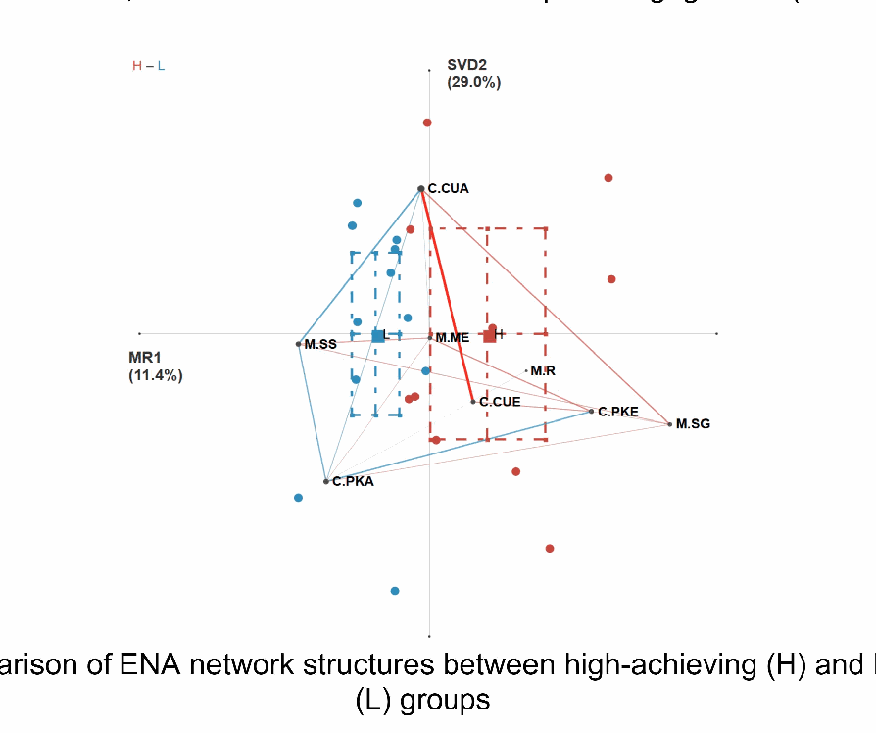
09 · RQ3 RESULT
ENA shows integrated versus fragmented cognitive networks
High-achievers built multidirectional cycles; low-achievers stayed procedural
Original ENA result figure from the source deck
H: integrated and multidirectional
L: fragmented and procedural
C.CUA
M.SG
M.SS
H: integrated, multidirectional regulatory network
C.PKE
C.PKA
M.R
L: fragmented, procedural, ask-execute pattern
C.PKE
The simplified editable schematic from v3 has been replaced by the original ENA evidence figure.
High-achievers connect planning, conceptual inquiry, execution, and reflection.
Low-achievers remain closer to ask-receive-execute procedural cycles.
TALPer x SRL 4L Framework | Kuo, Bai, & Lin
10 / 12
11 / 13

Slide 12
10 · IMPLICATION
Teachers need to teach students how to regulate with AI
Availability is not enough; strategic engagement must be scaffolded
TALPer's pedagogical effectiveness cannot be assumed from tool availability alone.
Guided questioning
Structured reflection
Dialogue modeling
Model how to ask conceptual questions, not only request answers.
Use prompts that make students check, explain, and revise.
Show examples of productive TALPer-mediated dialogue.
These supports are especially critical for low-achieving students who tend toward procedural dependence.
AI feedback should invite explanation, comparison, and reflection.
TALPer x SRL 4L Framework | Kuo, Bai, & Lin
11 / 12
12 / 13

Slide 13
11 · CLOSING
Take-home: AI scaffolding depends on regulatory awareness
Thank you. Questions and discussion welcome.
An AI learning companion is not a silver bullet.
Its scaffolding effect depends on learners' regulatory awareness.
Thank you. Questions and discussion welcome.
Bor-Chen Kuo · Zong-En Bai · Chia-Hua Lin | NTCU, Taiwan
Future work: scaffold regulatory awareness for low-achieving students; test long-term use across math domains.
Limitations: small sample (n = 44); longer-term studies needed.
TALPer x SRL 4L Framework | Kuo, Bai, & Lin
12 / 12
13 / 13

