Slide 1

MGT650 Managing People in Organisations
Why is managing people so difficult?
Professor Diane Burns d.burns@sheffield.ac.uk

Slide 2

Welcome!

Slide 3
What do organisations most need from their employees?

Slide 4



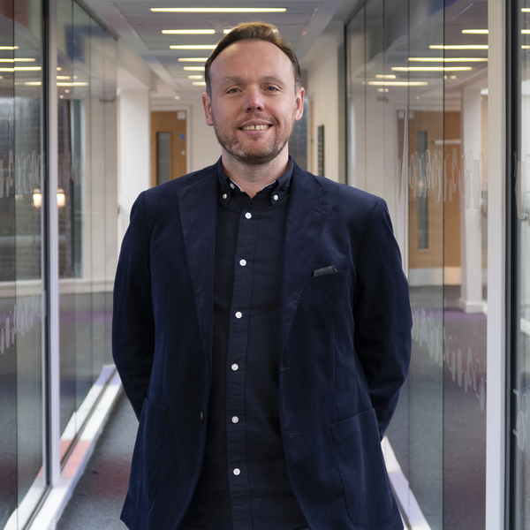


Teaching Team
Dr Edward Yates Dr Valiera Insarauto Dr John Wilson
Dr Martyn Griffin Dr Luke Neal Ms Yanan Yu

Slide 5
4 Things You Need to Know
Key Info: Check Blackboard
Teaching Timetable: Personal timetable and regularly check the announcements on Blackboard.
Tutorials: Attend your assigned tutorial. Any clashes email sums@sheffield.ac.uk
Assessment: Individual assignment of 3,000 words and a submission deadline in January 2027.

Slide 6
Topics – journey through the module
Getting People
Managing and Motivating People
HRM and Performance
Understanding Organisations

Slide 7
Lectures introduce ideas
Tutorials to apply, discuss and critically examine them (in a small interactive class)
Details of lecture topics and tutorial activities can be found in ‘Learning Materials’ on the Blackboard Site for the MGT650 Managing People in Organisations Module

Slide 8


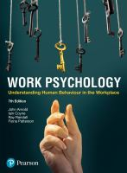
How to use the reading
Core texts available through the library;
Weekly essential/recommended readings on Blackboard;
Come to tutorials having completed specified preparation.
The full reference details and links to online materials can be found in the ‘Module Reading List’ on Blackboard for the module.

Slide 9
Assessment details
One 3,000-word individual assignment
Guidance and criteria available from Week 3
Final lecture and final 2 tutorials support assignment preparation
Use module concepts and literature in your analysis

Slide 10
Module Feedback & Changes
You said: ‘Interactions with teachers could be increase’
We did: Divided cohort into two smaller lecture groups each week. Introduced two dedicated times a week when MGT650 students can meet with me directly: Mondays 9.00–10.00am and Wednesdays 4.00 – 5.00 pm
You said: ‘Style of lecture slides can be improved, there was a slide where lots of capital letters in both content and titles which made us difficult to read’
We did: the teaching team is revising the module materials.
You said: ‘Salary design and labour law maybe important’:
We did: We now touch upon a few labour regulations in your upcoming lecture on Equality, Diversity & Inclusion in Week 3.
Keep telling us about any issues you might encounter – we want your feedback!

Slide 11
How to get help
Questions in lectures/tutorials/Wooclap
‘Frequently Asked Questions’ and the ‘Discussion Board’ on Blackboard.
Meet Diane — Monday 9–10 or Wednesday 16–17, email to book.

Slide 12
What are:
Organisations,
Organisational Behaviour (OB) and Human Resource Management (HRM).
What are some of the central debates about managing people?

Slide 13






Defining a Work Organisation
These organisations are very different. What makes all of them organisations?

Slide 14
Defining a Work Organisation Cont.
people
coordination
objectives
boundaries
rules/authority
relationship with the external environment
Definition: “An organisation is a social system in which people coordinate their activities to achieve particular goals.” (Scott and Davis, 2007).

Slide 15
Organisations differ enormously
Table: Variation in Ownership, Activity and Geography
Ownership | Activity | Geography
Private | Manufacturing | Local
Public | Services | National
Non-profit | Knowledge | Multinational
But every organisation has to organise people.

Slide 16
Understanding Organisational Behaviour (OB)
ORGANISATION & CONTEXT
MACRO
Culture • structure • technology • environment
↕
GROUPS & TEAMS
MESO
Leadership • power • teamwork• decision making
↕
INDIVIDUAL
MICRO
Motivation • attitudes • personality
OB examines behaviour at work,
at and across, these different levels

Slide 17
Human Resource Management (HRM)
OB asks: Why do people behave as they do at work?
HRM asks: How do organisations seek to manage the employment relationship and influence that behaviour?
“HRM includes anything and everything associated with the management of employment relationships in the firm .” (Boxall and Purcell, 2000: 184)

Slide 18
Human Resource Management (HRM)
Where did HRM come from?
What does HRM do?
Are there different ways of managing people?
Does HRM really produce the outcomes organisations want?

Slide 19
In other words…
Organisations face external pressures. One response is to ask how people can contribute more effectively to organisational goals.

Slide 20
What does a Human Resource Department actually do?
Getting people
Recruitment • selection • talent
Developing people
Training • careers • organisational development
Managing contribution
Performance • reward • engagement
Managing the employment relationship
Employee relations • EDI • wellbeing • change
Visit the Chartered Institute of Personnel and Development (CIPD) website: www.cipd.co.uk

Slide 21
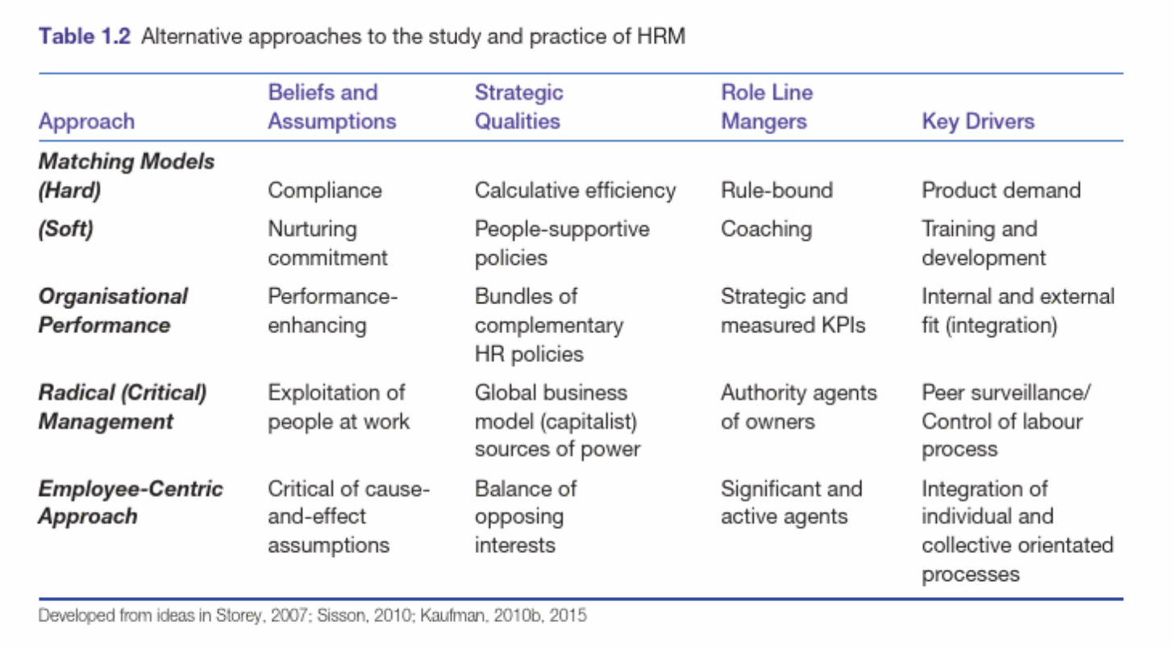
Approaches to the study of HRM

Slide 22
Scholars have distinguished between two broad approaches to managing people
Hard HRM | Soft HRM
Employees viewed primarily as resources/costs | Employees viewed as valued assets
Emphasis on efficiency and performance | Emphasis on commitment and development
Greater emphasis on managerial control | Greater emphasis on employee involvement
Employees expected to meet organisational requirements | Employees encouraged to contribute ideas and initiative
HR practices closely aligned to organisational needs | HR practices seek to develop and engage employees

Slide 23
Case Activity
Organisation A – SwiftServe Logistics
SwiftServe operates a large distribution network. Employees have tightly defined roles, individual productivity targets and closely monitored performance. Staffing levels are adjusted to match demand, and managers focus strongly on efficiency, costs and output. Training is mainly directed at ensuring employees can perform their assigned tasks effectively, while decisions about work are largely made by management.
Organisation B – NovaTech Solutions
NovaTech provides digital consultancy services. It invests heavily in employee development and career progression, encourages staff to contribute ideas and gives teams considerable discretion over how they organise their work. Managers regularly seek employee feedback and place emphasis on engagement, collaboration and long-term retention.

Slide 24
Case Activity: Multiple Choice Questions
Which organisation most closely reflects a hard HRM approach?
A. SwiftServe Logistics
B. NovaTech Solutions
C. Both equally
D. Neither
What feature most influenced your answer?
A. Close performance monitoring
B. Focus on efficiency and cost
C. Employee involvement in decisions
D. Investment in development
E. Team autonomy

Slide 25
Example: A large hotel chain
The organisation employs a wide range of staff. Managers and professional employees are offered permanent contracts, career development opportunities and considerable autonomy over how they organise their work. They are encouraged to contribute ideas and build a long-term career with the company.
By contrast, frontline staff such as housekeeping and food-service workers have more tightly specified tasks, closer performance monitoring and work schedules organised primarily around operational demand. Training focuses mainly on completing tasks efficiently and consistently.
Question:
Is this organisation practising hard HRM or soft HRM?

Slide 26
What’s really happening inside organisations?
Managers & Professional Staff | Frontline Service Staff
Permanent contracts | More variable or tightly scheduled hours
Career development opportunities | Training focused mainly on task performance
Greater autonomy over how work is organised | Closely specified tasks and procedures
Encouraged to contribute ideas | Performance closely monitored
Focus on engagement and long-term retention | Strong focus on efficiency and staffing costs

Slide 27
Key point
Both. Organisations may use different HR approaches for different groups of employees.
Why might organisations manage different groups of employees differently?

Slide 28
HRM also has to make organisations work
People management is not only about motivation and engagement. It also involves essential organisational functions.
Administration
Paying employees accurately and on time
Maintaining employee records
Applying organisational policies and procedures
Managing contracts, absence and working arrangements
Legal compliance
Ensuring employment practices comply with relevant laws and regulations
Supporting fair and consistent treatment
Recognising that employment regulation varies across countries and sectors
Key point:
Some HR activities are strategic; others are essential to the everyday functioning of the organisation.

Slide 29
HRM involves competing priorities
Table: of competing priorities
Control ↔ Employee autonomy | Efficiency & cost ↔ Development & wellbeing
Organisational goals ↔ Employee interests | Consistency ↔ Adapting to context
HRM therefore involves choices, tensions and trade-offs. Tere is rarely one universally ‘best’ way to manage people.

Slide 30
Can organisations both value and control employees?
Investment & Support
Training and development
Career opportunities
Employee involvement
Wellbeing initiatives
Control & Efficiency
Performance targets
Monitoring
Staffing flexibility
Cost control
The same organisation may do both, and different groups of employees may experience HRM very differently.
What does this tell us about the distinction between hard and soft HRM?

Slide 31
The employment relationship: a fundamental challenge
When an organisation employs someone, what exactly has it bought?
The employment contract specifies:
Pay + hours + responsibilities
But it cannot fully specify:
Effort + initiative + cooperation + judgement
Key Point: A wage is exchanged for an indeterminate amount of labour power.
The people management challenge: Recruitment • Motivation • Performance management • Training • Teams • Culture
How can organisations encourage employees to contribute more than the minimum required?

Slide 32
From managing people to Strategic HRM
Organisational goals
↓
HR policies & practices
recruitment • development • reward • performance • involvement
↓
Employee skills, attitudes & behaviour
↓
Organisational outcomes
Key Point: Strategic HRM (SHRM) is concerned with how HR policies and practices can be aligned with the organisation's longer-term goals.

Slide 33
Why might people provide strategic value?
Resource-Based View
An organisation's workforce may provide an advantage when its knowledge, skills and capabilities are:
Valuable • Difficult to imitate • Difficult to substitute
Key point: But if effective people management can improve organisational performance, why doesn't every organisation simply do it well?

Slide 34
Thinking point…
Key assumption:
HR practices can be designed and aligned in ways that support organisational strategy.
But does it work like this in practice?
The theory looks neat.
Organisations are not.

Slide 35
Why can Strategic HRM be difficult to implement?
Context
What works in one organisation may not work in another.
Culture
HR practices are interpreted through existing norms, routines and relationships.
Implementation
Policies have to be enacted by managers and may not be implemented as intended.
Employee agency
Employees do not simply respond to HR practices in predictable ways.
Competing priorities
Cost, performance, employee wellbeing and operational pressures may pull in different directions.
Key Point: This creates a theory–practice gap: what HR strategy intends is not necessarily what happens in practice.

Slide 36
From intended HRM to experienced HRM
INTENDED HRM
What senior managers and HR design
↓
IMPLEMENTED HRM
How line managers interpret and enact it
↓
EXPERIENCED HRM
How employees actually experience and respond to it
Possible gaps can emerge at every stage, for example:
a policy may be well designed but poorly implemented;
different managers may apply the same policy differently;
employees may interpret the same practice differently;
operational pressures may override formal HR intentions.

Slide 37
So... why is managing people so difficult?
Wooclap activity
Which of these is most important?
A. People have different interests and motivations
B. Managers interpret and implement policies differently
C. Organisational culture and context affect what works
D. Organisations face competing priorities
E. Employees exercise their own agency
F. All of the above

Slide 38
Lecture 1: Bringing it all together
Organisations depend on people
OB helps us to understand behaviour
HRM manages the employment relationship
But employment is indeterminate
HRM therefore uses practices to shape contribution
What is intended is not always what happens
Intended HRM ≠ Implemented HRM ≠ Experienced HRM
This is why managing people is both strategically important and difficult.

Slide 39
In one sentence, what is the main thing you are taking from today's lecture?
Wooclap activity

Slide 40
Key Reading - Lecture 1
Wilkinson, Redman & Dundon
Contemporary Human Resource Management
Chapter 1: Human Resource Management: A Contemporary Perspective
Available electronically through Leganto on
Module Reading List on Blackboard

Slide 41
Tutorial 1 – Assumptions about Organisations
(week commencing October 6)
Before the tutorial, think about an organisation you know.
What assumptions does it appear to make about how people behave at work?
In the tutorial you will:
reflect individually;
compare your assumptions with others;
discuss how different assumptions shape approaches to managing people.
Check Blackboard and your timetable for preparation, group, time and location.

