Slide 1

Performance Management
MGT650 Managing People in Organisations
Dr John P. Wilson
Material also from Dr Sally Wright.

Slide 2
Learning Objectives
National Performance and Indicators
Gain a comprehensive understanding of performance management, including its key objectives and functions within an organisation.
Provide a detailed overview of the stages involved in the performance management cycle and their significance.
Focus on the role of performance appraisals within the broader context of performance management.
Explore innovative approaches that extend beyond traditional performance appraisals.

Slide 3
Key reading
Please read one of the two following chapters
Chapter 7 (Performance Appraisal) in Wilkinson, A., Redman, T. and Dundon, T. (2017) Contemporary human resource management : text and cases. Fifth edition. Harlow, England: Pearson.
Chapter 4 (Assessing Performance at Work) in Arnold, J. et al. (2020) Work psychology: understanding human behaviour in the workplace. 7th edition. Harlow, England: Pearson.
You also need to read the journal article below for the tutorial on this topic:
Podsakoff, N. P., Whiting, S. W., Podsakoff, P. M., & Blume, B. D. (2009). Individual-and organizational-level consequences of organizational citizenship behaviors: A meta-analysis. Journal of applied Psychology, 94(1), 122.

Slide 4
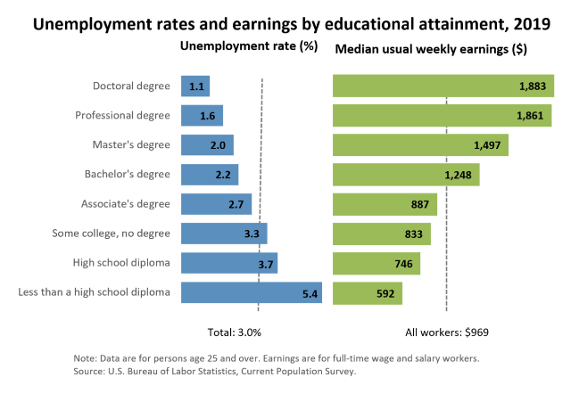
What is the Value of Higher Education?
Are you paid more because you have a degree certificate or because you will be more productive?
US Bureau of Labor Statistics: https://www.bls.gov/emp/chart-unemployment-earnings-education.htm

Slide 5
The Performance Equation
Performance = Motivation X Ability

Slide 6
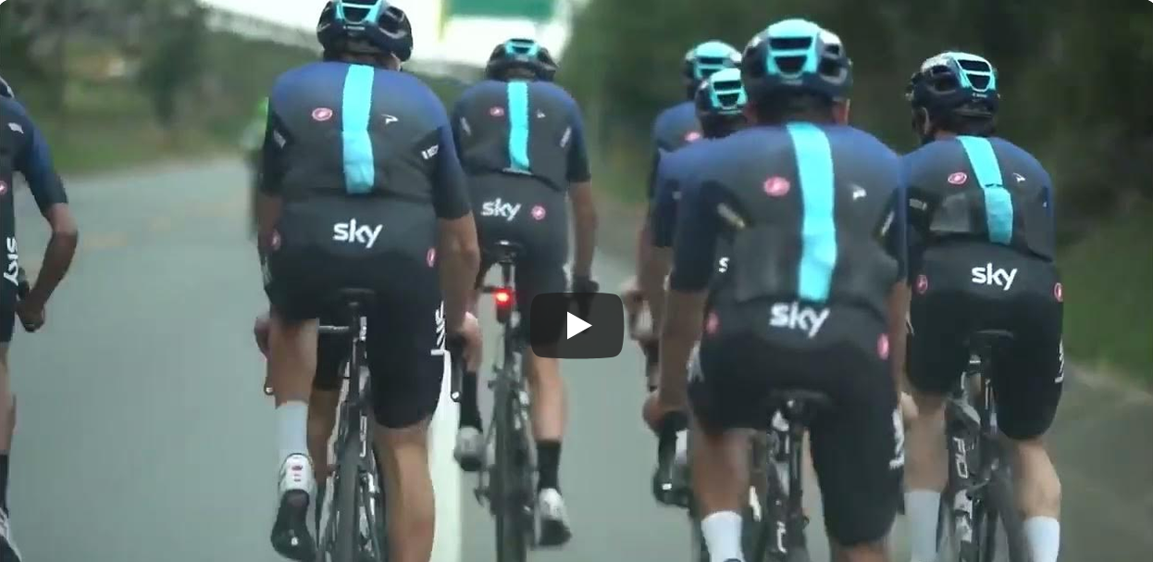
The 1% Strategy – Marginal Gains
https://www.youtube.com/watch?v=DWSuHPQId4c

Slide 7
The Grow Model

Slide 8
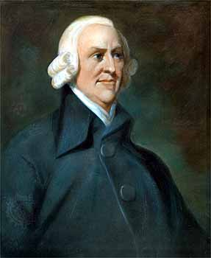
Productivity
[Productivity] “must in every nation be regulated by two different circumstances; first by the skill, dexterity, and judgment with which its labour is generally applied; and, secondly, by the proportion between the number of those who are employed in useful labour, and that of those who are not so employed...”
Adam Smith ‘An Inquiry into the Nature and Causes of the Wealth of Nations’ (1776/1904: I.I.I–I.I.3)

Slide 9
Productivity
UK Commission for Employment and Skills (2010: 3) stated:
“Prosperity ultimately depends on (i) the number of people in work (itself a function of the ‘employment rate’ and the number of people in the potential workforce); and (ii) the value that they produce when in work – the ‘productivity rate’.”
UK Commission for Employment and Skills (2010) The 2010 Report: Ambition 2020: World Class Skills and Jobs for the UK, Wath-upon-Dearne: UKCES.

Slide 10
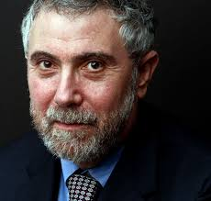
Productivity
  “Productivity isn’t everything, but in the long run it is almost everything. A country’s ability to improve its standard of living over time depends almost entirely on its ability to raise its output per worker.”
Krugman, P. (1999: 11). The Age of Diminishing Expectations. Washington, DC, Washington Post Company.

Slide 11
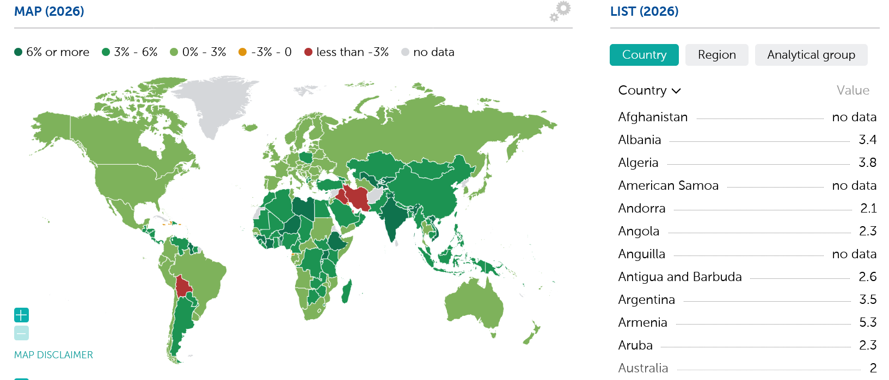
Gross Domestic Product
“Gross Domestic Product (GDP) is the most commonly used single measure of a country’s overall economic activity. It represents the total value at constant prices of final goods and services produced within a country during a specified time period, such as one year. (World Economic Outlook, 2006, International Monetary Fund).”
https://www.imf.org/external/datamapper/NGDP_RPCH@WEO/OEMDC/ADVEC/WEOWORLD

Slide 12
US Declaration of Independence - 1776
“We hold these truths to be self-evident, that all men are created equal, that they are endowed by their Creator with certain unalienable Rights, that among these are Life, Liberty and the pursuit of Happiness.”
Thomas Jefferson & Committee of Five

Slide 13
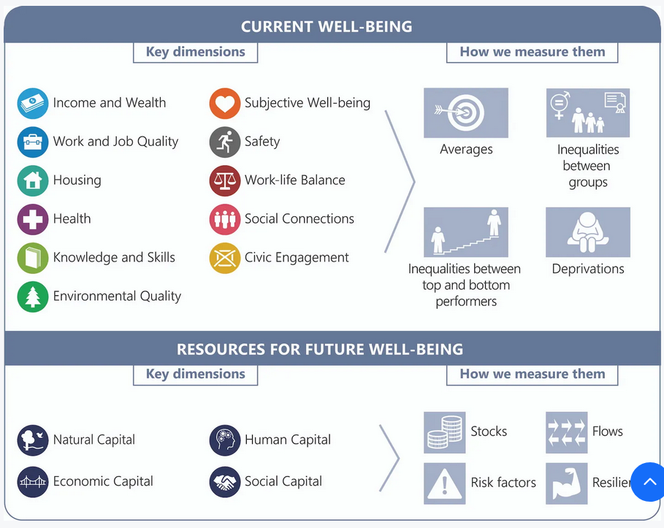
OECD: Wellbeing and Beyond GDP
“An economy that helps to improve the well-being of all people, future generations, and the planet.”
https://www.oecd.org/en/topics/policy-issues/well-being-and-beyond-gdp.html#well-being-framework

Slide 14
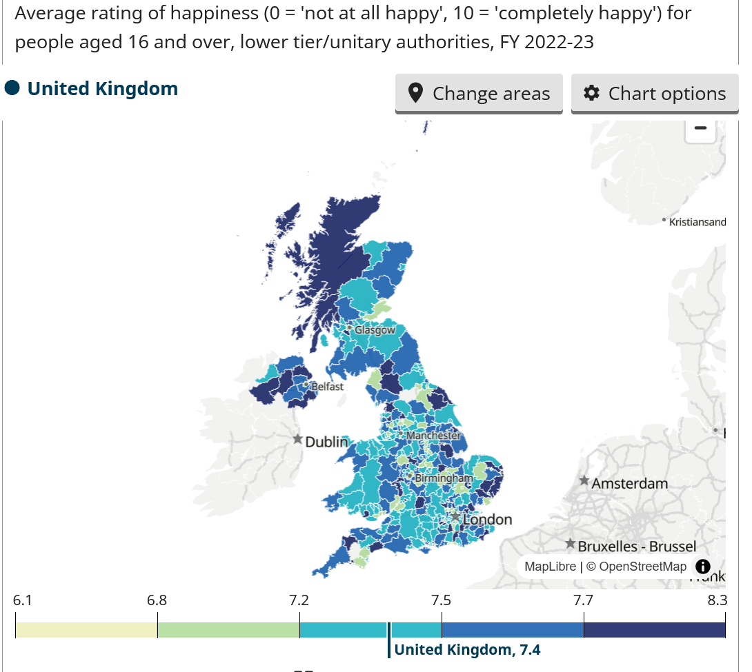
UK Happiness Levels
https://www.ons.gov.uk/explore-local-statistics/indicators/wellbeing-happiness

Slide 15
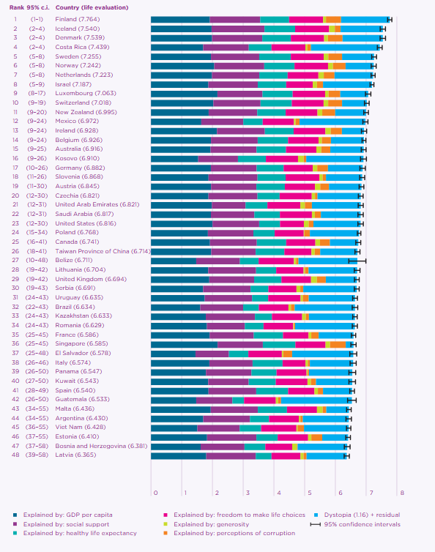
World Happiness Report
Helliwell, J. F., Layard, R., Sachs, J. D., De Neve, J.-E., Aknin, L. B., & Wang, S. (Eds.). (2026). World Happiness Report 2026. University of Oxford: Wellbeing Research Centre.

Slide 16
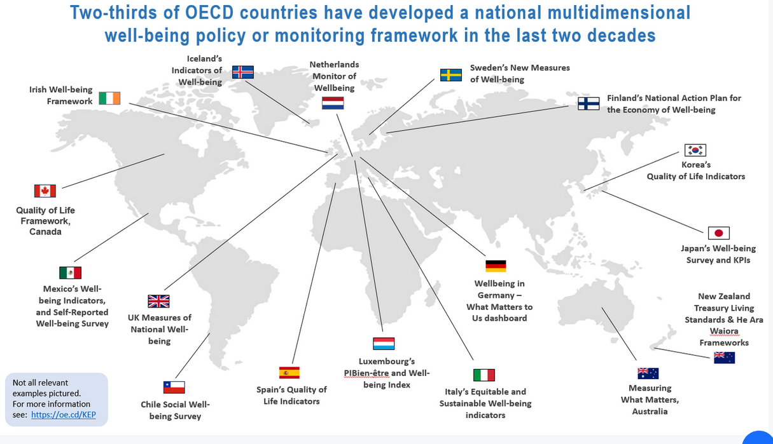
National Well-being Policies
https://www.oecd.org/en/topics/policy-issues/well-being-and-beyond-gdp.html#well-being-framework

Slide 17
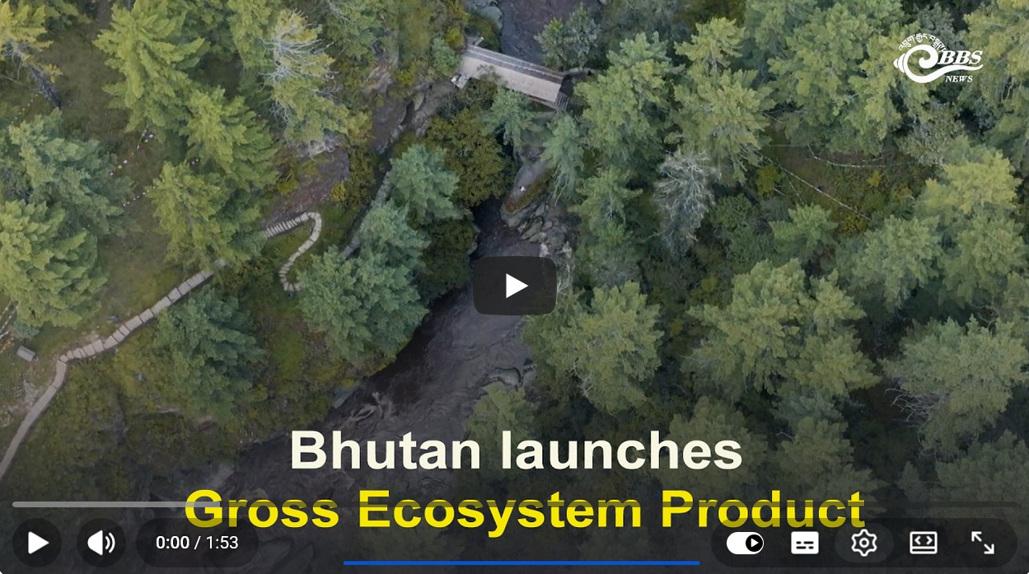
Bhutan’s Gross Ecosystem Product – Sept. 2026
https://www.youtube.com/watch?v=iqJ4qJm6ODQ
Notes:
So how do we evaluate performance in the workplace and what factors are important?

Slide 18
Understanding Performance Management
Performance management is an ongoing process of aligning individual, team, and organisational objectives to ensure that goals are achieved efficiently and effectively. It involves setting targets, monitoring progress, providing feedback, and fostering development across all levels of the organisation (Armstrong, 2020).

Slide 19
Performance Management
“‘Performance management’ refers to how organisations maximise the value of their employees. It aims to maintain and improve employees’ performance in line with organisational goals. Rather than a single activity, it's a group of practices that should be approached holistically.
Performance management typically involves:
Setting objectives for individuals and teams, aligned to organisational strategy.
Supporting improved performance across employees, teams and the organisation.
Holding people accountable by linking performance to reward, career progression and termination of contracts.
At its best, performance management is a two-way process of regular, open and supportive discussion on progress towards objectives. It brings together many principles that enable good people management practice, including learning and development, performance measurement and organisational development.”
https://www.cipd.org/uk/knowledge/factsheets/performance-factsheet/#one

Slide 20
Performance Management Chain
Past Performance
Objectives
Rating
Judgement
Feedback
Future Performance
https://www.cipd.org/globalassets/media/knowledge/knowledge-hub/factsheets/pdfs/links-in-the-performance-management-chain.png

Slide 21
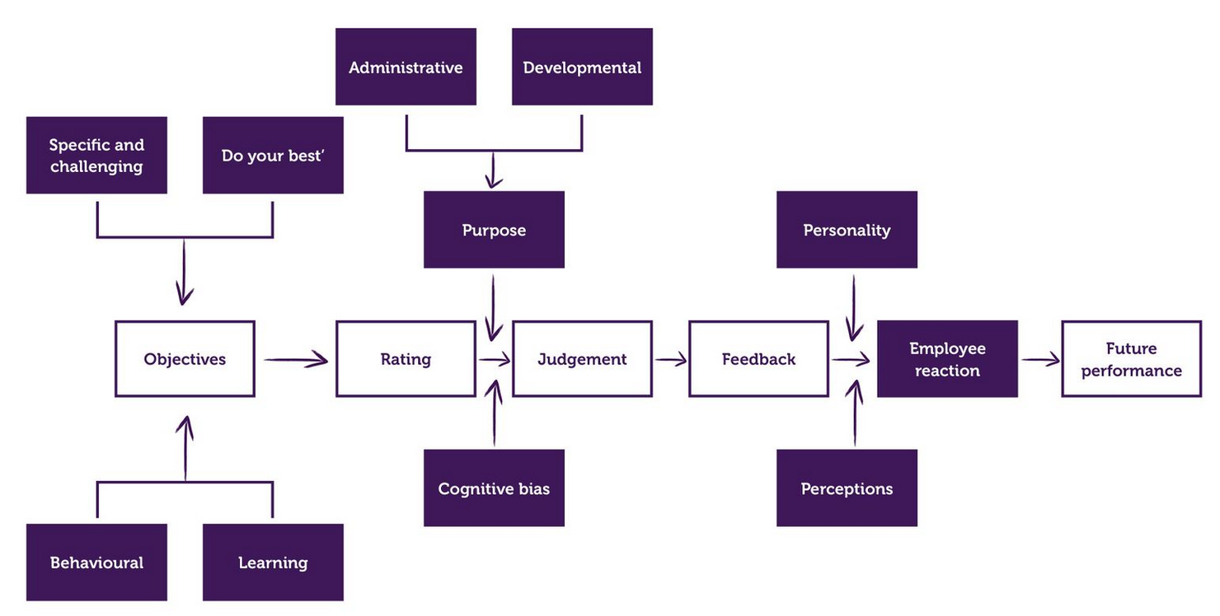
Factors Affecting the Performance Management Cycle
https://www.cipd.org/globalassets/media/knowledge/knowledge-hub/factsheets/pdfs/factors-affecting-the-performance-management-cycle.png

Slide 22
Purpose of Performance Management
Marchington et al (2021: 264-65) says a performance management and development system should:
    Communicate the organization’s vision and objectives to all staff
    Set departmental and individual performance targets linked to organizational objectives
    Use formal review procedures to communicate performance requirements
    Conduct formal review of progress
    Use the review process to identify training, development and reward outcomes
    Evaluates the whole process

Slide 23
‘Hard’ vs ‘Soft’ approaches to Performance Management
Managing individual performance has traditionally centred on assessing performance and linking good performance to rewards
Hard performance management: organisational targets, measurements and metrics applied at an individual level
Softer approach is more developmental and motivational, and involves making an effort to better link the individual and the organisation

Slide 24
Performance Management and Development Process
Resourcing & talent management
Induction, onboarding & socialisation
Reviewing & appraising performance
Enhancing & reinforcing performance standards
Well-being, counselling & support
Role of line manager is important
PM&D
Source: Figure 8.1. Marchington et al. (2021: 265)

Slide 25
Levels of Performance Management
"94% of troubles and possibilities for improvement belong to the system (responsibility of management), 6% special." Deming, Out of the Crisis
Individual Level - Focuses on managing the performance of employees through goal setting, feedback, and development. Aims to ensure employee objectives align with organisational goals.
  Personal development plans
  Performance reviews/appraisals
  Individual feedback and coaching
Team/Group Level - Oversees the collective performance of teams and/or departments and ensures team goals are met.
  Team goal setting
  Group performance evaluations
  Collaboration/team-building activities
Organisational Level - Focuses on overall organisational performance and strategic objectives. Aligns departments and teams toward shared long-term goals.
  Strategic planning
  Organisational performance metrics (KPIs)

Slide 26
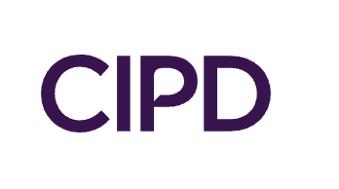
CIPD – Performance Management
Surveyed approx. 5000 employees in 2022 in the UK and found:
  48% of employees had some basic level performance management in their role (e.g. objectives were set by managers and then performance compared).
  28% of employees had systematic PM (e.g. also received feedback from managers and accountability).
  The key role of line managers was highlighted.
  Those employees who received feedback on their performance were then more likely to rate their managers positively!
  21% of employees had their performance linked in some way to their pay.
  Systematic performance management positively linked to task performance (those who receive feedback perform better).
  PRP (performance related pay) not associated with task performance
  (CIPD, 2023)

Slide 27
Categorizing Performance Management
Performance management for administrative purposes – e.g. how to manage, reward, promote, retain and terminate
Performance management for development purposes – e.g. how and where an organisation needs to build capability

Slide 28
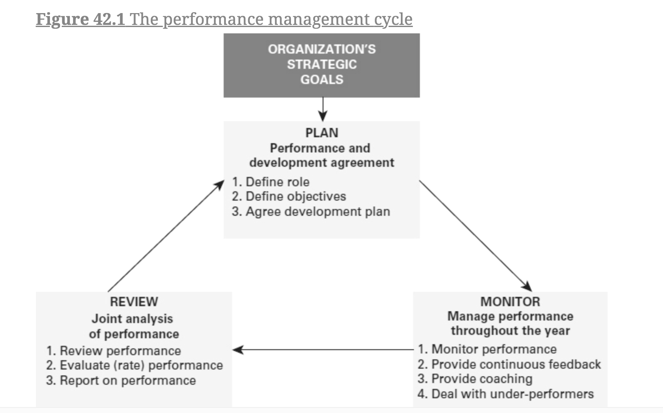
The Performance Management Cycle
(Armstrong & Taylor, 2023)

Slide 29
Defining Performance & Planning
The planning stage involves setting clear and measurable performance goals that are ideally aligned with organisational objectives. This phase establishes expectations and provides a framework for evaluating performance.
Key Components:
  Expectation Communication: Clearly communicate roles, responsibilities, and performance expectations to employees.
  Development Plans: Create individual development plans that support employees in achieving their goals/performance objectives.

Slide 30
Monitoring Performance
The monitoring stage involves the ongoing observation and assessment of employee performance and progress towards established goals/objectives throughout the performance cycle.
Key Components:
  Check-Ins: Scheduling meetings to discuss progress, address challenges, and provide support.
  Performance Metrics: Utilizing specific metrics and key performance indicators to evaluate performance against goals.
  Data Collection: Gather relevant information to assess performance trends and identify areas needing attention.

Slide 31
The Performance Review
The review stage entails formerly assessing employee performance against established goals and expectations, providing opportunities for feedback and future planning.
Key Components:
  Conduct formal evaluations to assess progress toward goals and overall performance.
  Offer constructive feedback on performance, highlighting both strengths and areas for improvement.
  Discuss developmental needs and adjust goals for the next performance cycle as needed.
This review often takes the form of a performance appraisal!

Slide 32
What is a performance appraisal?
A performance appraisal is a formalised process designed to assess and evaluate employee performance against established criteria and objectives.
Common HR practice: One of the most widely used practices in both public and private sectors to enhance workforce effectiveness.
Can range from simple evaluations to more complex systems.
Integration with Performance Management Systems: Can function as a stand-alone process or be incorporated into a comprehensive performance management system, promoting alignment and continuous improvement

Slide 33
Conducting Performance Appraisals: Methods & Approaches
Diverse Methodologies - Performance appraisals can utilize a variety of methods, ranging from basic ranking systems to more sophisticated approaches such as objective, standards-based, and competency-based evaluations, as well as complex behaviour-anchored rating scales.
Influencing Factors - The design of an organisation’s appraisal system may reflect its managerial philosophy, approach to HRM, available resources, and possession of expertise.
Smaller Organisations: Could be more likely to implement simpler ranking and rating methods due to limited resources.
Larger Organisations: May employ more intricate appraisal systems that accommodate a broader range of evaluation criteria and standards.

Slide 34
9-Box Grid
Develop
Develop / Stretch
Stretch
The 9-box grid enables you to categorize employees into nine groups using performance and potential. It can be used in performance review meetings to provide constructive feedback.
Where would you place yourself?
Discuss with a classmate(s)
Observe - Dilemma
Core
Stretch / Develop
POTENTIAL
Observe / Terminate
Observe / Effective
Trusted Professional
PERFORMANCE ASSESSMENT

Slide 35
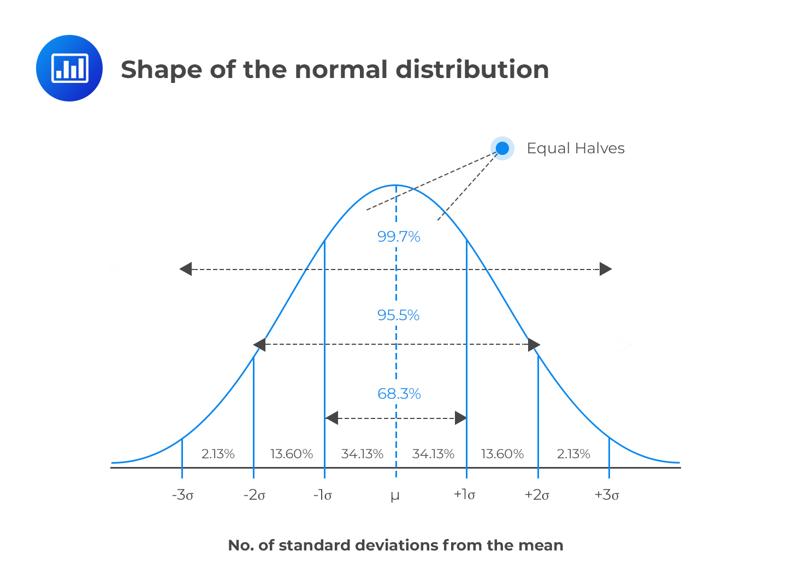
Stacked or Forced Ranking
Stacked or forced ranking involves ranking employees against each other rather than against specified individual performance targets.

Slide 36
Stacked or Forced Ranking
General Electric, under Jack Welch, classed employees as:
20% Most productive
70% Adequate
10% Fired each year.
When Welch left forced ranking stopped but it didn’t prevent GE’s massive decline.
In 2013, Microsoft abandoned forced ranking because:
“The fact is, rank-and-yank systems just don’t work. They tank employee morale. They create misdirected uncertainty and anxiety. They misdirect the spirit of competition so that one competes with the people on one's team rather than against the teams in other companies. They foster hiring and surrounding yourself with B and C players. They lead to information hoarding, finger pointing, backstabbing, and downright deceit.”
https://www.forbes.com/sites/forbesleadershipforum/2013/11/13/heres-to-the-death-of-microsofts-rank-and-yank/

Slide 37
Behaviourally Anchored Rating Scales (BARS)
Behaviorally Anchored Rating Scales (BARS) are a performance appraisal method that combines qualitative and quantitative assessments by linking specific behaviours to defined performance levels.
Behavioral Descriptors: Each performance level is anchored by specific examples of behaviour, making it easier for evaluators to assess performance consistently.
Clear Standards: BARS provide clear expectations for performance, reducing ambiguity and enhancing fairness in evaluations.
Objectivity: By focusing on observable behaviours rather than subjective opinions, BARS can help minimize biases in the appraisal process.

Slide 38
Behaviour Observation Scales (BOS)
Behavior Observation Scales (BOS) are a performance appraisal method that focuses on the frequency of specific behaviours demonstrated by employees in their roles.
Behavior Frequency Ratings: Employees are evaluated based on how often they exhibit certain desired behaviors, providing a quantitative measure of performance.
Observable Actions: The assessment emphasizes observable actions rather than outcomes, making it easier to assess performance in real-time.
Comprehensive Feedback: BOS encourages ongoing feedback by tracking performance over time.

Slide 39
Critiquing Traditional PA Methods
Simple Ranking
  Simple ranking methods offer no insight into why one employee performs better than another. They also do not really provide actionable feedback for improvement.
BARS
  Can be quite time consuming to develop. Require regular updating to stay relevant to a role (DeNisi & Smith, 2014).
BOS
  Emphasis on quantity of displayed behaviours rather than quality (Pulakos, 2009). Can place a high burden on managers, can lead to rater fatigue (DeNisi & Pritchard, 2006).

Slide 40
More General Criticisms of Performance Appraisals
Employees don’t seem to like them - regardless of whether they receive positive or negative feedback about their performance (Manni, 2002).
There are can be inconsistencies with ratings – research has consistently highlighted validity and reliability issues with ranking methods (Viswesveran et al, 1996).
They are vulnerable to subjectivity and bias (DeNisi & Murphy, 2021) – remember some of the cognitive biases that we explored in the recruitment and selection lecture – they could also be relevant when evaluating performance.
Retrospective focus - The focus on the past rather than the future can be developmentally unhelpful (Cappelli & Tavis, 2016).

Slide 41
The Politicalization of Performance Appraisal
While performance appraisals aim to highlight top performers, they don’t always achieve this effectively.
Supervisor Relationships: Employee performance ratings can be heavily influenced by the quality of their relationship with their supervisor.
Some supervisors are overly harsh or lenient, which can impact employee satisfaction and increase turnover (Poon, 2004).
Favoritism: Employees liked by supervisors tend to receive higher performance ratings, regardless of actual performance (Sutton et al, 2013).

Slide 42
The Politicalization of Performance Appraisal
Employees may engage in behaviours to influence their manager, termed ‘impression management’ (Wayne & Lidden, 1995).
  Self promotion – the highlighting and embellishing of accomplishments
  Ingratiation – doing favours and using flattery
  Intimidation – acting threateningly or intimidating
  Supplication – highlighting shortcomings to be seen as needy
  Exemplification – going above and beyond to be seen as a role model
Ingratiation found to have a positive influence on performance rating, while self promotion has a negative impact (Higgins et al, 2003).

Slide 43
Organisation Citizenship Behaviour (OCB)
Voluntary action not requested by managers or listed as performance objectives, but identified as important in helping the workplace a better environment:
  General courtesy
  Helping team-members when they are struggling
  Taking care of organisational property and adhering to informal rules
Meta-analysis by Podsakoff et al (2009) found OCB related to ratings of performance, productivity and the allocation of rewards.
Collectivist cultures may value OCB over individual work performance (Misha and Roch, 2017).
Concerns around burnout and invisible labour (Podsakoff et al, 2009).

Slide 44

Who should rate performance?

Slide 45
Who should rate performance?
Fundamentally, the person who rates an employee’s performance ‘should have the opportunity to observe employees’ performance over the assessment period’ (Sillup & Klimberg, 2010: 42)
There are multiple possible raters of performance:
                Immediate/line managers
              Peers/co-workers
              Direct reports
              Self-appraisal
              Customers/clients
Some research suggests that data from multiple sources are desirable because they give a more holistic picture about an employee’s performance, may reduce bias and reduce the chance of ethical concerns

Slide 46

Alternative Appraisal Methods
Upward appraisal
360-degree or multisource feedback
Customer appraisal
Team based appraisal

Slide 47
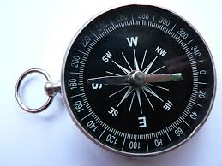
360- degree Feedback
“Feedback from others is a good way to try and see yourself through another person’s eyes. It can be difficult to hear messages that aren’t congruent with your own views but this can be very powerful. Many universities’ Learning and Development Departments will have access to activities such as 360 degree feedback mechanisms. You answer a set of questions about you and your behaviour, likes and dislikes at work for example, and then you identify a number of colleagues to do the same.
The key here is to use both the obvious colleagues such as your line manager but also the not so obvious ones – whose opinion do you really value? Who isn’t automatically going to give you ‘excellent’ in each area? Who will really spend time thinking and being honest?” (Gander, 2014: 100).
Gander, M. (2014). Managing your personal brand. Perspectives: Policy and Practice in Higher Education, 18(3), 99-102.

Slide 48
360-degree Feedback
360-degree feedback can be used for developmental purposes, and performance management / appraisal purposes. The two purposes are different and should not be linked together or they will compromise their distinct purposes.
360-degree or multi-source feedback was applied in WW2 by the German military to assess the performance of soldiers using supervisors, peers and subordinates. It informed pay and promotion. During the 1950s, Esso introduced this approach and it has grown steadily since then.
With the changes in the relationship between the organisation and the employee, “Companies don’t develop managers anymore; managers develop themselves. Companies no longer promise employment; they promise employability.” (Hollenbeck in Bracken et al, 1997: iii)
Hollenbeck, G.P. Foreword in Bracken, D. W., Dalton, M., Jako, R.A., McCauley, C. D. and Pollman, V.A. (1997). Should 360-degree Feedback Be Only Used For Developmental Purposes?. Greensboro, NC, Center for Creative Leadership.

Slide 49
90, 180, 270, 360, 540, 720 degree feedback
90-degree feedback: appraiser gives feedback to appraisee
180-degree feedback: Appraisee evaluates self as well as appraiser
270-degree feedback: Appraiser, appraise + peers or subordinates
360-degree feedback: Appraiser, appraisee, peers and subordinates
540-degree feedback: Appraiser, appraisee, peers, subordinates, and customers / stakeholders
720-degree feedback: 2 X 360-degree feedback – after time results are compared with earlier appraisal.

Slide 50
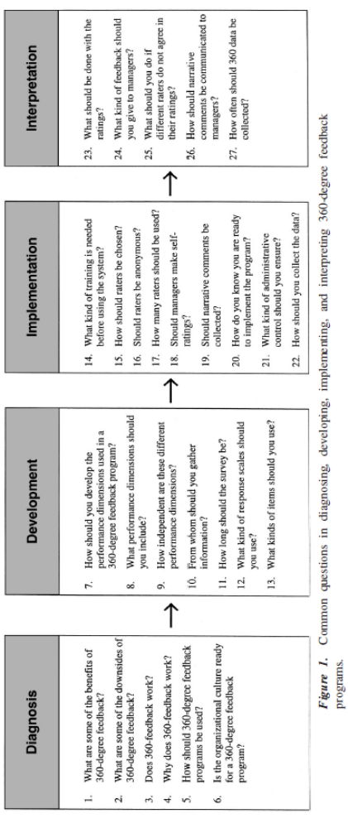
27 Questions About 360-degree Feedback
Morgeson, F. P., Mumford, T. V., & Campion, M. A. (2005). Coming Full Circle: Using Research and Practice to Address 27 Questions About 360-Degree Feedback Programs. Consulting Psychology Journal: Practice and Research, 57(3), 196.

Slide 51
Feedforward Appraisal
A proactive approach focusing on future performance and development rather than past performance (e.g. aims to help employees identify areas for improvement).
Emphasizes learning and potential, shifting the focus from evaluation to development.
Encourages dialogue between managers and employees about how they can achieve future goals.
Positive feedback can be motivating for employees. They discuss what can be improved, rather than dwelling on past failures.
Continuous development: Can create a culture of learning and ongoing feedback.

Slide 52
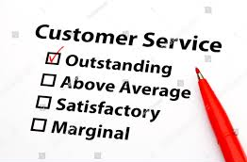
Customer Appraisal
Performance feedback directly from customers.
Measures how well employees meet customer expectations.
Customer-centric: aligns employee actions with customer satisfaction.
Actionable insights: Can provide real-time feedback for improving service quality.
External perspective: Could reduces bias in evaluations.
Improve relationships with customers

Slide 53

Team Appraisal
Organisations are increasingly dividing workforces into teams.
However, there remains debate about how to evaluate the performance of teams.
Team-level appraisals may provide teams with information regarding any problems/issues within the team and allows teams to develop their capabilities.
Can focus on ‘hard’ targets such as collective productivity, sales volume or customer complaints, or softer measures such as the quality of interactions between team members (OCB?).

Slide 54
Moving away from annual appraisals………

Slide 55
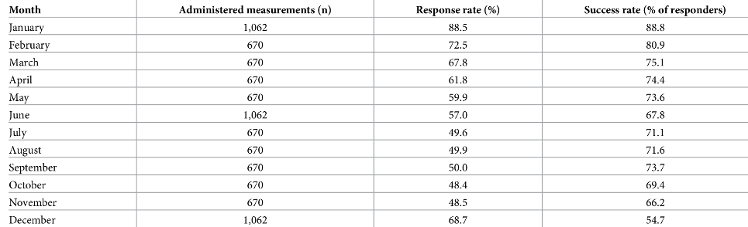
New Year Resolutions
Physical Health
Weight Loss
Eating
Self-improvement
Mental health and sleep
Work and studies
Tobacco
Consumption
Personal finance
Drinking
Friends and family
Home environment
Hobbies
Engagement
Love
“Readiness to change was related to positive outcomes” compared to those who did not make a resolution.
Support had a significant impact on achieving a resolution.
Of 1,062 participants, “58.9% considered themselves successful, compared to 47.1% of participants who set avoidance-oriented resolutions.”
Oscarsson, M., Carlbring, P., Andersson, G., & Rozental, A. (2020). A large-scale experiment on New Year’s resolutions: Approach-oriented goals are more successful than avoidance-oriented goals. Plos one, 15(12), e0234097.

Slide 56
Performance Management - developing trends……
https://www.washingtonpost.com/video/national/on-leadership/accenture-ceo-on-rewarding-and-motivating-millennials--on-leadership/2015/07/23/734a532c-30b5-11e5-a879-213078d03dd3_video.html

Slide 57
Continuous Performance Management
CPM is an ongoing process of regular feedback and check-ins between employees and managers.
It focuses on real-time development and goal adjustment throughout the year rather than a one-time review.
Development Focus: Prioritizes coaching and skill-building over just evaluation.
Agility: Goals can be updated in response to changing organisational needs or individual progress.
CPM promotes active employee participation in their own development, while traditional appraisals are usually more top-down.
Appraisals often emphasize evaluation and past performance, while CPM is future-focused, prioritizing growth and development.

Slide 58
Performance Management at Deloitte
Buckingham & Goodhall (2015) ‘Reinventing Performance Management’ Harvard Business Review April 2015, pp. 40-50
Deloitte decided its current performance management system (PMS) was not working, and was not aligned with the organisation’s objectives
A survey of Deloitte executives found 58% did not believe their current approach to performance management was driving neither employee engagement nor high performance
They found that assessing an employee’s skills produced inconsistent data (variance in ratings largely due to individual rater’s perceptions)
They found that completing forms, holding performance review meetings, and creating the ratings took close to 2 million hours a year!
They wanted to shift from a focus on the past to a focus on the present
They wanted to design a simple, agile, one-size-fits-all system, and constant learning, underpinned by a new way of collecting reliable performance data

Slide 59
Performance Management at Deloitte
MGT6060
The Problem | The Goal | The Solution
Employees, their managers and even HR departments question conventional wisdom of performance management, including its reliance on cascading objectives, backwards looking assessments, once-a-year rankings and reviews, and 360-degree feedback tools | Deloitte resolved to design a system that would fairly recognise varying performance, have a clear view into performance anytime, and boost performance in the future | Deloitte’s new approach separates compensation decisions from day-to-day performance management, produces better insight through quarterly or per-project ‘performance snapshots’ and relies on weekly check-ins with managers to keep performance on course

Slide 60
Performance Management at Deloitte
MGT6060
At the end of every project (or once every quarter for long-term projects) they decided to ask team leaders to respond to 4 future-focussed statements about each team member – a ‘performance snapshot’:
  ‘Given what I know of this person’s performance, and if it were my money, I would award this person the highest possible compensation increase and bonus’ (5-point scale from “strongly agree” to “strongly disagree”)
  ‘Given what I know about this person’s performance, I would always want them on my team’ (same 5-point scale as above)
  ‘This person is at risk of low performance’ (yes/no)
  This person is ready for promotion today’ (yes/no)
Every team leader checks with each team member once a week about near-term work.
Self-assessment tool used to identify strengths/weaknesses.

Slide 61
Performance Leadership
Performance leadership involves enhancing employee performance by motivating, inspiring, and providing guidance, while also supporting their well-being and skill development.
Effective Performance Leaders:
  Set Clear Goals and Direction: Ensure employees know what tasks to prioritize and where to focus their efforts.
  Provide Necessary Resources: Equip employees with the tools, training, and support they need to succeed in their roles.
  Inspire and Motivate: Foster enthusiasm and commitment by creating a positive, engaging work environment.
  Develop Skills and Capabilities: Encourage continuous learning and personal development.
  Track Progress and Give Feedback: Regularly monitor employee performance and provide constructive, timely feedback to help them improve.
  (Armstrong & Taylor, 2023)

Slide 62
Performance management by algorithm
The emergence of platform work (sometimes called the ‘gig economy’) and the rise in remote work/working from home/hybrid working raises concerns over the future of performance management
Technology-enabled remote monitoring practices, including AI-driven workplace surveillance and automated algorithmic dismissal can be used to collect employee data through the working day, which, in some cases, is being used to evaluate and rate performance.
Data collected, stored, analysed may include biometrics, text messages, telephone calls, entry/exit/movement sensors, online footprints, GPS position tracking, and key strokes
In-built bias in the algorithms used to make performance decisions may lead to unfairness and discrimination (others suggest bias may be reduced).
See Uber fined after ‘robo-firing’ drivers
by Jo Faragher 6 Oct 2023

Slide 63
Individual Workplace Metrics
Output / hour
Task completion rate
Quality score
Absenteeism
Support of colleagues etc

Slide 64
Surveillance in the Workplace
Physical Tracking
Video surveillance
GPS trackers
Telephone and Audio
Call logs and recording
Digital Tracking
Keystroke logs
Screen monitoring
Webcam / microphone
AI Analytics
AI assessment
“Employers must explain the amount of monitoring clearly in the staff handbook or contract. They should tell workers:
if they’re being monitored
what counts as a reasonable number of personal emails and phone calls
if personal emails and calls are not allowed”
https://www.gov.uk/monitoring-work-workers-rights/email-cctv-and-other-monitoring

Slide 65

Uber fined after ‘robo-firing’
In April 2023, a court in Amsterdam in The Netherlands fined Uber €584,000 when an algorithm made the decision to dismiss two drivers from the UK and Portugal.
The court ordered Uber to provide transparency in how it used automation to make decisions to workers.
Uber said drivers’ accounts were flagged due to very specific circumstances, and the decisions were reviewed by human teams but the Judge said the human review of the ‘robo-firing’ decision was nothing more than a “symbolic act”.
Personnel Today. 6 October 2023. Available at: https://www.personneltoday.com/hr/uber-robo-firing-fine/#:~:text=A%20court%20in%20Amsterdam%20has,from%20the%20UK%20and%20Portugal
California’s No Robo Bosses Act (September 2026), bans employers from relying solely on automated AI systems to fire or discipline workers without human corroboration and written notice.
This Photo by Unknown Author is licensed under CC BY

Slide 66
CIPD Insights in Performance Management
https://www.youtube.com/watch?v=PSfvZrLOtWE

Slide 67
Lecture Summary
In this lecture, we explored the concept of performance management, examining its core objectives and functions within organisations.
We provided an overview of the performance management cycle, emphasizing the importance of each stage.
We focused in depth on the role of performance appraisals and how they fit within the broader performance management framework.
We explored frequent criticisms of performance appraisals, particularly how they can become politicized and fail to account for certain types of employee behaviours.
Finally, we examined evolving approaches that move beyond the traditional appraisal methods, offering new perspectives on how performance can be effectively managed.

