Slide 1

MGT6046: Operations and Supply Chain Management
Week 6 - Cost Analysis: Make-or-Buy
and Break-even Analysis
Dr Sina Rastani

Slide 2
Learning outcomes
Identify fixed, variable and relevant costs
Calculate total cost, contribution and the break-even point
Compare make-or-buy options at different demand levels
Use costs, capacity and supplier performance to support a decision

Slide 3
Fixed costs
Fixed costs stay the same in total for a set period and range of output.
Examples | Why the cost is fixed
Premises rent | A set monthly or annual payment
Equipment rental | A set payment for using equipment
Business insurance | An agreed payment for the policy period
Supervisor salary | The same salary within the current level of capacity

Slide 4
Variable costs
Total variable cost rises as output rises. In this model, variable cost per unit stays the same.
Examples | How the cost changes
Raw materials and components | Each unit needs materials and parts
Packaging | Each finished unit needs packaging
Labour paid per unit | The payment rises with the number of units made
Production supplies and energy | More production uses more supplies and energy

Slide 5

Wooclap: cost behaviour
Output rises from 2,000 to 3,000 units within existing capacity. The rent stays at £6,000 per month. Which statement is correct?
A. Rent is fixed. Rent per unit falls.
B. Rent is variable. Rent per unit stays the same.
Event code: TSHGBUP
C. Total rent rises by 50%.
D. Rent becomes a sunk cost.

Slide 6
Mixed costs, total cost and step costs
Mixed describes one cost. Total cost adds all costs for the activity.
Term | Meaning and example
Mixed cost | One cost with a fixed and a variable part. Vehicle contract: monthly fee plus a charge per delivery.
Total cost | All fixed costs plus all variable costs for the activity: TC = F + vQ.
Step cost | Stays fixed up to a limit, then rises. A second supervisor when a second shift starts.

Slide 7
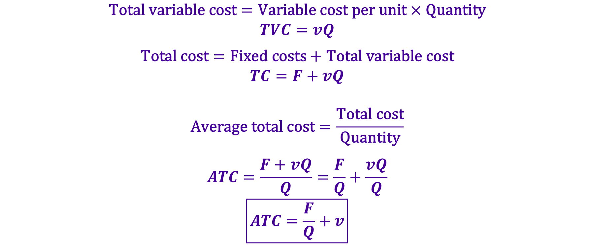
Cost-volume analysis
$$\text{Total} \text{variable} \text{cost}=\text{Variable} \text{cost} \text{per} \text{unit}×\text{Quantity}$$
$$TVC=vQ$$
$$\text{Total} \text{cost}=\text{Fixed} \text{costs}+\text{Total} \text{variable} \text{cost}$$
$$TC=F+vQ$$
$$\text{Average} \text{total} \text{cost}=\frac{\text{Total} \text{cost}}{\text{Quantity}}$$
$$ATC=\frac{F+vQ}{Q}=\frac{F}{Q}+\frac{vQ}{Q}$$
$$\boxed{ATC=\frac{F}{Q}+v}$$
F = total fixed cost for the period (£)
v = variable cost per unit (£/unit).
Q = units made in that period

Slide 8
Practice: desk organisers
A business makes 3,000 desk organisers per month. Calculate variable cost per unit, total cost and average total cost.
Monthly cost or output | Value
Monthly fixed costs | Rent £4,500 + equipment rental £3,000 + supervisor salary £1,500 = £9,000
Variable costs per organiser | Materials £4.00, labour £1.50, packaging £0.50
Output | 3,000 organisers per month
Operating conditions | Unit costs stay the same. Capacity is enough.

Slide 9
Desk organisers: worked solution
Monthly output: 3,000 organisers. Fixed cost: £9,000.
Variable cost per unit:
£4.00 + £1.50 + £0.50 = £6.00
Total variable cost:
£6 × 3,000 = £18,000 per month
--------------------------------------------------------------------------------------------------------
Total cost:
£9,000 + £18,000 = £27,000 per month
Average total cost:
£27,000 ÷ 3,000 = £9 per organiser

Slide 10
Relevant costs for operational decisions
Relevant costs are future costs that differ between options. Fixed/variable describes cost behaviour. Relevant/irrelevant describes the decision.
Cost type | Treatment in the decision
Avoidable fixed cost | Include: paid only if we choose that option
Additional variable cost | Include: changes with the chosen option
Sunk cost | Exclude: already incurred and cannot be recovered
Unavoidable cost, same in both options | Exclude: the decision does not change it
Opportunity cost | Include: contribution lost from another use

Slide 11
Wooclap: relevant costs
A machine rental costs £12,000 a year and can be cancelled if production is outsourced. How should this cost be classified?
A. Fixed and relevant
B. Fixed and irrelevant
C. Variable and relevant
D. A sunk cost

Slide 12
Cost classification: cafeteria production
A cafeteria is considering buying pastries instead of baking them. Which costs are relevant?
Oven rental paid only if the cafeteria bakes
Relevant: avoidable fixed cost
Ingredients needed for each pastry
Relevant: variable cost
Past market study with no refund
Irrelevant: sunk cost
Building rent paid under both options
Irrelevant: unavoidable fixed cost

Slide 13
Practice: pump covers and shared costs
Compare relevant costs and recommend make or buy. Both options meet quality needs and have enough capacity.
Annual cost or requirement | Value
Requirement | 5,000 pump covers
Make variable cost | £9 per cover
Fixed cost avoided if buying | £10,000 per year
Head-office cost shown in the report | £15,000. This cost continues under both options.
Supplier price including delivery | £12 per cover

Slide 14
Pump covers: relevant-cost solution
Annual requirement: 5,000 covers. Head-office cost stays the same under both options.
Shared head-office cost:
Leave out £15,000 because the choice does not change it
Relevant make cost:
£10,000 + (£9 × 5,000) = £55,000
Relevant buy cost:
£12 × 5,000 = £60,000
Recommendation:
Make saves £5,000. Adding shared costs only to make would mislead us.

Slide 15
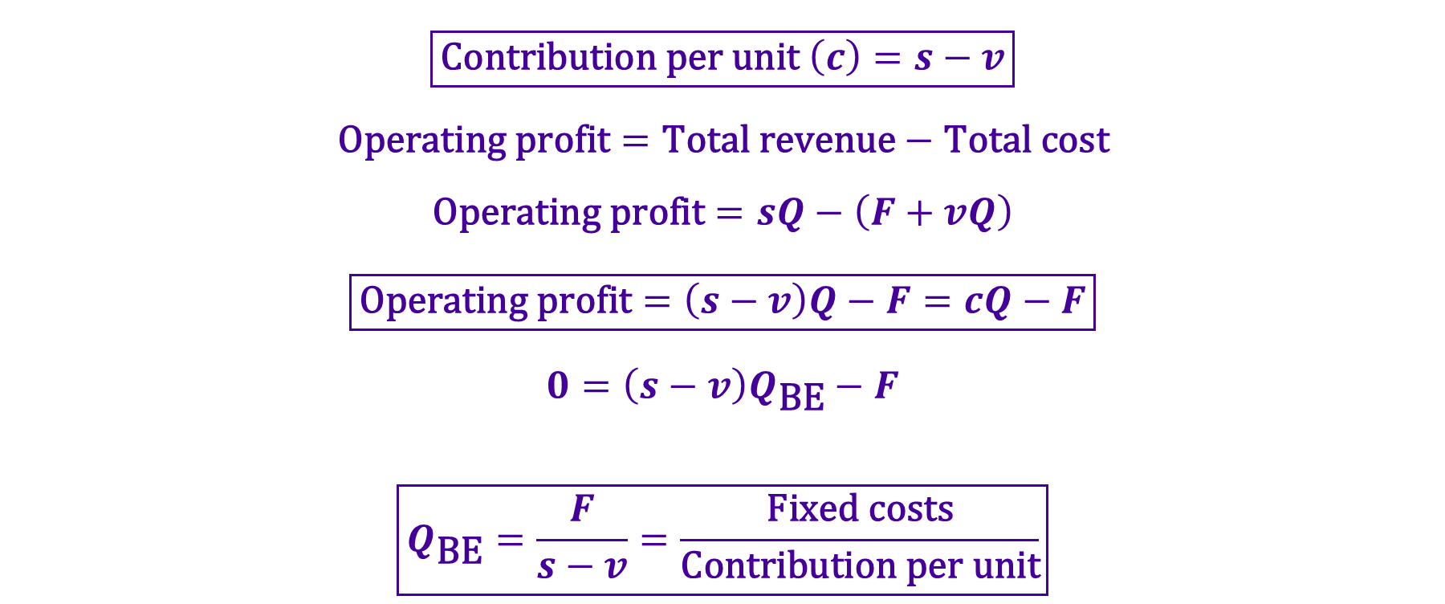
Contribution, profit and break-even point
$$\boxed{\text{Contribution} \text{per} \text{unit} \left(c\right)=s−v}$$
$$\text{Operating} \text{profit}=\text{Total} \text{revenue}−\text{Total} \text{cost}$$
$$\text{Operating} \text{profit}=sQ−\left(F+vQ\right)$$
$$\boxed{\text{Operating} \text{profit}=\left(s−v\right)Q−F=cQ−F}$$
$$0=\left(s−v\right)Q_{\text{BE}}−F$$
$$\boxed{Q_{\text{BE}}=\frac{F}{s−v}=\frac{\text{Fixed} \text{costs}}{\text{Contribution} \text{per} \text{unit}}}$$
At the break-even point, revenue equals total cost and operating profit is zero
This model assumes that all units made are sold

Slide 16
Worked example: coffee kiosk
Monthly fixed cost: £1,200. Monthly sales: 900 cups.
Selling price: £3.20/cup. Variable cost: £1.20/cup.
Contribution per cup:
£3.20 − £1.20 = £2.00
Break-even point:
£1,200 ÷ £2.00 = 600 cups per month
Total contribution at 900 cups:
900 × £2.00 = £1,800
Monthly operating profit:
£1,800 − £1,200 = £600

Slide 17
Cost-volume-profit graph
Break-even point: 600 cups per month. Revenue and total cost both equal £1,920.

Slide 18
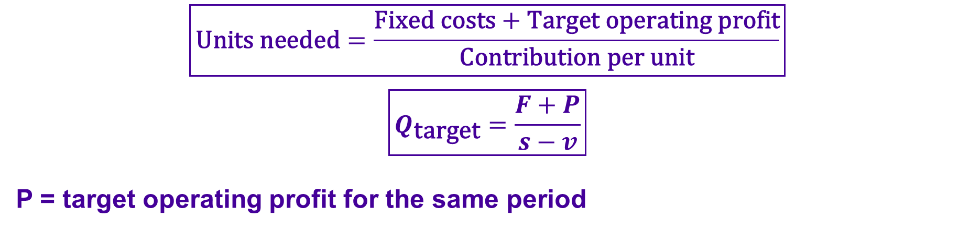
Target profit: reusable bottles
$$\boxed{\text{Units} \text{needed}=\frac{\text{Fixed} \text{costs}+\text{Target} \text{operating} \text{profit}}{\text{Contribution} \text{per} \text{unit}}}$$
$$\boxed{Q_{\text{target}}=\frac{F+P}{s−v}}$$
P = target operating profit for the same period
A business sells reusable bottles for £7 each
Variable cost is £3 per bottle. Monthly fixed cost is £2,400
How many bottles must it sell to earn £1,200 operating profit per month?
Can it reach that target with capacity of 800 bottles per month?

Slide 19
Reusable bottles: worked solution
Price: £7/bottle.
Variable cost: £3/bottle.
Monthly fixed cost: £2,400.
Contribution per bottle:
£7 − £3 = £4
Units for the target profit:
(£2,400 + £1,200) ÷ £4 = 900 bottles per month
Profit at the capacity limit:
(£4 × 800) − £2,400 = £800 per month
Capacity decision:
The target is £400 above this profit. Price, costs or capacity must change.

Slide 20
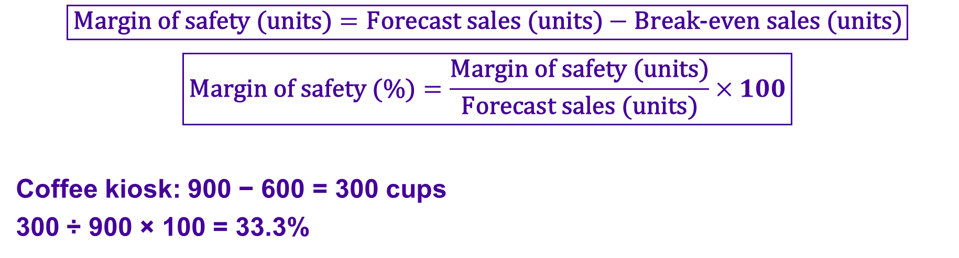
Margin of safety
$$\boxed{\text{Margin} \text{of} \text{safety}\text{ (}\text{units}\text{)}=\text{Forecast} \text{sales}\text{ (}\text{units}\text{)}−\text{Break}\text{−}\text{even} \text{sales}\text{ (}\text{units}\text{)}}$$
$$\boxed{\text{Margin} \text{of} \text{safety}\text{ (\%)}=\frac{\text{Margin} \text{of} \text{safety}\text{ (}\text{units}\text{)}}{\text{Forecast} \text{sales}\text{ (}\text{units}\text{)}}×100}$$
Coffee kiosk: 900 − 600 = 300 cups
300 ÷ 900 × 100 = 33.3%
Forecast sales can fall by 300 cups before the kiosk reaches break-even
A smaller margin of safety means greater risk from a fall in sales

Slide 21
Make-or-buy decisions
A make-or-buy decision compares internal production with buying from a supplier.
Sourcing means deciding how and from whom a business gets goods or services.
Make internally
Use internal resources and compare relevant production costs.
Goods or
services needed
Buy from supplier
Compare supplier price and other relevant buying costs.
Compare the same quantity, quality and period under both options.

Slide 22
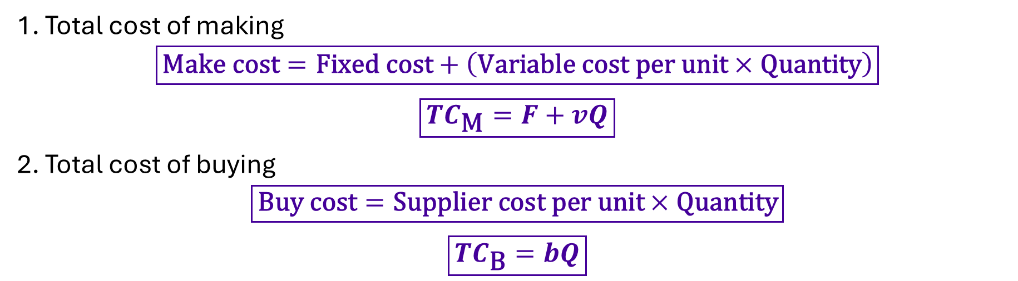
Make-or-buy model and break-even point
1. Total cost of making
$$\boxed{\text{Make} \text{cost}=\text{Fixed} \text{cost}+\left(\text{Variable} \text{cost} \text{per} \text{unit}×\text{Quantity}\right)}$$
$$\boxed{TC_{\text{M}}=F+vQ}$$
2. Total cost of buying
$$\boxed{\text{Buy} \text{cost}=\text{Supplier} \text{cost} \text{per} \text{unit}×\text{Quantity}}$$
$$\boxed{TC_{\text{B}}=bQ}$$
F = fixed cost avoided if we buy.
v = variable cost per unit if we make.
b = supplier price per unit, including delivery.
Q = annual quantity needed.

Slide 23
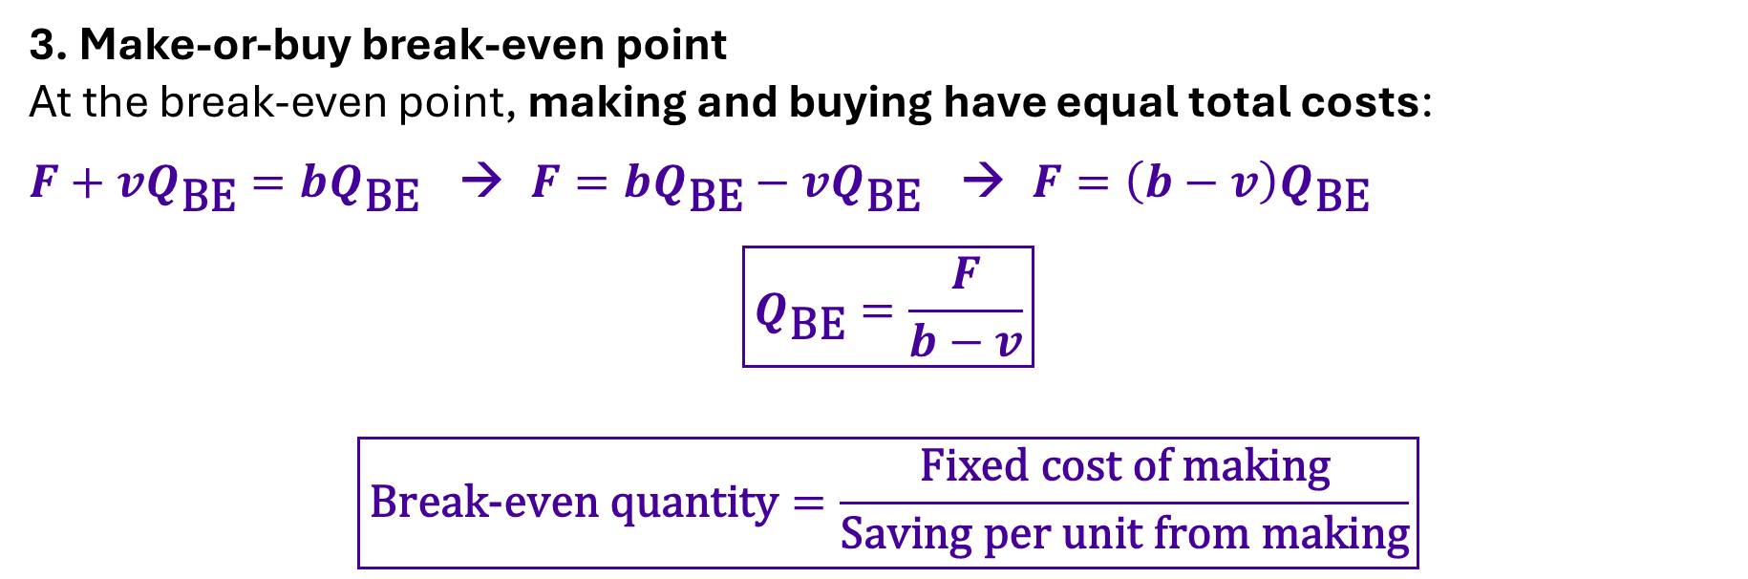
Make-or-buy model and break-even point
3. Make-or-buy break-even point
At the break-even point, making and buying have equal total costs:
$F+vQ_{\text{BE}}=bQ_{\text{BE}}$ → $F=bQ_{\text{BE}}−vQ_{\text{BE}}$ → $F=\left(b−v\right)Q_{\text{BE}}$
$$\boxed{Q_{\text{BE}}=\frac{F}{b−v}}$$
$\boxed{\text{Break}\text{−}\text{even} \text{quantity}=\frac{\text{Fixed} \text{cost} \text{of} \text{making}}{\text{Saving} \text{per} \text{unit} \text{from} \text{making}}}$
When F > 0 and b > v: buy below the break-even point and make above it
Here, the break-even point means equal make and buy costs

Slide 24
Case: university welcome packs
Annual cost or requirement | Value
Requirement | 8,000 completed packs
Printer rental, only if making | £24,000 per year
Variable costs per pack | Paper and ink £3.00 + binding £1.50 + finishing £1.50 = £6.00
Supplier price | £10 per completed pack, including delivery
Quality and capacity | Both options meet quality needs. Internal capacity: 12,000 packs/year

Slide 25
Welcome packs: total-cost comparison
Annual requirement: 8,000 packs
Variable cost per pack if making:
£3.00 + £1.50 + £1.50 = £6.00
Total annual make cost:
£24,000 + (£6 × 8,000) = £72,000
---------------------------------------------------------------------------------------
Total annual buy cost:
£10 × 8,000 = £80,000
Recommendation based on cost:
Make: annual saving = £80,000 − £72,000 = £8,000

Slide 26
Wooclap: break-even point
For the welcome packs, what is the annual make-or-buy break-even quantity?
Fixed make cost £24,000. Make cost £6/pack. Buy price £10/pack.
A. 2,400 packs
B. 4,000 packs
C. 6,000 packs
D. 8,000 packs

Slide 27
Wooclap: break-even point
For the welcome packs, what is the annual make-or-buy break-even quantity?
Fixed make cost £24,000. Make cost £6/pack. Buy price £10/pack.
A. 2,400 packs
B. 4,000 packs
C. 6,000 packs $Q_{\text{BE}}=\frac{F}{b−v}=\frac{£24,000}{£10−£6}=\boxed{6,000 \text{packs} \text{per} \text{year}}$
D. 8,000 packs

Slide 28
Welcome packs: break-even point
F = £24,000/year. v = £6/pack. b = £10/pack.
Saving per pack before fixed cost:
b − v = £10 − £6 = £4 per pack
Break-even point:
Q_{BE} = £24,000 ÷ £4 = 6,000 packs per year
Check that costs are equal:
Make: £24,000 + £6 × 6,000 = £60,000. Buy: £10 × 6,000 = £60,000
Meaning for the decision:
Buy below 6,000 packs. Make above 6,000, if capacity is enough.

Slide 29
Make-or-buy cost-volume graph
Break-even point: 6,000 packs per year at a total annual cost of £60,000.

Slide 30
Sensitivity analysis
Sensitivity analysis shows how the answer changes when an input changes. Change one input at a time.
Scenario | Revised break-even point
Base case: fixed cost £24,000, make £6/pack, buy £10/pack | 6,000 packs/year
Fixed cost rises to £30,000 | £30,000 ÷ (£10 − £6) = 7,500
Supplier price falls to £9 | £24,000 ÷ (£9 − £6) = 8,000
Make variable cost falls to £5 | £24,000 ÷ (£10 − £5) = 4,800

Slide 31
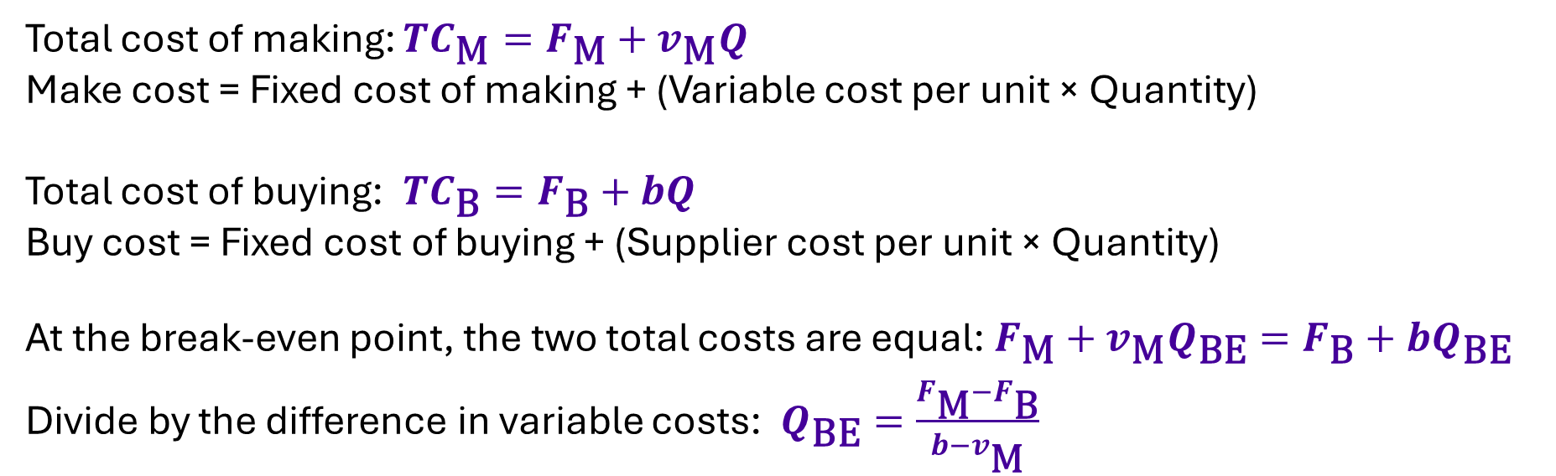
Fixed costs under both options
Total cost of making: $TC_{\text{M}}=F_{\text{M}}+v_{\text{M}}Q$
Make cost = Fixed cost of making + (Variable cost per unit × Quantity)
Total cost of buying: $TC_{\text{B}}=F_{\text{B}}+bQ$
Buy cost = Fixed cost of buying + (Supplier cost per unit × Quantity)
At the break-even point, the two total costs are equal:$F_{\text{M}}+v_{\text{M}}Q_{\text{BE}}=F_{\text{B}}+bQ_{\text{BE}}$
Divide by the difference in variable costs: $Q_{\text{BE}}=\frac{F_{\text{M}}−F_{\text{B}}}{b−v_{\text{M}}}$
F_{M} = fixed cost if making. F_{B} = fixed cost if buying
v_{M} = variable cost per unit if making. b = supplier price per unit
Use fixed costs that change with the decision
When F_{M} > F_{B} and b > v_{M}: buy below the break-even point, make above it

Slide 32
Practice: fixed costs under both options
Calculate the break-even point. Compare annual costs at 18,000 units and recommend an option.
Annual cost or requirement | Make and buy options
Making | Fixed cost £40,000. Variable cost £4 per unit.
Buying | Annual supplier-management fee £10,000, plus £6 per unit
Requirement | 18,000 units per year
Operating conditions | All costs shown are relevant. Quality and capacity are suitable.

Slide 33
Both options: worked solution
Make: F_{M} £40,000, v_{M} £4/unit. Buy: F_{B} £10,000, b £6/unit.
Break-even point:
(£40,000 − £10,000) ÷ (£6 − £4) = 15,000 units per year
Make cost at 18,000 units:
£40,000 + (£4 × 18,000) = £112,000
Buy cost at 18,000 units:
£10,000 + (£6 × 18,000) = £118,000
Recommendation:
Make saves £6,000 per year, assuming the stated quality and capacity.

Slide 34
Capacity and opportunity cost
Using a machine for one product may prevent us from making another product. A manufacturer needs a component and has two options:
Option | Cost and use of capacity
Make internally | Relevant production costs of £52,000. Uses machine hours needed for other work.
Buy from a supplier | Purchase cost of £60,000. Keeps the machine available for other work.
Buying keeps the machine available to earn £12,000 contribution from another product.
Opportunity cost is the benefit lost from the best alternative use of a resource.
Making the component means giving up the £12,000 contribution.

Slide 35
Including opportunity cost in the decision
Making appears £8,000 cheaper, but it prevents the business from earning £12,000 elsewhere.
Relevant make cost = Production costs + Opportunity cost
£52,000 + £12,000 = £64,000
Comparison | Make | Buy
Relevant production or purchase costs | £52,000 | £60,000
Contribution lost from other work | £12,000 | £0
Total relevant cost | £64,000 | £60,000
Decision: Buy. The financial advantage is £4,000.
Contribution = sales revenue minus variable costs, assuming other fixed costs stay unchanged.
If the machine has no other profitable use, opportunity cost is zero and making saves £8,000.

Slide 36
Practice: supplier price and extra charges
Calculate the full buy cost per unit, compare annual costs and recommend an option.
Annual cost or requirement | Value
Requirement | 10,000 units
Making | Fixed cost £20,000, plus £6 per unit
Supplier quote | £7.50 per unit, excluding delivery and incoming inspection
Extra costs only if buying | Delivery £0.40/unit. Incoming inspection £0.20/unit.
Operating conditions | The fixed cost is avoided if buying. Quality and capacity are suitable.

Slide 37
Supplier charges: worked solution
Annual requirement: 10,000 units. Delivery and inspection apply to every purchased unit.
Full buy cost per unit:
£7.50 + £0.40 + £0.20 = £8.10
Total annual buy cost:
£8.10 × 10,000 = £81,000
Total annual make cost:
£20,000 + (£6 × 10,000) = £80,000
Recommendation:
Make saves £1,000. The supplier quote alone leaves out £6,000 of costs.

Slide 38
Non-cost factors in sourcing decisions
Factor | Questions for the decision
Quality | Can the option meet quality needs and avoid defects?
Delivery and reliability | Can it deliver on time and keep supply running?
Capacity and flexibility | Can it meet demand and respond to changes?
Knowledge and control | Will we protect our designs and keep important skills?
Sustainability and staff | What are the effects on the environment and employees?

Slide 39
Packaging production: the decision
A business must choose make or buy before annual demand is known. Both options meet the required quality.
Information | Value
Fixed cost, only if making | £18,000 per year
Variable cost if making | £2.50 per unit
Supplier price | £4.00 per unit, including delivery
Annual demand | Forecast: 14,000 units. Possible range: 8,000–20,000 units.
Internal production capacity | 20,000 units per year
First compare costs at the forecast, then test alternative demand and price scenarios.

Slide 40
Wooclap: packaging at the forecast
Using the forecast of 14,000 units, which option has the lower annual total cost?
Make: £18,000/year + £2.50/unit. Buy: £4/unit.
A. Make
B. Buy
C. Both cost the same
Calculate both annual total costs before you vote.

Slide 41
Packaging: costs at the forecast
Forecast annual demand: 14,000 units. Compare the same quantity under both options.
Make
£18,000 + (£2.50 × 14,000)
= £53,000 per year
Buy
£4.00 × 14,000 = £56,000 per year
Break-even point
£18,000 ÷ (£4.00 − £2.50)
= 12,000 units per year
Answer A: Make saves £3,000 at the forecast of 14,000 units.

Slide 42
Packaging: if demand differs from the forecast
9,000 and 18,000 units are hypothetical demand scenarios within the 8,000–20,000 range. They are not calculated from the forecast.
Which option costs less at each demand level?
Buy costs less
Make costs less
8,000
9,000
12,000
14,000
18,000
20,000
Break-even
Forecast
Lower demand: 9,000 units
Make £40,500. Buy £36,000. Buying saves £4,500.
Higher demand: 18,000 units
Make £63,000. Buy £72,000. Making saves £9,000.
Making costs less at the forecast, but lower demand can favour buying.

Slide 43
Packaging: a lower supplier price
Separate what-if scenario: demand is confirmed at 16,000 units and the supplier quotes £3.50/unit. Make costs stay at £18,000/year + £2.50/unit.
Which option costs less now?
Make
£18,000 + (£2.50 × 16,000) = £58,000
per year
Buy
£3.50 × 16,000 = £56,000 per year
Revised break-even point
£18,000 ÷ (£3.50 − £2.50)
= 18,000 units per year
Buy saves £2,000 at the confirmed demand of 16,000 units.

Slide 44
Wooclap: cost saving and delivery risk
Buying saves £2,000, but the supplier won’t commit to a delivery date. What would you recommend?
State your choice, one operational risk and the information you need before signing the contract.

Slide 45
Wooclap: review questions
Explain your answers to these four questions.
1. At the make-or-buy break-even point, is profit always zero?
2. Should a past design cost with no refund affect the choice?
3. Can we use the make cost line beyond capacity without changes?
4. If F > 0 and b ≤ v, can higher volume make production cheaper?

Slide 46


Thank You
Any questions?
Sina Rastani

Slide 47
References
Franklin, M., Graybeal, P. and Cooper, D. (2019). Principles of Accounting, Volume 2: Managerial Accounting. OpenStax. Section 2.2: Cost behaviour.
OpenStax (2019). Section 10.1: Relevant information for decision-making.
OpenStax (2019). Section 10.3: Make-or-buy decisions.
OpenStax (2019). Section 3.2: Break-even point in units and sales value.
OpenStax (2019). Section 3.3: Break-even sensitivity analysis and target profit.

