Slide 1
Operations and Supply Chain Management
MGT6046
Dr Emilia Vann Yaroson

Slide 2
Welcome to the Module
Develop → Design → Deliver → Direct
These four areas provide the structure for the module and show how operational decisions fit together.
              Develop: How do organisations develop the operational capability required to meet customer and organisational needs?
              Design: How should processes, technologies, information systems and resources be designed?
              Deliver: How should organisations source, locate, manage inventory and coordinate supply chain activities to deliver products and services?
              Direct: How should operational activities, projects and resources be planned, coordinated and controlled?
Throughout the module, you will combine conceptual understanding, quantitative analysis and practical managerial decision-making.

Slide 3
Module Outline
Week | Week commencing | 4D Component | Lecture | Tutorial
1 | 28 September 2026 | Develop | Operations and Supply Chain Management Foundations Operations strategy, performance objectives, interdependencies and customer value. | No tutorial
2 | 5 October 2026 | Develop | Capacity, Utilisation, Efficiency and Little’s Law Design and effective capacity, utilisation, efficiency, WIP, throughput, flow time and demand-capacity relationships. | No tutorial
3 | 12 October 2026 | Design | Productivity, Throughput and Service Failure Analysis Productivity, throughput efficiency, process performance, waiting, delays, capacity-demand mismatch and service failure. Operational and ERP-derived data will be introduced to support process analysis. | Tutorial 1 – Applying Week 2: Capacity, utilisation and efficiency calculations; Little’s Law; WIP and throughput time; server and capacity calculations; operations strategy and performance objectives.
4 | 19 October 2026 | Design | Designing Operations: Theory of Constraints, Line Balancing, ERP and Digitalisation Process design, bottlenecks, cycle time, idle time, line balancing, ERP-enabled process integration, automation, AI, IoT and real-time operational visibility. | No tutorial
5 | 26 October 2026 | Design | Cost Analysis for Operational Decisions Relevant costs, operational trade-offs, productivity and throughput consequences, service performance and cost implications of operational constraints. | Tutorial 2 – Applying Week 4: Theory of Constraints; bottlenecks; idle time; balancing loss; revised balancing loss; productivity and throughput efficiency. Process and ERP data may be used to interpret operational constraints.
6 | 2 November 2026 | Deliver | Make-or-Buy Decisions and Break-even Analysis Internal versus external supply, outsourcing, sourcing decisions, fixed and variable costs, relevant costs and break-even quantity. | No tutorial

Slide 4
Module Outline
7 | 9 November 2026 | Deliver | Inventory Management and ABC Analysis Inventory roles and costs, stock availability, ABC classification, information sharing and supply-chain coordination. | Tutorial 3 – Applying Week 6: Make-or-buy costs; break-even quantity; relevant costs; sensitivity analysis and interpretation of sourcing decisions.
8 | 16 November 2026 | Deliver | Location Decisions and Location Models Facility location, supply network configuration, Centre of Gravity, cost-volume analysis, weighted scoring and strategic location considerations. | No tutorial
9 | 23 November 2026 | Direct | Project Management I: Planning and Precedence Networks Project activities, dependencies, sequencing, precedence relationships, network construction and operational planning. | Tutorial 4 – Applying Week 8: Centre of Gravity; changing loads; cost-volume analysis; weighted scoring; consolidation of inventory management and ABC analysis where appropriate.
10 | 30 November 2026 | Direct | Project Management II: Critical Path Analysis and Resource Planning. | No tutorial
11 | 7 December 2026 | Integration and Revision | Mock Examination, Worked Solutions and Final Revision | Tutorial 5 – Applying Week 10: Precedence networks; forward and backward passes; float; critical path; project duration; Gantt charts; resource histograms; project risk and resource levelling.
12 | 14 December 2026 | Online Support | Online Lecture and Revision Support Clarification of lecture material, quantitative techniques and examination preparation. No new substantive teaching. | No tutorial

Slide 5
How Lectures and Tutorials Work Together
Tutorials take place bi-weekly and are deliberately designed to follow the relevant lecture content.
This means that you will normally:
      Attend the lecture
      Attempt the exercises independently
      Attend the following tutorial
      Discuss your approach and resolve difficulties.
Tutorials are therefore not intended to introduce the material for the first time.
You should use lectures to understand the concepts and methods, complete the tutorial preparation independently, and then use the tutorial to strengthen your understanding.

Slide 6
Reading List –Some Books
Slack, N. and Brandon-Jones, A. (2024) Operations Management (11th Ed.) Pearson
Harrison, A., Van Hoek, R. and Skipworth, H. (2017) Logistics Management and Strategy: competing through the supply Chain (6th ed.) Harlow: Financial Times Prentice Hall.
Russell, S. and Taylor, B. (2016) Operations and Supply Chain Management (9th ed.). John Wiley
Heizer, J., Render, B. and Munson, C. (2020) Principles of Operations Management: Sustainability and Supply Chain Management (13th Edition) Pearson
Dennis, L. (2017) The Essentials of Project Management (4th Ed.). Farnham: Routledge
Dennis, L. (2013) Project management (10th ed.). Farnham: Ashgate Publishing, Limited

Slide 7
Session Learning Objectives
By the end of the session, students should be able to:
  Define operations management and supply chain management and explain their relationship.
  Explain how operations strategy supports organisational objectives and customer value.
  Identify the key performance objectives of cost, quality, speed, dependability and flexibility.

Slide 8

Ice Breaker Activity
1. Think of a product you used today.
      How did this product get to you?
      Discuss with the person next to you for 2 minutes.
What is one word that describes what was needed to get that product to you?
Edit Groups icebreakers - Wooclap
Event Code PJDHAEA

Slide 9


Let’s make a cup of tea or coffee!
Operations Management is a core organisational activity concerned with processes

Slide 10
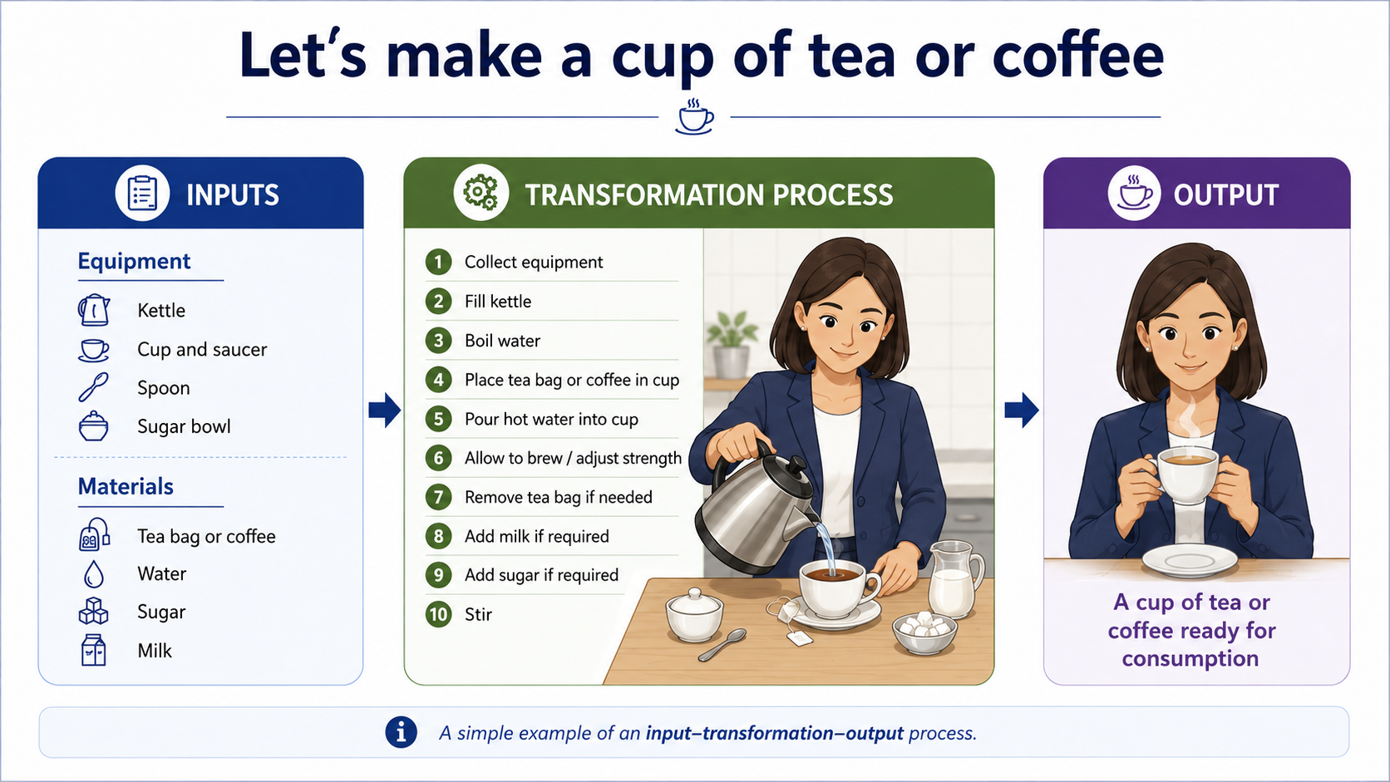
Let’s make a cup of tea or coffee!

Slide 11

How to Play
Work in groups of 5, using one device.
Scan the QR code to open the game.
Select the resources needed and arrange the coffee-making steps.
Predict and compare the time to make one cup versus ten cups. Try different coffees and preparation methods.

Slide 12
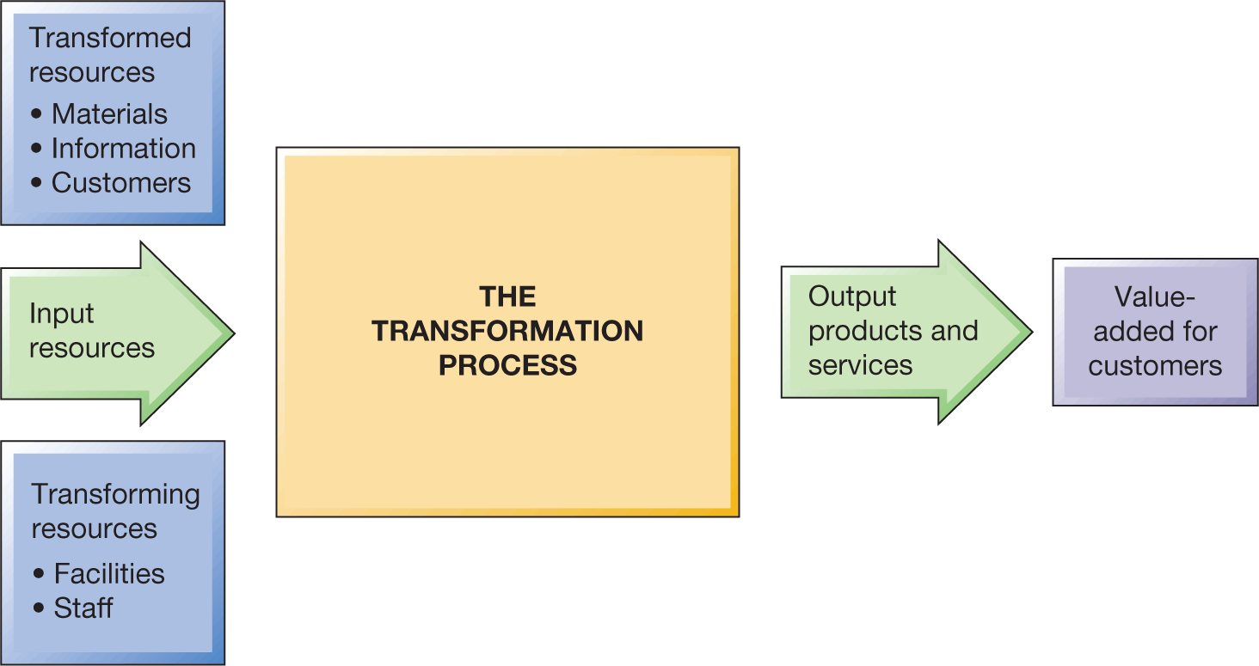
Let’s make a cup of tea/coffee!

Slide 13
What is Operations Management?
Operations are the processes by which
      people, capital and materials (inputs) are combined
      to produce the services and goods we consume (outputs).
Operations employ labour and management (people) and use facilities and equipment (capital) to change materials into finished goods (e.g. Farm tractors) or to provide services (e.g. Computer software development).
“Operations Management is the activity of managing the resources that create and deliver services and products to consumers ”.
Slack, N., Brandon-Jones, L., and Johnson, R. (2019). Operations Management, 9e, Pearson, p5

Slide 14
Three Es
Efficiency: Doing things right, producing the least waste, a ratio of useful work done by a machine, system or organisation.
Effectiveness: Doing the right things, making the right things for customers.
Economy: Careful use of money and resources to avoid unnecessary expenditure or waste. Thrift. Watching costs and reducing costs.

Slide 15
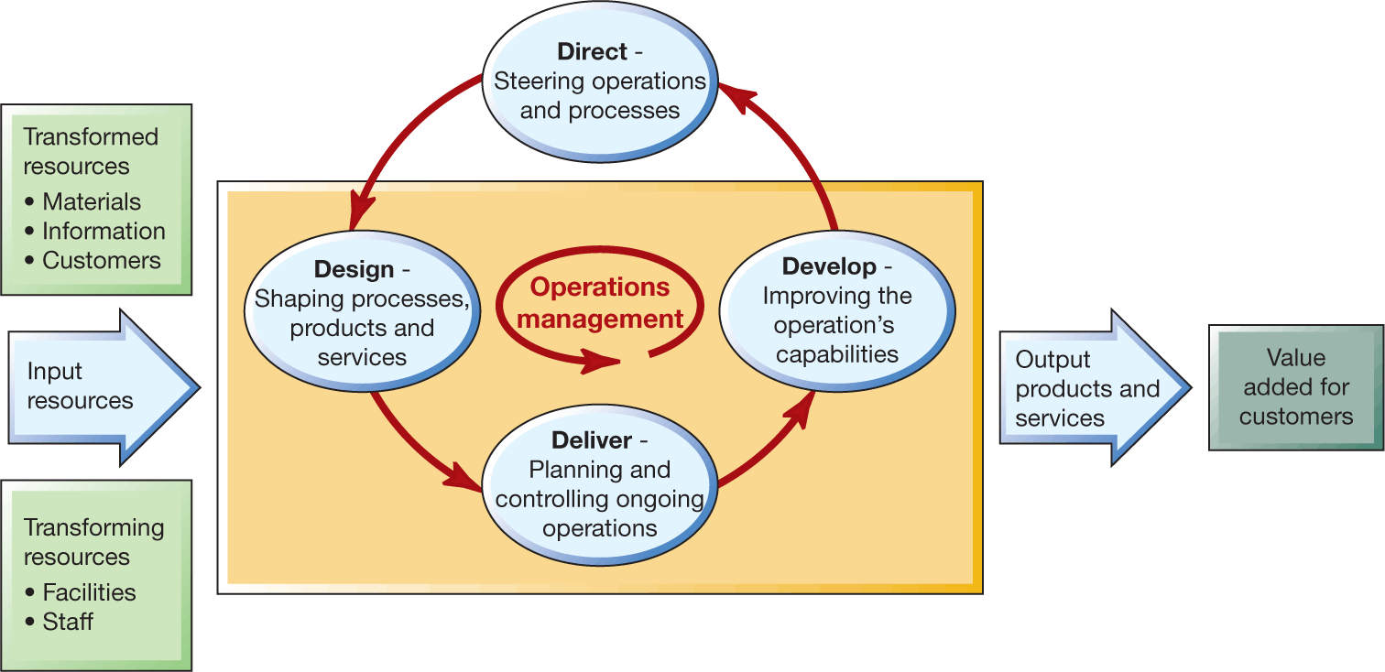
What do operations managers do?

Slide 16

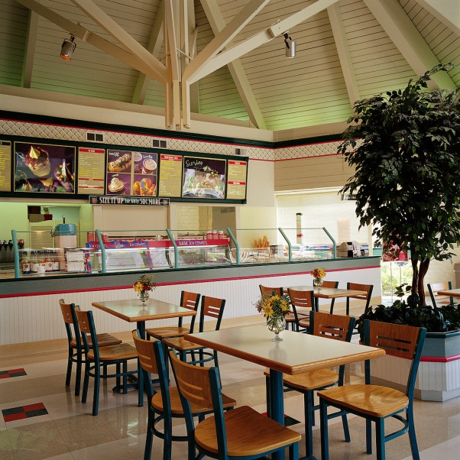


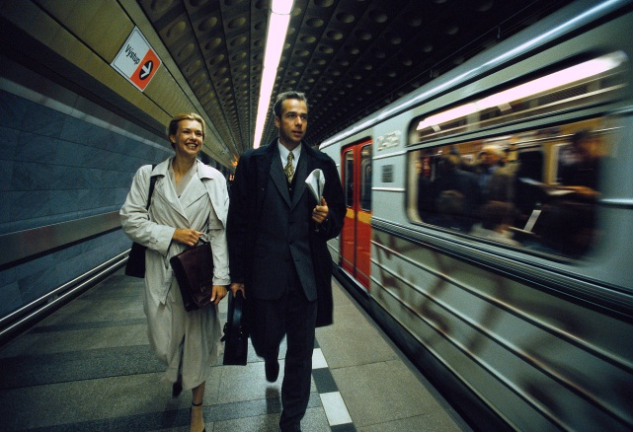
All organisations have ‘operations’ that produce mix of services and goods
Competitive position is a management outcome

Slide 17
Operations as a transformation process
Operation | Inputs | Processes | Outputs
Supermarkets | Goods for sale Staff Customers Shelf Fridge Check out systems | Display goods Provide sales advice Sell goods | Customers and goods ‘assembled’ together
Frozen food manufacturer | Fresh food Operators Processing technology Cold storage facilities | Source raw materials Prepare food Freeze food Pack and freeze food | Frozen food

Slide 18
Operations Management in Action
Watch the Speedee video
Concept of McDonalds - The Speedee system – YouTube
Identify Inputs → What happens? → Outputs
What is the main transformation process you observed?

Slide 19
Operations Strategy
The specific decisions and actions that shape the long-term vision, objectives and capabilities of the operation and its contribution to the overall strategy of the business.”
How an organisation designs and manages its operations so that they support the wider goals of the business.
  Implementing business strategy
  Supporting business strategy
  Driving business strategy
Slack, N., Brandon-Jones, L., and Johnson, R. (2019). Operations Management, 9e, Pearson, p5

Slide 20
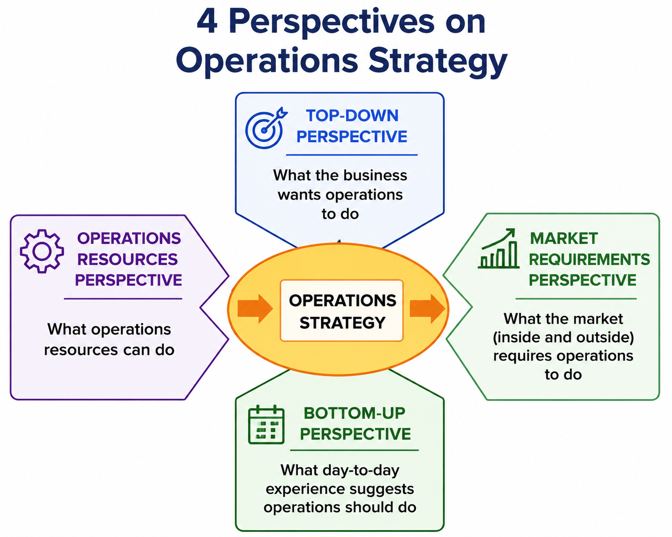
Operations Strategy
Slack, N., Brandon-Jones, L., and Johnson, R. (2019). Operations Management, 9e, Pearson, p5

Slide 21
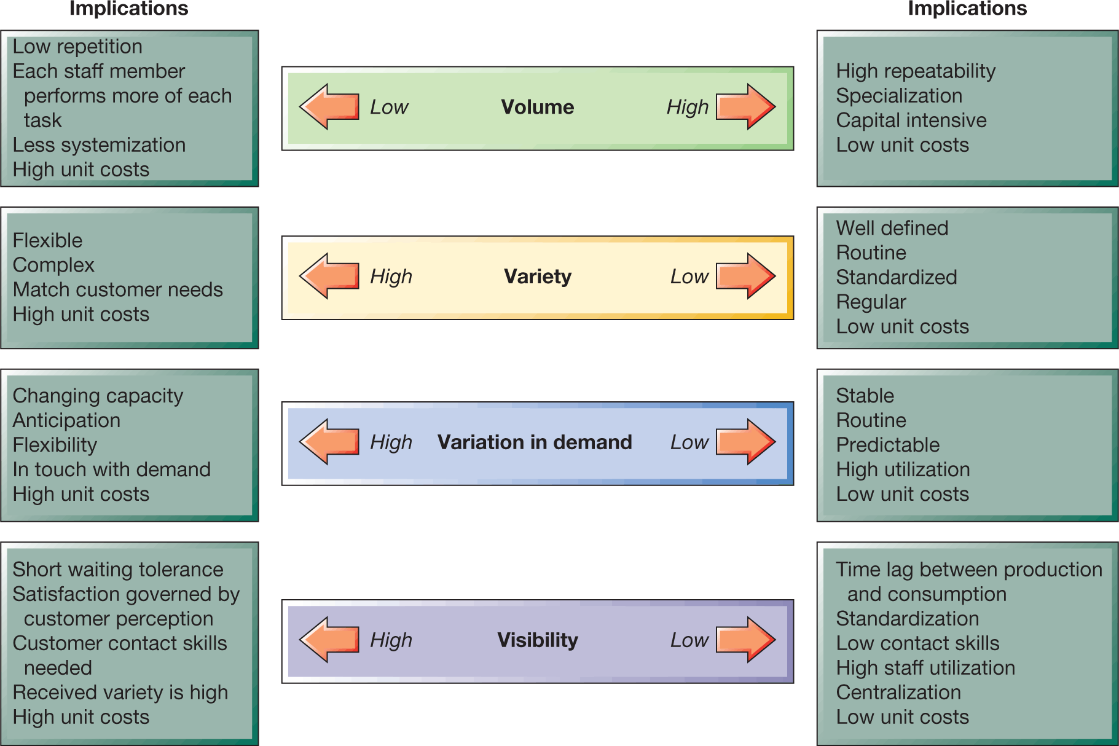
4 Vs of Operations Management

Slide 22
4 Vs of Operations Management
Complete the 4Vs challenge.
Screenshot your results and prepare one key observation to share.
How would making coffee at home differ from running a busy campus coffee shop across 4 V’s?

Slide 23
Performance Objectives
Performance objectives describe what good performance looks like.
It asks the question:
“What does this operation need to be good at?
‘Performance’ is not a straightforward concept
A single measure can never fully communicate the success

Slide 24
Performance Objectives
Performance objective | Simple meaning | Company example | Why?
Quality | Do things right | BMW | Consistent engineering, safety, reliability and finish
Speed | Do things fast | Amazon | Fast order processing and delivery
Dependability | Do things on time, as promised | British Airways | Customers expect flights and baggage to operate as scheduled
Flexibility | Respond to change | Zara | Responds quickly to changing fashion demand and product mix
Cost | Do things efficiently | Aldi | Limited product range, efficient stores, private-label focus and lean operating model help keep costs low
Sustainability | Do things responsibly | IKEA | Focus on materials, sourcing, waste, energy and circularity

Slide 25
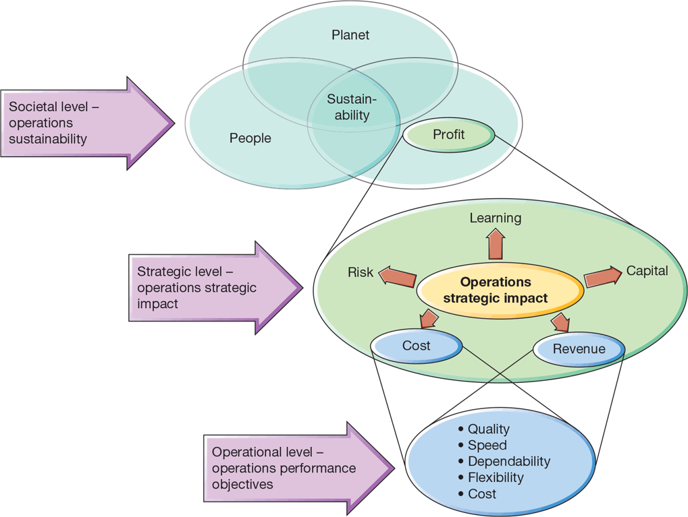
Performance objectives occurs at different interdependent levels

Slide 26
Interdependency between 4Vs and Performance Objectives
Example Starbucks.
        Its 4Vs might be:
      high volume;
      high variety;
      high variation in demand across the day;
      high visibility because customers directly experience the service.
These characteristics influence how Starbucks designs staffing, layout, processes and technology.
But its performance objectives might be:
Quality — high-quality coffee, consistent taste;
Speed — short waiting time;
Dependability — order ready when expected;
Flexibility — customise drinks;
Cost — operate efficiently;
Sustainability — responsible sourcing, waste reduction.

Slide 27
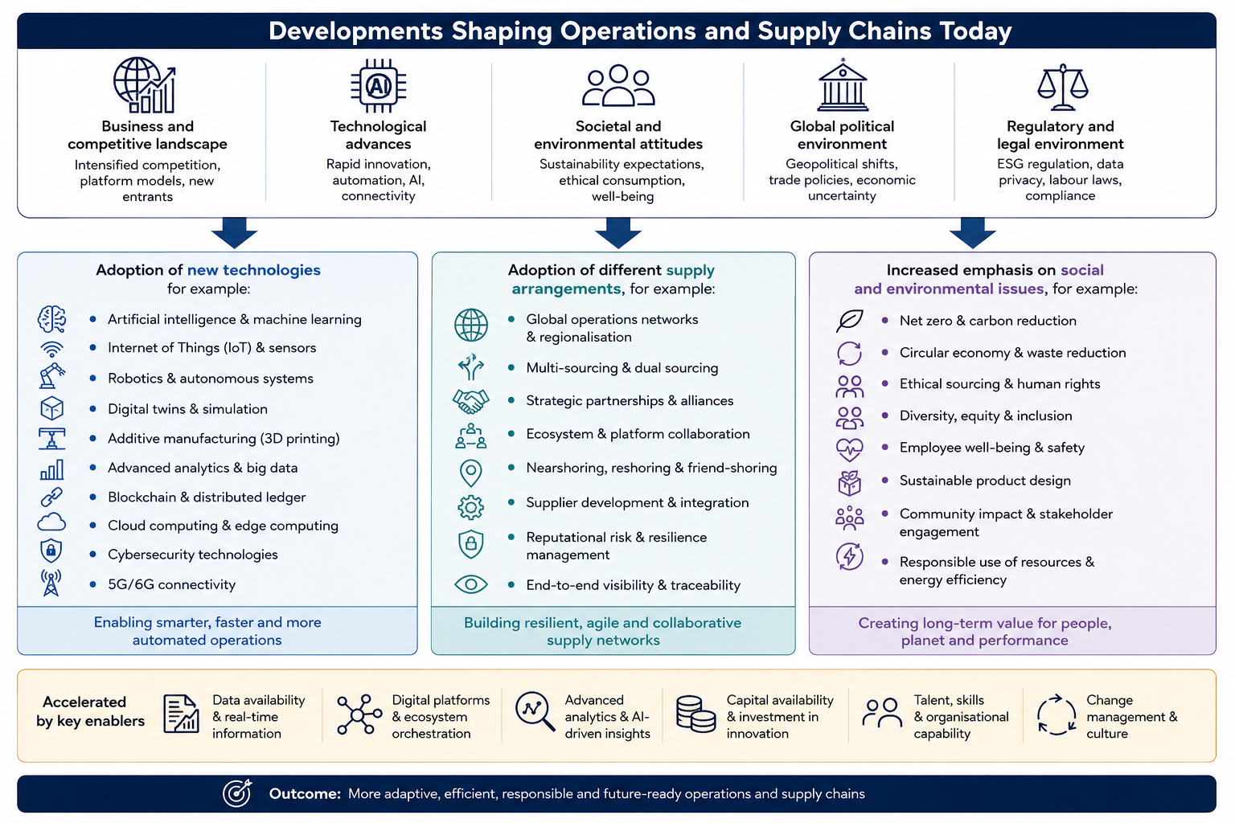
How do we measure operations?

Slide 28
Operations in Practice: Capacity and Flow in Action
Walk through a single of businesses and examine how they manage capacity and customer/product flow. For example, a coffee shop, a supermarket, a restaurant, a bank, fast-food outlet or retail store. During your visit, observe the operation and answer:
Concept | What you should observe
Design capacity | What do you think is the maximum number of customers/orders the operation could handle? Look at the number of tills, tables, service counters, machines, staff or checkout points.
Utilisation | How much of the available capacity appears to be in use? Are tills, self-check-out, tables, staff or machines busy or idle? Can you observe wasted time?
WIP | What is waiting to be processed? This could be customers in a queue, orders awaiting preparation, baskets at checkouts or products awaiting replenishment.
Throughput | Approximately how many customers/orders/products are completed in within a 10 minutes period?
Flow time | Approximately how long does one customer/order take from entering the process to completion?

Slide 29
www.sheffield.ac.uk

