Slide 1
Operations and Supply Chain Management
MGT6046
Capacity Utilisation and Little’s Law
Dr Emilia Vann Yaroson

Slide 2

Operations in Practice
Last week’s task
You walked through one business, such as a coffee shop, supermarket, restaurant, bank, fast-food outlet or retail store.
You observed how it manages capacity and the flow of customers or products.
Today: we pool what you saw on Wooclap and link it to capacity, utilisation and Little’s Law.
Scan to join
Join on Wooclap: scan the QR code, or go to wooclap.com and enter code RMTTOMX
Join this Wooclap event - Wooclap

Slide 3
Your Exam: What to Expect
3 hours
In person, pen and paper
4 of 5
Questions to answer
25 marks
Each question, 100 in total
Closed book
No notes or textbooks
Bring
University-approved calculator (required)
Pens, pencil, ruler and eraser
Your UCard
Optional: approved Chinese–English paper dictionary
Provided
Formula sheet, attached to the paper
Graph paper
Answer booklets
A4 paper
On the day
Spend about 45 minutes per question
Show every step of your workings
Label diagrams and axes clearly
Apply your answers to the scenario
Tutorials: all 5 tutorial sessions are dedicated to working on exam-related questions.
No phones or electronic devices. Full details are in the Exam Brief in the Assessment information area on Blackboard.

Slide 4
Learning Outcomes
By the end of the session, students should be able to:
Distinguish between design capacity and effective capacity and explain how operational constraints affect available capacity.
2. Calculate and interpret utilisation and efficiency to assess how effectively operational resources are being used.
3. Analyse process flow using WIP, throughput and flow time, and apply Little’s Law to operational problems.
4. Evaluate demand–capacity relationships and identify the operational implications of under-capacity, balanced capacity and over-capacity situations.

Slide 5
Performance Objectives
Performance objective | Simple meaning
Quality | Do things right
Speed | Do things fast
Dependability | Do things on time, as promised
Flexibility | Respond to change
Cost | Do things efficiently
Sustainability | Do things responsibly

Slide 6
Operational Measures
Operational measures are the specific indicators used to monitor how well an operation is actually performing.
Performance objectives tell us what matters. Operational measures tell us what to measure.

Slide 7
Operational Measures
Indicators | What it measures
Capacity | Maximum or available output the operation can handle
Utilisation | How much of available capacity is being used
Efficiency | How effectively resources are converted into output
Throughput | How much output is completed in each period
Work-in-progress (WIP) | How much is currently waiting or being processed
Flow time | How long an item/customer/order spends in the process
Productivity | Output produced relative to inputs used
Inventory turnover | How quickly inventory moves through the operation
Service level | How reliably customer demand is met
Queue / waiting time | How long customers or jobs wait before service
Defect/error rate | How often the operation gets things wrong
On-time delivery | How reliably promises are met
Cost per unit | Cost of producing or delivering one unit
Energy use / waste | Resource and sustainability performance

Slide 8
Examples
Performance objective | Examples of operational performance measures
Quality | Defect rate, error rate, customer complaints, returns, first-pass yield
Speed | Lead time, delivery time, processing time, waiting time
Dependability | On-time delivery %, schedule adherence, order fulfilment reliability
Flexibility | Changeover time, response time to demand changes, product mix flexibility
Cost | Cost per unit, labour cost, inventory cost, operating cost
Sustainability | Energy use, carbon emissions, waste, recycling rate, water use

Slide 9
Capacity
The theoretical maximum rate an operations can produce/deliver within a given period under normal working conditions.
The maximum amount of a product that can be made within a specified time (Waters, 1996; Collier and Evans, 2013).
              For example, if a café can make 100 cups of coffee per hour, its capacity is 100 cups per hour. If it actually makes 70 cups, that is its actual output.
          Capacity is conditional. It depends on resources such as staff, equipment, space and available working time, product mix and operating assumptions.
          The key question is: “How much can this operation produce or deliver in a given time?

Slide 10
Capacity in real life settings
Real-life setting | What “capacity” means | Typical capacity decision
Hospital | Beds, operating theatres, doctors/nurses, appointments | How many patients can be treated without excessive waiting?
Hotel | Rooms + housekeeping capacity | How many rooms can be made ready for arriving guests?
Airport | Runway slots, gates, terminal throughput | How many aircraft/passengers can be handled per hour?
Call centre | Number of agents and calls handled | How many staff are needed to meet service targets?

Slide 11
Capacity in real life settings
Real-life setting | What “capacity” means | Typical capacity decision
Factory | Machine hours, labour, production lines | How many units can be produced per day/week?
Restaurant | Tables, kitchen stations, staff | How many customers/orders can be served during peak periods?
Amazon fulfilment centre | Picking, packing, storage and labour capacity | How much order volume can be processed during demand peaks?
University | Teaching rooms, staff, lab places | How many students can be accommodated without reducing service quality?
Airline | Aircraft seats and flight frequency | How much seat capacity should be offered on a route?
Supermarket | Checkout lanes, shelf/storage space, staff | How much customer demand can the store process at peak time?

Slide 12
Concepts in Capacity
Design Capacity: the capacity of a process as it is designed to operate.
Downtime: the period when a resource that should be available for work is not operating.
              For example:
                A machine breaks down for 2 hours → 2 hours of downtime
                A production line stops for maintenance → production downtime
                A computer system is unavailable → IT downtime
                A hotel room cannot be sold because it is being repaired → room downtime
                A checkout is closed because no staff member is available → capacity downtime

Slide 13
Measuring Capacity
Planned Downtime or Unavoidable Lost time could be:
Regular maintenance, other planned stoppages and loading.
Product changeovers (set-ups).
No work scheduled
Quality sampling checks
Shift change times
Unplanned Downtime or Avoidable Lost time could be:
Breakdown repair and maintenance
Quality failure investigation
Raw material stock out
Waiting for partially processed products from another machine
Labour shortages (e.g. absenteeism, sickness, other health-related issues such as doctor visits; dental appointments etc.)

Slide 14
Measuring Capacity
Effective capacity: realistic capacity after allowing for things like downtime, maintenance, breaks and changeovers.
Effective capacity
What the operation can realistically produce
=
Design capacity − Planned downtime
Planned downtime is lost time you schedule in advance: maintenance, changeovers, breaks, quality checks and shift changes.

Slide 15
Measuring Capacity
Achieved capacity
What is actually produced
=
Effective capacity − Avoidable downtime
Utilisation
Share of the theoretical maximum that is used
=
Achieved capacity
× 100%
Design capacity
Efficiency
Performance against what is realistically possible
=
Achieved capacity
× 100%
Effective capacity

Slide 16
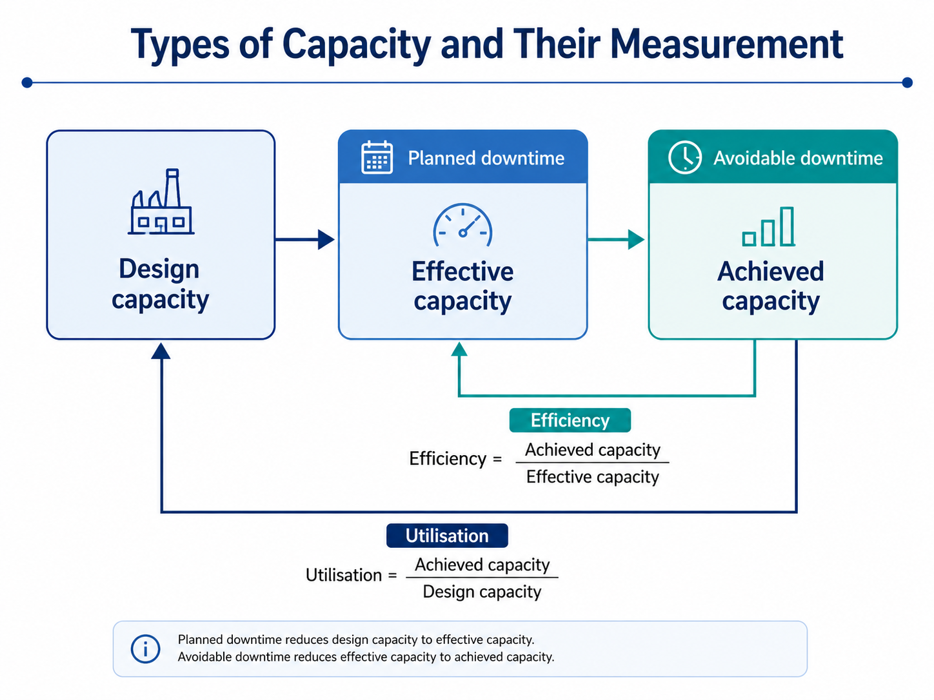

Slide 17
Measuring Capacity: Example
A factory has a design capacity of 1,000 units per day. Planned downtime reduces its daily output capacity by 150 units, while avoidable downtime causes a further loss of 300 units per day.
Calculate the factory’s:
Effective capacity.
Achieved capacity (actual output).
Capacity utilisation (%).
Efficiency (%).

Slide 18
Solution: Capacity Measures
Given: design capacity 1,000 units per day • planned losses 150 units • avoidable losses 300 units
Design capacity
1,000
Starting point
−150 planned
1. Effective capacity
850
1,000 − 150
−300 avoidable
2. Achieved capacity
550
850 − 300
3. Capacity utilisation
Achieved capacity ÷ design capacity × 100
550 ÷ 1,000 × 100 = 55%
4. Efficiency
Achieved capacity ÷ effective capacity × 100
550 ÷ 850 × 100 = 64.7%
What it means: the operation loses 45% of its design capacity. Avoidable losses (300) are twice the planned ones (150), so cutting breakdowns and other avoidable downtime is the biggest opportunity.

Slide 19
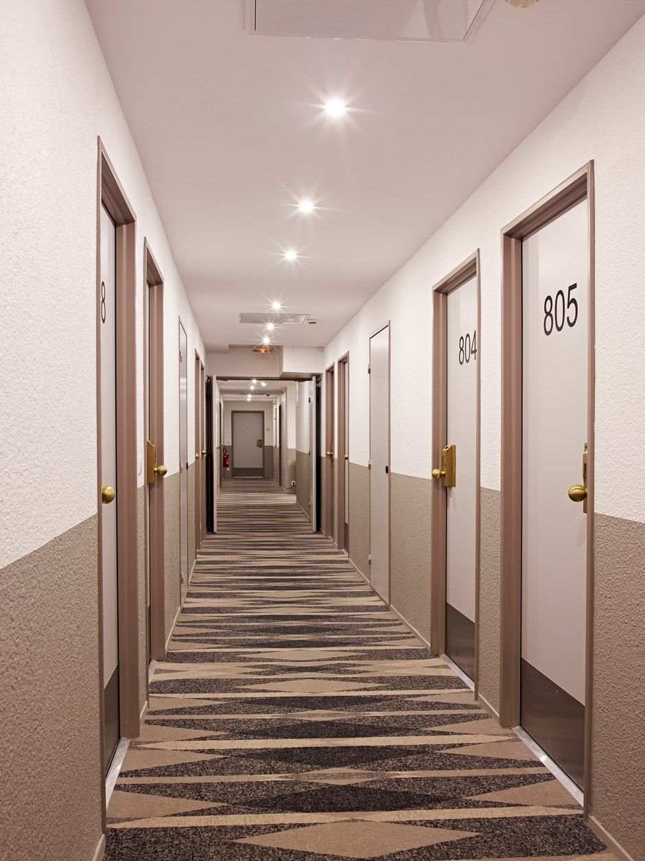
Class Activity
A hotel has 400 rooms. Only 340 rooms can be cleaned and made ready before check-in because of staffing constraints.
        What is the design capacity?
        What is the effective capacity?
        What is constraining the operation?
        If the hotel hires more cleaners, does its design capacity change?

Slide 20
Solution: Hotel Capacity
Given: 400 rooms • only 340 can be cleaned and made ready before check-in
1. Design capacity
400 rooms per night
The number of rooms the hotel was built to offer.
2. Effective capacity
340 rooms per night
The rooms that can realistically be prepared and sold. 60 rooms (15%) are lost every night.
3. What is the constraint?
Housekeeping
The bottleneck is cleaning staff, not rooms. Turnaround time limits how many rooms are ready by check-in.
4. Hire more cleaners?
Design capacity: no change
It stays at 400, because no rooms are added. Effective capacity rises towards 400 until another constraint appears.
Key idea: adding resources at the bottleneck raises effective capacity; only physical expansion raises design capacity.

Slide 21
ATTENDANCE
KL-MB-ON

Slide 22
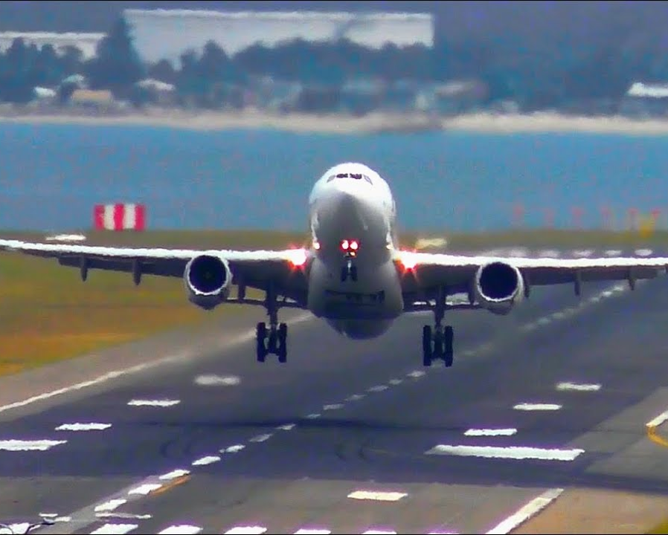
Class Activity
An airport runway capacity varies over a given day.
8–9am: 35 flights
9–10am: 48 flights
10–11am: 62 flights
11–12pm: 44 flights
Airport runway design capacity = 50 flights per hour.
“At what point does demand exceed capacity?”
“What operational consequences would you expect?”

Slide 23
Solution: Runway Capacity
Flights demanded per hour vs design capacity (50)
When does demand exceed capacity?
10–11am: 62 flights vs 50, so 12 too many (124%). At 96%, 9–10am is already close to the limit.
8–9am
35 (70%)
9–10am
48 (96%)
Knock-on effect: the 12-flight backlog spills into 11–12pm: 44 + 12 = 56, still over capacity.
10–11am
62 (124%)
11–12pm
44 (88%)
Operational consequences
Holding patterns and taxi queues
Delays and missed connections
Crew hours, fuel and slot penalties
Gate and terminal congestion
Capacity 50
Key idea: total demand is 189 flights against 200 of capacity over four hours. The problem is timing, not total capacity, so smooth demand by moving flights into 8–9am.

Slide 24
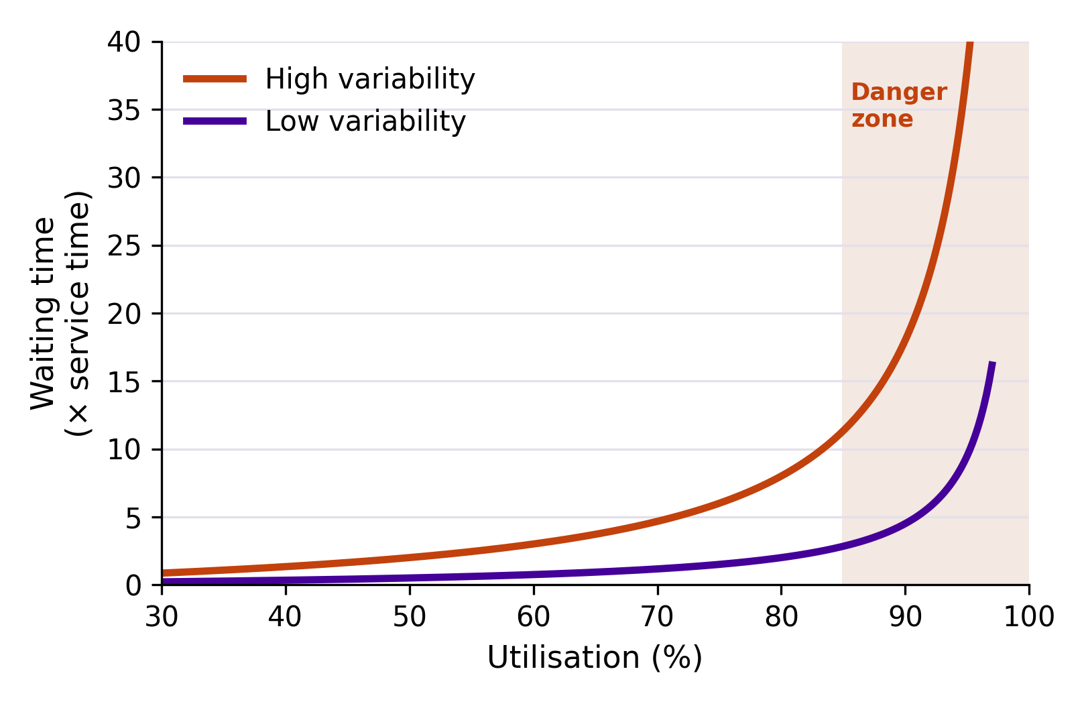
Why Not Run at 100%?
Kingman (1961)
Waiting time ≈ V × U × T
V = variability of arrivals and service, U = u ÷ (1 − u), T = service time
Wait when V = 1
80% busy: 4× service time
90% busy: 9× service time
95% busy: 19× service time
Going from 90% to 95% busy roughly doubles the wait. Variability makes every point worse.
Different theoretical arguments about capacity in the literature try to explain how capacity affects flow, waiting times and investment decisions

Slide 25
Theory Behind Spare Capacity
Heavy-traffic queueing Kingman (1961)
Near 100% utilisation, waiting time rises sharply, especially when arrivals or processing times vary.
For managers: Set utilisation targets by variability: a stable production line can run hotter than an A&E department.
Buffering Hopp & Spearman (2004)
Variability must be absorbed by something: inventory, waiting time or spare capacity.
For managers: “Unused” capacity is a buffer that buys responsiveness. Cut it and the cost moves into queues or stock.
Bottlenecks and congestion Spearman (1991)
Line performance depends on the bottleneck rate, raw processing time and congestion across the whole system.
For managers: Assess capacity at system level. Extra capacity away from the bottleneck adds cost, not output.
Investment under uncertainty Van Mieghem (2003)
Capacity decisions cover size, type (dedicated or flexible) and timing when demand is uncertain.
For managers: Some excess or flexible capacity works as a hedge against demand risk, much like insurance.
Discuss: If capacity is costly, why might an organisation deliberately operate below 100% utilisation?

Slide 26
Utilisation of Capacity
Utilisation measures the proportion of available capacity that is actually used (Waters, 1996). Multiply by 100 for a percentage.
Machine utilisation
Equipment: share of the designed output achieved
=
Achieved capacity
Design capacity
Resource utilisation
Staff, rooms, seats or vehicles in use
=
Resources used
Resources available
Demand utilisation
Service systems: how busy the servers are
=
Demand rate
Service rate × Number of servers

Slide 27
Worked Example: Utilisation
At an Amazon fulfilment centre, customer orders arrive at a packing station at 120 orders per hour. The station has three packers, each of whom can pack 50 orders per hour.
Demand rate
120 orders per hour
Number of servers
3 packers
Service rate
50 orders per hour each
a
What is the utilisation of the packers?
b
What service rate would be needed for a target utilisation of 85%?

Slide 28
Solution: Utilisation
(a) Utilisation of the packers
Formula: U = Demand rate ÷ (Service rate × Number of servers)
Substitute: U = 120 ÷ (50 × 3) = 120 ÷ 150
Result: U = 0.80, or 80%
20% of packer time is spare capacity, a buffer for order surges such as Prime Day.
(b) Service rate for 85% utilisation
Set up: 0.85 = 120 ÷ (Service rate × 3)
Rearrange: Service rate = 120 ÷ (0.85 × 3) = 120 ÷ 2.55
Result: about 47 orders per hour per packer
Each packer could work at about 47 orders an hour, a slightly slower pace with fewer packing errors, and the station would still keep up.
Why aim for 85%, not 100%? The spare 15% absorbs variability in order arrivals and packing times, so queues stay short (see “Why Not Run at 100%?”).

Slide 29
Little’s Law
Capacity tells us how much an operation can process.
WIP = R × T
1
When demand approaches capacity, work accumulates, queues grow and flow time increases.
WIP work-in-progress: customers or items inside the system
R throughput rate: units completed per unit of time
T flow time: time from entering to leaving
2
Little’s Law shows what happens inside the system: it links what is inside to how fast it flows.
3
Keep units consistent: if R is per minute, T must be in minutes.

Slide 30
Little’s Law: Flow Time (T)
Flow time (T) is the total time a customer, order, product or job spends inside a process, from entry to completion.
T = Processing time + Waiting time
Example: a coffee shop
Joins queue
Waits
Orders
Drink prepared
Receives drink
Your turn: a customer enters at 10:00 and receives the drink at 10:08. What is the flow time?

Slide 31
Little’s Law: Throughput (R)
Throughput (R) is the number of units an operation completes per unit of time: its rate of output. Units can be customers, products or jobs.
Example: a coffee shop
The baristas complete 30 drinks in 10 minutes.
R = 30 ÷ 10
R = 3 drinks per minute
R is a rate. Always state the time unit: per minute, per hour or per week.
Throughput vs capacity: R is what the operation actually completes. It can never be higher than the capacity of the bottleneck.

Slide 32
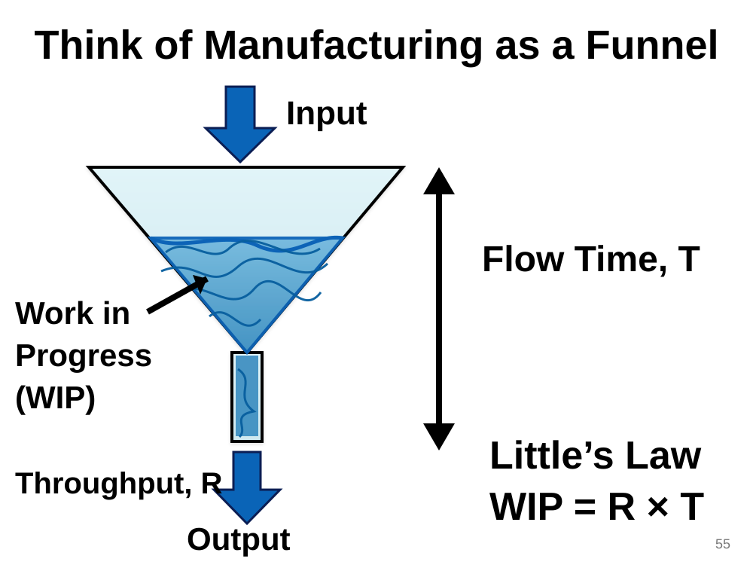
Work-in-Progress (WIP)
WIP is everything that has entered the process but not yet left: customers in the shop, orders in progress, parts on the line.
WIP = R × T
Coffee shop, putting it together
R = 3 drinks per minute, T = 8 minutes
WIP = 3 × 8 = 24 customers inside

Slide 33
Alternative Formulas
Key terms: throughput time = flow time (T). Cycle time = time between successive outputs, which is 1 ÷ R.
How long an item spends in the process
Throughput time = WIP × Cycle time
How many items are inside the process
WIP = Throughput time ÷ Cycle time
How often an item must leave the process
Cycle time = Throughput time ÷ WIP
How many staff or machines keep pace with demand
Servers required = Work content ÷ Cycle time

Slide 34
Worked Example: Little’s Law
Question
A restaurant makes 400 pieces of bread per week. Each uses 0.5 kg of dough, and it typically holds 70 kg of dough in stock.
Using Little’s Law, what is the average flow time of the dough?
Solution
1. Throughput: R = 400 × 0.5 kg = 200 kg per week
2. WIP: 70 kg of dough in stock
3. Rearrange WIP = R × T: T = WIP ÷ R = 70 ÷ 200 = 0.35 weeks
4. Convert: 0.35 × 7 days ≈ 2.5 days
So what? Dough waits about 2½ days before use, so it is not very fresh. Holding only 30 kg would cut flow time to about 1 day.

Slide 35
Productivity & Service Failure in Practice
Visit two different service businesses and observe each for 10–15 minutes. Examples: coffee shop, supermarket, restaurant, pharmacy or fast-food outlet.
Compare them using these questions:
Which business appears more productive, and which manages service failure better? Give evidence from your observations.
Area | What to observe
Productivity | Which business appears to produce more output with the resources available? Why?
Resource use | Are staff, equipment and space being used effectively?
Process waste | Where do you see waiting, unnecessary movement, duplication or rework?
Service failure | What could go wrong, or what did you observe going wrong?
Service recovery | How did/would the business respond to the failure?

Slide 36
References
Hasija, S., Pinker, E.J. & Shumsky, R.A. (2010), “Work Expands to Fill the Time Available: Capacity Estimation and Staffing Under Parkinson’s Law,” Manufacturing & Service Operations Management, 12(1), 1–18.
Kurz, J., 2016. Capacity planning for a maintenance service provider with advanced information. European journal of operational research, 251(2), pp.466-477.
Li, B. & Slaugh, V.W. (2026), “Capacity Planning for Resource Turnaround Operations,” Manufacturing & Service Operations Management, 28(2), 440–458.
Sinha, A.K. & Krishnamurthy, A. (2020), “Production and Capacity Utilization Strategies in Supply Chains for Complex Engineered Products,” Production and Operations Management, 29, 462–480.

