Slide 1
Operations and Supply Chain Management
MGT6046
Designing Operations: Theory of Constraints, Line Balancing and Process Technology
Dr Emilia Vann Yaroson

Slide 2


Join the Session on Wooclap
1
Scan the QR code
Point your phone camera at the code on the left.
2
Or go to app.wooclap.com
and enter the event code:
CITLFMY
3
Keep it open
We will use Wooclap for questions and activities throughout the session.
Scan with your phone camera
4

Slide 3

Module Outline
Wk | Starts | 4D | Lecture | Tutorial
1 | 28 Sep 2026 | Develop | Operations and Supply Chain Management Foundations Operations strategy, performance objectives, interdependencies and customer value. | No tutorial
2 | 5 Oct 2026 | Develop | Capacity, Utilisation, Efficiency and Little’s Law Design and effective capacity, utilisation, efficiency, WIP, throughput, flow time and demand–capacity relationships. | No tutorial
3 | 12 Oct 2026 | Design | Productivity, Throughput and Service Failure Analysis Productivity, throughput efficiency, waiting, delays, capacity–demand mismatch and service failure, using operational and ERP data. | Tutorial 1: applying Week 2 (capacity, utilisation, efficiency, Little’s Law, WIP, servers, strategy)
4 | 19 Oct 2026 | Design | Designing Operations: Theory of Constraints, Line Balancing, ERP and Digitalisation Bottlenecks, cycle time, line balancing, ERP, automation, AI, IoT and real-time visibility. | No tutorial
5 | 26 Oct 2026 | Delivering operations | Supply Chain Management Disruptions, resilience and sustainability. | Tutorial 2: applying Week 4 (TOC, bottlenecks, idle time, balancing loss, productivity)
6 | 2 Nov 2026 | Deliver | Make-or-Buy Decisions and Break-even Analysis | No tutorial
2

Slide 4
Learning Outcomes
By the end of the session, students should be able to:
Identify and analyse bottlenecks using the Theory of Constraints, its five focusing steps and drum–buffer–rope, and explain how constraints affect throughput.
Calculate and interpret cycle time, idle time and balancing loss to assess and improve process design.
Explain how operations technology has developed from MRP and ERP to today’s digital technologies, and how each can help identify, exploit and elevate constraints.
Assess emerging process technologies (big data, digital twins, agentic AI, blockchain, quantum computing, the metaverse) and evaluate technology choices using fit, performance objectives and NPV.

Slide 5






Productivity Gap
The difference between actual productivity and a target or benchmark.
WHAT DOES IT SHOW?
WHY IT MATTERS IN OPERATIONS
How much more output an operation could produce from the same resources.
Identify improvement opportunities
Investigate delays, bottlenecks and rework.
Reduce the cost per unit
Produce more with the same resources.
Coffee shop example
Actual: 30 drinks per labour-hour
Benchmark: 40 drinks per labour-hour
Guide resource decisions
Assess changes to processes, training or technology.
Gap = 10 drinks per labour-hour
= 10 ÷ 40 = 25% below the benchmark
Track improvement
Check whether changes close the gap.
Compare similar work and service standards. Productivity improvements must maintain quality.
5

Slide 6
Key Definitions: Productivity and Gap Analysis
Term | Definition | Formula
Productivity | Output achieved per unit of input (e.g. per labour-hour) | Productivity = Output ÷ Input
Productivity gap | How far actual productivity falls below the target | Gap = Target − Actual Gap % = (Target − Actual) ÷ Target × 100
Importance score | How much customers value a factor (1–9, where 9 = most important) | Measured by asking customers
Performance score | How well the operation performs on that factor (1–9, where 9 = best) | Measured against targets or competitors
Importance–performance gap | The shortfall on the things customers value | IP gap = Importance − Performance
Large positive gap
Priority for improvement (urgent action)
Gap near zero
Appropriate: maintain
Negative gap
Excess? Resources may be better used elsewhere
Source: Productivity: Week 3. Importance–performance: Slack, N., Brandon-Jones, A. and Johnston, R. (2013) Operations Management, 7th edn. Harlow: Pearson, ch. 20 (Slack’s 9-point scales run the other way, with 1 = best; here 9 = high for simplicity)
6

Slide 7

A Story Before the Analysis: Amazon at Peak Season
WORKED EXAMPLE 1A
“I pay for Prime so it arrives tomorrow. That’s the whole point.”
Fast delivery
A UK Amazon fulfilment centre before Christmas
Amazon Prime members pay for fast, reliable delivery. For many, “arriving tomorrow” is the reason they buy from Amazon rather than elsewhere.
Imagine a fulfilment centre in the run-up to Christmas. Products are genuine and correctly picked, so returns for wrong or faulty items are low. The site has also invested in new branded boxes and printed tape.
But order volumes have doubled. Parcels queue at the packing stations, and a growing share of Prime orders miss their promised delivery day. Some customers start shopping elsewhere.
“Right item, exactly as described. No complaints there.”
Order accuracy and quality
“The box is nice, but I just open it and recycle it.”
Packaging appearance
Before we analyse: what do Amazon’s Prime customers value most, how well is this site performing on it, and what should managers fix first?
Source: Illustrative scenario built on Amazon’s Prime delivery promise; customer remarks are illustrative, not real reviews or company data
7

Slide 8

Measuring the Importance–Performance Gap
WORKED EXAMPLE 1A
1 List the factors
What customers care about
2 Score importance
Customer survey, 1–9
3 Score performance
Operational evidence, 1–9
4 Calculate the gap
Importance − Performance
5 Plot and prioritise
Biggest positive gap first
Applied to the Amazon fulfilment centre at peak (illustrative figures):
Factor | Importance (survey) | Evidence of performance | Performance | Gap | Priority
Fast (Prime) delivery | 9 | Only 80% of Prime orders on time, against a 98% promise | 3 | +6 | Urgent action
Order accuracy and quality | 8 | Wrong or faulty item returns 0.5%, better than a 1% target | 8 | 0 | Maintain
Packaging appearance | 3 | Packaging rated 4.8 out of 5 by customers | 9 | −6 | Excess?
Scale: 9 = most important / best performance; 1 = least important / worst.
Result: fast delivery has the largest positive gap (+6), so it goes into the “urgent action” zone on the matrix (next slide).
Source: Illustrative figures, not Amazon data. Method after Slack, N., Brandon-Jones, A. and Johnston, R. (2013) Operations Management, 7th edn. Harlow: Pearson, ch. 20, pp. 652–654
8

Slide 9

The Importance–Performance Gap
WORKED EXAMPLE 1A
The gap between how important something is to customers and how well the operation performs on it. It shows which performance problems deserve priority.
Importance–performance matrix
Performance factor | Importance to customers | Current performance | Implication
Fast (Prime) delivery | High | Poor at peak | Priority for improvement
Order accuracy and quality | High | Good | Maintain performance
Packaging appearance | Low | Excellent | Additional investment may have limited value
Importance
(low ↑ high)
Urgent action
Appropriate: maintain
Fast (Prime) delivery
Order accuracy and quality
Improve (less urgent)
Excess?
Packaging
Amazon at peak: fast delivery has the largest gap (9 − 3 = +6), so it is the priority.
Performance (poor → excellent)
Source: Slack, N., Brandon-Jones, A. and Johnston, R. (2013) Operations Management, 7th edn. Harlow: Pearson, ch. 20, pp. 652–654
9

Slide 10

The Morning Coffee Shop
WORKED EXAMPLE 1B
Monday, 7.45am, by Sheffield station
“My train’s at 8.05. I can’t wait 12 minutes for a flat white.”
— Commuter
A small coffee shop serves commuters on their way to work. Between 7.30 and 9.00am most customers have a train to catch: they want their coffee quickly, and they want it right.
Two people are on shift. The cashier takes orders in seconds. The barista makes every drink, takes payment, warms the food and labels each cup, and she is proud of her elaborate latte art.
By 8am the queue is out of the door. Customers wait around 12 minutes; some give up and walk to the chain café opposite. Orders are almost never wrong, but the shop serves only 30 drinks per labour-hour, against 40 at similar shops.
“They’ve never got my order wrong, to be fair.”
— Regular customer
“I’m taking orders much faster than she can make them.”
— Cashier
Before we analyse: what do these customers value most? Where is the work piling up? How could the shop serve more drinks with the same two people?
Source: Illustrative scenario
10

Slide 11
Morning Coffee Shop: Measuring the Gaps
WORKED EXAMPLE 1B
1 List the factors
2 Score importance
3 Score performance
4 Calculate the gaps
5 Prioritise
Importance–performance gap (illustrative scores, 1–9):
Factor | Importance (survey) | Evidence of performance | Performance | Gap | Priority
Speed of service | 9 | Average wait 12 minutes against a 3-minute target | 3 | +6 | Urgent action
Order accuracy | 8 | 99% of orders correct | 8 | 0 | Maintain
Elaborate latte art | 3 | Art on every drink, about 10 seconds each | 9 | −6 | Excess? Review time
Productivity gap:
Actual
60 drinks ÷ 2 labour-hours = 30 per labour-hour
Benchmark
40 per labour-hour at similar shops
Gap
40 − 30 = 10 (10 ÷ 40 = 25% below)
Result: speed has the largest gap (+6), and the shop produces 25% fewer drinks per labour-hour than the benchmark. Both point to the same problem.
Source: Illustrative figures. Method after Slack, N., Brandon-Jones, A. and Johnston, R. (2013) Operations Management, 7th edn. Harlow: Pearson, ch. 20
11

Slide 12
Morning Coffee Shop: Plotting the Gaps
WORKED EXAMPLE 1B
Productivity gap (drinks per labour-hour)
Importance–performance matrix
Gap = 10 per labour-hour (25%)
Importance
(low ↑ high)
Urgent action
Appropriate: maintain
40
Speed
Accuracy
30
Improve (less urgent)
Excess?
Latte art
Actual
Benchmark
Performance (poor → excellent)
Both gaps agree: speed is in the urgent-action zone and output per labour-hour is 25% short. Next question: why is the service slow?
Source: Illustrative figures
12

Slide 13

The Theory of Constraints
Developed by Dr Eliyahu M. Goldratt in the early 1980s to explain throughput problems (i.e. bottlenecks) in manufacturing operations.
Goldratt introduced the concepts in a bestselling novel called “The Goal”, published in 1984.
Developed as an alternative to capacity management — concerned with capacity constraints, bottlenecks, and how to make the flow of product through the factory smooth and continuous.
A key aim is to reduce work in progress (WIP).
A corollary: spending time optimising non-constraints will not provide significant benefits. Only improve constraint to achieve organisations goal (more profit through increased throughput).
Every process has a constraint (a bottleneck); focusing improvement efforts there is the quickest and most effective way to improve throughput, WIP, turnover and profitability.
Goldratt suggests concentrating on one goal.
“Every process has a single constraint, and total process throughput can only be improved when the constraint is improved.”
13

Slide 14
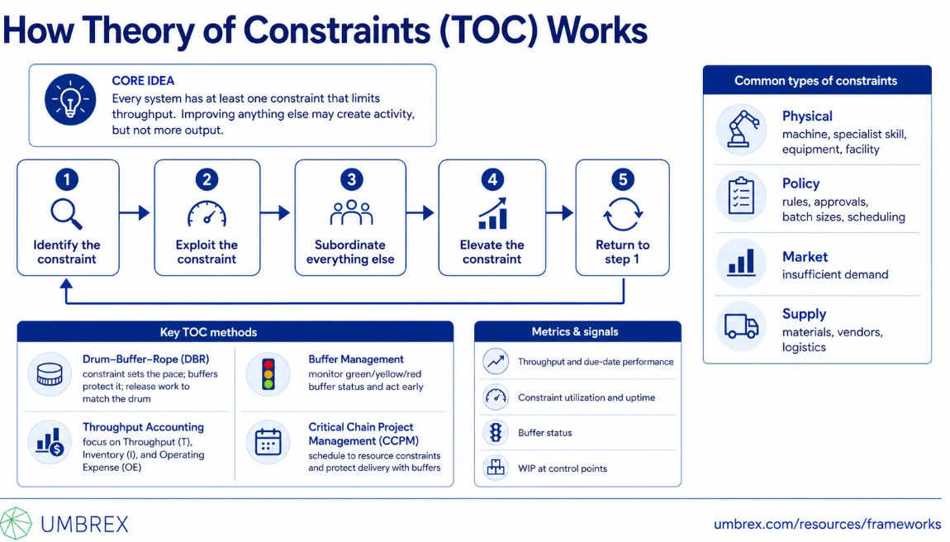
The Theory of Constraints
13

Slide 15
Principles of Management Using the Theory of Constraints
Non-Bottleneck Management Principles
Bottleneck Management Principles
Move jobs through non-bottleneck workstations as fast as possible until the job reaches the bottleneck.
Idle time is acceptable at non-bottleneck workstations if there is no work to do — utilisation may be low.
Use smaller order (lot/transfer batch) sizes at non-bottleneck workstations to keep work flowing to the bottleneck and eventually to the marketplace.
An hour lost at a non-bottleneck resource has no effect on total output and incurs no real cost.
Only bottleneck workstations are critical to process/factory objectives, and should be scheduled first.
An hour lost at a bottleneck resource is an hour lost for the entire process or factory output.
WIP buffer inventory should be placed in front of bottlenecks to maximise resource utilisation there.
Use large order sizes at bottleneck workstations to minimise setup time and maximise utilisation.
Bottleneck workstations should work at all times to maximise throughput and generate cash from sales.
14

Slide 16

What is Balancing Loss?
Balancing loss quantifies the lack of balance in a production line: time not used for productive purposes (total idle time) ÷ total time invested in making a product, expressed as a percentage.
It helps assess the most problematic parts of the design decisions in product layout: Line Balancing.
A perfectly balanced allocation of activities to workstations is nearly always impossible in practice — some imbalance results, leading to off-loading and on-loading of items on the line.
The effectiveness of line-balancing can be measured by balancing loss: the time wasted through unequal allocation of work.
The lower the balancing loss, the better the production line.
16

Slide 17

Cycle Time, Idle Time & the Balancing Loss Formula
Cycle Time – the average time between units of output emerging from a process; governed by the bottleneck.
Idle Time – when a machine is not processing an item and is waiting for work from the previous machine.
Number of Stages – the number of separate processes (e.g. machines) in the overall production process.
Idle Time on a stage = Bottleneck time − Processing time for that stage
Balancing Loss = Total Idle Time ÷ (Cycle Time × Number of Stages)
Total Idle Time for a process = ∑ (Idle Time on each stage)
17

Slide 18
Dealing with Bottlenecks
Any improvement at the current bottleneck is likely to cause a new, different bottleneck to appear elsewhere in the process.
General rules for dealing with bottlenecks:
(i) Invest in additional capacity at bottlenecks.
(ii) Slow the whole process down to the speed of the bottleneck.
(iii) Do a bit of both of these two methods: invest in the bottleneck and slow the whole process to its speed.
29

Slide 19

Morning Coffee Shop: Why Is Service Slow?
WORKED EXAMPLE 1B
Time each person spends per drink:
Cashier
Takes order: 20 s
Capacity 180 drinks/h
Barista
60 s per drink
Capacity 60 drinks/h
The barista’s 60 seconds per drink:
35s
10s
8s
4s
3s
orders queue
BOTTLENECK
Make drink 35s · Latte art 10s · Payment 8s · Food 4s · Label 3s
The cashier could take 180 orders an hour, but the barista can only make 60 drinks: orders pile up at the coffee machine.
One-quarter of the barista’s time (payment, food, labelling: 15 s) is work that does not need a barista.
A further 10 s goes on latte art, which customers rated low in importance.
Try it live
Scan, or click this card in slideshow
TOC diagnosis: the barista is the constraint. Output (60 drinks/h) and waiting time are set by the barista, not by the cashier.
Source: Illustrative figures
19

Slide 20
Coffee Shop: Rebalance, Then Measure
Before: barista 60 s per drink → 60 drinks/h
After: barista 45 s per drink → 80 drinks/h
Cashier
Barista
Second employee (35 s)
Barista
Take orders
Make drinks
Take payment
Prepare food
Label cups
Take orders
Take payment
Prepare food
Label cups
Make drinks
https://claude.ai/artifact/9ALFxyzdSsjCEpqgcCqFfi

Slide 21

Worked Example 2: Balancing Loss Calculation
BOTTLENECK
Stage 1
Stage 2
Stage 3
2 min
3 min
2.2 min
idle 1.0 min
idle 0.8 min
Stage | Processing Time | Idle Time (3.0 − time)
1 | 2.0 min | 1.0 min
2 (bottleneck) | 3.0 min | 0 min
3 | 2.2 min | 0.8 min
Total Idle Time = 1.0 + 0 + 0.8 = 1.8 minutes per cycle
Balancing Loss = 1.8 ÷ (3.0 × 3) = 1.8 ÷ 9.0 = 0.20 = 20%
23

Slide 22

Activity 1: Balance the Sandwich Line
8 MIN · INDIVIDUAL, THEN PAIRS
A sandwich bar has four stages (minutes per sandwich):
Remember
Idle time = cycle time − stage time
Balancing loss = total idle ÷ (cycle time × stages)
Output per hour = 60 ÷ cycle time
Bread & spread
1.5 min
Fill
2.5 min
Wrap
2.0 min
Pay
2.2 min
1
What is the cycle time? Which stage is the bottleneck?
2
Calculate the idle time at each stage, and the total.
3
Calculate the balancing loss and the output per hour.
4
Move 0.3 min of work from “Fill” to “Bread & spread”. Recalculate cycle time, balancing loss and output.
24
Notes:
Answers: cycle time 2.5 min (Fill). Idle 1.0 + 0 + 0.5 + 0.3 = 1.8 min. Balancing loss 1.8 ÷ (2.5 × 4) = 18%. Output 60 ÷ 2.5 = 24 per hour.
Rebalanced (1.8, 2.2, 2.0, 2.2): cycle time 2.2 min; idle 0.4 + 0 + 0.2 + 0 = 0.6; balancing loss 0.6 ÷ 8.8 = 6.8%; output 27.3 per hour (+14%).
Key point: rebalancing work raised output by 14% without any new technology. Always ask what can be done before buying equipment.

Slide 23
Answers: Balance the Sandwich Line
ACTIVITY 1 ANSWERS
Before: cycle time 2.5 min (Fill is the bottleneck)
After moving 0.3 min: cycle time 2.2 min
Stage | Time | Idle
Bread & spread | 1.5 | 1.0
Fill | 2.5 | 0
Wrap | 2.0 | 0.5
Pay | 2.2 | 0.3
Total idle |  | 1.8
Stage | Time | Idle
Bread & spread | 1.8 | 0.4
Fill | 2.2 | 0
Wrap | 2.0 | 0.2
Pay | 2.2 | 0
Total idle |  | 0.6
Balancing loss
1.8 ÷ (2.5 × 4) = 18% → 0.6 ÷ (2.2 × 4) = 6.8%
Output per hour
60 ÷ 2.5 = 24 → 60 ÷ 2.2 = 27.3 (+14%)
Takeaway: rebalancing the work raised output by 14% with no new technology. Fix the flow first, then ask what technology could add.
25

Slide 24

Drum, Buffer, Rope: TOC as a Planning and Control Technology
ROPE: release work only at the drum’s pace
Stage 1
non-bottleneck
Stage 2
non-bottleneck
DRUM
bottleneck
Stage 4
non-bottleneck
BUFFER
Drum
Buffer
Rope
The bottleneck sets the beat for the whole process; schedule it first.
Inventory in front of the drum so it never starves: an hour lost here is lost for the whole system.
Links material release to the drum, so non-bottlenecks don’t build up WIP.
OPT (Optimized Production Technology): Goldratt marketed TOC as proprietary software that scheduled production to the pace of the bottleneck, an early technology designed around the constraint. Unlike MRP/ERP, TOC itself needs little IT investment.
Source: Slack, N., Brandon-Jones, A. and Johnston, R. (2013) Operations Management, 7th edn. Harlow: Pearson, ch. 10, pp. 312–313; ch. 15, pp. 485–487
30

Slide 25
(a) Evaluating the Theory of Constraints
TOC (Goldratt, 1984): every system’s output is limited by at least one constraint. Performance improves by identifying, exploiting, subordinating to and elevating that constraint, then repeating. Success is measured by throughput, inventory and operating expense.
Strengths
Weaknesses
Focus: scarce resources go where they raise throughput
Quick, low-cost gains: exploit before investing
Whole-system view avoids local optimisation (busy ≠ productive)
Drum–buffer–rope cuts WIP and lead time
Simple and intuitive; needs little IT investment, unlike MRP/ERP
Assumes one clear, stable constraint; real bottlenecks shift with mix and demand
Hard to locate in services, complex networks or policy constraints
May neglect waste, quality and cost at non-bottlenecks (lean’s critique)
Buffers deliberately hold inventory
Focus on throughput/profit can overlook customer value and sustainability; evidence largely case-based
Evaluation: TOC is strongest as a focusing device; it tells managers where to act. It works best combined with lean and Six Sigma, which tell them how.
Source: Slack, N., Brandon-Jones, A. and Johnston, R. (2013) Operations Management, 7th edn. Harlow: Pearson, ch. 15, pp. 485–487
60

Slide 26
Process Technology
The machines, equipment and devices that help operations create and deliver products and services
Stage 1
Understand the process technology
Stage 2
Evaluate the process technology
Stage 3
Implement the process technology
What do operations managers need to know about process technology?
How does the process technology affect the operation?
How can operations managers introduce new process technology smoothly?
Source: Slack, N., Brandon-Jones, A. and Johnston, R. (2013) Operations Management, 7th edn. Harlow: Pearson, Fig. 8.2
33

Slide 27

What Is Process Technology?
Process technology: “the machines, equipment and devices that create and/or deliver (transform) products and services” (Slack et al., 2013, p. 225)
Direct and indirect process technology
Operations managers need not be technologists, but must:
Direct technology acts on the materials, information or customers being transformed: robots, bread ovens, body scanners, check-in kiosks.
Indirect technology helps managers plan, control and improve processes: ERP, scheduling and stock-control systems.
Many businesses now spend more on the systems that control their processes than on the direct technology itself.
Articulate what the technology should be able to do
1
2
Evaluate alternatives and share in the choice of technology
3
Implement it so it reaches its full potential
Technology affects every performance objective:
Quality
Speed
Dependability
Flexibility
Cost
Source: Slack, N., Brandon-Jones, A. and Johnston, R. (2013) Operations Management, 7th edn. Harlow: Pearson, ch. 8, pp. 225–226
34

Slide 28

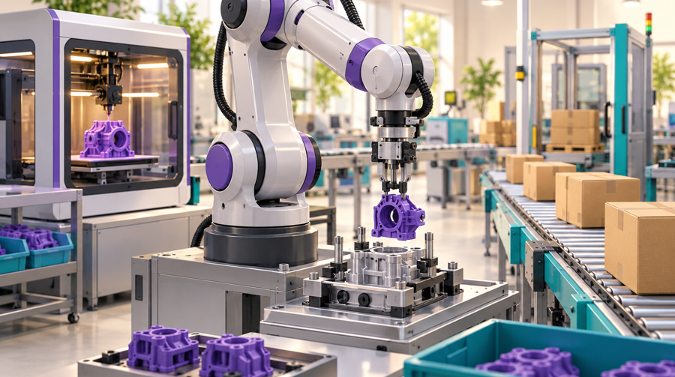

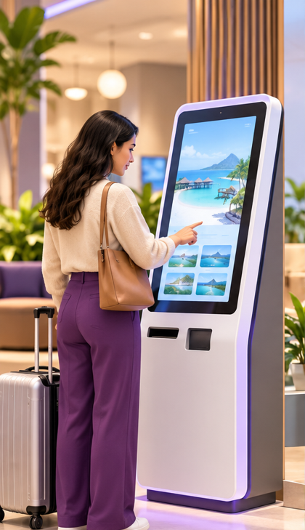


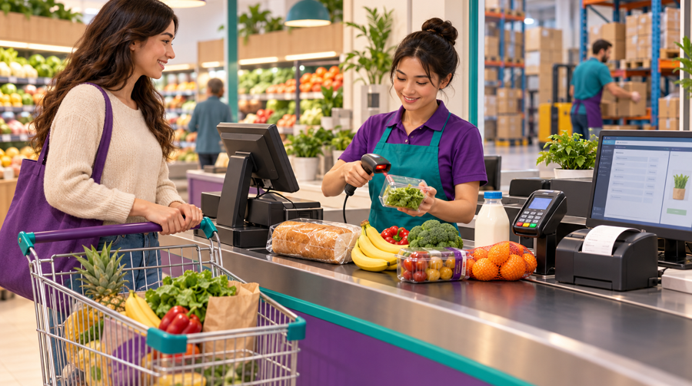
Classifying Process Technology by What It Transforms
Material-processing
Information-processing
Customer-processing
Integrating
ACTIVE
PASSIVE
HIDDEN
Shapes, transports, stores or changes physical objects.
Robots assemble products
Conveyors and automated warehouses move materials
3D printers create parts
Collects, manipulates, stores or distributes information: the most common type.
Analytics identifies patterns
ERP coordinates resources
AI supports decisions; also e-business, blockchain
Technology that customers use, are moved by, or are monitored by.
Active: customer operates it (kiosk, ATM, self service machines)
Passive: it moves them (lift, ride)
Hidden: it monitors them (footfall sensor, CCTV)
Processes a combination of materials, information and customers.
EPOS checkout: scan products, customer pays, stock updates
Internet of Things
Digital twins
What changes? The product’s form or location.
What changes? Data becomes useful information or action.
What changes? The customer’s location, state or experience.
What changes? Product, customer and data together.
Source: Slack, N., Brandon-Jones, A. and Johnston, R. (2013) Operations Management, 7th edn. Harlow: Pearson, ch. 8, pp. 226–227. Illustrations: AI-generated teaching images, not photographs of real operations
35

Slide 29






Another Lens: What Does the Technology Do?
Slack classifies technology by the resource it transforms. A second lens asks what job it performs in the operation.
SENSE
THINK
ACT
CONNECT
INTERACT
Perceive the physical world
Analyse data and decide
Do the physical work
Link systems and partners
Let people use it
See: machine vision, cameras, LiDAR
Hear: acoustic and vibration sensors
Feel: tactile and force sensors
Smell: electronic noses
Locate: RFID, GPS, IoT sensors
AI and agentic AI
Big data analytics
Digital twins (simulate “what if?”)
Quantum computing (optimise)
Robots and cobots
Automated guided vehicles
Drones
3D printers
ERP and cloud platforms
Blockchain
5G and the internet
Self-service kiosks and apps
AR / VR and the metaverse
Haptic gloves, voice assistants
Quality · Dependability
Speed · Dependability
Cost · Quality · Speed
Dependability · Flexibility
Speed · Flexibility
They work together: in a digital twin, sensors feed live data, the model thinks, robots act on the line and ERP connects the result. Sensing is also how TOC identifies the constraint in real time.
Source: Lecturer synthesis; robotics and sensory feedback: Slack et al. (2013), ch. 8, pp. 228–229
36
Notes:
Compare with Slack’s resource-based classification on the previous slide: that one asks WHAT is transformed (materials, information, customers); this one asks WHAT JOB the technology does.
Slack notes robots are “not always good at performing tasks which require delicate sensory feedback” (p. 229): tactile sensing is closing that gap, e.g. grippers that pick soft fruit.
Wooclap idea: matching question. Match the technology to its function: machine vision → Sense; demand forecasting → Think; warehouse robot → Act; blockchain → Connect; self-checkout → Interact.
Performance objectives shown are the main ones each group typically affects, for discussion.

Slide 30
Join the Session on Wooclap
1
Scan the QR code
Point your phone camera at the code on the left.
2
Or go to app.wooclap.com
and enter the event code:
CITLFMY
3
Keep it open
We will use Wooclap for questions and activities throughout the session.
https://youtu.be/MNUQukRUJLI?si=HWqZVq88D8YexoT9
Scan with your phone camera
4

Slide 31
The Four Key Questions
Applied to robotics. Operations managers need enough understanding to evaluate technical information and ask experts the right questions.
1
What does the technology do?
Handles materials (loading/unloading machines), processes using a gripped tool, and assembles parts.
2
How does it do it?
A programmable, computer-controlled, often multi-jointed arm with an end effector; some have vision and touch feedback.
3
What benefits does it give?
Works where conditions are hazardous or tasks repetitive; lower cost, greater accuracy and repeatability than people.
4
What constraints or risks does it impose?
Weak at delicate sensing and judgement; the human–robot interface must be managed, especially where jobs are replaced.
Managing the human side: Audi asked workers where robots could improve performance, then gave them jobs supervising, maintaining and programming the robots. Germany has about five times as many robots per 10,000 workers as Britain and has lost fewer manufacturing jobs.
Source: Slack, N., Brandon-Jones, A. and Johnston, R. (2013) Operations Management, 7th edn. Harlow: Pearson, ch. 8, ‘I, Robot’, pp. 224–229
36

Slide 32

From MRP to ERP and Beyond
1970s
1980s
1990s
2000s
2010s
2020s
MRP
Materials requirements planning: uses the bill of materials and master production schedule to calculate what materials are needed, and when.
Enabler: affordable computing power
MRP II
Manufacturing resource planning: adds capacity, finance and “what-if” modelling of the knock-on effects of change.
Enabler: local networks and desktop PCs
ERP
Enterprise resource planning: all functions share one integrated database (e.g. SAP R/3, 1992).
Enabler: client–server software
Web-integrated ERP
“Collaborative commerce”: customers and suppliers see order status, stock and invoices online.
Enabler: the internet
Cloud ERP + Industry 4.0
Subscription cloud platforms; IoT sensors and big data feed planning in real time.
Enabler: cloud, IoT, analytics
Intelligent operations
AI forecasting, digital twins and agentic AI embedded in planning: from recording to predicting and acting.
Enabler: AI and simulation
Covered in Slack et al. (2013)
Developments since
Pattern: each stage was unlocked by a new technology, and each widened the scope, from materials, to the firm, to the whole supply network.
Source: Slack, N., Brandon-Jones, A. and Johnston, R. (2013) Operations Management, 7th edn. Harlow: Pearson, ch. 14, pp. 440–443, Fig. 14.2; 2010s–2020s: lecturer synthesis
38

Slide 33

Beyond ERP: How Operations Technology Has Moved On
 | Traditional ERP | Digital operations today | Technologies
Data | Transactions keyed in by people, often after the event | Sensors stream data on machines, stock and shipments in real time | IoT, RFID
Planning | Periodic MRP runs that assume capacity is available | Constraint-based, finite-capacity scheduling; AI demand forecasts | Big data, AI, quantum (emerging)
Scope | One enterprise | Whole supply network shares one version of the truth | Web portals, blockchain
Analysis | Reports what happened | Predicts and simulates “what if?” before acting | Analytics, digital twins
Action | People act on reports | Software agents and automation act; people supervise exceptions | Agentic AI, robotics
Delivery | On-premise, heavily customised | Cloud, modular, continuously updated | Cloud ERP
ERP has not disappeared: it remains the transactional backbone, the “system of record”. The newer technologies sit around it, sensing, predicting and acting on its data.
Source: Lecturer synthesis building on Slack, N., Brandon-Jones, A. and Johnston, R. (2013) Operations Management, 7th edn. Harlow: Pearson, ch. 14
42

Slide 34









Emerging Process Technologies: An Overview
Row 1: covered in Slack et al. (2013). Row 2: newer technologies, assessed with the same four questions.
Robotics
3D printing
Internet of Things
Telemedicine
Big data & analytics
Arms that handle, process and assemble
TOC: Elevate
Builds products layer by layer
TOC: Exploit · Elevate
Sensors connect objects to networks
TOC: Identify · Exploit
Clinical care at a distance
TOC: Elevate
Turns vast data into decisions
TOC: Identify · Subordinate
Digital twins
Agentic AI
Blockchain
Quantum computing
Metaverse & XR
Live virtual replica of a process
TOC: Identify · Repeat
AI agents that plan and act
TOC: Exploit · Subordinate
Shared, tamper-resistant ledger
TOC: Identify · Subordinate
Qubits tackle hard optimisation
TOC: Exploit · Subordinate
Immersive 3D environments
TOC: Exploit · Elevate
For each one, ask: What does it do? How does it do it? What benefits does it give? What constraints or risks does it impose?
43

Slide 35
3D Printing (Additive Manufacturing)
TOC: Exploit · Elevate
Most process technology is efficient only for standard products in large batches. 3D printing could change the economics of making small quantities of varied products.
1 What does it do?
2 How does it do it?
Builds a 3D object layer by layer from a digital design (additive), instead of cutting material away (subtractive)
CAD design is digitally sliced; each layer is printed in plastic, metal or even food
Methods: inkjet + UV curing, extrusion, powder + binder, electron beam
3 What benefits does it give?
4 What constraints or risks?
Near-zero changeover cost, so small batches and customisation become economic
Much less waste: machining some aerospace parts wastes up to 90% of material
Rapid prototyping; production closer to the market
Slower and less reliable than mass production; machines are costly
Accuracy and surface finish can be inferior
Design files can be pirated (intellectual property)
Operations link: removes set-up time between products, the hidden constraint that forces large batches at many bottlenecks, and challenges the volume–variety trade-off.
Source: Slack, N., Brandon-Jones, A. and Johnston, R. (2013) Operations Management, 7th edn. Harlow: Pearson, ch. 8, pp. 230–231
44

Slide 36

How Are Process Technologies Evaluated?
1
2
3
Does it fit the task?
Its degree of automation, scale or scalability, and coupling should match the operation’s volume–variety position.
Does it improve performance?
Assess its effect on quality, speed, dependability, flexibility and cost: the objectives that matter to customers.
Is the financial return acceptable?
Costs come up front; benefits arrive over years. Use the time value of money: net present value (NPV).
Operations principle: process technologies can be evaluated in terms of their fit with process tasks, their effect on performance and their financial impact
Source: Slack, N., Brandon-Jones, A. and Johnston, R. (2013) Operations Management, 7th edn. Harlow: Pearson, ch. 8, pp. 237–242
55

Slide 37
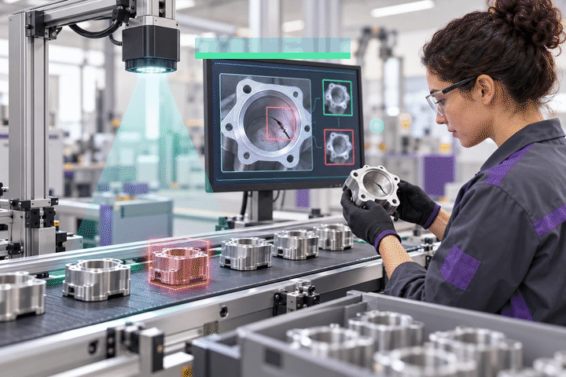
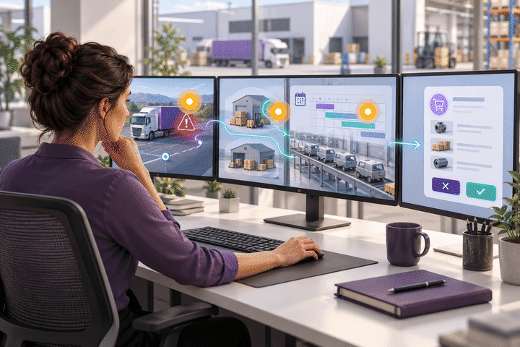
AI and Agentic AI
TOC: Exploit · Subordinate
AI recognises patterns, predicts or generates content. Agentic AI plans and executes a sequence of actions towards a delegated goal.
1 What does it do?
2 How does it do it?
AI: detects possible defects in production images
Agentic: coordinates a response to a delivery disruption
AI: a trained vision model scores images against learned patterns
Agentic: reads updates, plans steps, uses tools within approval limits
3 What benefits does it give?
4 What constraints or risks?
More consistent inspection; less review time
Faster replanning across systems
Missed defects, false alarms, model drift
Wrong actions can spread: set access limits and escalation
AI: a camera flags potentially defective parts for review
Objective | Possible effect | KPI to check
Quality | Detect defects earlier | Defect escape rate
Speed | Faster inspection and replanning | Inspection time; time to replan
Dependability | Protect promised deliveries | On-time delivery rate
Flexibility | Adapt to new products or suppliers | Time to switch supply
Cost | Less scrap and manual coordination | Cost per good unit / exception
Agentic AI: responds to a late delivery with a revised supply plan
Trade-off: more autonomy cuts delay but raises the cost of a wrong action.
Source: IBM, ‘What is artificial intelligence?’ and ‘What is agentic AI?’ (accessed 20 Oct 2026) · Illustrations: AI-generated teaching images of hypothetical scenarios
48
Notes:
Discussion: ask students to identify the affected resource, the bottleneck and the most relevant performance objective before revealing the table.
Performance-objective effects and KPIs are teaching interpretations to test, not measured benefits. Benefits depend on implementation, data quality and context.
TOC check: does the technology relieve the system bottleneck? A local improvement may leave total throughput unchanged.
The picture is an animated GIF: it plays in Slide Show mode (static in editing view and PDF).
Concept source: IBM, ‘What is artificial intelligence?’ and ‘What is agentic AI?’ (accessed 20 Oct 2026)

Slide 38
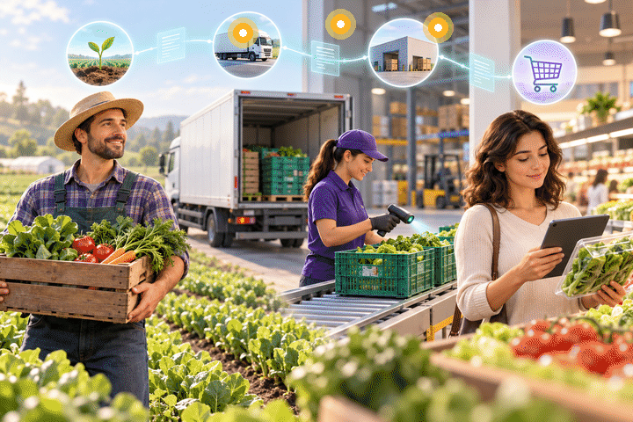
Blockchain Technology
TOC: Identify · Subordinate
A shared ledger records transactions across participants using agreed validation rules.
1 What does it do?
2 How does it do it?
Shares a tamper-evident history of batch transactions
Participants validate records and link them cryptographically
3 What benefits does it give?
4 What constraints or risks?
Better traceability
Less record reconciliation between partners
False inputs remain possible
Needs participation and governance
Objective | Possible effect | KPI to check
Quality | Verify provenance evidence | Records verified as accurate
Speed | Trace affected batches faster | Time to trace a batch
Dependability | Maintain shared record access | Record availability
Flexibility | Connect new supply partners | Partner onboarding time
Cost | Less reconciliation work | Cost per reconciled transaction
Example: partners record a food batch’s journey from farm to retailer, so an affected batch can be traced quickly.
Ask: why might a supermarket choose a shared database instead of blockchain?
Trade-off: shared verification can add delay and cost; a conventional shared database may be enough.
Source: IBM, ‘What is blockchain?’ (accessed 20 Oct 2026) · Illustrations: AI-generated teaching images of hypothetical scenarios
49
Notes:
Discussion: ask students to identify the affected resource, the bottleneck and the most relevant performance objective before revealing the table.
Performance-objective effects and KPIs are teaching interpretations to test, not measured benefits. Benefits depend on implementation, data quality and context.
TOC check: does the technology relieve the system bottleneck? A local improvement may leave total throughput unchanged.
The picture is an animated GIF: it plays in Slide Show mode (static in editing view and PDF).
Concept source: IBM, ‘What is blockchain?’ (accessed 20 Oct 2026)

Slide 39
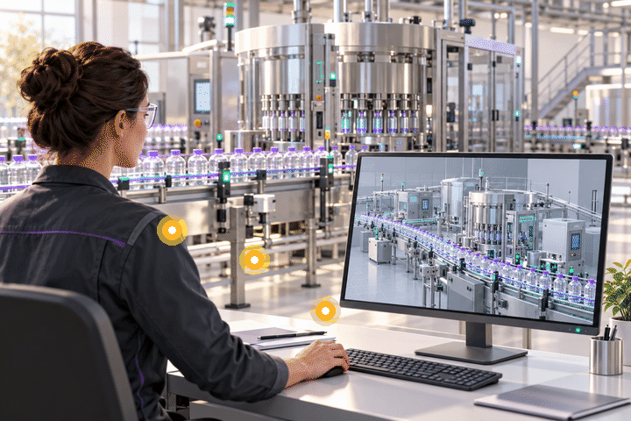
Digital Twin
TOC: Identify · Repeat
A digital representation of a physical asset or process, updated with relevant operational data.
1 What does it do?
2 How does it do it?
Represents the line and tests operational scenarios
Sensor data updates a model that supports simulation and analysis
3 What benefits does it give?
4 What constraints or risks?
Reveals bottlenecks
Less disruption during changes
Poor data or an inaccurate model gives misleading advice
Objective | Possible effect | KPI to check
Quality | Test process settings | First-pass yield
Speed | Explore bottleneck changes | Output per hour
Dependability | Plan maintenance better | Unplanned downtime
Flexibility | Test product changeovers | Changeover time
Cost | Avoid physical trials | Cost per validated change
Example: test a bottling-line change in the twin before altering the physical line.
Ask: if the twin shows the bottleneck moving to capping, what would you test next?
Trade-off: more model detail and frequent updates add cost. Validate predictions against the real process.
Source: IBM, ‘What is a digital twin?’ (accessed 20 Oct 2026) · Illustrations: AI-generated teaching images of hypothetical scenarios
51
Notes:
Discussion: ask students to identify the affected resource, the bottleneck and the most relevant performance objective before revealing the table.
Performance-objective effects and KPIs are teaching interpretations to test, not measured benefits. Benefits depend on implementation, data quality and context.
TOC check: does the technology relieve the system bottleneck? A local improvement may leave total throughput unchanged.
The picture is an animated GIF: it plays in Slide Show mode (static in editing view and PDF).
Concept source: IBM, ‘What is a digital twin?’ (accessed 20 Oct 2026)

Slide 40

Big Data Analytics
TOC: Identify · Subordinate
Methods and platforms that analyse large, fast-moving or varied datasets to find useful patterns.
1 What does it do?
2 How does it do it?
Identifies patterns across several operational data sources, demand forecasting,
Data pipelines combine records for analysis and forecasting
3 What benefits does it give?
4 What constraints or risks?
Better planning visibility
Better resource allocation
Inconsistent data, privacy issues and poor interpretation
Objective | Possible effect | KPI to check
Quality | Improve planning inputs | Forecast error
Speed | Refresh decisions sooner | Data-to-decision time
Dependability | Anticipate availability problems | Order fill rate
Flexibility | Detect demand shifts | Time to revise the plan
Cost | Reduce avoidable inventory | Holding + stockout cost
Example: a retailer combines sales, inventory and delivery data to plan replenishment.
Ask: where is the bottleneck here, and which objective matters most to customers?
Trade-off: more data does not guarantee better decisions. Check data quality and operational outcomes.
Source: IBM, ‘What is big data analytics?’ (accessed 20 Oct 2026) · Illustrations: AI-generated teaching images of hypothetical scenarios
52
Notes:
Discussion: ask students to identify the affected resource, the bottleneck and the most relevant performance objective before revealing the table.
Performance-objective effects and KPIs are teaching interpretations to test, not measured benefits. Benefits depend on implementation, data quality and context.
TOC check: does the technology relieve the system bottleneck? A local improvement may leave total throughput unchanged.
The picture is an animated GIF: it plays in Slide Show mode (static in editing view and PDF).
Concept source: IBM, ‘What is big data analytics?’ (accessed 20 Oct 2026)

Slide 41
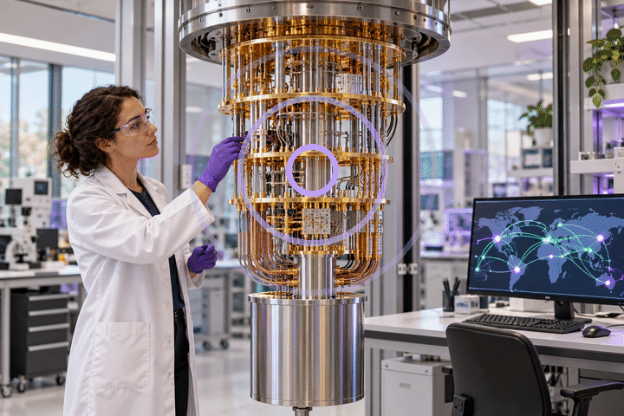
Quantum Computing
TOC: Exploit · Subordinate
Quantum computers use qubits and quantum operations for specialised computations.
1 What does it do?
2 How does it do it?
Investigates selected, very difficult computation problems
A hybrid workflow combines classical processing with quantum circuits
3 What benefits does it give?
4 What constraints or risks?
Potential optimisation benefits, which need application-specific evidence
Noise, scale and total computing cost limit practical value
Objective | Possible effect | KPI to check
Quality | Potentially better feasible plans | Constraint violations
Speed | Potentially faster useful solution | End-to-end solve time
Dependability | Repeatable plan quality | Runs meeting service targets
Flexibility | Test replanning scenarios | Replanning time
Cost | Test net economic value | Total compute + operating cost
Example: a research team benchmarks a hybrid quantum approach to delivery routing against a strong classical method.
Ask: what evidence would you need before investing in quantum routing?
Trade-off: these are evaluation targets, not promised gains. Always compare with a strong classical baseline.
Source: IBM, ‘What is quantum computing?’ (accessed 20 Oct 2026); arXiv:2305.07323 · Illustrations: AI-generated teaching images of hypothetical scenarios
50
Notes:
Discussion: ask students to identify the affected resource, the bottleneck and the most relevant performance objective before revealing the table.
Performance-objective effects and KPIs are teaching interpretations to test, not measured benefits. Benefits depend on implementation, data quality and context.
TOC check: does the technology relieve the system bottleneck? A local improvement may leave total throughput unchanged.
The picture is an animated GIF: it plays in Slide Show mode (static in editing view and PDF).
Concept source: IBM, ‘What is quantum computing?’ (accessed 20 Oct 2026); arXiv:2305.07323

Slide 42
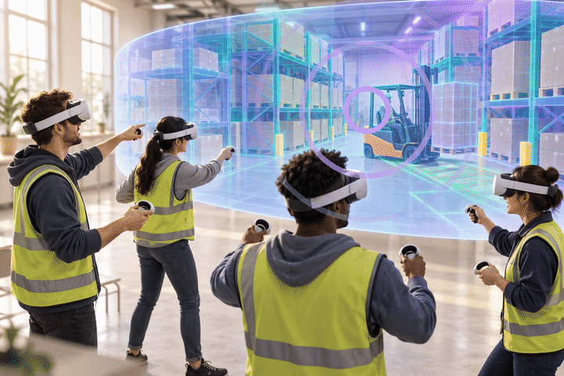
The Metaverse
TOC: Exploit · Elevate
Connected, shared virtual environments let people interact, practise or collaborate in 3D.
1 What does it do?
2 How does it do it?
Shared virtual spaces for training and collaboration
Design layouts, facility locations,
3D environments with avatars, via screens or headsets
3 What benefits does it give?
4 What constraints or risks?
Repeatable practice without interrupting live operations
Equipment cost, accessibility, transfer to real work
Objective | Possible effect | KPI to check
Quality | Practise correct procedures | Errors in real tasks after training
Speed | Shorten supervised learning | Time to competence
Dependability | Repeat standard training | Procedure compliance
Flexibility | Rehearse different scenarios | Time to train a new task
Cost | Less travel and live disruption | Cost per competent worker
Example: warehouse staff practise procedures together in a virtual environment before working on the live floor.
Ask: how would you prove the VR training actually reduced picking errors?
Trade-off: virtual success does not prove workplace competence. Assess real task performance.
Source: NVIDIA, ‘What is the metaverse?’ (accessed 20 Oct 2026) · Illustrations: AI-generated teaching images of hypothetical scenarios
53
Notes:
Discussion: ask students to identify the affected resource, the bottleneck and the most relevant performance objective before revealing the table.
Performance-objective effects and KPIs are teaching interpretations to test, not measured benefits. Benefits depend on implementation, data quality and context.
TOC check: does the technology relieve the system bottleneck? A local improvement may leave total throughput unchanged.
The picture is an animated GIF: it plays in Slide Show mode (static in editing view and PDF).
Concept source: NVIDIA, ‘What is the metaverse?’ (accessed 20 Oct 2026)

Slide 43

Emerging Technologies and the Performance Objectives
Technology | Quality | Speed | Dependability | Flexibility | Cost
AI and agentic AI | ◆ Medium | ▲ High | ▲ High | ◆ Medium | ▲ High
Blockchain | ▲ High | ▲ High | ◆ Medium | ● Low | ◆ Medium
Quantum computing | ◇ Potential | ◇ Potential | ◇ Potential | ◇ Potential | ◇ Potential
Digital twins | ▲ High | ◆ Medium | ▲ High | ▲ High | ◆ Medium
Big data analytics | ▲ High | ▲ High | ▲ High | ◆ Medium | ▲ High
Metaverse / XR | ▲ High | ◆ Medium | ◆ Medium | ▲ High | ◆ Medium
▲ High ◆ Medium ● Low ◇ Potential (not yet proven at scale). Ratings are for discussion, not measured data.
Discuss: which objective matters most to the operation you are studying? Choose the technology that improves that objective at the constraint, not the one with the most ▲s.
Source: Lecturer synthesis; performance objectives after Slack, N., Brandon-Jones, A. and Johnston, R. (2013) Operations Management, 7th edn. Harlow: Pearson, chs 2–3 and 8
54
Notes:
Ask students to challenge one rating with an example. Quantum is “potential” across the board because benefits are not yet proven at scale.

Slide 44
Join the Session on Wooclap
1
Scan the QR code
Point your phone camera at the code on the left.
2
Or go to app.wooclap.com
and enter the event code:
CITLFMY
3
Keep it open
We will use Wooclap for questions and activities throughout the session.
Scan with your phone camera
4

Slide 45

How Are Process Technologies Implemented?
Resource and process “distance”
Customer acceptability
Anticipating problems
Resource distance: how novel the technology is to the operation
Process distance: how much existing processes must change
The greater the distance, the harder the implementation, and the harder it is to learn what worked and why
Where possible, change one thing at a time
Customers must know how to use customer-facing technology
Ease of “training” customers depends on complexity, repetition and variety of tasks
Trust: people may prefer a person even when technology performs better (robot surgery, pilotless aircraft)
Murphy’s Law: “if anything can go wrong, it will”
Adjustment costs come from mismatches between technology and operation
Old performance level
Performance dips at go-live
Operations principle: the difficulty of implementing process technology depends on its novelty and the changes it requires. Budget for the “Murphy curve” ramp-up period.
Source: Slack, N., Brandon-Jones, A. and Johnston, R. (2013) Operations Management, 7th edn. Harlow: Pearson, ch. 8, Figs 8.6–8.7, pp. 242–245
63

