Slide 1

MGT6046: Operations and Supply Chain Management
Week 7 - Inventory Management
and ABC Analysis
Dr Sina Rastani

Slide 2
Learning outcomes
Explain why organisations hold inventory and identify its costs
Calculate reorder points, inventory position and a basic EOQ
Complete an ABC analysis using annual usage value
Use value, service risk and reliable records to choose suitable controls

Slide 3
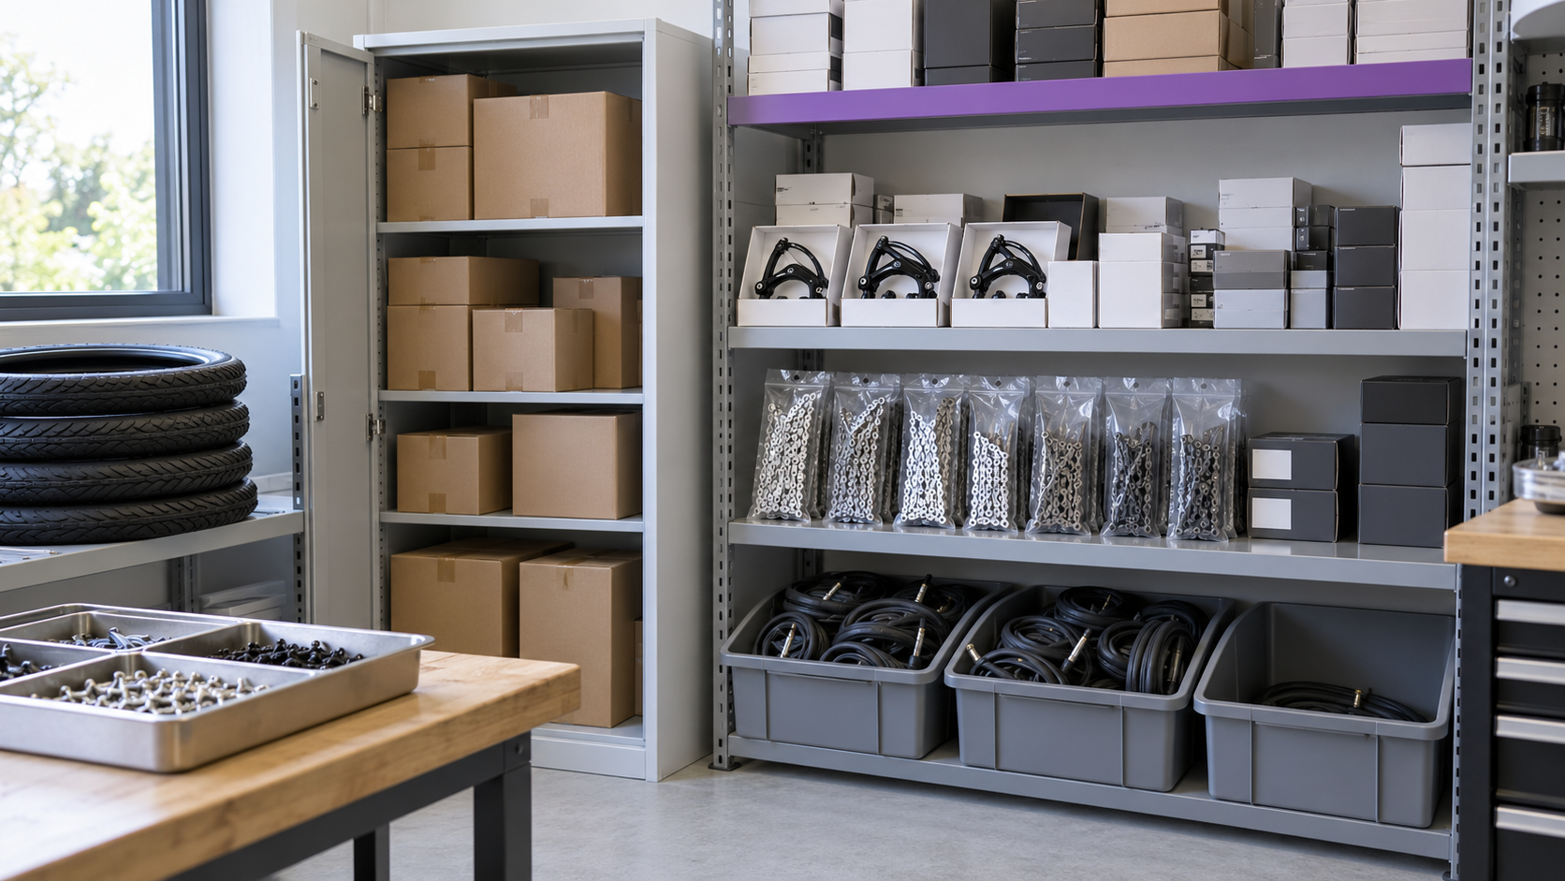
What should this workshop keep in stock?
What could run out?
Which stock ties up cash and space?
What data would help you decide?
Case setting: a campus cycle workshop.

Slide 4
Inventory takes different forms
Inventory is stock held to support production, service or sales.
Form | Example
Raw materials and components | Parts waiting to enter bicycle assembly
Work in progress (WIP) | Partly assembled bicycles awaiting the next stage
Finished goods | Completed bicycles ready for sale
Repair and replacement parts | Brake kits and chains held for maintenance
Consumables | Cleaning materials and gloves used during work

Slide 5
A stock keeping unit is a distinct item
SKU = one separately identified product variant
3 sizes × 2 colours = 6 SKUs
20 units of each SKU = 120 physical units
A small blue shirt and a large blue shirt are different SKUs
SKU count measures variety. Unit count measures quantity
In ABC analysis, a percentage of SKUs counts distinct items, not units

Slide 6
Why hold inventory?
Safety stock is a purpose for holding stock. It can apply to materials, WIP or finished goods.
Purpose | What the stock does
Cycle stock | Stock held to meet normal customer demand until the next delivery arrives.
Safety stock | Provides a buffer against uncertain demand or supply
Anticipation stock | Builds ahead of a known seasonal peak or planned shutdown
Pipeline stock | Stock that is on its way from one location to another and has not yet arrived.
Notes:
Cycle stock
For example, if a shop receives deliveries every Monday, its cycle stock covers sales during the week.
Pipeline Stock:
For example, goods travelling from a supplier to a warehouse.

Slide 7
Four inventory cost categories
Cost | Examples
Purchase cost | The price paid for each item
Ordering or setup cost | Preparing an order, delivery administration or production setup
Holding cost | Capital tied up, storage, insurance, damage, and outdated or is no longer needed
Shortage cost | Lost sales, delayed work, emergency buying and reduced service

Slide 8
Purchase price and annual holding cost
A component costs £20. Its annual holding-cost rate is 20%. Average stock is 200 units.
Holding cost per unit per year
H = £20 × 20% = £4 per unit per year
Average money tied up in stock
200 × £20 = £4,000
Annual holding cost
200 × £4 = £800 per year
Meaning of the two figures
£20 is the purchase price. £4 estimates a year of holding one unit.

Slide 9

Wooclap: larger orders
A business buys 12,000 units each year. It increases its order size from 500 to 1,000 units. If the cost of placing each order stays the same, what happens to its annual ordering cost?
Each order costs £60 to process, regardless of its quantity.
A. It halves
app.wooclap.com
Event code: TSHGBUP
B. It doubles
C. It stays the same
D. It falls to zero

Slide 10
Wooclap: larger orders
A business buys 12,000 units each year. It increases its order size from 500 to 1,000 units. If the cost of placing each order stays the same, what happens to its annual ordering cost?
Answer: Annual ordering cost is halved because the number of orders falls from 24 to 12 per year.
Annual ordering cost = Number of orders per year × Cost per order.
A. It halves
B. It doubles
C. It stays the same
D. It falls to zero

Slide 11
Three different inventory decisions
Question | Decision tool
How much should we order? | Order quantity, including the EOQ model (Economic Order Quantity)
When should we order? | Reorder point and inventory position
Which items need most control? | ABC analysis, supported by risk and criticality

Slide 12
The stock balance
Closing on-hand stock = Opening stock + Receipts − Issues
100 + 60 − 40 = 120 units
Opening stock: stock available at the start of the period.
Receipts: stock received during the period.
Issues: stock taken out for production, customer orders, or other use.
Closing on-hand stock: stock physically available at the end of the period.
On-hand stock is the physical quantity held at that moment
Receipts increase on-hand stock. Issues to customers or production reduce it
Accurate records are essential before applying any re-ordering rule

Slide 13
Reorder point: covering the lead time
Reorder point = Demand per day × Lead time in days
ROP = d × L
40 units/day × 5 working days = 200 units
Lead time is the time between placing an order and receiving usable stock
Use the same time basis for demand and lead time
With no uncertainty or safety stock, order when inventory position reaches 200 units

Slide 14
Inventory position prevents duplicate orders
Inventory position = On hand + On order − Backorders
80 + 400 − 0 = 480 units
On hand: 80 units physically held. On order: 400 units already ordered
Backorders are customer demand that is still unfilled. Here there are none
ROP = 200. Position 480 is above it, so do not place another order
Low physical stock alone does not mean that another order is needed

Slide 15
How replenishment works
Order quantity: 400 units. Usage: 40 per working day. Lead time: 5 working days. Start: 400 on hand, no outstanding orders and no safety stock.
1. Day 5: stock reaches 200. Place an order for 400.
2. Wait 5 days. Use the remaining 200 units. The order is already on its way.
3. Day 10: receive 400 units. On-hand stock rises to 400.
The reorder point triggers the order. The order quantity sets the delivery size.

Slide 16
Wooclap: a delayed delivery
At the order date, 200 units remain. Delivery arrives after 7 working days. How much demand cannot be met before it arrives? Usage is 40 per working day.
Usage is 40 units per working day. No safety stock or other receipts.
A. 0 units
B. 40 units
C. 80 units
D. 280 units

Slide 17
Delayed delivery: the result
The order was based on 5 working days, but delivery takes 7. Usage stays at 40 units/day.
Demand during the actual lead time
40 × 7 = 280 units
Stock available when the order was placed
200 units
Unmet demand
280 − 200 = 80 units
What would cover this scenario?
An 80-unit buffer would cover this two-day delay, if usage stays at 40/day.

Slide 18
Safety stock adds protection and cost
Reorder point (ROP) = Expected lead-time demand + Safety stock
ROP = (40 × 5) + 80 = 280 units
Extra annual holding cost = Safety stock × holding cost (per unit)
= 80 × £4 = £320
Safety stock is extra inventory held for uncertainty in demand or supply
The 80-unit buffer covers the illustrated delay, not every possible disruption
Higher protection usually costs more. Better supply reliability can reduce the buffer needed

Slide 19
Practice: should another order be placed?
Calculate the reorder point and inventory position. Decide whether to order, and state the position immediately after ordering.
Information | Value
Expected usage and lead time | 30 units/day and 4 working days
Safety stock | 50 units
On hand / already on order | 50 units / 100 units
Backorders | 0 units
Fixed order quantity | 300 units

Slide 20
Reorder decision: worked solution
Usage 30/day. Lead time 4 days. Safety stock 50. On hand 50. On order 100. Q = 300.
Reorder point
ROP = (30 × 4) + 50 = 170 units
Inventory position
50 + 100 − 0 = 150 units
Decision
150 is below 170, so place one order for 300 units
Position immediately after placing it
150 + 300 = 450 units. Do not place a duplicate order.

Slide 21
Continuous and periodic review
Feature | Continuous review | Periodic review
When stock is checked | After each recorded transaction | At fixed review dates
When an order is triggered | Position reaches the reorder point | At a review, if more stock is needed
Typical quantity | A fixed quantity in the basic model | Enough to reach a chosen target
Protection must cover | Lead-time uncertainty | Review interval plus lead time

Slide 22
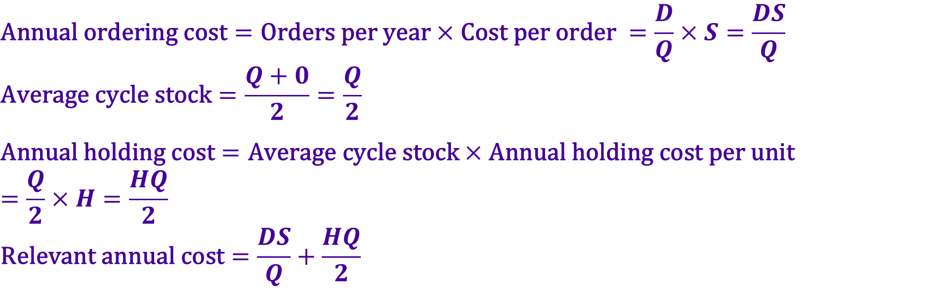
The order-quantity cost trade-off
$$\text{Annual} \text{ordering} \text{cost}=\text{Orders} \text{per} \text{year}×\text{Cost} \text{per} \text{order} =\frac{D}{Q}×S=\frac{DS}{Q}$$
$$\text{Average} \text{cycle} \text{stock}=\frac{Q+0}{2}=\frac{Q}{2}$$
$$\text{Annual} \text{holding} \text{cost}=\text{Average} \text{cycle} \text{stock}×\text{Annual} \text{holding} \text{cost} \text{per} \text{unit} \\ =\frac{Q}{2}×H=\frac{HQ}{2}$$
$$\text{Relevant} \text{annual} \text{cost}=\frac{DS}{Q}+\frac{HQ}{2}$$
D = annual demand (units/year).
Q = units ordered each time
S = cost per order (£/order).
H = holding cost (£/unit/year)
Larger Q means fewer orders but more average cycle stock
This basic model has no safety stock.
Constant-price annual purchases are D × unit price.

Slide 23
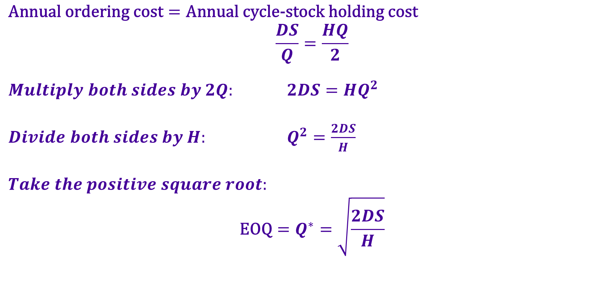
Economic Order Quantity: the EOQ
$$\text{Annual} \text{ordering} \text{cost}=\text{Annual} \text{cycle}\text{-}\text{stock} \text{holding} \text{cost}$$
$$\frac{DS}{Q}=\frac{HQ}{2}$$
$Multiply both sides by 2Q:$ $2DS=HQ^{2}$
$Divide both sides by H:$ $Q^{2}=\frac{2DS}{H}$
$$Take the positive square root:$$
$$\text{EOQ}=Q^{∗}=\sqrt{\frac{2DS}{H}}$$
EOQ is the order quantity that minimises annual ordering plus holding costs in this model
Assume constant known demand and lead time, one receipt per order, no discounts and no shortages
Notes:
In the basic EOQ model:
Larger orders mean fewer orders per year, reducing annual ordering cost.
Larger orders also mean more average stock, increasing annual holding cost.
For a small percentage increase in order quantity, ordering cost falls by approximately that percentage, while holding cost rises by that percentage.
Therefore:
If ordering cost is higher, increasing the order quantity reduces total cost.
If holding cost is higher, reducing the order quantity reduces total cost.
The minimum occurs where these two costs balance.

Slide 24
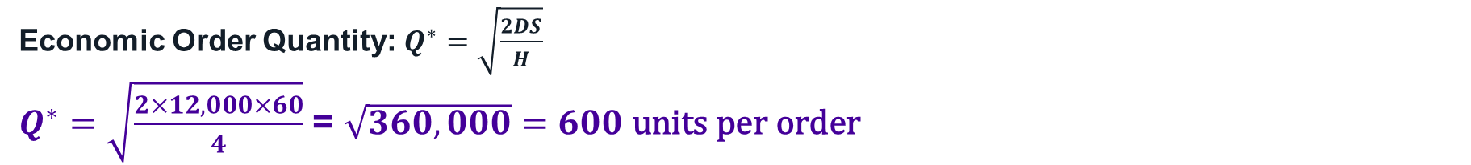
EOQ: a component distributor
D = 12,000 units/year. S = £60/order. H = £4/unit/year. Current Q = 400. No safety stock.
Economic Order Quantity: $Q^{∗}=\sqrt{\frac{2DS}{H}}$
$Q^{∗}=\sqrt{\frac{2×12,000×60}{4}}$ = $\sqrt{360,000}=600 \text{units} \text{per} \text{order}$
Orders and average cycle stock
$\frac{DS}{Q∗}$= 12,000 ÷ 600 = 20 orders/year. $\frac{Q}{2}$= 600 ÷ 2 = 300 units.
Annual ordering and holding costs
$\frac{DS}{Q}$= 20 × £60 = £1,200. $\frac{HQ}{2}$= £4 × 300 = £1,200.
Annual cost comparison
EOQ costs £2,400.
Current Q = 400 costs £2,600. Savings: £200/year.

Slide 25
Why the EOQ is 600 units
Annual ordering plus cycle-stock holding costs. D = 12,000, S = £60 and H = £4. Purchase price is constant.
At Q = 600: ordering £1,200 + holding £1,200 = £2,400 per year.

Slide 26
Wooclap: the cost of a larger order
If the distributor orders 1,200 units each time, what is its annual cycle-stock holding cost?
D = 12,000/year. H = £4/unit/year. No safety stock.
A. £600
B. £1,200
C. £2,400
D. £4,800

Slide 27
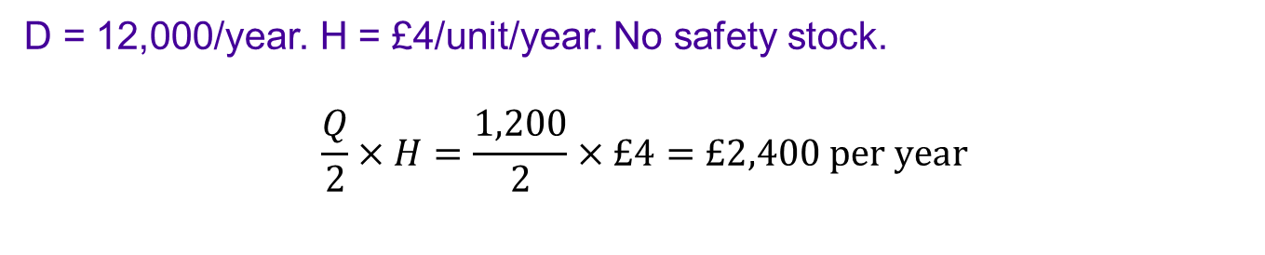
Wooclap: the cost of a larger order
If the distributor orders 1,200 units each time, what is its annual cycle-stock holding cost?
D = 12,000/year. H = £4/unit/year. No safety stock.
$$\frac{Q}{2}×H=\frac{1,200}{2}×£4=£2,400 \text{per} \text{year}$$
A. £600
B. £1,200
C. £2,400
D. £4,800

Slide 28
ABC analysis prioritises control effort
ABC analysis classifies inventory into three groups according to their financial importance, usually measured by annual usage value: annual demand × unit cost.
Rank inventory items using a clearly stated measure of value
Give high-value A items closer financial attention and accurate records
Use proportionate controls for B and C items
The 80:20 pattern is a guide. Actual shares and class boundaries vary

Slide 29
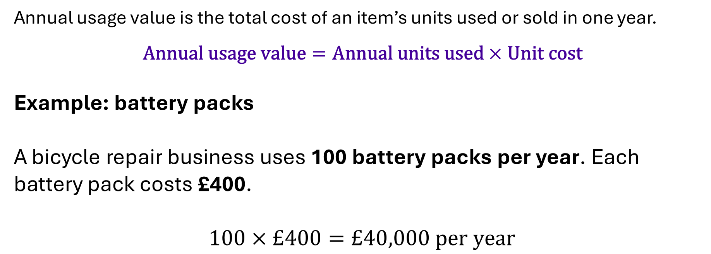
Annual usage value is the ranking measure
Annual usage value is the total cost of an item’s units used or sold in one year.
$$\text{Annual} \text{usage} \text{value}=\text{Annual} \text{units} \text{used}×\text{Unit} \text{cost}$$
Example: battery packs
A bicycle repair business uses 100 battery packs per year. Each battery pack costs £400.
$$100×£400=£40,000 \text{per} \text{year}$$

Slide 30
Wooclap: which item ranks higher?
Which item has the higher annual usage value?
Battery packs: 100/year at £400. Brake kits: 1,000/year at £40.
A. Battery packs
B. Brake kits
C. They have equal annual usage value
D. Unit price alone decides the ranking

Slide 31
Wooclap: which item ranks higher?
Which item has the higher annual usage value?
Battery packs: 100/year at £400. Brake kits: 1,000/year at £40.
They have equal annual usage value.
Battery packs: 100 × £400 = £40,000 per year Brake kits: 1,000 × £40 = £40,000 per year
Battery packs cost more per unit, but fewer are used each year.
A. Battery packs
B. Brake kits
C. They have equal annual usage value
D. Unit price alone decides the ranking

Slide 32
The steps in an ABC analysis
Use a consistent value measure and keep every SKU whole.
Input data
Annual value
Ranked SKUs
ABC classes
Annual units and unit cost
Multiply units by cost
Sort by value, then add shares
Apply the stated class policy
Class boundaries are a policy choice.
Common ABC policy is:
A: Items accounting for approximately 80% of total annual usage value.
B: Items accounting for the next 15%.
C: Items accounting for the remaining 5%.

Slide 33
Case: the workshop’s six SKUs
Use forecast annual demand and unit cost to calculate annual usage value. Each code is one SKU.
Item | Annual demand | Unit cost
W4 Tyres | 350 units | £20
W1 Battery packs | 100 units | £400
W6 Bolts | 2,000 units | £1
W3 Chains | 800 units | £10
W2 Brake kits | 1,000 units | £40
W5 Inner tubes | 600 units | £5

Slide 34
Step 1: calculate annual usage value
Multiply each annual demand by its unit cost. Total annual usage value = £100,000.
Item | Annual units | Unit cost | Annual value
W1 Battery packs | 100 | £400 | £40,000
W2 Brake kits | 1,000 | £40 | £40,000
W3 Chains | 800 | £10 | £8,000
W4 Tyres | 350 | £20 | £7,000
W5 Inner tubes | 600 | £5 | £3,000
W6 Bolts | 2,000 | £1 | £2,000

Slide 35
Step 2: rank and accumulate the value
Rank high to low. Break ties by SKU code.
Share = item value ÷ £100,000 × 100. Cumulative % is the running total.
Item | Annual value | Share | Cumulative
W1 Battery packs | £40,000 | 40% | 40%
W2 Brake kits | £40,000 | 40% | 80%
W3 Chains | £8,000 | 8% | 88%
W4 Tyres | £7,000 | 7% | 95%
W5 Inner tubes | £3,000 | 3% | 98%
W6 Bolts | £2,000 | 2% | 100%
$$\text{Item}\text{’}\text{s} \text{share}\text{ (\%)}=\frac{\text{Item}\text{’}\text{s} \text{annual} \text{usage} \text{value}}{\text{Total} \text{annual} \text{usage} \text{value} \text{of} \text{all} \text{items}}×100$$

Slide 36
Step 3: apply a stated class policy
Policy for the lecture cases: classify the ranked SKUs in order. Each SKU stays in one class.
A
Include whole SKUs until cumulative value reaches at least 80%.
B
Continue with whole SKUs until cumulative value reaches at least 95%.
C
Put all remaining SKUs in class C.

Slide 37
Workshop ABC classes
A reaches 80% of value. B takes the cumulative total to 95%. C contains the remaining SKUs.
Item | Cumulative value | Class
W1 Battery packs | 40% | A
W2 Brake kits | 80% | A
W3 Chains | 88% | B
W4 Tyres | 95% | B
W5 Inner tubes | 98% | C
W6 Bolts | 100% | C
A = 80% of value. B = 15%. C = 5%. Each class contains two SKUs.

Slide 38
The ABC pattern in the workshop
Two of six SKUs account for 80% of annual usage value. The 80:20 rule is not an exact requirement.
A items: W1 and W2. They are 33.3% of SKUs and 80% of annual value.

Slide 39
Different classes need different controls
Set review and count frequency to fit value, criticality, lead time and error risk.
Class | Typical control | Managerial attention
A | Frequent review and accurate counts | Track value, supplier performance and excess stock
B | Regular review and reliable records | Use proportionate monitoring and replenishment
C | Simpler, low-cost replenishment | Avoid expensive administration but protect critical items

Slide 40
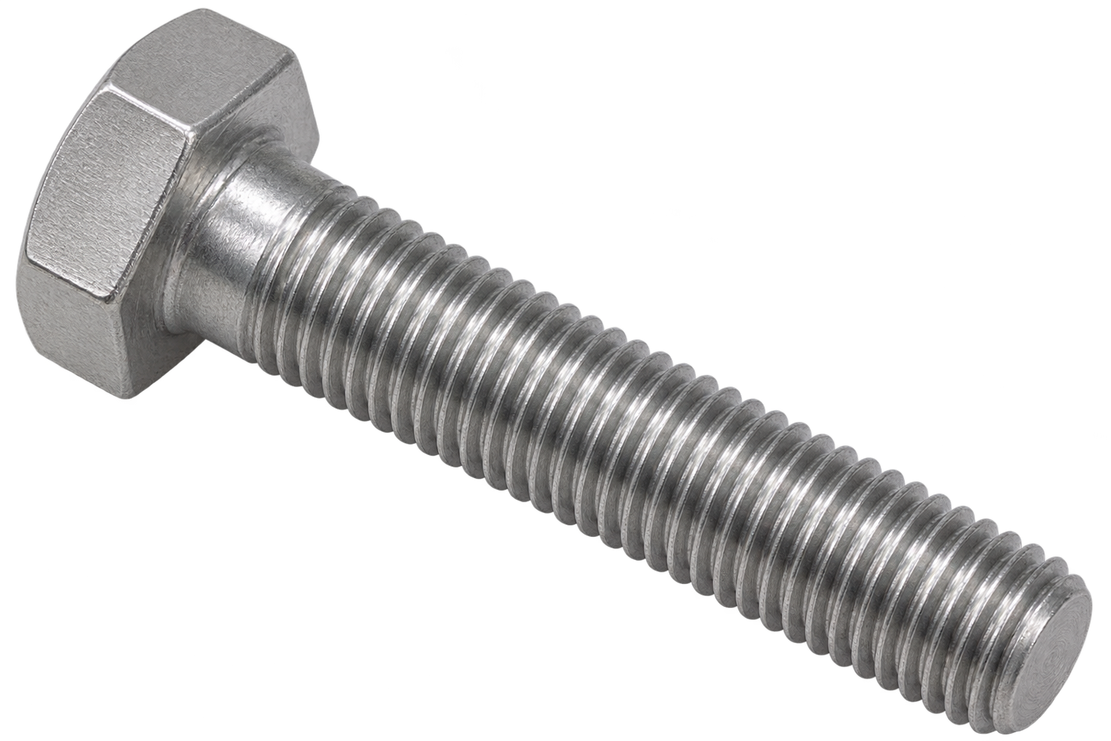
Wooclap: a critical C item
A £1 bolt is class C by annual usage value, but a shortage stops repairs. What should the manager do?
A. Stop stocking it because it is class C
B. Protect availability and assess criticality alongside ABC
C. Ignore its delivery lead time
D. Automatically class every low-cost item as A

Slide 41
Wooclap: a critical C item
A £1 bolt is class C by annual usage value, but a shortage stops repairs. What should the manager do?
The manager should treat the bolt as operationally critical, even though it is class C by annual usage value.
Keep enough stock to avoid shortages, set a suitable reorder point and safety stock, and check supplier reliability.
ABC analysis measures financial importance. It does not measure the consequences of a shortage.
A cheap bolt may need close stock monitoring because repairs cannot continue without it.
A. Stop stocking it because it is class C
B. Protect availability and assess criticality alongside ABC
C. Ignore its delivery lead time
D. Automatically class every low-cost item as A

Slide 42
Practice: a four-item ABC analysis
Rank by annual usage value. A includes whole SKUs until at least 80%; B continues to at least 95%; C is the rest.
Item | Annual demand | Unit cost
P1 Sensors | 300 | £240
P2 Motors | 300 | £60
P3 Cables | 1,500 | £4
P4 Clips | 4,000 | £1
Calculate annual values, cumulative percentages and classes. Keep each SKU whole.

Slide 43
Practice: a four-item ABC analysis
Rank by annual usage value. A includes whole SKUs until at least 80%; B continues to at least 95%; C is the rest.
Item | Annual demand | Unit cost | Annual usage value | Share of total value | Cumulative share | ABC class
P1 Sensors | 300 | £240 | £72,000 | 72% | 72% | A
P2 Motors | 300 | £60 | £18,000 | 18% | 90% | A
P3 Cables | 1,500 | £4 | £6,000 | 6% | 96% | B
P4 Clips | 4,000 | £1 | £4,000 | 4% | 100% | C
Total |  |  | £100,000 | 100%
Calculate annual values, cumulative percentages and classes. Keep each SKU whole.

Slide 44
Cycle counting and stock accuracy
Count selected SKUs regularly and compare physical stock with the records
An illustrative schedule is A monthly, B quarterly, and C annually
Increase the frequency for critical items, regardless of class

Slide 45
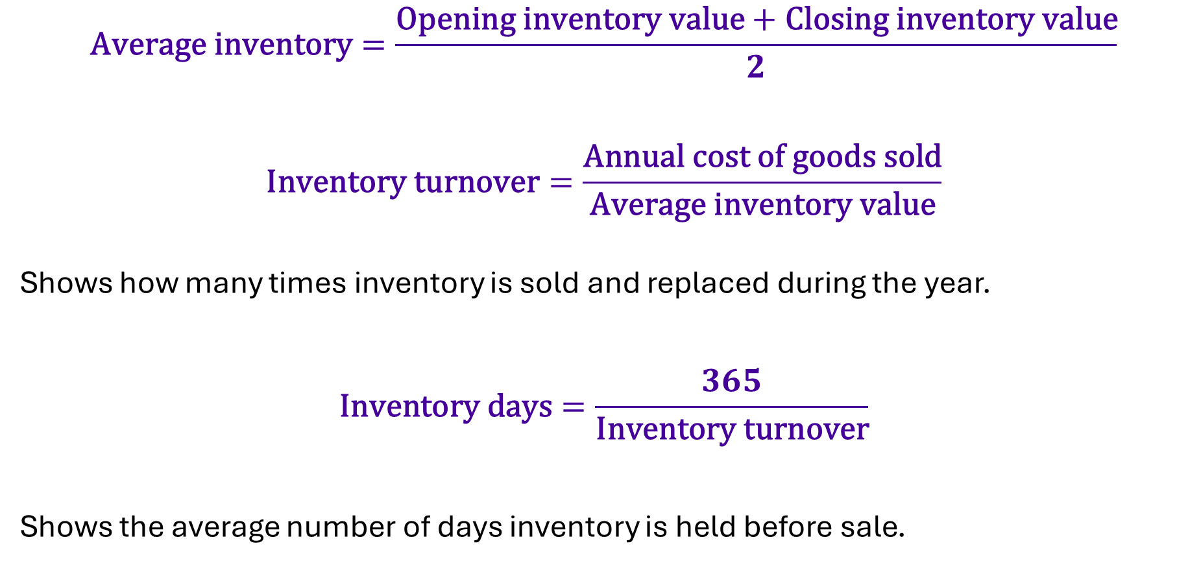
Inventory turnover and days held
$$\text{Average} \text{inventory}=\frac{\text{Opening} \text{inventory} \text{value}+\text{Closing} \text{inventory} \text{value}}{2}$$
$$\text{Inventory} \text{turnover}=\frac{\text{Annual} \text{cost} \text{of} \text{goods} \text{sold}}{\text{Average} \text{inventory} \text{value}}$$
Shows how many times inventory is sold and replaced during the year.
$$\text{Inventory} \text{days}=\frac{365}{\text{Inventory} \text{turnover}}$$
Shows the average number of days inventory is held before sale.

Slide 46
Inventory performance: worked example
Annual cost of goods sold £240,000. Opening inventory £50,000. Closing inventory £30,000. All at cost.
Average inventory
(£50,000 + £30,000) ÷ 2 = £40,000
Inventory turnover
£240,000 ÷ £40,000 = 6 times per year
Inventory days
365 ÷ 6 = 60.8 days
Interpretation
Compare with prior periods and service performance. Low stock is not always better.

Slide 47
Wooclap: inventory decisions
Match each term with its purpose.
Term
Purpose
1. EOQ
A. Prioritise control effort
2. Reorder point
B. Buffer against uncertainty
3. Safety stock
C. Choose an order quantity
4. ABC analysis
D. Trigger replenishment

Slide 48
Wooclap: inventory decisions
Match each term with its purpose.
Term
Purpose
1. EOQ
C. Choose an order quantity
2. Reorder point
D. Trigger replenishment
3. Safety stock
B. Buffer against uncertainty
4. ABC analysis
A. Prioritise control effort

Slide 49
An inventory action plan
Define each SKU and maintain reliable demand, cost and stock records
Use ABC and criticality to decide where control effort matters most
Choose a feasible order quantity and set a reorder trigger with suitable protection
Monitor stock accuracy, service, inventory days and the cost of the policy

Slide 50


Thank You
Any questions?
Sina Rastani

Slide 51
References
Slack, N., Brandon-Jones, A. and Burgess, N. (2022). Operations Management. 10th ed. Pearson.
NC State Supply Chain Resource Cooperative (2011). Economic Order Quantity Model.
OpenStax (2022). Principles of Finance, section 19.5: Inventory Management.
NC State Supply Chain Resource Cooperative (2011). Safety Stock Analysis.
OpenStax (2019). Principles of Accounting, Volume 1, section 10.5: Inventory Management Ratios.
Oracle. Inventory User’s Guide, Release 12.2: ABC Analysis and cycle counting.
MIT OpenCourseWare (2009). ESD.273J: Inventory and EOQ Models.

