Slide 1

MGT650
Managing People in Organisations
Semester 1 2026/2027
Lecture 3
Equality, Diversity & Inclusion (ED&I)
Dr Edward Yates
e.yates@sheffield.ac.uk
Sheffield University Management School

Slide 2
Learning Objectives
Be able to understand the concepts and principles of EDI in the workplace
Show knowledge of key EDI legislation and relevant terms
Have awareness of discrimination in the workplace
Understand relevant theories and concepts of why discrimination in the workplace occurs
Understand the concept of managing diversity, including the different rationale doing so
Be able to conceptualise the principles of diversity management
Show knowledge of the different diversity initiatives that organisations commonly utilise and critique these initiatives.

Slide 3
Key reading
Chapter 12 (Managing Diversity) in Wilkinson, A., Dundon, T., & Yates, E. (2025). Contemporary human resource management: Text and cases (7th ed.). SAGE.
This is your core text for this module and is available as an e-book and with hard copies in the library/IC.
You can also use the 6th edition (2021) and there are hard copies of this version in the library or the 4th edition, which has hard copies in the library and is an e-book on Starplus

Slide 4
Understanding Equality, Diversity & Inclusion at Work
Equality
  The principle of fairness
  That employees are treated equally irrespective of any differences (that may or may not be the same!)
  That if disadvantage exists, then those people are given the means to access equal opportunities
Diversity
  Recognizing and respecting our differences
  Celebrating uniqueness
Inclusion
  Creating a work environment where all employees feel valued and comfortable

Slide 5
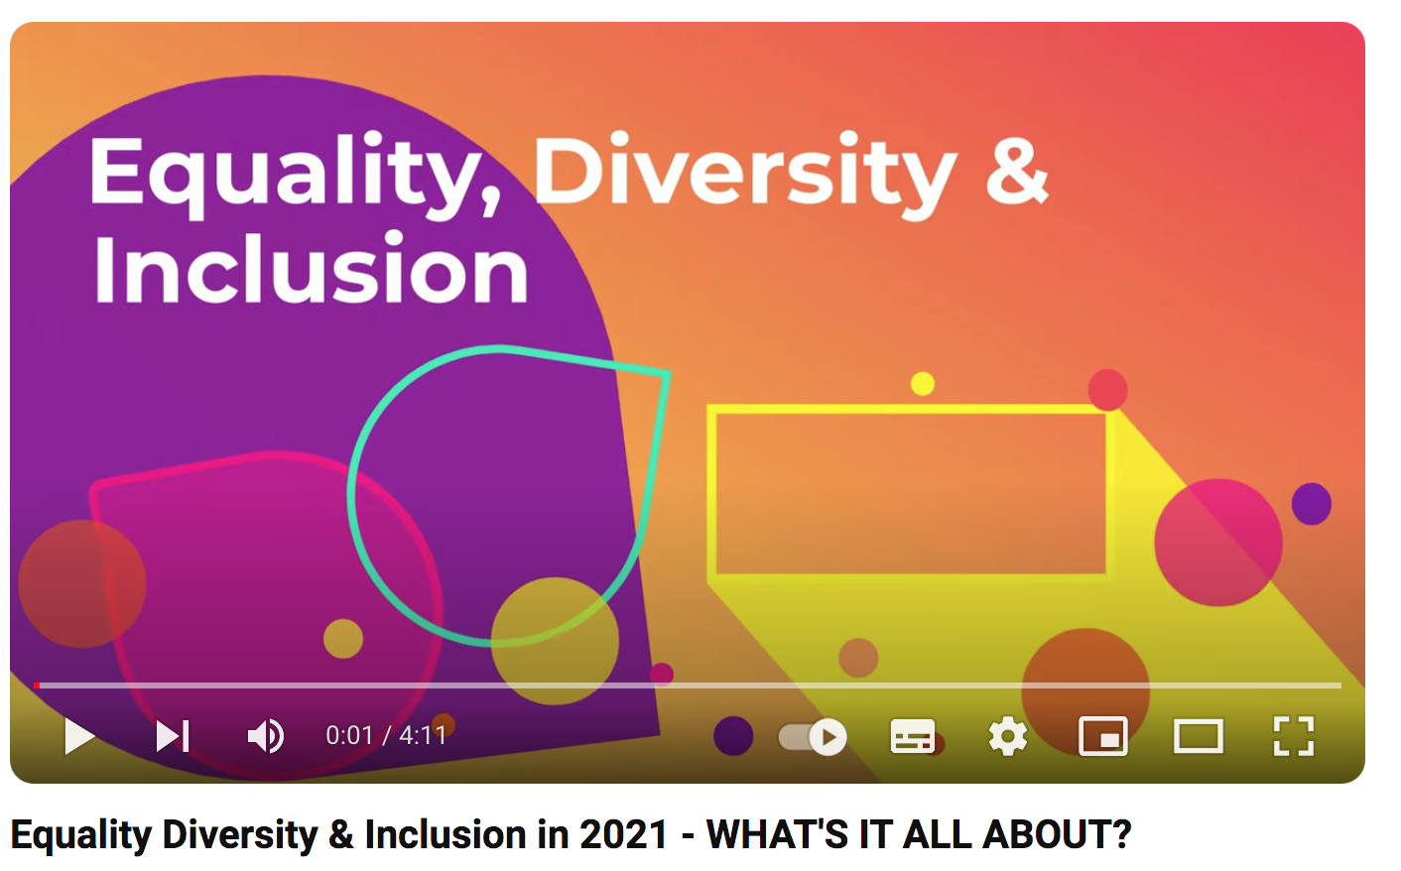
https://www.youtube.com/watch?v=maw6hmlNh44

Slide 6
WOOCLAP 1
What do you think of when you hear the phrase EDI?
HBJHRZA

Slide 7
Key Legislation in the UK
The 2010 Equality Act
The Equality Act protects people against discrimination in the workplace because of certain protected characteristics
Under the Equality Act, there are nine protected characteristics:
  Age
  Disability
  Gender reassignment
  Marital status (including civil partnership)
  Pregnancy and maternity
  Race or Ethnicity
  Religion or Religious belief
  Sex
  Sexual orientation
Are there any characteristics that are not on that list, that you think should be?

Slide 8
Key Terms
Direct discrimination - when a person is treated less favorably because of a protected characteristics
Indirect discrimination – when a rule, condition or practice disadvantages some people
Discrimination by association - discrimination against a person because they associate with a person who has a protected characteristic
Harassment – unwanted conduct relating to a protected characteristic
Victimisation – when an employee is treated poorly because they have made or supported a complaint under the 2010 Equality Act

Slide 9
Key Terms cont…..
Positive discrimination – employing members of certain groups who have been traditionally discriminated against (rather than because they are suitable for the role). Also, relates to the use of quotas based on protected characteristics- Illegal in the UK but not in all countries!
Positive Action – encouraging applications from certain groups and taking action to ‘level the playing field’
Occupational Genuine Requirement – a defense of claims of positive discrimination (allows employers to state because of the nature of the job, a genuine requirement is necessary e.g. women’s centre

Slide 10
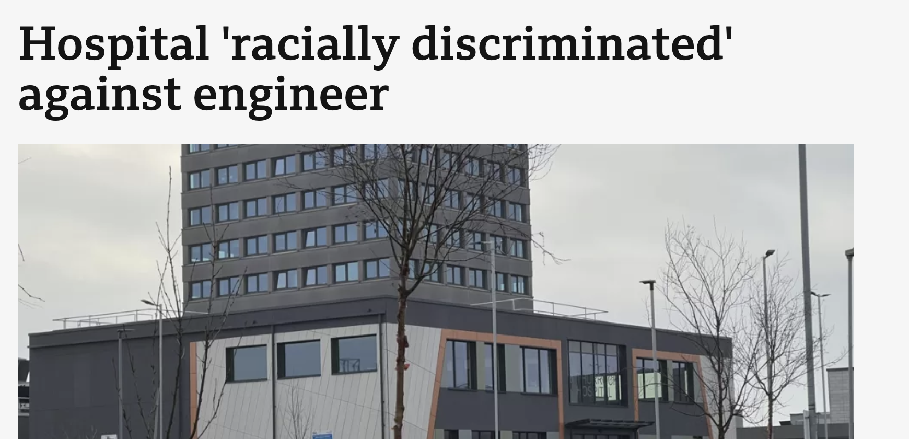

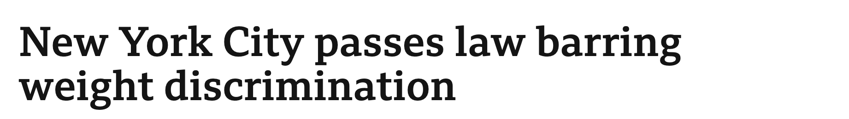
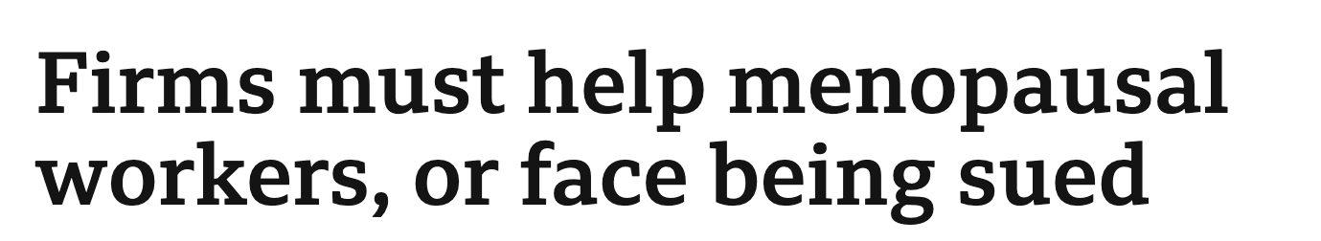
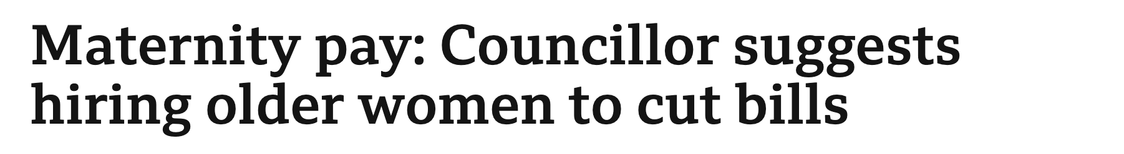
Discrimination Headlines…….

Slide 11
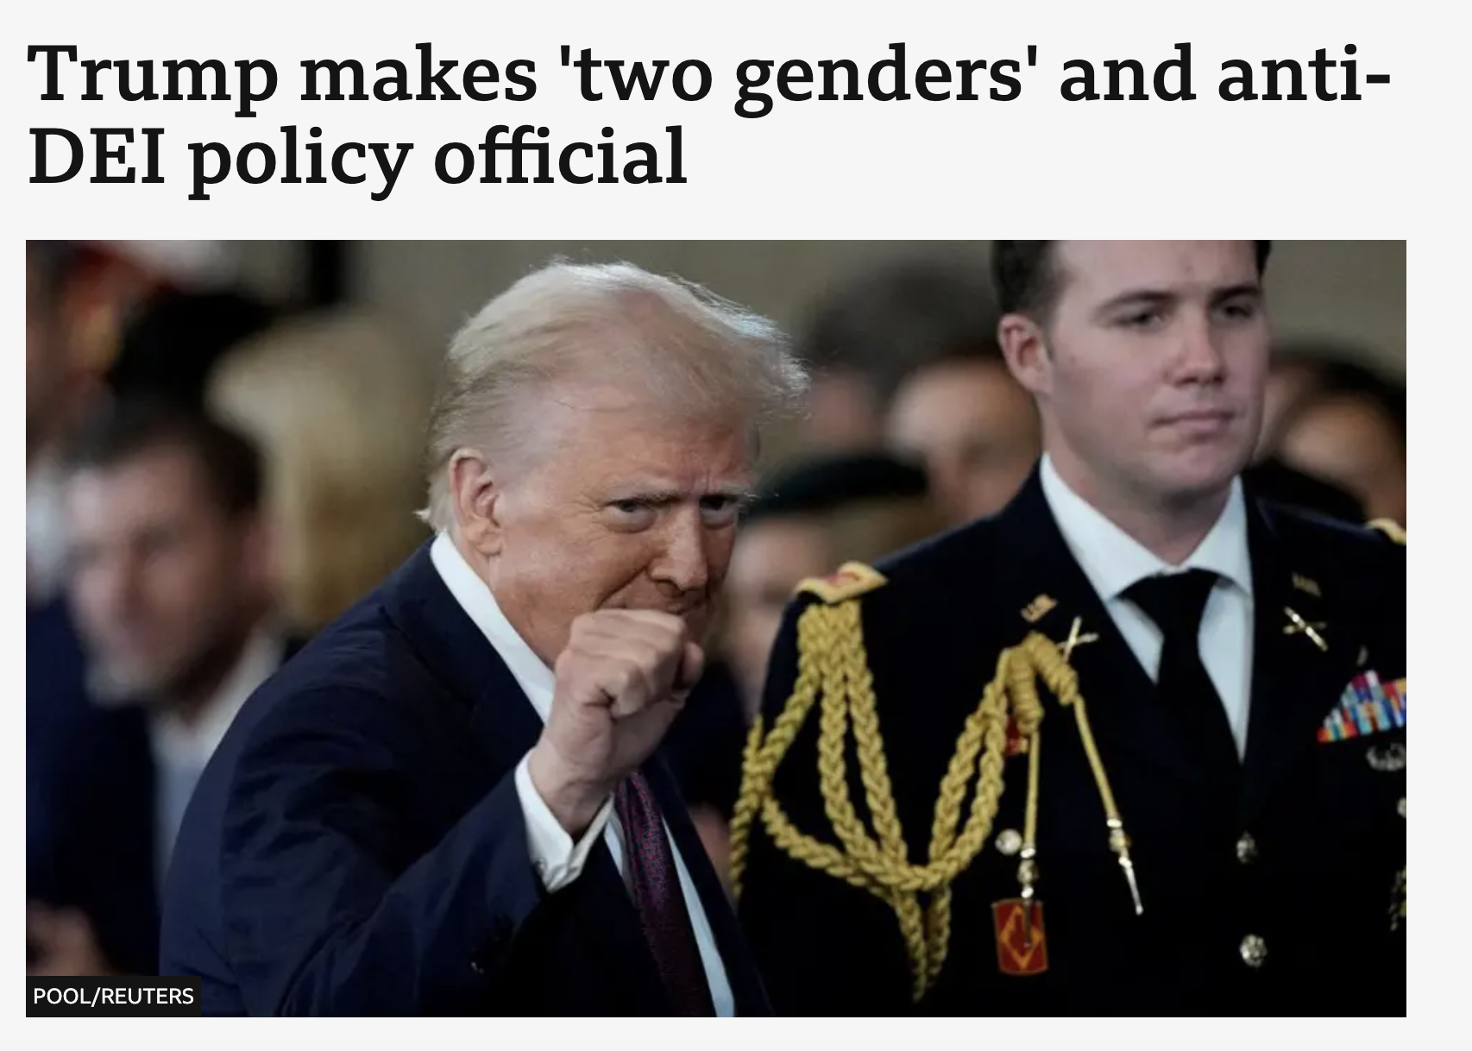
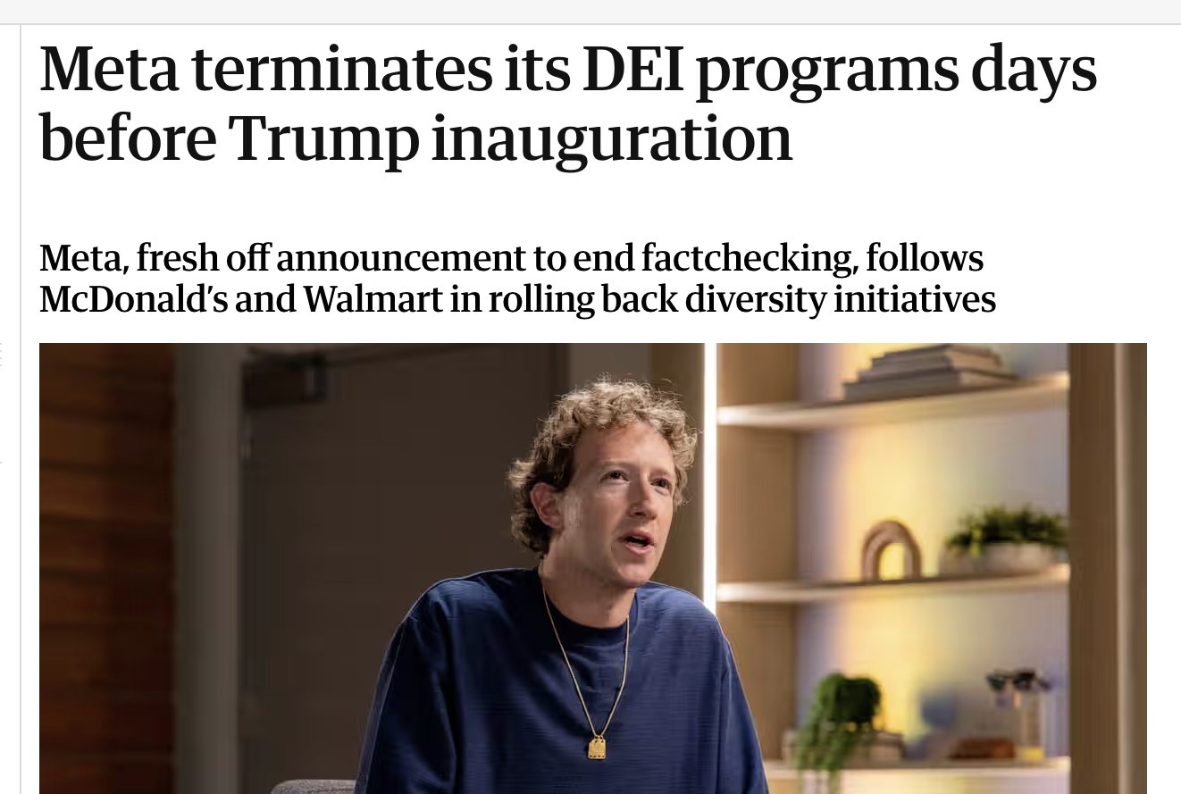
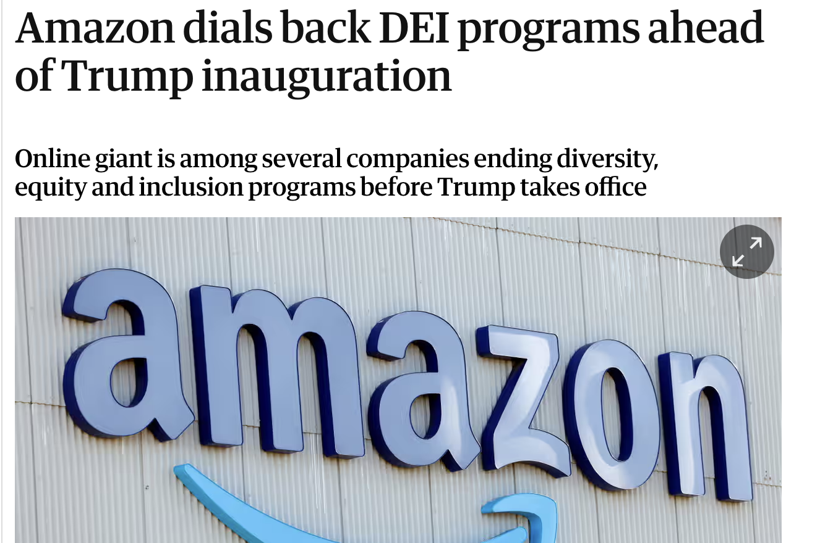
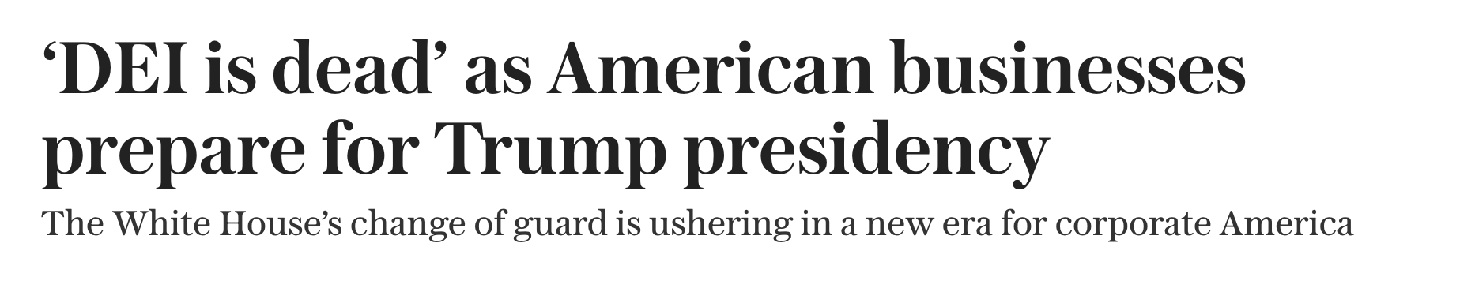

Slide 12

BBC Storyville: Speechless - The New Campus Revolution (April 2026)
https://www.bbc.co.uk/programmes/m002v2w6

Slide 13
Discrimination in the Workplace
Gender
The gender pay gap for full-time workers is entirely in favour of men for all occupations
When looking at age groups, the gap for full-time workers remains small at younger ages; however, from age 40 onwards the gap widens reaching its peak between ages 50 to 59.
According for the Office for National Statistics (ONS), median hourly pay for full-time employees was 7.7% less for women than for men in April 2023,
Office for National Statistics (GB) Nov 2023
https://www.ons.gov.uk/employmentandlabourmarket/peopleinwork/earningsandworkinghours/bulletins/genderpaygapintheuk/2023#:~:text=In%202023%2C%20the%20gap%20among,seen%20in%202019%20(17.4%25).

Slide 14
Discrimination in the Workplace
Race
Employment pay gap: black workers get paid 8.3% less than white workers – costing them an average of £1.15 an hour.
Qualifications pay gap: black workers whose highest qualifications are A-levels earn 10% less than their white peers – missing out on an average £1.20 per hour.
Type of employment: ethnic minority workers are over a third more likely than white workers to be stuck in temporary or zero-hours work.
Abuse at work: more than a third (37%) of ethnic minority workers have been bullied, abused or singled out at work.
Effects of racism : TUC polling shows that over half (57%) of BME women affected by bullying and harassment have suffered mental health problems.

Slide 15
Discrimination in the Workplace
LGBTQ+
In Britain almost one in five LGBTQ+ staff (18%) have been the target of negative comments or conduct from work colleagues in the last year because they're LGBT.
One in eight trans people (12%) have been physically attacked by customers or colleagues in the last year because of being trans.
One in ten black, Asian and minority ethnic LGBTQ+ staff (10%) have similarly been physically attacked because of their sexual orientation and/or gender identity, compared to three per cent of white LGBTQ+ staff.
More than a third of LGBTQ+ staff (35%) have hidden or disguised their identity at work in the last year because they were afraid of discrimination.
One in eight lesbian, gay and bi people (12%) wouldn’t feel confident reporting any homophobic or bi-phobic bullying to their employer.
• Stonewall, LGBT At Work, Report 2018

Slide 16

Why do people discriminate?

Slide 17
WOOCLAP 2
Should organisations be allowed to set targets for the proportion of certain groups e.g. women or ethnic minorities in senior management?

Slide 18
Theorising equality, diversity and inclusion

Slide 19
John Rawls: A Theory of Justice
How should the basic institutions of society distribute rights, opportunities and resources?
Justice as Fairness
Rawls asks which principles people would choose for society if the choice were made under fair conditions.
The focus is the 'basic structure' of society: major political, social and economic institutions.
Inequality is not automatically unjust — the key question is whether institutions are fair.
1. Equal basic liberties
Each person should have an equal claim to an adequate scheme of fundamental liberties compatible with the same liberties for others.
2. Fair equality of opportunity
Social and economic positions should be genuinely open to all under conditions of fair equality of opportunity.
3. Difference principle
Social and economic inequalities are permissible only where they work to the greatest benefit of the least advantaged.
Source: Rawls, J. (1971). A Theory of Justice. Harvard University Press.

Slide 20
The Veil of Ignorance
A thought experiment for deciding what a fair society would look like
You do NOT know…
your class, wealth, gender, ethnicity, abilities, religion, social status or life chances
You DO know…
general facts about society, economics and human behaviours
You must choose…
the rules and institutions that everyone will live under
Why does this matter for EDI?
Because you do not know which social position you will occupy, you have a reason to design institutions that protect people who could be disadvantaged.
Rawls provides a moral argument for fairness that does not depend on EDI producing higher profits or organisational performance.
For HRM, the question becomes: what employment rules would we choose if we did not know whether we would be advantaged or disadvantaged by them?
Discussion question
Behind the veil of ignorance, what rules would you choose for recruitment, pay, promotion and workplace treatment if you did not know what position you would occupy in society?

Slide 21
Social Identity Theory (Tajfel & Turner, 1979)
People categorize themselves in terms of the social groups with which they identify (e.g. gender, ethnicity, age, religion, nationality, occupation etc.)
Examples: I am a women, I am a mother, I am an academic
Categorization provides lots of benefits to individuals:
  Provides them with a sense of belonging
  Positive impact on their self-esteem
  A guide for behaviour (e.g. norms associated with different social identities)
In group = those that are the same, out-group = those that are in different but relevant groups
Being categorized as out-group can lead to stereotyping and other forms of bias (such as prejudice)

Slide 22
Intersectionality
Intersectionality is a framework for understanding how various aspects of a person's identity, such as race, gender, socioeconomic status, sexual orientation, and more, intersect and interact, creating overlapping systems of discrimination or privilege.
Term originated by the scholar Kimberley Crenshaw in the 1980s to show how discrimination laws in the USA were not able take into account the intersection of multiple minority identities (e.g. black, working class)
Multiple Identities - people belong to more than one social category or identity.
Oppressions and privileges are not isolated. Systems like racism, sexism, classism, and ableism are interconnected and can amplify one another.

Slide 23
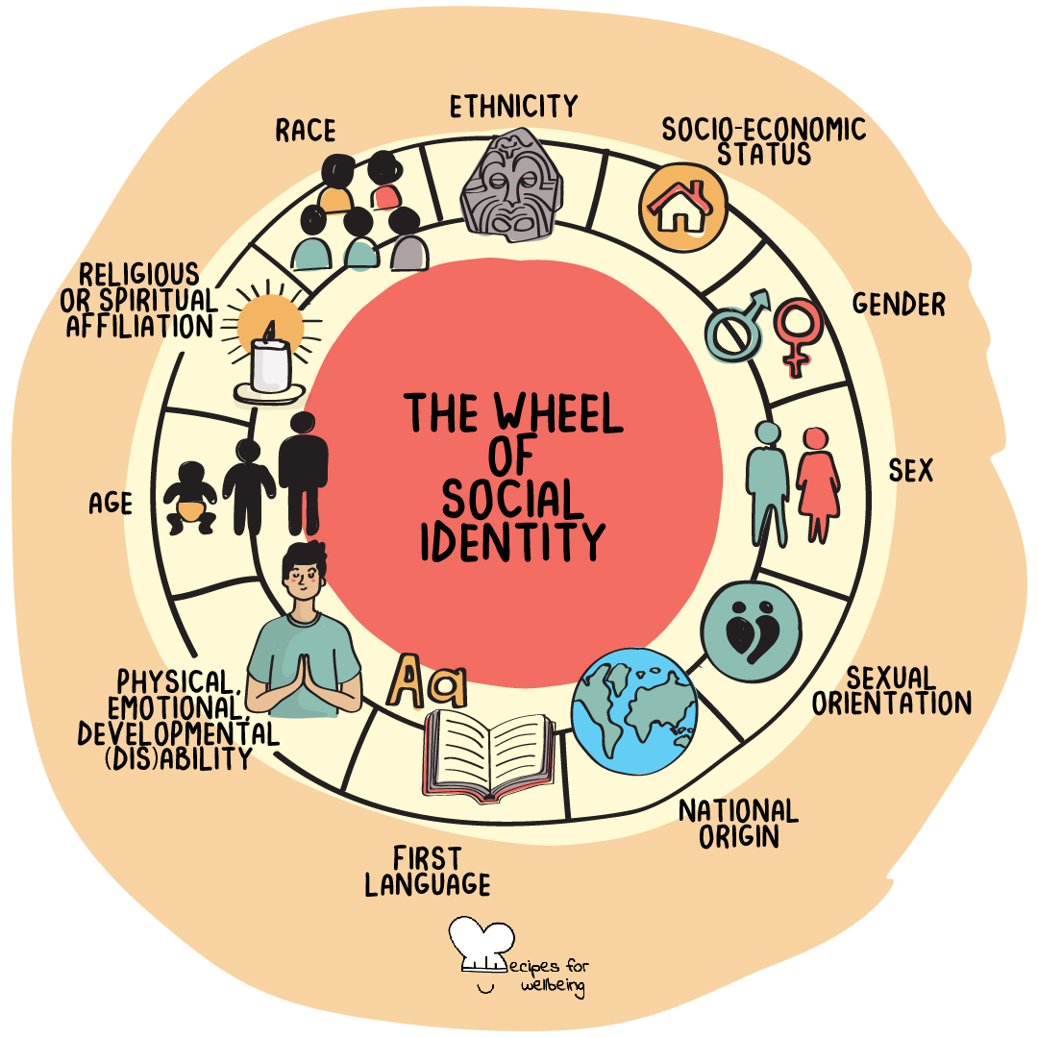
The Identity Wheel

Slide 24
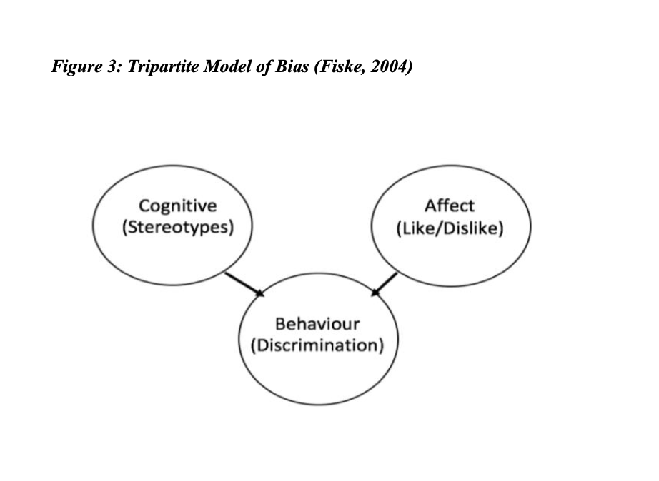
What is Bias?
Tri-partite model of bias (Fiske, 2004)
Cognitive element - what we think about other groups, including stereotypes (e.g. men make better leaders than women)
Affective element – what we feel about other groups, do we like them or dislike them? Do they make us angry? Often referred to as ‘prejudice’
Behavioural element – what we actually do is often because of our thoughts (stereotypes) and feelings (prejudice) (example could be not promoting a women into a leadership role)

Slide 25
Stereotyping - Discrimination
A widely held but oversimplified (e.g. a generalisation) idea about a person (or group of people)
Examples of stereotypes in the workplace:
  Older workers are slower and less productive than younger workers
  Older workers are less able with technology than younger workers
  Younger workers are less committed to their jobs than older workers
  Younger workers are lazier than older workers
Stereotypes have been found to have a negative impact on a variety different work outcomes including: recruitment and selection decisions, promotion and career opportunities, performance management, and redundancies (Bradley-Geist & Schmidtke, 2018; Heilman, 2012; Posthuma et al, 2012)

Slide 26
Implicit or Unconscious Bias
Unconscious bias relates to the implicit associations we have about people outside of our conscious awareness
This is why perceptions of own ‘isms’ are often flawed (e.g. “I’m not racist or sexist”)
This concept has led to the development of numerous unconscious bias tests and a training area for employees.
However, it has been argued that unconscious bias training may be largely ineffective (Noon, 2018), which raises questions about its utility (Onyeador et al, 2021).

Slide 27
Managing Diversity
The concept of ‘diversity management’ emerged in the late 1980s.
Managing diversity encompasses lots of different concepts and refers to the systematic and planned commitment on the part of organizations to recruit and retain employees from diverse backgrounds (Thomas, 1992).
Managing diversity often presents a business case for equal opportunities, linking diversity related initiatives with business strategy.
What do you think - do you think organisations should manage diversity as it makes good business sense?

Slide 28
Managing Diversity……A Changing World
Huge demographic changes for the labour market
An ageing population, globalization, and changes in work/home life
Increase in numbers of women, ethic minorities and older workers in the labour market.
Organizations wanted to turn these demographic changes into an advantage - to capitalise on the new talent that was not previously available to them

Slide 29
The Moral or Social Justice Rationale
Having fair and equitable workplaces is the ‘right’ thing to do
Organisations should promote interaction between groups (women and men, able bodied and less able bodied)
Helps to foster culture change in an organization (culture can shape our beliefs, norms and behaviour)
Encourages attitude adjustment and can counter prejudice in the workplace
Can increase commitment/loyalty to the employer
Creates organisational harmony – it is socially ‘just’ and morally desirable

Slide 30
The Economic Rationale for Managing Diversity
'The Business Case’
Improves productivity and encourages more innovative solutions to problems (could increase profits!)
Assists in the understanding of a greater number of customer needs thus potentially increases the customer base (Segal, 1997)
Enhances corporate competitiveness and continued survival
Helps lower the likelihood of litigation

Slide 31
Principles of Diversity Management
Pitts (2006) conceptualizes diversity management to consist of three inter-related components:
  Recruitment and outreach – organisations should actively seek out diverse employees
  Valuing difference – differences (both visible and non-visible) must be valued
  Pragmatic programs and policies – a set of management tools that ensures that diverse groups in the workplace have their needs met

Slide 32
Diversity Initiatives
Encourage voice/representation from all employees (e.g. advisory councils, support groups)
IBM has created network groups for LGBTQ employees in 12 countries
Career development initiatives (e.g. leadership development programs specifically aimed at women, ethnic minorities)
Stereotype and unconscious bias training
~£10 billion pounds spent annually on diversity training in USA, as of 2025

Slide 33
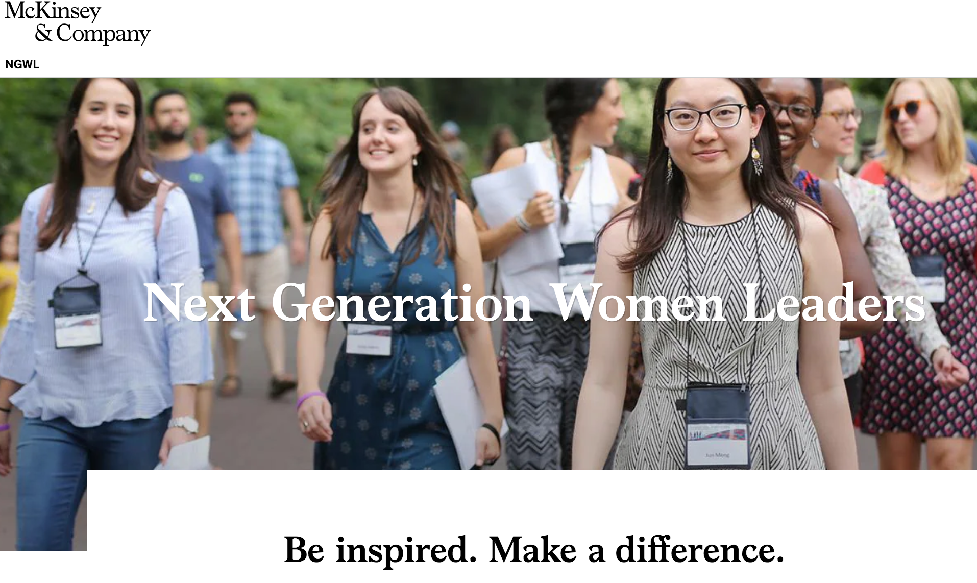


Examples of Diversity Initiatives
IBM

Slide 34
CASE STUDY 1 – IBM’s global HRM and LGBT+ inclusion
IBM
Why IBM is useful: it lets us compare a global corporate EDI policy with different legal and cultural contexts.
IBM globally
Western IBM / LGBT+
Critical issue
US-headquartered technology and consulting multinational
IBM presents inclusion as linked to innovation, creativity and competitive success
Long institutional narrative: IBM traces non-discrimination policy back to 1953
Current global policy covers sexual orientation, gender identity and gender expression
LGBT+ inclusion sits within wider equality, anti-harassment and employee voice frameworks
Western legal systems often give clearer employment protection and relationship recognition
A global EDI policy is not experienced identically everywhere
US/Western DEI is now also legally and politically contested
Question: compliance, social justice, business case, or corporate identity?
Discussion: does a global multinational have a responsibility to standardise LGBT+ rights across its operations, or should it adapt to local law and culture?

Slide 35
LGBT+ law: West and China
“The West” is not uniform, but UK/US/EU contexts generally give clearer statutory workplace protections than mainland China.
Issue | UK/US/EU-type Western position | Mainland China position
Employment protection | Sexual orientation and gender reassignment / gender identity are generally protected in employment law. | No long-standing explicit national statutory protection in labour law; some recent judicial signals may support claims, but protection is less codified.
Relationship recognition | Same-sex marriage or civil partnership is legally recognised in many Western jurisdictions, including the UK. | Same-sex marriage and civil unions are not legally recognised.
Corporate visibility | Pride networks, employee resource groups and partner benefits are relatively normalised in many large firms. | More privacy risk: participation in LGBT+ schemes may disclose identity or relationship status.
HRM problem | EDI often framed as compliance + inclusion + employer branding. | EDI requires localisation: confidentiality, cautious visibility, and mechanisms not dependent on legal marriage certificates.

Slide 36
IBM China: LGBT+ policies
IBM
IBM China shows how a global EDI framework can be adapted where formal legal recognition is weaker.
What IBM China introduced
Why it is analytically interesting
EAGLE LGBT+ employee network
“EAGLE and Friends” ally group open to all employees
(EAGLE - Employees And friends of Gays and LEsbians)
Executive sponsor for the network
Ally training and reverse mentoring: LGBT+ employees mentor line managers
Same-sex partner benefits from 2011 using an IBM affidavit rather than a marriage certificate
Pride month awareness events and external work with Aibai Culture and Education Centre a Chinese non-profit organisation dedicated to promoting equal rights for the LGBT+ community through public advocacy, education, and medical support for those living with HIV
Moves beyond training: benefits, networks, voice and management learning
“Friends” model reduces the risk that participation publicly identifies LGBT+ staff
Employer can partly compensate for absent legal marriage recognition
But benefits require disclosure of sensitive relationship data to HR
Evidence gap: public material shows policy design, but limited independent evaluation of outcomes
Seminar question: is IBM changing the causes of workplace inequality, or mainly creating a safer organisational micro-environment inside a more unequal wider context?
Sources: Stonewall Global Workplace Briefing: China (2018); IBM Data & Policies / Inclusion@IBM; Community Business China resource guide.

Slide 37
Case Study 2 - Mastercard and Diversity Management
A useful case because it combines visible EDI initiatives, global branding, STEM pipeline work and recent controversy over pay equity.
Context
• Global payments and technology company operating in 200+ countries and territories.
• EDI is linked to talent, innovation, brand reputation and access to the digital economy.
• The case is not only about internal HR: Mastercard also frames inclusion through social-impact programmes.
Main EDI initiatives
STEM pipeline
Girls4Tech/Kids4Tech educated 279,000 students in 2025; aims to widen future access to technology careers.
Pay equity
Public commitment to equal pay for equal work across gender, race and ethnicity.
Culture and voice
Inclusion policies, employee communities/resource groups and employer-branding around belonging.
Critical issues
• Pipeline initiatives may improve future access but do not automatically alter promotion, pay or senior representation now.
• Adjusted “equal pay for equal work” can coexist with wider median pay gaps if groups are concentrated in lower-paid roles.
• In 2025 Mastercard agreed a $26m settlement in a US pay-bias lawsuit while denying wrongdoing; the settlement included audits of employment practices.

Slide 38
Mastercard
Mastercard offers a number of key initiatives including:
  Encouraging school age girls to consider STEM careers
  Equal pay for equal work (is committed to closing racial and gender pay gaps)
  Sex reassignment surgery coverage
One in four of senior managers are not white and nearly half of its global workforce are women

Slide 39
Do diversity initiatives actually work?
Are they culturally specific? (or can they be transferred to other areas of the globe)
European Commission claims that managing diversity benefits businesses (EC, 2005):
  They have access to a wider talent pool
  They may improve their brand reputation/corporate image
  Bring more innovation
However, companies are not evaluating many of their diversity initiatives
Managers do not know the impact of these strategies and do not want to know (Kochan et al, 2003)
The diversity-performance link is more a matter of belief than scientific measurement (Klarsfield, 2009).

Slide 40
Diversity in practice
Some argue that the business case for EDI hinders diversity in the workplace (Wilkinson, Dundon and Yates, 2025). This is because in difficult times diversity may not be seen as a priority by organisations.
Businesses may also engage in ‘diversity washing’ without being committed to real and meaningful change.
Some minority groups may be favoured over others. Woodhams and Danieli (2000) argue that rarely has there been a ‘business case’ for more disabled workers.
Does the business case actually obscure the aims of the social justice/moral approach to diversity? (e.g. to promote fairness).

Slide 41

Artificial Intelligence & EDI 1
Analyse data and provide EDI insights to organisations
Potentially reduce bias in HRM processes and decision making
Recruitment and selection – anonymize CV’s/application forms, filter candidates etc.
Performance management – evaluate performance data
Provide targeted EDI training for employees

Slide 42
Artificial Intelligence & EDI 2
Algorithmic Bias – Who designed the algorithm, what data is basing it’s learning on, can end up reinforcing inequalities instead of eradicating!
Transparency – what data is it basing its decisions on?
Using technology for human related processes – does this limit real social change?
Power relations – who designs and has access to AI systems? (are minority groups included?)
Privacy – issues around use of data/consent etc.
Answer – AI is a tool and requires proper management and oversight in the workplace. Shouldn’t be given too much automated control over HR/employment relations issues

Slide 43
Lecture Summary
EDI remains a key issue for many organisations
Employees in the UK are protected by legislation such as the 2010 equality act.
The use of positive discrimination and quotas is still illegal in the UK.
In spite of legislation, discrimination is still widespread, as evidenced by the gender and racial pay gaps.
There are various theories as to why discrimination occurs, however, key concepts appear to be stereotyping and unconscious bias.
The concept of ’managing diversity’ first emerged in the late 1980s in response to demographic changes in the labour market.
There are various different diversity management initiatives and organisations invest huge sums of money into these programs, however, there is some debate about how effective these initiatives actually are!

Slide 44
References
Ellis, C., 1994. Diverse approaches to managing diversity. Human Resource Management, 33(1), pp.79-109.
Heilman, M.E. and Eagly, A.H., 2008. Gender stereotypes are alive, well, and busy producing workplace discrimination. Industrial and Organizational Psychology, 1(4), pp.393-398.
Klarsfeld, A., 2009. The diffusion of diversity management: The case of France. Scandinavian Journal of Management, 25(4), pp.363-373.
Noon, M., 2018. Pointless diversity training: Unconscious bias, new racism and agency. Work, employment and society, 32(1), pp.198-209.
Pitts, D.W., 2006. Modeling the impact of diversity management. Review of Public Personnel Administration, 26(3), pp.245-268.
Shen, J., Chanda, A., D'netto, B. and Monga, M., 2009. Managing diversity through human resource management: An international perspective and conceptual framework. The International Journal of Human Resource Management, 20(2), pp.235-251.
Tajfel, H. and Turner, J.C., 2004. The social identity theory of intergroup behavior. In Political psychology (pp. 276-293). Psychology Press.
Wilkinson, A., Dundon, T., & Yates, E. (2025). Contemporary human resource management: Text and cases (7th ed.). SAGE

