Slide 1
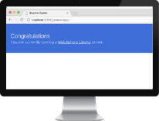
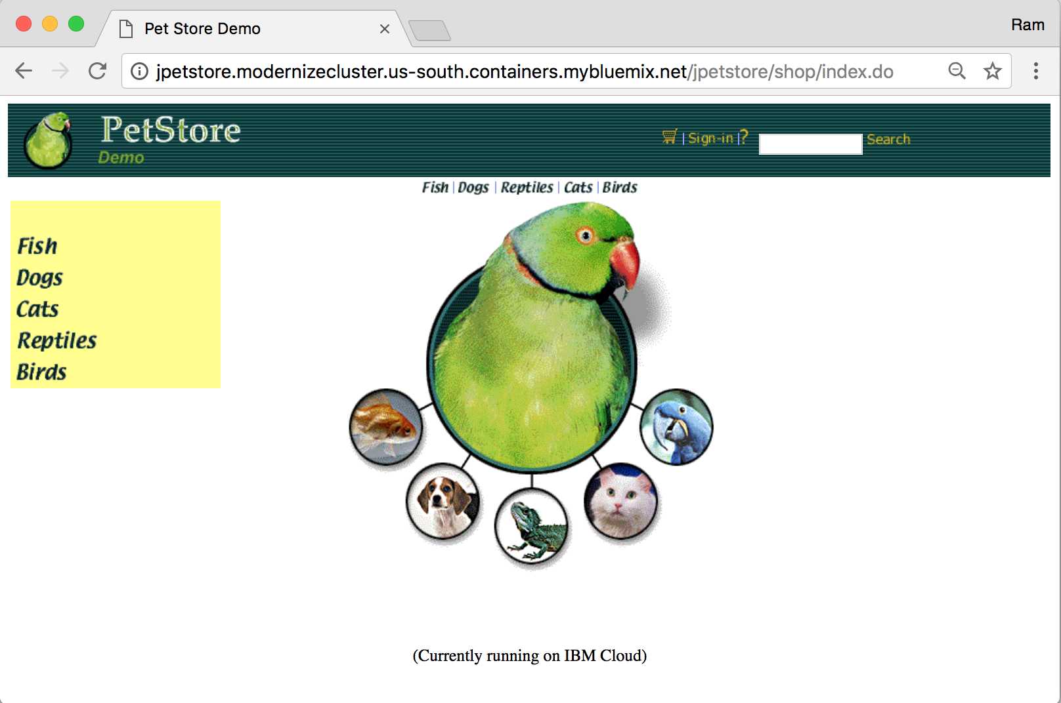




Java JPetStore
MySQL DB
TWILIO
MMS SEARCH
WATSON
VISUAL RECOGNITION
IBM CLOUD
KUBERNETES
SERVICE

