Slide 1
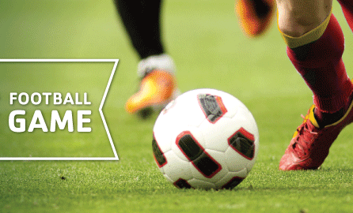
Football Management System

Slide 2
Overview
Introduction
Motivation
Scope
Objective
Contribution
Design
▪ER Diagram
▪Tabular Representation
Design verification
▪Which normal form it follows?
Conclusion

Slide 3
Introduction
Football Management System is a system that will be used to manage football competitions. It will be focused on managing all the information used during any tournament started from registration process, during the tournament and until the tournament is over. Still most of the football organization use filing method to store and manage all the information during the tournament period. The filing method gives few complications for staffs to handle all those data. The paper also might get decay if it’s been using severally. But this system that is going to be developed will provide a complete systematic database which will maintain all the tournament data and solve the problem. Therefore all the jobs during the tournament that will take part will become easier, faster and perfectly manageable.

Slide 4
Motivation
The football management system will benefit in many ways; it will help to control the overall processes during a tournament. The system will provide numerous facilities such as it will help to register new players and it will manage the payroll of the particular players based on the certain criteria’s given in the scenario. The system will manage the stock of the teams clothing in the inventory and it will help in keeping the track of what the maintenance part is going on in a team.
Previously we talked about most organization using filing method to store all the information during a tournament. This has cause few typical problems due to filing method of storage.
Filing method is hard to be managed these days. Information that store using paper might get decay if it is being used severally. This may cause the document hard to be read. Searching a document also will cost a long period to be done.

Slide 5
But the main purpose of designing this management system is to manage the whole system online so that all the work goes in a very systematic manner. An account maintaining technique or we can say that all the system which is handled manually to maintain the register which leads to loss of data and security problem issue is also being faced.
In this system, the main role is of players who can become a member of a team by doing registration. Players can view their profile and can also see their payrolls if given
Also tournament tickets for football viewers are managed by the database which makes it easy to get the tickets. All the information about the games are also included. It will also keep the good record of maintenance of the stadium.
This management system is prepared for providing all the necessary things which is needed by the player, the viewer and the other staffs. This system can also keep the record of all the game information in the database.

Slide 6
Scope
The system will cover all the tournament process started from registration process, during the tournament and until the tournament is over. However, it will not cover any matters other than the tournaments or games and teams. It is because usually other person or department manages extra curriculum activities. There are six main modules that are going to be developed which are;
Profile:
Every player and team has their own profile which is filled with legit information about them. Admin can change the profiles as needed .
Tournament Management:
It manages the registration process before the tournament held. The system able to register teams, coaches. players, officials that are going to involve in the tournament. It consist data that are going to be used along the tournament besides showing their status along the tournament.

Slide 7
Fixture Generation :
This module create fixture calendar for the whole tournament and match calendar for each team compete in the tournament. It consists location and important details of each matches.
Matches Management:
System will be able to register player selection for each match. It can produce pre-printed paper which been use to fill in the match result and report. It also compile all the matches results and reports .
Results and Reports:
On this module, system able to generate tounament-standing table that show the position of each team based on points collected after each matches. All matches result and report can be view through this module. Other report also can be view here such as top league goal scorer, yellow cards and player contributions in the tournament.

Slide 8
Financial Aspects:
All the stocks cost, salary, teams cost, every financial facts are stored here.
To short, the information system will have to manage the following functions:
Registration of new players, new teams etc.
Purchase of sports apparels – shirts, shorts, boots, gloves, etc.
Maintenance of Stadium
Managing of players’ payroll
Match playing bonus
Goal bonus
Claims
Salary increments
Bonus for corner goal
Managing the tickets of the games
Managing results of the games.

Slide 9
Objective
Although a management system makes others job easier and faster, but creating the database is really difficult . It takes much effort and time to create a full database. Due to our limitation of time we cant go for all the scopes. But what should we do is :
Go for the objective modules.
Objective modules :
To produce an efficient system which can manages players. coaches, teams and matches information during the tournament.
To generate common reports that can be used during the football tournament such as tournament standing based on the match result.
To sell tickets of the football tournaments online and save the data of filled seats.

Slide 10
Contribution
This database management system can fulfill the given objective mostly. This project can help :
to manages the registration process . Admin can insert, delete and update information and can view every necessary data as needed.
to manages players coaches, teams and matches information during the tournament.
to have a count of which ticket has been sold and which has not been of a tournament.

Slide 11
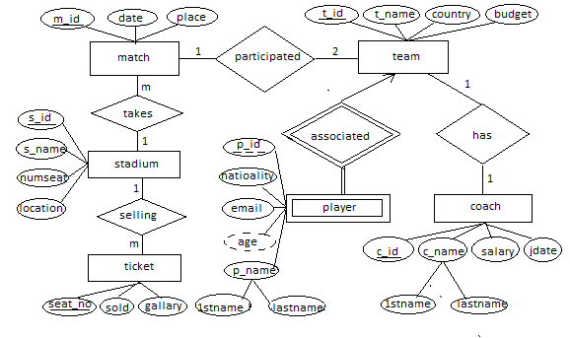
ER Diagram

Slide 12
Tabular Representation
match(m_id, date, place)
team(t_id, t_name,country, budget)
player(p_id, 1stname,lastname,nationality, email, dob)
coach(c_id, 1stname,lastname,salary,jdate)
staduim(s_id,s_name, numseat, location)
ticket(seat_no,sold,gallery)

Slide 13
Which normal form it follows?
It follows 4NF,
which needs two criteria’s. 1) Must be 3NF
# Must be 2NF
i) Must be 1NF
a) Primary key exists.
b) No derived key belongs here.
c) There can not stay multiple columns in same information.
ii) No partial key belongs here.
# No transitive dependency belongs here.
2) No multivalued dependency belongs here.

Slide 14
Conclusion:
Overall, this Football Management System stores the players details, teams details, information of selling tickets etc. It allows storing the details of all the data related to football . The implementation of the system in the organization will considerably reduce data entry, time and also provide readily calculated reports.
Language has been used: ○ C# and SQL language has been used .
Kind of database :
○ This is a desktop based database.
Limitation:
This project has limitations. Such as it is a desktop based database. It is not well upgraded.

Slide 15

Thank You Group member: Jinat Afroj Puspo ; Id:2013-1-60-037 Nabil Shawkat Neal ; Id:2013-1-60-023

