Slide 1

Air Ticket Management System

Slide 2

Participants
Md. Abdullah-Al-Kafi
ID: 2013-1-60-033
S. M. Amirul Islam
ID: 2013-1-60-048

Slide 3
Content
Introduction
Motivation
Scope
Contribution
Details
ER Diagram
Tabular Representation
Normalization
Conclusion

Slide 4
Introduction
Air ticket management system is a computerized system.
Air ticket management system is made for customers to book tickets for desired destinations.

Slide 5
Motivation
Air ticket management system reduces the amount of paper work thus saving time and effort of the customers. They can place their request as per their requirement and get results immediately on particular flight as per their desired location and as per price.

Slide 6
Scope
Online flight booking
Various information like:
Customer information
Flight details
Different types of flights
Different types of planes
Airline information
Customer can reserve tickets based on:
Business class or Economy class
Fare determined by airlines and routes

Slide 7
Contribution
We can’t fulfill all our scopes for some limitations. However, We can implement-
Desktop based ticket booking system
Flight booking system based on only time, date and destination
Fixed fare for all seats in a specific flight

Slide 8
Details
“Air Ticket Management System” books tickets in seller’s point of view.
It registers customers information and books ticket based on customers’ requirements. The system uses flight, fare and other information from database to achieve that goal.
The system returns total fare after booking a ticket.
A customer can book various amount of tickets.

Slide 9
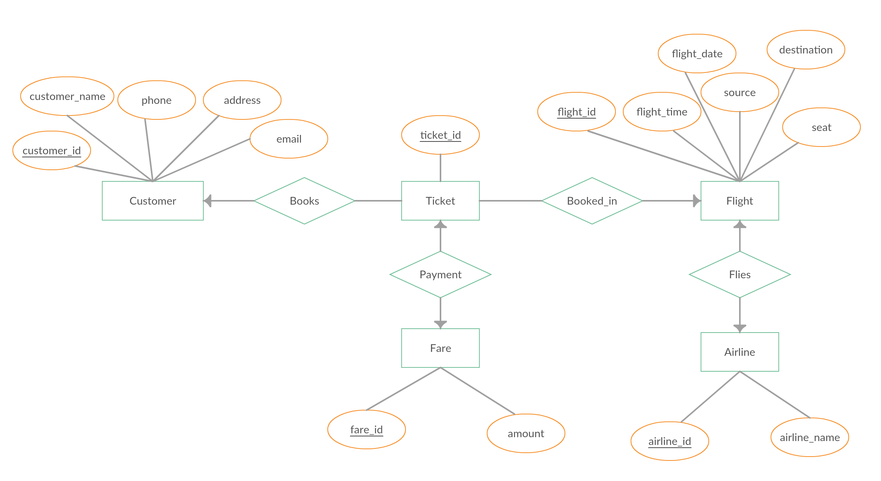
ER Diagram

Slide 10
Tabular Representation
Customer(customer_id, customer_name, phone, address, email )
Ticket(ticket_id, customer_id, flight_id)
Flight(flight_id, flight_time, flight_date, source, destination, seat)
Airline(airline_id, airline_name, flight_id)
Fare(fare_id, amount, ticket_id)

Slide 11
Normalization
Which normal form it follows?
Customer Table
It is in 1NF because primary key is set and no multiple column for same attribute.
It is in 2NF because there is no partial key dependency.
It is in 3NF because there is no transitive dependency.
It is in 4NF because there is no multivalued dependency.
Ticket Table
Because primary key is set, so it is in 1NF.
There is 1FD and no multivalued dependency so it is in 4NF.
Flight Table
Because primary key is set, so it is in 1NF.
There is 1FD and no multivalued dependency so it is in 4NF.

Slide 12
Normalization (continued)
Airline Table
Because primary key is set, so it is in 1NF.
There is 1FD and no multivalued dependency so it is in 4NF.
Fare Table
Because primary key is set, so it is in 1NF.
There is 1FD and no multivalued dependency so it is in 4NF.

Slide 13
Conclusion
This system will ensure clear advantage over the manual system in more reliable, efficient and faster way. It will maximize work within minimum amount of time.

Slide 14
Thank You!

