Slide 1
CSC 104 | OBJECT-ORIENTED PROGRAMMING
CLINIC STAFF
FINAL PROJECT
Presentation & System Demonstration
APPOINTMENTS
Clinic Appointment System
MaITeam/CKHX1
RECORDS
CONFIRMED
Caraga State University • College of Computing and Information Sciences

Slide 2
Presentation roadmap
A focused 15-minute defense of the problem, design, OOP implementation and working system.
01
Introduction
Problem, target users, proposed solution
2 min
02
System Design
UML diagrams and workflow
3 min
03
OOP Implementation
Show where required OOP concepts are used
3 min
04
Live Demonstration
Core functions, CRUD, persistence, error handling
5 min
05
Questions & Defense
Answer questions and explain contributions
2 min
CSC 104 • OBJECT-ORIENTED PROGRAMMING • FINAL PROJECT DEFENSE
2

Slide 3
1. Project overview
The problem, primary users and the implemented response.
Project background
Problem statement
Clinic staff coordinate patient records, doctor details and appointment requests. Keeping these records separately makes it harder to check availability and track changes.
A small clinic needs linked records, reliable doctor-hour checks and protection against two active bookings for the same doctor at an identical date and time.
Target users
Proposed solution
Clinic staff / receptionist are the direct users. Patients and doctors are stakeholders, but this version provides no patient portal or separate doctor interface.
A Java console application for patient / doctor CRUD, automatic record IDs, appointment booking and lifecycle changes, doctor-schedule validation, exact-slot conflict checks and local file persistence.
The current build is a single-user, staff-operated console application.
CSC 104 • OBJECT-ORIENTED PROGRAMMING • FINAL PROJECT DEFENSE
3

Slide 4
Project objectives, scope, and limitations
The implemented features map directly to the clinic record and scheduling problem.
Objectives
Scope
Limitations
• Maintain linked patient and doctor records
• Manage booking, rescheduling, cancellation and completion
• Enforce doctor schedules, prevent active exact-slot conflicts and retain generated IDs
• Staff-operated Java console; patient / doctor CRUD and schedule management
• Appointment search and lifecycle operations
• Four domain data files plus id_sequences.txt; Save Data and normal Exit persist changes
• Single-user console; no login, roles or patient / doctor portal
• No database, server API or real email / SMS delivery
• Exact-start conflicts only; past dates, duration overlap, holidays and automatic doctor assignment are not handled
CSC 104 • OBJECT-ORIENTED PROGRAMMING • FINAL PROJECT DEFENSE
4

Slide 5
Why object-oriented programming?
OOP is the primary paradigm; procedural control flow and functional checks still support the application.
Procedural
Functional
Object-oriented
Organizes code around procedures and step-by-step operations. It can work for a small script, but shared record structures and repeated rules can become tightly coupled.
Uses functions to transform values, often avoiding mutation. Pure validation is predictable, but interactive input and file I/O still need a program boundary.
Models the clinic through objects that combine state and behavior. Classes, relationships and interfaces give records and operations clear responsibilities.
Why OOP? Patient and Doctor share Person fields; Appointment links existing people; services own booking rules. This fits the system’s persistent entities and state changes.
CSC 104 • OBJECT-ORIENTED PROGRAMMING • FINAL PROJECT DEFENSE
5

Slide 6
Requirements and system features
User needs are implemented as record-management and appointment workflows.
Functional requirements
Quality and validation
• Add, view, search, update and delete patients
• Add, view, search, update and delete doctors
• View / add doctor schedules (automatic SCH IDs)
• Book / view appointments (automatic APT IDs)
• Reschedule, cancel and complete appointments
• Automatic PNT / DOC IDs; save and restore records and counters
• Require key fields; enforce positive age and unique IDs
• Parse strict calendar dates and valid 12 / 24-hour times
• Check an available doctor schedule before booking / rescheduling
• Reject active same-doctor, same-date, exact-time conflicts
• Use custom exceptions and clear menu feedback
• Protect record links and service collection structure
Only claim behavior shown in the uploaded Java source; notifications are console demonstrations, not real delivery.
CSC 104 • OBJECT-ORIENTED PROGRAMMING • FINAL PROJECT DEFENSE
6

Slide 7
2. System design: Use Case Diagram
Clinic Staff is the only direct actor in the current console version.
CLINIC APPOINTMENT SYSTEM
STAFF GOALS
Manage patients
(create / view / update / delete)
Manage doctors
(CRUD and schedules)
• Maintain patient and doctor records
• Manage appointment lifecycle
• Review / search records and schedules
• Save records and generated ID counters
• Run the notification demonstration
Book appointment
Reschedule appointment
Cancel / complete appointment
View / search records
Clinic Staff
Save data / exit
Demonstrate notifications
Shared booking check: doctor schedule + active exact-slot conflict
Patients and doctors do not log in directly.
CSC 104 • OBJECT-ORIENTED PROGRAMMING • FINAL PROJECT DEFENSE
7

Slide 8
System design: Class Diagram
Core domain classes and relationships; supporting service and ID-utility classes are summarized below.
Person «abstract»
- id, name, phone, email
+ getRole()
extends
extends
Patient
- age, gender, address
+ getRole()
Doctor
- specialization
- schedules: List<Schedule>
+ addSchedule()
Schedule
- scheduleId, doctorId, day/date
- start, end, available
+ covers(date, time)
0..* schedules
1 patient
1 doctor
Appointment references existing Patient and Doctor objects. Doctor groups Schedule objects; exclusive ownership is not enforced.
Appointment
- appointmentId, patient, doctor
- date, time, reason, status
+ setDate() / setTime() / setStatus()
Supporting classes: PatientService, DoctorService and AppointmentService apply CRUD and booking rules. service.IdGenerator provides next(), observe(), load() and save(); FileManager handles data files.
CSC 104 • OBJECT-ORIENTED PROGRAMMING • FINAL PROJECT DEFENSE
8

Slide 9
System workflow: Activity Diagram
The system previews an appointment ID, resolves patient / doctor records, then validates the booking before adding it.
3 Required fields
and IDs valid?
4 Schedule covers time
and no active conflict?
1 Preview APT ID;
enter patient / doctor IDs,
date, time and reason
2 Resolve Patient
and Doctor IDs
5 Create Appointment
with generated ID;
status = CONFIRMED
Yes
No
No
Add to appointments
List (in memory)
Display validation /
lookup error; no record
Reject unavailable or
occupied slot
Main catches
exceptions
Persistence is separate: Save Data or normal Exit writes four domain files plus id_sequences.txt.
Cancelled / Completed appointments do not block the exact slot.
CSC 104 • OBJECT-ORIENTED PROGRAMMING • FINAL PROJECT DEFENSE
9

Slide 10
System design: Sequence Diagram
Scenario: Main previews an APT ID through IdGenerator, resolves the people, books, then saves the data.
Clinic Staff
Main
Lookup
Services
Appointment
Service
FileManager
1 Request booking; preview next APT ID; enter patient / doctor IDs and details
2 findPatientById() and findDoctorById()
3 bookAppointment(generatedId, patient, doctor, date, time, reason)
4 Validate data, schedule and active exact-slot conflict
5 Create Appointment; add to List; return success
6 Later: choose Save Data or Exit
7 Write patients, doctors, schedules and appointments; persist ID counters
A booking first changes memory. Save Data / Exit writes the four domain files; IdGenerator.save() stores DOC / PNT / APT / SCH counters in id_sequences.txt.
CSC 104 • OBJECT-ORIENTED PROGRAMMING • FINAL PROJECT DEFENSE
10

Slide 11
3. OOP implementation: show evidence in the code
Each concept is tied to a concrete type, method or source responsibility.
Classes & objects
Main creates Patient / Doctor objects; service.nextId() previews IDs. AppointmentService creates Appointment only after validation.
Encapsulation
Private fields in Person / Appointment; accessors control field access; service getters expose unmodifiable lists.
Inheritance
Patient and Doctor extend abstract Person and call super(...) for shared identity and contact fields.
Polymorphism
Main.notificationDemo() calls send() through Notification; EmailNotification and SMSNotification provide runtime implementations.
Abstraction
Person requires getRole(); Notification defines send(recipient, message) for interchangeable implementations.
Relationships & collections
Appointment references Patient + Doctor; Doctor stores List<Schedule>. Schedule has exact-slot and range constructors.
Exceptions & persistence
Custom checked exceptions + argument / state errors; FileManager saves four domain files, while IdGenerator saves counters in id_sequences.txt.
The notification implementations print to the console; they do not send real email or SMS.
CSC 104 • OBJECT-ORIENTED PROGRAMMING • FINAL PROJECT DEFENSE
11

Slide 12
Code organization and design decisions
Five packages organize 17 application source files; IdGenerator is the current addition in the service package.
User interface
Business logic
Persistence
project.Main
Console menus, input prompts, startup loading and save / exit coordination.
model: Person, Patient, Doctor, Appointment, Schedule, Notification
service: PatientService, DoctorService, AppointmentService
IdGenerator creates DOC / PNT / APT / SCH IDs and retains the high-water counters.
repository.FileManager reads / writes patients.txt, doctors.txt, schedules.txt and appointments.txt.
service.IdGenerator separately persists counters in id_sequences.txt. Startup loads counters, then people / schedules before appointments.
Key design decision: Appointment stores references to existing Patient and Doctor objects instead of copying personal details. IdGenerator is a separate utility so ID sequencing is not mixed into each entity class.
CSC 104 • OBJECT-ORIENTED PROGRAMMING • FINAL PROJECT DEFENSE
12

Slide 13
Testing and debugging results
The latest uploaded Java source was recompiled and checked with the supplied regression and ID-generation test classes.
Test scenario
Expected result
Actual result
Status
CRUD + auto IDs
CRUD / search works; generated IDs are unique, sequential and retained after deletion / restart.
T02–T05 PASS; TestAutoIds: 16/16 PASS across duplicates, prefixes, high-water counters and persistence.
PASS
Booking validation
Accept valid data; reject invalid date/time, duplicate ID and occupied exact slot.
T06–T11 PASS: valid values normalized; invalid date / time, duplicate IDs and occupied exact slots rejected.
PASS
Schedule checks
Accept only matching available doctor hours; closing time is exclusive.
G02 / S01–S03 / S07 PASS: schedule range, weekday, availability and exclusive closing-time checks.
PASS
Lifecycle + references
Reschedule / cancel / complete correctly; prevent deleting referenced people.
T12–T16 PASS: reschedule / cancel / complete rules enforced; referenced people cannot be deleted.
PASS
Save / load + recovery
Linked records, schedule ranges and malformed-row recovery behave as expected.
T17–T21, G03–G05, S04–S08 PASS; ID counter save / load also passed in the separate suite.
PASS
Uploaded source compiled with Java 21.0.12.1 (Debian); TestClinic 34/34 PASS and TestAutoIds 16/16 PASS. S07 used Phase 4's 18-row schedule fixture; rerun against the team's actual data folder before defense.
CSC 104 • OBJECT-ORIENTED PROGRAMMING • FINAL PROJECT DEFENSE
13

Slide 14
4. Live system demonstration
Five-minute demo path: patient CRUD and auto IDs, doctor schedule check, appointment booking, conflict rejection, rescheduling and persistence.
Launch
Patient CRUD
Run project.Main. Confirm that saved patient, doctor, schedule, appointment and ID-counter records load before the main menu appears.
Add a temporary demo patient and show generated ID PNT-006. View, update and delete this unreferenced patient record.
Doctor schedule
Book appointment
Open Doctor Management → View Doctor Schedules. Show DOC-514’s Tuesday, Thursday and Saturday shift from 9:00 AM to 1:00 PM.
Book PNT-004 with DOC-514 for 2026-11-10 at 10:30 AM. The system generates APT-006 and marks it CONFIRMED.
Conflict + reschedule
Search + persistence
Repeat the same doctor, date and time to show rejection. Reschedule APT-006 to 11:00 AM and verify RESCHEDULED.
Search for APT-006, choose Save Data, exit and relaunch. Search again to confirm the updated appointment remains saved.
The next two slides show console output captured from this sequence using an isolated sample dataset; your original project files are not changed.
CSC 104 • OBJECT-ORIENTED PROGRAMMING • FINAL PROJECT DEFENSE
14

Slide 15
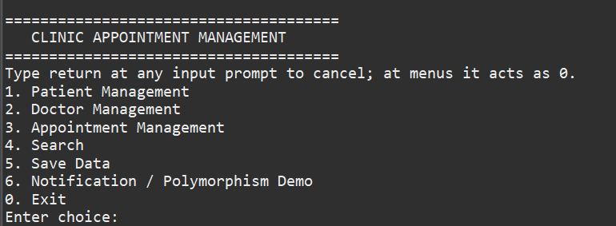
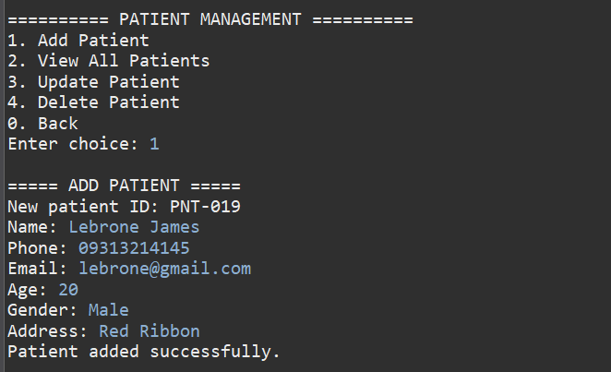
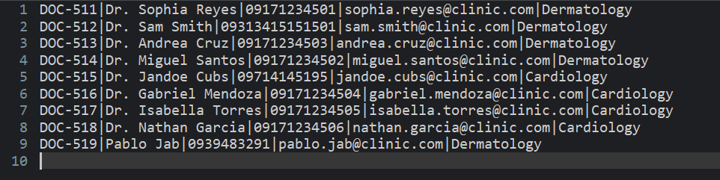
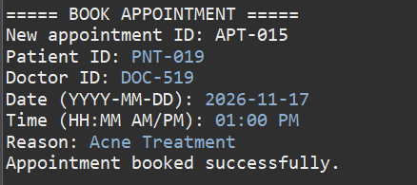
Live demo evidence (1 of 2)
Actual console output from the submitted Java source, captured with isolated sample records.
1. Application launch and main menu
2. Patient CRUD and generated patient ID
3. Doctor schedule availability
4. Appointment booking and CONFIRMED status
CSC 104 • OBJECT-ORIENTED PROGRAMMING • FINAL PROJECT DEFENSE
15

Slide 16
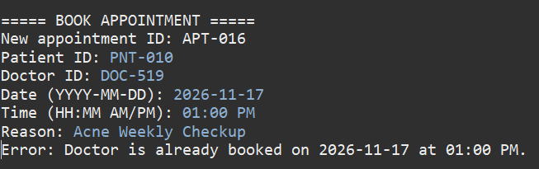
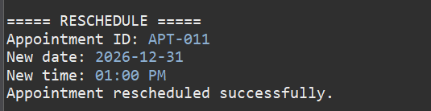
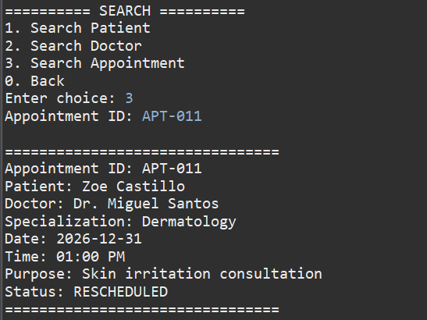
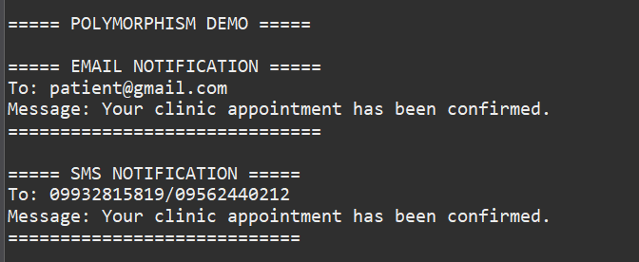
Live demo evidence (2 of 2)
The screenshots show conflict validation, rescheduling, saved-data recovery and the notification interface demo.
5. Duplicate doctor / date / time rejected
6. Appointment rescheduled to 01:00 PM
7. Searching Appointment APT-011 – Displaying Appointment Details and
Rescheduled Status
8. Notification interface: email and SMS output
CSC 104 • OBJECT-ORIENTED PROGRAMMING • FINAL PROJECT DEFENSE
16

Slide 17
Limitations and future improvements
Current constraints are explicit in the implementation and report.
Current limitations
Future improvements
• Single-user console app; no authentication, roles or patient / doctor portal
• Notification classes print to the console; no real provider integration
• Conflicts compare exact start times only; past dates are not blocked; no duration overlap, holiday or overnight model
• Add authentication, roles and a client / server interface
• Use database transactions and concurrency control
• Connect real email / SMS providers and strengthen import validation
• Add duration-aware overlaps, holiday rules and automatic doctor assignment
• Validate purpose of appointment with doctor specialization
These changes would improve usability, reliability and safe multi-user operation.
CSC 104 • OBJECT-ORIENTED PROGRAMMING • FINAL PROJECT DEFENSE
17

Slide 18
Conclusion
✓
Our application links patient, doctor, schedule and appointment records for clinic staff.
✓
It supports CRUD, automatic IDs, schedule validation, appointment lifecycle management, exact-slot conflict checks and local persistence.
✓
OOP structures the system through Person inheritance, Notification abstraction / polymorphism, encapsulation and object relationships.
✓
Latest uploaded source: 34 regression tests and 16 auto-ID tests passed locally on Java 21.0.12.1; rerun on the team's machine before defense.
Thank you • Questions and Defense

Slide 19
Questions and individual contributions
Be ready to explain both the whole application and your own verified contribution.
Contribution summary
Be prepared to explain
The supplied phase documents do not identify individual member names or task assignments.
Before presenting, add each member’s actual role, such as model / services, console UI, persistence, UML design, testing or documentation.
• Why is Person abstract?
• How does Notification demonstrate runtime polymorphism?
• How are DOC / PNT / APT / SCH IDs generated and retained after restart?
• How do schedule ranges and exact-slot conflict checks work?
• What do the 34 + 16 tests verify — and what remains untested?
Add the actual team names and individual contributions before the defense.
CSC 104 • OBJECT-ORIENTED PROGRAMMING • FINAL PROJECT DEFENSE
19

