Slide 1
Elevation Android App
Sandeep Manchem
GTID: 902745732

Slide 2
Motivation
Several Micro-sensors in every Smart-Phone.
Example: Accelerometer, Gyroscope … etc
Use Accelerometer to compute:
Ascent
Descent
Reduce reliance on GPS coordinates for distance and speed computation.

Slide 3
Approach
Gather Accelerometer data in the Y-direction
Apply filters to reduce noise
Model a specific type motion and customize filter
Make the model as generic as possible

Slide 4
Experience
Noise levels are incredible
Stationary Phone records movement upto 30 feet.
Integrating Acceleration twice to obtain distance is very error prone.
An approximate formula is derived

Slide 5
Algorithm
// Set distance to zero at start-up:
var distance_X = 0
var velocity_X = 0
function update_acceleration_X (acceleration_X)
{
velocity_X = velocity_X + acceleration_X distance_X = distance_X + velocity_X
}
// Sampled at very high frequency

Slide 6
Elevation Android App
Two Modes
Long Session: GPS Data is used – longer distances
Short Session: Sensor Data is used – shorted distances.
Logs
Session is saved and can be loaded.

Slide 7
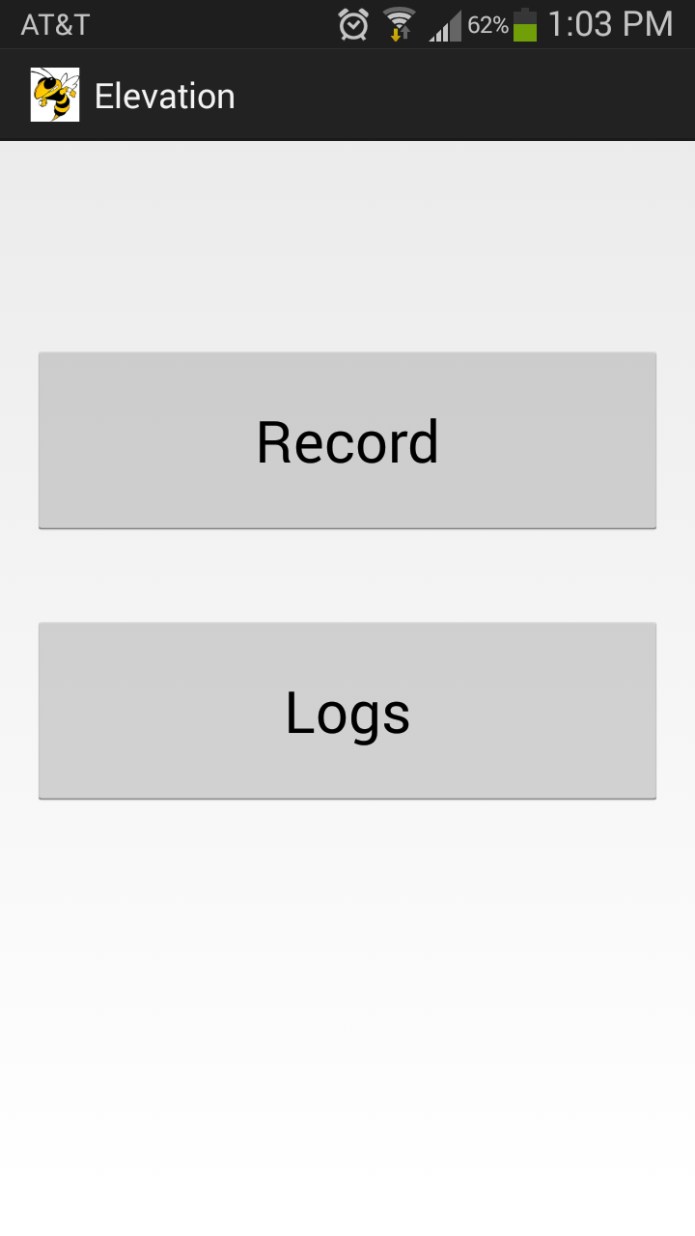
Android App GUI

Slide 8
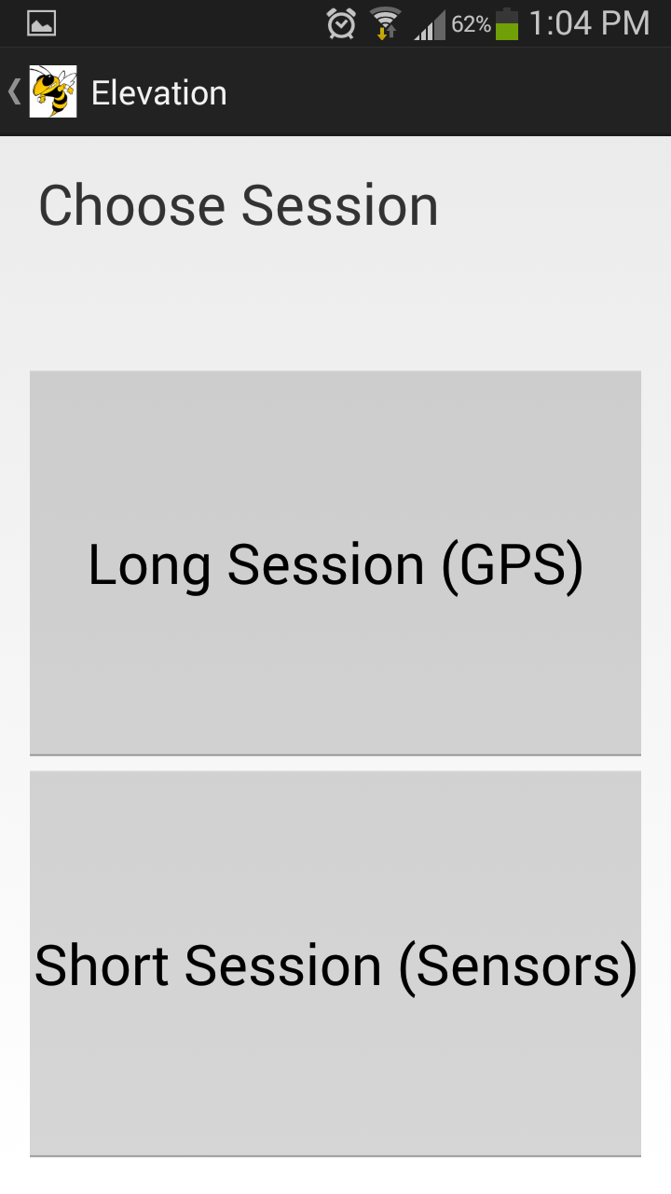
Android App GUI

Slide 9
Android App Implementation
Simple GUI
Upon selecting mode (long/short) a new thread is spawned.
Thread polls GPS or Sensor periodically.
GPS polling: every 30 seconds
Sensor polling: every 500 milli seconds
When Stopped or Paused, ascent and descent are computed.

Slide 10
Lessons Learnt
The micro-sensors in smart-phones are far from being accurate.
Accelerometers can effectively detect movements and the direction of movement, but not the magnitude.
More stabilizing factors are required like:
Reduction in vibrations
Depth perception using images
Gyroscope readings can improve filters

Slide 11
Future Work
Improve filters.
Make the App more social network friendly
Have the option of using remote server for computation (requires Internet).
Google’s Project Tango is offering devices with better micro-sensors and developing APIs for them.
Participate in Project Tango.

Slide 12
THANK YOU

